Slide 1
Optimal Scheduling in the Multiserver-job Model under Heavy Traffic
Isaac Grosof
(CMU → GA Tech → UIUC → Northwestern)
Ziv Scully (Cornell)
Mor Harchol-Balter (CMU)
Alan Scheller-Wolf (CMU)
ACM SIGMETRICS 2023, June 21st

Slide 2
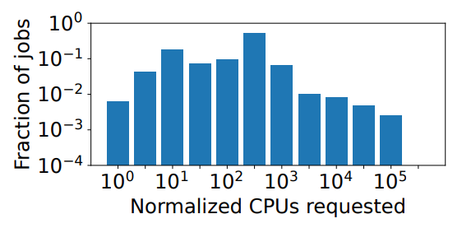
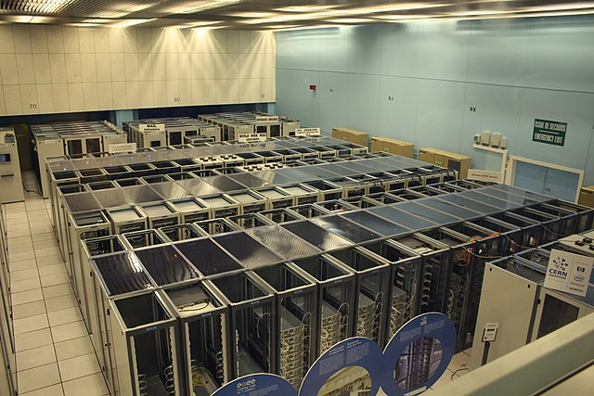

Modern Computing Systems
Modern Computing: Many servers
Also: Many servers per job
CERN Datacenter
Frontier Supercomputer
Google Borg cluster

Slide 3
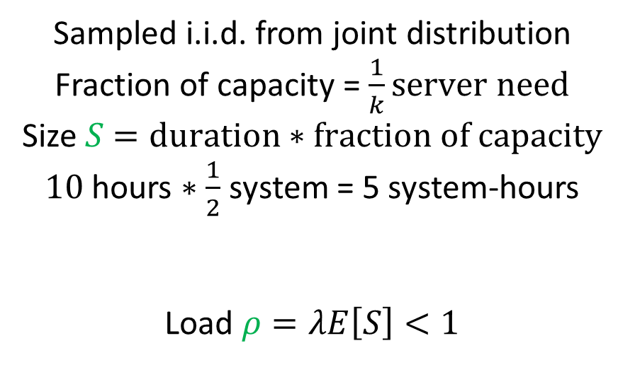
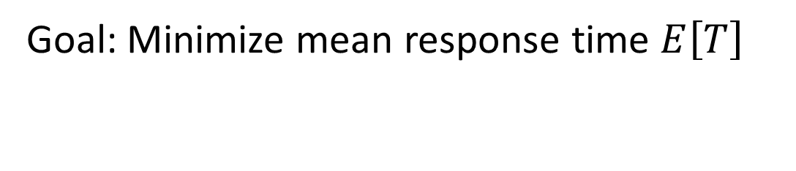
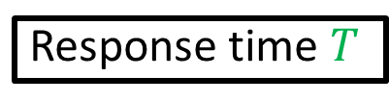
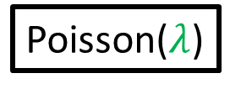

Multiserver Job Model
3
Job: (duration, server need)
Sampled i.i.d. from joint distribution
Fraction of capacity = $\frac{1}{k}server need$
Size $S$ $=duration∗fraction of capacity$
$10$ hours $∗\frac{1}{2}$ system = 5 system-hours
Load $ρ=λE\left[S\right]<1$
Poisson($λ$)
2
4
2
3
$$k$$
1
1
Size
2
Server need
Response time $T$
Goal: Minimize mean response time $E\left[T\right]$
Notes:
Size: Inherent work of a job
Load: Fraction of servers occupied

Slide 4
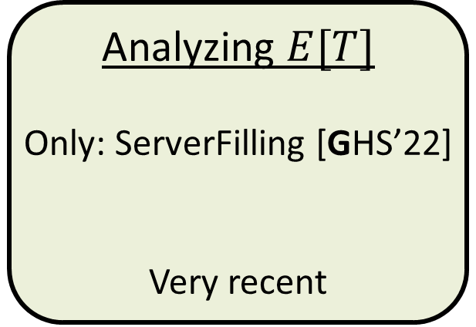
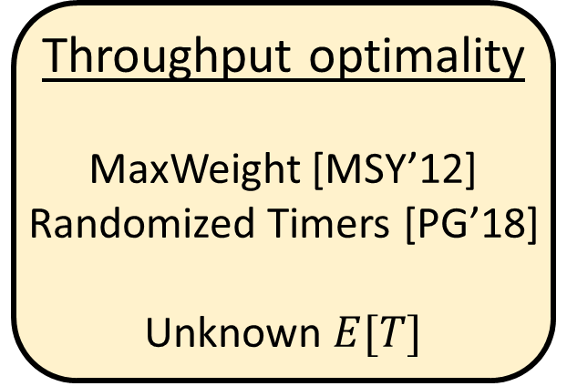
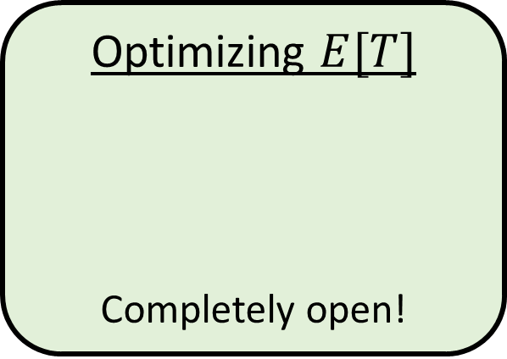
Prior work on MSJ Scheduling
Throughput optimality
MaxWeight [MSY’12]
Randomized Timers [PG’18]
Unknown $E[T]$
Analyzing $E[T]$
Only: ServerFilling [GHS’22]
Very recent
Optimizing $E[T]$
Completely open!

Slide 5

New scheduling policy: ServerFilling-SRPT
Concept: Scheduling to favor small jobs
Setting: $k$ is power of 2, all server needs are powers of 2.
ServerFilling-SRPT:
Find minimal subset M of jobs of least remaing size with total server need $≥k$servers
Among M, serve largest server need first. (tiebreak by remaining size)
M
Least remaining size order
2
4
1
2
8
1
k=8
1
4
4
1
2
1
1
Notes:
Small means small size.

Slide 6

New scheduling policy: ServerFilling-SRPT
Concept: Scheduling to favor small jobs
Setting: $k$ is power of 2, all server needs are powers of 2.
ServerFilling-SRPT:
Find minimal subset M of jobs of least remaing size with total server need $≥k$servers
Among M, serve largest server need first. (tiebreak by remaining size)
Whenever M changes, rearrange preemptively.
Theorem: If $≥k$ jobs present, fills all servers
M
Least remaining size order
4
2
4
1
2
8
1
k=8
1
4
1
2
1
1
2
1
1
Notes:
Small means small size.

Slide 7


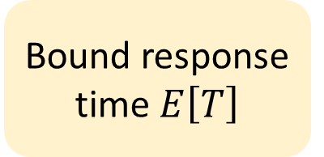

Understand $E[T]$ for ServerFilling-SRPT
ServerFilling-SRPT
4
SRPT-1
$$⟺$$
1
2
4
1
2
Resource-pooled super-server
Size = duration
Lower bound on optimal MSJ scheduling
2
Proof plan:
Compare against resource-pooled SRPT-1
Bound relevant work $E\left[W_{x}\right]$
Bound response time $E\left[T\right]$

Slide 8


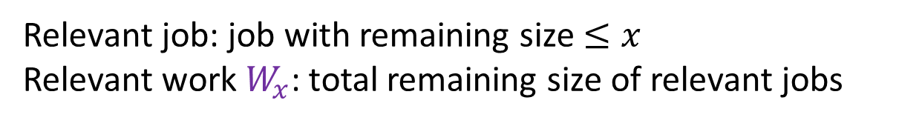


Background for Proof: Relevant work
SRPT-1
ServerFilling-SRPT
4
$$W_{x}^{k}$$
$$⟺$$
$$W_{x}^{1}$$
1
2
4
1
2
$$x$$
1
2
Relevant job: job with remaining size $≤x$
Relevant work $W_{x}$: total remaining size of relevant jobs

Slide 9
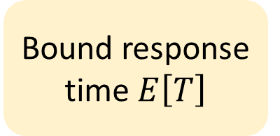



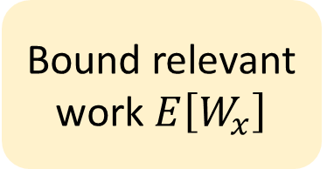
History of multiserver $E\left[T\right]$ bounds
Bound relevant work $E\left[W_{x}\right]$
Bound response time $E\left[T\right]$
M/G/k/SRPT [GSH’18]: (one-server-per-job)
Many-jobs few-jobs
$$W_{x}^{k}≤W_{x}^{1}+kx$$
Multiserver tagged job
$$W_{x}→T_{x}$$
Fails in MSJ: Single Straggler

Slide 10
Single Straggler Problem
M
Least remaining size order
2
4
2
2
8
4
2
4
k=8
4
2
2
2
1
Notes:
If we just put these four into service, the next job wouldn’t fit. Not very SRPT!

Slide 11
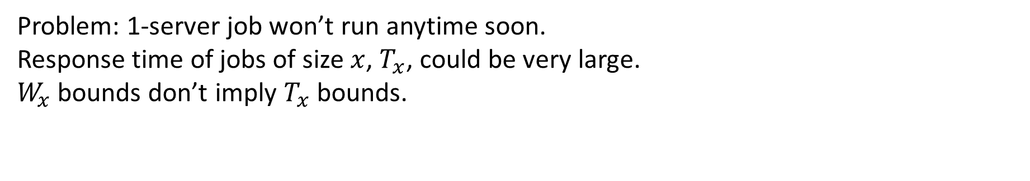
Single Straggler Problem
M
Least remaining size order
4
2
4
2
2
8
4
2
4
k=8
2
2
2
2
1
2
Problem: 1-server job won’t run anytime soon.
Response time of jobs of size $x$, $T_{x}$, could be very large.
$W_{x}$ bounds don’t imply $T_{x}$ bounds.

Slide 12
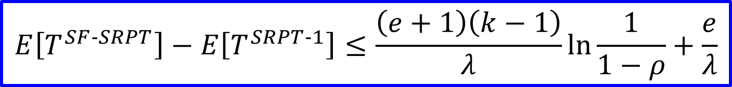
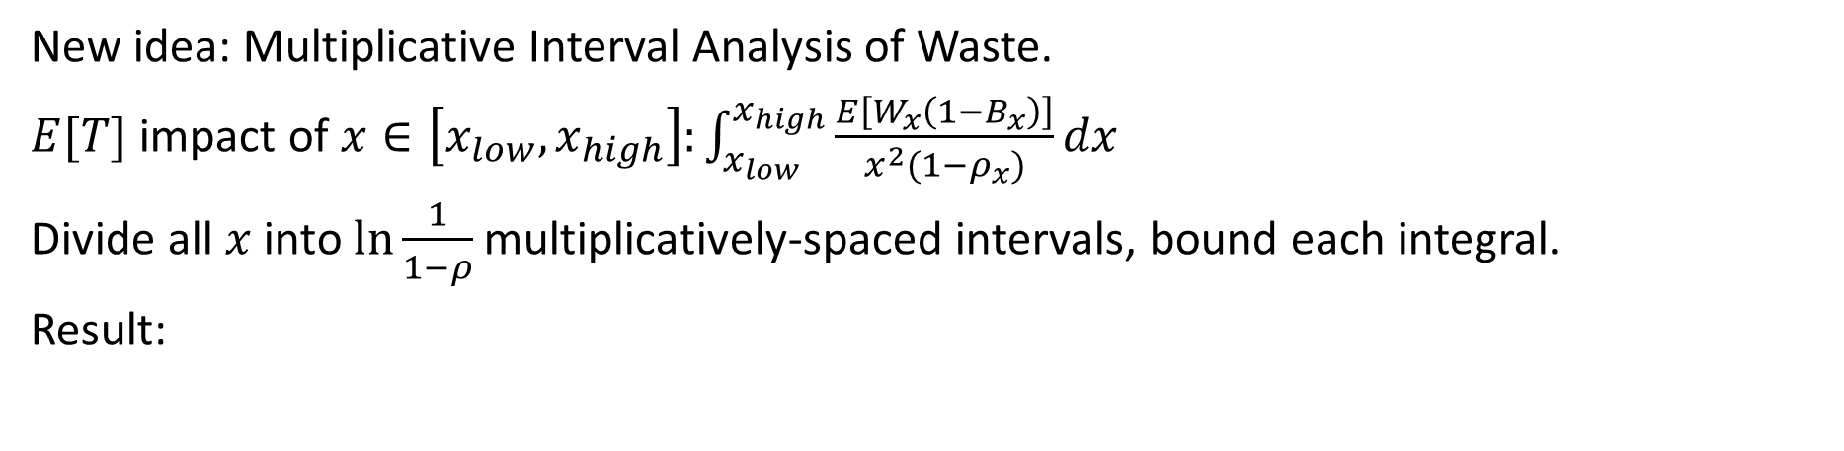

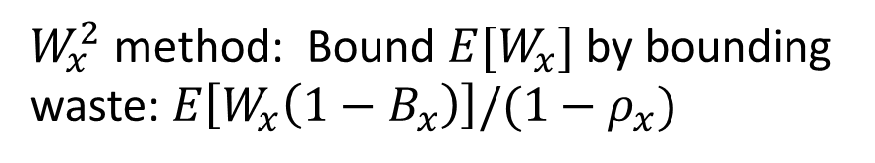
New Proof Ingredient: MIAOW
Bound relevant work $E\left[W_{x}\right]$
Bound response time $E\left[T\right]$
Ideas from M/G/k/Gittins [SGH’21]:
$W_{x}^{2}$ method: Bound $E[W_{x}]$ by bounding waste: $E\left[W_{x}\left(1−B_{x}\right)\right]/(1−ρ_{x})$
WINE: $E\left[T\right]=\frac{1}{λ}\int_{x=0}^{∞}{\frac{E\left[W_{x}\right]}{x^{2}}dx}$
New idea: Multiplicative Interval Analysis of Waste.
$E[T]$ impact of $x∈\left[x_{low},x_{high}\right]:\int_{x_{low}}^{x_{high}}{\frac{E\left[W_{x}\left(1−B_{x}\right)\right]}{x^{2}{(1−ρ}_{x})}dx}$
Divide all $x$ into $ln\frac{1}{1−ρ}$ multiplicatively-spaced intervals, bound each integral.
Result:
$$E\left[T^{SF‐SRPT}\right]−E\left[T^{SRPT‐1}\right]≤\frac{\left(e+1\right)\left(k−1\right)}{λ}ln\frac{1}{1−ρ}+\frac{e}{λ}$$

Slide 13


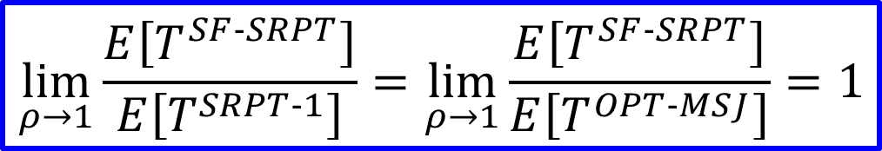
Results
$$E\left[T^{SF‐SRPT}\right]−E\left[T^{SRPT‐1}\right]≤\frac{\left(e+1\right)\left(k−1\right)}{λ}ln\frac{1}{1−ρ}+\frac{e}{λ}$$
Bound:
Optimality: For any $S$ s.t. $E[S^{2}{\left(log S\right)}^{+}]<∞$,
ServerFilling-SRPT has asymptotically optimal mean response time!
$$\lim_{ρ→1}\frac{E\left[T^{SF‐SRPT}\right]}{E\left[T^{SRPT‐1}\right]}=\lim_{ρ→1}{\frac{E\left[T^{SF‐SRPT}\right]}{E\left[T^{OPT‐MSJ}\right]}=1}$$

Slide 14
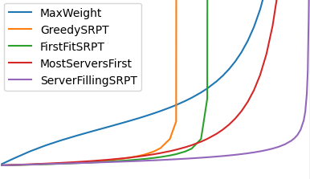
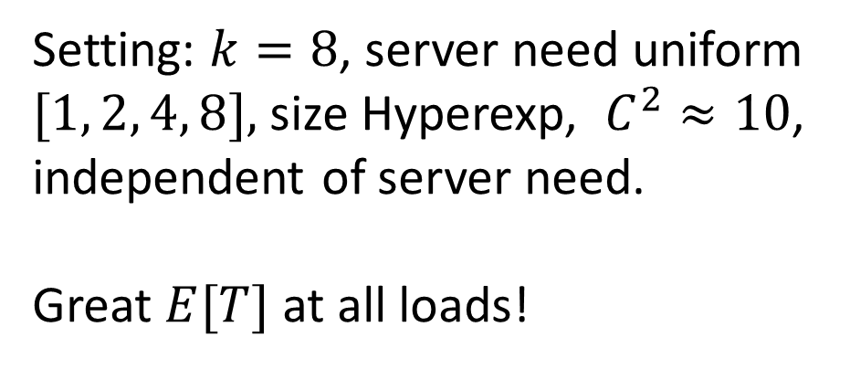

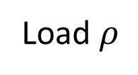
Empirical Validation
Setting: $k=8$, server need uniform $[1, 2, 4, 8],$ size Hyperexp, $C^{2}≈10$, independent of server need.
Great $E[T]$ at all loads!
5
4
3
$$E[T]$$
2
1
0
0
0.2
0.4
0.6
0.8
1.0
Load $ρ$
Notes:
Proof at heavy traffic, great E[T] at all loads.

Slide 15

Generalizations
Unknown or estimated sizes: ServerFilling-Gittins. Heavy traffic optimality!
Server needs are divisors of $k$: DivisorFilling-SRPT & DivisorFilling-Gittins. Heavy traffic optimality!

Slide 16
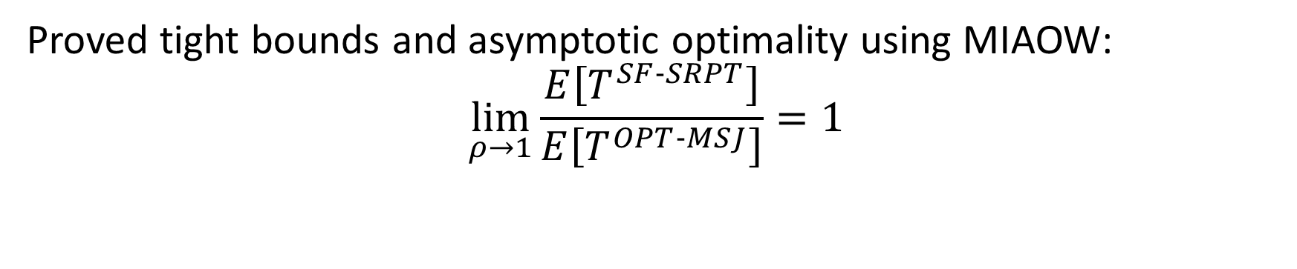
Conclusion
ServerFilling-SRPT
4
1
2
4
1
2
2
Proved tight bounds and asymptotic optimality using MIAOW:
$$\lim_{ρ→1}{\frac{E\left[T^{SF‐SRPT}\right]}{E\left[T^{OPT‐MSJ}\right]}=1}$$

