Slide 1
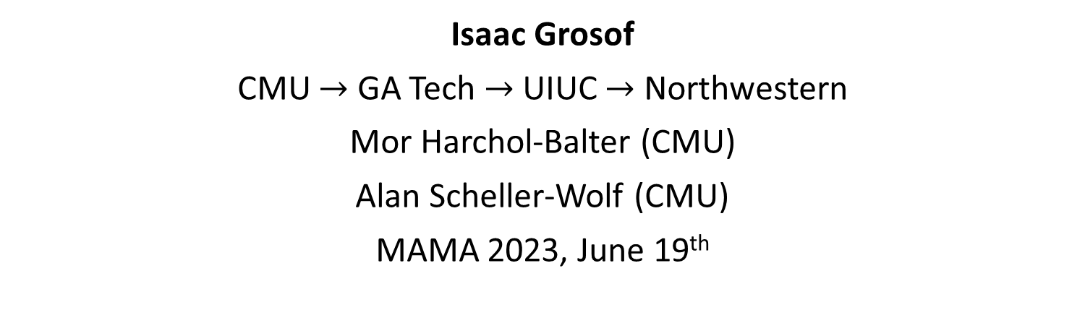
Stability for the Multiserver-job Model via Product-form Saturated Systems
Isaac Grosof
CMU $→$ GA Tech $→$ UIUC $→$ Northwestern
Mor Harchol-Balter (CMU)
Alan Scheller-Wolf (CMU)
MAMA 2023, June 19th

Slide 2
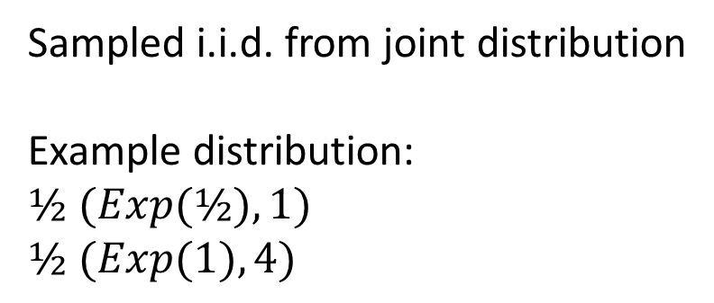

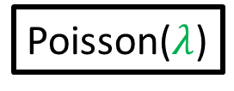
Multiserver-job Model
Job: (duration, server need)
FCFS
1
Expected duration
4
Poisson($λ$)
1
$$k$$
Server need
1
1
4
4
Sampled i.i.d. from joint distribution
Example distribution:
$½ (Exp(½), 1)$
$½ (Exp(1), 4)$
Idle servers
Notes:
Topic of this talk: MSJ model. Different jobs require different numbers of servers. Motivated by big compute clusters, where we see this behavior.
Duration is unknown, so the height is the expected duration

Slide 3
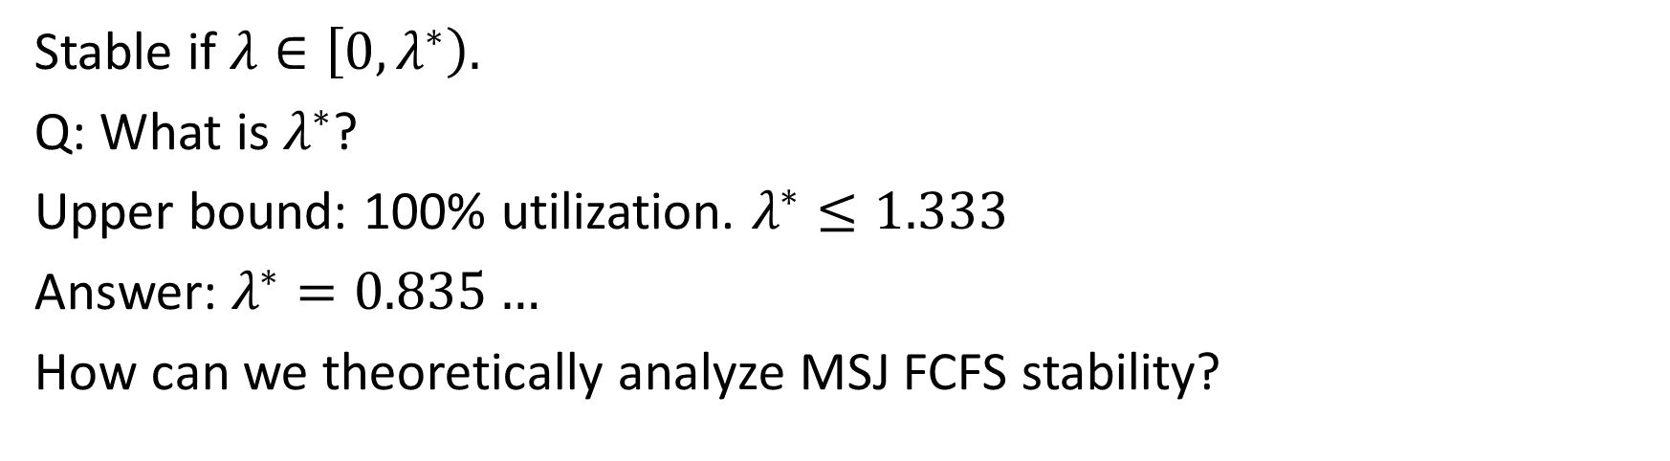
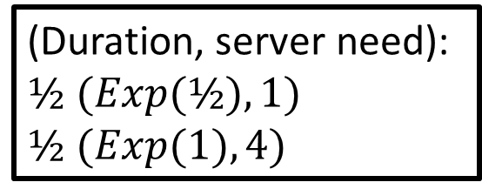
MSJ FCFS Stability
(Duration, server need):
$½ (Exp(½), 1)$
$½ (Exp(1), 4)$
FCFS
1
Poisson($λ$)
1
$$k$$
1
1
4
4
Stable if $λ∈\left[0,λ^{∗}\right).$
Q: What is $λ^{∗}$?
Upper bound: 100% utilization. $λ^{∗}≤1.333$
Answer: $λ^{∗}=0.835…$
How can we theoretically analyze MSJ FCFS stability?
Notes:
Define stability: If lambda high enough, jobs back up, queue length diverges to infinity. That’s instability, we want stability.
How did we come up with this number?

Slide 4
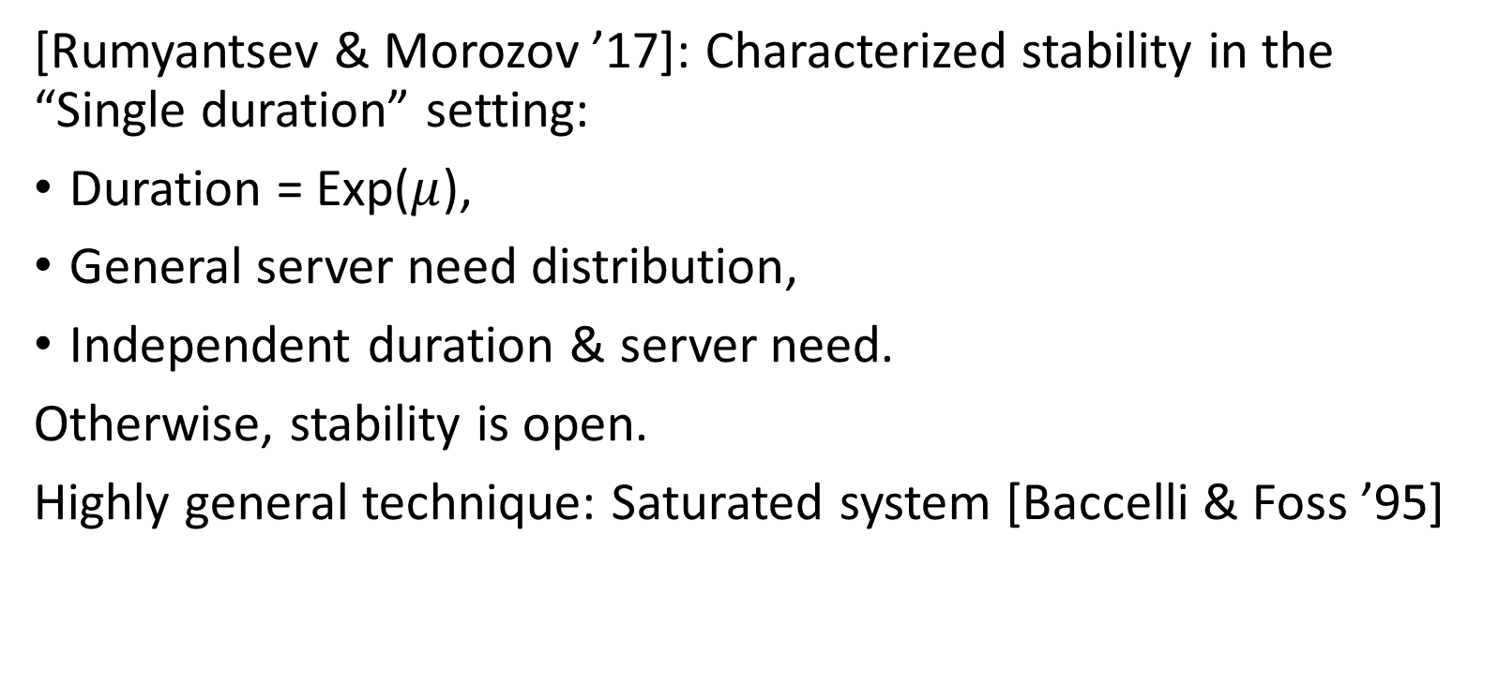
Prior work
[Rumyantsev & Morozov ’17]: Characterized stability in the “Single duration” setting:
Duration = Exp($μ$),
General server need distribution,
Independent duration & server need.
Otherwise, stability is open.
Highly general technique: Saturated system [Baccelli & Foss ’95]

Slide 5
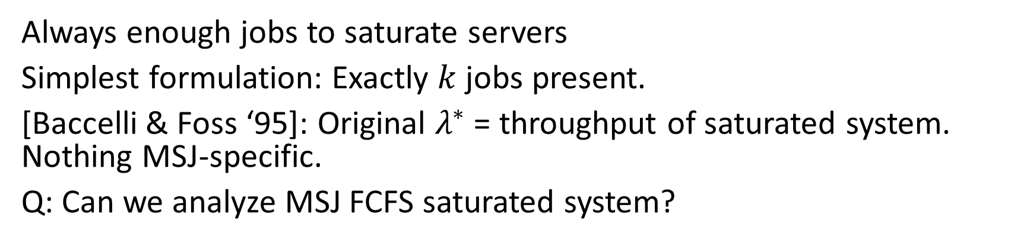
Saturated System
New arrival!
FCFS
1
1
1
1
4
4
Always enough jobs to saturate servers
Simplest formulation: Exactly $k$ jobs present.
[Baccelli & Foss ‘95]: Original $λ^{∗}$ = throughput of saturated system. Nothing MSJ-specific.
Q: Can we analyze MSJ FCFS saturated system?
Notes:
Closed system. Always enough to saturate the servers – New jobs wouldn’t be in service.
If we can find Saturated System’s steady state, we can characterize lambda^*.

Slide 6
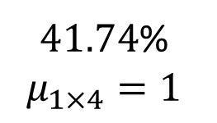
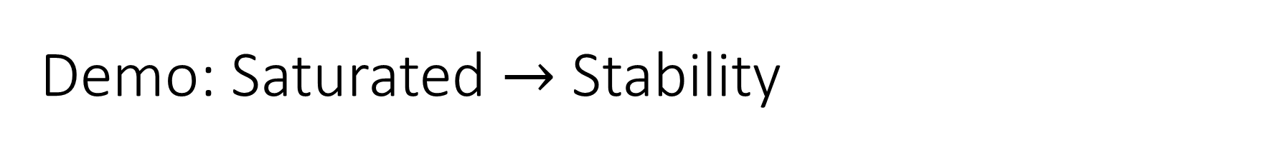
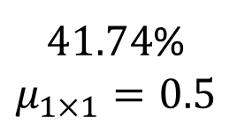

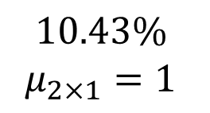

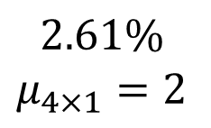
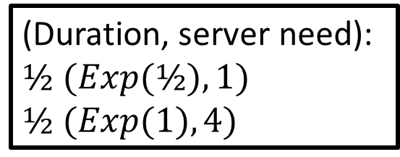
Demo: Saturated $→$ Stability
(Duration, server need):
$½ (Exp(½), 1)$
$½ (Exp(1), 4)$
Want to calculate saturated throughput. We characterize steady-state:
Throughput: 0.835
$λ^{∗}=0.835$
1
1
1
1
1
1
1
1
1
4
1
$$2.61\%$$
$$μ_{4×1}=2$$
$$3.48\%$$
$$μ_{3×1}=1.5$$
$$10.43\%$$
$$μ_{2×1}=1$$
$41.74$%
$$μ_{1×1}=0.5$$
$41.74$%
$$μ_{1×4}=1$$

Slide 7
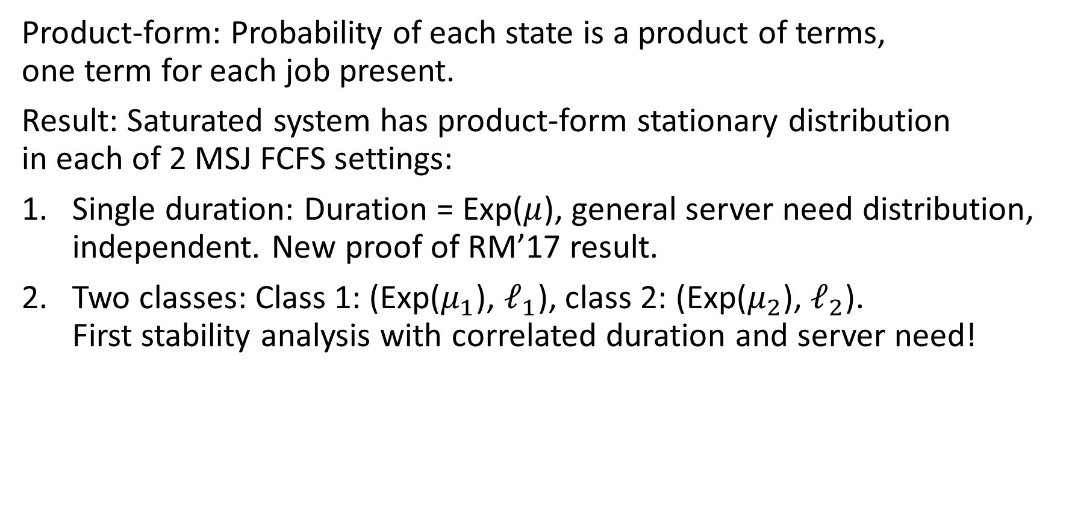
Our Result: Product-form Stationary Distributions
Product-form: Probability of each state is a product of terms, one term for each job present.
Result: Saturated system has product-form stationary distribution in each of 2 MSJ FCFS settings:
Single duration: Duration = Exp($μ$), general server need distribution, independent. New proof of RM’17 result.
Two classes: Class 1: (Exp($μ_{1}$), $ℓ_{1}$), class 2: (Exp($μ_{2}$), $ℓ_{2}$). First stability analysis with correlated duration and server need!

Slide 8
Stationary distribution: Departure-average
Saturated system has 2 natural stationary distributions:
CTMC, time-average distribution.
DTMC, departure-average distribution.
Easy to convert between distributions.
We derive product-form formulas for departure-average distribution, in both single-duration and two-class settings.

Slide 9
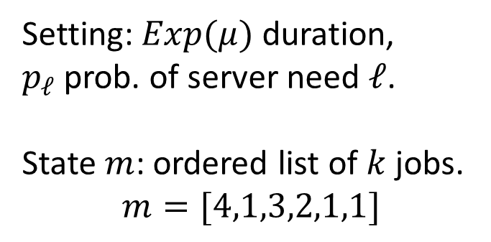
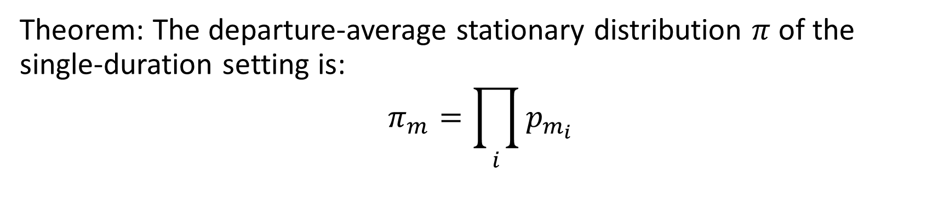
Single duration result
Setting: $Exp(μ)$ duration, $p_{ℓ}$prob. of server need $ℓ$.
State $m$: ordered list of $k$ jobs.
$$m=[4,1,3,2,1,1]$$
New arrival!
FCFS
2
1
4
1
3
1
Theorem: The departure-average stationary distribution $π$ of the single-duration setting is:
$$π_{m}=\prod_{i}{p_{m_{i}}}$$

Slide 10
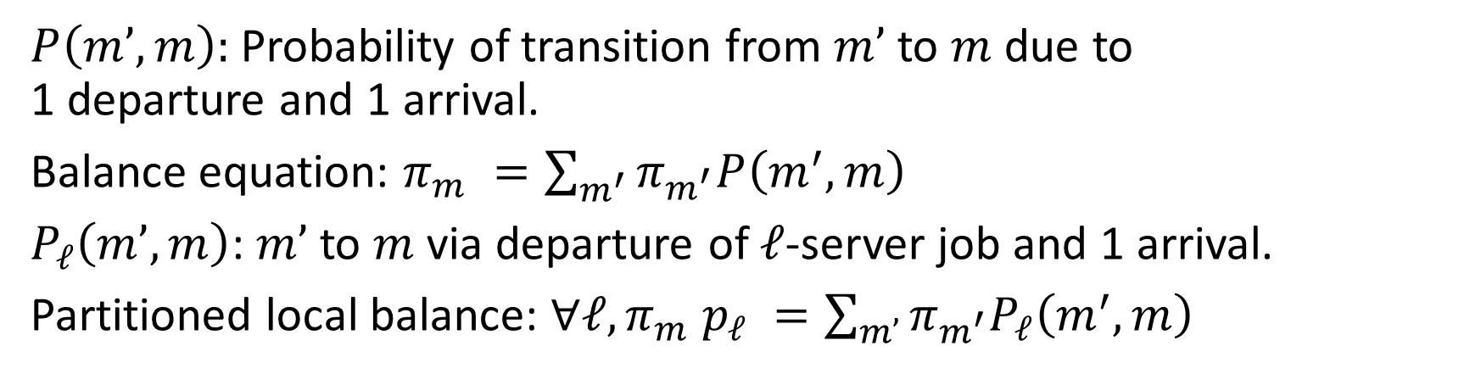
Single duration: Partitioned local balance
New arrival!
FCFS
2
1
4
1
3
1
$P\left(m’,m\right):$Probability of transition from $m’$to $m$ due to 1 departure and 1 arrival.
Balance equation: $π_{m} =\sum_{m^{′}}{π_{m^{′}}P\left(m^{′},m\right)}$
$P_{ℓ}\left(m’,m\right)$: $m’$ to $m$ via departure of $ℓ$-server job and 1 arrival.
Partitioned local balance: $∀ℓ, π_{m} p_{ℓ} =\sum_{m’}{π_{m^{′}}P_{ℓ}\left(m^{′},m\right)}$
Notes:
Note that P_l is often zero – only a few states are capable of such a transition.

Slide 11
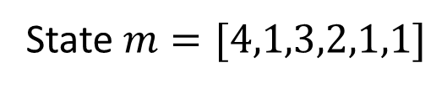
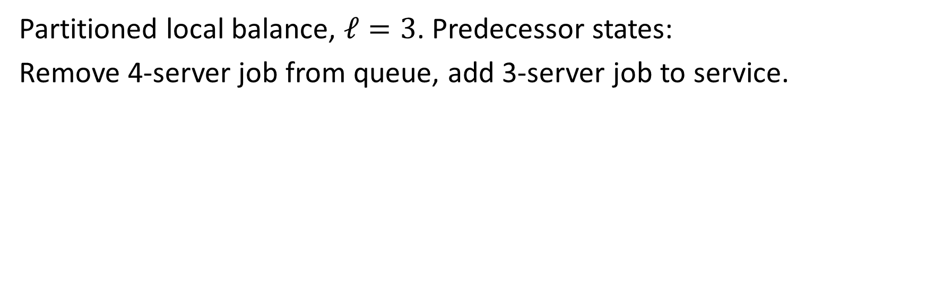
Single duration: Partitioned local balance
New arrival!
FCFS
2
State $m=[4,1,3,2,1,1]$
1
4
1
3
1
Partitioned local balance, $ℓ=3$. Predecessor states:
Remove 4-server job from queue, add 3-server job to service.

Slide 12
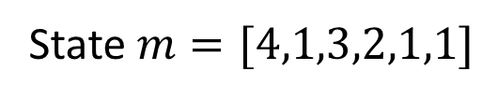
Single duration: Partitioned local balance
New arrival!
FCFS
2
State $m=[4,1,3,2,1,1]$
1
1
3
1
Partitioned local balance, $ℓ=3$. Predecessor states:
Remove 4-server job from queue, add 3-server job to service.

Slide 13
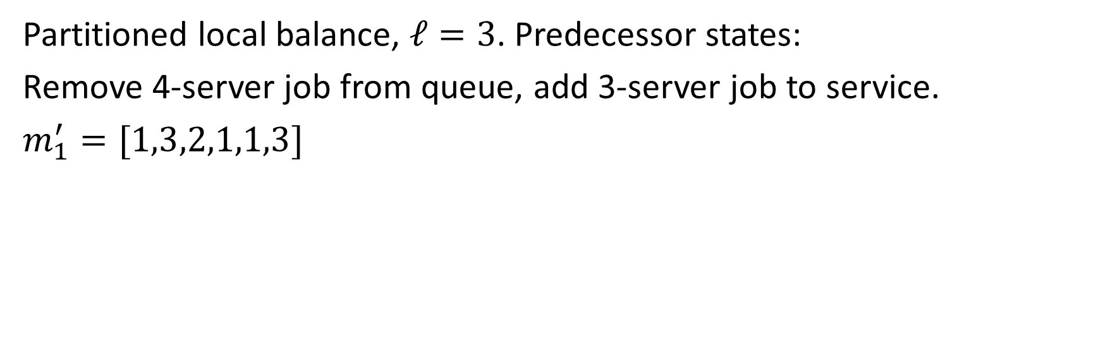
Single duration: Partitioned local balance
New arrival!
1
FCFS
State $m=[4,1,3,2,1,1]$
1
1
1
3
2
3
2
3
Partitioned local balance, $ℓ=3$. Predecessor states:
Remove 4-server job from queue, add 3-server job to service.
$m_{1}^{′}=[1,3,2,1,1,3]$

Slide 14
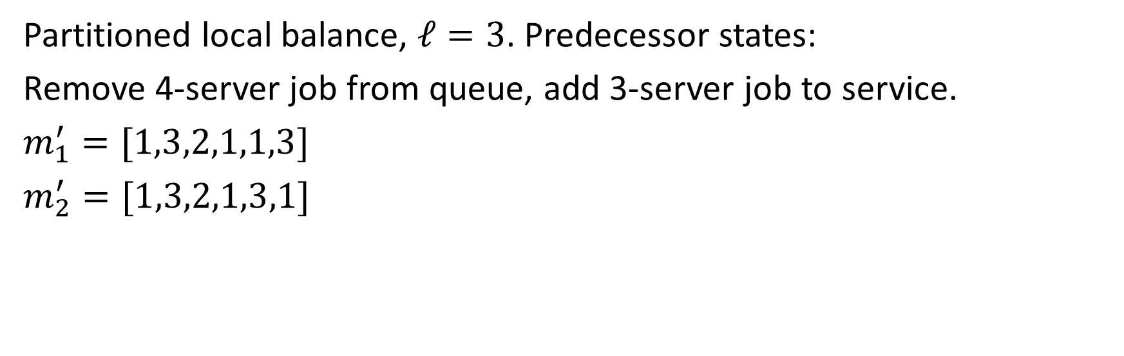
Single duration: Partitioned local balance
New arrival!
1
FCFS
State $m=[4,1,3,2,1,1]$
3
1
3
2
1
Partitioned local balance, $ℓ=3$. Predecessor states:
Remove 4-server job from queue, add 3-server job to service.
$m_{1}^{′}=[1,3,2,1,1,3]$
$m_{2}^{′}=[1,3,2,1,3,1]$

Slide 15
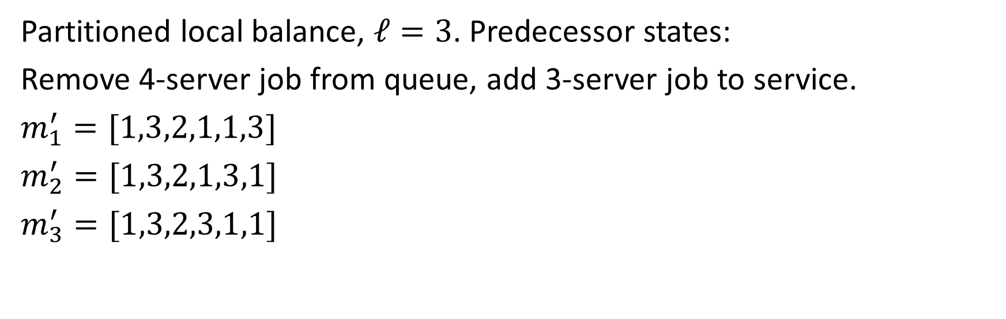
Single duration: Partitioned local balance
New arrival!
FCFS
State $m=[4,1,3,2,1,1]$
3
1
3
2
1
1
Partitioned local balance, $ℓ=3$. Predecessor states:
Remove 4-server job from queue, add 3-server job to service.
$m_{1}^{′}=[1,3,2,1,1,3]$
$m_{2}^{′}=[1,3,2,1,3,1]$
$m_{3}^{′}=[1,3,2,3,1,1]$

Slide 16
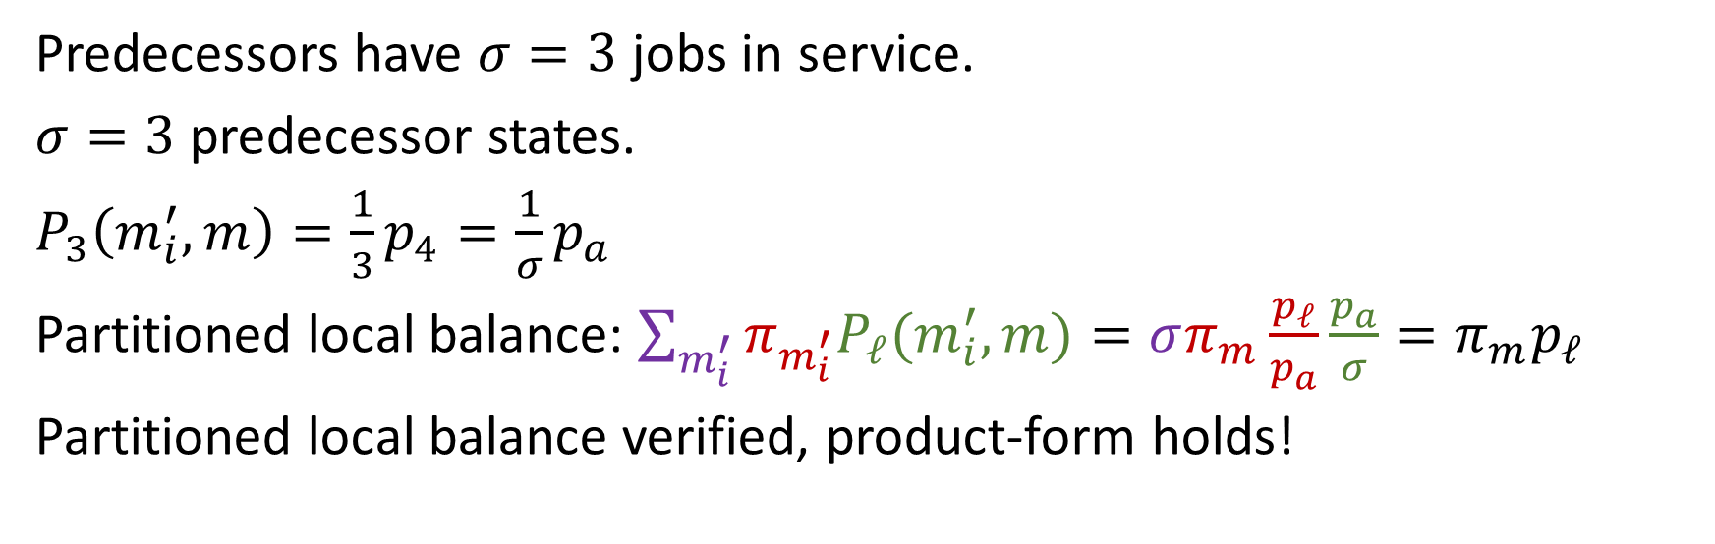
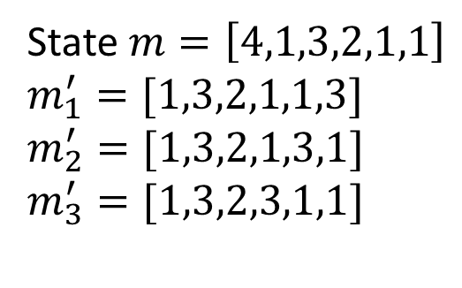
Single duration: Partitioned local balance
New arrival!
FCFS
State $m=\left[4,1,3,2,1,1\right]$
$m_{1}^{′}=[1,3,2,1,1,3]$
$m_{2}^{′}=[1,3,2,1,3,1]$
$m_{3}^{′}=[1,3,2,3,1,1]$
3
1
3
2
1
1
Predecessors have $σ=3$ jobs in service.
$σ=3$ predecessor states.
$P_{3}\left(m_{i}^{′},m\right)=\frac{1}{3}p_{4}=\frac{1}{σ}p_{a}$
Partitioned local balance: $\sum_{m_{i}^{′}}{π_{m_{i}^{′}}P_{ℓ}(m_{i}^{′},m)}=σπ_{m}\frac{p_{ℓ}}{p_{a}}\frac{p_{a}}{σ}=π_{m}p_{ℓ}$
Partitioned local balance verified, product-form holds!
Notes:
Each job is equally likely to complete next

Slide 17

Results outline
Single duration: $π_{m}=\prod_{i}{p_{m_{i}}}$
Two-class: Up next

Slide 18
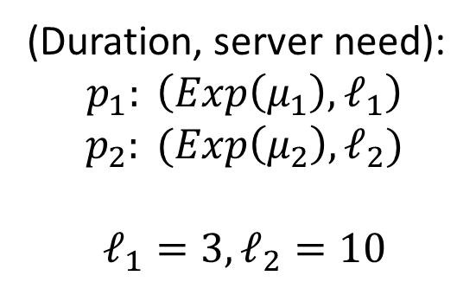
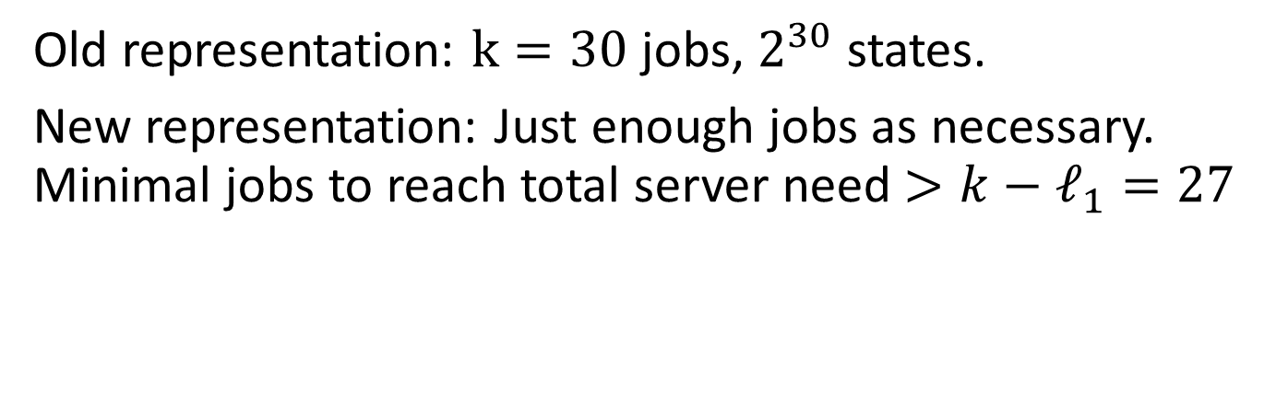

Two-class: New view
New arrival!
(Duration, server need):
$$p_{1}: \left(Exp\left(μ_{1}\right),ℓ_{1}\right)$$
$$p_{2}: (Exp\left(μ_{2}\right),ℓ_{2})$$
$$ℓ_{1}=3, ℓ_{2}=10$$
FCFS
10
3
3
3
10
$$k=30$$
10
10
10
3
Old representation: $k=30$ jobs, $2^{30}$ states.
New representation: Just enough jobs as necessary. Minimal jobs to reach total server need $>k−ℓ_{1}=27$

Slide 19
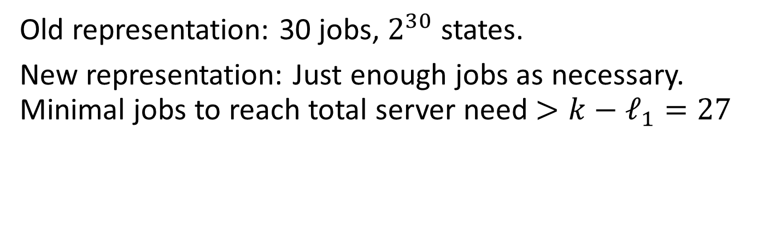
Two-class: New view
New arrival!
(Duration, server need):
$$p_{1}: \left(Exp\left(μ_{1}\right),ℓ_{1}\right)$$
$$p_{2}: (Exp\left(μ_{2}\right),ℓ_{2})$$
$$ℓ_{1}=3, ℓ_{2}=10$$
10
3
10
$$k=30$$
10
10
3
Old representation: 30 jobs, $2^{30}$ states.
New representation: Just enough jobs as necessary. Minimal jobs to reach total server need $>k−ℓ_{1}=27$

Slide 20
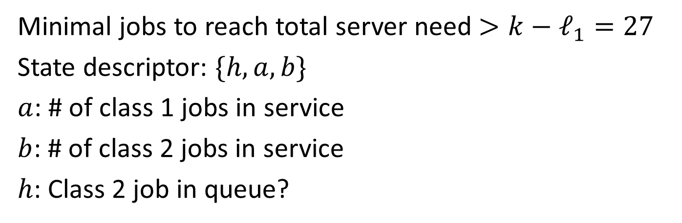
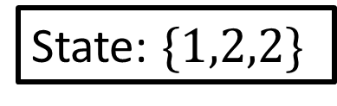
Two-class: New view
New arrival!
(Duration, server need):
$$p_{1}: \left(Exp\left(μ_{1}\right),ℓ_{1}\right)$$
$$p_{2}: (Exp\left(μ_{2}\right),ℓ_{2})$$
$$ℓ_{1}=3, ℓ_{2}=10$$
10
3
State: $\{1,2,2\}$
10
$$k=30$$
10
10
3
Minimal jobs to reach total server need $>k−ℓ_{1}=27$
State descriptor: $\{h,a,b\}$
$a$: # of class 1 jobs in service
$b$: # of class 2 jobs in service
$h$: Class 2 job in queue?

Slide 21
Two-class: New view
New arrival!
(Duration, server need):
$$p_{1}: \left(Exp\left(μ_{1}\right),ℓ_{1}\right)$$
$$p_{2}: (Exp\left(μ_{2}\right),ℓ_{2})$$
$$ℓ_{1}=3, ℓ_{2}=10$$
3
State: $\{1,2,2\}$
3
10
$$k=30$$
10
10
10
Minimal jobs to reach total server need $>k−ℓ_{1}=27$
State descriptor: $\{h,a,b\}$
$a$: # of class 1 jobs in service
$b$: # of class 2 jobs in service
$h$: Class 2 job in queue?

Slide 22
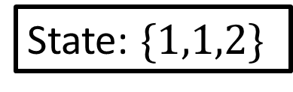
Two-class: New view
New arrival!
(Duration, server need):
$$p_{1}: \left(Exp\left(μ_{1}\right),ℓ_{1}\right)$$
$$p_{2}: (Exp\left(μ_{2}\right),ℓ_{2})$$
$$ℓ_{1}=3, ℓ_{2}=10$$
3
State: $\{1,1,2\}$
10
$$k=30$$
10
$$k=30$$
10
10
Minimal jobs to reach total server need $>k−ℓ_{1}=27$
State descriptor: $\{h,a,b\}$
$a$: # of class 1 jobs in service
$b$: # of class 2 jobs in service
$h$: Class 2 job in queue?

Slide 23
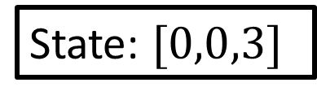
Two-class: New view
New arrival!
(Duration, server need):
$$p_{1}: \left(Exp\left(μ_{1}\right),ℓ_{1}\right)$$
$$p_{2}: (Exp\left(μ_{2}\right),ℓ_{2})$$
$$ℓ_{1}=3, ℓ_{2}=10$$
10
State: $[0,0,3]$
10
10
$$k=30$$
10
Minimal jobs to reach total server need $>k−ℓ_{1}=27$
State descriptor: $\{h,a,b\}$
$a$: # of class 1 jobs in service
$b$: # of class 2 jobs in service
$h$: Class 2 job in queue?

Slide 24
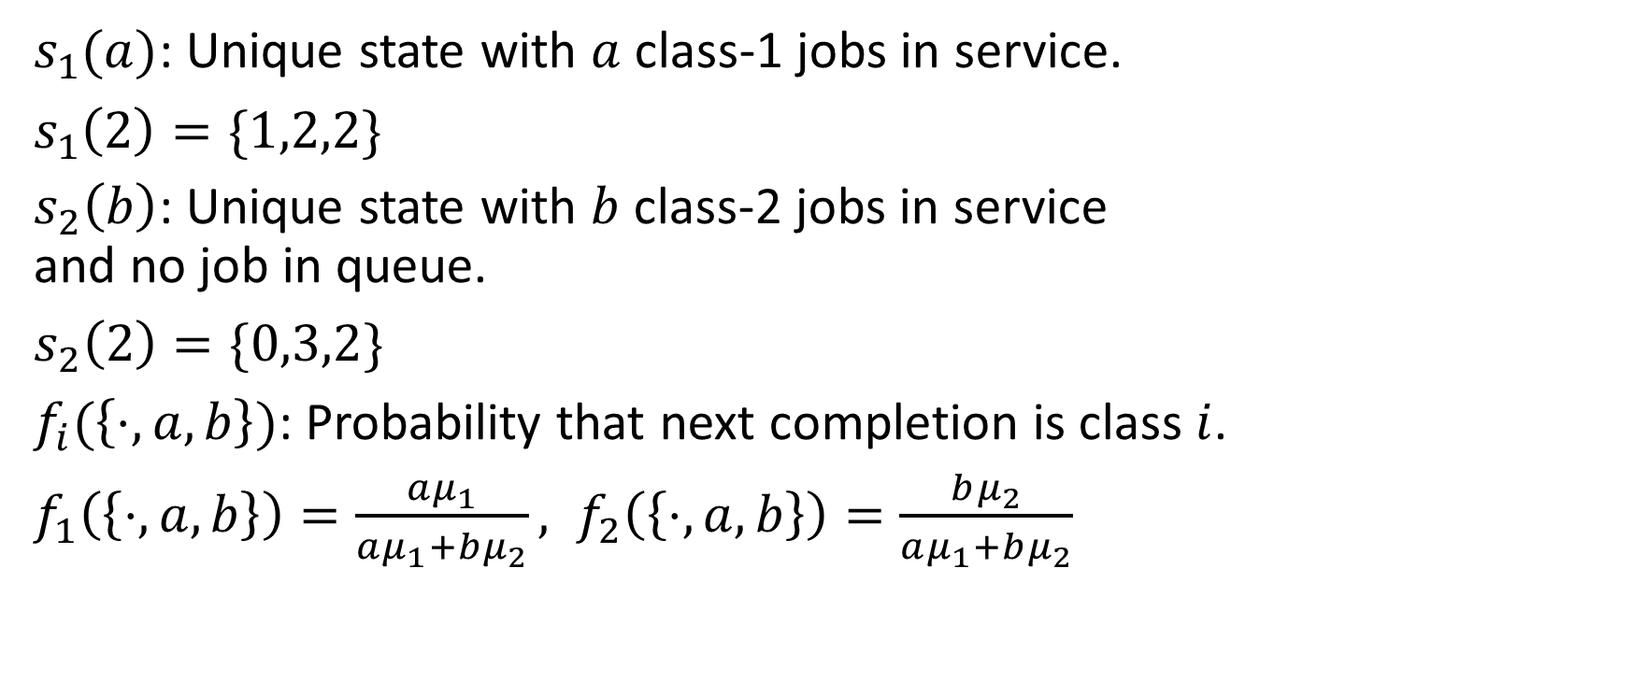
Two-class: Notation
New arrival!
3
3
10
10
$s_{1}(a)$: Unique state with $a$ class-1 jobs in service.
$s_{1}\left(2\right)=\{1,2,2\}$
$s_{2}\left(b\right)$: Unique state with $b$ class-2 jobs in service and no job in queue.
$s_{2}\left(2\right)=\{0,3,2\}$
$f_{i}(\left\{⋅,a,b\right\})$: Probability that next completion is class $i$.
$f_{1}\left(\left\{⋅,a,b\right\}\right)=\frac{aμ_{1}}{aμ_{1}+bμ_{2}}, f_{2}\left(\left\{⋅,a,b\right\}\right)=\frac{bμ_{2}}{aμ_{1}+bμ_{2}}$
10
10
New arrival!
3
3
10
3
10
10

Slide 25
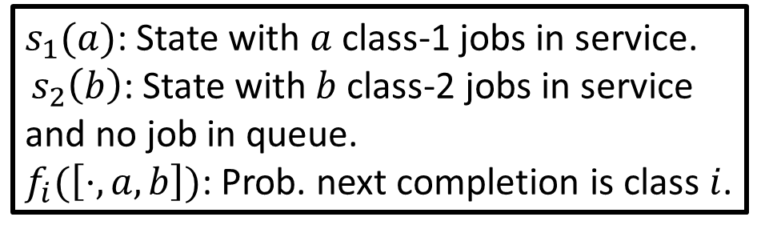

Two-class: Result
$s_{1}(a)$: State with $a$ class-1 jobs in service.
$s_{2}\left(b\right)$: State with $b$ class-2 jobs in service and no job in queue.
$f_{i}(\left[⋅,a,b\right])$: Prob. next completion is class $i$.
Theorem: The departure-average stationary distribution $π$ of the two-class setting is:
$$π_{\left\{h,a,b\right\}}=p_{1}^{a}p_{2}^{b+h}\prod_{i=1}^{a}{\frac{1}{f_{1}\left(s_{1}\left(i\right)\right)}\prod_{j=1}^{b}{\frac{1}{f_{2}\left(s_{2}\left(j\right)\right)}}}$$

Slide 26
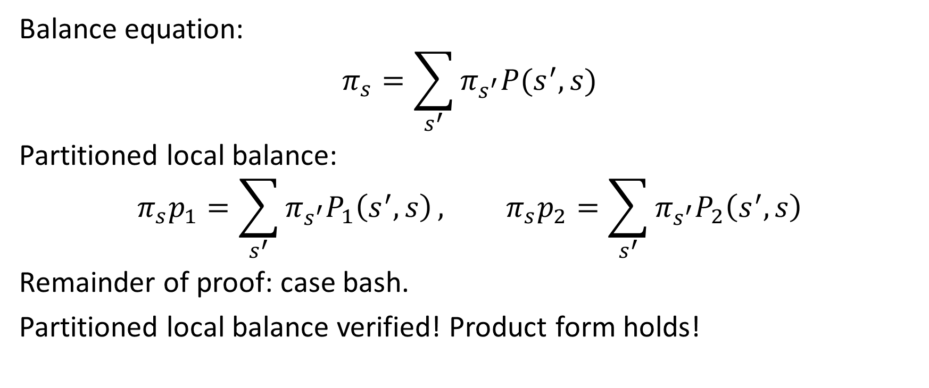
Two-class: Proof sketch
Balance equation:
$$π_{s}=\sum_{s^{′}}{π_{s^{′}}P(s^{′},s)}$$
Partitioned local balance:
$$π_{s}p_{1}=\sum_{s^{′}}{π_{s^{′}}P_{1}\left(s^{′},s\right)}, π_{s}p_{2}=\sum_{s^{′}}{π_{s^{′}}P_{2}\left(s^{′},s\right)}$$
Remainder of proof: case bash.
Partitioned local balance verified! Product form holds!

Slide 27
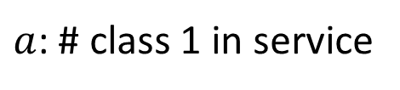
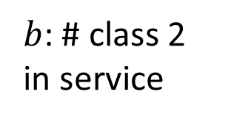
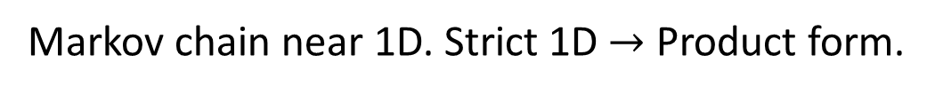
Two-class: Proof intuition
3
{0,0,3}
{1,1,2}
{1,2,2}
{0,3,2}
$b$: # class 2 in service
{1,4,1}
{1,5,1}
{0,6,1}
0
{1,7,0}
{1,8,0}
{1,9,0}
{0,10,0}
0
$a$: # class 1 in service
10
Markov chain near 1D. Strict 1D $→$ Product form.

Slide 28

Results outline
Single duration: $π_{m}=\prod_{i}{p_{m_{i}}}$
Two-class: $π_{\left\{h,a,b\right\}}=p_{1}^{a}p_{2}^{b+h}\prod_{i=1}^{a}{\frac{1}{f_{1}\left(s_{1}\left(i\right)\right)}\prod_{j=1}^{b}{\frac{1}{f_{2}\left(s_{2}\left(j\right)\right)}}}$

Slide 29
Future directions
Beyond MSJ FCFS: FCFS + general constraint on service. Single duration + 2-class results still hold?
Relating MSJ FCFS mean response time to saturated system? Student Research Competition poster & talk!

Slide 30
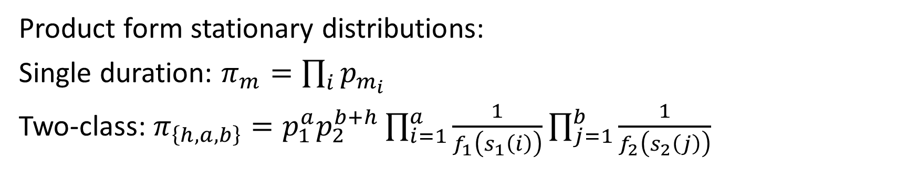
Conclusion
MSJ Stability
Saturated System
New arrival!
FCFS
FCFS
2
1
1
1
1
1
4
1
3
1
4
4
Product form stationary distributions:
Single duration: $π_{m}=\prod_{i}{p_{m_{i}}}$
Two-class: $π_{\left\{h,a,b\right\}}=p_{1}^{a}p_{2}^{b+h}\prod_{i=1}^{a}{\frac{1}{f_{1}\left(s_{1}\left(i\right)\right)}\prod_{j=1}^{b}{\frac{1}{f_{2}\left(s_{2}\left(j\right)\right)}}}$

