Slide 1
The RESET Technique for Multiserver Job Analysis
Isaac Grosof (CMU → GATech → UIUC → Northwestern)
Acknowledging:
Yige Hong (CMU)
Mor Harchol-Balter (CMU)
Alan Scheller-Wolf (CMU)
ACM SIGMETRICS Student Research Competition 2023, June 22nd

Slide 2
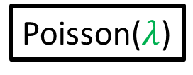

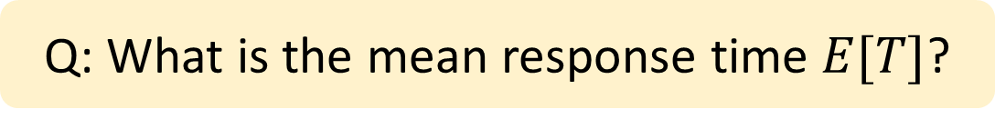

Multiserver-job Model
Modeling large computing systems: Many servers/job.
Job: (duration, server need)
FCFS
2
2
Server need
Poisson($λ$)
$$k$$
Sampled i.i.d. from joint distribution
3
4
1
2
1
Response time $T$
Idle server
Q: What is the mean response time $E[T]$?
Notes:
Topic of this talk: MSJ model. Different jobs require different numbers of servers. Motivated by big compute clusters, where we see this behavior.

Slide 3
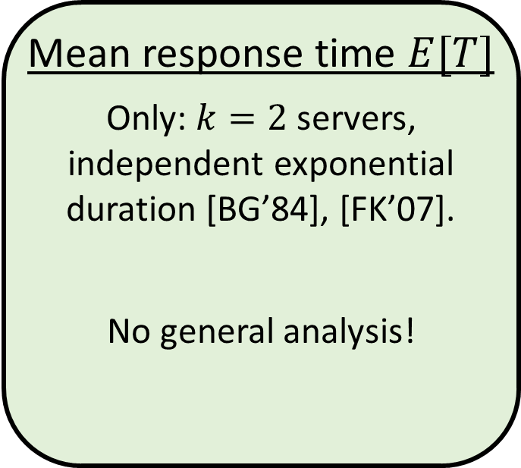
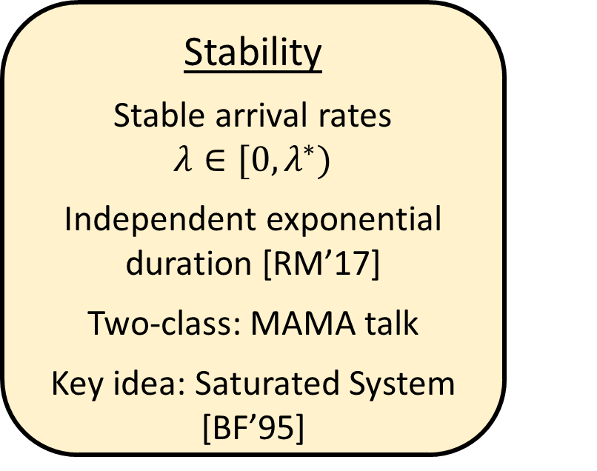
Prior work on MSJ FCFS
Stability
Stable arrival rates $λ∈[0,λ^{∗})$
Independent exponential duration [RM’17]
Two-class: MAMA talk
Key idea: Saturated System [BF’95]
Mean response time $E[T]$
Only: $k=2$ servers, independent exponential duration [BG’84], [FK’07].
No general analysis!
Also E[T] analysis for MSJ with scheduling!

Slide 4

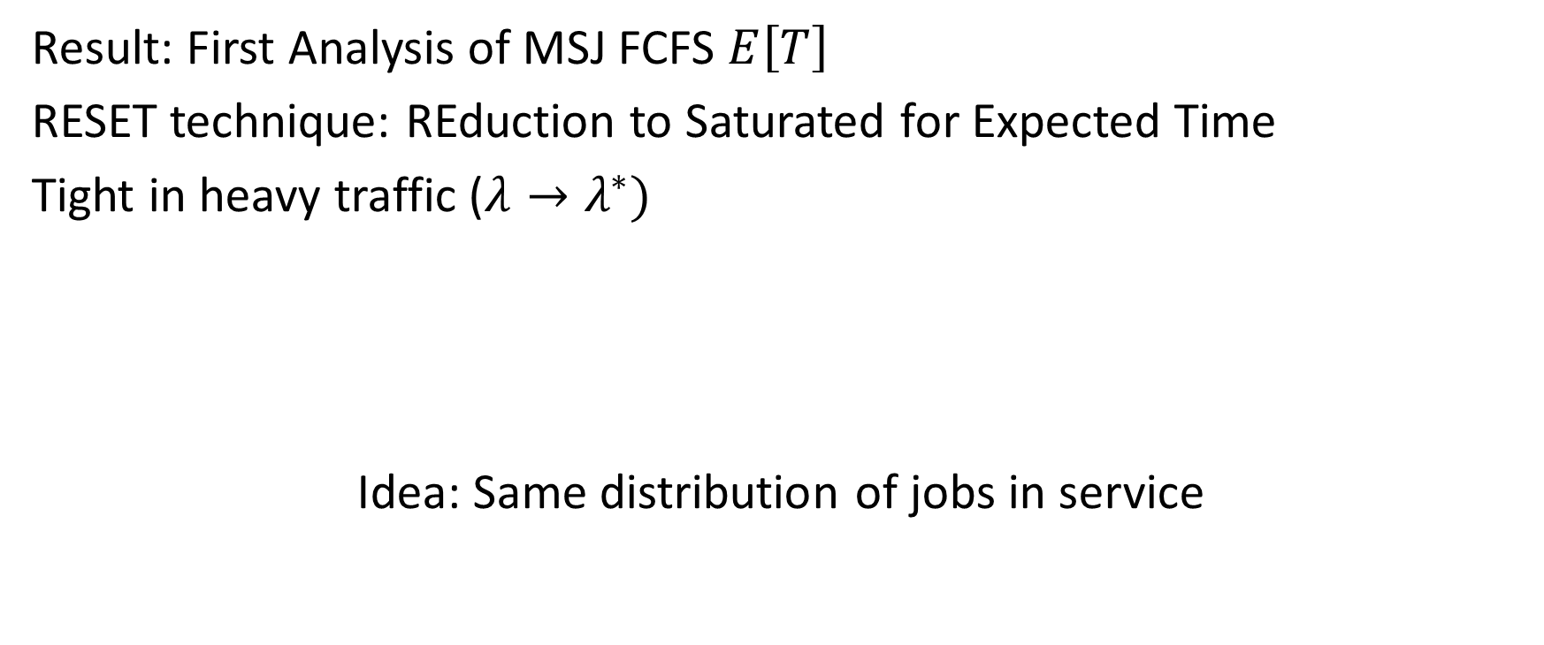
Results & Proof Strucuture
Result: First Analysis of MSJ FCFS $E\left[T\right]$
RESET technique: REduction to Saturated for Expected Time
Tight in heavy traffic ($λ→λ^{∗})$
Idea: Same distribution of jobs in service
Saturated System
MSJ
$$≈$$
New job
2
2
3
4
1
2
1
1
2
1

Slide 5
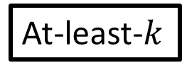

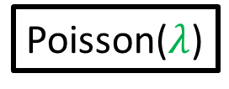
RESET technique: MSJ FCFS -> At-least-$k$
At-least-$k$
2
Poisson($λ$)
1
2
1

Slide 6
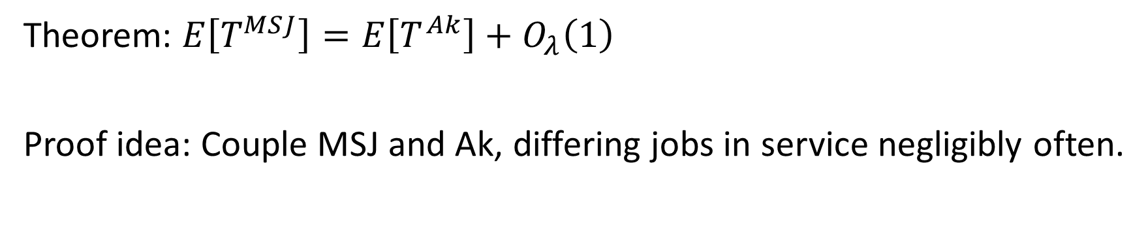
RESET technique: MSJ FCFS -> At-least-$k$
At-least-$k$
2
Poisson($λ$)
4
1
2
Extra arrival!
Theorem: $E\left[T^{MSJ}\right]=E\left[T^{Ak}\right]+O_{λ}\left(1\right)$
Proof idea: Couple MSJ and Ak, differing jobs in service negligibly often.
Notes:
Intuitively makes sense: k more jobs, O(1) E[T] impact.

Slide 7
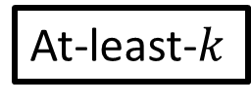


At-least-$k$ = MMSR + Saturated System
At-least-$k$
Ignore
2
Idea: Front $k$ jobs don’t care about queue state.
4
1
2

Slide 8

At-least-$k$ = MMSR + Saturated System
At-least-$k$
1
Ignore
Idea: Front $k$ jobs don’t care about queue state.
2
3
4
Saturated System
New job
1
2
3
4
Well-known system: [BF’95], [RM’17], MAMA talk.

Slide 9


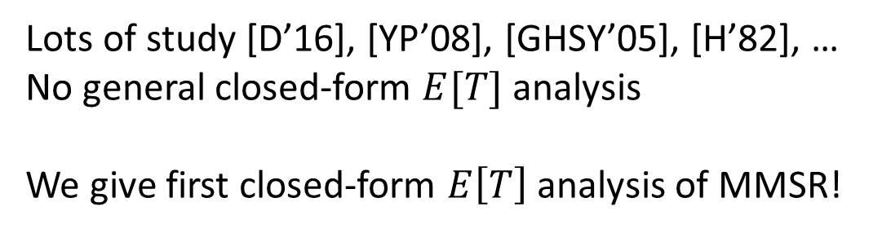
At-least-$k$ = MMSR + Saturated System
Ignore
1
Idea: States of jobs in queue irrelevant
At-least-$k$
$$2μ$$
Idea: Front $k$ jobs don’t care about queue state.
3
2
4
M/M/1 w/ Markovian Service Rate (MMSR)
Saturated System
New job
1
Lots of study [D’16], [YP’08], [GHSY’05], [H’82], …
No general closed-form $E[T]$ analysis
We give first closed-form $E\left[T\right]$ analysis of MMSR!
2
3
4
Well-known system: [BF’95], [RM’17], MAMA talk.

Slide 10
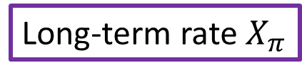
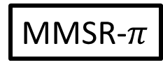

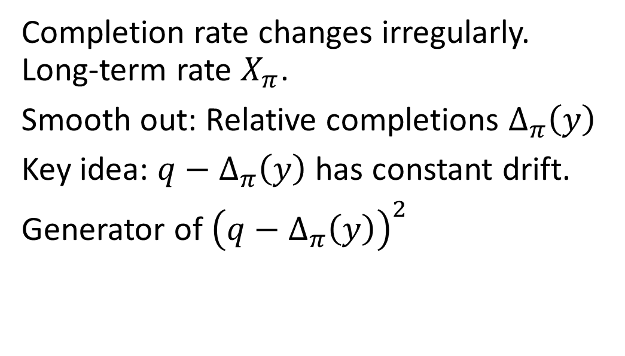



Analyze M/M/1 with Markovian Service Rate
MMSR-$π$
Service process $π$
y
Expected completions, starting at $y$
Completion rate changes irregularly. Long-term rate $X_{π}$.
Smooth out: Relative completions $Δ_{π}\left(y\right)$
Key idea: $q−Δ_{π}\left(y\right)$ has constant drift.
Generator of ${\left(q−Δ_{π}\left(y\right)\right)}^{2}$
Completions
$$Δ_{π}\left(y\right)$$
Long-term rate $X_{π}$
$$t$$

Slide 11
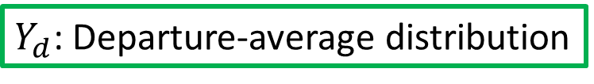
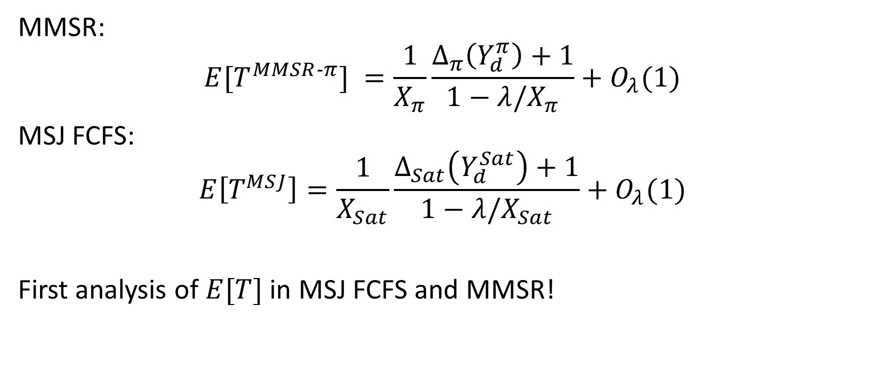
Results
$Y_{d}$: Departure-average distribution
MMSR:
$$E[T^{MMSR‐π}] =\frac{1}{X_{π}}\frac{Δ_{π}\left(Y_{d}^{π}\right)+1}{1−λ/X_{π}}+O_{λ}(1)$$
MSJ FCFS:
$$E\left[T^{MSJ}\right]=\frac{1}{X_{Sat}}\frac{Δ_{Sat}\left(Y_{d}^{Sat}\right)+1}{1−λ/X_{Sat}}+O_{λ}(1)$$
First analysis of $E[T]$ in MSJ FCFS and MMSR!

Slide 12

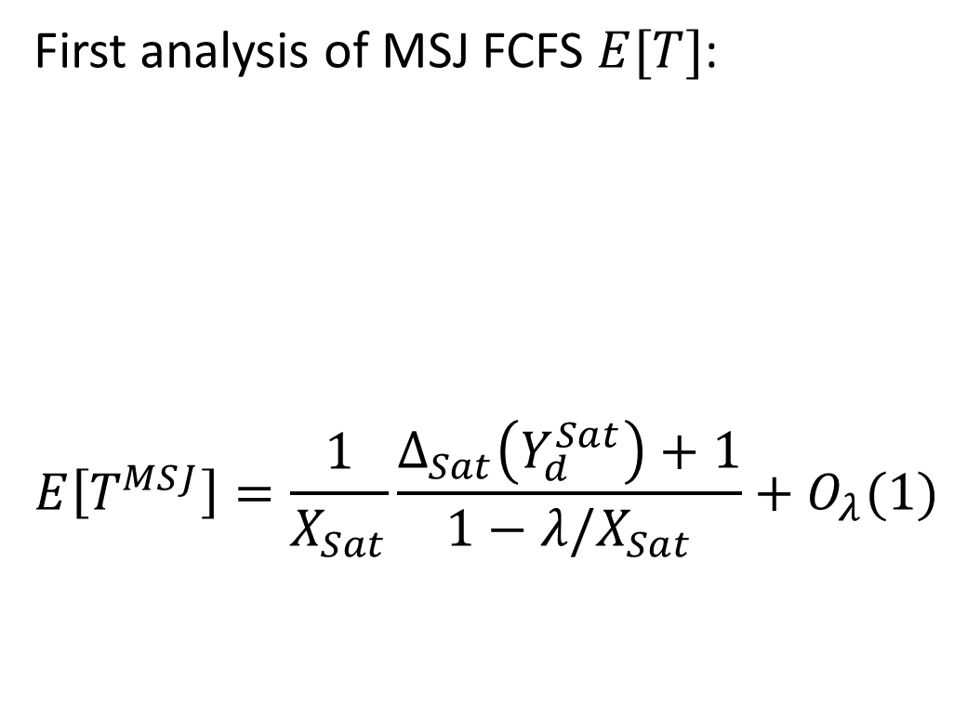

Conclusion
First analysis of MSJ FCFS $E[T]$:
$$E\left[T^{MSJ}\right]=\frac{1}{X_{Sat}}\frac{Δ_{Sat}\left(Y_{d}^{Sat}\right)+1}{1−λ/X_{Sat}}+O_{λ}(1)$$
M/M/1 w/ Markovian Service Rate (MMSR)
MSJ
Saturated System
2
$$≈$$
New job
$$+$$
3
4
1
2
2
1
1
2
1

Slide 13
Bonus: Extensions
Multidimensional resources
Variable server need
Alternative scheduling policies: Limited backfilling
Job locality/contention
Server affinity/heterogeneous servers

