Slide 1

Scheduling with Infinitely Heterogeneous Resource Requirements
Izzy Grosof
Heyuan Yao
Willow Kowalik
Northwestern University
Industrial Engineering & Management Science

Slide 2

Datacenter Scheduling: Heterogeneous resources
Datacenters: Huge resource capacities:
CPUs, GPUs, memory, bandwidth, etc.
Extremely heterogeneous job
requirements: Scale & resource mix
Goal: Schedule to optimize performance

Slide 3


Existing theoretical paradigm:
Limited resource heterogeneity
Existing performance modeling theory: Heterogeneity via handful of resource requirement classes – like VMs, small, medium, large
Reality: massive heterogeneity. Google Borg scheduling trace: In first 1M jobs, 3.7k unique memory reqs., 540k unique CPU reqs., 950k unique pairs.
Real systems, and corresponding simulators understand this.
Popular policies: FCFS + Backfilling policies, learning policies.
Need new theory!

Slide 4
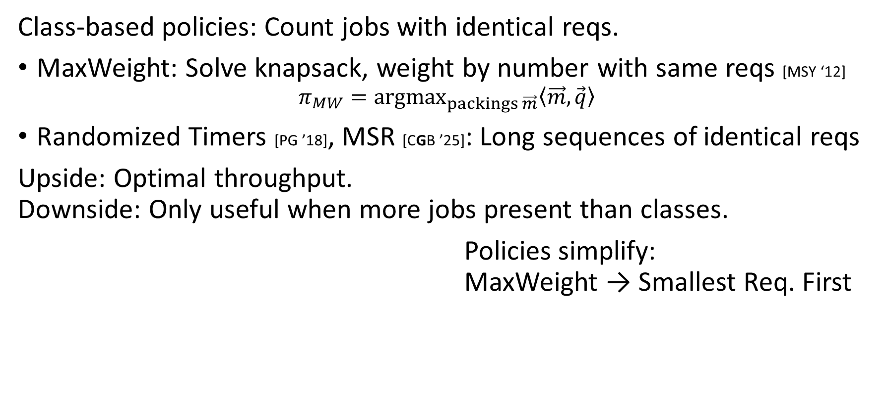
Prior theoretical work
Class-based policies: Count jobs with identical reqs.
MaxWeight: Solve knapsack, weight by number with same reqs [MSY ‘12]
$$π_{MW}={argmax}_{packings \vec{m}}\left\langle \vec{m},\vec{q}\right\rangle$$
Randomized Timers [PG ’18], MSR [CGB ’25]: Long sequences of identical reqs
Upside: Optimal throughput.
Downside: Only useful when more jobs present than classes.
Policies simplify:
MaxWeight → Smallest Req. First

Slide 5
Prior theoretical work
Index-based policies: Simple ordering, greedily place into service.
FCFS with HOL blocking [RM ’17,GHHS ‘23]. Backfilling [CS ’01] and variants.
Unfortunately: Not throughput optimal – wasting some capacity.
Goal: Theoretical guarantees of class-based policies,
broad applicability of index-based

Slide 6
Outline
.9
.2
.5
.7
Theoretical model
New policies: Controlled Discretization
Theoretical results
Empirical results, including trace data
Extension: Changing requirements over time
.08
.25
.13

Slide 7
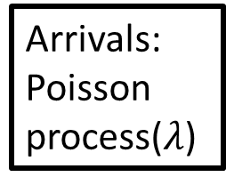
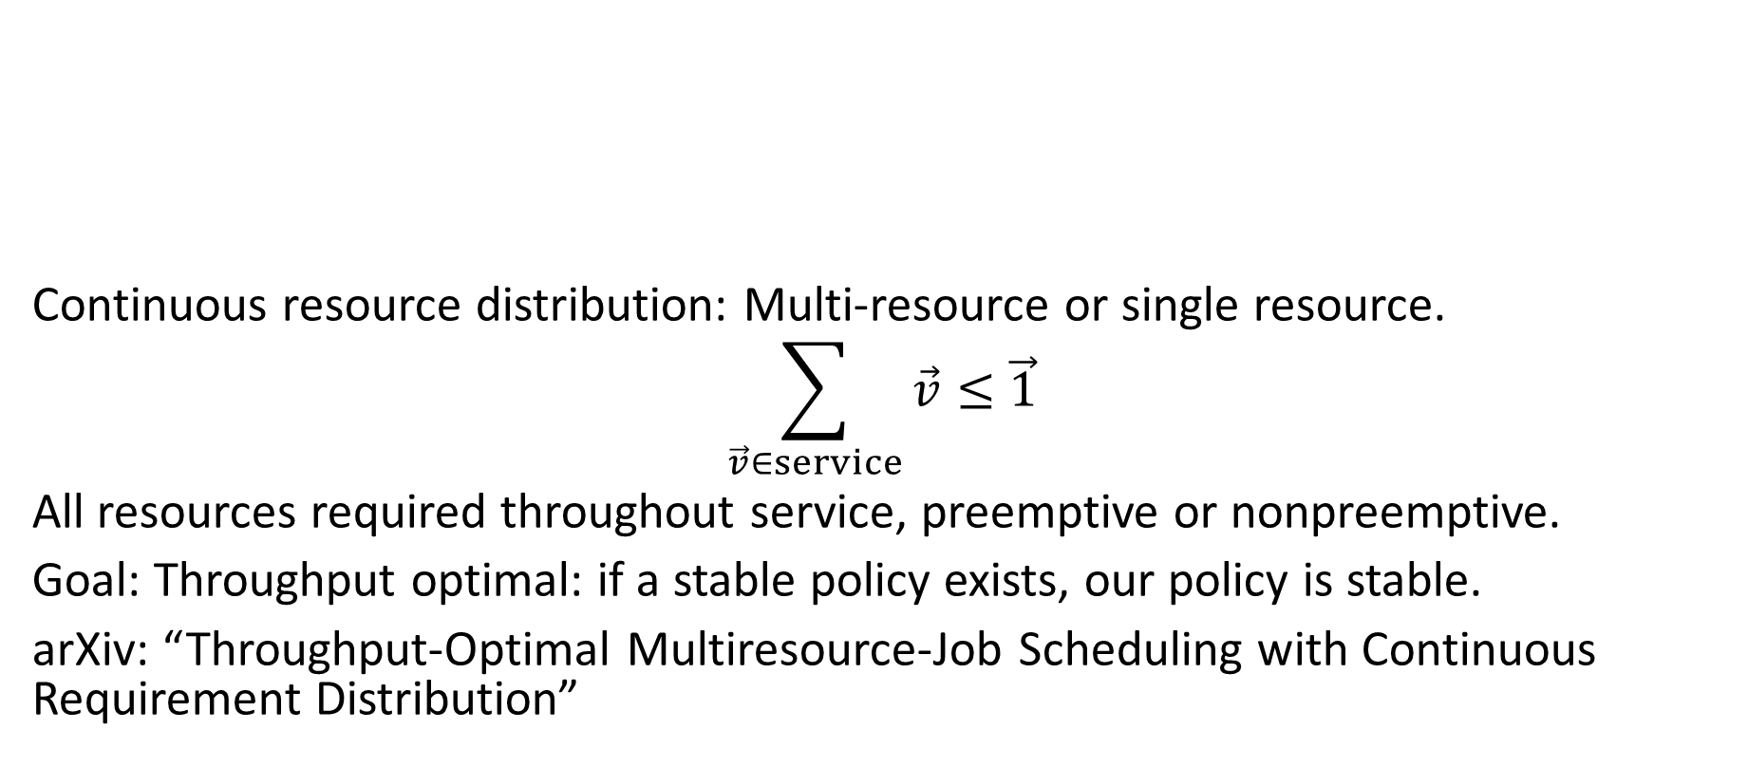


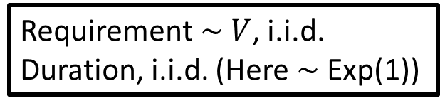
Model
Requirement $\sim V$, i.i.d.
Duration, i.i.d. (Here $\sim$ Exp(1))
.9
.2
Arrivals: Poisson process($λ$)
.5
Continuous resource distribution: Multi-resource or single resource.
$$\sum_{\vec{v}∈service}{\vec{v}}≤\vec{1}$$
All resources required throughout service, preemptive or nonpreemptive.
Goal: Throughput optimal: if a stable policy exists, our policy is stable.
arXiv: “Throughput-Optimal Multiresource-Job Scheduling with Continuous Requirement Distribution”
.7
.08
$$f_{V}(v)$$
.25
$0$ $v$ $1$
Capacity (normalized to 1)
.13

Slide 8
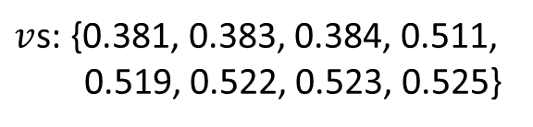
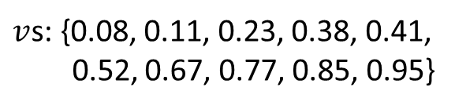
Policy Intuition
$v$s: {0.08, 0.11, 0.23, 0.38, 0.41,
0.52, 0.67, 0.77, 0.85, 0.95}
Pack efficiently – use all available resources
Avoid clumps of jobs of similar requirements
Problem: Very few options!
Multi-resource: Bottleneck on one resource
Single resource: Doesn’t divide cleanly
Class-based policies: prioritize jobs with many identical reqs present. Ex: MaxWeight – weight is number with same reqs.
Our policies: Prioritize jobs with many similar requirements present.
$v$s: {0.381, 0.383, 0.384, 0.511,
0.519, 0.522, 0.523, 0.525}
Notes:
Very clumped: few options

Slide 9

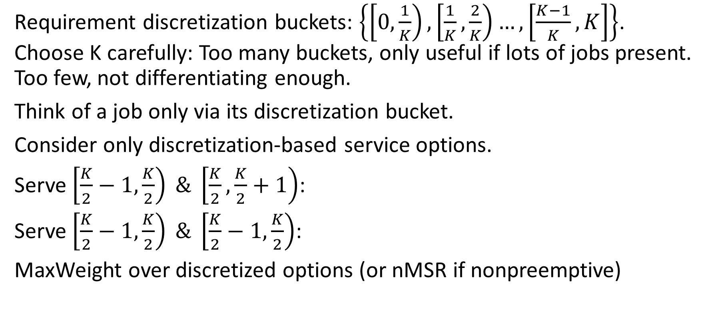

Discretization
Requirement discretization buckets: $\left\{\left[0,\frac{1}{K}\right),\left[\frac{1}{K},\frac{2}{K}\right)…,\left[\frac{K−1}{K},K\right]\right\}$.
Choose K carefully: Too many buckets, only useful if lots of jobs present. Too few, not differentiating enough.
Think of a job only via its discretization bucket.
Consider only discretization-based service options.
Serve $\left[\frac{K}{2}−1,\frac{K}{2}\right) \& \left[\frac{K}{2},\frac{K}{2}+1\right)$:
Serve $\left[\frac{K}{2}−1,\frac{K}{2}\right) \& \left[\frac{K}{2}−1,\frac{K}{2}\right)$:
MaxWeight over discretized options (or nMSR if nonpreemptive)
Counts $q_{K}\left(v\right)$
$0$ $v$ $1$

Slide 10

K-Discretized MaxWeight: Result
K-Discretized MaxWeight:
${argmax}_{M_{K}}⟨\vec{q_{K}},M_{K}⟩$, where $M_{K}$ is a K-discretized service option
Thm: The K-Discretized MaxWeight policy family is throughput optimal.
For any arrival rate $λ$ and any Lipschitz-continuous requirement distribution $V$ for which a stabilizing policy exists, there exists a K such that K-MaxWeight is stable.
Thm: Also optimal in any number of requirement dimensions
Thm: K-discretized nMSR (nonpreemptive) also throughput optimal

Slide 11

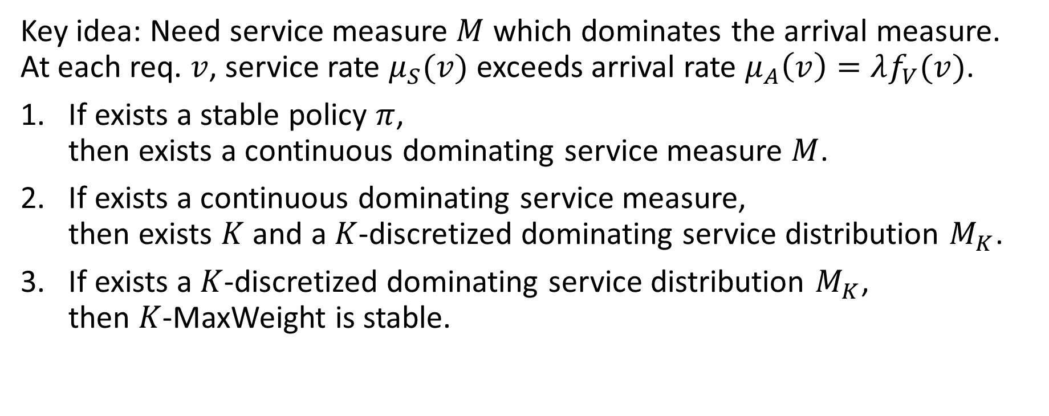


Proof sketch
$$μ_{S}\left(v\right)$$
$$μ_{A}\left(v\right)$$
$0$ $v$ $1$
Key idea: Need service measure $M$ which dominates the arrival measure.
At each req. $v$, service rate $μ_{S}(v)$ exceeds arrival rate $μ_{A}\left(v\right)=λf_{V}(v)$.
If exists a stable policy $π$,
then exists a continuous dominating service measure $M$.
If exists a continuous dominating service measure,
then exists $K$ and a $K$-discretized dominating service distribution $M_{K}$.
If exists a $K$-discretized dominating service distribution $M_{K}$,
then $K$-MaxWeight is stable.
Time average, nonempty
?
Standard class-based MaxWeight theorem

Slide 12



Continuous to Discrete Service Options
Challenge: Map continuous service option to discrete service option
Ex: $m=\left[0.73, 0.21, 0.02\right], K=10$
Approach 1: Round up. $m_{K}=[0.8,0.3,0.1]$
Approach 2: Round down. $m_{K}=[0.7,0.2]$
$$μ_{S}\left(v\right)$$
$$μ_{A}\left(v\right)$$
$0$ $v$ $1$

Slide 13
Continuous to Discrete Service Options
Challenge: Map continuous service option to discrete service option
Ex: $m=\left[0.73, 0.21, 0.02\right], K=10$
Approach 1: Round up. $m_{K}=[0.8,0.3,0.1]$
Approach 2: Round down. $m_{K}=[0.7,0.2]$
$$μ_{S}\left(v\right)$$
$$μ_{A}\left(v\right)$$
$0$ $v$ $1$

Slide 14

Continuous to Discrete Service Options
Challenge: Map continuous service option to discrete service option
Ex: $m=\left[0.73, 0.21, 0.02\right], K=10$
Approach 1: Round up. $m_{K}=[0.8,0.3,0.1]$
Approach 2: Round down. $m_{K}=[0.7,0.2]$
Due to Lipschitz continuity,
if $K$ is large enough,
round-down $M_{K}$ is dominating*.
$$μ_{S}\left(v\right)$$
$$μ_{A}\left(v\right)$$
$0$ $v$ $1$

Slide 15
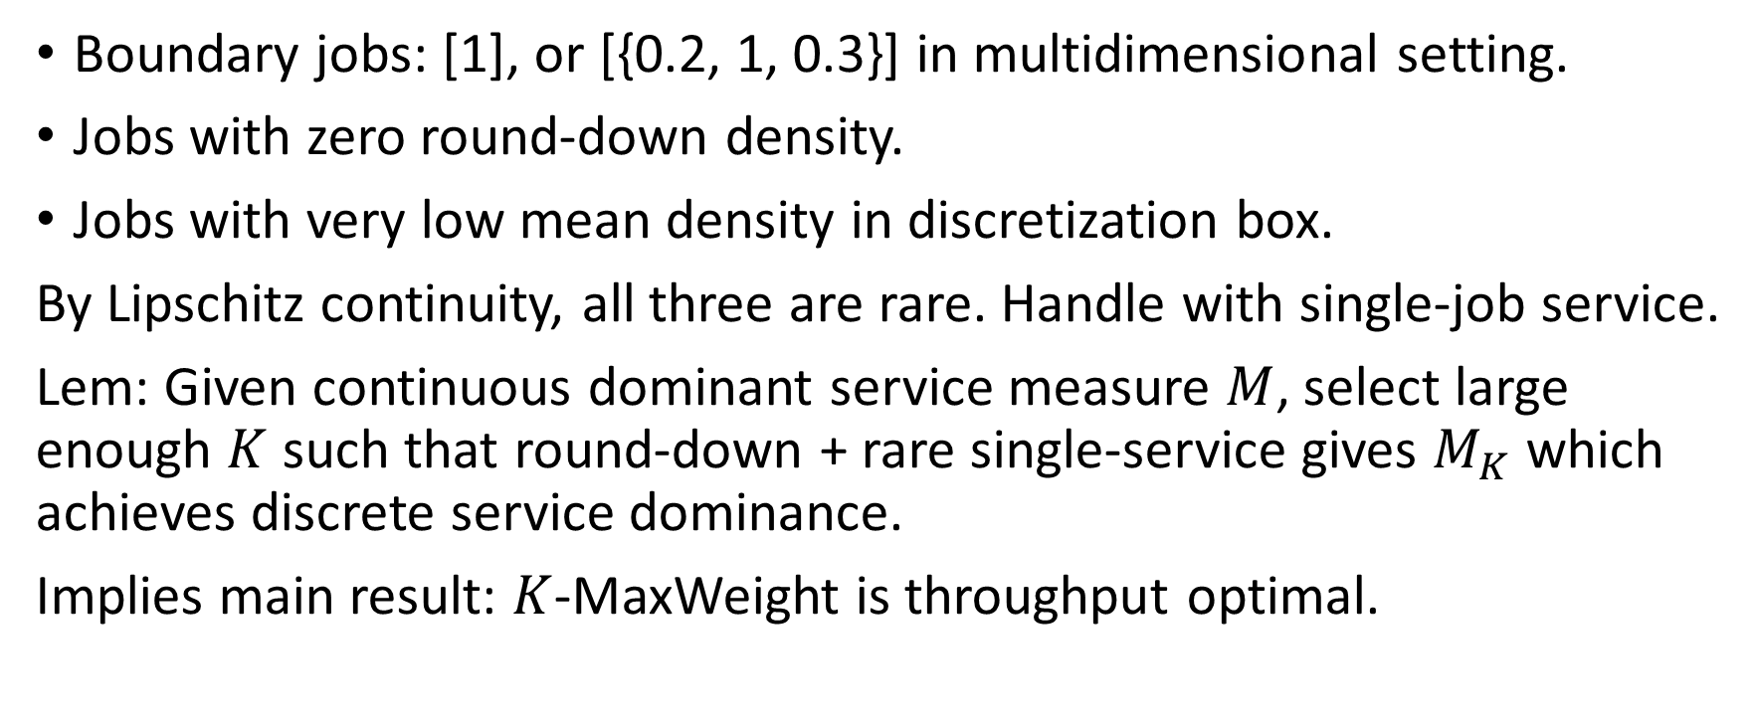
Special cases & key result
Boundary jobs: [1], or [{0.2, 1, 0.3}] in multidimensional setting.
Jobs with zero round-down density.
Jobs with very low mean density in discretization box.
By Lipschitz continuity, all three are rare. Handle with single-job service.
Lem: Given continuous dominant service measure $M$, select large enough $K$ such that round-down + rare single-service gives $M_{K}$ which achieves discrete service dominance.
Implies main result: $K$-MaxWeight is throughput optimal.

Slide 16
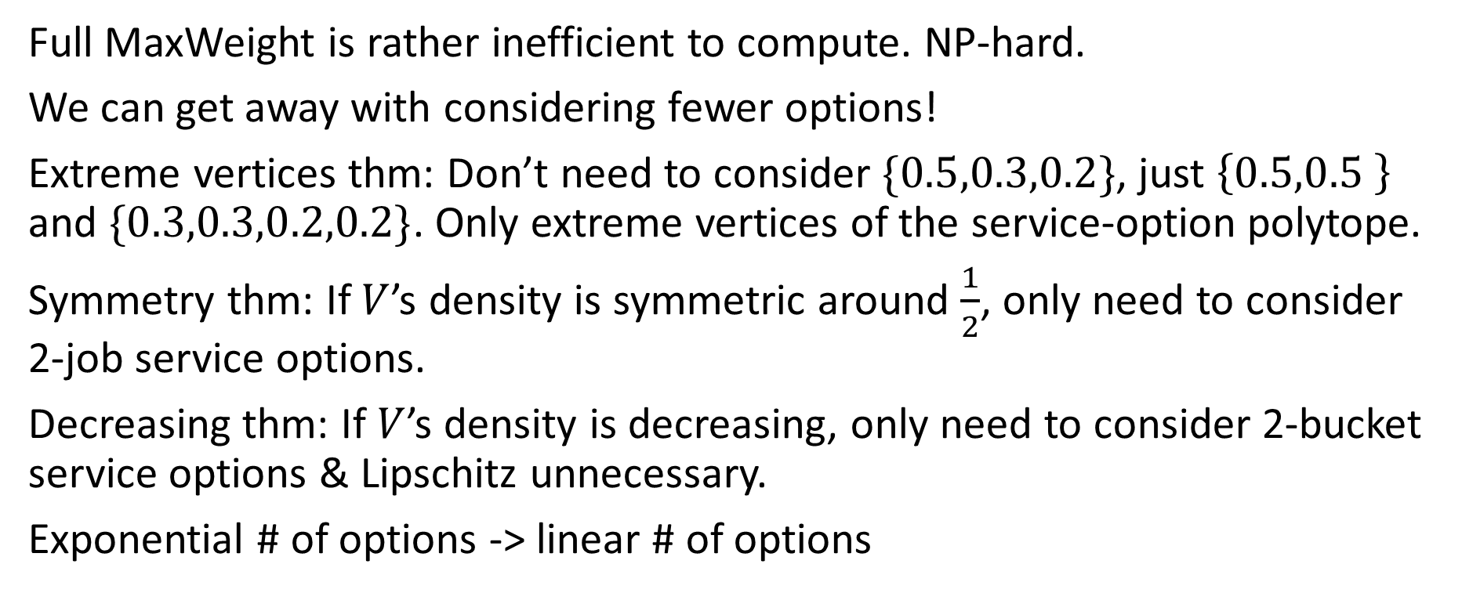
Smaller search space: more efficient
Full MaxWeight is rather inefficient to compute. NP-hard.
We can get away with considering fewer options!
Extreme vertices thm: Don’t need to consider $\{0.5,0.3,0.2\}$, just $\left\{0.5,0.5 \right\}$ and $\{0.3,0.3,0.2,0.2\}$. Only extreme vertices of the service-option polytope.
Symmetry thm: If $V$’s density is symmetric around $\frac{1}{2}$, only need to consider 2-job service options.
Decreasing thm: If $V$’s density is decreasing, only need to consider 2-bucket service options & Lipschitz unnecessary.
Exponential # of options -> linear # of options

Slide 17
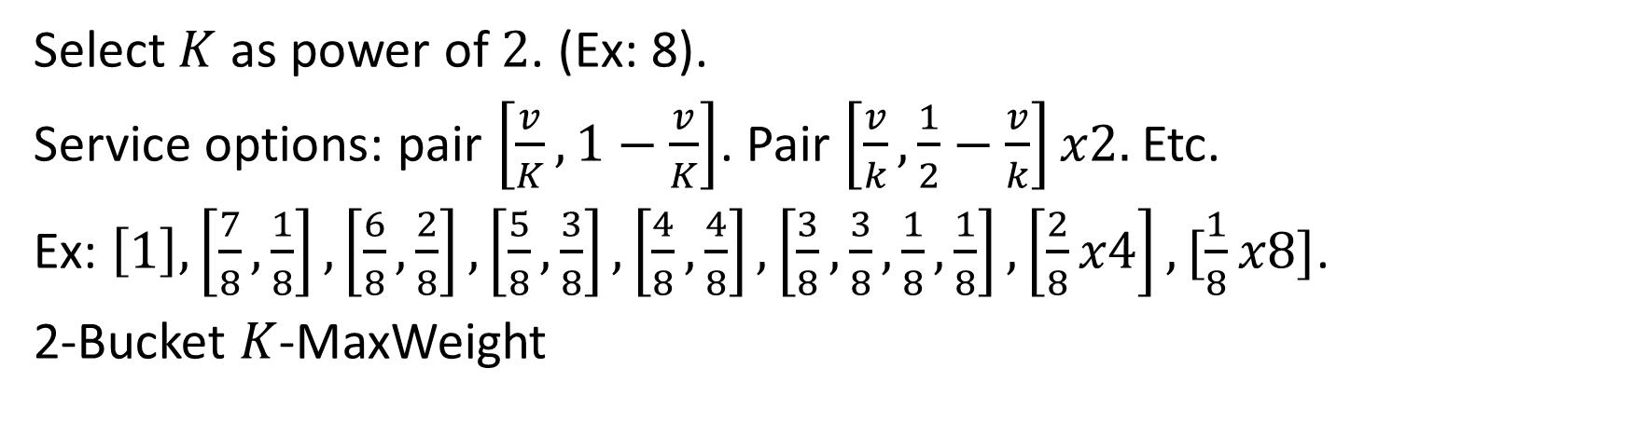

Decreasing density: 2-bucket service options
$$μ_{A}\left(v\right)$$
$0$ $v$ $1$
Select $K$ as power of $2$. (Ex: 8).
Service options: pair $\left[\frac{v}{K},1−\frac{v}{K}\right]$. Pair $\left[\frac{v}{k},\frac{1}{2}−\frac{v}{k}\right]x2.$ Etc.
Ex: $\left[1\right],\left[\frac{7}{8},\frac{1}{8}\right],\left[\frac{6}{8},\frac{2}{8}\right],\left[\frac{5}{8},\frac{3}{8}\right],\left[\frac{4}{8},\frac{4}{8}\right],\left[\frac{3}{8},\frac{3}{8},\frac{1}{8},\frac{1}{8}\right],\left[\frac{2}{8}x4\right],[\frac{1}{8}x8]$.
2-Bucket $K$-MaxWeight

Slide 18
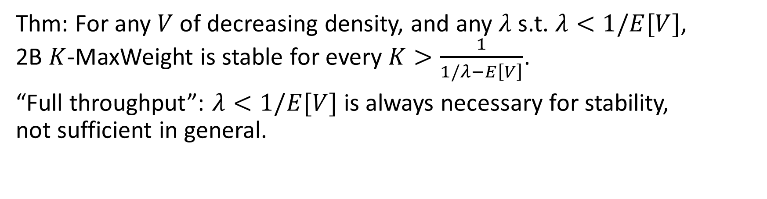
Decreasing density: 2-bucket service options
$$μ_{A}\left(v\right)$$
$0$ $v$ $1$
Thm: For any $V$ of decreasing density, and any $λ$ s.t. $λ<1/E[V]$,
2B $K$-MaxWeight is stable for every $K>\frac{1}{1/λ−E\left[V\right]}$.
“Full throughput”: $λ<1/E[V]$ is always necessary for stability,
not sufficient in general.

Slide 19
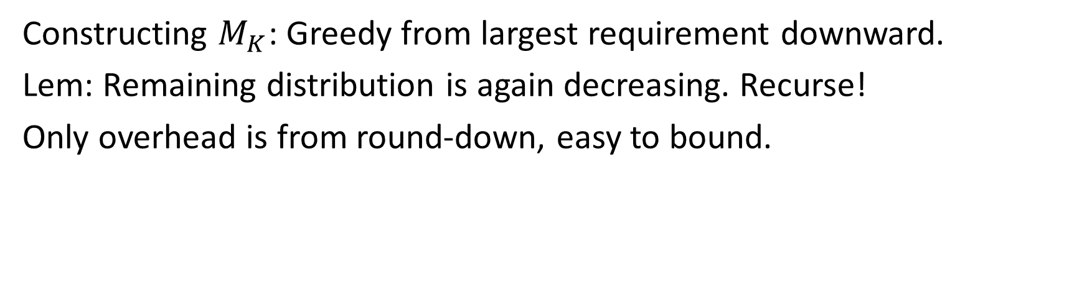
Decreasing density: 2-bucket service options
$$μ_{A}\left(v\right)$$
$0$ $v$ $1$
Constructing $M_{K}$: Greedy from largest requirement downward.
Lem: Remaining distribution is again decreasing. Recurse!
Only overhead is from round-down, easy to bound.

Slide 20
Outline
.9
.2
.5
.7
Theoretical model
New policies: Controlled Discretization
Theoretical results
Empirical results, including trace data
Extension: Changing requirements over time
.08
.25
.13

Slide 21
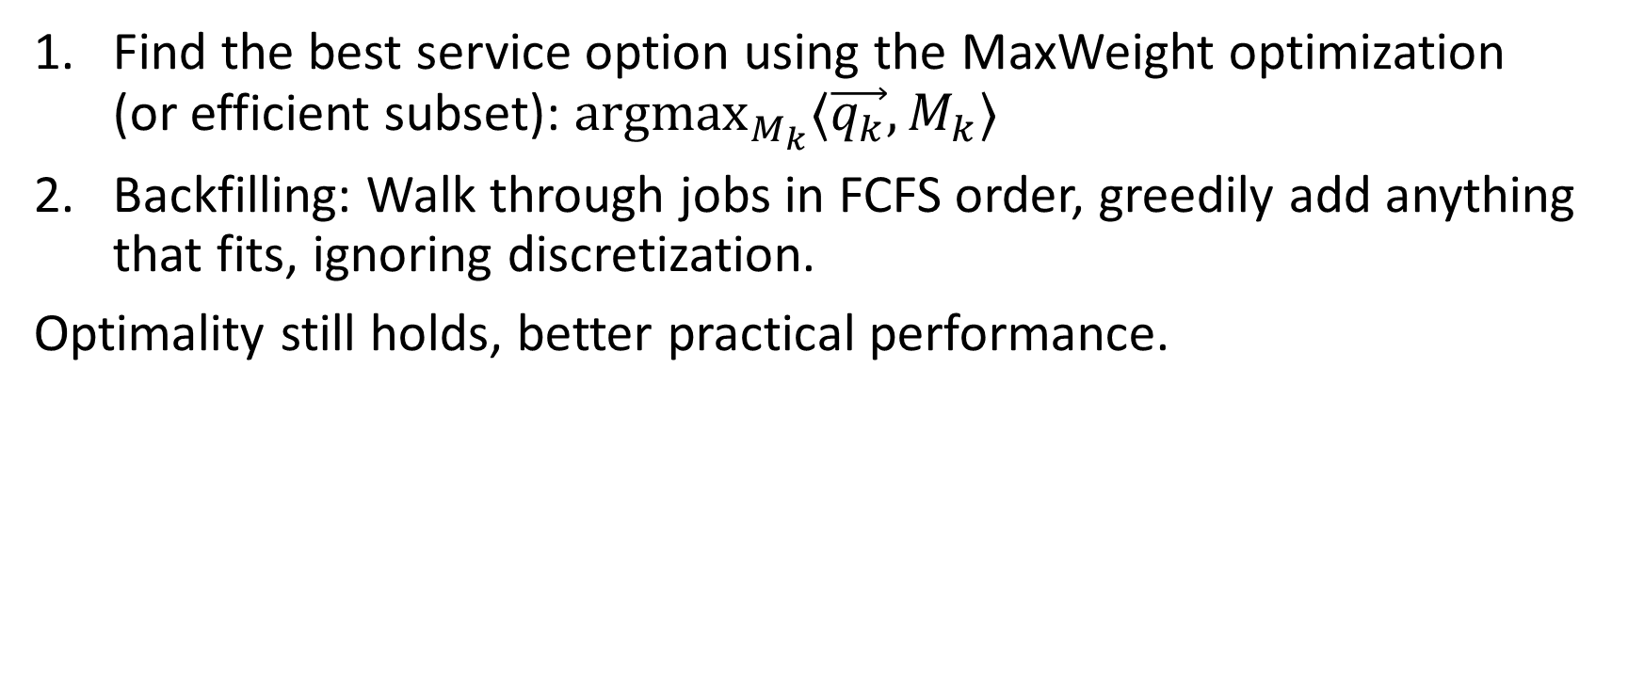
Practical: Discretized MaxWeight + Backfilling
Find the best service option using the MaxWeight optimization
(or efficient subset): ${argmax}_{M_{k}}⟨\vec{q_{k}},M_{k}⟩$
Backfilling: Walk through jobs in FCFS order, greedily add anything that fits, ignoring discretization.
Optimality still holds, better practical performance.

Slide 22
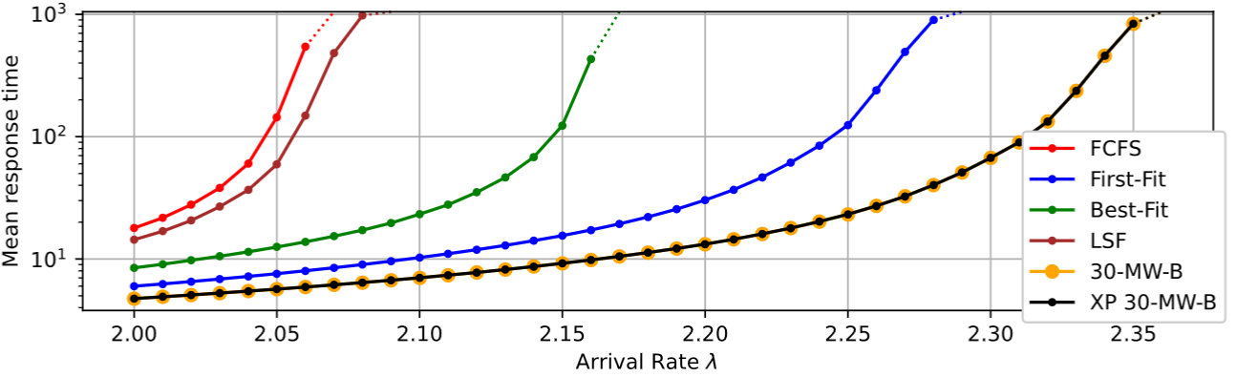
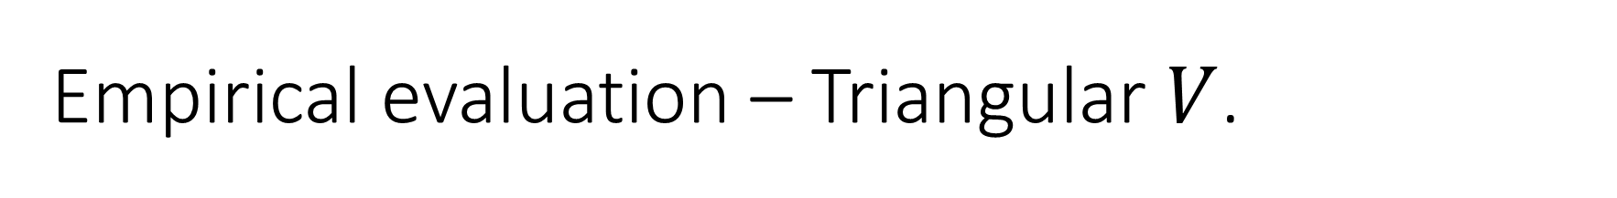

Empirical evaluation – Triangular $V$.
$$f_{V}(v)$$
$V:$ Centered triangular, support $\left[\frac{1}{4},\frac{1}{2}\right]$.
$0$ $v$ $1$

Slide 23


Empirical evaluation – Triangular $V$.
$$f_{V}(v)$$
$V:$ Centered triangular, support $\left[\frac{1}{4},\frac{1}{2}\right]$.
$0$ $v$ $1$
Naïve MaxWeight

Slide 24
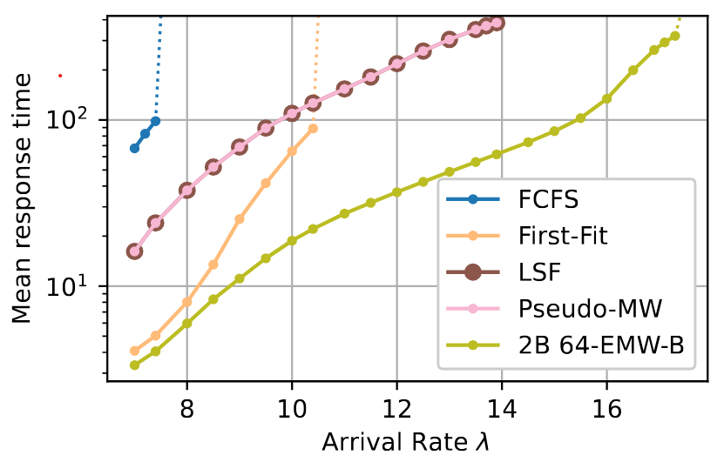

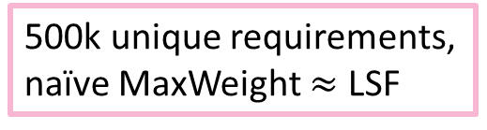
Empirical evaluation – CPU reqs.
Google Borg scheduling trace [Tirmazi ’19]: CPU reqs, memory reqs. Not i.i.d.
Focus on 90% of jobs with lower requirements, normalize.
$K=64$buckets,
power-of-two pairing,
backfilling
500k unique requirements, naïve MaxWeight $≈$ LSF
Notes:
Dotted lines: over 1000, indistinguishable from unstable.

Slide 25
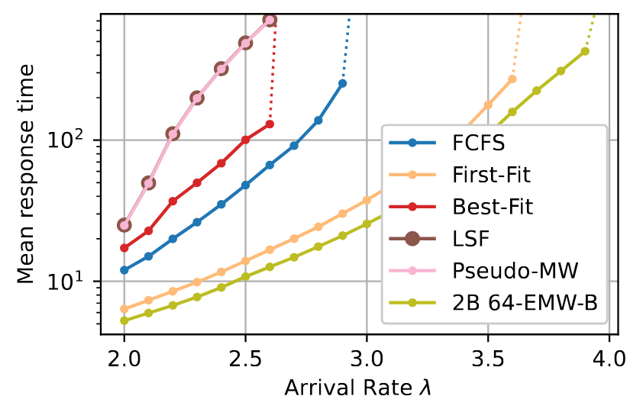

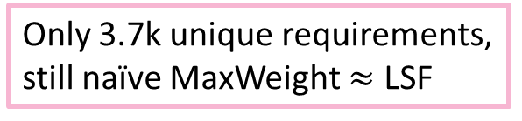
Empirical evaluation – Memory reqs.
$K=64$buckets,
power-of-two pairing,
backfilling
Only 3.7k unique requirements, still naïve MaxWeight $≈$ LSF

Slide 26

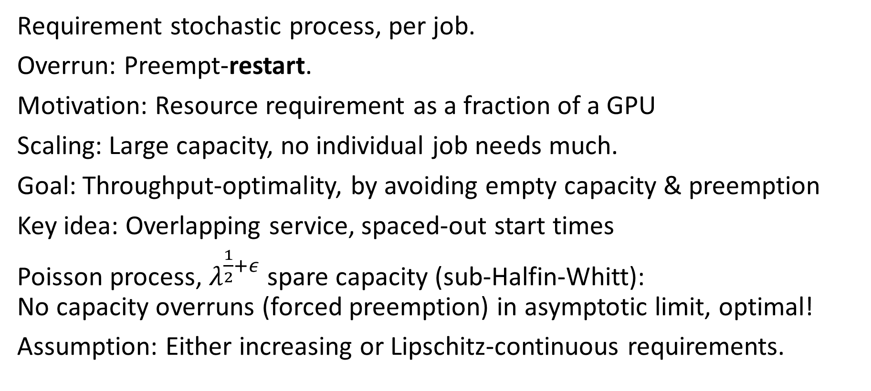

Ongoing: Changing requirements over time
$$Req(t)$$
Requirement stochastic process, per job.
Overrun: Preempt-restart.
Motivation: Resource requirement as a fraction of a GPU
Scaling: Large capacity, no individual job needs much.
Goal: Throughput-optimality, by avoiding empty capacity & preemption
Key idea: Overlapping service, spaced-out start times
Poisson process, $λ^{\frac{1}{2}+ε}$ spare capacity (sub-Halfin-Whitt):
No capacity overruns (forced preemption) in asymptotic limit, optimal!
Assumption: Either increasing or Lipschitz-continuous requirements.
$0$ time $t$

Slide 27
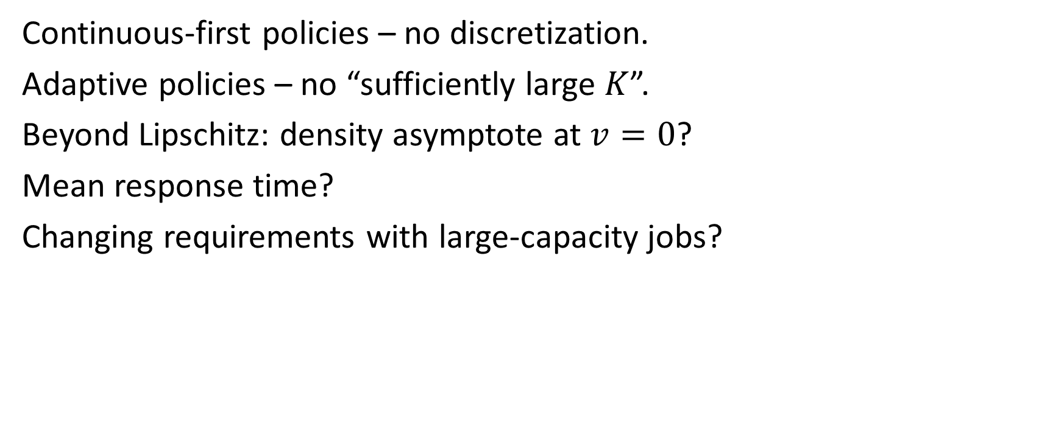
Lots of future directions!
Continuous-first policies – no discretization.
Adaptive policies – no “sufficiently large $K$”.
Beyond Lipschitz: density asymptote at $v=0$?
Mean response time?
Changing requirements with large-capacity jobs?
$$f_{V}(v)$$
$0$ $v$ $1$

Slide 28
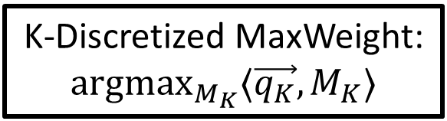


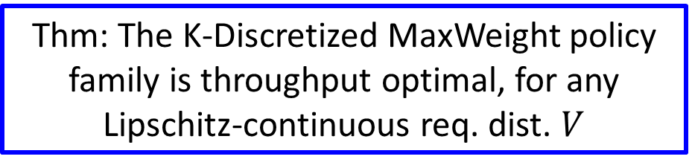
Conclusion
Continuous requirement distributions
.9
.2
.5
.7
.08
$$f_{V}(v)$$
.25
$0$ $v$ $1$
.13
K-Discretized MaxWeight: ${argmax}_{M_{K}}⟨\vec{q_{K}},M_{K}⟩$
Thm: The K-Discretized MaxWeight policy family is throughput optimal, for any Lipschitz-continuous req. dist. $V$

