Slide 1

Pareto-Optimal Scheduling in the Half-Batch Multiserver-job Model
Ziyuan Wang and Izzy Grosof
Northwestern University, IEMS

Slide 2

Motivation: Supercomputing Scheduling
Extremely large supercomputers (Frontier, Aurora, etc.)
Jobs specify # of nodes needed.
Fixed number throughout service.
Multiserver-job model
Nonpreemptible.
Which jobs to serve at which time?

Slide 3
Prioritizing Large-requirement jobs
Priority: “Leadership-class jobs”:
>6k nodes out of 10k nodes available.
Mid-tier: 2k-6k nodes
Low-priority: <2k nodes
Goals:
Low latency for leadership-class jobs
High total throughput
Tradeoff!

Slide 4
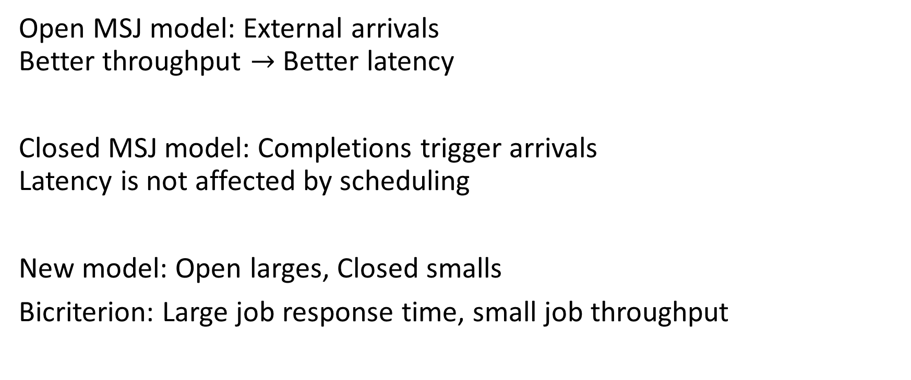
Existing MSJ Models can’t capture tradeoff
n
1
1
Open MSJ model: External arrivals
Better throughput $→$ Better latency
Closed MSJ model: Completions trigger arrivals
Latency is not affected by scheduling
New model: Open larges, Closed smalls
Bicriterion: Large job response time, small job throughput
1
1
1
1
1
1
1
n
1
1
1
1
1
1
1
1
1

Slide 5
Prior work on Nonpreemptible MSJ
Open Models:
Stability-optimal: Randomized Timers [G’16], Markovian Service Rate [CGB’25]
FCFS: Stability region [RM’17], response time [GHHS’23]
Scaling regimes: [HW’24], [GA’25]
Closed Models:
FCFS: Equivalence between closed and open throughput and response time. [BF’95], [GHHS’23]. Product forms [CG ’26].
Large and small jobs: Throughput characterization [OMBM’23].

Slide 6
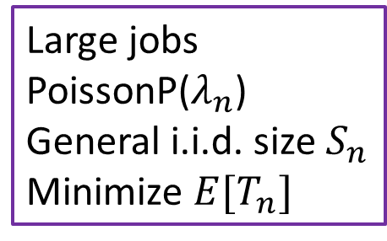
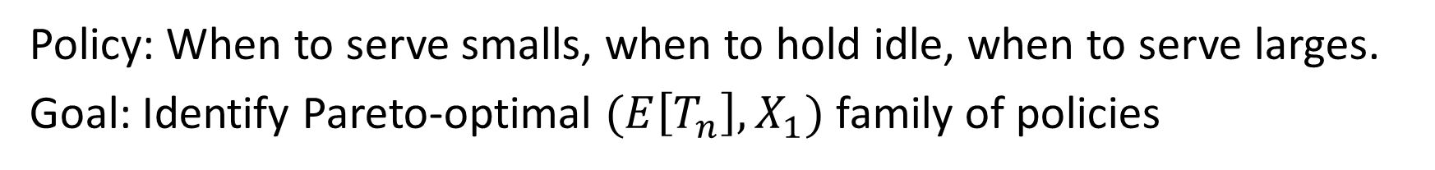
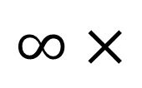
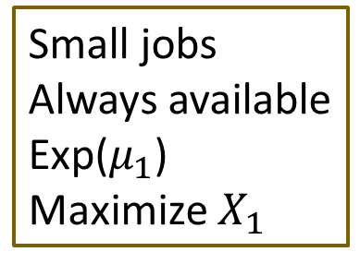
Half-batch MSJ Model [WG ‘26]
Large jobs
PoissonP($λ_{n}$)
General i.i.d. size $S_{n}$
Minimize $E[T_{n}]$
n
n
n
1
n
1
1
1
or
1
Small jobs
Always available
Exp($μ_{1}$)
Maximize $X_{1}$
1
$$∞×$$
1
1
Policy: When to serve smalls, when to hold idle, when to serve larges.
Goal: Identify Pareto-optimal $(E\left[T_{n}\right],X_{1})$ family of policies

Slide 7

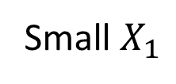
Pareto-optimal policies
Small $X_{1}$
Convex Hull
Large $E\left[T_{n}\right]$

Slide 8
Pareto-optimal policies
Goal: Pareto-Optimal Policy family
Small $X_{1}$
Convex Hull
Large $E\left[T_{n}\right]$

Slide 9


Convoy Policies
$(k, n)$-convoy: Serve small jobs on all $n$ servers until $k$ large jobs arrive.
Then let all servers empty, and serve all large jobs.
1
1
1
n
n
n
n
n
n
1
1
1
1
1
1
…
1
1
1
1
1
1
1
Wait until $k$ large jobs arrive

Slide 10
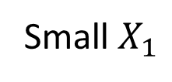



Main result
Thm: For any $n, λ_{n}, μ_{1},$ and $S_{n}$, the Pareto-optimal frontier is formed by the $\left(k, n\right)$-convoy policies, the “only large” policy, and convex combinations.
$(k, n)$-convoy policies
Only
larges
Small $X_{1}$
Large $E\left[T_{n}\right]$

Slide 11
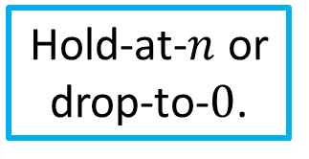
Proof outline: Narrowing optimality
Replication!
Convexity!
All policies
Mixture-of-thresholds policies
Hold-at-$n$ or drop-to-$0$.
Convoy policies
Threshold policy: Either hold smalls fixed, or drop to target # of smalls.
Mixture of thresholds: Probabilistic mixture of threshold policies, between each pair of large arrivals.

Slide 12

Proof details: Replication lemma
Replication lemma: Between any two large arrivals, for any policy $π$, we construct a mixture-of-thresholds (MoT) policy which matches $π$ in terms of:
Distribution of number of small jobs completed
Distribution of number of small jobs in service when the large job arrives.
This is sufficient to replicate any policy’s $X_{1}$ and $E[T_{n}]$.
v

Slide 13

Proof details: Convexity lemma
Convexity lemma: Among threshold policies, both $X_{1}$ and $E[T_{n}]$ are convex in the number of small jobs in service as of the final large arrival.
As a result, any MoT policy can be improved by a convex combination of the hold-at-$n$ and drop-to-$0$ policies.
This implies that convoy policies (and the Only Large policy) are the only Pareto-Optimal policies.

Slide 14
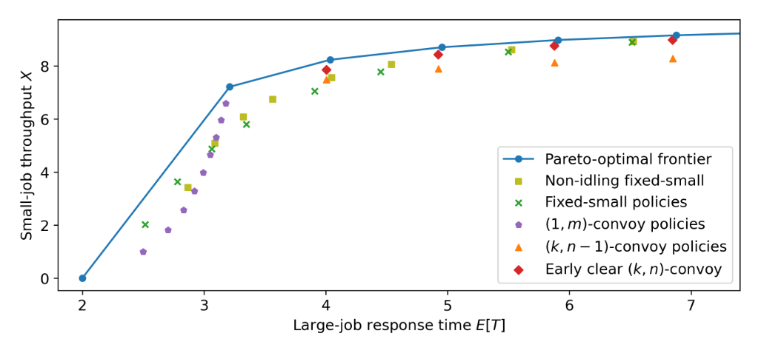
Empirical validation
Empirically, optimality holds for IHR small jobs, not for DHR.
Holds if large $∈(n/2,n)$.

Slide 15
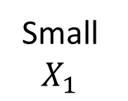

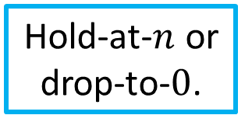
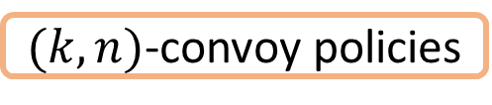
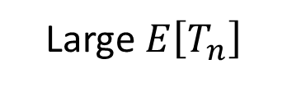
Conclusion
n
n
n
1
n
1
1
1
or
1
1
$$∞×$$
1
1
Only
larges
$(k, n)$-convoy policies
Replication!
Convexity!
Small $X_{1}$
All policies
Mixture-of-thresholds policies
Hold-at-$n$ or drop-to-$0$.
Large $E\left[T_{n}\right]$

