Slide 1
Multiserver-job Response Time under Multilevel Scaling
Izzy Grosof – Northwestern IEMS
Hayriye Ayhan – Georgia Tech ISyE

Slide 2

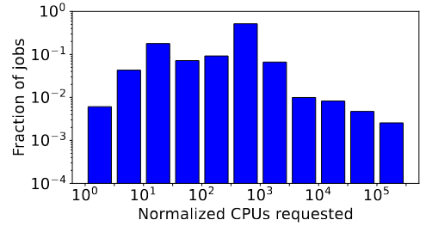
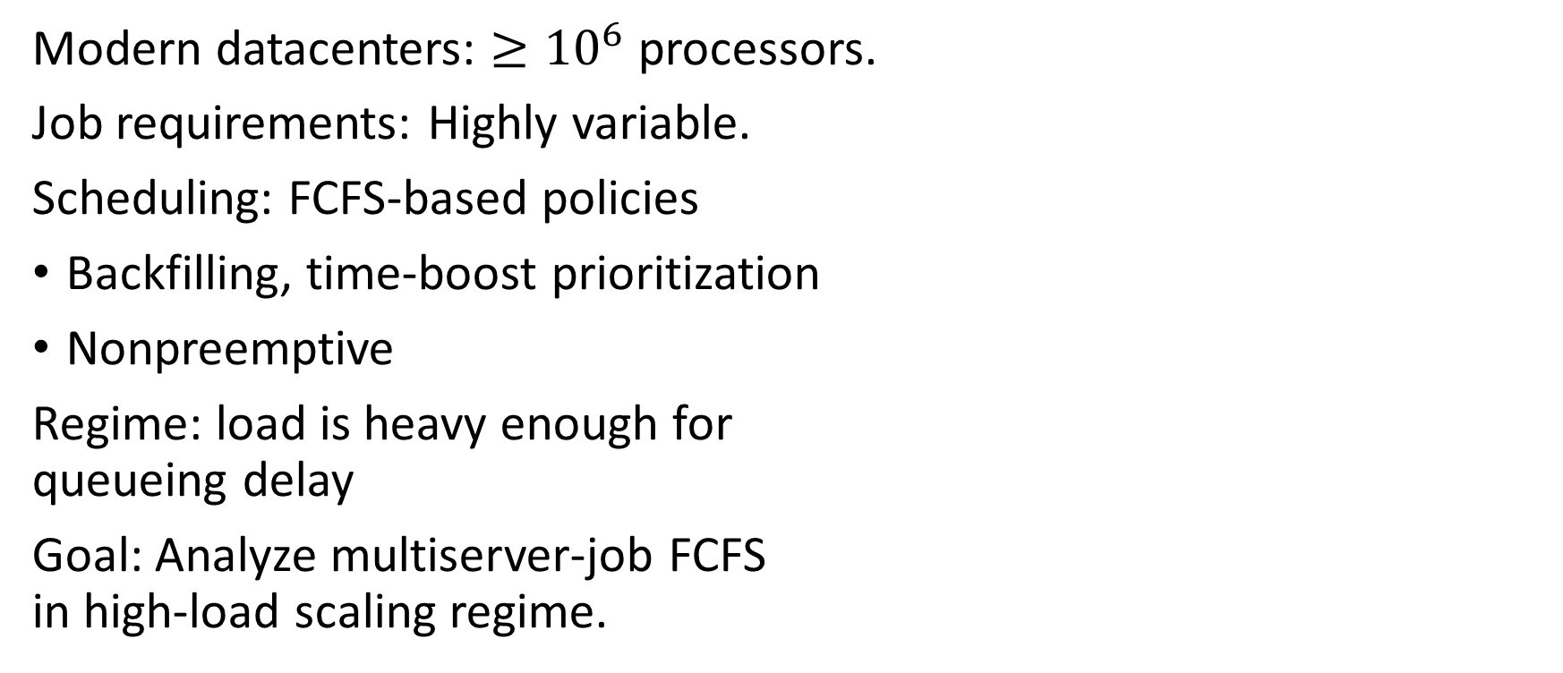
Large-scale Datacenters: Varying resources
Modern datacenters: $≥{10}^{6}$ processors.
Job requirements: Highly variable.
Scheduling: FCFS-based policies
Backfilling, time-boost prioritization
Nonpreemptive
Regime: load is heavy enough for
queueing delay
Goal: Analyze multiserver-job FCFS
in high-load scaling regime.

Slide 3
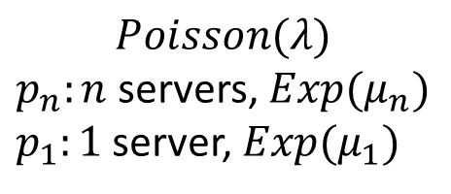
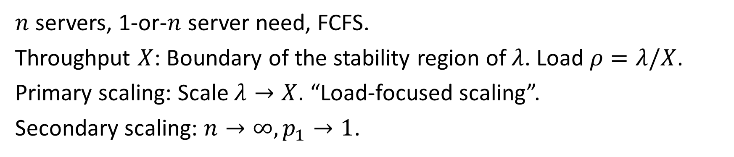
MSJ Model: 1-and-n, load-focused scaling
1
n
1
1
$$Poisson(λ)$$
$p_{n}:n$ servers, $Exp(μ_{n})$
$p_{1}:1$ server, $Exp(μ_{1})$
1
1
1
1
1
1
$n$ servers, 1-or-$n$ server need, FCFS.
Throughput $X$: Boundary of the stability region of $λ$. Load $ρ=λ/X$.
Primary scaling: Scale $λ→X$. “Load-focused scaling”.
Secondary scaling: $n→∞, p_{1}→1$.

Slide 4
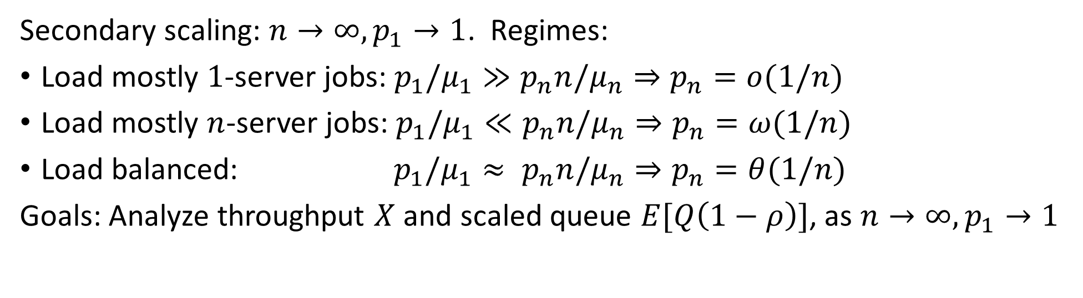
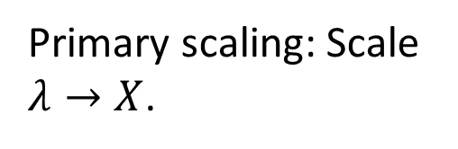
MSJ Model: 1-and-n, load-focused scaling
1
Primary scaling: Scale $λ→X$.
n
1
1
$$Poisson(λ)$$
$p_{n}:n$ servers, $Exp(μ_{n})$
$p_{1}:1$ server, $Exp(μ_{1})$
1
1
1
1
1
1
Secondary scaling: $n→∞, p_{1}→1$. Regimes:
Load mostly $1$-server jobs: $p_{1}/μ_{1}≫p_{n}n/μ_{n}⇒p_{n}=o(1/n)$
Load mostly $n$-server jobs: $p_{1}/μ_{1}≪p_{n}n/μ_{n}⇒p_{n}=ω(1/n)$
Load balanced: $p_{1}/μ_{1}≈ p_{n}n/μ_{n}⇒p_{n}=θ(1/n)$
Goals: Analyze throughput $X$ and scaled queue $E[Q\left(1−ρ\right)]$, as $n→∞,p_{1}→1$

Slide 5
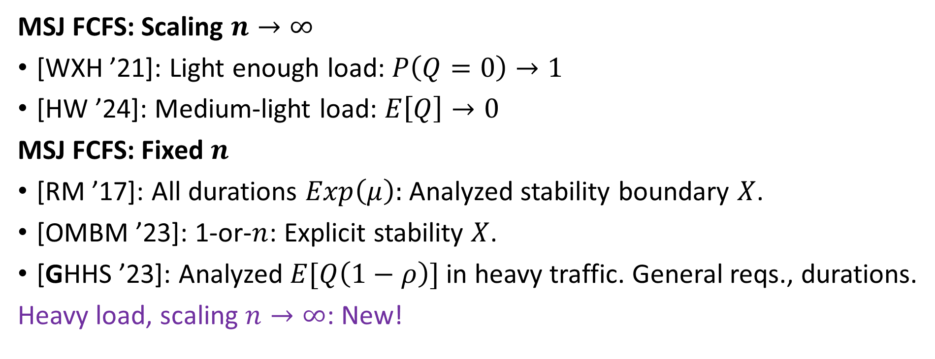
Prior work
MSJ FCFS: Scaling $n→∞$
[WXH ’21]: Light enough load: $P\left(Q=0\right)→1$
[HW ’24]: Medium-light load: $E\left[Q\right]→0$
MSJ FCFS: Fixed $n$
[RM ’17]: All durations $Exp\left(μ\right):$ Analyzed stability boundary $X$.
[OMBM ’23]: 1-or-$n$: Explicit stability $X$.
[GHHS ’23]: Analyzed $E[Q\left(1−ρ\right)]$ in heavy traffic. General reqs., durations.
Heavy load, scaling $n→∞$: New!

Slide 6
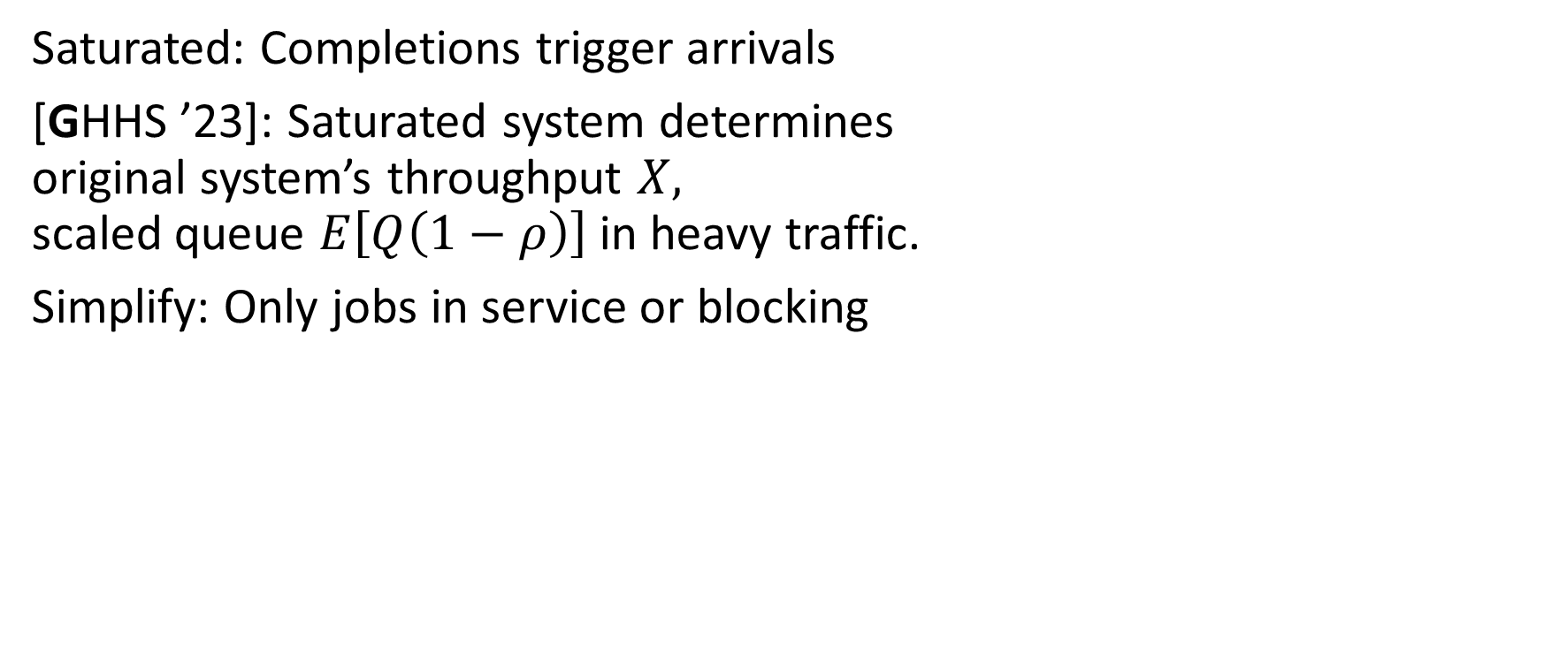
Key tool: Saturated System
1
n
1
1
1
Saturated: Completions trigger arrivals
[GHHS ’23]: Saturated system determines
original system’s throughput $X,$
scaled queue $E\left[Q\left(1−ρ\right)\right]$ in heavy traffic.
Simplify: Only jobs in service or blocking
1
1
1
1
1

Slide 7
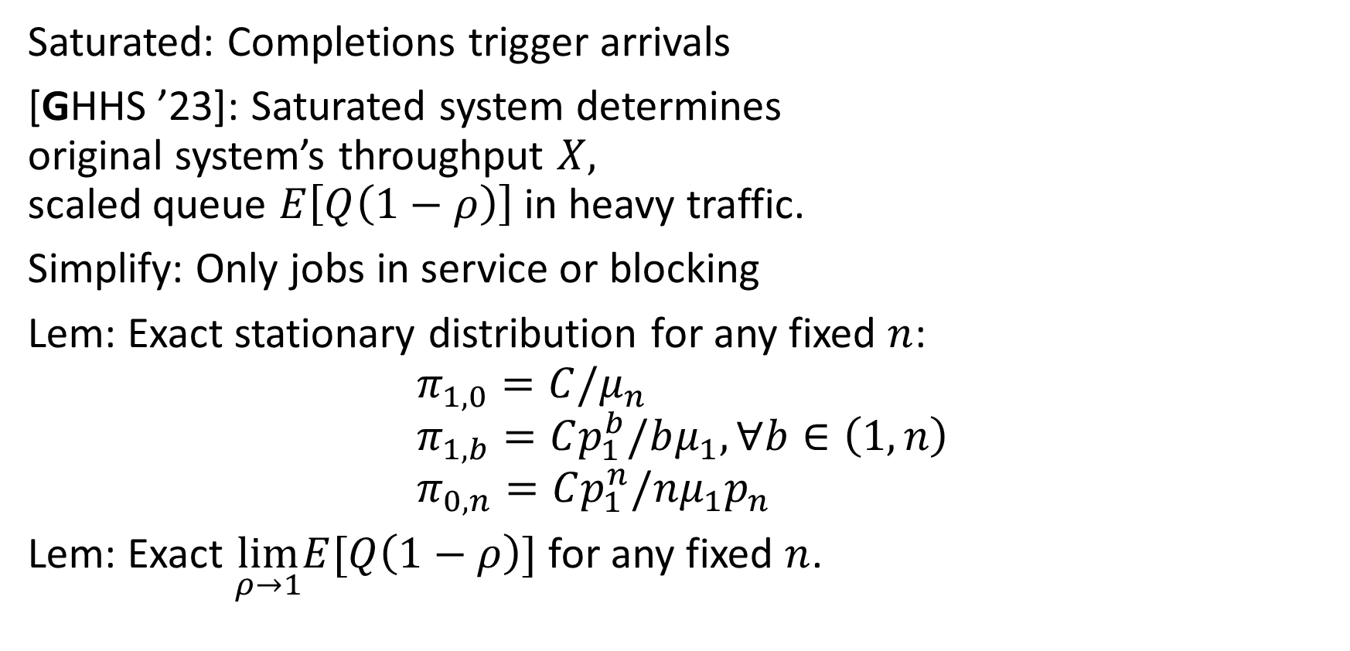
Key tool: Saturated System
1
n
1
1
1
Saturated: Completions trigger arrivals
[GHHS ’23]: Saturated system determines
original system’s throughput $X,$
scaled queue $E\left[Q\left(1−ρ\right)\right]$ in heavy traffic.
Simplify: Only jobs in service or blocking
Lem: Exact stationary distribution for any fixed $n$:
$$π_{1,0}=C/μ_{n} \\ π_{1,b}=Cp_{1}^{b}/bμ_{1}, ∀b∈\left(1,n\right) \\ π_{0,n}=Cp_{1}^{n}/nμ_{1}p_{n}$$
Lem: Exact $\lim_{ρ→1}E[Q\left(1−ρ\right)]$ for any fixed $n$.
1
1
1

Slide 8


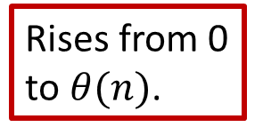


Results: Mostly $n$-server load, balanced load
Thm: If $p_{n}=ω\left(1/n\right)$ or $θ\left(1/n\right),$ throughput $X∼\frac{μ_{1}}{p_{n}ln(1/p_{n})}$,
Scaled queue $\lim_{ρ→1}{E\left[Q\left(1−ρ\right)\right]∼1/2p_{n}}$
Rises from 0 to $θ(n)$.
n
n
Servers occupied
$$∼1/p_{n}$$
1
1
Time
$$∼ln⁡(1/p_{n})$$

Slide 9







Results: Mostly $1$-server load
Specific case of $p_{n}=o\left(1/n\right):$ $p_{n}=1/n^{α}, α>1$
Thm: Throughput $X=μ_{1}n−μ_{1}n^{2−α}\left(\ln{n+\frac{μ_{1}}{μ_{n}}−1+o\left(1\right)}\right)$
Scaled queue $\lim_{ρ→1}{E\left[Q\left(1−ρ\right)\right]∼}\frac{1}{2}n^{2−α}\ln^{2}{n}$
Falls from $≈θ(n)$ to 0.
n
n
Servers occupied
$$1$$
$$1$$
Time
$$∼n^{α}$$
$$∼\ln{n}$$

Slide 10
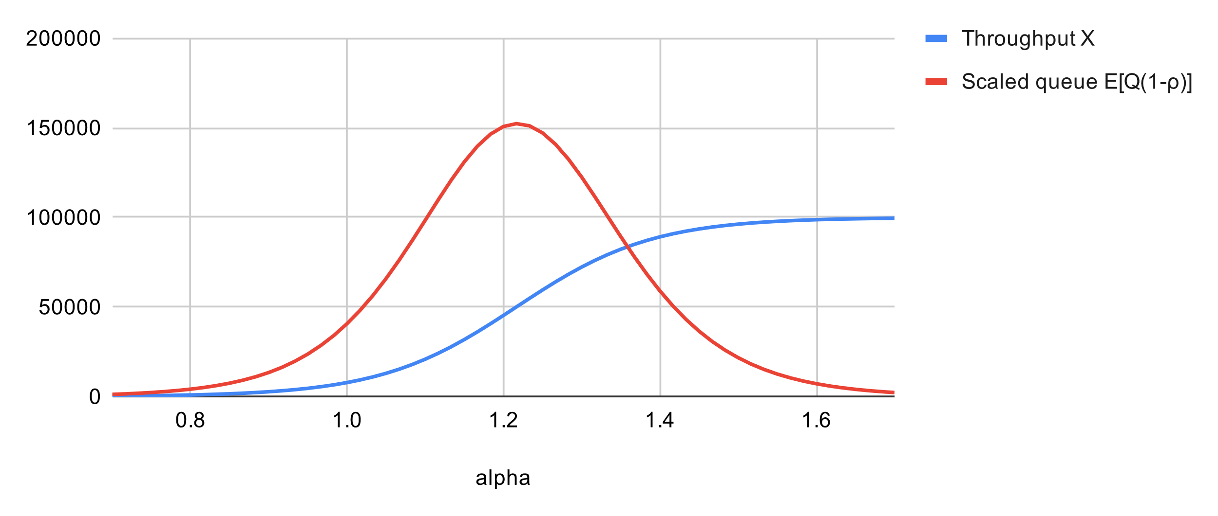


Insights
As load moves from $n$-server jobs to 1-server jobs:
Throughput rises, from typically blocked to typically full.
Scaled queue length $\lim_{ρ→1}E[Q\left(1−ρ\right)]$ (variability) rises, peaks near balanced load, falls again.
Numerical evaluation:
$$n={10}^{5}, \\ p_{n}=\frac{1}{n^{α}}, \\ α∈[0.7,1.7]$$

Slide 11

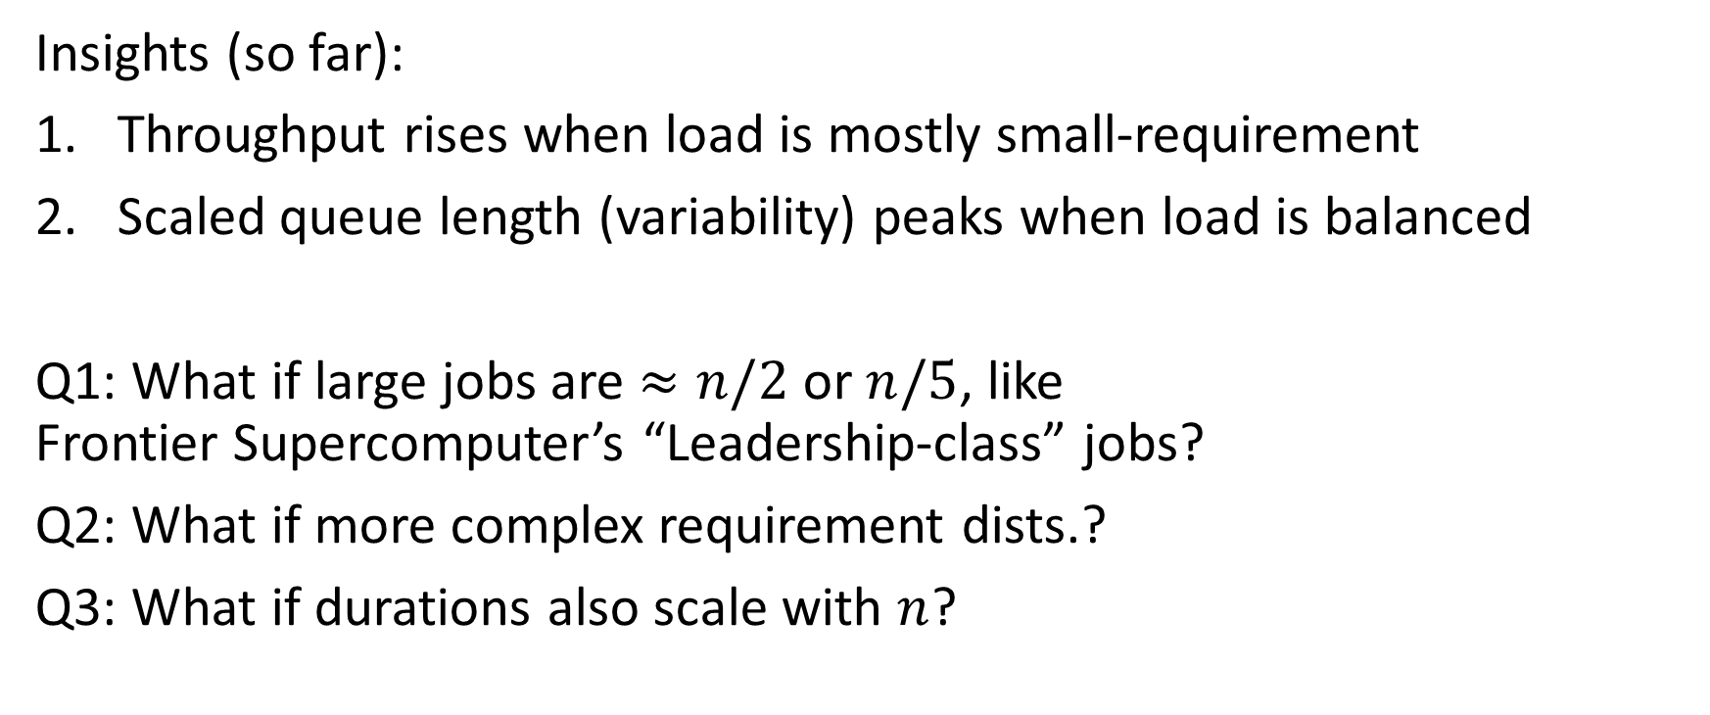
Next: Numerically generalizing insights
Insights (so far):
Throughput rises when load is mostly small-requirement
Scaled queue length (variability) peaks when load is balanced
Q1: What if large jobs are $≈n/2$ or $n/5$, like
Frontier Supercomputer’s “Leadership-class” jobs?
Q2: What if more complex requirement dists.?
Q3: What if durations also scale with $n$?

Slide 12
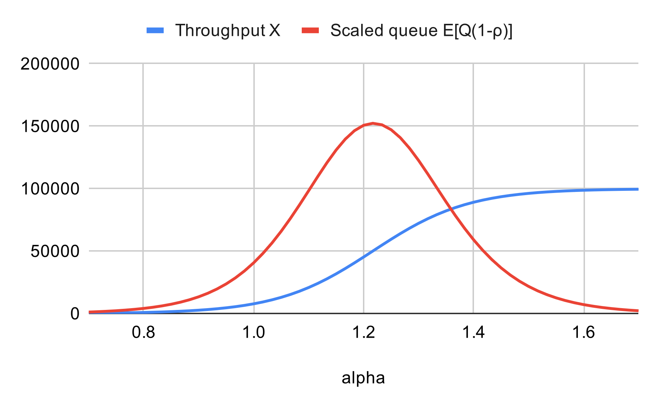
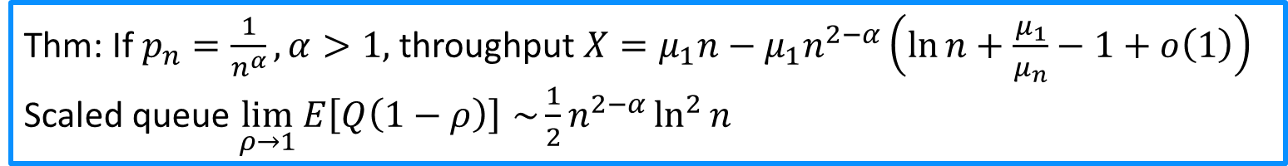
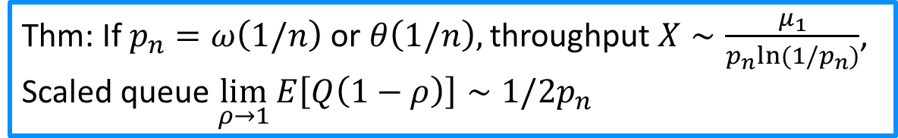
Conclusion: Load-focused MSJ scaling
1
n
1
1
1
1
1
1
1
1
Thm: If $p_{n}=ω\left(1/n\right)$ or $θ\left(1/n\right),$ throughput $X∼\frac{μ_{1}}{p_{n}ln(1/p_{n})}$,
Scaled queue $\lim_{ρ→1}{E\left[Q\left(1−ρ\right)\right]∼1/2p_{n}}$
Thm: If $p_{n}=\frac{1}{n^{α}}, α>1,$ throughput $X=μ_{1}n−μ_{1}n^{2−α}\left(\ln{n+\frac{μ_{1}}{μ_{n}}−1+o\left(1\right)}\right)$
Scaled queue $\lim_{ρ→1}{E\left[Q\left(1−ρ\right)\right]∼}\frac{1}{2}n^{2−α}\ln^{2}{n}$

