Slide 1
Stochastic Scheduling with Predictions
Isaac Grosof
CMU Computer Science
Ziv Scully (CMU -> Cornell)
Michael Mitzenmacher (Harvard)

Slide 2

Scheduling with Predictions
“Uniform Bounds for Scheduling with Job Size Estimates” ITCS 2022
Goal: Minimize mean response time (E[T])
Response time $T$

Slide 3

Scheduling with Predictions
“Uniform Bounds for Scheduling with Job Size Estimates” ITCS 2022
Goal: Minimize mean response time (E[T])
Known sizes: Shortest Remaining Processing Time (SRPT) is optimal
Predicted sizes: ?
1.2
0.8
0.8
0.3
0.4
Response time $T$

Slide 4


Stochastic Scheduling with Predictions
Two ways to study:
Why stochastic analysis for scheduling?
Worst Case Analysis
Stochastic Analysis
This talk
Overcomes worst-case barriers
Challenging, subtle problems
Reflects real world

Slide 5
Why Stochastic Arrivals?
Worst case setting: General arrival sequence
Size
Time

Slide 6
Why Stochastic Arrivals?
Worst case setting: General arrival sequence
Real world: lots of independent arrival sequences
Size
Time
…

Slide 7
Why Stochastic Arrivals?
Worst case setting: General arrival sequence
Real world: lots of independent arrival sequences
Approximation for large systems:
Exponential interarrival times (Poisson)
I.i.d. sizes
Size
Time

Slide 8
Example of Scheduling with Predictions
1
1
1
1.01

Slide 9
Example of Scheduling with Predictions
1
1
1
1.01
ALG: 3 jobs
0.01
0.01
0.01
0.01

Slide 10
Example of Scheduling with Predictions
Tiny prediction error → 3/2 competitive ratio
Very unlikely in our stochastic model
Goal: Tiny prediction error → Near-perfect performance
1
1
1
1.01
ALG: 3 jobs
0.01
0.01
0.01
0.01
OPT: 2 jobs

Slide 11

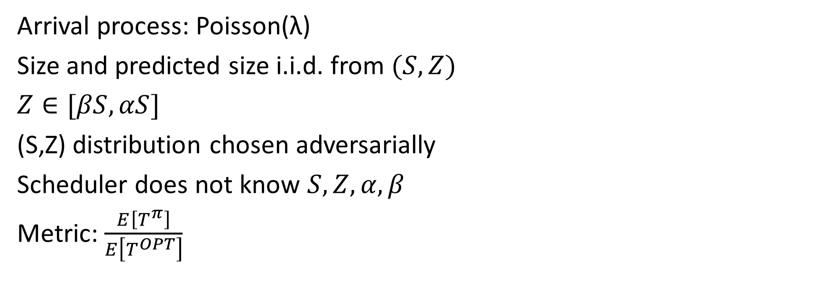
Specific model
Z
Z
Z
Z
Poisson(λ)
S
Z
S
S
S
S
Arrival process: Poisson(λ)
Size and predicted size i.i.d. from $(S, Z)$
$Z∈[βS,αS]$
(S,Z) distribution chosen adversarially
Scheduler does not know $S,Z,α,β$
Metric: $\frac{E\left[T^{π}\right]}{E\left[T^{OPT}\right]}$
$=\frac{E\left[T^{π}\right]}{E\left[T^{SRPT}\right]}$

Slide 12
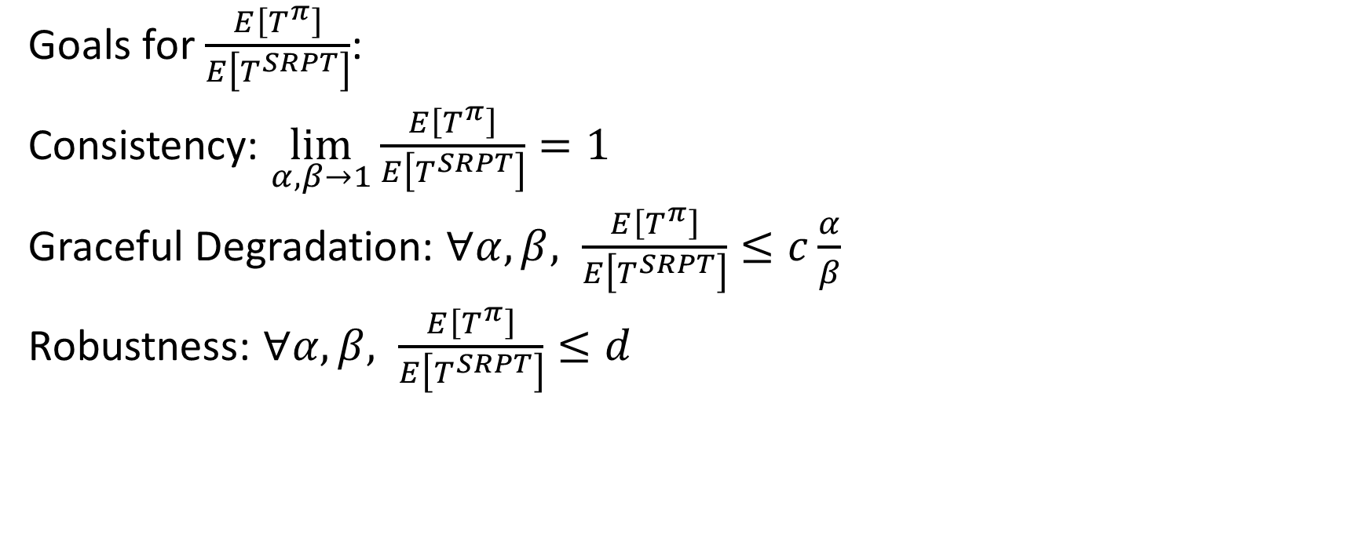
Performance Goals
Goals for $\frac{E\left[T^{π}\right]}{E\left[T^{SRPT}\right]}$:
Consistency: $\lim_{α,β→1}\frac{E\left[T^{π}\right]}{E\left[T^{SRPT}\right]}=1$
Graceful Degradation: $∀α,β, \frac{E\left[T^{π}\right]}{E\left[T^{SRPT}\right]}≤c\frac{α}{β}$
Robustness: $∀α,β, \frac{E\left[T^{π}\right]}{E\left[T^{SRPT}\right]}≤d$

Slide 13
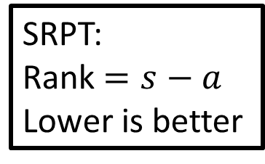
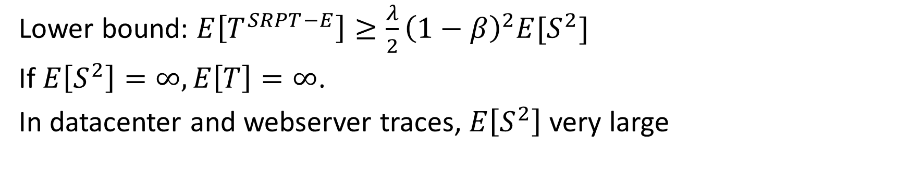
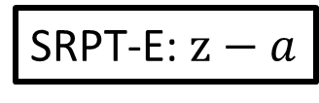
Naïve Scheduling Policy
SRPT:
Rank $=s−a$
Lower is better
SRPT-E: $z−a$
rank
s
z
age
s
z
Jobs uninterrupted when exceed prediction
Lower bound: $E\left[T^{SRPT−E}\right]≥\frac{λ}{2}{\left(1−β\right)}^{2}E[S^{2}]$
If $E\left[S^{2}\right]=∞, E\left[T\right]=∞$.
In datacenter and webserver traces, $E\left[S^{2}\right]$ very large

Slide 14
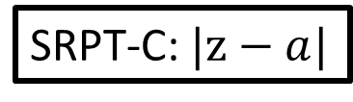
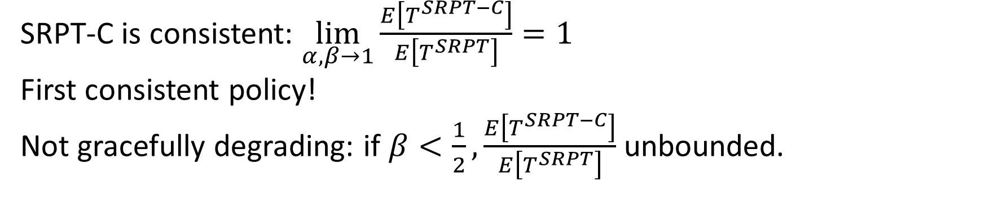
SRPT with Checkmark
SRPT-C: $|z−a|$
rank
z
age
z
2z
SRPT-C is consistent: $\lim_{α,β→1}\frac{E\left[T^{SRPT−C}\right]}{E\left[T^{SRPT}\right]}=1$
First consistent policy!
Not gracefully degrading: if $β<\frac{1}{2},\frac{E\left[T^{SRPT−C}\right]}{E\left[T^{SRPT}\right]}$ unbounded.

Slide 15
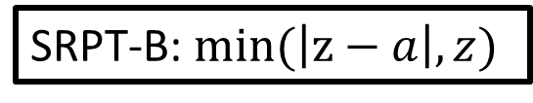
SRPT with Bounce
SRPT-B: $min(\left|z−a\right|,z)$
rank
z
age
z
2z
First policy to be consistent and gracefully degrading!

Slide 16
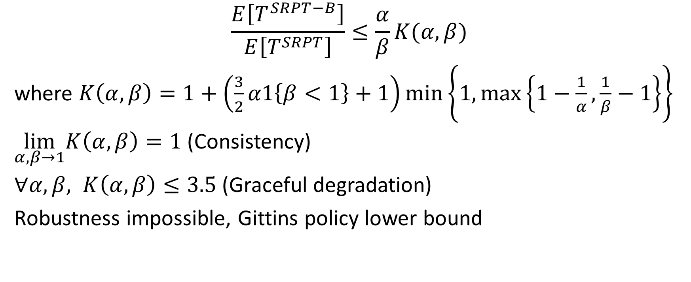
Results
rank
z
age
z
2z
$$\frac{E\left[T^{SRPT−B}\right]}{E\left[T^{SRPT}\right]}≤\frac{α}{β}K(α,β)$$
where $K\left(α,β\right)=1+\left(\frac{3}{2}α1\left\{β<1\right\}+1\right)min\left\{1,max\left\{1−\frac{1}{α},\frac{1}{β}−1\right\}\right\}$
$\lim_{α,β→1}K\left(α,β\right)=1$ (Consistency)
$∀α,β, K\left(α,β\right)≤3.5$(Graceful degradation)
Robustness impossible, Gittins policy lower bound

Slide 17
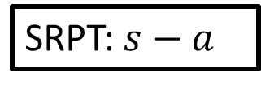

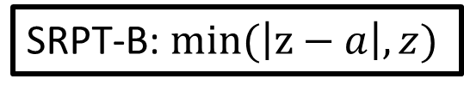

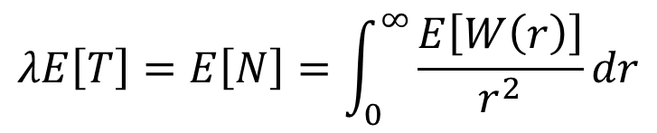
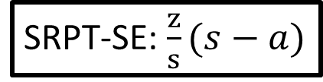
Proof Methods
SRPT-B: $min(\left|z−a\right|,z)$
SRPT-SE: $\frac{z}{s}(s−a)$
SRPT: $s−a$
rank
$$\frac{α}{β}$$
$$K\left(α,β\right)$$
z
s
z
age
z
2z
s
s
Proof uses cutting-edge queueing theory:
SOAP
WINE
Analysis of E[T] for rank-function policies
$$λE\left[T\right]=E\left[N\right]=\int_{0}^{∞}{\frac{E\left[W\left(r\right)\right]}{r^{2}}dr}$$

Slide 18
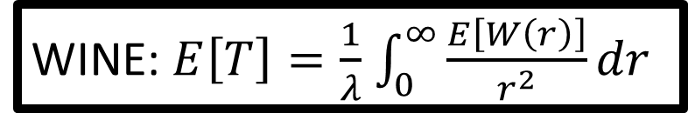
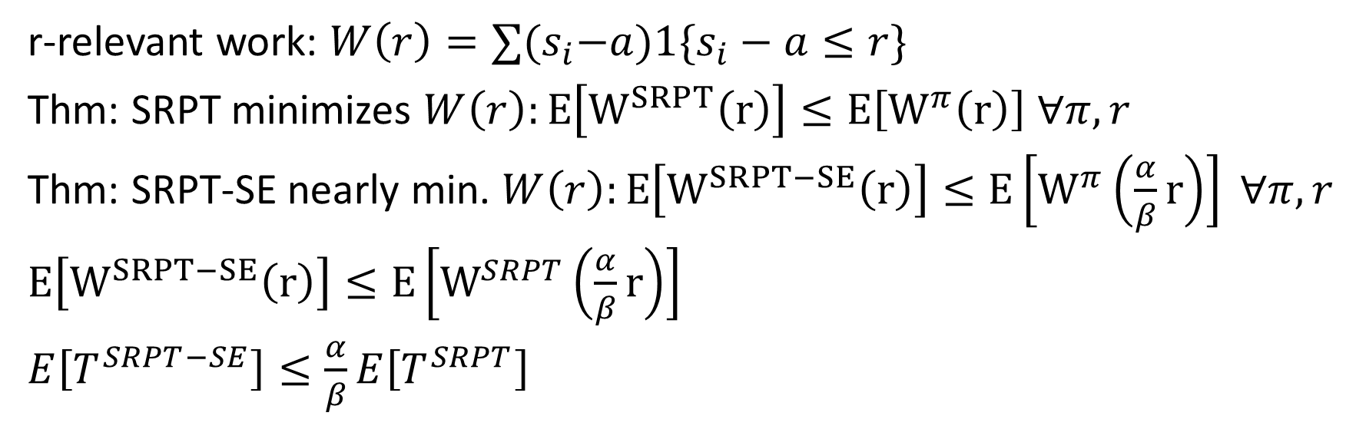
SRPT-SE vs. SRPT
SRPT-SE: $\frac{z}{s}(s−a)$
SRPT: $s−a$
$$\frac{α}{β}$$
s
z
r
s
s
r-relevant work: $W\left(r\right)=∑{(s}_{i}−a)1\{s_{i}−a≤r\}$
Thm: SRPT minimizes $W\left(r\right):E\left[W^{SRPT}\left(r\right)\right]≤E\left[W^{π}\left(r\right)\right] ∀π,r$
Thm: SRPT-SE nearly min. $W\left(r\right):E\left[W^{SRPT−SE}\left(r\right)\right]≤E\left[W^{π}\left(\frac{α}{β}r\right)\right] ∀π,r$
$E\left[W^{SRPT−SE}\left(r\right)\right]≤E\left[W^{SRPT}\left(\frac{α}{β}r\right)\right]$
$E\left[T^{SRPT−SE}\right]≤\frac{α}{β}E\left[T^{SRPT}\right]$
WINE: $E\left[T\right]=\frac{1}{λ}$ $\int_{0}^{∞}{\frac{E\left[W\left(r\right)\right]}{r^{2}}dr}$

Slide 19
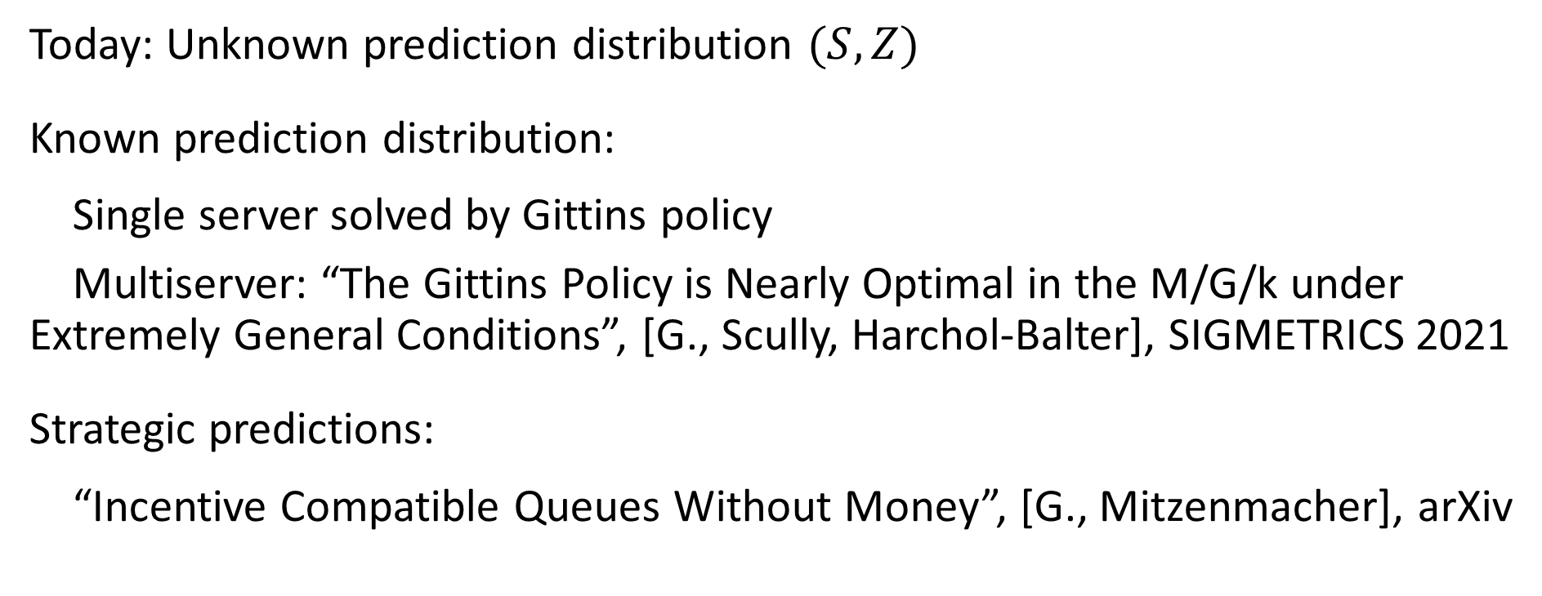
Zooming Out on Scheduling with Predictions
Today: Unknown prediction distribution $(S,Z)$
Known prediction distribution:
Single server solved by Gittins policy
Multiserver: “The Gittins Policy is Nearly Optimal in the M/G/k under Extremely General Conditions”, [G., Scully, Harchol-Balter], SIGMETRICS 2021
Strategic predictions:
“Incentive Compatible Queues Without Money”, [G., Mitzenmacher], arXiv

Slide 20
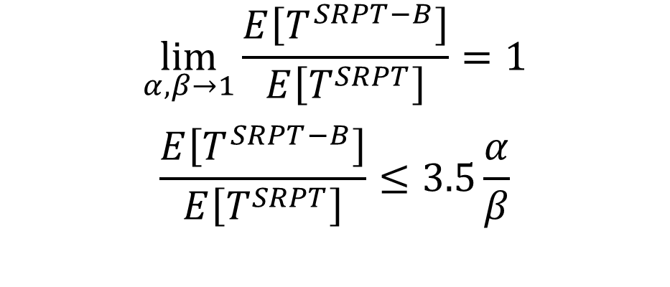
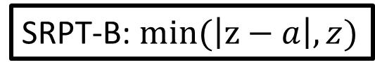
Stochastic Scheduling with Predictions
igrosof@cmu.edu
isaacg1.github.io
rank
$$\lim_{α,β→1}\frac{E\left[T^{SRPT−B}\right]}{E\left[T^{SRPT}\right]}=1$$
$$\frac{E\left[T^{SRPT−B}\right]}{E\left[T^{SRPT}\right]}≤3.5\frac{α}{β}$$
SRPT-B: $min(\left|z−a\right|,z)$
z
age
z
2z

