Slide 1
SRPT for Multiserver Systems
Isaac Grosof
Ziv Scully
Mor Harchol-Balter
Carnegie Mellon University

Slide 2
M/G/1
Response time: T
Remaining size
Job size
Age
Notes:
1: Explain M/G/1
2: Explain SRPT
Order by remaining size, preemptive

Slide 3
M/G/1
Response time: T
Remaining size
Job size
Q:
Can we analyze E[T]^{M/G/1/SRPT}?
Q: What policy minimizes mean response time, E[T]?
A: SRPT
[Schrage ‘68]
A: Yes!
[Schrage ‘66]
Age
3
Notes:
SRPT is worst case optimal
We can analyze it

Slide 4
M/G/k
SRPT-k: Run k jobs w/ least remaining size
k
Q: Can we analyze E[T]^{M/G/k/SRPT}?
Q: What policy is optimal?
Q: What policy is optimal?
Q: Is SRPT-k?
?? OPEN
Notes:
SRPT: k smallest, leave server empty if not enough jobs
Open question

Slide 5
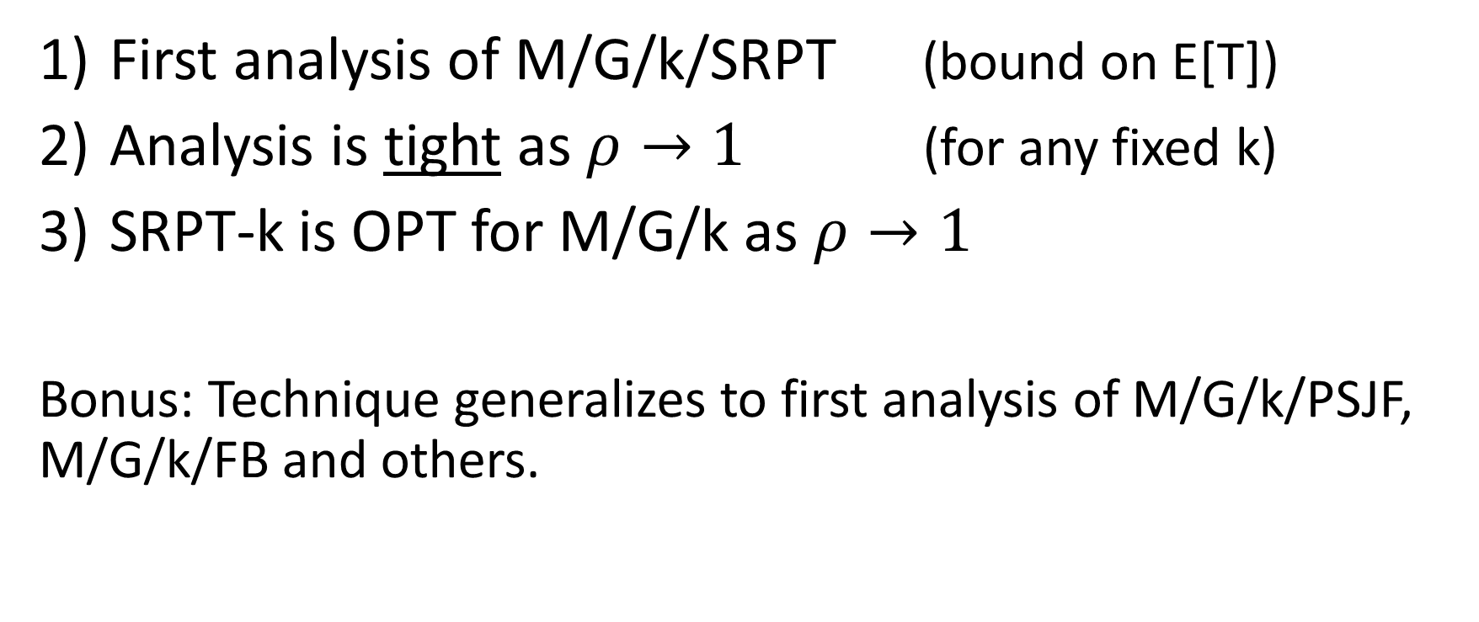
Our 3 Results
First analysis of M/G/k/SRPT (bound on E[T])
Analysis is tight as $ρ→1$ (for any fixed k)
SRPT-k is OPT for M/G/k as $ρ→1$
Bonus: Technique generalizes to first analysis of M/G/k/PSJF, M/G/k/FB and others.
Notes:
SLOW DOWN
This is a big deal
Most people, M/G/k means M/G/k/FCFS
Even for this very simple policy, approximations only. Approximations are bad.
This is way beyond what people have done before.

Slide 6
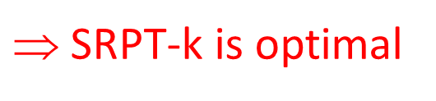
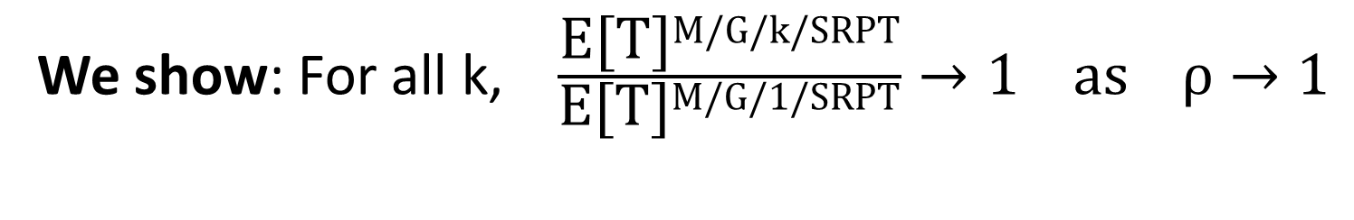
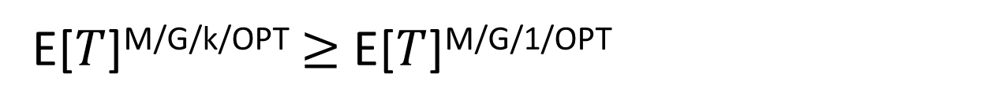
More Specifics
M/G/1
M/G/k
Speed 1/k
Speed 1/k
Speed 1/k
Speed 1/k
Speed 1
E[$T$]^{M/G/k/OPT}$≥$ E[$T$]^{M/G/1/OPT}
E[$T$]^{M/G/k/SRPT} $≥$ E[$T$]^{M/G/k/OPT} $≥$ E[$T$]^{M/G/1/OPT}
E[$T$]^{M/G/k/SRPT} $≥$ E[$T$]^{M/G/k/OPT} $≥$ E[$T$]^{M/G/1/OPT} $=$E[$T$]^{M/G/1/SRPT}
We show: For all k, $\frac{\text{E}\text{[}\text{T}\text{]}\text{M}\text{/}\text{G}\text{/}\text{k}\text{/}\text{SRPT}}{\text{E}\text{[}\text{T}\text{]}\text{M}\text{/}\text{G}\text{/1/}\text{SRPT}}→1 \text{as} ρ→1$
$$SRPT-k is optimal
Notes:
Explain that the single server in M/G/1 can process work as fast as all k in M/G/k
Since M/G/k/OPT is bounded between SRPT-k and SRPT-1, this shows SRPT-k converges to OPT

Slide 7
Prior work on M/G/k scheduling
M/G/k/FCFS
Bounds based on first two moments [Kingman ‘70], [Daley ‘97]
Arbitrarily tight bounds [Gupta, Osogami ‘11]
M/PH/k/PRIORITY
Numerical solutions, limited priority classes [Sleptchenko et al ‘05], [Osogami et al ‘05]
No prior work on M/G/k/SRPT, M/G/k/PSJF, M/G/k/FB, M/G/k/RS
We can analyze all!
Notes:
FCFS: Approximations based on Mean and Variance
PH: Only practical for simple PH distributions

Slide 8
Outline
Analyze mean response time of M/G/k/SRPT
Show SRPT-k is asymptotically optimal for M/G/k
Empirical evaluation
Notes:
Bound
Optimality at high load

Slide 9
Analyzing Response time in M/G/k/SRPT
We focus on a tagged job, j
j is of size x
Our goal is to bound T_{j}
SRPT-k implies that at any moment when j is in the system, either:
A server is working on j, or
All servers are working on jobs with less remaining size than j (relevant jobs)
Notes:
Here’s the high level approach
We’ll call those jobs the relevant jobs

Slide 10
Example
z
j
c
b
a
Server 3
Increasing remaining job size
Server 2
Server 1
Time
Notes:
SLOW DOWN
Let’s take a look at an example
In service, over time
Increasing remaining job size
When j arrives, 5 jobs in the system

Slide 11
Example
z
j
c
Q: What happens next?
Q: What jobs are initially in service?
b
a
c
Server 3
Increasing remaining job size
Increasing remaining job size
b
Server 2
a
Server 1
Time
Notes:
What jobs are in service? <Wait>
What happens next? <Wait>
Right.

Slide 12
Example
z
j
c
Q: What happens next?
b
a
c
j
Server 3
Increasing remaining job size
Increasing remaining job size
b
c
Server 2
a
b
Server 1
Time
Notes:
And what happens after that?

Slide 13
Example
z
j
c
b
a
n
c
c
j
j
j
j
z
z
z
z
Server 3
Increasing remaining job size
Increasing remaining job size
b
z
Server 2
b
c
c
c
j
j
j
a
Server 1
a
b
c
n
c
j
Time
Notes:
At this point, a new job, n, arrives in the system.
N complets, then c completes, and then we’re done.

Slide 14

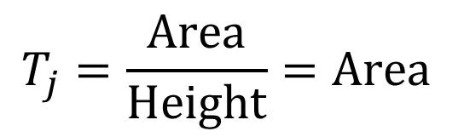
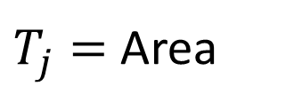

Response Time
Irrelevant
z
Tagged
j
c
Relevant
b
$$T_{j}=\frac{\text{Area}}{\text{Height}}$$
a
$$T_{j}=\frac{\text{Area}}{\text{Height}}=\text{Area}$$
$T_{j}=$ Area
n
c
Speed 1/k
c
j
j
j
j
z
z
z
z
Server 3
Increasing remaining job size
Increasing remaining job size
z
b
z
Server 2
Speed 1/k
b
c
c
c
j
j
j
a
Server 1
Speed 1/k
a
b
c
n
c
j
T_{j}
Notes:
Let’s draw a box around j’s time in the system.
Here’s our key idea: Tj = Area/height.
If we bound this area, we can bound Tj.
Remember that each server does work at rate 1/k
So Tj = Area
With that in mind, let’s try to bound Area. Recall relevant jobs:

Slide 15
Response Time
Irrelevant
z
Tagged
j
c
Old Relevant
b
Virtual work
a
$T_{j}=$ Area
New Relevant
n
Tagged work
c
c
j
j
j
j
z
z
z
z
Server 3
Old relevant work
Increasing remaining job size
Increasing remaining job size
b
z
Server 2
b
c
c
c
j
j
j
a
Server 1
a
b
c
n
c
j
New relevant work
T_{j}
Notes:
Let’s split up relevant jobs into ones that arrived before j, and after j.
Let’s arrange these jobs into 4 categories of work
Any time that the servers spend empty, we’ll include in virtual work.

Slide 16



Response Time
Irrelevant
z
Tagged
j
c
Old Relevant
Virtual work
b
Virtual work
$$≤\left(k−1\right)x$$
a
$T_{j}=$ Area
New Relevant
n
Tagged work
$$=x$$
Tagged work
c
c
j
j
j
j
z
z
z
z
Server 3
Old relevant work
Increasing remaining job size
Old relevant work
$${RelWork}_{≤x}$$
Increasing remaining job size
z
b
z
Server 2
b
c
c
c
j
j
j
a
Server 1
a
b
c
n
c
j
New relevant work
Relevant busy period
New relevant work
T_{j}
Notes:
Virtual work only happens when the tagged job is in service
Busy period: Amount of time to empty, standard technique
RelWork: Random Variable. Since the job arrives according to a poisson process, it sees a time average.
Just need to bound RelWork

Slide 17
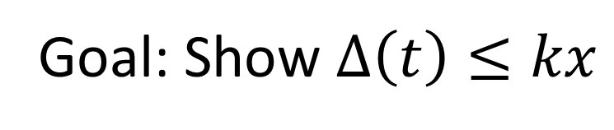



Relevant Work
Relevant work is work made up of jobs of remaining size $≤x$
$$∆(t)$$
Relevant work
SRPT-1 $+kx$
SRPT-k
SRPT-1
Time
Goal: Show $∆\left(t\right)≤kx$
Notes:
Work in the system made up of jobs of remaining size at most x, which is j’s size.
We’ll bound remaining work in SRPT-k relative to SRPT-1
Always in this blue region, no more than SRPT-k + kx

Slide 18
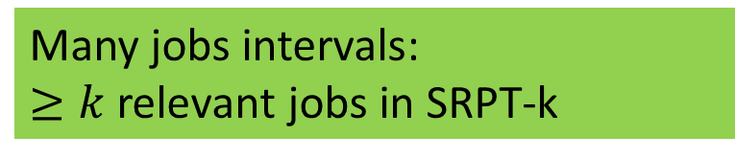

Relevant Work
$$∆(t)$$
Relevant work
SRPT-1 $+kx$
SRPT-k
SRPT-1
Few jobs intervals:
$<k$ relevant jobs in SRPT-k
Time
Many jobs intervals:
$≥k$ relevant jobs in SRPT-k
Notes:
Split up time.
Few jobs intervals, not many relevant jobs in SRPT-k system. An empty server or an irrelevant job in service.
Many jobs intervals, at least k relevant jobs in SRPT-k.
Few: not much total
Many: same speed, so difference doesn’t go up.

Slide 19
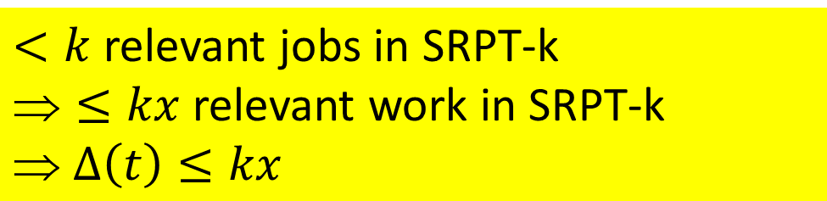


Few jobs intervals
$$∆(t)$$
Relevant work
SRPT-1 $+kx$
SRPT-k
SRPT-1
Time
$<k$ relevant jobs in SRPT-k
$≤kx$ relevant work in SRPT-k
$ ∆\left(t\right)≤kx$
Notes:
Split up time.
Few jobs intervals, not many relevant jobs in SRPT-k system. An empty server or an irrelevant job in service.
Many jobs intervals, at least k relevant jobs in SRPT-k.
Few: not much total
Many: same speed, so difference doesn’t go up.

Slide 20
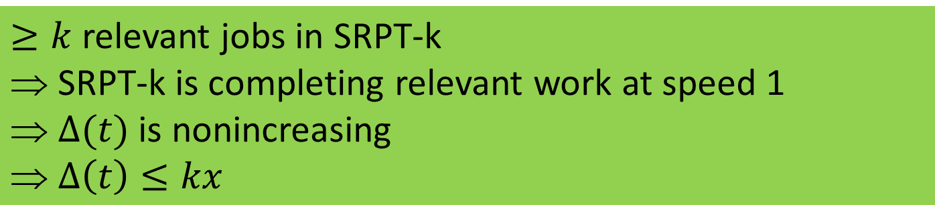
Many jobs intervals
$$∆(t)$$
Relevant work
SRPT-1 $+kx$
SRPT-k
SRPT-1
Time
$≥k$ relevant jobs in SRPT-k
$$ SRPT-k is completing relevant work at speed 1
$ ∆(t)$ is nonincreasing
$ ∆\left(t\right)≤kx$
Notes:
Split up time.
Few jobs intervals, not many relevant jobs in SRPT-k system. An empty server or an irrelevant job in service.
Many jobs intervals, at least k relevant jobs in SRPT-k.
Few: not much total
Many: same speed, so difference doesn’t go up.

Slide 21
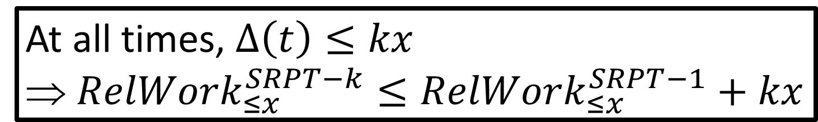
Many jobs intervals
$$∆(t)$$
Relevant work
SRPT-1 $+kx$
SRPT-k
SRPT-1
Time
At all times, $∆\left(t\right)≤kx$
${ RelWork}_{≤x}^{SRPT−k}≤{RelWork}_{≤x}^{SRPT−1}+kx$
Notes:
Split up time.
Few jobs intervals, not many relevant jobs in SRPT-k system. An empty server or an irrelevant job in service.
Many jobs intervals, at least k relevant jobs in SRPT-k.
Few: not much total
Many: same speed, so difference doesn’t go up.

Slide 22
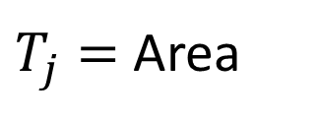
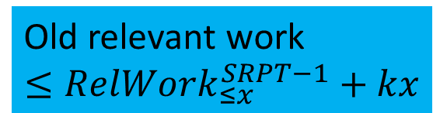
Response Time
$$T_{j}≤B_{≤x}(x+\left(k−1\right)x+{RelWork}_{≤x}^{SRPT−1}+kx)$$
$x+\left(k−1\right)x+{RelWork}_{≤x}^{SRPT−1}+kx$
$x+\left(k−1\right)x$
$x$
Virtual work
Virtual work
$$≤\left(k−1\right)x$$
$T_{j}=$ Area
Tagged work
$$=x$$
Tagged work
c
c
j
j
j
j
z
z
z
z
Server 3
Old relevant work
$$≤{RelWork}_{≤x}^{SRPT−1}+kx$$
Increasing remaining job size
Old relevant work
Increasing remaining job size
z
b
z
Server 2
b
c
c
c
j
j
j
a
Server 1
a
b
c
n
c
j
New relevant work
Relevant busy period
New relevant work
T_{j}
Notes:
We now can bound the response time. Let’s start with tagged work …

Slide 23

Outline
Analyze mean response time of M/G/k/SRPT
Show SRPT-k is asymptotically optimal for M/G/k
Empirical evaluation

Slide 24
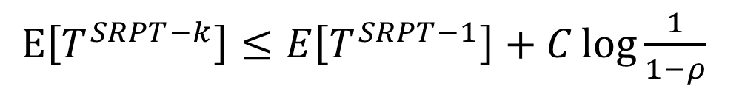
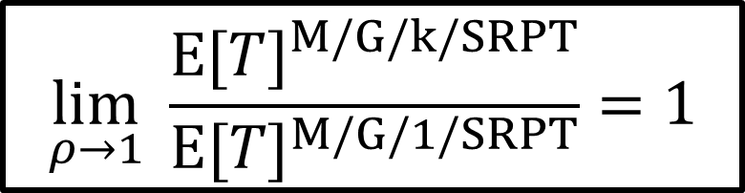
Optimality
Our result: $T^{SRPT−k}\left(x\right)≤B_{≤x}(x+\left(k−1\right)x+{RelWork}_{≤x}^{SRPT−1}+kx)$
After some algebra
$\text{E}\left[T^{SRPT−k}\right]≤E\left[T^{SRPT−1}\right]+C\log{\frac{1}{1−ρ}}$
*
[Lin, Wierman, Zwart ‘11]: $E\left[T^{SRPT−1}\right]=ω\left(\log{\frac{1}{1−ρ}}\right) \text{as} ρ→1$
*
$$\lim_{ρ→1}{ \frac{{\text{E}[T]}^{M/G/k/SRPT}}{{\text{E}[T]}^{M/G/1/SRPT}}=1}$$
* Subject to technical assumption on job size distribution

Slide 25
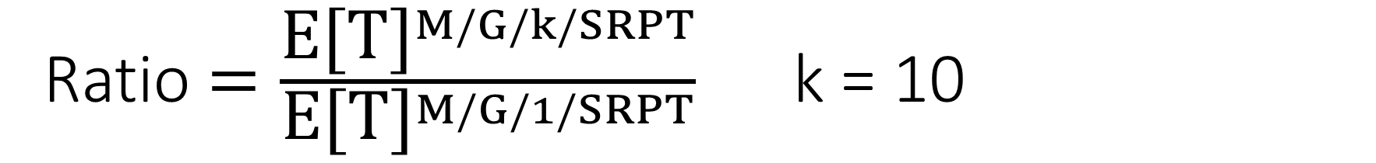
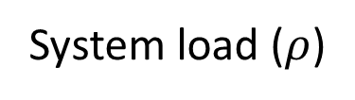
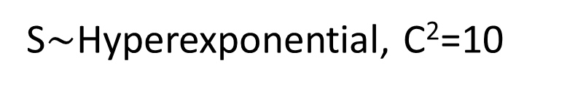
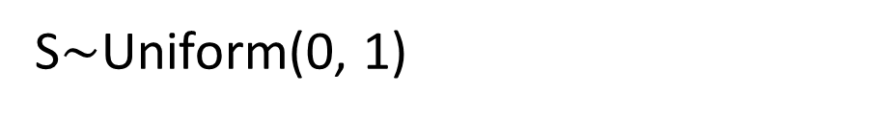
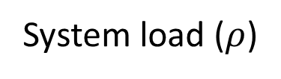
Ratio $=\frac{{\text{E}\text{[}\text{T}\text{]}}^{M/G/k/SRPT}}{{\text{E}\text{[}\text{T}\text{]}}^{M/G/1/SRPT}}$ k = 10
Ratio
Ratio
Analysis bound
Simulation
10
Analysis bound
Simulation
10
Shows optimality
1
1
0 1-10⁻² 1-10⁻⁴ 1-10⁻⁶ 1-10⁻⁸
0 1-10⁻² 1-10⁻⁴ 1-10⁻⁶ 1-10⁻⁸
System load ($ρ$)
System load ($ρ$)
S$\sim$Uniform(0, 1)
S$\sim$Hyperexponential, C²=10
Notes:
Uniform
Hyperexponential
Bound is tight at high load, which shows optimality

Slide 26
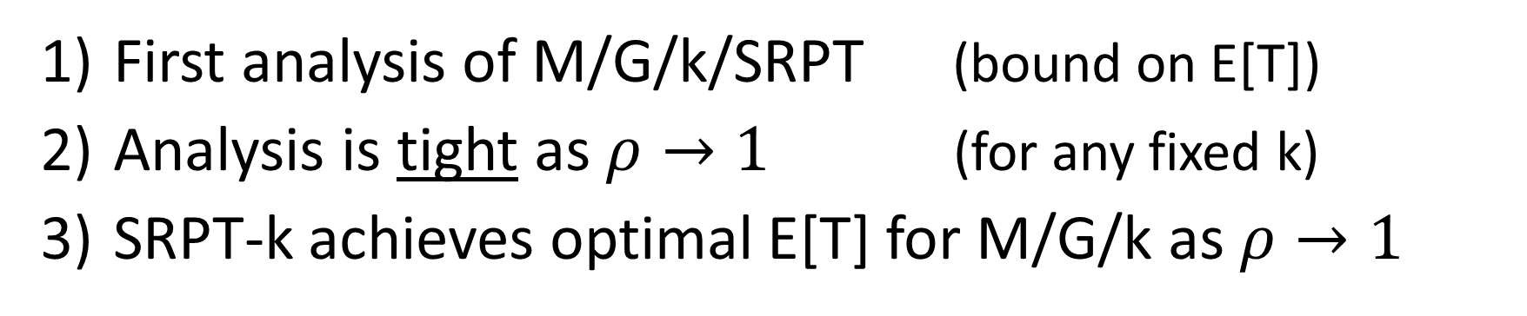
Conclusion
First analysis of M/G/k/SRPT (bound on E[T])
Analysis is tight as $ρ→1$ (for any fixed k)
SRPT-k achieves optimal E[T] for M/G/k as $ρ→1$
c
c
j
j
j
j
z
z
z
z
Server 3
Increasing remaining job size
Increasing remaining job size
z
b
z
Server 2
b
c
c
c
j
j
j
a
Server 1
a
b
c
n
c
j
T_{j}

