Slide 1
Multiserver Stochastic Scheduling: Analysis and Optimality
Isaac Grosof – CMU
Northwestern University, Jan. 31, 2023

Slide 2

Theory of Large-Scale Computing Systems
Datacenters, Supercomputers
1% of world’s electricity
205 TWh, 140 Mt CO₂, $320B.
Need systems to be:
Fast: low response time
Efficient: minimal resources
Scheduling is a key tool

Slide 3

Abstract Model: Queueing Theory
Arrivals
Response time: $T$
Varying job sizes (inherent work of a job)
Arrivals are a stochastic process
Scheduling policy preemptively determines which job to serve
Modern computing systems: many servers.
Notes:
Ultra simplified – one server
Server, queue, arrivals, jobs,
Size is inherent work of a job
Response time, stochastic
Very old-school

Slide 4
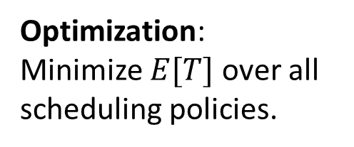
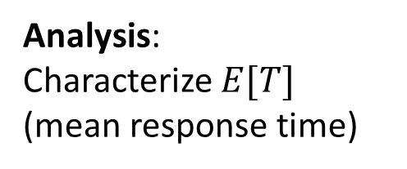
Prior work: Single-server & Multiserver Scheduling
1 server
Multiserver
Analysis: Characterize $E[T]$ (mean response time)
Well understood! [Pollaczek ‘30], [Schrage & Miller ‘66], [Scully ‘18].
Analysis only for First-Come First-Served (FCFS) [Köllerström ‘74 & ‘79]. Nothing for complex scheduling policies.
This talk:
Multiserver results, building on single-server progress.
Optimization: Minimize $E[T]$over all scheduling policies.
Shortest Remaining Processing Time (SRPT) is optimal! [Schrage ‘68].
Entirely open. Negative worst-case results [Leonardi & Raz ‘97].

Slide 5
First Scheduling Analysis & Optimality
1 server/job (M/G/k)
Multiple servers/job (MSJ)
First analysis & optimality results for each system.
3
2
4
1
3
3
1

Slide 6



One server/job (M/G/k) model
Load $ρ=λE\left[S\right]<1$
Size: $S$, i.i.d.
SRPT-k
Poisson($λ$)
k servers
Notes:
Size is amount of service necessary to complete the job.
Load is long-term fraction of busy servers.
Specify Poisson, I.i.d.
How to make optimal? Paper, award.
SRPT-1
SRPT-k? Worst-case not competitive, so not exact optimum, can still say something?
First analysis
Prove opt as rho -> 1

Slide 7

One server/job (M/G/k) model
Load $ρ=λE\left[S\right]<1$
Size: $S$, i.i.d.
SRPT-k
Poisson($λ$)
k servers
“SRPT for Multiserver Systems”. Grosof, Scully, Harchol-Balter. IFIP Performance ‘18. Best Student Paper Award.
Better scheduling: 37% higher completion rate, same resources, same response time.
Notes:
Size is amount of service necessary to complete the job.
Load is long-term fraction of busy servers.
Specify Poisson, I.i.d.
How to make optimal? Paper, award.
SRPT-1
SRPT-k? Worst-case not competitive, so not exact optimum, can still say something?
First analysis
Prove opt as rho -> 1

Slide 8
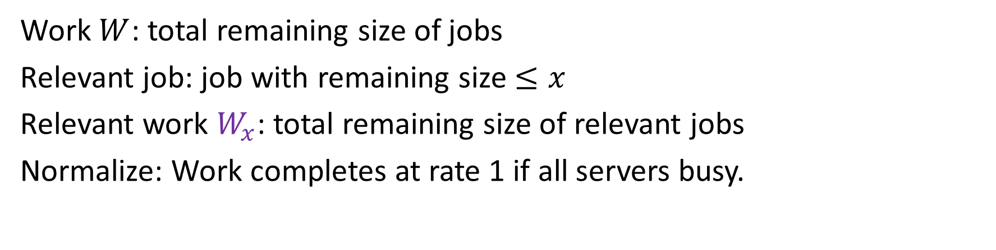
Background: Relevant work
x
SRPT-k
Work
Relevant work
Work $W$: total remaining size of jobs
Relevant job: job with remaining size $≤x$
Relevant work $W_{x}$: total remaining size of relevant jobs
Normalize: Work completes at rate 1 if all servers busy.

Slide 9





Analysis and Optimality of SRPT-k
Speed $1/k$
Speed $1$
SRPT-k
SRPT-1
Speed $1/k$
$$⟺$$
Speed $1/k$
Idea: Bound SRPT-k relative to resource-pooled SRPT-1
Lemma: Bound SRPT-k relevant work relative to SRPT-1 relevant work
Goal: Bound SRPT-k response time relative to SRPT-1 response time
Notes:
Compare to SRPT-1
Dream of a Parallel computing person.
Bound W_r: Coupling, worst-case.
W_r -> T: Tagged job, work that runs while tagged job in system
Thm: Bound T.
Thm: Near SRPT-1. OPT.

Slide 10

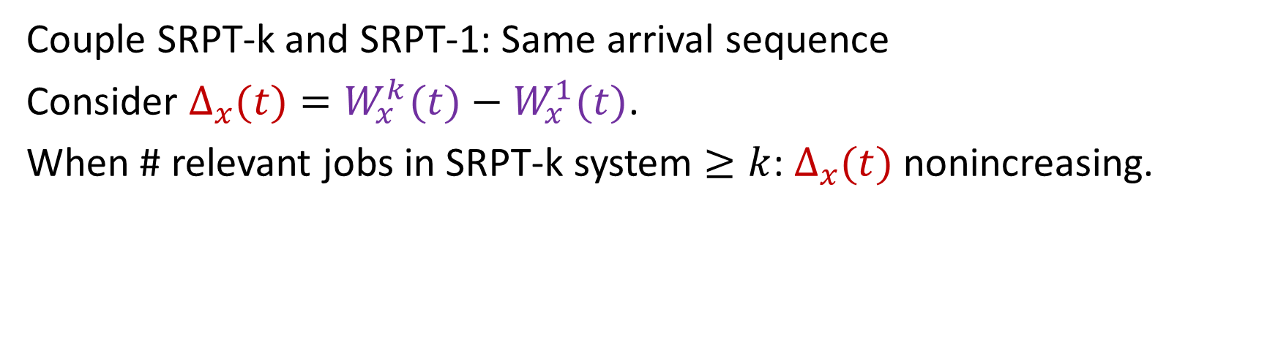


Step 1: Bound relevant work
SRPT-k
SRPT-1
$$W_{x}^{k}$$
$$⟺$$
$$W_{x}^{1}$$
Couple SRPT-k and SRPT-1: Same arrival sequence
Consider $Δ_{x}(t)=W_{x}^{k}(t)−W_{x}^{1}(t)$.
When # relevant jobs in SRPT-k system $≥k$: $Δ_{x}(t)$ nonincreasing.

Slide 11

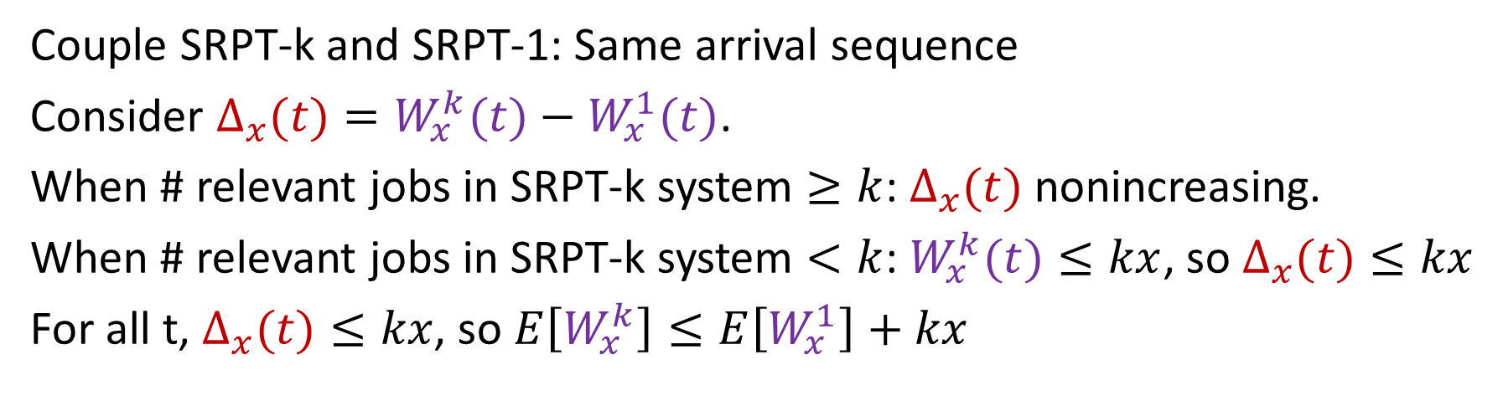

Step 1: Bound relevant work
SRPT-k
SRPT-1
$$W_{x}^{k}$$
$$⟺$$
$$W_{x}^{1}$$
Couple SRPT-k and SRPT-1: Same arrival sequence
Consider $Δ_{x}(t)=W_{x}^{k}(t)−W_{x}^{1}(t)$.
When # relevant jobs in SRPT-k system $≥k$: $Δ_{x}(t)$ nonincreasing.
When # relevant jobs in SRPT-k system $<k$: $W_{x}^{k}(t)≤kx$, so $Δ_{x}(t)≤kx$
For all t, $Δ_{x}(t)≤kx$, so $E\left[W_{x}^{k}\right]≤E\left[W_{x}^{1}\right]+kx$
Notes:
We’ve shown work is similar – does that mean we wait the same amount of time? Unclear! Preemption, jump ahead, slower service.

Slide 12

Step 2: Bound response time
x
SRPT-k
Key idea: Bound on x’s response time implied by bound on work completed while x in system.
Work while x in queue
Work while x in service

Slide 13
Step 2: Bound response time
SRPT-k
x
Key idea: Bound on x’s response time implied by bound on work completed while x in system.
Work while x in queue – Relevant work
Work while x in service
Relevant work seen on arrival

Slide 14
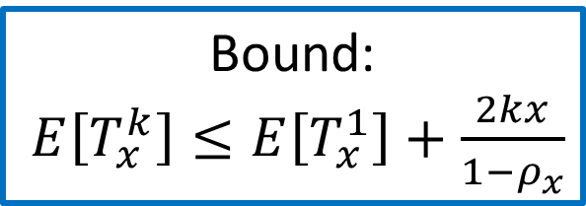


Step 2: Bound response time
SRPT-k
x
Key idea: Bound on x’s response time implied by bound on work completed while x in system.
Work while x in queue – Relevant work
Work while x in service
Relevant work seen on arrival
Lemma: $E\left[W_{x}^{k}\right]≤E[W_{x}^{1}]+kx$
Bound:
$E\left[T_{x}^{k}\right]≤E\left[T_{x}^{1}\right]+\frac{2kx}{1−ρ_{x}}$
Relevant work arriving after x
Same as single server
$$≤kx$$
Notes:
\rho_x: Load of relevant jobs

Slide 15
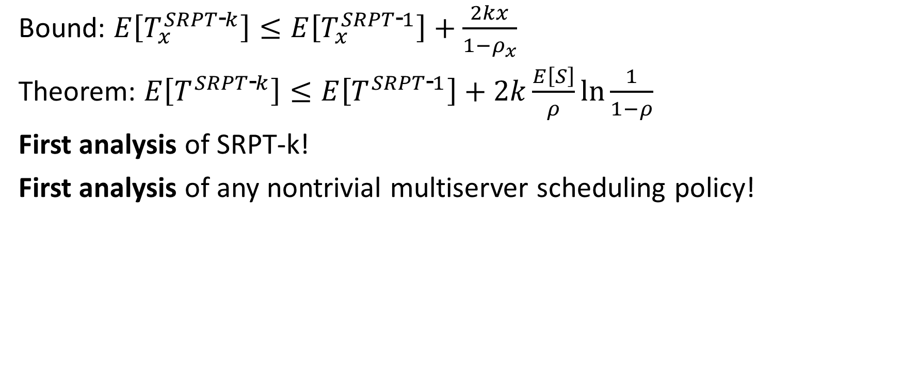
SRPT-k Analysis
SRPT-k
x
Bound: $E\left[T_{x}^{SRPT\text{‐}k}\right]≤E\left[T_{x}^{SRPT\text{‐}1}\right]+\frac{2kx}{1−ρ_{x}}$
Theorem: $E\left[T^{SRPT\text{‐}k}\right]≤E\left[T^{SRPT\text{‐}1}\right]+2k\frac{E\left[S\right]}{ρ}\ln{\frac{1}{1−ρ}}$
First analysis of SRPT-k!
First analysis of any nontrivial multiserver scheduling policy!

Slide 16
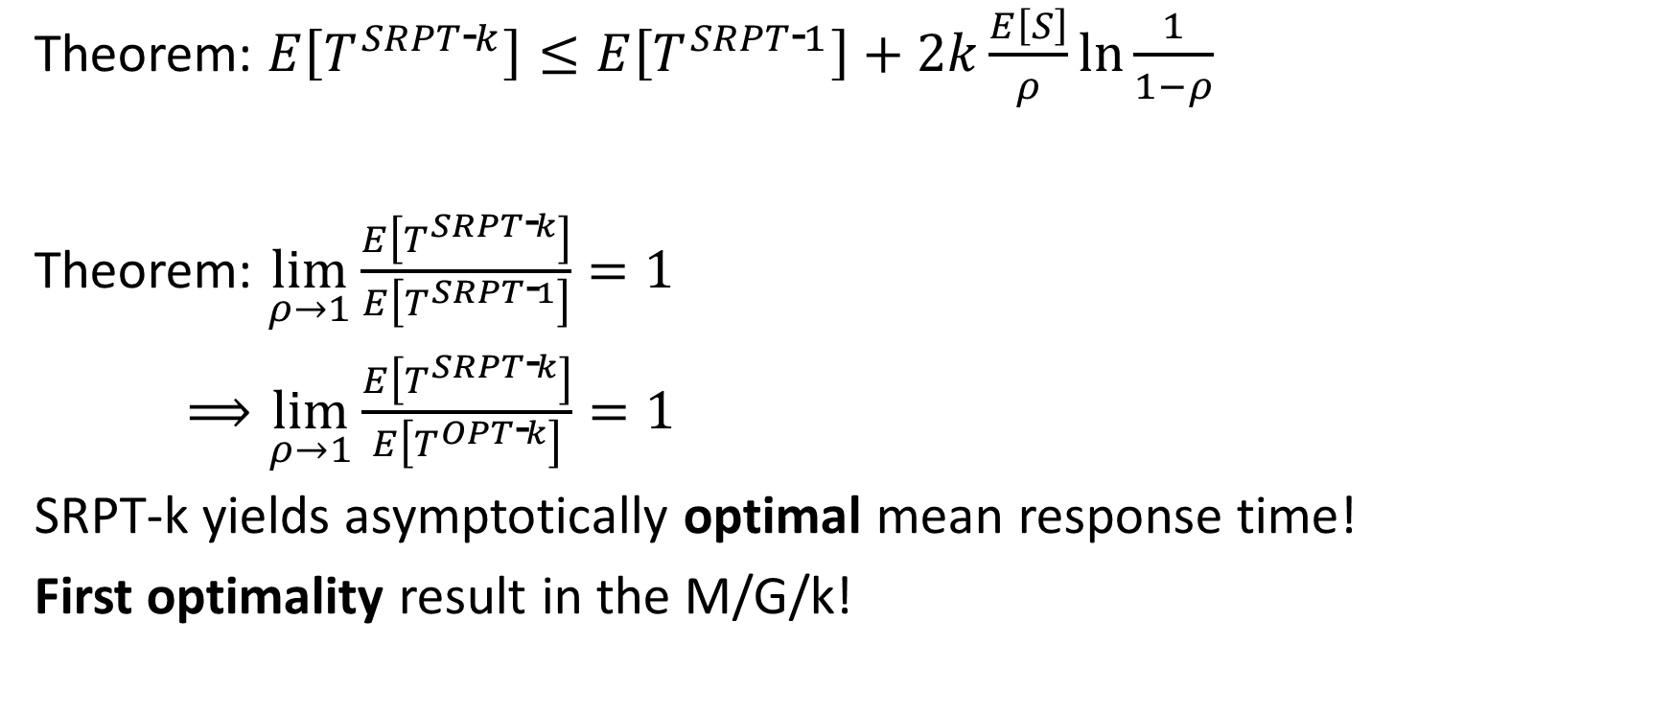
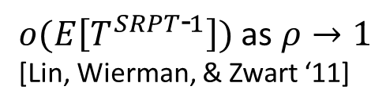
SRPT-k Optimality
SRPT-k
x
Theorem: $E\left[T^{SRPT\text{‐}k}\right]≤E\left[T^{SRPT\text{‐}1}\right]+2k\frac{E\left[S\right]}{ρ}\ln{\frac{1}{1−ρ}}$
Theorem: $\lim_{ρ→1}{\frac{E\left[T^{SRPT\text{‐}k}\right]}{E\left[T^{SRPT\text{‐}1}\right]}=1}$
$⟹\lim_{ρ→1}{\frac{E\left[T^{SRPT\text{‐}k}\right]}{E\left[T^{OPT\text{‐}k}\right]}=1 }$
SRPT-k yields asymptotically optimal mean response time!
First optimality result in the M/G/k!
$o(E\left[T^{SRPT\text{‐}1}\right])$ as $ρ→1$
[Lin, Wierman, & Zwart ‘11]

Slide 17
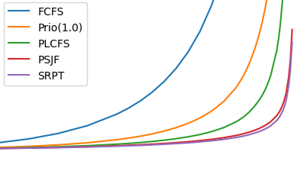

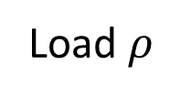
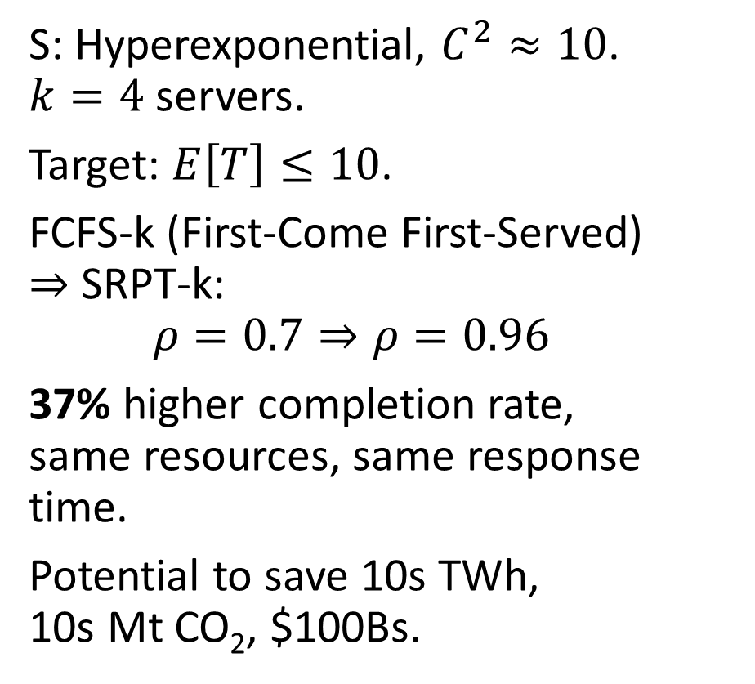
Empirical Impact
S: Hyperexponential, $C^{2}≈10$. $k=4$ servers.
Target: $E\left[T\right]≤10$.
FCFS-k (First-Come First-Served) $⇒$ SRPT-k:
$$ρ=0.7⇒ρ=0.96$$
37% higher completion rate, same resources, same response time.
Potential to save 10s TWh, 10s Mt CO₂, $100Bs.
30
FCFS-k
Prio-k
PLCFS-k
PSJF-k
SRPT-k
25
20
$$E[T]$$
15
10
5
0
0.5
0.6
0.7
0.8
0.9
1.0
Load $ρ$
Notes:
Load rho=0.5 to 1, interesting behavior.
High variance, k=4
Lower is better, SRPT is the best – PSJF policy also really good - we also prove it’s asymptotically optimal in our paper.

Slide 18
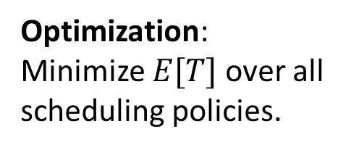
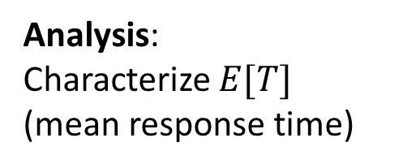
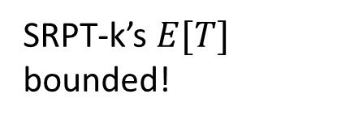
Prior Work: Single-server & Multiserver Scheduling
Multiserver 1 server/job
1 server
Analysis: Characterize $E[T]$ (mean response time)
Well understood! [Pollaczek ‘30], [Schrage & Miller ‘66], [Scully ‘18].
SRPT-k’s $E[T]$ bounded!
Optimization: Minimize $E[T]$over all scheduling policies.
SRPT is optimal! [Schrage ‘68].
SRPT-k is optimal!

Slide 19
Prior Work: Single-server & Multiserver Scheduling
Multiserver 1 server/job
Multiserver many servers/job
1 server
3
3
2
2
4
2
1
Analysis: Characterize $E[T]$ (mean response time)
Well understood! [Pollaczek ‘30], [Schrage & Miller ‘66], [Scully ‘18].
SRPT-k’s $E[T]$ bounded!
No analysis for any scheduling policy.
Optimization: Minimize $E[T]$over all scheduling policies.
SRPT is optimal! [Schrage ‘68].
SRPT-k is optimal!
Completely open

Slide 20

Multiserver-job (MSJ) Model
Motivated by Google Borg scheduler [Tirmazi et al. ‘20].
Trace: Factor of ${10}^{5}$ variation in server need.
Prior scheduling: Heuristics and/or poor response time
3
Size (height) = duration × server need
4
2
2
3
3
1
Notes:
I went looking in their trace data.

Slide 21
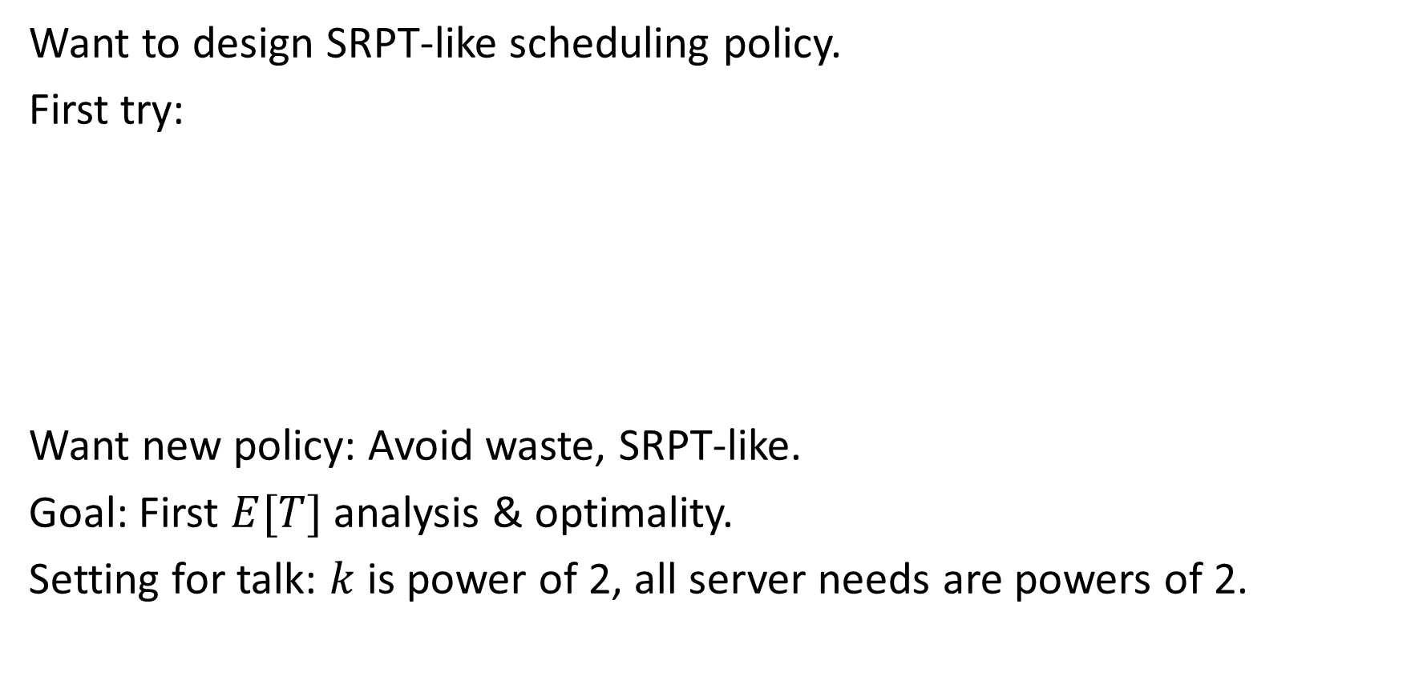
New Multiserver-job (MSJ) Scheduling Policy
Want to design SRPT-like scheduling policy.
First try:
Want new policy: Avoid waste, SRPT-like.
Goal: First $E[T]$ analysis & optimality.
Setting for talk: $k$ is power of 2, all server needs are powers of 2.
Greedy-SRPT
3
3
2
4
2
3
1
Wasted Server
Notes:
Common in datacenters
Paper studies a more general setting

Slide 22
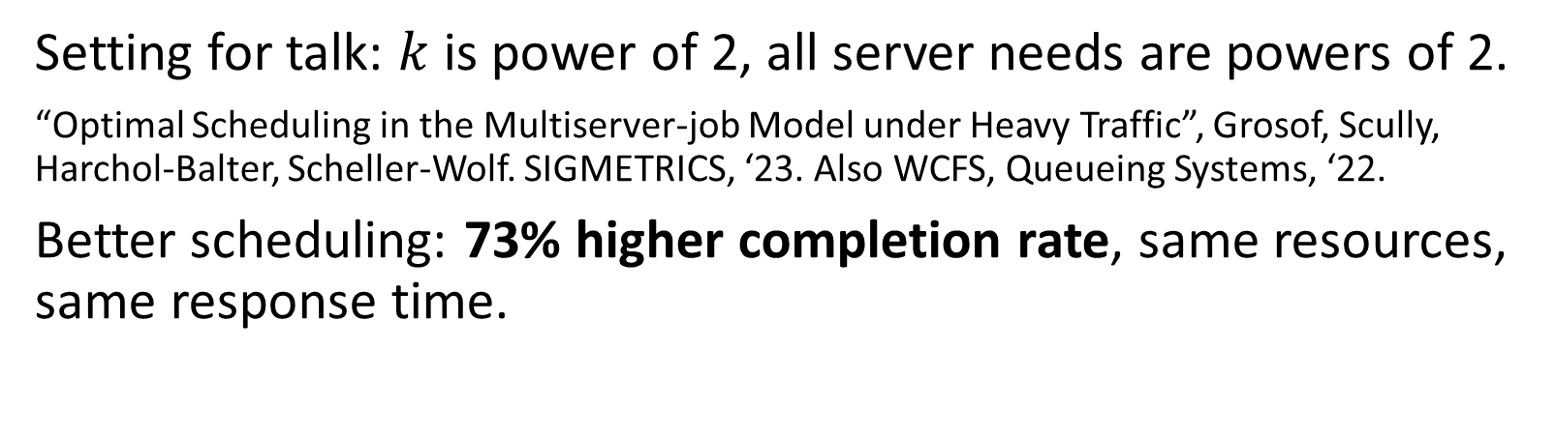
New Multiserver-job (MSJ) Scheduling Policy
8
1
2
4
2
Setting for talk: $k$ is power of 2, all server needs are powers of 2.
“Optimal Scheduling in the Multiserver-job Model under Heavy Traffic”, Grosof, Scully, Harchol-Balter, Scheller-Wolf. SIGMETRICS, ‘23. Also WCFS, Queueing Systems, ‘22.
Better scheduling: 73% higher completion rate, same resources, same response time.
Notes:
Common in datacenters
Paper studies a more general setting

Slide 23
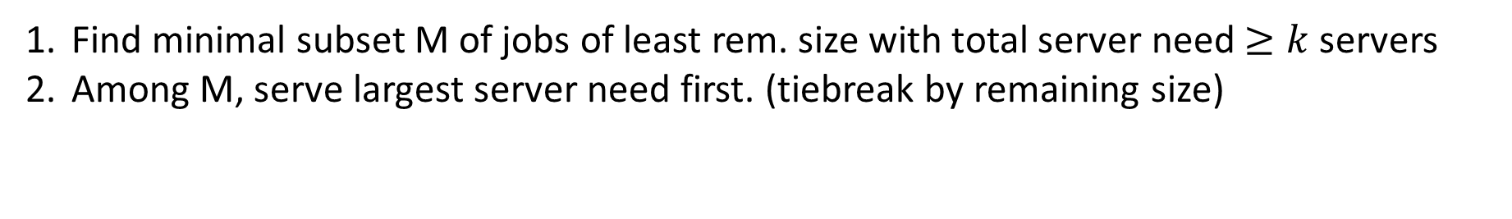
Define ServerFilling-SRPT
M
Least remaining size order
2
4
1
2
8
1
k=8
1
4
4
1
2
1
1
Find minimal subset M of jobs of least rem. size with total server need $≥k$servers
Among M, serve largest server need first. (tiebreak by remaining size)
Notes:
If we just put these four into service, the next job wouldn’t fit. Not very SRPT!

Slide 24
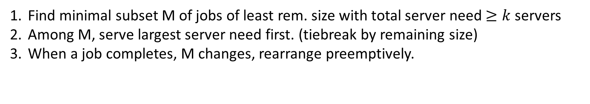
Define ServerFilling-SRPT
M
Least remaining size order
4
2
4
1
2
8
1
k=8
1
4
1
2
1
1
2
1
1
Find minimal subset M of jobs of least rem. size with total server need $≥k$servers
Among M, serve largest server need first. (tiebreak by remaining size)
When a job completes, M changes, rearrange preemptively.
Notes:
If we just put these four into service, the next job wouldn’t fit. Not very SRPT!

Slide 25
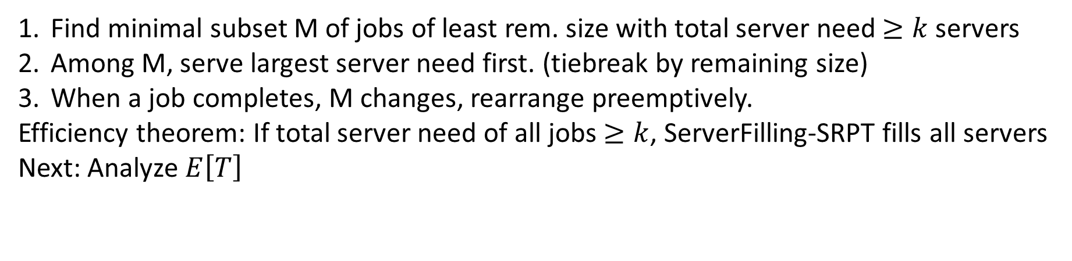
Define ServerFilling-SRPT
M
Least remaining size order
4
2
4
1
2
8
1
k=8
1
4
1
2
1
1
Find minimal subset M of jobs of least rem. size with total server need $≥k$servers
Among M, serve largest server need first. (tiebreak by remaining size)
When a job completes, M changes, rearrange preemptively.
Efficiency theorem: If total server need of all jobs $≥k$, ServerFilling-SRPT fills all servers
Next: Analyze $E\left[T\right]$
Server need is power of 2
Notes:
More general setting in paper

Slide 26
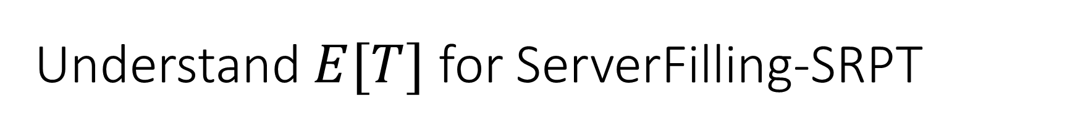

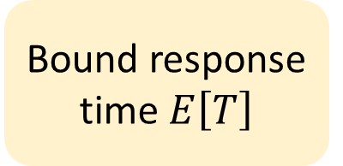

Understand $E[T]$ for ServerFilling-SRPT
1/k
1/k
1/k
1/k
1/k
1/k
1/k
1/k
ServerFilling-SRPT
4
SRPT-1
$$⟺$$
1
1
2
4
1
2
2
Proof plan:
Compare against resource-pooled SRPT-1
Bound relevant work $E\left[W_{x}\right]$
Bound response time $E\left[T\right]$
But: Obstacles at each step!
Notes:
TODO: Redo work w/ server need.

Slide 27
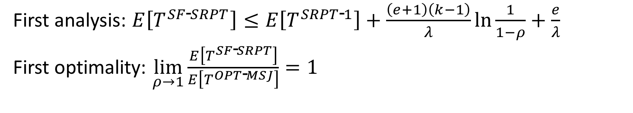
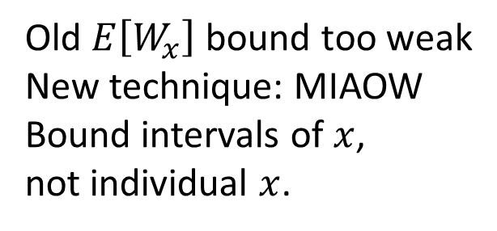
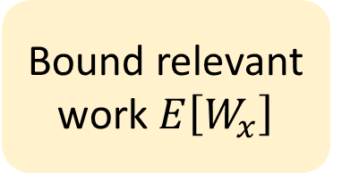
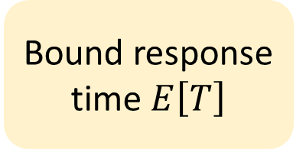
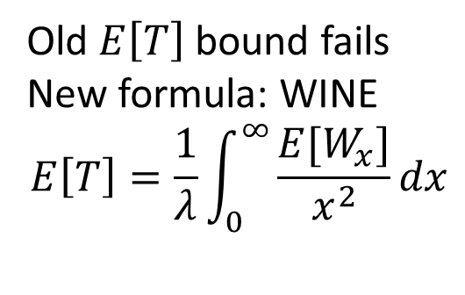
ServerFilling-SRPT: Analysis & Optimality
Compare against resource-pooled SRPT-1
Bound relevant work $E\left[W_{x}\right]$
Bound response time $E\left[T\right]$
?
What size distribution?
Size = duration × server need
?
Old $E\left[W_{x}\right]$ bound too weak
New technique: MIAOW
Bound intervals of $x$, not individual $x$.
?
Old $E\left[T\right]$ bound fails
New formula: WINE
$$E\left[T\right]=\frac{1}{λ}\int_{0}^{∞}{\frac{{E[W}_{x}]}{x^{2}}}dx$$
!
!
!
First analysis: $E\left[T^{SF\text{‐}SRPT}\right]≤E\left[T^{SRPT\text{‐}1}\right]+\frac{\left(e+1\right)\left(k−1\right)}{λ}ln\frac{1}{1−ρ}+\frac{e}{λ}$
First optimality: $\lim_{ρ→1}{\frac{E\left[T^{SF\text{‐}SRPT}\right]}{E\left[T^{OPT\text{‐}MSJ}\right]}=1 }$
Notes:
This make s

Slide 28
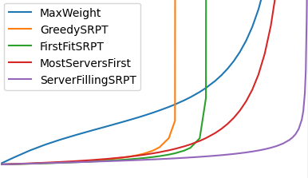
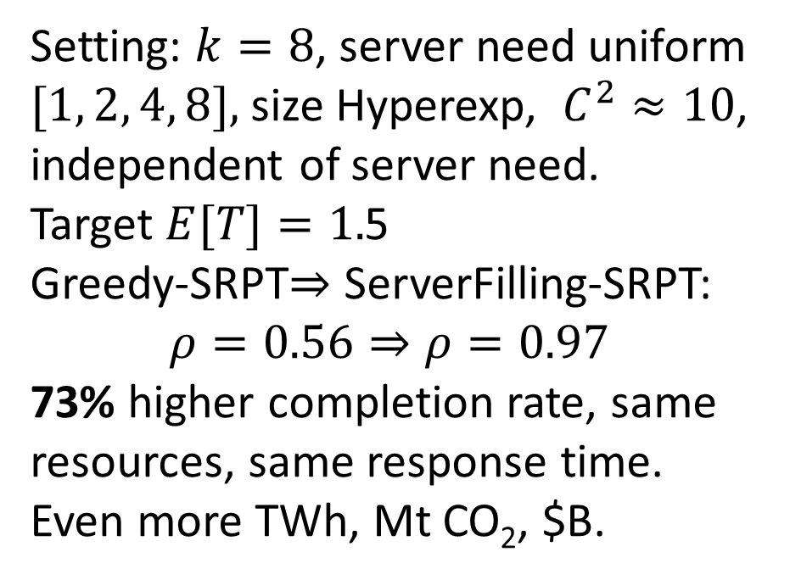

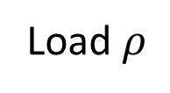
Empirical Impact
Setting: $k=8$, server need uniform $[1, 2, 4, 8],$ size Hyperexp, $C^{2}≈10$, independent of server need.
Target $E[T]=1.$5
Greedy-SRPT$⇒$ ServerFilling-SRPT:
$$ρ=0.56⇒ρ=0.97$$
73% higher completion rate, same resources, same response time.
Even more TWh, Mt CO₂, $B.
5
4
3
$$E[T]$$
2
1
0
0
0.2
0.4
0.6
0.8
1.0
Load $ρ$
Notes:
Admit as many customers as possible subject to E[T] limit.

Slide 29



Theory → Practical Power Management
Response Time Guarantees
Huge Waste of Capacity & Energy
No Preemption
+
$$⇒$$
Problem:
Current solution: Heuristics [Autopilot ‘20]
My approach:
3
1
Wasted Servers
Learning Workload Distributions
Advanced Scheduling
Mathematical Guarantees
+
$$⇒$$
Notes:
Remind about preemption
Most datacenters at 20-30% utilization
Autopilot squeezes it up to 50% utilization

Slide 30



Future directions: Response time tails
$$f_{T}\left(t\right)$$
Response time $t$
Problem: Practitioners care about tail of response time. Analysis only for mean $E\left[T\right]$. Analyze tail? Schedule to optimize tail?
Current theory: Optimal worst-case max. response time: FCFS.
Asymptotic tail analysis. Conjecture: FCFS optimal for light-tailed sizes.
My work and future approach:
Overturned conjecture with Nudge [GYSH, SIGMETRICS ‘21].
Intermediate tails?
Multiserver tails?
Notes:
Concrete example: Amazon – If page load > 0.2 seconds, users start to leave.

Slide 31

Future directions: Scheduling with Estimates
Problem: Don’t know sizes
Current solution: Non-size-based scheduling (FCFS). Schedule based on age & size distribution: Gittins Index [Gittins & Nash ‘77].
My approach:
Bring Gittins to multiserver world: Gittins-k [SGH, ‘21]. ServerFilling-Gittins.
Distribution-robust scheduling: SRPT-B [SGM, ‘22].
Confidence bounds from learning theory
New theory integrating scheduling + learning.
Notes:
Gittins is for single-server
Concrete example: ML Learning predictions, some jobs inherently unpredictable, others not. Nm n

Slide 32
Broader Scope: My Papers
SRPT-k, Performance ‘18, GSH
Guardrails, SIGMETRICS ‘19, GSH
M-Gittins-k, Performance ‘20, SGH
Gittins-k, SIGMETRICS ‘21, SGH
Nudge, SIGMETRICS ‘21, GYSH
SRPT-B, ITCS ‘22, SGM
ServerFilling-FCFS, Queueing Systems ‘22, GHS
ServerFilling-SRPT, SIGMETRICS ‘23, GSHS
+4 non-queueing-theory papers
Notes:
Unifying themes: Power of scheduling, models reflection large-scale computing systems, multiserver, estimates, tails.

Slide 33
Conclusion: Multiserver Analysis & Optimality
One server/job: First optimality result: SRPT-k
Multiple servers/job: First analysis & first optimality: ServerFilling-SRPT
2
SRPT-k
ServerFilling-SRPT
2
4
2
4
1
1

Slide 35
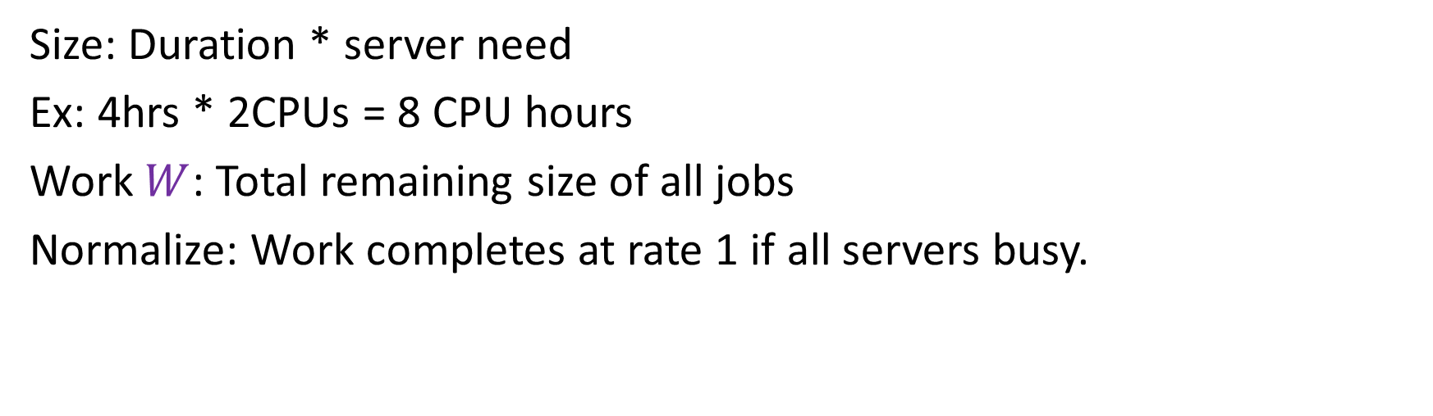
Key tool: Size & Work
2
4
4
2
2
1
1
Size: Duration * server need
Ex: 4hrs * 2CPUs = 8 CPU hours
Work $W$: Total remaining size of all jobs
Normalize: Work completes at rate 1 if all servers busy.

Slide 36
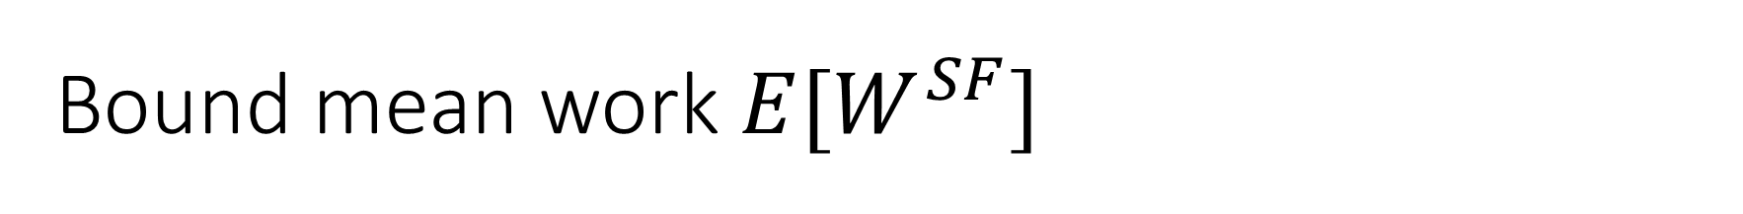
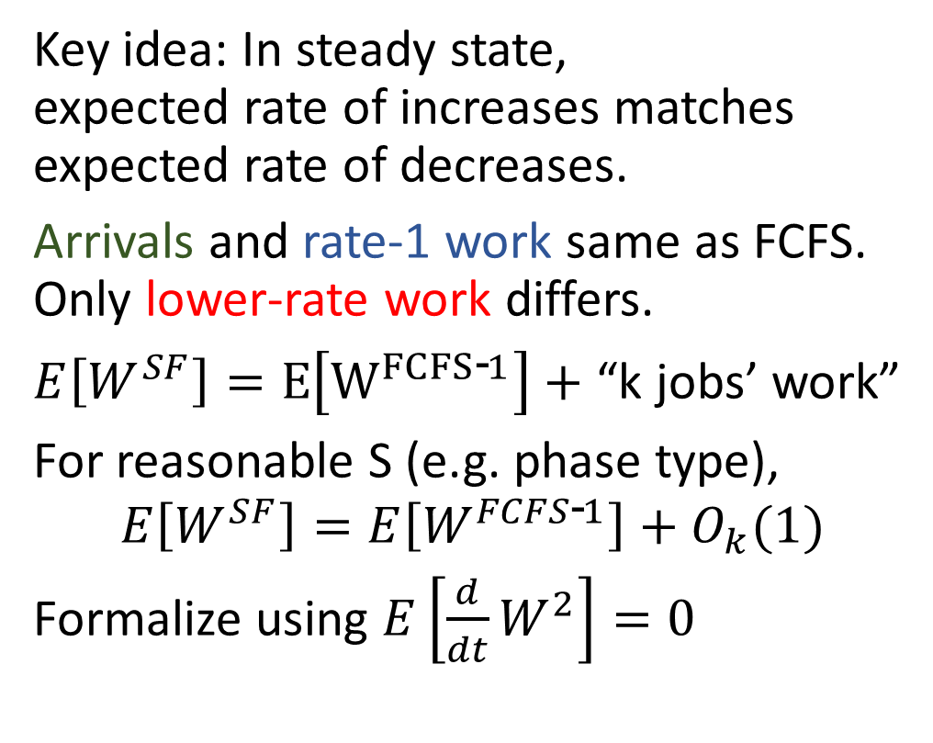
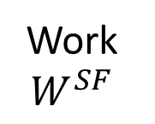
Bound mean work $E[W^{SF}]$
Key idea: In steady state, expected rate of increases matches expected rate of decreases.
Arrivals and rate-1 work same as FCFS. Only lower-rate work differs.
$E\left[W^{SF}\right]=E\left[W^{FCFS\text{‐}1}\right]+$ “k jobs’ work”
For reasonable S (e.g. phase type),
$$E\left[W^{SF}\right]=E\left[W^{FCFS\text{‐}1}\right]+O_{k}(1)$$
Formalize using $E\left[\frac{d}{dt}W^{2}\right]=0$
Job arrives
Work at rate 1
Work $W^{SF}$
Too few jobs: lower rate
Time
Notes:
d/dt W^2 tells us about E[W]

Slide 37

ServerFilling Analysis
Lemma: $E\left[W^{SF}\right]=E\left[W^{FCFS\text{‐}1}\right]+O_{k}(1)$
Theorem: $E\left[T^{SF}\right]=E\left[T^{FCFS\text{‐}1}\right]+O_{k}(1)$
First analysis for any multiserver-job scheduling policy!
Job arrives
Work at rate 1
Work $W^{SF}$
Too few jobs: lower rate
Time

Slide 38
Multiserver-Job Optimality
ServerFilling: based on FCFS.
For optimality: ServerFilling-SRPT.
“Optimal Scheduling in the Multiserver-job Model under Heavy Traffic”. Grosof, Scully, Harchol-Balter, Scheller-Wolf. SIGMETRICS ‘23.
M
Least remaining size order
4
2
k=8
2
1
1
1
2
1
1
1
2
1
Notes:
MSJ-SF-SRPT. Paper.
Define
Like SRPT-k: Bound W_r, W_r -> T
W_r -> T: Tagged Fails, WINE.
Bound W_r: Bound Waste, MIAOW (continuity of B_r, \rho_r in r) – much more complicated.
Theorem.
Graph.

