Slide 1

Designing User Experience
A guide to HCI, UX and Interaction Design
Fourth Edition
Part I
The essentials of designing user experience
Chapter 1
An introduction to user experience

Slide 2
Contents
1.1 The variety of UX
1.2 The concerns of UX
1.3 Being digital
1.4 The skills of the UX designer
1.5 Why being human-centred is important

Slide 3
Aims
User experience (UX) is concerned with developing high-quality interactive systems, products and services that fit with people and their ways of living.
Computing and communication devices are embedded in all sorts of everyday devices such as washing machines and televisions, ticket machines and jewelry.
No self-respecting exhibition, museum or library is without its interactive component.
We carry and wear technologies that are far more powerful than the computers of just a few years ago.
There are websites, on-line communities, ‘apps’ for mobile phones and tablets and all manner of other interactive devices and services that need developing.
UX is about all this.

Slide 4
Overview
In this chapter, we explore the width and breadth of UX. After studying this chapter, you should be able to:
Understand the concepts underlying UX.
Understand why being human-centred is important in UX design.
Understand the historical background to the subject.
Understand the skills and knowledge that the UX designer needs to draw upon.

Slide 5
1.1 The variety of UX
UX is concerned with many different types of interactive services and products.
It is about designing web services that will run on a computer at work.
It is about designing apps, games, interactive products such as home control systems, digital cameras and applications for tablet devices such as the iPad.
It is about designing whole environments, such as new retail spaces, in which phones, tablets, laptop computers, digital projectors and other devices and services communicate with one another and through which people interact with one another.
It is about designing interactive systems, products and services for home, for work or to support communities.

Slide 6
Example 1: The iPhone (1 of 2)
In 2007, Apple Inc. changed the face of mobile technologies when they introduced the iPhone (Figure 1.1).
The iPhone was beautifully made and had a carefully crafted, purpose-designed interface to make use of the finger as the input device.
It had a revolutionary touch-sensitive screen that allowed for multi-touch input.
This facilitated new interaction techniques such as pinching an image and drawing it in to make it smaller, or pinching and moving the fingers out to make an image larger.
Many mobile devices and larger screen systems have now adopted this technology but the iPhone was its genesis.
The iPhone also includes sensors that can register how the phone is being held and whether it is vertical, horizontal or sloping.
This allows for other novel interaction methods. For example, the display will automatically adjust from portrait view to landscape.

Slide 7
Example 1: The iPhone (2 of 2)
In 2008, the ‘app store’ was launched, turning the iPhone into an open platform for developers to design and produce their own software, creating an entire new industry of app development.
Combined with the iTunes delivery service, this turned the iPhone into a versatile, multimedia device with hundreds of thousands of applications, from sophisticated games to trivial pieces of entertainment to useful information applications.
This created new experiences and new services for a new set of customers that has now spread to many other devices running the Android operating system (from Google) or Windows (from Microsoft).
The iPhone includes a speech recognition system called Siri that allows people to call or text their friends, enter appointments in a calendar or search the Web just by speaking into the phone.
Google Now and Microsoft Cortana perform similar functions.

Slide 8
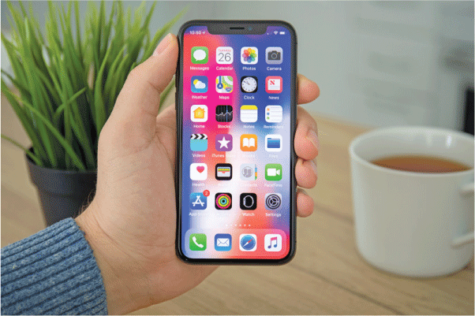
Figure 1.1
The iPhone

Slide 9
Example 2: Nest Home control
A ‘smart thermostat’ to control central heating in people’s houses was developed by a company called Nest in 2014.
The look of this device is elegant.
It has a simple user interface for setting the temperature and rotating a dial on the outside of the device.
It communicates through a proprietary communications protocol called heatlink with the boiler to turn it on and off.
It is also linked to a home’s wi-fi system.
It comes with an app for the user’s smartphone and tablet so that the temperature can be changed from locations remote from the home.
In 2015, Nest was acquired by Google and now there are a variety of other devices such as smoke alarms, lights and cameras that can be linked to the same system.

Slide 10
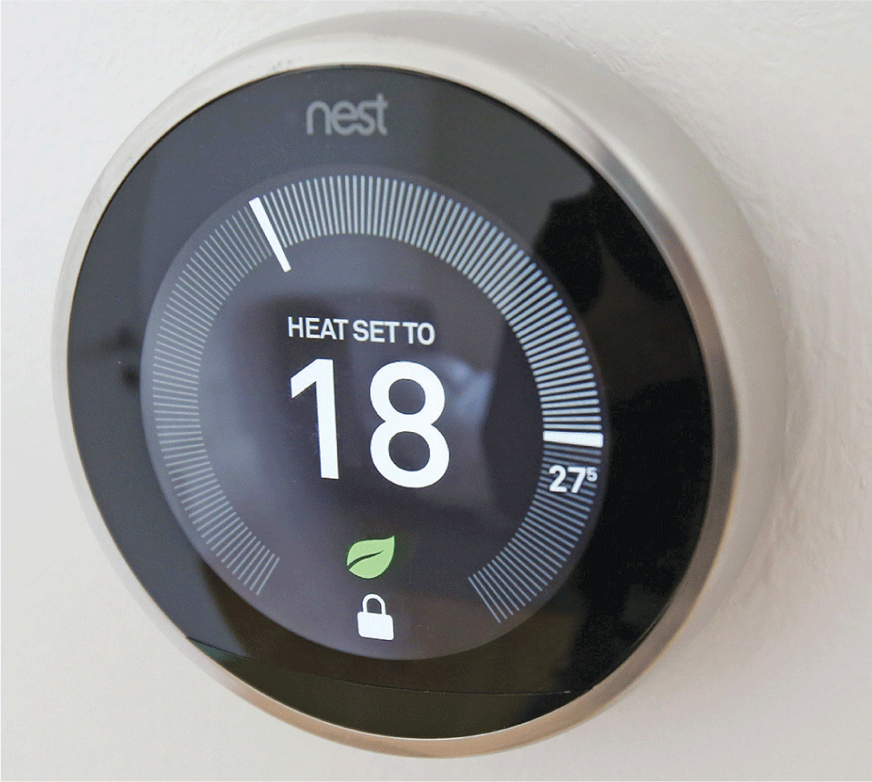
Figure 1.2
The Nest thermostat

Slide 11
Further thoughts: Device ecologies
UX is often experienced through an ecology of devices rather than on a single device.
The idea of ecology is to look at a part of the world through an interdisciplinary lens, focusing on the organisms and how they interact with one another and their environment.
UX is increasingly concerned with interactions that involve a number of different devices; a device ecology.
For example, I was sitting in a café with my wife the other day. She was connected to wi-fi and found a picture she wanted me to see, so she sent it using the Airdrop function to my iPhone.
Just one example of a typical interaction in a miniature device ecology — two iPhones and a wi-fi connection — that provides a good UX.
Other ecologies could include an Apple watch, a digital projector and people using personal computers (PCs) made by someone other than Apple and smartphones running the Android operating system.
In these cases, creating a successful ecology where all the devices can communicate and share content can be surprisingly difficult causing frustration and anger. These circumstances lead to a poor UX.
Other good examples of device ecologies include running technology such as that shown in Figure 1.3.

Slide 12
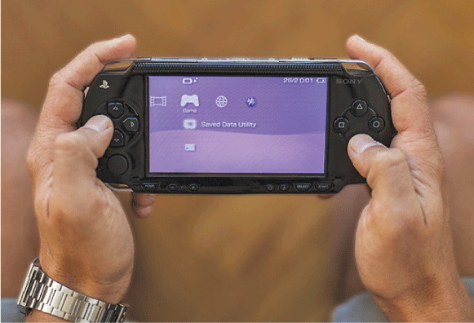
Figure 1.3
Sony’s PS Vita works with the PS4
to create a device ecology

Slide 13
Example 3: Burberry
Burberry is an up-market brand of clothing manufacturer and retailer.
Its flagship store in Regent Street, London provides an enriched and interactive experience for customers, ‘blurring the digital and physical worlds’.
Technology has been integrated throughout the architecture of the building including wireless communications, stereo speakers, large display screens and interactive products.
Customers can watch fashion shows and interact with brand content.
RFID is woven into some clothing and accessories, triggering bespoke user experiences that can be consumed on in-store screens or on the customer’s smartphone or tablet.
There are mirrors that can turn instantly into screens so that customers can see what they would look like in a particular garment without trying it on.
Alternatively, they can try on a physical garment and see it in different colours.
Digital signage displays content in key areas and staff with iPad apps can provide purchase history and customer preferences to enable a personalized shopping experience.

Slide 14
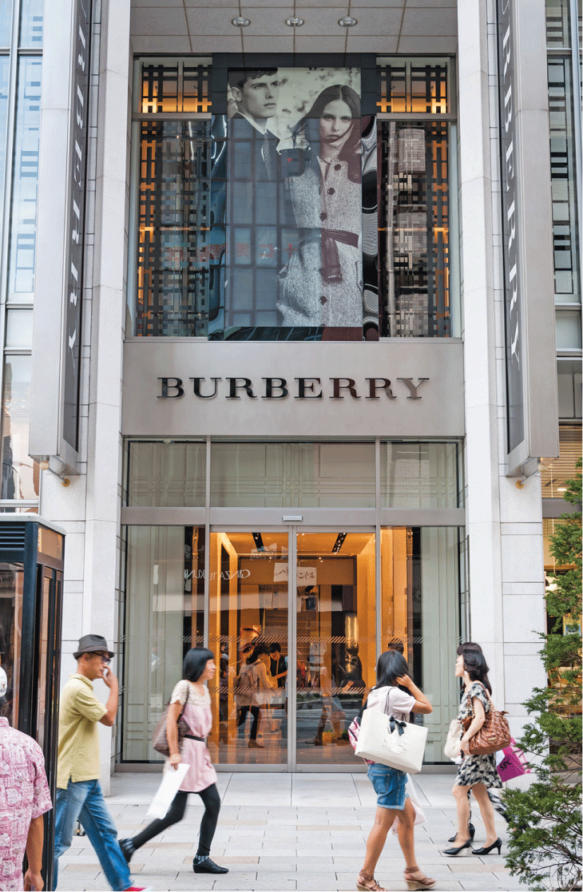
Figure 1.4
Burberry store

Slide 15
Example 4: i Robo-Q domestic toy robot
The i Robo-Q domestic toy robot is an example of the new children’s toys that are increasingly available (Figure 1.5).
Toys are using all manner of new technologies to enhance the experiences of children at play. They use robotics, voice input and output and a variety of sensors to provide novel and engaging interactions.

Slide 16
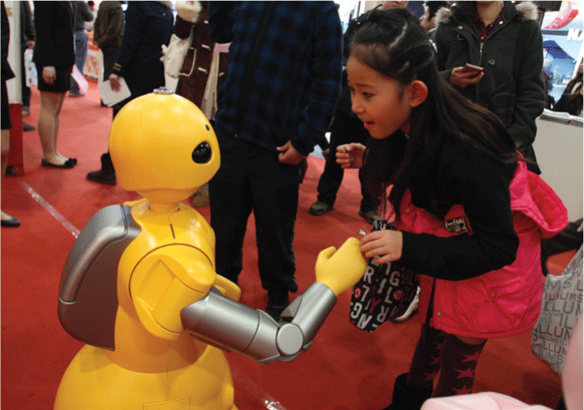
Figure 1.5
i Robo-Q domestic toy robot

Slide 17
Example 5: Facebook
Facebook is a highly popular website that allows people to keep in contact with their friends.
Known as social networking sites, or social media, there are many similar systems around.
Facebook is the most popular with over 2 billion users worldwide.
Facebook is increasingly becoming an important platform for a wide variety of activities and it allows people to add applications (apps) in a similar way to the Apple and Android platforms.
People can store and share digital photos, write notes to each other and get regular updates about what their friends are doing.
Other examples of social media include web services for dating, connecting mothers with other mothers, knitting enthusiasts, crossword solvers or just about any activity or hobby you can think of.

Slide 18
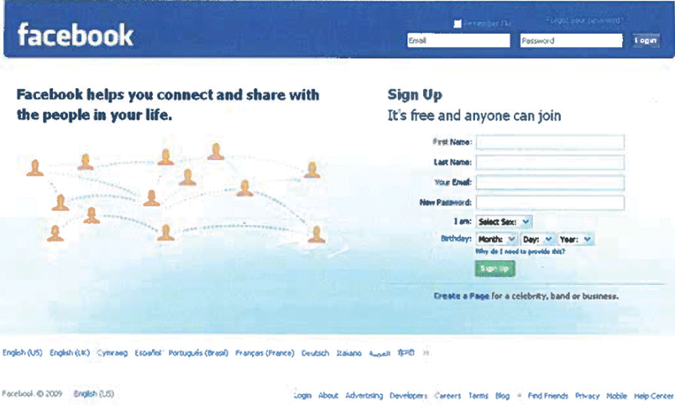
Figure 1.6
Facebook

Slide 19
Summary
These five examples of interactive systems and services capture many of the features that the UX designer has to work with.
The UX designer needs to understand the possibilities that exist for new forms of interaction, with fixed devices or mobiles, for people on their own or for connecting people to each other through text messages or through animation and video.
It is a fascinating area to work in.

Slide 20
Challenge 1.1
Find five interactive products or services that you use – perhaps a coffee machine, a particular smartphone app, a theme park, a TV service such as Sky or Virgin, a computer game such as Grand Theft Auto and a web service such as the Huffington Post.
Write down what it is that you like about each of them and what it is that you do not like.
Think about the whole experience and not just the functions.
Think about the content that each provides: Is it what you want? Is it fun to use?
If possible, find a friend or colleague to discuss the issues. Criticism and design are social activities that are best done with others. What do you agree on? What do you disagree on? Why?

Slide 21
1.2 The concerns of UX
UX design covers a very wide range of activities.
Sometimes designers will be working on both the hardware and the software for a system, in which case the term ‘product design’ seems to be most appropriate to describe what they are doing.
Sometimes the designer will be producing a piece of software to run on a computer, on a programmable device or over the Internet. In these cases, the terms ‘system design’ or ‘designing interactive systems’ seem more appropriate.
Sometimes the designer will be working on providing a connected group of facilities that are available over a number of devices in which case ‘service design’ is most appropriate.
We switch between these expressions accordingly.

Slide 22
The key concerns of the UX designer may be summed up as follows:
Design. What is design and how should you do it?
Technologies. These are the interactive systems, products, devices and components themselves. The UX designer needs to know about technologies.
People. The UX designer needs to consider who will use the systems and services and whose lives would they like to make better through their designs.
Activities and contexts. UX is about what people want to do, about their goals, feelings and achievements. UX needs to consider the contexts within which those activities take place.

Slide 23
Design (1 of 4)
What is design? It’s where you stand with a foot in two worlds – the world of technology and the world of people and human purposes – and you try to bring the two together (Mitch Kapor in Winograd (1996), p. 1).
The term ‘design’ refers both to the creative process of specifying something new and to the representations that are produced during the process.
So, for example, to design a website, a designer will produce and evaluate various designs, such as a design of the page layout, a design of the colour scheme, a design for the graphics and a design of the overall structure.
In a different field of design, an architect produces sketches and outlines and discusses these with the client before formalising a design in the form of a blueprint.

Slide 24
Design (2 of 4)
Design is rarely a straightforward process and typically involves much iteration and exploration of both requirements (what the system is meant to do and the qualities it should have) and design solutions.
There are many definitions of ‘design’.
Most definitions recognize that both problem and solution need to evolve during the design process; rarely can you completely specify something before some design work has been done.

Slide 25
Design (3 of 4)
One thing that is useful is to distinguish the amount of formality associated with a design:
At one end of a spectrum is engineering design (such as the design of a bridge, a car or a building) where scientific principles and technical specifications are employed to produce formal models before construction starts.
At the other end of this spectrum is creative or artistic design where innovation, imagination and conceptual ideas are the key ingredients.
Somewhere in the middle lies ‘design as craft’ which draws upon both engineering and creative approaches.

Slide 26
Design (4 of 4)
Most design involves aspects of all of these.
A fashion designer needs to know about people and fabrics, an interior designer also needs to know about paints, lighting and so on and a jewelry designer needs to know about precious stones and the properties of metals such as gold and silver.
The famous design commentator Donald Schön has described design as a ‘conversation with materials’, by which he means that in any type of design, designers must understand the nature of the materials that they are working with (Schön, 1959).
Design works with, and shapes, a medium; in the case of UX, this medium consists of interactive systems and services and the physical spaces in which the interactions take place.
Others emphasize that design is a conscious, social activity and that much design is often undertaken in a design team.

Slide 27
Interactive systems (1 of 2)
Interactive system is the term we use to describe the technologies that UX designers work with. This term is intended to cover components, devices, products, services and software systems that are primarily concerned with interactively processing information content.
‘Content’ is the term often used for this and includes all ways of presenting information including text, graphics, video, audio, 2D animation, 3D animation in all the various formats and high medium or low definition.
Interactive systems and services are things that deal with the transmission, display, storage or transformation of content that people can perceive.
They are devices and systems that respond dynamically to people’s actions.

Slide 28
Interactive systems (2 of 2)
This definition is intended to exclude things such as tables, chairs and doors (since they do not process information content) but to include things such as:
Mobile phones (since they transmit, store and transform information)
Websites (since they store and display information and respond to people’s actions)
A system to track the delivery of parcels (consisting of a web service, a smartphone app, delivery vans, parcel identification codes and code readers and so on).
Increasingly, interactive components are being included in all manner of other products (such as clothes, buildings and buses) and work together forming device ecologies (see Further thoughts).
The Internet of Things (IoT) will enable much more connectivity between devices and the internet.
UX is not just concerned with one person using one device. It is concerned with interaction that crosses devices and channels of interaction.

Slide 29
People and technologies
A fundamental challenge for UX is to deal with the fact that people and interactive systems are different (see Box 1.1).
Of course, we take a people-centred view but many designers still take a machine-centred view because it is quicker and easier for them, though not for the person who finishes up using the product.
Another difference between people and machines is that we speak different languages.
People express their desires and feelings in terms of what they want to do or how they would like things to be (their goals).
Machines need to be given strict instructions.

Slide 30
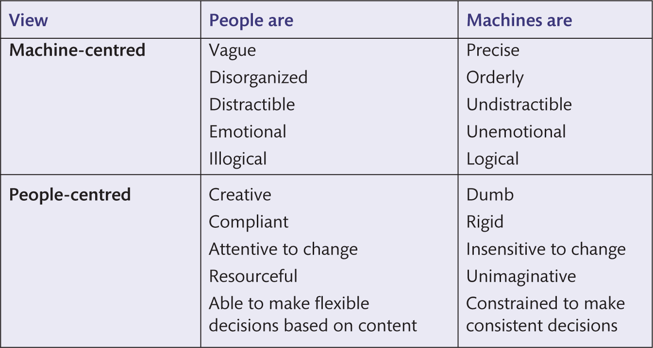
Box 1.1
Machine- and people-centered views

Slide 31
The interface
The interface needs to provide some mechanisms so that people can provide instructions and enter data into the system: ‘input’.
It also needs to provide some mechanisms for the system to tell people what is happening by providing feedback and mechanisms for displaying the content: ‘output’.
This content might be in the form of information, pictures, movies, animations and so on.
The interface may enable connectivity between devices and services provided by an environment such as the internet. Figure 1.7 shows a variety of interfaces.

Slide 32
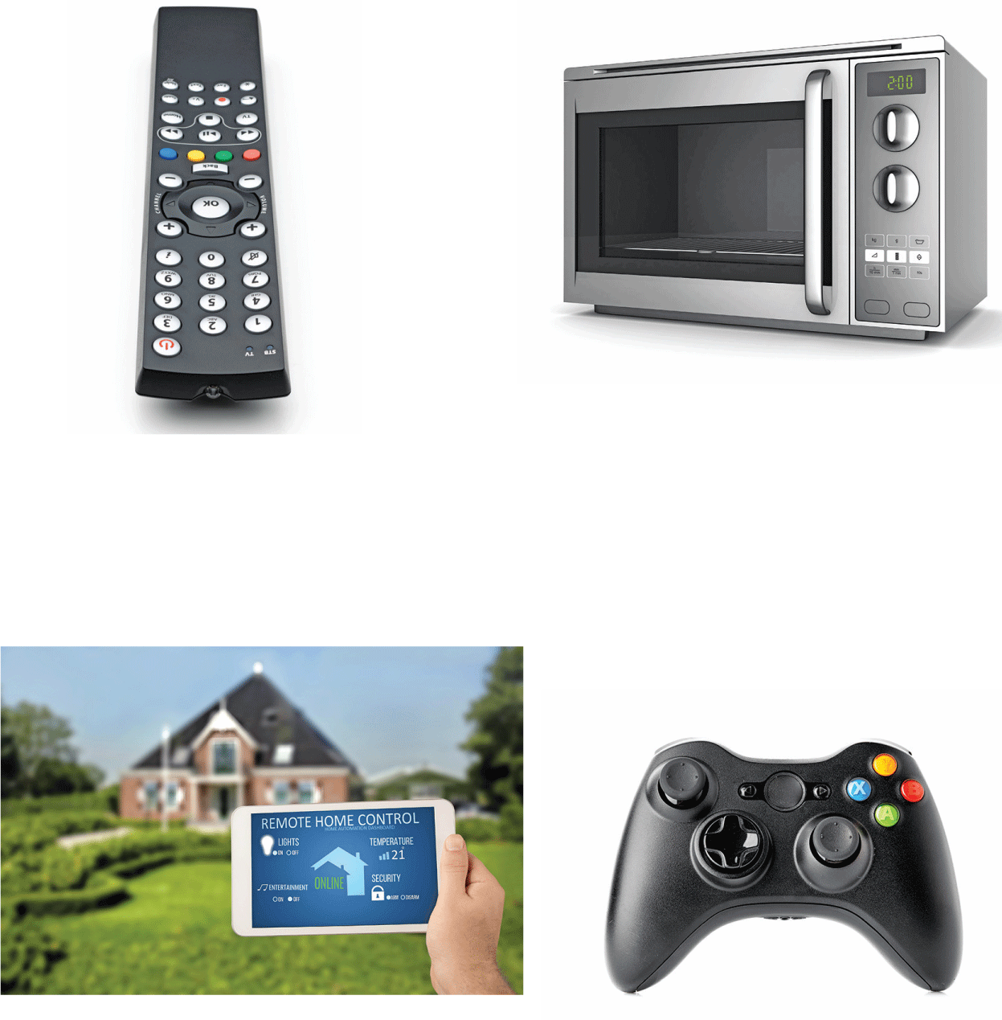
Figure 1.7
Various user interfaces

Slide 33
Challenge 1.2
Look at the pictures in Figure 1.7. What does the interface to (a) the remote control, (b) the microwave, (c) the home system and (d) the Xbox controller consist of?

Slide 34
UX
UX is not just a question of designing interfaces, however.
The whole human–device ecology needs to be considered, as does the human–human interaction that is often enabled through such systems.
Increasingly, interactive systems consist of many interconnected devices, some worn by people, some embedded in the fabric of buildings and some carried.
UX designers are concerned with connecting people through devices and channels; they need to consider the whole environment they are creating.

Slide 35
Being human-centred
UX is ultimately about creating interactive experiences for people. Being human-centred is about putting people first; it is about designing interactive systems to support people and for people to enjoy.
Being human-centred is about:
Thinking about what people want to do rather than what the technology can do.
Designing new ways to connect people with people.
Involving people in the design process.
Designing for diversity.

Slide 36
Box 1.2 The evolving nature of UX (1 of 1)
The first discipline contributing to being human-centred in design is human–computer interaction (HCI).
HCI arose during the early 1980s, evolving into a subject ‘concerned with the design, evaluation and implementation of interactive computing systems for human use and with the study of major phenomena surrounding them’ (ACM SIGCHI, 1992, http://old.sigchi.org/cdg/index.html).
HCI drew on cognitive psychology for its theoretical base and on software engineering for its design approach.
During the 1990s, the closely related area of Computer Supported Cooperative Work (CSCW) focused on technology support for cooperative activities and brought with it another theoretical base that included sociology and anthropological methods.
At the same time, designers in many different fields found that they had to deal with interactive products and components, and in 1989, the first computer-related design course was established at the Royal College of Art in London.

Slide 37
Box 1.2 The evolving nature of UX (1 of 2)
In America, the designers at Apple were putting their ideas together in a book called The Art of Human–Computer Interface Design (Laurel, 1990a), and a meeting at Stanford University in 1992 resulted in the book Bringing Design to Software (Winograd, 1996).
By the mid-2000s, interaction design was firmly established as a discipline in its own right with the first textbooks on interaction design coming out (including the first edition of this book) and leading designers contributing their own insights.
The term ‘user experience’ (UX) was adopted by Don Norman in 1993 when he joined Apple as head of the Advanced Technology Group (Gabriel-Petit, 2005).
Today, UX encompasses a wide range of activities across many areas of work and relaxation.

Slide 38
1.3 The development of UX
In 1995, Nicholas Negroponte, head of the Massachusetts Institute of Technology’s ‘Media Lab’, wrote a book called Being Digital in which he explored the significance of an era in which we change atoms for bits.
We live in a digital age, where all manner of devices represent things using binary digits (bits).
The significance of being digital is that bits are transformable, transmittable and storable using digital technologies.
Consider the following scenario.
In the morning you get woken up by a digital alarm clock which automatically turns on the radio. To change the radio channel, you might press a button that searches for a strong signal. You pick up your mobile, cellular phone and check for messages. You might go to your computer and download a personalized newspaper into a tablet device. As you leave the house, you set the security alarm. In the car, you adjust the heating, use the radio and attend to the various warning and information symbols that detect whether doors are open or seat belts are buckled. Arriving at the station, you scan your season ticket through the car parking machine, get a train ticket from the ticket machine and get money from an automated teller machine (ATM). On the train, you read the newspaper on your tablet, scrolling through text using your finger. Arriving at your office, you log on to the computer network, check e-mail, use various computer packages, browse the Web and perhaps listen to an Internet radio station broadcasting from another country. You have a video link with colleagues in other cities and perhaps work together on a shared document. During the day, you use a coffee machine, make calls on the cellphone, check names and numbers in the address book, download a new ringing tone, photograph a beautiful plant that you see at lunchtime and video the swans on the river. You upload these to your social networking website where they are automatically tagged with the location and time they were taken, and with the names of people whose faces the software recognized. Arriving home, you open the garage doors automatically by keying a number on your phone and in the evening you spend an hour or so on the games machine, watch TV and program the set top box to record a late-night show.

Slide 39
Here and now
This is the world we are living in and the world that UX designers are designing for.
The huge range of interactions that we engage in and the interfaces that we use offer an exciting if daunting challenge.
Moreover, increasingly, designers are having to deal with the issue of people engaged in multiple interactions with different devices in parallel.
They also need to deal with people accessing services and undertaking activities using a range of devices in different contexts.

Slide 40
How we got here (1 of 8)
The revolution that has brought us to where we are today started towards the end of the Second World War, in 1945, with the development of the first digital computers.
These were huge machines housed in specially built, air-conditioned rooms.
They were operated by scientists and specialist computer programmers and operators, who physically pressed switches and altered circuits so that the electronics could complete their calculations.
During the 1960s, computer technology was still dominated by scientific and accounting applications.
Data was stored on paper tape or cards with holes punched in them, on magnetic tapes and large magnetic disks, and there was little direct interaction with the computer.
Cards were sent to the computer centre, data was processed and the results were returned a few days later.
Under the guidance of ‘Lick’ Licklider, however, things were beginning to change.

Slide 41
How we got here (2 of 8)
The first screens and cathode ray tubes (CRTs) were being used as interactive devices and the first vision of a computer network – an internet – was formulated by Licklider.
He worked at the Advanced Research Projects Agency (ARPA) at the US Department of Defense.
Licklider was followed by the pioneering work of Ivan Sutherland at MIT, Doug Englebart who is credited with inventing the computer mouse, and Ted Nelson who developed the concept of hypertext, the idea of linking digital objects and being able to jump directly from one object to the next.
In the United Kingdom, pioneering work on computers was based at Manchester University, and in 1959, Brian Shackel had published the paper ‘Ergonomics for a computer’.

Slide 42
How we got here (3 of 8)
During the 1970s, computing technology spread into businesses and screens linked to a central computer began to emerge.
Computers were becoming networked together and indeed the first email was sent over the ARPANET in 1972.
The method of interaction for most people in the 1970s was still primarily ‘batch’; transactions were collected together and submitted as a batch of work and computing power was shared amongst different people.
Interest in HCI began to grow, with publications in the International Journal of Man–Machine Studies.
As the decade ended, keyboards and screens became more common, but it was not until 1982 that the first real graphically based interfaces appeared in the form of the Xerox Star, Apple Lisa and Apple Macintosh computers.
These used a bit-mapped display, allowing a graphical user interface (GUI) and interaction through pointing at icons and with commands grouped into menus.

Slide 43
How we got here (4 of 8)
This style became ubiquitous when, in 1985, the Windows operating system appeared on (what were then usually IBM) personal computers (PCs).
The personal computer and Windows-like operating system are attributed to another important pioneer, Alan Kay.
Kay obtained his PhD, studying under Ivan Sutherland, in 1969, before moving to Xerox Palo Alto Research Center (PARC).
It was here that the object-oriented computer programming language Smalltalk was developed.
Many argue that it was the development of the VisiCalc spreadsheet program on the Apple II computer (the ‘killer app’) in 1979 that really fired the personal computer market (Pew, 2003).

Slide 44
How we got here (5 of 8)
The 1980s was the decade of the microcomputer, with the BBC Micro home computer selling over 1 million units and a whole plethora of home computers being adopted worldwide.
Game consoles were also gaining in popularity in the home entertainment market.
In business, people were getting networked and the internet began to grow, based around email.
It was during the 1980s that human–computer interaction (HCI) came of age as a subject. In both the United States of America and Europe, the first big conferences on HCI were held: the CHI ’83 conference on Human Factors in Computing Systems in Boston, MA, and INTERACT ’84 in London.
Don Norman published his famous paper ‘The trouble with UNIX: the user interface is horrid’ (Norman, 1981) and Ben Shneiderman published Software Psychology (Shneiderman, 1980).

Slide 45
How we got here (6 of 8)
In the 1990s, colour and multimedia arrived on the PC, which had begun to dominate the computer market.
In 1993, a new interface was produced that took advantage of a simple mark-up or specification ‘language’ (called hypertext mark-up language, HTML).
Thus the ‘World Wide Web’ came about and revolutionized the whole process of transmitting and sharing files.
Pictures, movies, music, text and even live video links were suddenly available to everyone at work and at home.
The growth of personal, community and corporate websites was phenomenal and the vision of a wholly connected ‘global village’ community began to become a reality.
Of course, this growth was primarily in the West and in the United States of America in particular, where ‘broadband’ communications enabled a much more satisfying experience of the Web than the slow connections in Europe.
Many parts of the world were not connected, but in the twenty-first century, connections to the Web are global.

Slide 46
How we got here (7 of 8)
By the turn of the century, the convergence of communications and computing technologies was just about complete.
Anything could potentially be connected to anything, anywhere.
Since all the data was digital, it could all be transmitted over the airwaves or over wired networks and it could easily be transformed from one form into another.
The proliferation of mobile devices, coupled with the wide availability of the internet, brings us to the age of ‘ubiquitous computing’, a term first coined by the late Mark Weiser in 1993 when he talked of interaction through ‘pads, tabs and boards’.
His vision was realized, initially by Apple and subsequently by Google through the Android platform, when Apple unveiled the iPhone in 2007 and the iPad in 2010.

Slide 47
How we got here (8 of 8)
Computing devices are now pervasive amongst people and across the world, providing all manner of services and experiences.
Computing power continues to double every 18 months or so (according to Moore’s law), producing mobile devices that are more powerful now than the largest computers were even just a few years ago.
In the twenty-first century, computing is truly ubiquitous and interaction is increasingly through speech, touch and gesture rather than the keyboard that has been the main method of input since the PC revolution began.
We now have Weiser’s pads, tabs and boards in the form of phones and tablets in various sizes, large public screens and wearable computational devices such as the Apple Watch, Google Glass and various sports and health devices.
They all have access to the Web and run different apps.
A huge amount of data is stored, and there are billions of videos on YouTube and photos on Flickr.
Everything is synchronized and stored in the ‘cloud’ (in reality the cloud is a network of vast data centres full of computers), and broadband and wireless connectivity is becoming increasingly fast.
The interconnectivity provided by the Web and wireless communications makes this a fascinating time to be an UX designer.

Slide 48
Where are we heading? (1 of 2)
It is a brave person who makes any strong prediction about where new technologies are headed as there are so many confounding factors.
It is never just a technology that wins, but technology linked with a good business model linked with timing.
Don Norman delivers an interesting insight into both the past and future of technologies in his book The Invisible Computer (1999).
Discussing such things as why the VHS video format succeeded over Betamax and why Edison’s phonograph was not as successful as Emile Berliner’s, he points to the three ‘legs’ of successful products: technology, marketing and user experience (Figure 1.8).

Slide 49
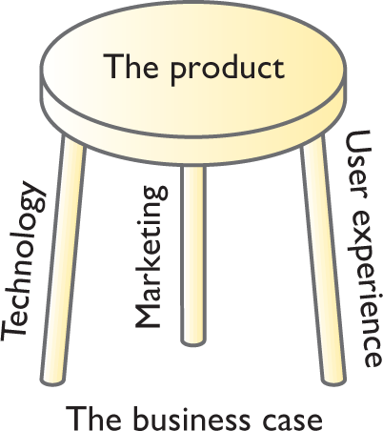
Figure 1.8
The three legs of product development

Slide 50
Further thoughts: Whom do you trust?
Wireless connectivity amongst devices is now common both through the ‘wi-fi’ standard called IEEE 802.11 and through Bluetooth.
For example, your mobile phone will connect to your laptop computer via Bluetooth and the laptop may be connected to an internal company network via a wireless network and hence to the internet through the company’s wired connection and hence to any other device in the world.
How will you know where any piece of data that you look at actually is?
If you look at the address book ‘in your phone’, you might in reality be accessing an address book on your laptop or on any computer on the company’s network or indeed anywhere on the World Wide Web.
If data is duplicated, how will it be kept consistent? Across which devices will the consistency be reliable?

Slide 51
Where are we heading? (2 of 2)
Although we do not know exactly what products will be introduced over the next few years, we do know that new products, business models, services and a range of other features will rapidly come into the world and the UX designer has to be ready to cope.
Increasingly, devices will be embedded in the fabric of buildings, roads and other aspects of the environment that will sense different types of data and connect together creating the Internet of Things (IoT).
This embedding of technologies has already had a profound effect on sports such as tennis and cricket where the rules of the game have changed to accommodate embedded technologies.
For example, the rules of international tennis have changed since the introduction of the Hawkeye system (Figure 1.9). Players can now appeal a number of decisions and umpires can review disputed points.
Quite fundamental changes occur to the way we do things and to how we think about things happen as a result of technological changes.
IoT will disrupt the nature of some activities and UX designers will contribute to that.

Slide 52
Microsoft’s vision of HCI
In Microsoft’s vision of HCI in 2020 (Microsoft, 2008), they argue that ‘HCI needs to move forward from concerns about the production and processing of information toward the design and evaluation of systems that enable human values to be achieved’.
This is something also emphasized by Cockton (2009) and his call for worth-centred design and Bødker in her consideration of ‘third wave’ HCI (Bødker, 2006).

Slide 53
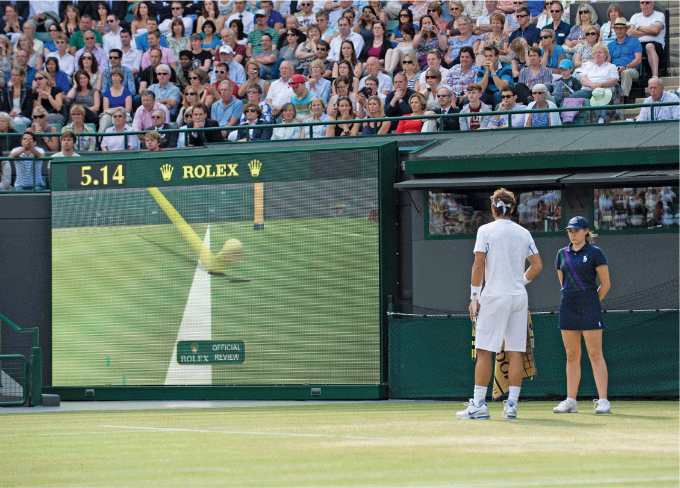
Figure 1.9
The Hawk-Eye system

Slide 54
Challenge 1.3
The design company IDEO undertakes a wide range of projects in UX design.
Some projects explore different ideas of changing concepts such as identity, others aim to produce new products and others look to see how people use technologies in their daily lives.
Visit the website of IDEO and look at their projects. Talk about the ideas with a friend.

Slide 55
1.4 The skills of the UX designer (1 of 2)
UX designers need a variety of skills and need to understand a variety of disciplines if they are to be able to do their jobs well. They need the mixture of skills that allows them to be able to:
Study and understand the activities, goals and aspirations of people and the contexts within which some technology might prove useful and hence generate requirements for technologies (sometimes called ‘user research’).
Know the possibilities offered by technologies.
Create technological solutions that fit in with people, the activities they want to undertake and the contexts in which those activities occur (sometimes called ‘ideation’).
Evaluate alternative designs and iterate (do more research and more design) until a solution is arrived at.

Slide 56
The skills of the UX designer (2 of 2)
The range of skills and academic disciplines that will contribute to such a person is significant.
Indeed, it is often the case that no single person possesses all the skills needed for some design activity, which is why UX design is often an affair for a design team.
A UX designer may be involved in a community information system project on one occasion — designing an app, a website and some promotional materials, perhaps — a kiosk for processing photographs on another, the information architecture to support a firm of estate agents on another, and a children’s educational game on another!
UX people cannot be expert in all these fields, of course, but they must be aware enough to be able to take techniques from different areas, or access research in different disciplines when appropriate.
We group the subjects that contribute to the design of interactive systems under the headings of knowledge of people, technologies, activities and contexts, and design, and illustrate the relationships in Figure 1.10.

Slide 57
People
People are social beings, so it is important that the approaches and techniques adopted in the social sciences are used to understand people and technologies.
Sociology is the study of the relationships between people in society, the social, political and other groups that they participate in and the settings in which such relationships take place.
Anthropology is similar but focuses also on the study of culture, biology and language and on how these have evolved and changed over time.
Both use techniques such as interviews and observation to arrive at their conclusions. A key approach, particularly in anthropology, is ‘ethnography’, which uses qualitative methods such as observations and unstructured interviews to produce a description of a particular culture or social group and its setting.
Also related is cultural studies, which looks at people and their relationship with cultural issues such as identity, but also much more prosaic cultural activities such as shopping, playing computer games or watching TV.
Descriptions tend to be from a more literary criticism background, informed by experience and reflection. Bardzell and Bardzell (2015) provide an introduction to ‘humanistic HCI’, bringing a new approach to understanding UX.
Psychology is the study of how people think, feel and act. In particular, cognitive psychology seeks to understand and describe how the brain functions, how language works and how we solve problems.
Ergonomics is the study of the fit between people and machines. In designing interactive systems, the designer will borrow much from each of these disciplines, including methods to help understand and design for people.

Slide 58
Technologies
The technologies that interactive systems designers need to know about include both software and hardware.
Software engineering has developed methods for specifying and implementing computer programs. Programming languages are used to issue instructions to any programmable device such as a phone, computer, robot dog or earrings, shirts and chairs.
Designers need to be aware of hardware for sensing different types of data (sensors) and for bringing about some change (actuators or effectors).
There are many different components available that produce many different effects and here designers will draw upon engineering knowledge, principles and methods.
Communication between devices uses various communication ‘protocols’. Designers need to know how different devices can communicate.

Slide 59
Activities and contexts
Interaction will usually take place in the context of some ‘community of practice’. This term is used to denote groups of people who have shared interests and values and engage in similar activities.
In business communities and organizations, information systems methods have developed over the years to ensure that information systems are developed that are effective and meet the needs of people who work there.
In particular, soft systems theory (Checkland and Scholes, 1999) provides a very useful framework for focusing on the design of interactive systems.
Social and organizational psychology are needed to look at the effects of technological change on organizations, and recently, knowledge management and social computing have become important areas.
Finally, new technologies offer new opportunities as business and interactive systems designers find that they are sometimes creating whole new ways of working with their designs.

Slide 60
Design
Principles and practices of design from all manner of design disciplines are used in UX.
Ideas and philosophy from architecture, garden design, interior design, fashion and jewelry design all crop up in various ways and different forms. It is not easy to simply pick up ideas from design disciplines, as much design knowledge is specific to a genre.
Designers need to know the materials they work with and it is likely that more specialist design disciplines will emerge.
One such discipline is product design, which is itself changing as it takes on board the nature of interactivity. Product design is an important contributing discipline to the skills of the UX designer.
Graphic design and information design are particularly important for issues of information layout and the understandability and aesthetic experience of products.
Human–computer interaction has itself evolved many techniques to ensure that designs are people-focused.

Slide 61
Challenge 1.4
Imagine that you are put in charge of a design team that is to work on a project investigating the possibility of a new set of Web services for a large supermarket.
These services will allow connection from any fixed or mobile device from any location, allowing food items to be ordered and delivered.
The client even wants to investigate the idea of a ‘smart refrigerator’ that could automatically order items when it ran out.
What range of skills might you need and which subject areas would you expect to draw upon?

Slide 62
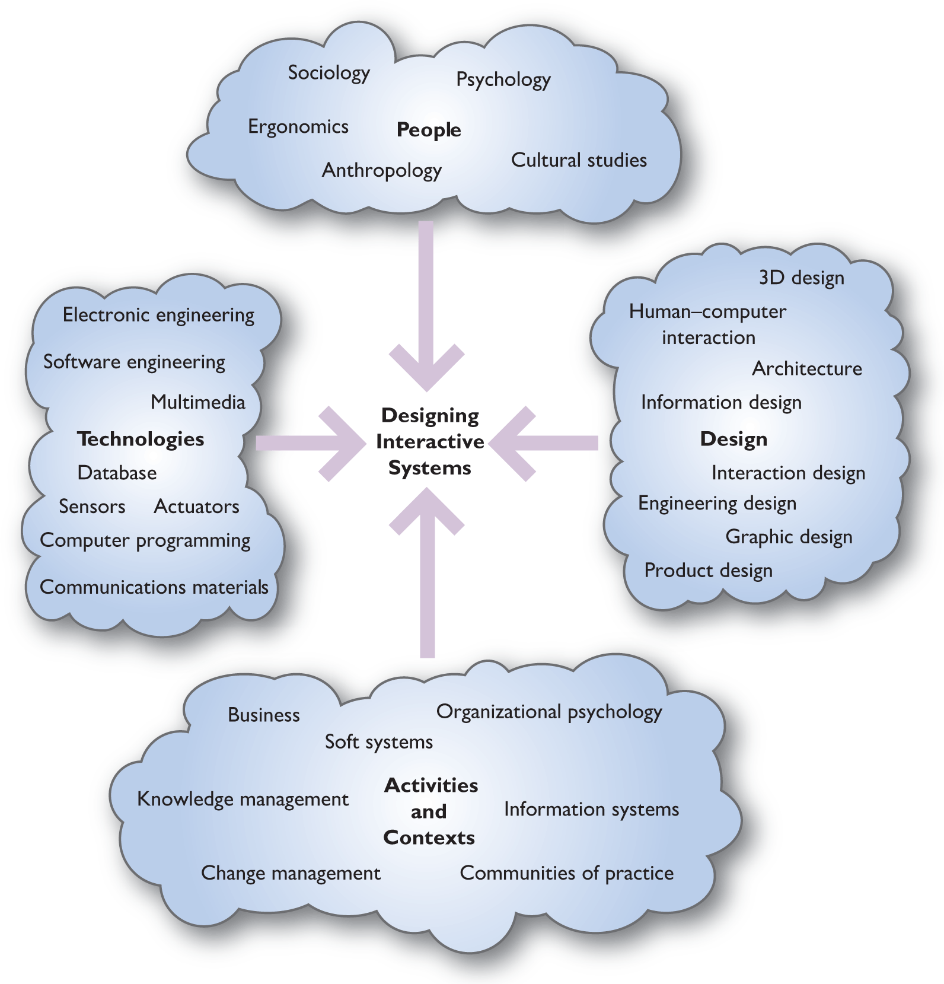
Figure 1.10
Disciplines contributing to interactive systems design

Slide 63
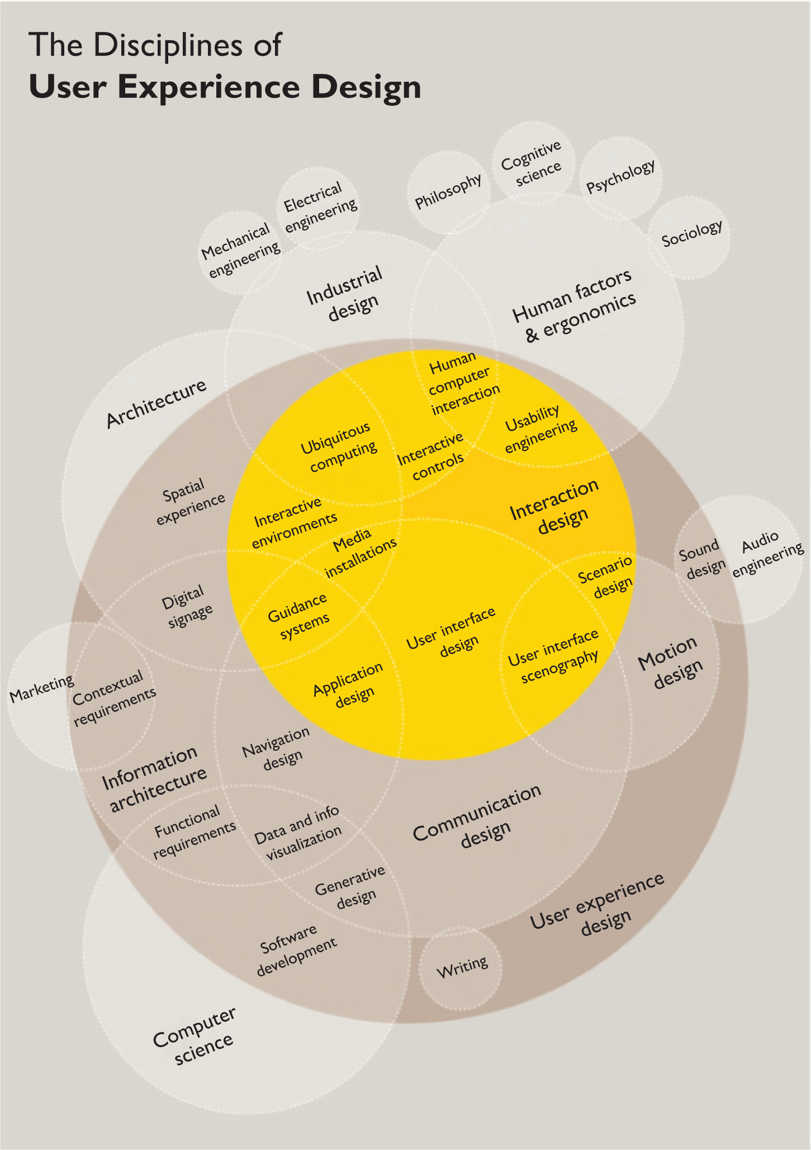
Figure 1.11 UX in design
This shows where UX fits into a range of design disciplines providing another perspective on what skills a UX person needs to know or needs to be able to get access to. Many UX agencies will specialize in one or two areas and will employ freelance specialists when they need particular expertise.

Slide 64
1.5 Why being human-centred is important
Being human-centred in design is expensive.
It involves observing people, talking to people and trying ideas out with people, and all this takes time.
Being human-centred is an additional cost to any project, so businesses rightly ask whether taking so much time to talk to people, produce prototype designs and so on is worthwhile.
The answer is a fundamental ‘yes’.
Taking a human-centred approach to the design of interactive systems is advantageous for a number of reasons.

Slide 65
Return on investment
Williams et al. (2007) provide details of a number of case studies looking at the costs of taking a human-centred approach to interactive systems design and at the benefits that arise.
Paying attention to the needs of people, to the usability of the product and to the overall UX results in reduced calls to customer helplines, fewer training materials, increased throughput, increased sales and so on.
Involving people closely in the design of their systems will help to ensure acceptability.
Systems will be more effective if they are designed from a human-centred perspective and people will be more productive.
Nowhere is the economic argument more pertinent than in Web design and e-commerce sites.
Jared Spool and his company User Interface Engineering have a number of reports demonstrating the importance of good UX to e-commerce and claim that sales can be increased by 225 per cent by turning ‘browsers’ into ‘buyers’.

Slide 66
Safety
In the early 1980s, there was an accident at a nuclear power plant at Three Mile Island in the United States of Ameica that almost resulted in a ‘meltdown’.
Reportedly one of the problems was that the control panel indicated that a valve was closed when it was in fact open and another indicator was obscured by a tag attached to another control: two fundamental design errors – one technical and one organizational – that human-centred design techniques would help avoid.
Other classic horror tales include a number of plane and train disasters that have been attributed to faulty displays or to operators not understanding or interpreting displays correctly.
Systems have to be designed for people and for contexts. It is no good claiming ‘human error’ if the design was so bad in the first place that an accident was waiting to happen.

Slide 67
Ethics (1 of 2)
Being human-centred also ensures that designers are truthful and open in their design practice.
Now that it is so easy to collect data surreptitiously and to use that data for purposes other than what it was intended for, designers need to be ever more vigilant.
As systems are increasingly able to connect autonomously with one another and share data, it is vital that people know where the data that they give is going and how it might be used.
People need to trust systems and be in a position to make choices about privacy and how they are represented.
The issue of intellectual property is another important aspect of ethical design; it is very easy to take an image from a website and use it without giving proper acknowledgement for its source.
There are many issues associated with plagiarism or other dishonest uses of written materials.
Privacy, security, control and honesty are all significant features of the UX designer’s life.

Slide 68
Ethics (2 of 2)
Equality and attention to access are two of the ‘political’ issues that designers must address.
As technology changes so do traditional views and approaches to big moral and ethical questions.
There are standards and legal requirements that need to be met by designs.
Fundamentally, ethical design is needed because the systems that are produced should be easy and enjoyable to use, as they affect the quality of people’s lives.
Designers have power over other people and must exercise that power in an ethical fashion.
The ACM (Association of Computing Machinery) code of ethics gives good advice on ethical design.

Slide 69
Sustainability
Interactive systems have a big impact on the world, and designers should approach interaction design from the perspective of what is sustainable.
Millions of mobile phones and other devices are thrown away each year and they contain metals that are potentially dangerous to the environment.
Large displays and projectors gobble up power.
Cultures get swamped by the views and values of the dominant suppliers of hardware and software, and local languages die out when all information is in English, Chinese or Hindi.
Human-centred design needs to recognize diversity and design to enhance human values.

Slide 70
Summary and key points
UX is a challenging and fascinating discipline because it draws upon and affects so many features of people’s lives.
There is a huge variety of interactive systems, services and products, from business applications of computers to websites to dedicated apps to whole information spaces that blend physical and digital spaces.
Designing UX is concerned with designing for people using technologies to undertake activities in contexts.
Designing UX needs to be human-centred.
UX has developed over the years from work in HCI and interaction design into the central focus of much design work.
UX draws upon many different different design disciplines.
UX designers need to know about people, technologies, the activities people want to undertake and the contexts in which those activities occur.
UX is necessary if we are to have safe, effective, ethical and sustainable design.

