Slide 1
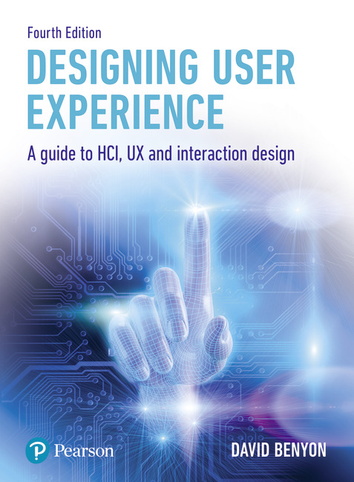
Designing User Experience
A guide to HCI, UX and Interaction Design
Fourth Edition
Chapter 4
Cross-channel UX

Slide 2
Contents
4.1 Introduction
4.2 The elements of UX
4.3 User journeys
4.4 Cross-channel UX
4.5 Information architecture

Slide 3
Background
UX is concerned with developing high-quality interactive systems, products and services that fit with people and their ways of living.
Increasingly, UX designers are concerned not just with the details of the user interface, or how a website works, but they are concerned with providing a service.
Services are provided for users by stringing together a number of interaction moments, so the design of these momentary ‘microinteractions’ is important.
But the whole service may include many different devices and many different communication channels, including the web, mobile apps, social media and interactions in the physical environment.
Quite quickly what appeared to be a simple app or web service can evolve into a complex web of cross-channel interactions.

Slide 4
Aims
In this chapter, we explore UX in the context of the modern-day world when we are interacting in all sorts of different circumstances and using many different channels of interaction. After studying this chapter, you should be able to:
Understand service design.
Understand the multilayered elements of UX.
Understand the user, or customer, journey.
Understand cross-channel UX.
Understand the importance of information architecture to UX.

Slide 5
Introduction
Gillian Crampton-Smith (2004) has argued that ‘The job of the designer is now not just to design the device, the software and the way you interact with it, but to design the whole experience of the service so it is coherent and satisfying’ (p. 3).
Over the last few years, UX has moved from designing a website or an app to do a single thing to designing a service.
In the context of UX, a service is a sequence of interactions that constitute a whole, more abstract achievement.
For example, a smartphone might provide a service that lets users find out how many steps they have walked.
This service allows the users to find this information in a particular time period, over a day or over a week.
The service provides graphs and other forms of visualization to display the data.
The service can be provided because the smartphone has a pedometer which itself consists of a motion sensor and some software to interpret the movement.

Slide 6
Services
The key thing about services is that there are multiple ‘touch points’ where people encounter a service and that interactions with services happen over time.
To be well designed, these touch points need to demonstrate some consistency whether through look and feel, brand or consistent values.
However, sometimes this is out of the designer’s control.
For example, if a user is buying car insurance, they may use a comparison website that is outside the control of any car insurance company.
Most products, websites and apps provide a number of services that together constitute some larger system.

Slide 7
Services example
A great example of service design comes from Apple.
Their web image is carefully constructed and is tied into its physical stores with slick styling and beautiful products on display.
Unlike many other companies that have to deliver a web presence and an in-store experience, Apple use the same information architecture to structure the web and store.
All are currently organized in terms of mac, ipad, iphone, watch, TV and music.
Getting the information architecture right is essential for providing a good UX.
Besides the on-line and in-store experience, the App store and iTunes services manage the process of buying apps.
Renting storage space on iCloud using an AppleID maintains a user’s relationship with the company.
iCloud ensures that all the apple devices that a person owns and the content that they have (photos, music, videos, contact information and so on) are synchronized.

Slide 8
Channels and services
Interactions with services may happen intermittently and take place from different locations and devices.
Thus, designers need to consider these different media channels of interaction.
Exactly what constitutes a media channel will depend on how the users think about their needs and desires in a domain and how the UX designer interprets this.
For example, people could consider the phone to be a channel.
However, smartphones have many apps on them each of which can be considered as a media channel.
Twitter, Instagram and Facebook are examples of channels.
Comparison websites such as Comparethemarket.com are channels. eBay is a channel, texting is a channel and WhatsApp is a different texting channel from iMessage, Snapchat or Messenger.

Slide 9
Time and services
The time dimension is also important for service design.
For example, you may stay with the same organization that provides your banking service for years and years.
You will stay with the same dentist or doctor for years.
Other services such as the purchase of a new washing machine will require extensive research, selection of a suitable supplier, weighing up the different packages on offer, the purchase itself, the delivery and installation and the use of the machine over many years.
Although services may be distinguished from products in that services are intangible, people still have to interact with the service and this takes place through a physical interface at a touchpoint (or service moment).
Designers need to consider the whole UX across devices, across media, throughout the whole user journey (see Section 4.3) and over time.

Slide 10
Challenge 4.1
Write down the touchpoints for the activity of going for a holiday in a rented house in the wilderness. What media channels do the touchpoints use?

Slide 11
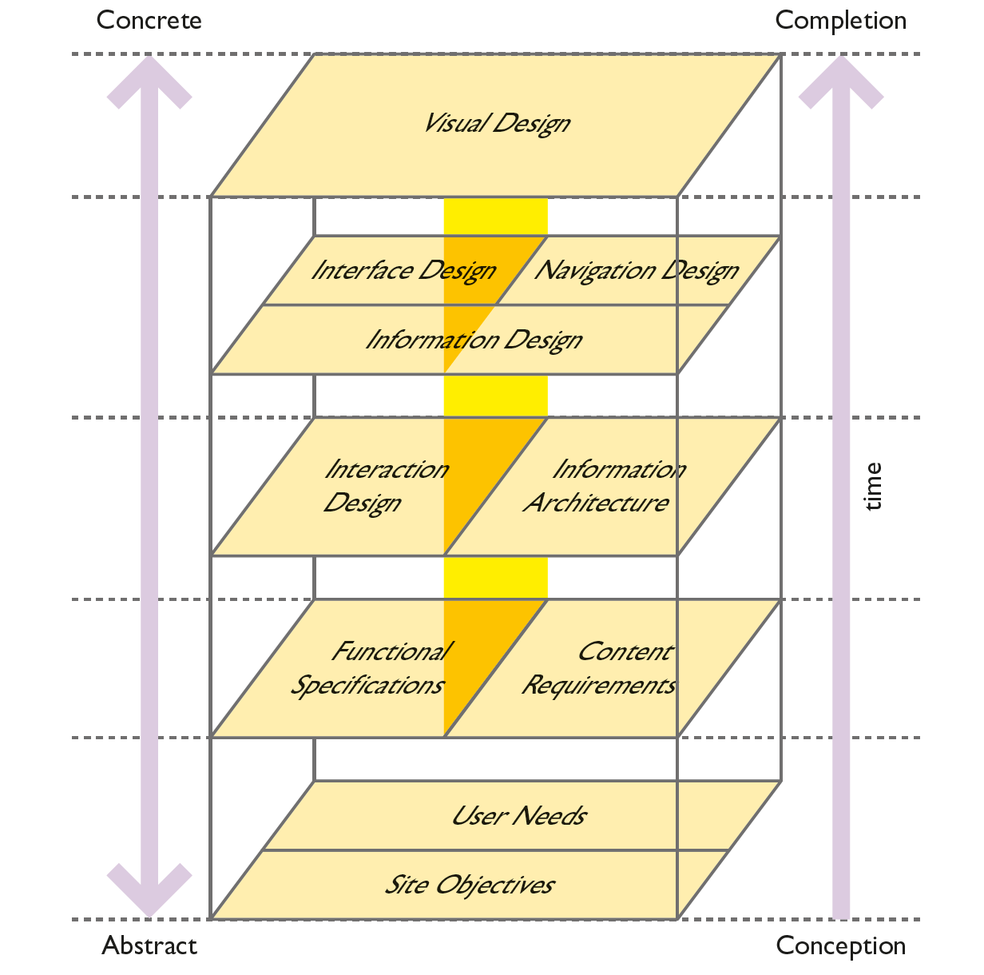
The elements of UX overview
In 2003, Jesse James Garrett (Garrett, 2003) conceptualized the development of websites in terms of five elements: strategy, scope, structure, skeleton and surface.
This led to a famous figure that was widely adopted as a guide to good web design.
In 2011, he produced the second edition of his book arguing that these elements were useful more generally in interaction design and could be applied to the design of products, apps and services whether being delivered on the web or not.
Notes:
Figure 4.2 The elements of UX

Slide 12
The elements of UX (1of 3)
The elements describe UX going from the abstract ideas of objectives and user needs to the concrete instantiation in visual designs in much the same way as we discussed conceptual (abstract) scenarios and concrete scenarios in Chapter 3.
The bottom layer is the most abstract (furthest from implementation). This is the ‘strategy’ plane concerned with understanding the overall objective of the interactive system or service, the nature of the people who will be using it and what their needs and desires are. Strategy is also concerned with business goals, the organization’s brand and a market analysis.
The next layer is the ‘scope’ plane where the emphasis is on functionality (what the system will enable people to do) and on content (the information) that the system will hold.
Garret argues that spending time on the scope plane is important so that UX designers know what they are designing and what they are not designing!
The result of scoping the UX is a clear plan for the development process (which may involve much iteration and the development of different releases of a service over a period of time).
Notes:
Figure 4.2 The elements of UX

Slide 13
Service ecologies
A service ecology describes all the stakeholders (actors) and the services that they access and contribute to.
In much the same way as we discussed device ecologies in Chapter 1, so we can use the concept of an ecology to look at services.
For example, the service ecology of a city is a very complex mix of physical services such as rubbish collection, road maintenance and the provision of parks and open spaces to the council services for collecting local taxes, licensing shops and running local government to information services about where to find things and how to travel around the city.
The ecology will look very different for a local resident and a tourist visiting the city for a few days.
The design company Live Wire develops service maps to try to capture different features of services such as the map of in-car services.
These maps bear some similarity to the rich picture that we introduced in Chapter 3.

Slide 14
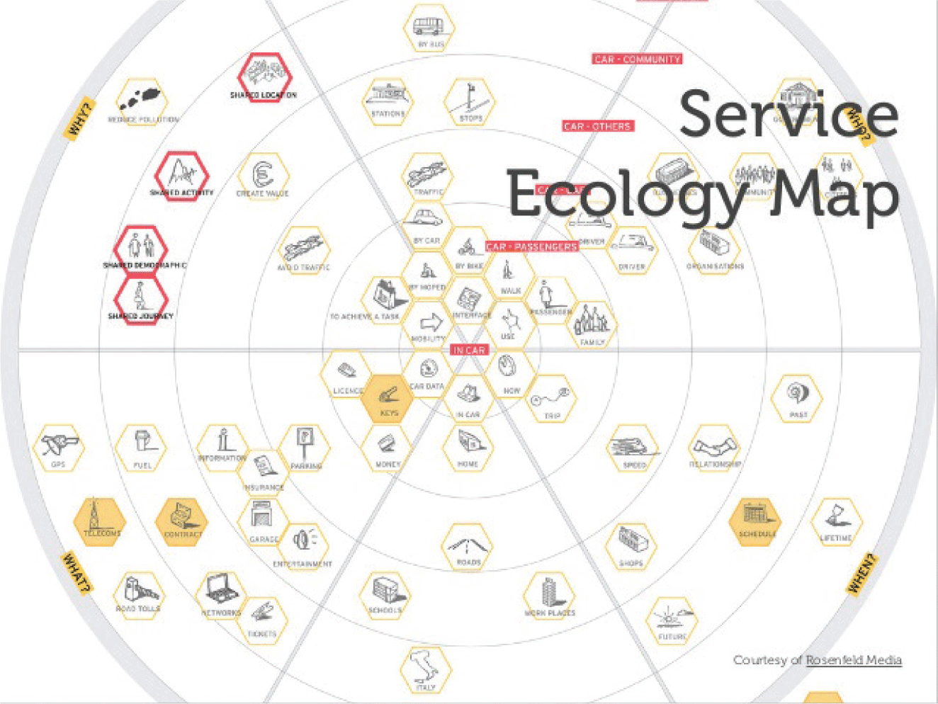
Service ecology map
Notes:
Figure 4.3 Map of in-car services

Slide 15
The elements of UX (2 of 3)
The third layer of the elements of user experience is called the ‘structure’ plane.
It covers information architecture (Section 4.5) but also includes specifying the interaction design, the data flows and allocation of function between user and system.
The ‘skeleton’ plane is concerned with information design, navigation design and interface design.
Information design is concerned with how to lay out information content and present data in a useful and meaningful way.
Navigation design is concerned with the design of menus, links, task bars and all the other ways that users can get from one part of the system or service to another.

Slide 16
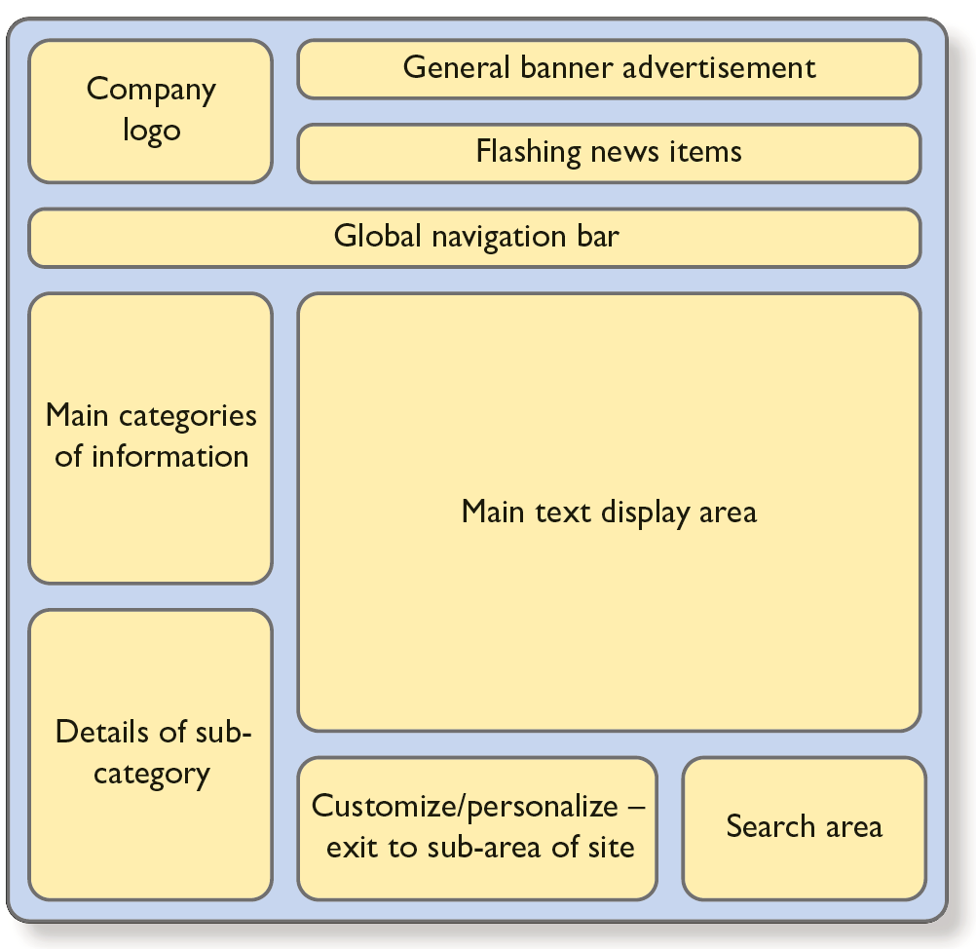
Wireframes
A key technique for bringing all these elements together is the ‘wireframe’. Wireframes aim to capture a skeleton of a general page layout whether for an app or a web service.
They are on the border between information architecture and information design as the various components of a page are assembled into the standard structures described by wireframes.
Interface design concerns how all the elements of information layout, navigation and interaction design are brought together into a coherent whole.
Notes:
Figure 4.4 Wireframe

Slide 17
The elements of UX (3 of 3)
The final element of Garrett’s scheme is the ‘surface’ plane, which he calls visual design but in fact may consist of many modalities including sound and touch.
We called this representational design in Chapter 3.
This element of design is concerned with the aesthetics of the design and with ensuring that good design guidelines are followed.
Consistency and appropriateness of the presentation are critical here.
An effective way of achieving this consistency is through the use of a design language.
Design languages may be different for different channels but attention to common principles will help ensure a consistent look and feel across different channels of interaction.
A design language specifies not just the elements of a particular design (such as font style, size and colour) but also the rules for combining different elements of a design and what happens when interactions occur.

Slide 18
Microinteractions
In contrast to this multi-layered view of UX, Dan Saffer focuses on microinteractions.
These are small focused features of the interaction design such as turning your phone to silent, signing in to a web service, checking for email or joining a wi-fi network.
He promotes designing for delight. The ‘micro’ in microinteractions is not just about small actions. It is also about getting the details right, designing a great UX through paying attention to the details of design.
He provides a large number of examples showing how the operational design of the interaction is linked to the representational and interaction design through looking at what triggers the interaction, how interaction is controlled through rules, loops and modes and how to provide feedback so that people can follow what is going on.
Microinteractions are touchpoints of UX and can be highly significant in the overall acceptance and use of a service.
Saffer talks about how some microinteractions become signature moments. Simple but delightful moments of interaction can define the UX.
However, notice that other touchpoints can be ‘walk away’ moments and a poor design can lead to people leaving the service.

Slide 19
User journeys
The design of moments of interaction is one aspect of providing a good UX but it is also important to consider how the moments link together into meaningful strings of interactions (services) that will allow users to achieve their goals.
This ‘bigger picture’ of interaction design is concerned with the whole user journey, or customer journey.
The idea of a user journey is to map out all the various ways in which users will access a service, taking time to design these service ‘touchpoints’ in order to provide a coherent and consistent UX.
For example, someone wishing to rent a car will somehow become aware that there is a car hire service available (perhaps through TV advertising or googling ‘car hire’), go on-line using their laptop computer to browse the options available, make a reservation through their phone, pick up the car from the depot and use a tablet device to provide feedback once the car hire is completed.

Slide 20
Touchpoints
The design of the touchpoints – both the digital ones and the physical ones (such as the visit to the depot) – and how they come together into a consistent and engaging UX is a real challenge for UX designers.
The design of touchpoints can be critical for UX.
For example, one large on-line retailer found that many customers were dropping out of the on-line shopping journey when they reached the delivery request process. When they investigated, they found that the ‘proceed with order’ button would not work if the value of the order was less than £10. An error message was displayed but it was in a small type face near the bottom of the screen.
To the users it appeared as if nothing was happening so they would give up (it was a ‘walk away’ microinteraction).
By introducing a wobble to the ‘proceed with order’ button when it was clicked and the value of the order was less than £10, users understood that something was wrong and many more orders were converted into sales.

Slide 21
Services
Advice for how to design these services comes from a variety of perspectives including operations management, innovation management, service ‘science’, marketing, business studies and interaction design. Blomberg and Darrah (2015) provide an in-depth analysis.
These different perspectives on service design produce interesting tensions in the subject.
For sales people, the emphasis tends to be on how to convert browsing into buying behaviour and for them a successful service design produces sales.
From an interaction design perspective, the focus of design is on providing a good experience as measured in terms such as enjoyment, engagement and satisfaction.
Dubberley and Evenson distinguish the sales cycle from the experience cycle. Whereas the sales cycle is intended to push people towards a purchase, the experience cycle considers products in the wider context and aims to deliver experiences that are ‘compelling’ and ‘reverberating’.

Slide 22
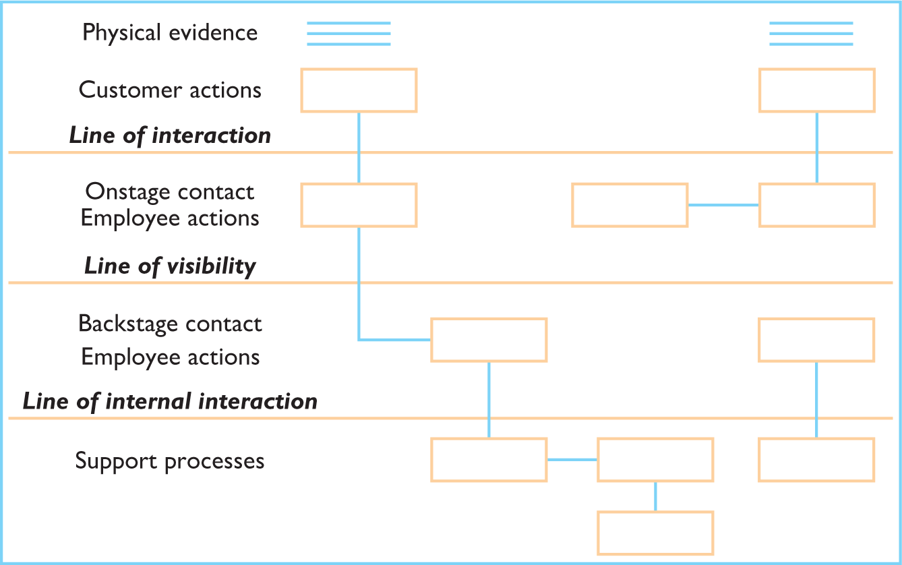
Service blueprint
The advice for designers developing a customer journey is to draw up a list of the touchpoints and then lay them out as a service blueprint.
This shows the user interactions, touchpoints for the service and how they are supported by ‘backstage’ activities.
Think about the performance of a rock band on tour.
The audience see a great performance but there is a lot of work going on backstage to provide that experience.
Notes:
Figure 4.6 A service blueprint shows user actions and what has to happen ‘backstage’ in order to provide them

Slide 23
Frontstage and backstage
The distinction between ‘frontstage’ and ‘backstage’ aspects of the touchpoint is important.
The support processes are vital if the cross-channel experience is to be delivered effectively.
The system must somehow keep track of the interactions and the interaction history of a user.
From the user’s point of view, the technologies supporting the service are often irrelevant. They just want to get on with their activities.
But from the perspective of the delivery of the service, maintaining relevant data about the interactions is critical.
Hence the so-called ‘cloud-based’ services have the advantage that data is stored in the cloud so that it can be accessed by any device connected to the cloud itself.

Slide 24
Digital and physical space
The interactions in the digital space spill over into physical space.
For example, it is common to get a paper receipt following the completion of a service, particularly one that involves the exchange of money.
Restaurant bills, till receipts, cinema tickets and airplane boarding passes are all channels of interaction.
They need to be designed to provide a consistent and engaging UX.
Stepping back further into physical space, the design of the restaurant itself contributes to the UX of a restaurant, in-store layout is important in retail experiences, labelling on clothes is a service touchpoint, lighting design in cinema foyers contributes to the cinema UX and airport security contributes to the UX of a flight.

Slide 25
UX and services
These touchpoints or service moments need to be designed to encourage and engage users.
UX designers should consider how the user encounters a touchpoint and the channel they are using.
They need to consider the elements of the UX and the multilayered nature of the whole UX.
They need to consider how to hold on to the users and keep them engaged so they do not ‘walk away’ during the execution of the touchpoint.
UX designers need to think about how to finish the service, what users will take away from the service and how to complete the transaction.

Slide 26
UX, services and abstraction
As with other artifacts of design, touchpoints, services and user journeys can all be described at different levels of abstraction.
One of the skills UX designers learn is how to find an appropriate level of description that suits the users and their needs but also suits the people developing the ‘backstage’ of the interaction design.
Being human-centred in the design approach will help the designer to master this.

Slide 27
UX, before, during and after (1 of 3)
Service moments come together into user journeys, and just like a touchpoint, a user journey will often consist of ‘before’, ‘during’ and ‘after’ experiences.
Before you go on holiday, you check out different options for where to go. Before you buy a TV, you look at adverts and read review magazines. After your holiday, you look at photos and remember your trip.
Before the user gets to engage with the actual system or service, they need to know it exists. Hence, the design of the before stage should consider the anticipation of the user, advertising and how the service appears on search engines or comparison websites.
This in turn will require designers to consider how it is described through the metadata that is used.
The before section also includes the design of social media and how information is shared about the services that exist.

Slide 28
UX, before, during and after (2 of 3)
During the experience, the focus of the UX design is on enabling the user to complete whatever it is they want to do as smoothly and enjoyably as possible.
Even if the service is a physical activity such as having a meal in a restaurant, there will still often be technological infrastructure running behind the scenes that enables the experience to happen.
Other services might be entirely on-line such as watching a video or engaging with social media.
In these circumstances, users may not just consume content but they may also generate content through their own posts or photo uploads.

Slide 29
UX, before, during and after (3 of 3)
After the user has achieved their primary goal, they will reflect back over the experience.
They may want to take away a memento of the experience, particularly if it was a touristic experience or a special event such as visiting a theme park.
They may want to provide feedback to the experience provider and share the experience with others.
By sharing with others, whether through word of mouth or through social media, they become part of the ‘before’ experience for others.

Slide 30
Back to user journeys
There are any number of different ways of representing user journeys and there is no standard, so designers need to choose one that is appropriate for what they are looking at and that captures the things about the journey that they want to stand out.
For example, Fig. 4.8 includes a representation of the UX on a particular journey and Fig. 4.9 shows some other aspects such as emotion.
Our preferred style is used in Fig. 4.10 showing the device and channel down the left hand side and the touchpoints across the top.
Thus the representation is essentially a blueprint for the entire domain with key customer journeys picked out in green.

Slide 31
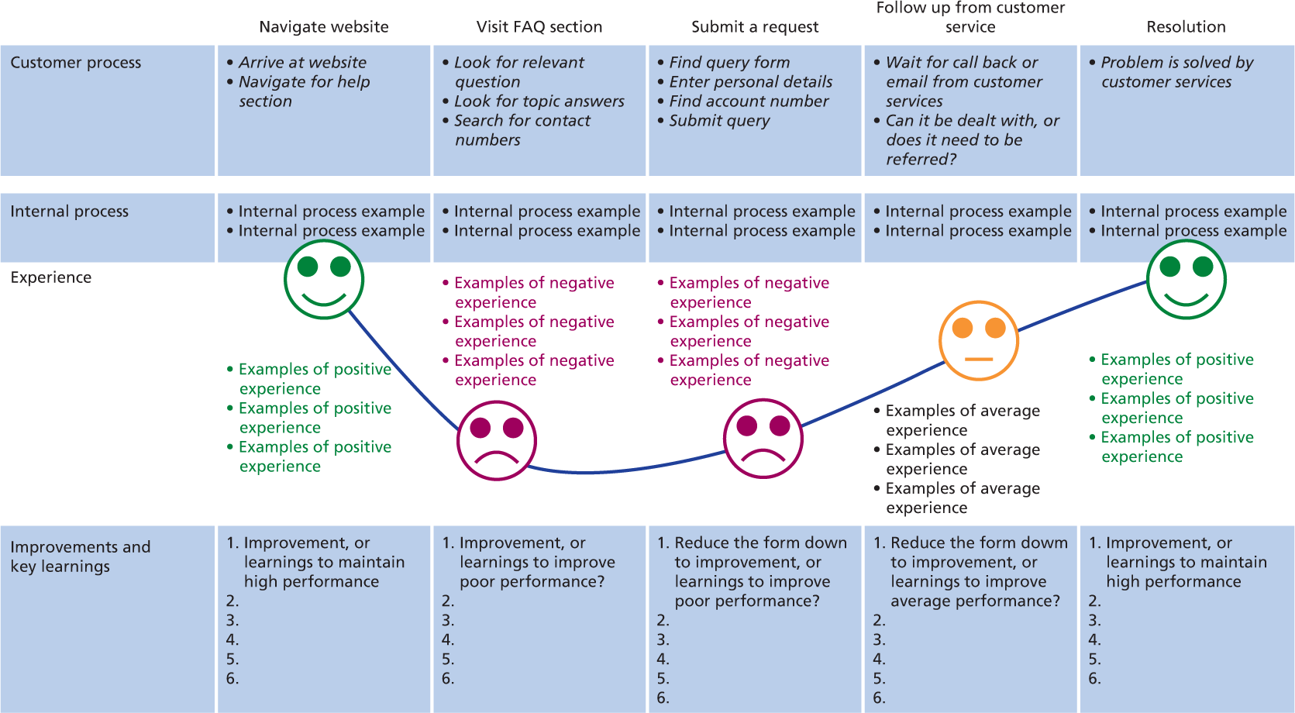
Figure 4.8
User journey mapping

Slide 32
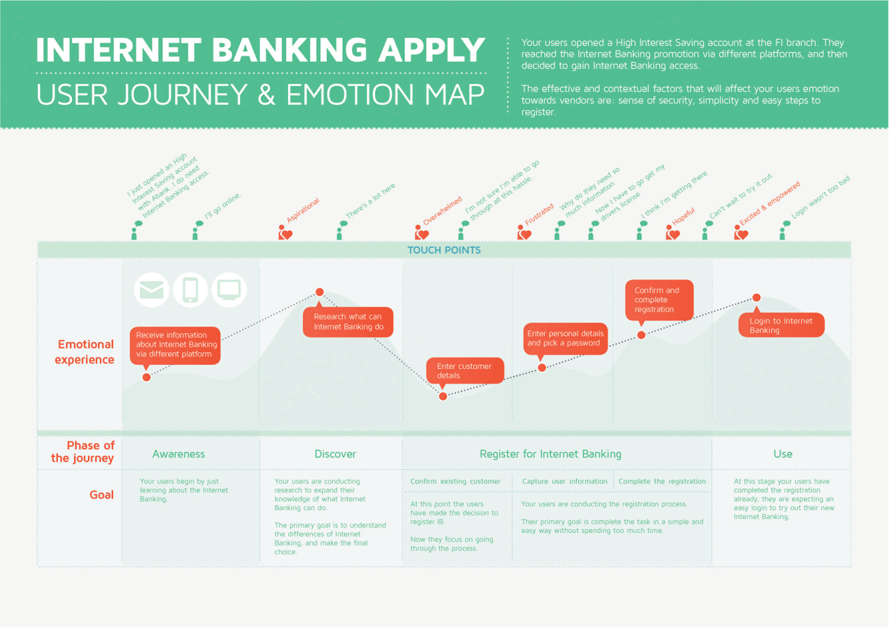
Figure 4.9
User journey mapping

Slide 33
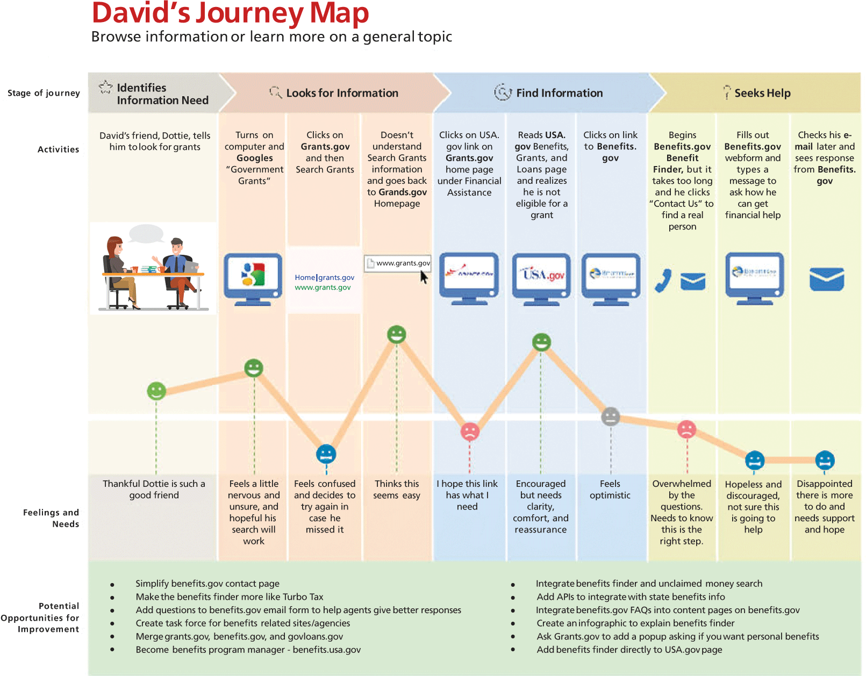
Notes:
Figure 4.10 User journey mapping

Slide 34
Further thoughts: Business Models (1 of 2)
Although in this book we do not talk much about business models (as our focus on services is the UX), getting the business model right is essential for new services and products to be successful.
For example, should a service provided charge a monthly fee, or should they lock their customers into longer term contracts?
Netflix and other broadcasters charge a monthly fee whereas Sky TV requires people to sign up for two years.
Many phone providers also like to sign customers up to long term plans. If customers agree, they get bonus features such as free data usage and free text messages not available to those who use a ‘pay as you go’ business model.

Slide 35
Further thoughts: Business Models (2 of 2)
Some smartphone apps have to be purchased up front.
Others are free but then charge for additional features.
Others might be free for six months and then charge customers to continue using the service.
Some apps charge for extras when the user needs them (called in-app purchases).
Besides the model adopted, service providers have to decide on what a suitable charge is.
Getting the balance right amongst the functions of the service, the amount charged for the service and the additional revenues from extra functions or longer term usage is critical to the success of the service.

Slide 36
Cross-channel UX (1 of 2)
One of the problems with mapping out user journeys is that in reality, few users will follow the ideal journey carefully crafted by designers.
In the multi-device, many-channel world that we now have designers face a new challenge of designing to support users who come and go to a service, switch their plans, come back to it later, pick up some other device (expecting to be at the same touchpoint that they were in the service) and look to continue where they left off.
Moreover, users will frequently not be doing this alone but will want to share their experiences with others at various points in the journey and get input from others into their journey through collaborative activities.

Slide 37
Cross-channel UX (2 of 2)
It is against this background that a number of interaction design and user experience professionals and academics are calling for a radical change in approach.
Resmini and Rosati argue that we are now moving from multichannel services to cross channel when ‘a single service is spread across multiple channels in such a way that it can be experienced as a whole (if ever) only by polling a number of different environments and media’ (p. 10).
Interaction design is now much more like architecture and city planning in that new developments need to fit in with the existing infrastructures and make use of existing services and the different devices different users have.

Slide 38
Cross-channel services
Of course, there are many examples of successful cross-channel services:
Take a photo and post on Facebook to get comments.
Send a map of your location to a group of friends.
Transfer the music you are listening to on your iPhone to the speakers in your living room.
Watch a film on a tablet on the bus and pick it up later on your TV.
Work on a shared spreadsheet or document.
The problem arises when the service crosses several of these specific activities.

Slide 39
UX as berry picking
This is when UX becomes like picking blackberries from a bush.
When you see a juicy blackberry ready for eating and you lean forward to pick it, you change your view of the bush and suddenly other berries come into sight.
Now you lean over to pick one of these and more berries can be seen.
You started the process with a plan to pick a berry, but soon you are reacting to what you see and are engaged in a wholly different activity.
UX design can be like this with designers trying to accommodate users as they switch their goals and interests as they see some new opportunity for interaction.

Slide 40
Cross-channel ecosystems
For this reason, Resmini talks about cross-channel ecosystems which he defines as ‘an ecosystem resulting from actor-driven choice, use and coupling of channels, either belonging to the same or to different systems or services, within the context of the strategic goals and desired future states actors intend to explicitly or implicitly achieve’ (p. 52).
Actors (users, customers, clients, etc.) are not bound by specific channels to undertake some activity.
They are immersed in ecosystems of devices and services and it is within these ecosystems that they formulate their goals, develop their needs and have experiences.

Slide 41
Channels and (information) content
Resmini and Rosati (2011) describe how a channel identifies a pervasive layer for the transmission of information in the context of a service or product ecosystem.
For example, signage on the streets of a city constitutes a channel and the individual signs placed at different locations throughout the city define touchpoints.
Resmini and Rosati (2011) discuss how users become more like intermediaries contributing content and as well as consuming it.
Experiences are hybrid, crossing digital and physical, and information architectures need to accommodate existing systems and services in an ever changing environment.
This is the cross-channel UX.

Slide 42
Cross-channel design
Resmini and Rosati (2011) provide five heuristics to guide designers of cross-channel ecosystems:
Help users develop a sense of place and legibility.
Be consistent across media channels.
Be resilient and design to accommodate different users.
Get away from complexity and clutter.
Help users see connections between services.

Slide 43
Navigation design
The idea of a user journey leads naturally to consider how the user gets from one touchpoint to the next, navigation.
Navigation involves three types of activity.
Wayfinding is concerned with navigating towards a known destination.
Exploration is concerned with finding out about an environment and how it relates to other environments.
Object identification concerns understanding and classifying the objects in an environment, with finding categories, clusters and configurations of objects and what content they contain.
There are plenty of principles coming from the design if navigation in physical spaces are relevant to the design of user journeys (see Chapter 26).

Slide 44
Trajectories
A similar notion is the idea of interaction trajectories developed by Steve Benford and his colleagues over a number of years (Benford, et al., 2009) derived from their experiences with a several mixed reality, cultural experiences.
They identify the importance of design for interactions that take place over time and through physical as well as digital spaces.
They discuss how these ‘hybrid experiences’ take people through mixed spaces, times, roles and interfaces.
Trajectories ‘take their participants on journeys’ (p. 712).
They argue that the trajectories need to be coherent, carefully orchestrated and part of a connected whole.
However, they also note that the canonical trajectories devised by designers are not always followed by users who will take their own paths through the space.

Slide 45
UX and user journeys
In terms of the UX of user journeys in cross-channel ecosystems, designers should pay attention to providing content that helps with navigation.
Maps show an overview of an environment, signposts show direction and distance, information signs and ‘you are here’ signs help orientate users and paths, and routes and landmarks are all needed to support wayfinding.
Different types of support are need as users transition between adopting different roles, for example, of consumer, producer, explorer, browser or buyer.
Different designs will enable transitions across digital and physical spaces, at different times, and through the layers of the ecologies.
UX unfolds as users move through and across channels consuming and creating content.
The transitions between touchpoints of interaction are an important part of the overall UX.
People need to be attracted to the transition point, engaged in the interaction that follows and allowed to gracefully exit to move onto the next moment in the service.
People will move in and out of the physical spaces and digital spaces, across channels and across devices.

Slide 46
UX and cross-channel user journeys
Designers ideally need to present a common design identity across different channels of interaction.
They often need to enable users to interrupt an experience on one channel and seamlessly pick it up on another.
The cross channel nature of interaction design and UX will continue to be a significant feature of UX design over the next few years.
Already, designers have to design for wearable devices that link with a smartphone and a website, for example.
The heating system in my house has a wireless connection between the boiler and the thermostat (using the Zigbee communication protocols) and another to the home hub (using wi-fi).
The thermostat can be controlled using the device’s interface directly, using a web interface or using an app on my smartphone.
This little device ecology will continue to grow as I add more devices for controlling lighting, cameras and sensors onto my home automation service.

Slide 47
Information architects
Information architecture is concerned with the design of information spaces.
Just as real world architects have to understand client needs and design appropriate structures to enable those needs to be realized, so information architects have to design the structures that will enable information needs to be met.
These structures are realized in the digital space as apps and websites and in the physical space as objects such as maps, signs or physical structures.
These structures also include people who both consume information content and generate content that becomes part of the information space.
At various points in the overall design process, the UX designer has to be an information architect.

Slide 48
Information content
Information architecture concerns understanding and designing the information, that is, the content, that is going to be useful for people undertaking some activity or that will otherwise contribute to the user experience.
For example, if I want to visit a historical site, what information is going to provide me with a good experience? Should the information architect provide information on the dates of events that happened there, or information about famous people who visited there or information about the geography and geology?
Should the information architect provide video of past events, links to websites for further information or an audio guide to provide a tour around the site?
Should they provide information boards at key locations, maps of the site and guide books, or should they provide all this sort of information on a smartphone app?
Should the information architect allow visitors to take photos or leave audio messages and tag them with a geo-location so that other visitors can see them? (This is often called user generated content, UGC.)

Slide 49
Information architecture: Ontology
The information architect is going to provide the structure within which the user experience will unfold.
This structure will be described in a conceptual model, a representation of the concepts that are used to describe the domain of interest.
This process is often called developing an ontology, ‘a designed conceptualization of some activity’ .
An information architect goes through the understanding process and analyses some domain (a sphere of activity) and, after much discussion, iteration and evaluation, decides on the objects of interest (the ontology) and the relationships between those objects (the taxonomy).
There is a wealth of work on conceptual modelling with a good introductory book from Johnson and Henderson (2011).
But finding an appropriate ontology is critical and will affect all the other characteristics of the information space and subsequent UX.

Slide 50
The impact of ontology
Information architecture is concerned with the structure and organization of objects in an interactive system.
The first thing designers must do, then, is to decide how to conceptualize the domain; they need to define an ontology.
The ontology – the chosen conceptualization of a domain – is critical and will affect all the other characteristics of the information space.
Deciding on an ontology for some domain of activity is deciding on the conceptual entities, or objects, and relationships that will be used to represent the activity.
Choosing an appropriate level of abstraction for this is vital as it influences the number of entity types, the number of instances of each type and the complexity of each object.

Slide 51
Coarse- or fine-grained ontology
A coarse-grained ontology will have only a few types of object, each of which will be ‘weakly typed’ – i.e. will have a fairly vague description – and hence the objects will be quite complex and there will be a lot of instances of these types.
Choosing a fine-grained ontology results in a structure which has many strongly typed simple objects with a relatively few instances of each. In a fine-grained ontology, the object types differ from each other only in some small way; in a coarse-grained ontology, they differ in large ways.
For example, consider the ontology that you (acting as an information architect) choose to help with the activity of organizing the files in your office.
Some people have a fine-grained structure with many types (such as ‘Faculty Research Papers’, ‘Faculty Accommodation’, ‘Faculty Strategy’ and so on) whilst others have a coarser structure with only a few types (such as ‘Faculty Papers’).
These different structures facilitate or hinder different activities.
The person with the fine-grained ontology will not know where to put a paper on ‘Faculty Research Accommodation’ but will have less searching to do to find ‘Minutes of April Research Committee’.

Slide 52
Coarse- or fine-grained ontology and tasks
In my office, I have a large pile of papers.
This makes filing a new paper very easy – I just put it on the top.
But it makes retrieval of specific papers much more time-consuming.
My colleague carefully files each paper she receives, so storage takes longer but retrieval is quicker.

Slide 53
Information spaces
The size of an information space is governed by the number of objects which in turn is related to the ontology.
A fine-grained ontology results in many object types with fewer instances of each type and a coarse-grained ontology results in fewer types but more instances.
A larger space will result from a finer-grained ontology but the individual objects will be simpler.
Hence, the architecture should support locating specific objects through the use of indexes, clustering, categorization, table of contents and so on.
With the smaller space of a coarse-gained ontology, the emphasis is on finding where in the object a particular piece of information resides.
A fine-grained ontology will require moving amongst objects; a coarse-grained ontology requires moving within the object.

Slide 54
Information spaces example
For example, if an information architect is designing a clothes shopping website, the ontology would include objects such as ‘women’s tops’, ‘men’s tops’, ‘women’s trousers’, ‘women’s jackets’ and so on.
This is the ontology, the way that the physical space and the physical objects are conceptualized.
Quite often, the information architects of websites come up with quite strange ontologies, which is why you may find it difficult to find certain objects on websites.
For example, in one well-known clothes shopping site, the term ‘Levi’s’ is not recognized by the search engine nor does it appear under any other category such as ‘Jeans’.
The designers of this site have not included ‘Levi’s’ in their ontology, so no one can find them!

Slide 55
Challenge 4.4 Write down an ontology for a restaurant. Compare with others and discuss.

Slide 56
Information architecture and physical interaction
Information architecture also effects the physical aspects of the interaction.
For example, if the information architect puts all the objects into a single page on a website, users will need to scroll down through the page to find the information that they are interested in.
Information architecture is central to delivering a top quality UX.
It can be used to focus on the structural knowledge that underlies users’ mental models.
It can be used to organize the physical spaces of some domain.
For example, in the retail domain, it is vital that physical goods are described in the store in the same way that they are described on the store’s website.
Information architecture will also be used to design websites and apps. It also underlies the design of blended spaces.

Slide 57
Information architecture and blended spaces
Blended spaces are spaces where a physical and a digital space are closely intertwined to deliver a new UX.
The information architect exploits the correspondences between physical and digital spaces in terms of their ontology.
Additionally, information architects will look at the correspondences amongst the spaces’ topology, volatility and agency.
Topology concerns the relationships between objects such as the distance between objects and on the direction relations between object types and instances.
Volatility concerns the speed of change in a domain and agency concerns both the human and artificial agents and what they are able to do.

Slide 58
Ontology and topology
For example, the ontology affects the topological relationships such as next and previous relations between instances.
Is the next item next in chronological order, alphabetical order or is there some other relationship?
How close is a particular instance to the current location, or how close, and in which direction do I need to go to get to a different type of object in the space?

Slide 59
Volatility
Volatility is concerned with how often the types and instances of the objects change.
In general, it is best to choose an ontology that keeps the types of object stable.
Given a small, stable space, it is easy to invent maps or guided tours to present the content in a clear way.
But if the space is very large and keeps changing, then very little can be known of how different parts of the space are and will be related to one another.
In such cases, interfaces will have to look quite different and the UX will be different.

Slide 60
Agency (1 of 2)
Agency is about the different types of people and their roles in the information space and the existence of any artificial agents.
Agency also concerns the activities that can be undertaken in the space.
In some spaces, users are on their own and there are no other people about – or they may be about but users do know about them.
In other spaces, users can easily communicate with other people (or artificial agents), and in other spaces, there may not be any people now but there are traces of what they have done.
The availability of agents (sometimes represented as virtual assistants) in a blended space is another key feature affecting its usability and the UX.

Slide 61
Interaction and devices
People interact with information content using different technologies; the device ecology.
The device ecology includes all the characteristics of digital technologies and non-digital information artefacts relevant to the domain.
The technologies for content creation, consumption and manipulation have a huge impact on the UX of the information space.
For example, displays may be large or small, color or monochrome, touch-enabled or not and high-resolution or not. There may be speech as part of the ecology as input or output. There may be music and other forms of non-speech sound. There may be gesture recognition, tangible interaction or haptic feedback. There may be video, animation or 3D representations, augmented reality or virtual reality interaction.
And there will be different applications, software for the production, consumption, manipulation and transmission of content.
Different devices providing different services will be part of the ecology depending on the different people who are engaged with it at different times.

Slide 62
Example: Commuting to work
Commuting to work by bus is an activity that many people engage in.
In a case study of the public transportation company in Sweden (Lang and Schlegel, 2015), the main elements taken into consideration for the conceptualization of the cross-channel ecosystem that supports this activity included the bus company’s web presence, its mobile app, its printed customer information, and its staff and the city environment, including signage, distances and city layout.
Analysing the situation identifies six primary channels: mobile, web, printed media, service points, bus system and people.
These consist of a variable number of touchpoints in both digital and physical space.
Printed media, for example, includes paper tickets, booklets, the bus timetables and the bus lines maps.

Slide 63
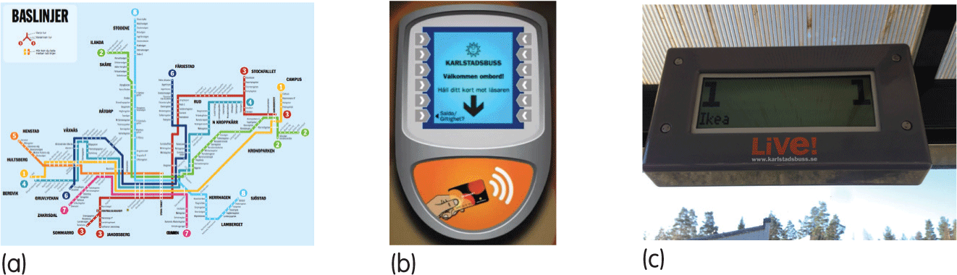
Some physical devices in commuting to work
Notes:
Figure 4.16 Some of the physical touchpoints in the commuting to work ecology

Slide 64
IA
The ontology of the bus system includes buses, bus stops, lines, routes, journeys and destinations amongst other things.
The topology determines which bus stops have distance and directional relations with each other and with routes and destinations.
This basic information architecture is distributed across devices, channels and touchpoints.
The part of the information space concerned with routes, lines and bus stops is fairly static.
It does change but fairly infrequently. Accordingly, touchpoints such as maps can be produced on paper.
However, the movement of the buses and the timing of journeys are where the volatility of the space is a key characteristic.
In the case study, real-time bus information is provided by a smartphone app and at displays at bus stops.
The digital space of these bus tracker systems deals with the volatile part of the information space and allows for the real-time recalculation of routes and destination times.

Slide 65
Agency (2 of 2)
Note the additional agency that this provides.
The original domain of commuting to work by bus needs people to stand at a bus stop, consult the paper timetable and wait.
With the real-time bus tracker in the digital information space, new functions emerge such as ‘get me home from here’ and ‘calculate my arrival time’.
Agency also includes the people who are in the information space such as the bus driver.
This agent can be consulted on a variety of issues and provides real-time, personalised information.
The analysis of this case study results in the service blueprint shown in Figure 4.16.

Slide 66
Service blueprint for commuting to work domain
The devices are listed down the left hand side of the figure along with different interaction channels.
The main activities are listed along the top of the figure and this allows the different touchpoints to be identified.
Notice that this service blueprint does not include the backstage activities. Another diagram would be necessary for that.
What the blueprint does enable, however, is to represent typical user journeys.
Over 15 different journeys were identified through the ecology and were mapped out against the blueprint. One such journey is shown in Figure 4.17.

Slide 67
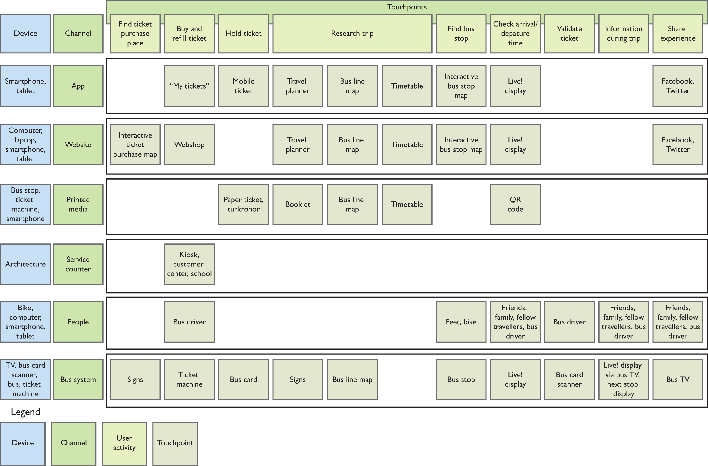
Notes:
Figure 4.17
Service blueprint for commuting to work domain

Slide 68
User journey mapping
The analysis of this case study takes Resmini and Rosata’s heuristics in order to look at issues of design and how the system could be improved to encourage more people to travel by bus.
One of their key design recommendations was that the design should attend to the concept of place-making.
People would make better use of the ecosystem for traveling if they could conceptualize the bus system and how it related to the city as a whole.
The designers looked at the UX of the different places in the ecosystem.
Before the journey, the sense of place included the ontology and topology of the city and the bus systems as a whole.
In other words people need to know – easily, enjoyably and effectively, that is, as a good UX – which bus to get to go where.
Other places in the ecosystem included the bus stop design, the ticket machine place, the buses themselves and the departure and destination places.

Slide 69
Summary
UX occurs in the context of sometimes complex ecosystems of devices, services and physical spaces.
Designers need to consider the design of the overall system in addition to considering the details of specific interfaces.
Designers need to consider how the system is conceptualized from the users’ perspective.
They need to design for navigation and movement through the system – the ‘hybrid trajectories’ – of people as they access different digital spaces and move through physical spaces.
UX here is difficult as different users will take different routes through the information space.

Slide 70
Key points
UX is multilayered with elements of strategy, scope, structure, skeleton and surface to consider.
UX design must consider both the service moments and how they are connected into user journeys.
User journeys will be different for different users because they will have different devices and they use different channels.
The UX designer needs to consider the information architecture of a domain to develop a conceptual model that will guide design.

