Slide 1
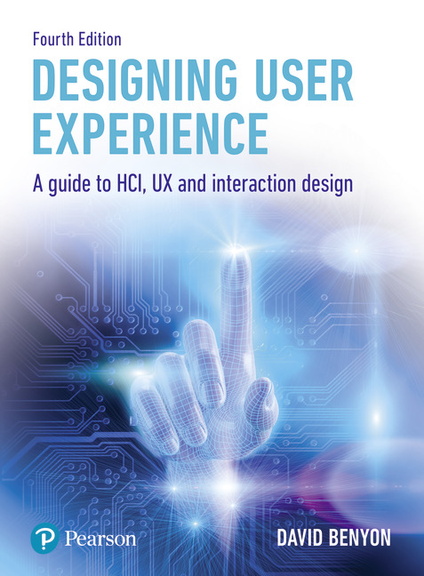
Designing User Experience
A guide to HCI, UX and Interaction Design
Fourth Edition
Chapter 5
Usability

Slide 2
Contents
5.1 Introduction
5.2 Accessibility
5.3 Usability
5.4 Acceptability
5.5 Design principles

Slide 3
Aims
Usability has always been the central pursuit of human–computer interaction (HCI).
The original definition of usability is that systems should be easy to use, easy to learn, flexible and should engender a good attitude in people (Shackel, 1990).
As the variety of people, activities, contexts and technologies of interactive system design has increased, so this definition, whilst still being valid, hides many important issues.
For example, accessibility is now a key design aim, as is the acceptability of a design.
The goals of usability are now primarily seen as concerned with efficiency and effectiveness of systems, and there are issues concerning the values and worth that usability should deliver .
Usability underlies good UX, and with attention to some general design principles, designers will produce systems and services that are easily learnable, efficient and understandable, safe to use and that can be used in a way that suits different people.

Slide 4
After studying this chapter you should be able to:
Understand the key issues and concepts of accessibility.
Understand the principles underlying usability.
Understand the key issues of acceptability.
Understand the general principles underlying good UX design.

Slide 5
Introduction
Good design cannot be summed up in a simple way and nor can the activities of the UX designer, particularly one who takes a human-centred approach to design.
One view might say, ‘The UX designer aims to produce systems and products that are accessible, usable, socially and economically acceptable’.
Another view might say, ‘The UX designer aims to produce systems that are learnable, effective and accommodating’.
A third view could be, ‘The aim of UX designer is to balance the PACT elements with respect to a domain’.
All of these views are valid.
In this chapter, we explore these complementary views of good design.
We also develop some high-level design principles that can guide designers and be used to evaluate design ideas.
Finally, we put these ideas into practice by looking at some examples of good and bad design across different design contexts.

Slide 6
Overview
Accessibility concerns removing the barriers that would otherwise exclude some people from using a service, product or system at all.
Usability refers to the quality of the interaction in terms of parameters such as time taken to perform tasks, number of errors made and the time to become a competent user.
Clearly a system must be accessible before it is usable.
A system may be assessed as highly usable according to some usability evaluation criteria but may still fail to be adopted or to satisfy people.
Acceptability refers to fitness for purpose in the context of use.
It also covers personal preferences that contribute to users ‘taking to’ an artefact or service, or not.

Slide 7
Accessibility
Access to physical spaces for people with different physical abilities has long been an important legal and ethical requirement and this is now becoming increasingly so for information spaces.
Legislation such as the United Kingdom’s Equality Act 2010 and Section 508 in the United States of America now requires software to be accessible.
The United Nations and the World Wide Web Consortium (W3C) have declarations and guidelines on ensuring that everyone can get access to information that is delivered through software technologies.
With an increasingly wide range of computer users and technologies, designers need to focus on the demands their designs make on people’s abilities.
Designers have to design for the elderly and for children.
Newell (1995) points out that the sorts of issues that face an ordinary person in an extraordinary environment (such as under stress, time pressures and so on) are often similar to the issues that face a person with disabilities in an ordinary environment.

Slide 8
Exclusions (1 of 2)
People will be excluded from accessing interactive systems for a number of reasons:
Physically, people can be excluded because of inappropriate placement of equipment or through input and output devices making excessive demands on their abilities.
For example, an ATM may be positioned too high for a person in a wheelchair to reach, a mouse may be too big for a child’s hand or a mobile phone may be too fiddly for someone with arthritis to use.
Both motor and sensory capabilities of potential users need to be considered.
Conceptually, people may be excluded because they cannot understand complicated instructions or obscure commands or they cannot form a clear mental model of the system or service.
The cognitive capabilities of users need to be considered against the cognitive demands of the design.

Slide 9
Exclusions (2 of 2)
Economically people are excluded if they cannot afford some essential technology or make use of some service.
Cultural exclusion results from designers making inappropriate assumptions about how people work and organize their lives.
For example, using a metaphor based on American football would exclude those who do not understand the game.
People can be excluded if they do not understand the language that a service uses.
Social exclusion can occur if technology is unavailable at an appropriate time and place or if people are not members of a particular social group and cannot understand particular social mores or messages.

Slide 10
Overcoming barriers
Overcoming these barriers to access is a key design consideration.
Two main approaches to designing for accessibility are ‘design for all’ and inclusive design.
Design for all (also known as universal design) goes beyond the design of UX and applies to all design endeavors.
It is grounded in a certain philosophical approach to design encapsulated by an international design community (see Box 5.1).
Inclusive design is based on four premises:
Varying ability is not a special condition of the few but a common characteristic of being human and we change physically and intellectually throughout our lives.
If a design works well for people with disabilities, it works better for everyone.
At any point in our lives, personal self-esteem, identity and well-being are deeply affected by our ability to function in our physical surroundings with a sense of comfort, independence and control.
Usability and aesthetics are mutually compatible.

Slide 11
Principles of universal design
Equitable use. The design does not disadvantage or stigmatize any group of users.
Flexibility in use. The design accommodates a wide range of individual preferences and abilities.
Simple, intuitive use. Use of the design is easy to understand, regardless of the user’s experience, knowledge, language skills or current concentration level.
Perceptible information. The design communicates necessary information effectively to the user, regardless of ambient conditions or the user’s sensory abilities.
Tolerance for error. The design minimizes hazards and the adverse consequences of accidental or unintended actions.
Low physical effort. The design can be used efficiently and comfortably and with a minimum of fatigue.
Size and space for approach and use. Appropriate size and space are provided for approach, reach, manipulation and use, regardless of the user’s body size, posture or mobility.

Slide 12
Inclusive design (1 of 2)
Inclusive design is a more pragmatic approach that argues that there will often be reasons (e.g. technical or financial) why total inclusion is unattainable.
Benyon et al. (2001) recommend undertaking an inclusivity analysis that ensures that inadvertent exclusion will be minimized and common characteristics that cause exclusion and which are relatively cheap to fix will be identified.
Distinguishing between fixed and changing user characteristics, they present a decision tree (see Figure 5.1).
We all suffer from disabilities from time to time (e.g. a broken arm) that affect our abilities to use interactive systems, so accessibility is not something that is an issue for only a few people.

Slide 13
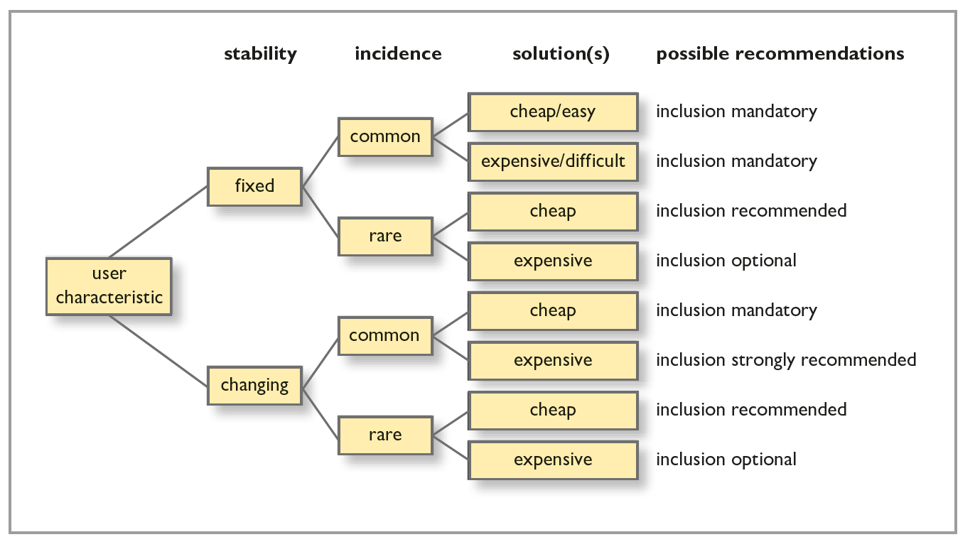
Figure 5.1 Decision tree for inclusivity analysis
Source: after Benyon et al. (2001), Figure 2.3, p. 38

Slide 14
Inclusive design (2 of 2)
As a way of ensuring an accessible system, designers should:
Include people with special needs in requirements generation, user research and analysis of existing systems.
Consider whether new features affect users with special needs (positively or negatively) and note this in the specification.
Take account of guidelines – include evaluation against guidelines.
Include special needs users in usability testing and beta tests.

Slide 15
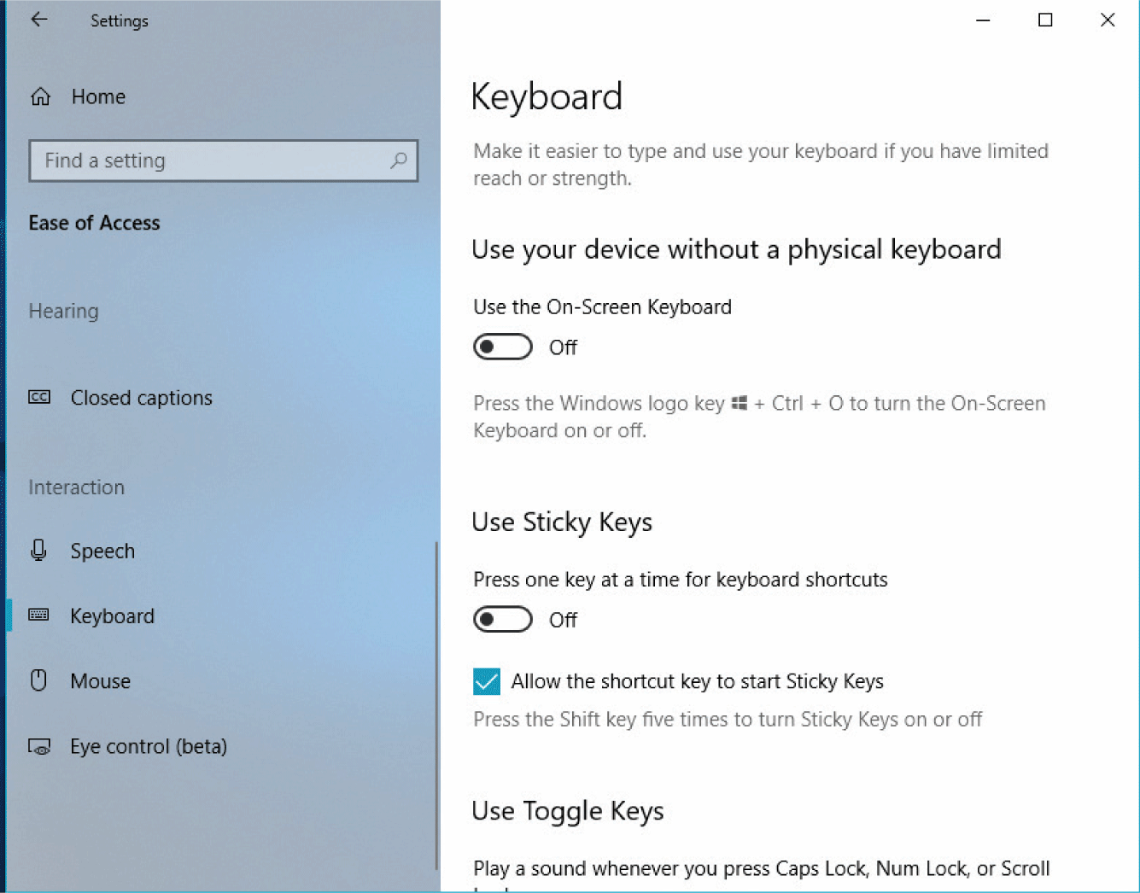
Assistive technologies
Notes:
Figure 5.2 Options for accessibility keyboard settings

Slide 16
Web accessibility
Web accessibility is a particularly important area as many websites exclude people who are not fit and able.
The W4A conference and ACM’s SIGACCESS group contain many specialist papers and discussions.
The W3C web accessibility initiative (WAI) lists many automated tools that will check web pages for conformance to the W3C standards and conformance to section 508.
However, in a study of university websites, Kane et al. (2007) found serious accessibility problems, showing that there is still some way to go before these issues are overcome.

Slide 17
Design for all
To a large extent, design for all is just good design.
The aim is to design to cater for the widest range of human abilities.
By considering access issues early in the design process, the overall design will be better for everyone.
Stephanidis (2001) provides a range of views on how this can be accomplished, from new computer ‘architectures’ that can accommodate different interfaces for different people, to better requirements generation processes, consideration of alternative input and output devices and the adoption of international standards.
Most of the main equipment manufacturers now have excellent accessibility options.
Apple devote considerable time to accessibility both in their iOS operating system and their tvOS operating system that now includes Siri for voice activation, zoom to make text and pictures larger, increased contrast and audio descriptions of programs and films.

Slide 18
Usability
A system with a high degree of usability will have the following characteristics:
It will be efficient in that people will be able to do things using an appropriate amount of effort.
It will be effective in that it contains the appropriate functions and information content, organized in an appropriate manner.
It will be easy to learn how to do things and remember how to do them after a while.
It will be safe to operate in the variety of contexts in which it will be used.
It will have high utility in that it does the things that people want to get done.

Slide 19
Gould and Lewis principles
Early focus on users and tasks. Designers must first understand who the users will be, in part by studying the nature of the expected work to be accomplished and in part by making users part of the design team through participative design or as consultants.
Empirical measurement. Early in the development process, intended users’ reactions to printed scenarios and user manuals should be observed and measured. Later on they should actually use simulations and prototypes to carry out real work and their performance and reactions should be observed, recorded and analysed.
Iterative design. When problems are found in user testing, as they will be, they must be fixed. This means design must be iterative: there must be a cycle of design, test and measure, and redesign, repeated as often as necessary. Empirical measurement and iterative design are necessary because designers, no matter how good they are, cannot get it right the first few times.
As a result of their experiences with that project, they added a fourth principle, integrated usability.
All usability factors must evolve together and responsibility for all aspects of usability should be under one control (p. 766).

Slide 20
The Olympic Message System (OMS)
The development of the Olympic Message System (OMS) is described in detail in Gould et al. (1987) and it still makes interesting reading in terms of the different types of testing that were done from written scenarios of use to ‘try-to-destroy-it’ tests!
However, these classic principles are not advocated by everyone.
Cockton (2009), for example, argues that designers need to understand the values that their designs are aiming at and that the sort of advice offered by Gould and Lewis (1985) is dangerous and out of date.
Whilst not going as far as that, we would certainly agree that designers need to consider what worth their designs bring to the world!

Slide 21
Value sensitive design
Value sensitive design is a design approach that aims to account for human values in a principled and comprehensive manner emphasizing the moral perspective, usability and personal preferences. It focuses on three types of investigations:
Conceptual investigations concern philosophically informed analyses of the central constructs and issues under investigation.
Empirical investigations focus on the human response to the technical artefact and on the larger social context in which the technology is situated.
Technical investigations focus on the design and performance of the technology itself, involving both retrospective analyses of existing technologies and the design of new technical mechanisms and systems.

Slide 22
Usability and PACT
One way to look at usability is to see it as concerned with achieving a balance between the four principal factors of human-centred UX design, PACT:
People
Activities people want to undertake
Contexts in which the interaction takes place
Technologies (hardware, software and content).
The combinations of these elements are very different in, for example, a public kiosk, a shared diary system, an airline cockpit or a mobile phone, and it is this wide variety that makes achieving a balance so difficult.
Designers must constantly evaluate different combinations in order to reach this balance.

Slide 23
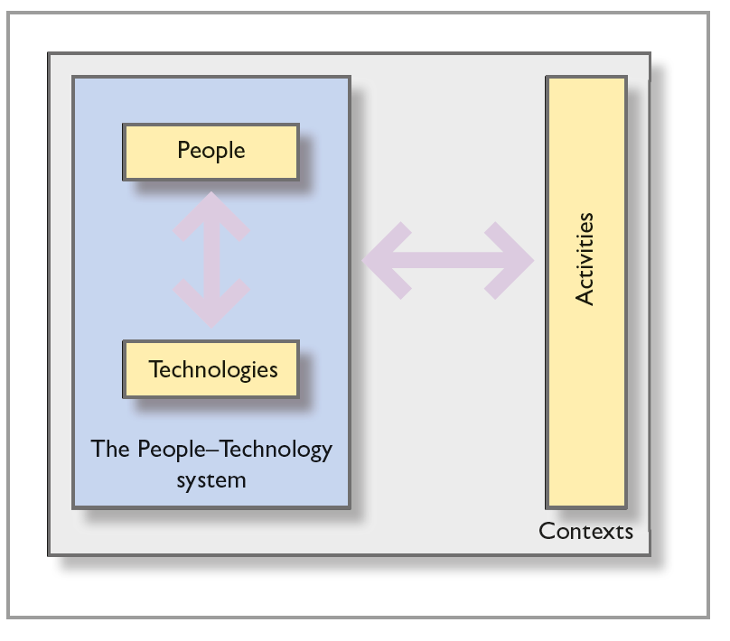
Two relationships for usability
In UX design, there are two relationships that need to be optimized.
On the one hand, there is the interaction between people and the technologies that they are using. This focuses on the user interface.
On the other hand, the other relationship is the interaction between the people and technologies considered as a whole (the people–technology system), the activities being undertaken and the contexts of those activities.
Notes:
Figure 5.4 Usability aims to achieve a balance in the PACT elements

Slide 24
People–technology systems
The idea of a people–technology system optimized for some activities is nicely illustrated with an example from Erik Hollnagel.
He discusses the difference between a person on a horse travelling across open countryside and a person in a car travelling along a road.
The combinations of technologies are balanced for the different contexts of travelling; neither is better in all circumstances.
It is important to remember that the people–technology system may consist of many people and many devices working together to undertake some activities.

Slide 25
Challenge 5.2
Think of the activity of writing and all the various contexts in which we undertake this activity. For example, you might be writing a report for a student assignment, writing a postcard from a poolside chair on holiday, writing down some thoughts on a train, taking notes in a lecture and so on. Now think about the different technologies that we use for writing: ballpoint pens, felt-tipped pens, computers, palmtop devices and so on. Which combinations are most usable in which circumstances? Why?

Slide 26
The gulfs of interaction
Don Norman (Norman, 1988) focuses on the interface between a person and the technology and on the difficulty of people having to translate their goals into the specific actions required by a user interface.
Norman’s characterization is as follows:
People have goals – things they are trying to achieve in the world. But devices typically only deal with simple actions. This means that two ‘gulfs’ have to be bridged.
The gulf of execution is concerned with translating goals into actions and the gulf of evaluation is concerned with deciding whether the actions were successful in moving the person towards his or her goal.
These gulfs have to be bridged both semantically (does the person understand what to do and what has happened?) and physically (can the person physically or perceptually find out what to do or what has happened?).

Slide 27
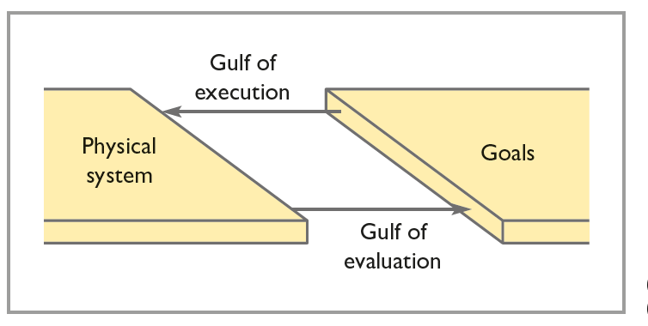
Figure 5.5 Bridging the gulfs
Source: after Norman and Draper(eds) (1986)

Slide 28
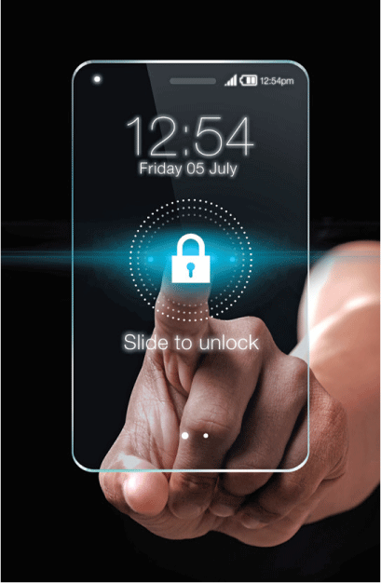
A key issue for usability
Very often technology gets in the way of people and the activities they want to do.
If we compare using an interactive device such as a remote control to using a hammer or driving a car, we can see the issue more clearly.
Very often when using an interactive system, we are conscious of the technology; we have to stop to press the buttons; we are conscious of bridging the gulfs.
When hammering or driving, we focus on the activity not on the technology.
The technology is ‘present to hand’.
Vermeulen, et al. (2013) point to the importance of good affordances and feedforward techniques to help bridge the gulf of execution and the importance of good feedback to bridge the gulf of evaluation.
They cite the example of the iPhone’s lock screen (Figure 5.6) as a good example of feedfoward, though this has been changed in iOS 10 and 11.
Notes:
Figure 5.6
’Slide to unlock’

Slide 29
Technological breakdown
When using a hammer, driving or writing with a pen, we will usually focus on the activity itself: we are hammering, driving or writing.
It is only when something happens to interfere with the smooth operation of these technologies that we become aware of them.
If you hit your finger whilst hammering, if you have to swerve to avoid a hole in the road or if the pen stops working, then the unconscious use of the technology turns into a conscious interaction with the technology.
Winograd and Flores (1986) refer to this as a ‘breakdown’.
One aim of interactive systems design is to avoid such breakdowns, as it results in an impoverished UX.
Designers should aim to provide people with a way of undertaking activities without really being aware of the technologies that enable them to do what they are doing.

Slide 30
Back to mental models
Another important aspect of usability is to try to engender an accurate mental model of the system.
A good design will have adopted a clear and well-structured conceptual design that can be easily communicated to people.
A complex design will make this process much more difficult.
Striving for a clear, simple and consistent conceptual model will increase the usability of a system.

Slide 31
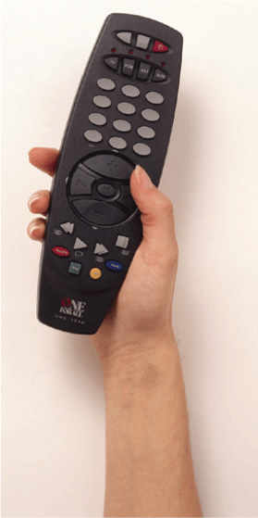
Challenge 5.3
The remote control for my TV is shown in Figure 5.7. Yes, all the numbers have got rubbed off the buttons! Write down the processes that a user of this device goes through if they want to enter a code number, 357998, say.
Source: Steve Gorton and Karl Shone/DK Images
Notes:
Figure 5.7 My TV remote control

Slide 32
Acceptability
Acceptability is about fitting technologies and services into people’s lives.
For example, some railway trains have ‘quiet’ carriages where it is unacceptable to use mobile phones, and cinemas remind people to turn their phones off before the film starts.
A computer playing loud music would generally be considered to be unacceptable in an office environment.
An essential difference between usability and acceptability is that acceptability can only be understood in the context of use.
Usability can be evaluated in a laboratory (though such evaluations will always be limited).
Acceptability cannot be evaluated in a laboratory.

Slide 33
The Technology Acceptance Model
The Technology Acceptance Model (TAM) is a way of looking at technologies and whether they will be accepted by communities.
It has its origins in business studies rather than in computing or psychology.
TAM looks at technology acceptance from two perspectives: ease of use and effectiveness.
Each of these is further broken down into more specific characteristics of the technology.
There are many variants of TAM as it gets adapted to the particular characteristics of a technology.
Some of our own work involved looking at the acceptance of biometrics.
We felt that a third aspect was important to the acceptance of biometric technology, namely trust.

Slide 34
The key features of acceptability (1 of 2)
Political. Is the design politically acceptable? Do people trust it?
In many organizations, new technologies have been introduced for simple economic reasons, irrespective of what people may feel about them and the ways that people’s jobs and lives might change.
In the broader environment, human rights might be threatened by changes in technologies, for example by gathering personal data on people.
Convenience. Designs that are awkward or that force people to do things may prove unacceptable.
Products and services should fit effortlessly into the situation.
Many people send documents electronically nowadays but some people find reading on-screen unacceptable.
They take a printout of the document because it is more convenient to carry and read.

Slide 35
The key features of acceptability (2 of 2)
Cultural and social habits. If political acceptability is concerned with power structures and principles, cultural and social habits are concerned with the way people like to live.
It is rude to disturb other people, for example.
People like to engage with social media such as Twitter but may find the insulting comments of internet ‘trolls’ unacceptable.
Usefulness. This goes beyond the notions of efficiency and effectiveness and concerns usefulness in context.
For example, many people have found the diary service on their phone perfectly usable but not sufficiently useful in the context of everyday living and keeping it up to date can be an unacceptable constraint.
Economic. There are many economic issues that render some technology or service acceptable or not.
Price is the obvious one and whether the technology offers value for money.
But the economic issues go further than that as the introduction of new technologies may completely change the way businesses work and how they make money.
A new ‘business model’ is often a part of economic acceptability.

Slide 36
Design principles
Over the years, many principles of good interactive system design have been developed.
Don Norman in his book The Design of Everyday Things (Norman, 1998) provides several design priciples, as does Jacob Nielsen in Usability Engineering (Nielsen, 1993).
These are on-line at https://www.nngroup.com/articles/ten-usability-heuristics/ along with links to other lists such as the one by Bruce Toggnazzini.
These principles will guide the designer and they will also form the basis of evaluation of products and services.
Usability questionnaires (such as Systems Usability Scale), based on the guidelines, can be used with users to evaluate how useable a product or service is.

Slide 37
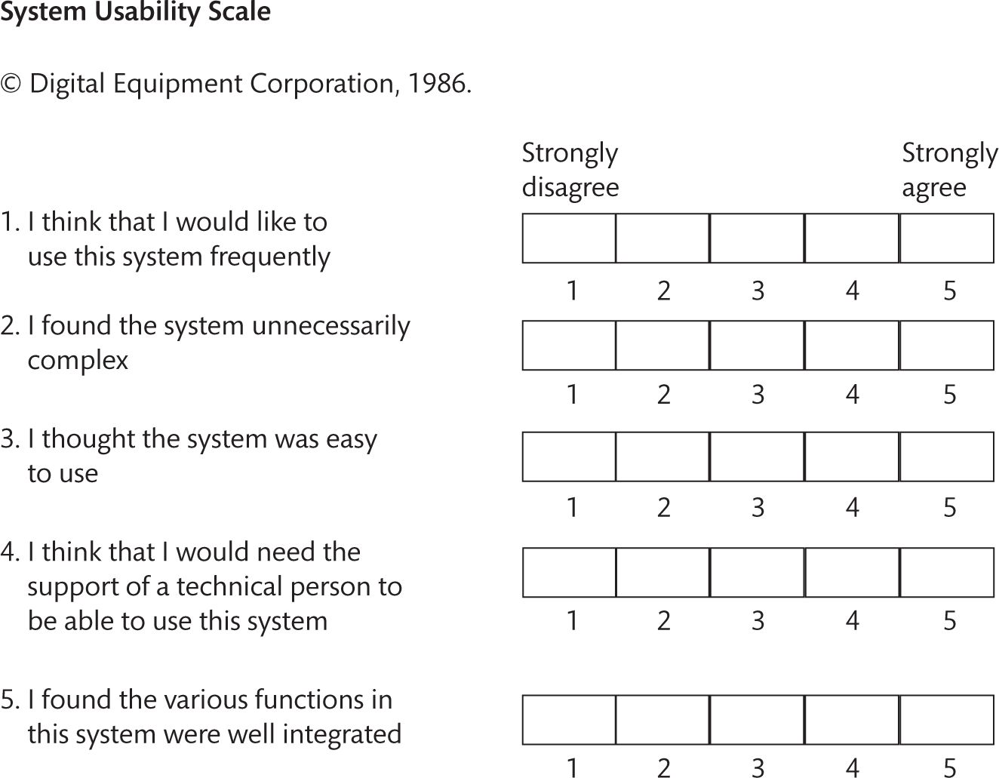
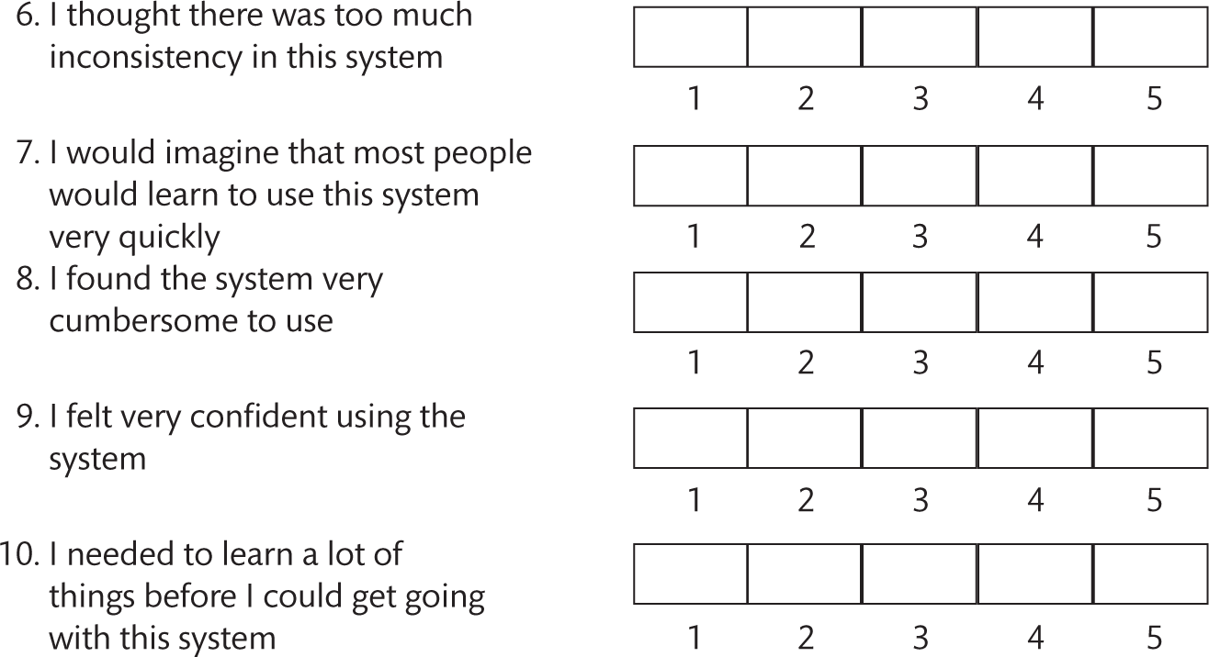

Slide 38
Types of principles (1 of 2)
Design principles can be very broad or they can be more specific.
For example, some good design principles are derived from psychology, such as ‘minimize memory load’, that is do not expect people to remember too much.
We discuss many of these principles in Chapters 12 and 13 on interface design and provide the background psychology in Part IV of this book.
More specific user interface design guidelines are provided by Apple, Microsoft and Google.
The application of design principles has led to established design guidelines and patterns of interaction in certain circumstances.
These may be implemented in a system or service with a feature such as the ‘Undo’ command in a Windows application or the ‘Back’ button on a website.
These features enable people to be in control and to recover from their previous action.

Slide 39
Types of principles (2 of 2)
Design principles can guide the designer during the design process and can be used to evaluate and critique prototype design ideas.
Our list of high-level design principles, put together from Norman, Nielsen and others, is shown below.
All the principles interact in complex ways, affecting each other, sometimes conflicting with each other and sometimes enhancing each other.
But they help to orientate the designer to key features of good design – a design with a high degree of usability – and sensitize the designer to important issues.
Delivering a product or service with a high degree of usability will result in a better UX.

Slide 40
High level principles
For ease of memorizing and use, we have grouped them into three main categories – learnability, effectiveness and accommodation – but these groupings are not rigid.
Systems should be learnable, effective and accommodating.
Principles 1–4 are concerned with access, ease of learning and remembering (learnability).
Principles 5–7 are concerned with ease of use, and principles 8 and 9 with safety (effectiveness).
Principles 10–12 are concerned with accommodating differences amongst people and respecting those differences (accommodation).

Slide 41
Learnability (1 of 2)
Designing interactive systems from a human-centred perspective is concerned with the following, helping people access, learn and remember the system:
Visibility. Try to ensure that things are visible so that people can see what functions are available and what the system is currently doing. This is an important part of the psychological principle that it is easier to recognize things than to have to recall them. If it is not possible to make it visible, make it observable. Consider making things ‘visible’ through the use of sound and touch.
Consistency. Be consistent in the use of language and design features and be consistent with similar systems and standard ways of working. Consistency can be something of a slippery concept (see the Further thoughts box). Both conceptual and physical consistency are important.
Familiarity. Use language and symbols that the intended audience will be familiar with. Where this is not possible because the concepts are quite different from those people know about, provide a suitable metaphor to help them transfer similar and related knowledge from a more familiar domain.
Affordance. Design things so it is clear what they are for; for example, make buttons look like push buttons

Slide 42
Learnability (2 of 2)
so people will press them:
Affordance refers to the properties that things have (or are perceived to have) and how these relate to how the things could be used.
Buttons afford pressing, chairs afford sitting on and Post-it Notes afford writing a message on and sticking next to something else.
Affordances are culturally determined.

Slide 43
Effectiveness (1 of 2)
Giving people the sense of being in control, knowing what to do and how to do it is called effectiveness:
Navigation. Provide support to enable people to move around the parts of the system: maps, directional signs and information signs.
Control. Make it clear who or what is in control and allow people to take control. Control is enhanced if there is a clear, logical mapping between controls and the effect that they have. Also make clear the relationship between what the system does and what will happen in the world outside the system.
Feedback. Rapidly provide feedback information from the system to people so that they know what effect their actions have had. Constant and consistent feedback will enhance the feeling of control.

Slide 44
Effectiveness (2 of 2)
Safety and securety:
Recovery. Enable recovery from actions, particularly mistakes and errors, quickly and effectively.
Constraints. Provide constraints so that people do not try to do things that are inappropriate. In particular, people should be prevented from making serious errors through properly constraining allowable actions and seeking confirmation of dangerous operations.

Slide 45
Accommodation
The way the technology suits peple is called accomodation:
Flexibility. Allow multiple ways of doing things so as to accommodate people with different levels of experience and interest in the system. Provide people with the opportunity to change the way things look or behave so that they can personalize the system.
Style. Designs should be stylish and attractive.
Conviviality. Interactive systems should be polite, friendly and generally pleasant. Nothing ruins the experience of using an interactive system more than an aggressive message or an abrupt interruption.
Design for politeness. Conviviality also suggests joining in and using interactive technologies to connect and support people.

Slide 46
Consistency
Consistency is a slippery concept because consistency is always relative.
A design will be consistent with respect to some things but may be inconsistent with respect to others.
There are also times when to be inconsistent is a good thing because it draws people’s attention to something that is important.
The difference between conceptual consistency and physical consistency is important.
Conceptual consistency is about ensuring that the mappings are consistent and that the conceptual model remains clear.
This involves being consistent both internally to the system and externally as the system relates to things outside it.
Physical consistency is ensuring consistent behaviours and consistent use of colours, names, layout and so on.

Slide 47
Conceptual consistency
One famous example of the difficulty of maintaining conceptual consistency in a design comes from the design of the Xerox Star interface (described in Smith et al., 1982).
To print a document, the document was dragged onto a printer icon.
This was consistent with the overall style.
The question then arose as to what to do with it after it had been printed.
The options considered were (1) the system deletes the icon from the desktop, or (2) the system does not delete the icon but (a) replaces it on the desktop in its previous location, (b) places it at an arbitrary location on the desktop or (c) leaves it on the printer for the user to deal with.
Discuss!

Slide 48
Consistency trade-offs
Kellogg (1989) quotes the designers as saying that in this example the trade-off was between
the external consistency of not deleting the icon, as it behaved more like a real-world object (a photocopier) and
against the internal consistency of behaving like other actions in the interface, such as dragging the icon to the wastebasket or to a folder icon.
They opted for option 2a.
Whether designers would do that nowadays, when more people are much more familiar with these types of interface, is another matter.

Slide 49
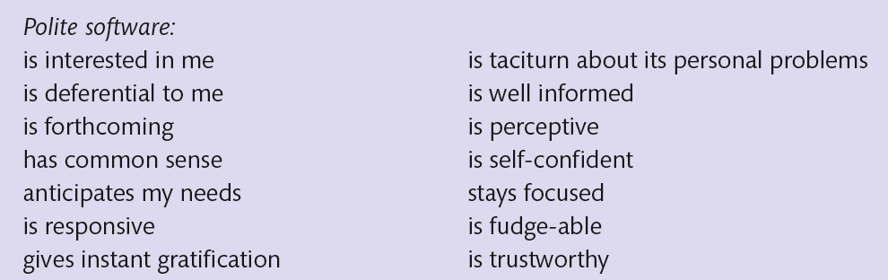
Polite software
Alan Cooper (1999) argues that if we want people to like our software, we should design it to behave like a likeable person.
Drawing on work by Reeves and Nass (1996), who found that people interacting with new media were treating the media like a person (‘The Media Equation’), they argue that the essentials of polite behaviour are quality, quantity, relevance and clarity.
Cooper continues with his list of characteristics:

Slide 50
Design principles in action
In Part III of this book, we look at design in a number of specific contexts including the web, cooperative systems, mobile computing, wearable computing and ubiquitous computing systems.
Specific design issues and principles for those contexts are discussed there. There are also related issues discussed in Chapters 12 and 13 on interface design.
Here we look at some general examples of the design principles in action.
The computer ‘desktop’ is likely to remain with us for some time, with its familiar combination of windows, icons, menus and pointer called a WIMP interface.
This form of interaction – the graphical user interface (GUI) – is as ubiquitous as information and communication technologies are becoming and appear on handhelds and other mobile devices as well as on desktop computers.

Slide 51
Guidelines for GUI (1 of 7)
A key issue is consistency.
There are clear guidelines for issues such as menu layout, ordering, dialogue boxes and use of the other ‘widgets’ associated with graphical user interfaces.
There are standards for providing constraints such as greying out items on a menu that are not relevant at a particular point.
Screen design is a key issue and attention needs to be paid to the layout of objects on a screen.
Avoiding clutter will help ensure visibility.
Attention needs to be paid to the use of appropriate, non-clashing colours and the careful layout of information using tables, graphs or text as appropriate.

Slide 52
Dark patterns
Besides these guidelines for developing good designs, we should acknowledge that there are interaction patterns aimed at duping users, or aimed at getting them to do things that they did not intend to do.
These so-called ‘dark patterns’ aim to get users to sign up to full priced services, post items on their social media, frighten users into making some choice or do a host of other things.
There is a comprehensive list at www.darkpatterns.org.

Slide 53
Guidelines for GUI (2 of 7)
Often in the design of GUI applications, the designer can talk to the actual future stakeholders of the system and find out what they want and how they refer to things.
This will help the designer to ensure that familiar language is used and that the design follows any organizational conventions.
It can be fitted in with preferred ways of working.
Participatory design techniques – involving people closely in the design process – can be used, and stakeholders can participate in the design process through workshops, meetings and evaluation of design ideas.
Documentation and training can be given.

Slide 54
Guidelines for GUI (3 of 7)
A good design will ensure that there is easy error recovery by providing warning signs for drastic actions such as ‘Are you sure you want to destroy the database?’.
A good example of designing for recovery is the Undo command.
Affordances are provided by following design guidelines and sometimes by using a skeumorphic design (where something on the screen looks like its real-world counterpart).
People will expect to see a menu at the top of the screen and will expect the menu items to be displayed when the header is clicked on.
Items that are not greyed out will afford selecting.
The various ‘widgets’ such as check boxes, radio buttons and text entry boxes should afford selecting because people familiar with the standards will know what to expect.
However, care needs to be taken to ensure that opportunities are easily and correctly perceived.
On mobile devices, the physical buttons afford pressing, but because of the limited screen space, the same button has to do different things at different times.
Here the menu is generally at the bottom of a screen.
Consistency is difficult to achieve.

Slide 55
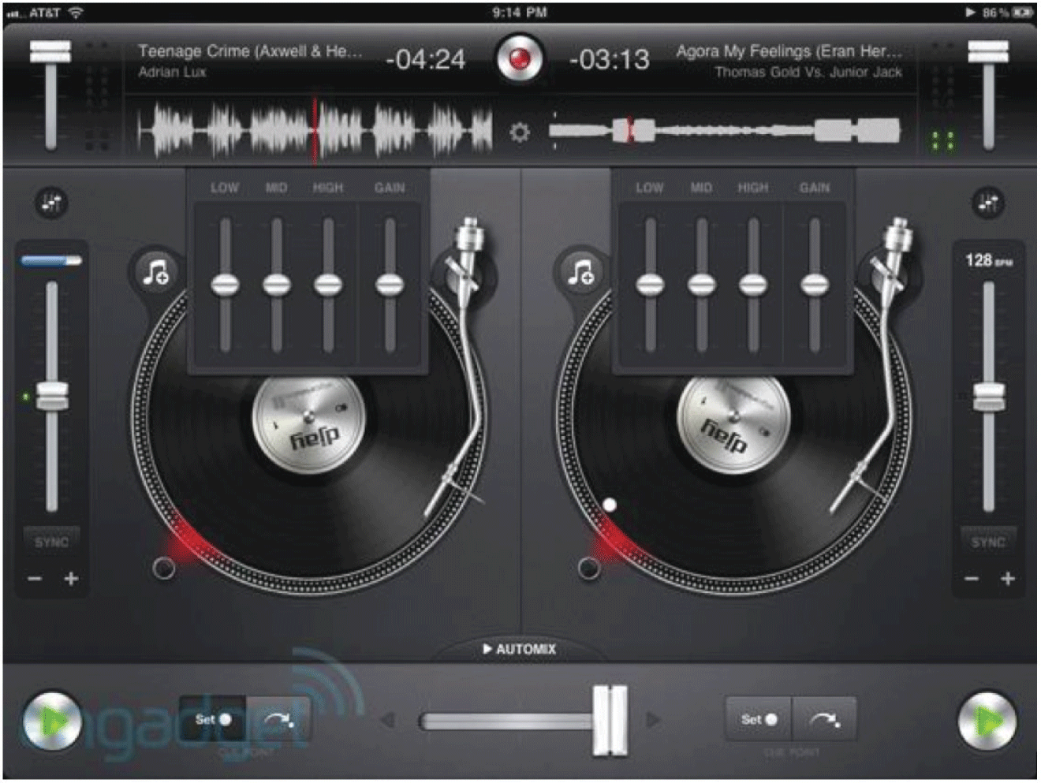
Skeumorphic design
Notes:
Figure 5.10 Example of affordances/skeuomorphism

Slide 56
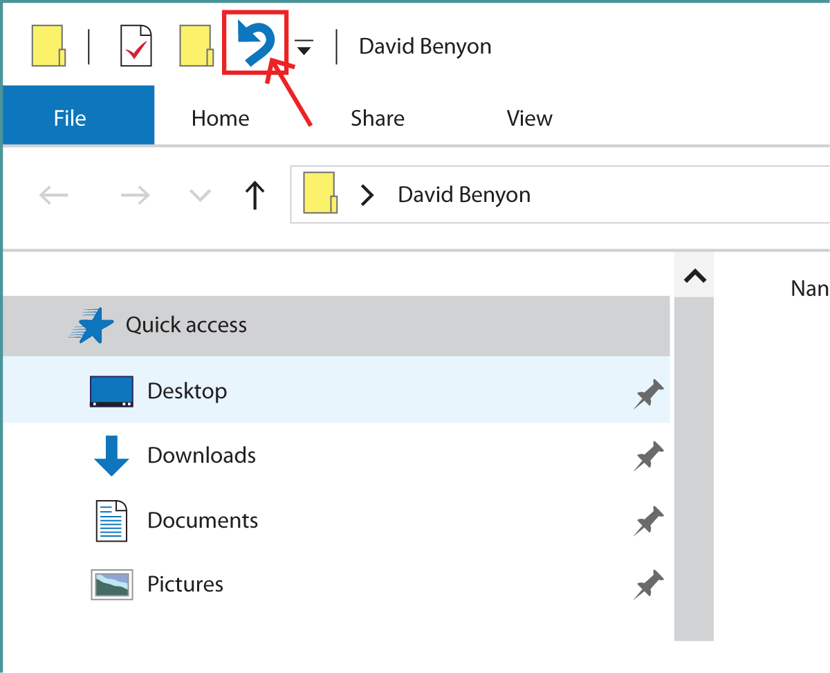
5.11 Example
Notes:
Figure 5.9 Example of recovery

Slide 57
Guidelines for GUI (4 of 7)
Menus are the main form of navigation in GUI applications.
People move around the application by selecting items from menus and then by following dialogue structures.
Many applications make use of ‘wizards’.
These provide step-by-step instructions for undertaking a sequence of operations, allowing users to go forward and backward to ensure that all steps are completed.
Control is usually left in the hands of the users.
They have to initiate actions, although some features that provide security are undertaken automatically.
Many applications, for example, automatically save people’s work to help with recovery if mistakes are made.

Slide 58
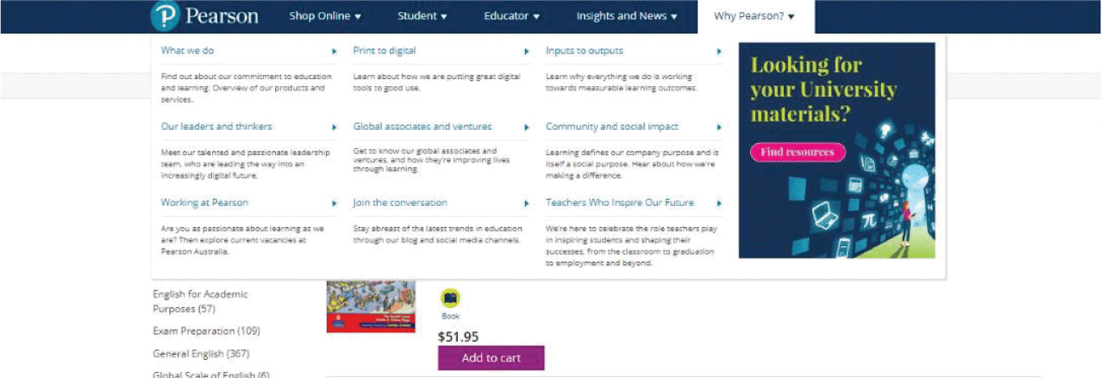
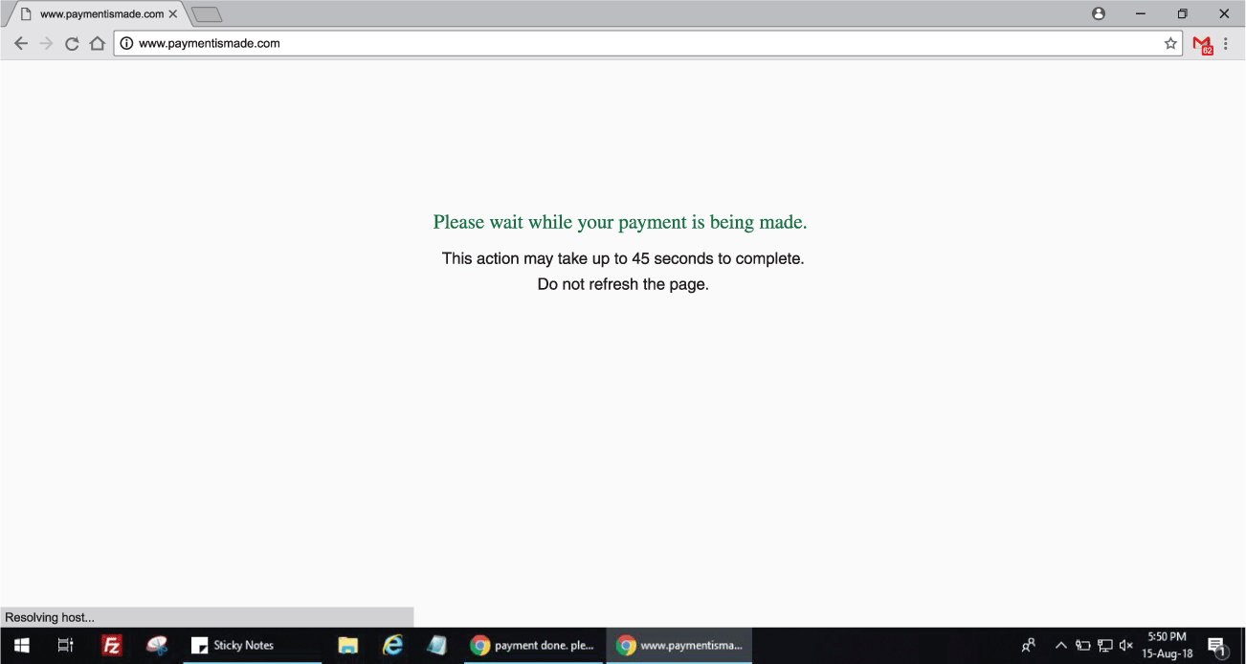
Navigation and e-commerce
Notes:
Figure 5.11 Example of navigation
Figure 5.13 Example of e-commerce

Slide 59
Guidelines for GUI (5 of 7)
Feedback is provided in a variety of ways.
An ‘egg timer’ symbol is used to indicate that the system is busy doing something.
Counters and progress bars are used to indicate how much of an operation is complete.
Feedback can be provided through sound, such as a beep when a message is received on an email system or a sound to indicate that a file has been safely saved.
Flexibility is provided with things such as shortcut keys, allowing more expert users to use combinations of keyboard controls in place of using menus to initiate commands and navigate through the system.
Many Windows applications allow the user to set their own preferences, to configure features such as the navigation bars and menu items and to disable features that are not often used.

Slide 60
Guidelines for GUI (6 of 7)
In terms of style and conviviality, GUI applications tend to be more limited than web applications as they should remain within the standard design guidelines.
Windows 10 and OSX from Apple try to make things look as nice as possible.
Error messages are one area where the designer can move towards a more convivial design by thinking hard about the words used on the messages.
However, all too frequently messages appear very abruptly and interrupt people unnecessarily.

Slide 61
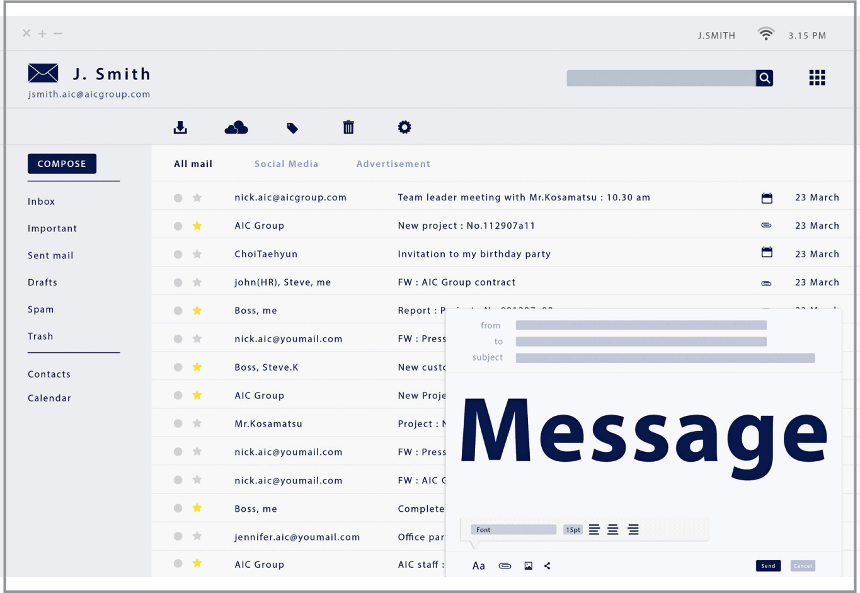
Challenge 5.4
Look at an example of a GUI application. Critique the design from the perspective of the general design principles.
Notes:
Figure 5.12 ’Entourage’ on the Mac

Slide 62
Guidelines for GUI (7 of 7)
Issues of recovery, feedback and control figure most highly in shopping sites.
There are often long pauses when processing things such as a payment transaction.
Feedback is critical here and statements such as ‘this action may take 45 seconds to complete’ are used to persuade people not to do anything while the transaction is processed.
However, there is no way of enforcing constraints in these circumstances.
Conviviality can be provided by allowing people to join in, to support and create communities.
Websites and apps can easily connect people with one another.
Style is also key to websites and offers the most opportunities for designers to demonstrate their creative flair.
The use of animation, video and other design features can really develop a whole sense of engagement with the site.

Slide 63
Summary
Good design is about usability.
It is about ensuring that systems are accessible to all and that designs are acceptable for the people and contexts in which they will be used.
Designers need to evaluate their designs with people and involve people in the design process.
Paying attention to design principles can help sensitize the designer to key aspects of good design.

Slide 64
Key points
Access to interactive systems for all people is an important right.
Usability is concerned with balancing the PACT elements in a domain.
Acceptability is concerned with ensuring that designs are appropriate to contexts of use.
Twelve design principles are particularly important. They can be grouped into three main design issues of learnability, effectiveness and accommodation.

