Slide 1
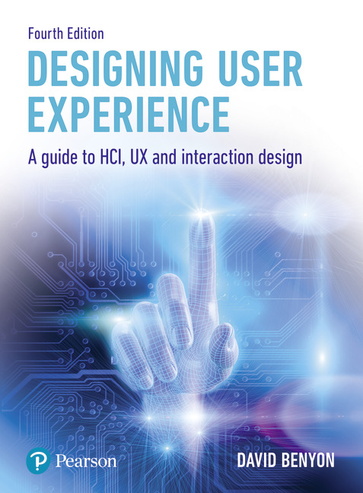
Designing User Experience
A guide to HCI, UX and Interaction Design
Fourth Edition
Chapter 6
Experience design

Slide 2
Contents
6.1 Introduction
6.2 Engagement
6.3 Designing for pleasure
6.4 Aesthetics
6.5 Lifestyle

Slide 3
Overview
UX designers are increasingly finding themselves going beyond the design of usable systems and are instead expected to design systems that provide people with great experiences.
Of course, game designers have been doing exactly this for years, but new platforms such as the iPhone and Android are blurring the distinction between games and regular applications.
A shopping list application on the iPhone, for example, needs to be much more than functional; it needs to be fun to use, engaging and enjoyable.
Websites have to attract and keep customers if they are to be profitable and, once they provide appropriate functionality and content, they will only do that if people enjoy using them.
Ubiquitous computing environments need to be responsive to people’s needs but also need to provide engaging and aesthetic experiences.

Slide 4
Creating high quality experiences
Contributions to an understanding of experience design come from many different areas.
Nathan Shedroff published a very engaging book on the subject.
McCarthy and Wright explore the wider issues of experiences through their book Technology as Experience, drawing on the philosophy of John Dewey.
Patrick Jordan and Don Norman have both published books on the importance of designing for pleasure and others talk about ‘ludic’ design, ‘hedonomics’ and ‘funology’.
Work on aesthetics has a long history and has recently been applied to interactive systems design.

Slide 5
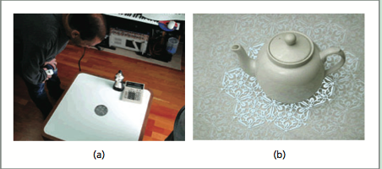
Bill Gaver
In an on-line interview, Gaver says of play: ‘I don’t mean joining in a set of kind of arbitrary rules to see who can win in some situation. On the contrary, I mean by play something much more fluid and self-motivated ,so examples of play are things like, I don’t know, anything from fooling round with friends and taking on imaginary roles when you’re just having a chat with them to maybe starting to take over things where you stack up things to see how many things you can balance on one another before they all tumble down or taking a new walk on the way home from work just to see where you get, but also I tend to allow that category to extend beyond the obviously playful to taking things like enjoyment of the scenery or just sort of staring out the window and wondering about how the wind is moving around the leaves and the trees and so forth’.
Source: Copyright the Interaction Research Studio, Goldsmiths
Notes:
Figure 6.1 (a) Drift table and (b) History tablecloth

Slide 6
Experience design
Experience design is about recognizing that interactive products and services do not just exist in the world, they affect who we are.
They influence our culture and identity.
As Dewey says ‘experience is the irreducible totality of people acting, sensing, thinking, feeling and meaning-making including their perception and sensation of the artefact in context’ (quoted in McCarthy and Wright, 2004).
For Jodi Forlizzi, experience is ‘the constant stream of self-talk that happens while we are conscious’. In addition to experience, Forlizzi stresses the importance of the social side of things in co-experience.
Designers can design for experience, but it is individuals and groups who have the experience.

Slide 7
Experience
Experience is concerned with all the qualities of an experience that really pull people in – whether this is a sense of immersion that one feels when reading a good book, a challenge one feels when playing a good game, or the fascinating unfolding of a drama.
It is concerned with all the qualities of the interactive experience that make it memorable, satisfying, enjoyable and rewarding.
McCarthy and Wright highlight the need to take a holistic approach to experience.
The argument is that experiences have to be understood as a whole and cannot be broken down into their constituent parts because experience lies in the relations amongst the parts.
Interactivity, as we have seen, involves the combination of people, technologies, activities and the contexts in which the interaction happens.
This context includes the wider social and cultural context as well as the immediate context of use.

Slide 8
Engagement
Engagement is about ensuring that the interaction flows.
If usability is concerned with optimizing or balancing the PACT elements in some domain, engagement is when the PACT elements are truly harmonized.
There is, of course, much debate as to what the key features of engagement are and, arguably, this is really the domain of artistic creation.
However, Nathan Shedroff in his book Experience Design (Shedroff, 2001) presents a ‘manifesto’ for what he sees as a new discipline.
Shedroff’s key elements of engagement are identitiy, adaptivity, narrative, immersion and flow.

Slide 9
Identity
A sense of authenticity is needed for identity and expression of the self.
The sense of authenticity is often only noticed when it breaks down.
If you are engaged in some experience and something happens that suddenly reminds you that it is not real, then the authenticity of the experience can be lost.
Shedroff is also getting at the idea of identifying with something as a key element of engagement.
Are you a ‘Mac’ or a Windows person or don’t you care?

Slide 10
Adaptivity
Adaptivity is to do with change and personalization with changing levels of difficulty, pace and movement.
Musical instruments are often cited as examples of great interaction design.
Engagement is not about making things easy; it is about making things that can be experienced at many levels of skill and enjoyment.

Slide 11
Narrative
Narrative is to do with telling a good story, with convincing characters, plot and suspense.
Narrative is not just about fiction, however.
Good narrative is just as important for a company’s promotional video, a lecture on interaction design, a menu structure on a mobile phone or any other design problem.

Slide 12
Immersion
Immersion is the feeling of being wholly involved within something, with being taken over and transported somewhere else.
You can get immersed in all manner of things (such as reading a book), so immersion is not about the medium; it is a quality of the design.

Slide 13
Flow
Flow is the sense of smooth movement, the gradual change from one state to another.
Flow is an important concept introduced by the design philosopher Mihaly Czikszentmihaly.
‘Flow needs contexts. A river, for example, needs riverbanks otherwise it spreads out in every direction until it becomes a brackish swamp. Similarly, cars need highways, capital needs markets and life’s energy needs bodies through which to course’.
Flows influence one another.
When you order a book from Amazon, the flow of data on the web has an effect outside the web, namely, it causes a package to be put on an airplane.
This in turn has geographic consequences: the warehouse where your order is filled is probably located near an airport.
Where regular crossovers between flows occur, places emerge.

Slide 14
Digital ground: McCullough
Flow is the sense of engagement that emerges, between boredom and anxiety, when practised abilities are applied to challenges that are just about manageable.
This notion of engaged tacit knowledge grounds much interaction design.
We tend to be familiar with psychological notions of ‘activity theory’, ‘situated actions’ and ‘persistent structures’.
We know how possibilities for action are perceived especially amid engaged activity (and we overuse the word ‘affordance’ to describe this).
Increasingly, we understand how that perception depends on persistent structures, both mental and physical, that surround and give meaning to those activities.
We recognize how such response to context is not necessarily deliberative. We find the phenomenology of engagement at the roots of interactivity.
So this is the heart of the matter: Flow needs fixity.
Persistently embodied intentional settings, also known as architecture, provide a necessary context for flow.

Slide 15
Gamification
Computer games have to be designed to be engaging and many of the principles of engagement can be seen in this design.
Increasingly, these principles are being applied to various interactive systems.
Websites need to hold people’s attention.
And principles of games (‘gamification’) can be used to interest and motivate people.

Slide 16
Engagement
A medium is engaging if it draws the person in, if it seems to surround the activity and if it stimulates the imagination.
An engaging medium allows for continuity and variety and for ‘flow’ and movement amongst many subtle differentiations of conditions.
The medium can take many slightly different positions along a spectrum that are just discernible by a person.
Think of the way the lights go down in a cinema just before the movie starts. The sense of anticipation, satisfaction and being drawn-in is created by the just discernible change in lighting.
Interactive technologies are the medium that the interactive system designer shapes.

Slide 17
Engagement in games
An engaging animated computer game will allow for these differentiations of conditions.
An important feature here is also the integration of media.
A boring computer game relies on too little change and flow and too little depth in the media components.
Computer games illustrate all the other features of engagement above – a feeling of immersion, the need for a good story line, the authenticity of the gameplay and identification with characters, the different levels accommodating different abilities and the gradual smooth change of scenes: the flow.
One of the most engaging games was Myst which appeared on the Macintosh in the early 1990s and remains a best seller today with the 2008 launch on the Nintendo DS.
The atmosphere was considerably enhanced by excellent use of sound and by character and the slow pace of the movement.

Slide 18
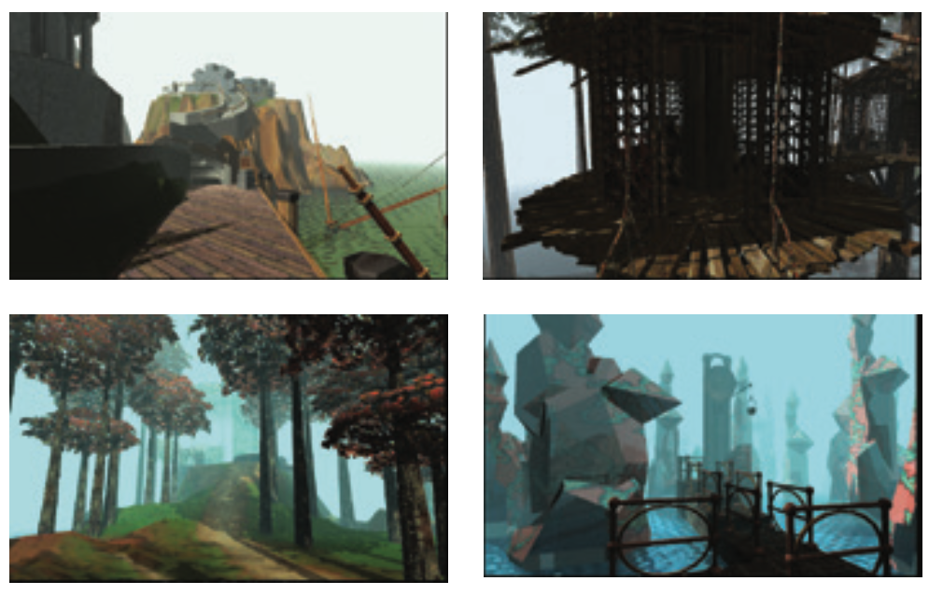
Myst
Source: http://sirrus.cyan.com/Online/Myst/GameShots. © Cyan Worlds, Inc. Used by permission
Notes:
Figure 6.2 Pictures from the game Myst

Slide 19
GameFlow and gerontoludic design (1 of 2)
The GameFlow model (Sweester and Wyeth, 2005) is a characterization of player enjoyment in games.
It draws on many of the characteristics of enjoyment, pleasure and flow that we discuss in this chapter.
The GameFlow model has eight core elements: concentration, challenge, skills, control, clear goals, feedback, immersion and social interaction.
As the authors acknowledge, these elements are closely related to Csikszentmihalyi’s concept of flow and the balance between skills and challenges.
Sweester, Johnson and Wyeth (2012) revisited the original model in 2012 in the context of real-time strategy games and developed a number of heuristics for how the elements could be implemented through the different media of the game (graphics, sound, narrative and so on).
For example, immersion can be increased by having an engaging animation with good sound as the game is loading.

Slide 20
GameFlow and gerontoludic design (2 of 2)
Laura Oades (2016) applied the model to the design of games for older people, gerontoludic design (De Schutter and Vanden Abeele, 2015).
She found that the original model of GameFlow had to be extended for this demographic.
More attention should be paid to implementing support to help concentration, challenge, control and particularly social interaction.
The older people in her study needed to experience self-efficacy (Bandura, 1977) and a sense of fulfilment in their gameplay.
They needed to experience gameplay as meaningful in the sense that the skills and knowledge developed through the game are useful in the world outside the game.

Slide 21
Nicole Lazzaro
Nicole Lazzaro (Lazzaro, 2012) draws the link between fun and emotion in her contribution to understanding what makes interactive activities engaging.
She identifies five ways that emotions impact the gaming experience:
Enjoy. Emotions create strong shifts in internal sensations.
Focus. Emotions help gamers to focus effort and attention.
Decide. Emotions are central to decision making in games.
Perform. Emotions increase appeal to enhance performance.
Learn. Emotions are important for motivation and attention.

Slide 22
Four fun keys model (1 of 2)
Lazzaro presents the four fun keys model in which she distinguishes four different types of fun — hard fun, easy fun, serious fun and people fun — each of which goes on to unlock emotions, such as curiosity, relaxation, excitement and amusement, that contribute to a good player experience. More generally we can see these as key emotions in contributing to a high-quality user experience:
Hard fun is concerned with overcoming adversity, the emotion that Lazzaro calls Fiero. It relates to the gamification effects of mastery, challenge and strategy. For example, in a car racing game, it is no fun if it is hard to start the car and start the race. However, it is fun if it is hard to avoid the obstacles or keep the car on track whilst driving fast. The hard fun comes from mastering the driving.
Easy fun evokes the key emotion of curiosity. Gamification mechanics such as novelty, ambiguity, fantasy and role play make people curious to explore the interaction. It is more open-ended interaction than the focused, goal-centred interaction of hard fun.
Serious fun is about relaxation. It arises when an interactive experience provides rewards that increase people’s self-worth and allow them to focus on activities. Serious fun is about doing work!
People fun concerns the emotion of amusement. It arises when people are connected to one another in cooperative or competitive activities. It is the social side of gamification, connecting into people’s social networks and desire to share.

Slide 23
Four fun keys model (2 of 2)
Advantages of four fun keys model:
Using these four fun keys helps the interaction designer to produce a UX that moves the user through different emotions, helping create engaging experiences.
In terms of the design process, UX designers need to consider what type(s) of experience(s) they are trying to create for users of their systems.
The four fun keys provide a good way into thinking about this.
Subsequently, designers can consider the mechanisms that they are going to use to try to evoke those experiences.

Slide 24
Four fun keys model mechanisms
Deciding what challenges to include in the product and whether these are short-term challenges or longer-term ‘quests’
Deciding how to deal with the different skill levels of different users and how to accommodate changing skill levels
Deciding what rewards to provide people with and how rewards relate to challenges and skill levels
Deciding if people can collect things, or complete things like puzzles, and if they do collect things how they relate to rewards, abilities and skills
Deciding how people will relate to other people through competition such as league tables and posting achievements or through cooperation and working with others to achieve a common goal

Slide 25
Funware
Funware refers to software that is designed to make particular systems or services more enjoyable to use with the aim of increasing use of the service.
Funware mechanics utilise all the different methods described in this section.
For example, the TripAdvisor app on Facebook gives points to users who upload reviews of hotels, restaurants and so on.
Users get a badge once they have uploaded more than three reviews and different colours of badge reflect different numbers of reviews.
This enables users to gain an overall score depending on their contributions and may become a destination expert of a place.
Other users rate peoples’ reviews giving them social points based on ratings given and activities such as gifting points to others.
Users can add personal information such as who they travel with so that they get notified when their friends write reviews or travel to particular places.
The app has a leader board showing how friends compare with their social group.
Similar approaches are used in professional groups. For example, academics are rated on the ResearchGate website, and a web service called Klout measures a user’s on-line profile.

Slide 26
Designing for pleasure
Product designers have long been concerned with building in pleasure as a key marketing point.
Pleasure is a focus for many design situations that were once much more dominated by the more functional aspects of usability.
The Apple Mac Air is advertised as being lightweight and elegant (it is only 3 cm thick) with a distinctive and attractive titanium shell.
While all of these features contribute to the laptop’s usability, they also contribute to the pleasure of owning, using and (perhaps) being seen with it.

Slide 27
Designing pleasurable products
Designing for pleasure can be as important as ensuring that an interactive device is usable.
Jordan describes pleasure as being ‘the condition of consciousness or sensation induced by the enjoyment or anticipation of what is felt or viewed as good or desirable; enjoyment, delight and gratification’.
In the context of interactive devices or products, designing for pleasure contributes to ‘emotional, hedonistic and practical benefits’.
Jordan’s approach draws heavily on the work of Lionel Tiger, who is an anthropologist and has developed a framework for understanding and organizing thinking about pleasure.
Tiger has argued that there are four dimensions or aspects of pleasure. These are physio-pleasure, socio-pleasure, psycho-pleasure and ideo-pleasure.

Slide 28
Physio-pleasure
This is concerned with the body and the senses.
Physio-pleasure arises from touching or handling devices or from their smell – think about the smell of a new car, or the pleasingly solid but responsive feel of a well-designed keyboard.
This sort of pleasure is also derived from using devices which fit seamlessly with the human body – although this is more usually noticed when the fit is less than ideal.
The physical fit of technology to people has long been a central concern for ergonomists working on the design of new products.

Slide 29
Socio-pleasure
Socio-pleasure arises from relationships with others.
Products and devices which have a socio-pleasurable aspect either facilitate social activity or improve relationships with others.
A very obvious example is the key role which text messaging has in enhancing social communication for many people, the use of Twitter to keep in touch or the popularity of social networking websites such as Facebook.
Pleasure derived from enhanced status or image is also considered a socio-pleasure and of course is much exploited by the vendors of successive generations of small personal technologies.

Slide 30
Psycho-pleasure
Psycho-pleasure (short for psychological pleasure) refers to cognitive or emotional pleasure in Tiger’s framework.
This dimension of pleasure is useful for pulling together sources of pleasure such as the perceived ease of use and effectiveness of a device and the satisfaction of acquiring new skills.
For some people, learning a complex programming language generates a degree of satisfaction which would never be obtained from moving icons around the screen in a GUI.

Slide 31
Ideo-pleasure
Ideo-pleasure (ideological pleasure) concerns people’s values – things one holds dear or meaningful – and aspirations.
We are more likely to enjoy using items that fit our value system.
Aspects which come readily to mind here might include a respect for careful craftsmanship and design, the desirability or otherwise of having an obviously expensive device and our perceptions of the trading ethics of the supplier (for example, commercial software as against free shareware).

Slide 32
The four dimensions in practice
Jordan uses this framework to develop a product benefit specification to help focus design.
He also develops personas (though he does not use the term) based on a holistic analysis of the potential users of products.
It is also worth noting that this type of analysis is similar to Lazzaro’s analysis of different types of fun as discussed in the previous section and to Zimmerman’s view of product attachment described below.
Although primarily focused on product design, designing for pleasurable experiences is clearly an important aspect of the UX of services as well.

Slide 33
The Mac Air
Physio-pleasure. The machine is light, the texture of the titanium shell is pleasing and the keyboard is responsive.
Socio-pleasure. Certainly when first released, owning a Mac Air might be thought to enhance image as it distinguishes the owner as someone with the discernment to adopt a stylish remodelling of the laptop. There is also a certain socio-pleasure in being part of a small (rather administratively inconvenient) group of Apple devotees amongst a much larger community of PC users in our particular workplace.
Psycho-pleasure. The Mac Air provides relatively seamless integration amongst different media and so generates satisfaction from streamlining many work tasks.
Ideo-pleasure. For some consumers, Apple products remain an embodiment of independence, creativity and free-thinking – attributes inherited from the early image of the corporation. Whether this is still an accurate perception is not the point: it is enough that people feel that it is so.

Slide 34
Challenge 5.2
Using Tiger’s classification, what do you consider is the main pleasure evoked by the design of one of the interactive devices/systems you enjoy owning or using? If possible, compare your response to those of one or more colleagues for a similar device.

Slide 35
Product attachment theory (1 of 3)
Zimmerman (2009) discusses how to bring product attachment theory into interaction design.
Product attachment concerns the feelings that people have for products and the ways in which the products take on meanings for them.
He reflects on a number of products from the perspective of ‘designing for the self’, by which he means designing for other people to realize themselves through interacting with the product.
He looked specifically at six products and at the characteristics they possessed in terms of design patterns.
Design patterns are regularities in designs that capture some aspects of successful design.
Design patterns are an important part of interactive systems design and are discussed in Chapter 9 as part of our design approach.

Slide 36
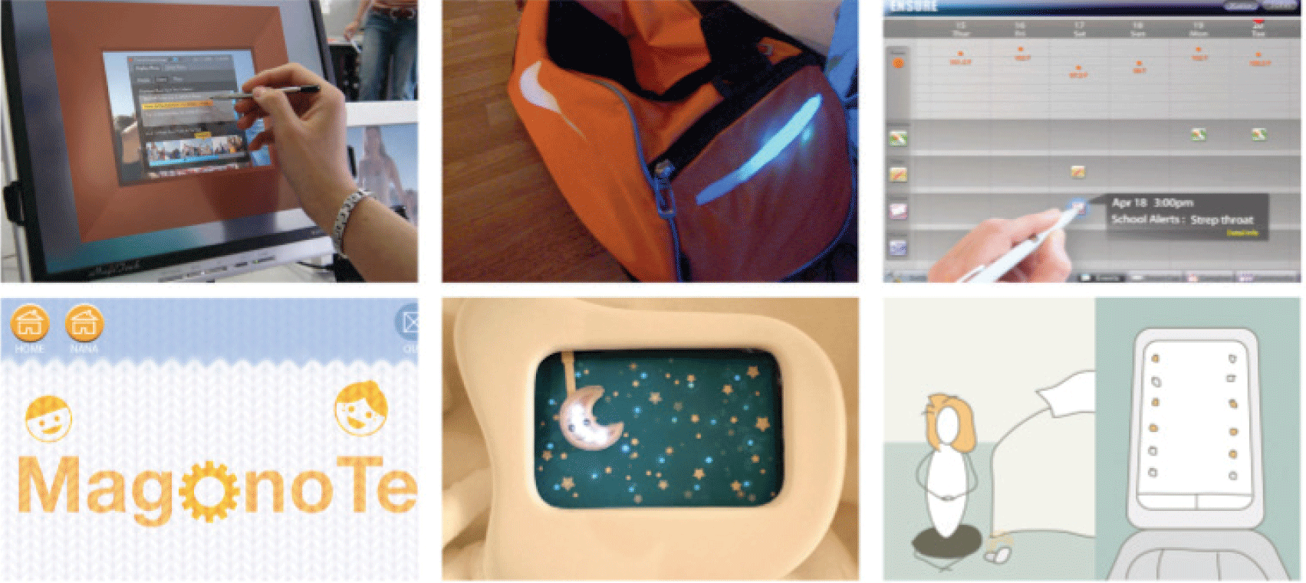
Product attachment theory (2 of 3)
Source: Zimmerman, J. (2009) Designing for the self: making products that help people become the person they desire to be, CHI ‘09: Proceedings of the SIGCHI Conference on Human Factors in Computing Systems, pp. 395–404. © 2009 ACM, Inc. Reprinted by permission. doc.acm.org/10.1145/1518701.1518765
Notes:
Figure 6.4 Products examined by Zimmerman – Ensure, designed by Hee Young Jeong and Sun Young Park; Smart Bag, designed by Min-Kyung Lee; Cherish, designed by Jeong Kim; Share Moments, designed by Rhiannon Sterling Zivin; Magonote, designed by Mathew Forrest; Reverse Alarm Clock, designed by Kursat Ozenc

Slide 37
Product attachment theory (3 of 3)
The products examined by Zimmerman included Cherish, a smart photo frame, a smart bag for organizing and carrying athletic kit that is connected to the family’s calendar and the reserve alarm clock that aimed to stop children waking their parents at night. From his analysis, he arrived at six ‘framing constructs’ that captured important elements of product attachment:
Role engagement concerned support for the different roles that people play in their lives. It arises from the observation that people have to switch roles depending on the context, such as the time of day, or relationship required for a particular activity.
Control concerned empowering people, giving them control over the product. This could be control over the ‘look and feel’ of the product, personalizing it to their tastes or it could be control over the functionality of the product.
Affiliation concerns how people develop feelings for a product by ensuring that the product meets a real need for them.
Ability and bad habit is a construct concerned with enhancing people’s abilities and preventing them from making mistakes or engaging in their bad habit. The smart bag, for example, stopped people from forgetting things.
Long-term goals need supporting as well as short-term functions. People build their attachment by recognizing that the product supports their long-term goals.
Ritual concerns how the product fits in with important ritual aspects of the person’s life.

Slide 38
Zimmerman
Zimmerman encourages designers to keep these framing constructs in mind during the understanding, envisioning, designing and evaluation processes of the whole design process.
In doing so, they will focus more on designing for the self and on developing products that people will form an attachment to.

Slide 39
Kansei
Kansei engineering is concerned with bringing an emotional and aesthetic element to engineering.
It is used across all manner of engineering design practices in order to try to understand and embody what it is that will get people really involved in a design.
To date it has been applied very little in interaction design.
Kansei sits alongside Chinsei as one of the two threads of the design and engineering process, Kansei dealing with the emotional and Chinsei with the functional.
Although the method has not entered the mainstream of UX, there is evidence that designing in order to create an emotional engagement can be important.
For example, first impressions of websites are made within 50ms (Lindgaard, et al., 2006).

Slide 40
Aesthetics
Aesthetics is a large area of study concerned with human appreciation of beauty and how things are sensed, felt and judged.
Aesthetics takes us into the world of artistic criticism and the philosophy of art itself.
The perennial debate here is whether aesthetics can ever be inherent in something or whether ‘beauty is in the eye of the beholder’.
In terms of the design of interactive systems, aesthetics has become increasingly important over the last few years from a number of different directions.
From the perspective of work on emotion, both Don Norman and Pieter Desmet emphasize the importance of taking emotions into consideration in design.

Slide 41
Emotional design
Don Norman discusses people’s experiences in terms of visceral, behavioural and reflective elements:
At the visceral level, lie the perceptual aesthetics of an experience.
At the behavioural level, a positive emotional response will come from feeling in control and from the understanding that comes through use.
At the reflective level are issues of personal values and self-worth.
Pieter Desmet identifies a number of product emotions in his book Designing Emotions.
He sees these as a manageable set of emotions such as boredom, inspiration, amusement and so on that are particularly relevant for product designers.

Slide 42
Desmet’s emotions
This work has resulted in a database of anecdotal evidence about products and emotions, the product and emotion navigator and a non-verbal method for measuring people’s response to product features, called PrEmo.
PrEmo consists of 14 animations of a cartoon character, each expressing an emotion.
There are seven positive emotions, that is inspiration, desire, satisfaction, pleasant surprise, fascination, amusement and admiration, and seven negative emotions, that is disgust, indignation, contempt, disappointment, dissatisfaction, boredom and unpleasant surprise (Figure 6.5).
Various versions of PrEmo exist and similar methods have been developed aimed at children, getting reactions to designs without needing to use words.

Slide 43
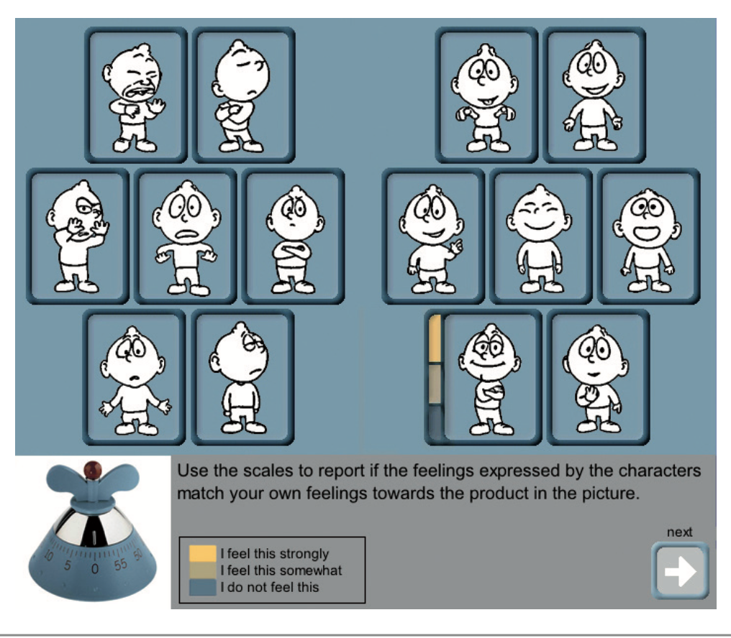
PrEmo
Source: Desmet, P.M.A. (2003), pp. 111–123
Notes:
Figure 6.5 PrEmo

Slide 44
Hassenzahl
Hassenzahl (2007) discusses aesthetics in terms of pragmatic attributes and hedonic attributes where the pragmatic attributes are broadly similar to traditional views of usability and the hedonic attributes concern many of the issues addressed in this chapter.
Hassenzahl (2010) describes experiences in general (and hence UX) in terms of ‘be-goals’ that are concerned with meaning, motivation and emotion, ‘do-goals’ concerned with concrete, desired outcomes and ‘motor-goals’ concerned with issues at the physical level, providing a similar type of structure as Jordan’s (Jordan, 2000).
Pragmatic aesthetics and quality concern the product or service’s ability to achieve the do-goals, and hedonic aesthetics and quality support the be-goals.

Slide 45
Operationalizing the ideas
Hassenzahl and his colleagues have operationalised these ideas by developing a questionnaire (see Chapter 10) that looks at 10 attributes of the UX.
Pragmatic quality is assessed on the scales of confusing–structured, impractical–practical, unpredictable–predictable and complicated–simple.
Hedonic quality is measured in terms of dull–captivating, tacky–stylish, cheap–premium, unimaginative–creative, and good–bad and beautiful —ugly are measures of general product evaluation.
Their AttrakDiff measure of UX is discussed in Chapter 10.

Slide 46
Eudemonics
A recent criticism of the concept of hedonics, however, points to the alternative concept of eudemonics that focuses on the enjoyment of having a good life and not simply engaging in enjoyment in a hedonistic fashion (Mekler and Hornbook, 2016).
This draws on the discussion earlier about the different types of fund identified by Lazarro and on the different types of pleasure.
Ideo-pleasure in particular focuses on the importance of people’s values and how different experiences will satisfy these values.
The eudemonic motives attend to longer lasting, meaningful engagements and individual need fulfillment.

Slide 47
Aesthetics
Lavie and Tractinsky (2004) see the aesthetics of interactive systems in terms of classical aesthetics (clean, clear, pleasant, aesthetic and symmetrical) and expressive aesthetics (original, sophisticated, fascinating, special effects and creative).
They assert that ‘what is beautiful is useable’ because users seemed willing to tolerate systems with less usability so long as they were aesthetically pleasing.
However, Hartman et al. (2008) see it as more complex than this and point to the importance of
the type of tasks people are doing (serious or less serious),
their background including cultural background and
and the order in which they are doing things as factors that affect people’s aesthetic judgment.

Slide 48
Sutcliffe
Sutcliffe (2009) develops a complex model of engagement, UX and emotion showing how each of these is influenced by many factors.
Certainly, there is more than traditional usability at work in people’s judgments of the aesthetics and quality of interactive systems.
Content, services and brand are also factors to be taken into consideration.
To add to this complexity, we need to keep in mind the issues of cross-channel UX described in Chapter 4, how people encounter the various touchpoints of interaction and how these come together to contribute to the UX of the whole user journey.
For Boehner et al. (2008), the issue is to make products not just right but meaningful.
They seek to intimately couple the codification necessary in design with the ineffable nature of human experience.

Slide 49
Lifestyle
Of course different people enjoy different things.
They have different views on aesthetics.
Some people like playing games and others do not.
Some people find one thing pleasurable and others find something else pleasurable.
Designers need to think of the experience that they are creating for different people and the different lifestyles they have.
As we discussed in Section 6.3, people take ideo-pleasure in different things.
This pleasure reflects their values, motivations, desires and dislikes.
Lifestyle concerns aspirations and achievements over time.

Slide 50
Brand
The development of a brand identity is an important part of people liking and enjoying a system.
Some people are ‘Microsoft’ people, others are ‘Apple’ people.
Some people love Nike and others Reebok.
These companies spend a great deal of effort and money developing, refining and promoting their brand.
They like to be associated with certain events, or to sponsor certain football or baseball teams, as these associations help develop the brand.
A brand will often deliver consistent guidelines for designers, such as colours, use of particular fonts and so on.

Slide 51
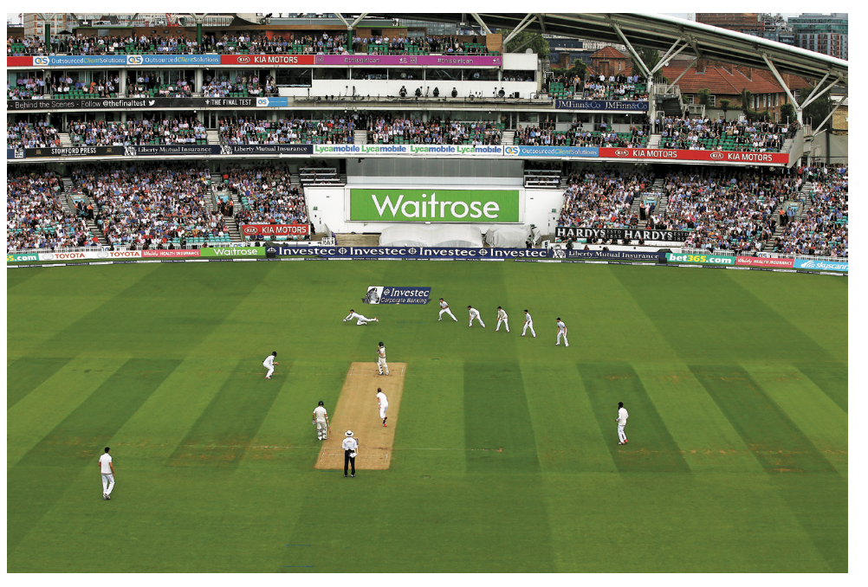
Brand and identity
Brand immediately leads to a sense of identity, one of the key aspects of experience.
And conversely, experience will affect the brand.
People’s experiences in interacting with branded products and services create the feelings and values they have for the brand.
Figure 6.6 shows the upmarket UK shopping brand Waitrose that sponsors the English cricket team.
The complex associations between playing cricket and shopping for groceries is the focus of their sponsorship.
Notes:
Figure 6.6 Cricket sponsored by Waitrose

Slide 52
Experience design
Experience design, then, concerns the relationship between brand and lifestyle of the users or customers.
Organizations must pay careful attention to their brand and what differentiates them from others.
They must provide the right services in the right way that suits the lifestyle of their customers.
UK luxury clothing brand, Burberry, is a good example of a company that has taken its brand (trench coat, check fabrics and so on) and targeted the younger richer people who have a life style of country walks and city parties.
They carry this brand through the different experiences that they offer in-store, on-line and through their apps.

Slide 53
Design for life
Karen Holzblatt and Hugh Beyer have recently revisited their ideas on contextual design, and through a project called ‘Project Cool’, they have examined how new technologies fit in with people’s lifestyles (Holzblatt and Beyer, 2015).
They identify
the Joy of Life that is described in terms of accomplishment, connection, identity and sensation and
the Joy in Use which concerns the simple fulfillment of intent, removal of hassle and ease of learning.
They point out the importance of these characteristics in providing a great UX and how important it is to gather data about the users life experience on core human motives and behaviours, on the wider dimensions of life and how the user’s integrated life fits together.

Slide 54
Summary
Experience design is concerned with all the issues that go into providing an engaging and enjoyable experience for people in both the short and longer term.
Experience design includes the before, during and after aspects of the experience, the multilayered nature of the elements of experience and the journeys through the experiences.
Understanding experiences includes aesthetics, pleasure and emotional engagement in terms of both the product and the service provided in the context of the user’s lifestyle, goals, values and aspirations.
Furthermore, it is important to consider experiences at a physical, behavioural and social level and in terms of the meanings people derive from their experiences.
Experience design draws on:
Theories of engagement
Theories of emotion
Theories of aesthetics
Theories of games.

Slide 55
Conclusion
Experience design is concerned with all the issues that go into providing an engaging and enjoyable experience for people in both the short and longer term.
This includes aesthetics, pleasure and emotional engagement in terms of both the product and the service provided.
In particular, it is important to consider experiences at a physical, behavioral, social level and in terms of the meanings people derive from their experiences. Experience design draws on theories of experience, of emotion, of aesthetics and of design.

