Slide 1

Designing User Experience
A guide to HCI, UX and Interaction Design
Fourth Edition
Chapter 11
Task analysis

Slide 2
Contents
11.1 Goals, tasks and actions
11.2 Task analysis and systems design
11.3 Hierarchical task analysis
11.4 GOMS: a cognitive model of procedural knowledge
11.5 Structural knowledge
11.6 Cognitive work analysis

Slide 3
Aims
The notion of a ‘task’ has been central to work in human–computer interaction (HCI) since the subject started.
Undertaking a task analysis is a very useful technique – or rather set of techniques – for understanding people and how they carry out their work.
Looking at the tasks that people do, or the tasks that they will have to do because of some redesigned system, is a necessary part of human-centred design.
This chapter provides some philosophical background on what task analysis is and where it fits into UX design.
It then provides practical advice on doing different types of task analysis.

Slide 4
After studying this chapter you should be able to:
Understand the difference between goals, tasks and actions.
Undertake a hierarchical task analysis.
Undertake a procedural cognitive task analysis.
Understand the importance of considering a structural view of a domain.

Slide 5
Goals, tasks and actions (1 of 3)
Some authors consider ‘task analysis’ to encompass all manner of techniques (such as interviewing, observation, development of scenarios and so on). We do not.
We consider task analysis to be a specific view of UX design that leads to specific techniques.
This chapter looks more formally at the concept of task, how to undertake task analyses and what benefit designers might get from such analyses.
In the final section, we look at the importance of understanding a structural perspective of a domain.

Slide 6
Goals, tasks and actions (2 of 3)
The distinction between the key concepts in task analysis – goals, tasks and actions – may be identified as follows:
A task is a goal together with some ordered set of actions.
The concept of task derives from a view of people, or other agents, interacting with technologies trying to achieve some change in an application domain.
Taken together, the people and technology constitute what is sometimes called a ‘work system’, which is separate from the ‘application domain’.
Dowell and Long (1998) emphasize that the application domain (or simply ‘domain’) is an abstraction of the real world, that is some abstract representation (such as a database, a website or an iPhone app).
Importantly, task analysis is concerned with some aspects of the performance of a work system with respect to a domain.
This performance may be the amount of effort to learn a system, to reach a certain level of competence with a system, the time taken to perform certain tasks and so on.

Slide 7
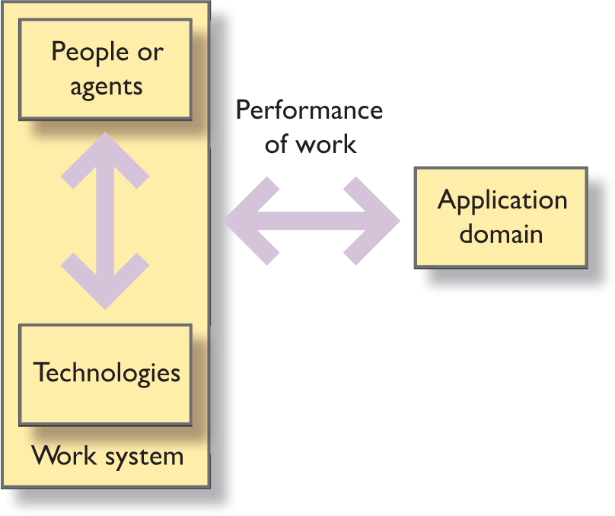
Figure 11.1 Task analysis is concerned with the performance of work by a work system

Slide 8
Diaper’s full definition of task analysis
Work is achieved by the work system making changes to the application domain.
The application domain is that part of the assumed real world that is relevant to the functioning of the work system.
A work system in HCI consists of one or more human and computer components and usually many other sorts of thing as well.
Tasks are the means by which the work system changes the application domain.
Goals are desired future states of the application domain that the work system should achieve by the tasks it carries out.
The work system’s performance is deemed satisfactory as long as it continues to achieve its goals in the application domain.
Task analysis is the study of how work is achieved by tasks.

Slide 9
Diaper’s view
This view of the separation of work system and domain is not shared by everyone but this definition does result in some useful task analysis techniques for systems analysis and design. Other definitions are as follows.
Goals:
A goal is a state of the application domain that a work system wishes to achieve. Goals are specified at particular levels of abstraction.
This definition allows for artificial entities such as technologies or agents or some combination to have goals.
For example, we might be studying the organizational goals of a company, or the behaviour of a software system in terms of its goals.
It is not just people who have goals; the work system as a whole may have goals.
For this reason, the term ‘agent’ is often used to encompass both people and software systems that are actively and autonomously trying to achieve some state of the application domain.
The term ‘technology’ is used to encompass physical devices, information artefacts, software systems and other methods and procedures.

Slide 10
Example (1 of 2)
For example, an agent might have a goal such as to write a letter, to record a programme on TV or to find the strongest mobile phone signal.
The assumption is that the domain is in one state now – no letter written, the TV programme not recorded and the signal not confirmed as the strongest – and the agent has to undertake some activities, that is some tasks, in order to get it into the required state.
Usually a goal can be achieved in a variety of different ways.
So the first thing the agent has to decide is which technology to use to achieve the goal.
For recording a TV programme, for example, an agent could use the following technologies:
Ask a friend to record it.
Press ‘Rec’ on the PVR (personal video recorder).
Set the timer using a manual setting.
Set the timer using an on-screen TV guide.

Slide 11
Example (2 of 2)
Of course, the agent needs to know quite a lot about each of these technologies and the pros and cons of each and will select different ones at different times depending on the circumstances.
The agent may misunderstand some of the technologies and so may not take the optimum course of action.
The selection of a technology will depend on the agent’s knowledge of the functions, structure and purpose of particular technologies, and this knowledge may be quite erroneous.
Once a technology has been decided upon, the tasks can now be defined.

Slide 12
Tasks and actions (1 of 2)
A task is a structured set of activities required, used, or believed to be necessary by an agent to achieve a goal using a particular technology.
A task will often consist of subtasks where a subtask is a task at a more detailed level of abstraction.
The structure of an activity may include selecting between alternative actions, performing some actions a number of times and sequencing of actions.
The task is broken down into more and more detailed levels of description until it is defined in terms of actions.
Actions are ‘simple tasks’, whereas a task might include some structure such as doing things in a particular sequence, making decisions as to alternative things to do (selection) and doing things several times (iteration), an action does not. This structure is often called a plan or method.
An action is a task that has no problem solving associated with it and which does not include any control structure.
Actions and tasks will be different for different people.

Slide 13
Tasks and actions (2 of 2)
For example, in the case of recording a TV programme, if the programme is just about to come on, it might be best to press ‘Rec’ on the PVR which would start recording immediately.
This brings its own problems as the PVR might be tuned to the wrong channel depending on the particular connections between the devices.
Alternatively, the agent could set the timer manually.
Using an on-screen menu system is more laborious as the agent has to turn the TV on to use the on-screen menu.
If the agent is not very well informed about the operation of the system, the agent may fiddle around selecting the PVR channel, finally getting to the on-screen programming and so on.
The agent may do things that are strictly unnecessary because the agent had a poor conceptualization of the mental model of the device.

Slide 14
Task analysis methods
Task analysis methods can be divided into two broad categories: those concerned with the logic of the task – the sequence of steps that need to be undertaken by a work system to achieve a goal – and those concerned with cognitive aspects.
Cognitive task analysis is concerned with understanding what cognitive processes the work system will have to undertake in order to achieve a goal.
Cognition is concerned with thinking, solving problems, learning, memory, and their mental models.

Slide 15
Challenge 11.1
Write down the task structure for manually recording a programme using a PVR. Think about the decisions that an agent would need in order to undertake this task and about the differences between tasks and actions for different agents with different knowledge. Discuss with a friend or colleague.

Slide 16
Knowledge
People also have knowledge of how to do things in general and how to do things with specific technologies.
People make use of things in the environment (such as displays on a computer screen or notes on a piece of paper) as part of the cognitive processes.
Cognitive task analysis has a long-established tradition in human–computer interaction, with a large number of methods coming from a variety of slightly different backgrounds.
Most of the theoretical treatments of cognition and action presented in Chapter 23 have resulted in some technique applied to the design or evaluation of interactive systems.

Slide 17
Goals, tasks and actions (3 of 3)
In terms of the goals, tasks and actions, we need to consider both the goal–task mapping (knowing what to do to achieve some goal) and the task–action mapping (knowing how to do it).
There is also a need to consider the goal formation stage – knowing that you can do something in the first place.
In addition to this procedural knowledge, people have structural knowledge.
Structural knowledge concerns knowing about concepts in a domain and knowing how those concepts are related.
This sort of knowledge is particularly useful when things go wrong and when understanding the relationships amongst the components in a system will help with troubleshooting.

Slide 18
Task analysis and systems design (1 of 2)
There are many views on, and methods for, task analysis and task design.
As noted previously, some authors equate task analysis with the whole of systems development.
Others equate methods of task analysis with methods of requirements generation and evaluation.
Yet others distinguish task analysis (understanding existing tasks) from task design (envisioning future tasks).
Diaper and Stanton (2004a) provide a comprehensive overview of 30 different views.
One thing that people agree upon is that a task analysis will result in a task model, though, as we will see, these models can take very different forms.

Slide 19
Task analysis and systems design (2 of 2)
Balbo et al. (2004) emphasize the expressive power of different methods in their taxonomy of task analysis techniques.
For example, they focus on whether a technique captures optionality (is a task mandatory or optional in pursuing a goal?), parallelism (can tasks be performed in parallel?) or non-standard actions such as error handling or automatic feedback.
They also classify methods along the following axes:
The goal of using the notation. By this they mean the stage in the development life cycle; is it best for understanding, design, envisionment or evaluation?
Its usability for communication. Some task analysis techniques can be very hard to read and understand, particularly those that are based on a grammar rather than graphical notation.
Its usability for modelling tasks. Task analysis methods have to fit into the software development process and be used and understood by software engineers. It has long been a problem that software engineers do not have ready access to a good task analysis technique. Some methods are intended to assist in the automatic generation of systems (see Further thoughts box).
The adaptability of a task analysis technique to new types of system, new aims or new requirements. To what extent is the technique extensible to other purposes? (e.g. a task analysis technique aimed specifically at website design may not be very adaptable).

Slide 20
Diaper and Stanton
Diaper and Stanton (2004b) make an important observation regarding many task analysis techniques, namely that they are usually mono-teleological.
That is to say, they assume that the agent or work system has a single purpose which gives rise to its goal.
Teleology is the study of purposes, causes and reasons, a level of description of activities that is missing from most task analysis approaches.
In reality, of course, people and work systems may be pursuing multiple goals simultaneously.
Task analysis is an important part of systems development but it is a term that encompasses a number of different views.
It is undertaken at different times during systems development for different purposes.

Slide 21
Model-based user interface design (1 of 2)
One particular branch of task analysis concerns the formal representation of systems so that the whole system, or part of it, can be automatically generated by a computer system from the specification or model.
Work on model-based design has continued, without much success, in several areas.
In user interface design, several systems have been tried (see Abed et al., 2004, for a review) that represent systems at the domain level, an abstract level of description and the physical level of different styles of widget such as scroll bars, windows and so on.
One aim of the model-based approaches is to enable different versions of a system to be automatically generated from the same underlying model.
For example, by applying different physical models an interface for a smartphone, a computer and a tablet could be generated from the same abstract and domain models.
Stephanidis (2001) uses this approach to generate different interfaces for people with varying levels of ability.

Slide 22
Model-based user interface design (2 of 2)
Model-based approaches have also been tried in software engineering for many years (e.g. Benyon and Skidmore, 1988), again with limited success.
The screen-design systems that automate the generation at the physical layer (such as UX tool kits) have been successful but automatically linking this to an abstract level of description proves difficult.
However, important work on dependable systems does exploit the benefits of formal task models, many using petri-nets as the basis.
A recent discussion is provided in Martinie et al. (2016).

Slide 23
TA and systems development (1 of 3)
During the understanding process, for example, the task analysis should aim to be as independent as possible from the device (or technology), for the aim is to understand the essential nature of the work in order to inform new designs.
During the design and evaluation of future tasks, task analysis focuses on the achievement of work using a particular technology (i.e. a particular design) and hence is device-dependent.
During understanding, task analysis is concerned with the practice of work, with the current allocation of function between people and technologies, with existing problems and with opportunities for improvement.
During design and evaluation, task analysis is concerned with the cognition demanded by a particular design, the logic of a possible design and the future distribution of tasks and actions between people and technologies.

Slide 24
TA and systems development (2 of 3)
Task analysis is in many ways similar to scenario-based design, for tasks are just scenarios in which the context and other details have been stripped away.
Task analysis is best applied to one or two key activities in a domain.
Task analysis is not quick or cheap to do, so it should be used where there is likely to be the best pay-off.
In an e-commerce application, for example, it would be best to do a task analysis on the buying-and-paying-for-an-item task.
In designing the interface for a mobile phone, key tasks would be ­making a call, answering a call, calling a person who is in the address book and finding your own phone number.

Slide 25
TA and systems development (3 of 3)
In the rest of this chapter, we look at two analysis techniques.
The first is based on hierarchical task analysis (HTA) and is concerned with the logic of a task.
The second, based on the goals, operators, methods and selection rules (GOMS) method, is concerned with a cognitive analysis of tasks, focusing on the procedural knowledge needed to achieve a goal.
This is sometimes called ‘how to do it’ knowledge.
Finally, we look at understanding structural knowledge, sometimes called ‘what it is’ knowledge.

Slide 26
Hierarchical task analysis
Hierarchical task analysis (HTA) is a graphical representation of a task structure based on a structure chart notation.
Structure charts represent a sequence of tasks, subtasks and actions as a hierarchy and include notational conventions to show whether an action can be repeated a number of times (iteration) and the execution of alternative actions (selection).
Sequence is usually shown by ordering the tasks, subtasks and actions from left to right.
Annotations can be included to indicate plans.
These are structured paths through the hierarchy to achieve particular goals.
For example, making a call using a mobile phone has two main routes through the hierarchy of tasks and subtasks. If the person’s number is in the phone’s address book, then the caller has to find the number and press ‘call’. If it is not, the caller has to type the number in and press ‘call’.

Slide 27
HTA (1 of 5)
HTA was developed during the 1960s and has appeared in a variety of guises since then. Stanton (2003) gives a detailed account.
There are a number of notational conventions that can be used to capture key features of the tasks.
We recommend using an asterisk in the box to show that an action may be repeated a number of times (iteration) and a small ‘o’ to show optionality.
The plans are used to highlight sequencing.

Slide 28
HTA (2 of 5)
Others (e.g. Stanton, 2003) like to show decision points as parts of the plans.
HTA is not easy.
The analyst must spend time getting the description of the tasks and subtasks right so that they can be represented hierarchically.
Like most things in UX design, undertaking a hierarchical task analysis is highly iterative and you will not get it right first time.
The analyst should return to the task list and try to redefine the tasks so that they can be represented hierarchically.

Slide 29
HTA (3 of 5)
HTA appears in many different methods for interactive systems design.
For example, Stanton (2003) uses it as part of his method for error identification. He develops an HTA model of a system and then works through the model looking for possible error situations.
At the action level (bottom level of an HTA), people might make a slip such as pressing the wrong button.
What happens if they do this?
At the task and subtask levels, the analyst can consider what type of task it is and hence what types of error might occur.

Slide 30
HTA (4 of 5)
Annett (2004) provides a step-by-step guide to how to do an HTA:
Decide on the purpose of the analysis. This is typically to help with systems design or to design training materials.
Define the task goals.
Data acquisition. How are you going to collect data? Observation, getting people to use a prototype, etc.
Acquire data and draft a hierarchical diagram.
Recheck validity of decomposition with stakeholders.
Identify significant operations and stop when the effects of failure are no longer significant.
Generate and test hypotheses concerning factors affecting learning and performance.

Slide 31
HTA (5 of 5)
Lim and Long (1994) use HTA slightly differently in their HCI development method, called MUSE (Method for Usability Engineering).
They illustrate their approach using a ‘Simple ATM’ example as shown in Figure 11.2.
This shows that the ‘Simple ATM’ consists of two subtasks that are completed in sequence: Present Personal ID and Select Service.
Present Personal ID consists of two further subtasks: Enter Card and Enter PIN.
In its turn, Enter PIN consists of a number of iterations of the Press Digit action. Select Service consists of either Withdraw Cash or Check Balance.

Slide 32
GOMS: a cognitive model of procedural knowledge (1 of 4)
GOMS is the most famous and long-lasting of a large number of cognitive task analysis methods (Kieras, 2012).
GOMS focuses on the cognitive processes required to achieve a goal using a particular device. The aim is to describe tasks in terms of the following:
Goals. What are people trying to do using some system (e.g. make a call using a cell phone.)
Operators. These are the actions that the system allows people to perform, such as clicking on menus, scrolling through lists, pressing buttons and so on.
Methods. These are sequences of subtasks and operators. Subtasks are described at a more abstract level than operators – things such as ‘select name from address book’ or ‘enter phone number’.
Selection rules. These are the rules that people use to choose between methods of achieving the same subtask (if there are options). For example, to select a name from an address book, a person could scroll through the names or type in the first letter and jump to a part of the address book.

Slide 33
GOMS: a cognitive model of procedural knowledge (2 of 4)
There are many different ‘flavours’ of GOMS, focusing on different aspects of a task, using different notations and different constructs.
In this book, we do not claim to teach GOMS as a method but just to alert readers to its existence and provide some illustrative examples. Kieras (2004) provides his version and John (2003) provides hers.
Looking at the constructs in GOMS, it is clear that the method is applicable only if people know what they are going to do.
John (2003) emphasizes that selection rules are ‘well-learned’ sequences of sub-goals and operators.
GOMS is not a suitable analytical method where people are problem-solving.
Also, it is mainly applicable to systems being used by a single person where it can give accurate estimates of performance and help designers think about different designs.

Slide 34
GOMS: a cognitive model of procedural knowledge (3 of 4)
John (2003) gives the example of a GOMS analysis in project Ernestine.
She and co-worker Wayne Gray constructed 36 detailed GOMS models for telephone operators using their current workstation and for them using a new proposed workstation.
The tasks such as answer call, initiate call and so on are broken down into the detailed operations that are required, such as enter command, read screen and so on.
Times for these operations are then allocated and hence the overall time for the task can be calculated.
The new workstation had a different keyboard and screen layout, different keying procedures and system response time.
The company believed the new workstation would be more effective than the old.
However, the results of the modelling exercise predicted that the new workstation would be on average 0.63 second slower than the old.
In financial terms this cost an additional $2m a year.
Later, field trials were undertaken which confirmed the predicted results.

Slide 35
GOMS: a cognitive model of procedural knowledge (4 of 4)
John (2003) provides much more detail on this story but perhaps the most important thing is that the modelling effort took two person-months and the field trial took 18 months and involved scores of people.
Undertaking a GOMS analysis shares with HTA the need to describe, organize and structure tasks, subtasks and actions hierarchically.
As we have seen, this is not always easy to do.
However, once a task list has been formulated, working through the model is quite straightforward.
Times can be associated with the various cognitive and physical actions and hence one can derive the sort of predictions discussed by John (2003).

Slide 36
Structural knowledge
Task analysis is about procedures.
But before a person sets about some procedure, they need to know what types of things can be accomplished in a domain.
For example, if I am using a drawing package, I need to know that there is a facility for changing the thickness of a line, say, before I set about working out how to do it.
I need some conception of what is possible, or what is likely.
So in this section, instead of focusing on the steps that people have to go through to achieve a goal (hence looking at a procedural representation), we can look at the structural knowledge that people have and how an analysis of this can help in designing better systems.

Slide 37
Steven Payne
Payne (2007) shows how the concept of a ‘mental model’ can be used to analyse tasks.
He proposes that people need to keep in mind two mental spaces and the relationships between them.
A goal space describes the state of the domain that the person is seeking to achieve.
The device space describes how the technology represents the goal space.
An analysis of the different representations used can highlight where people have difficulties.

Slide 38
Goal space and device space
If the device space employs concepts that are very different from those that the person uses in the goal space, then translating between them, and explaining why things happen or why they do not, is made more difficult.
A good example of this is the history mechanism on web browsers.
Different browsers interpret the history in different ways and some wipe out visits to the same site.
If a person tried to retrace their steps through a web space, this will not be the same as the steps stored in a history (Won et al., 2009).

Slide 39
Mental maps
Payne (2007) also discusses the concept of a ‘mental map’, which is analogous to a real map of some environment and can be used to undertake tasks.
He discusses how an analysis of mental models can be useful in highlighting differences between people’s views of a system.
In one piece of empirical work, he looked at different mental models of an ATM and found several different accounts of where information such as the credit limit resided.
Green and Benyon (1996) describe a method called ERMIA (entity–relationship modelling of information artefacts) that enables such discrepancies to be revealed.
ERMIA models structural knowledge and so can be used to represent the concepts that people have in their minds.
Relationships between the entities are annotated with ‘1’ or ‘m’, indicating whether an entity instance is associated with one or many instances of the other entity.
Figure 11.4 shows the different beliefs that two subjects had about ATMs in a study of mental models undertaken by Payne (1991).

Slide 40
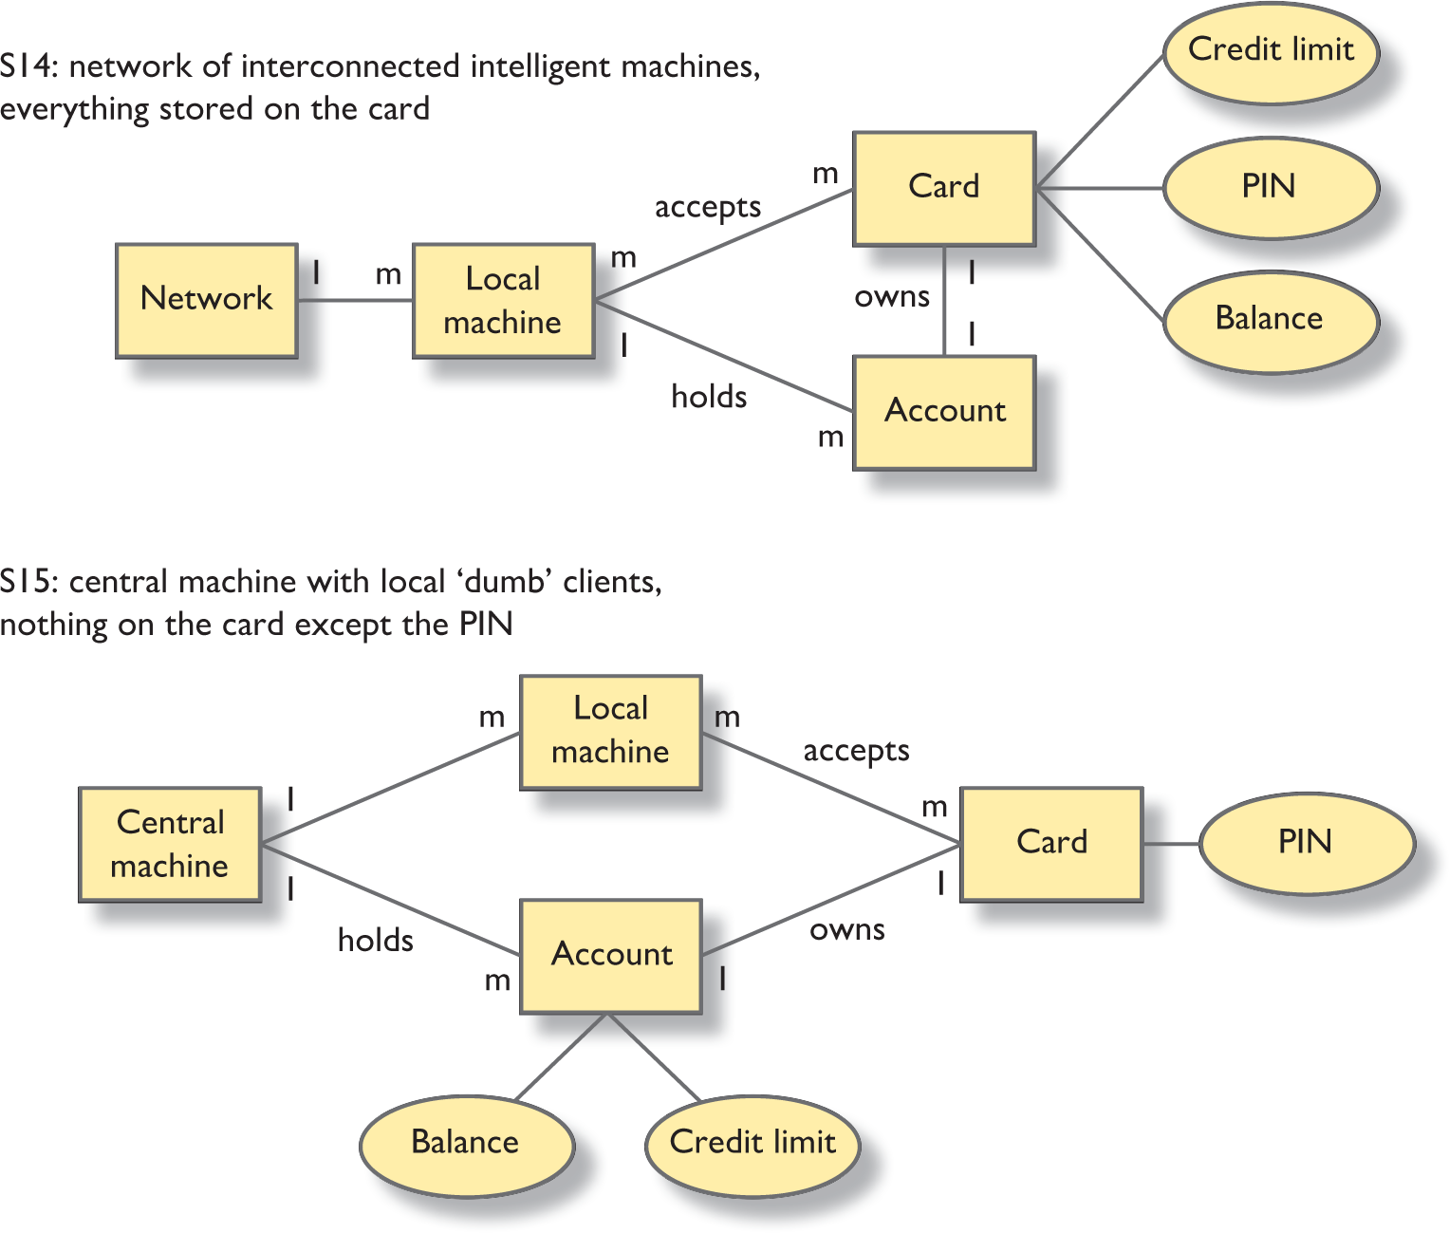
Figure 11.4 Comparison of two mental models of ATMs described by Payne (1991)
Source: After Green and Benyon, 1996

Slide 41
ERMIA (1 of 6)
ERMIA uses an adaptation of entity–relationship modelling to describe structures.
In Figure 11.5, we can see a typical menu interface.
An important part of this type of analysis is that it helps expose differences amongst the designer’s model, the system image and the ‘user’s’ model. What are the main concepts at the interface?
Menu systems have two main concepts (entities).
There are the various menu headings, such as File, Edit and Arrange, and there are the various items that are found under the headings, such as Save, Open, Cut and Paste.
More interestingly, there is a relationship between the two kinds of entity.
Can we imagine an interface that contains a menu item without a menu heading? No, because there would be no way to get at it.
You have to access menu items through a menu header; every item must be associated with a heading.
On the other hand, we can imagine a menu that contained no items, particularly while the software is being developed.

Slide 42
ERMIA (2 of 6)
This, then, is the basis of ERMIA modelling – looking for entities and relationships and representing them as diagrams. Benyon et al. (1999) provide a practical guide to developing ERMIA models, and Green and Benyon (1996) provide the background and some illustrations.
A key feature of ERMIA is that we use the same notation to represent the conceptual aspects of a domain and the perceptual aspects.
The conceptual aspects concern what people think the structure is and what the designer thinks the concepts are.
The perceptual aspects concern how the structure is represented perceptually.
In the case of menus, we have the concepts of menu header and menu item and we represent these perceptually by the bold typeface and position on a menu bar and by the drop-down list of items.
A different perceptual representation is to represent the menu using a toolbar.

Slide 43
ERMIA (3 of 6)
Returning to the relationships between menu headers and menu items, each menu heading can list many items, while each item is normally found under only one heading – in other words, the relationship of heading to item is one to many (written 1:m).
Is it strictly true that the relationship between menu items and menu headers is 1:m?
Not quite; by being forced to consider the question precisely, we have been alerted to the fact that different pieces of software are based on differing interpretations of the interface guidelines.
There is actually nothing to prevent the same menu item being listed under more than one heading.
So an item like ‘Format’ might be found under a Text heading and also under the Tools heading; the true relationship between heading and item is therefore many to many, or m:m as it is written.

Slide 44
ERMIA (4 of 6)
Many-to-many relationships are inherently complex and can always be simplified by replacing the relationship with a new entity that has a many-to-one relationship with each of the original entities.
This is a surprisingly powerful analytical tool as it forces the designer to consider concepts that would otherwise remain hidden.
Look again at the top diagram in Figure 11.4 and consider the m:m relationship between local machine and card. What is this relationship and does it help us to understand anything?
The answer is that the relationship represents a transaction: a usage of a local machine by a card.
There is nothing particularly interesting in this except perhaps that it means that the local machine will not store long-term details of the card but just deals with transaction details.

Slide 45
ERMIA (5 of 6)
ERMIA represents both physical and conceptual aspects of interfaces, which enables comparisons to be made and evaluations to be carried out.
Like GOMS and HTA, this enables the analyst to undertake model-based evaluation.
Because ERMIA presents a clear view of the different models, it can be used as part of the process of reasoning about the models.
If we have a designer’s model that the designer wishes to reveal, he or she can look at the model of the interface and see to what extent the ‘intended’ model shows up.
Similarly, one can gather different user views, in the manner of Payne’s work (1991), and compare them to the designer’s view, making the models and their possible differences explicit through ERMIA.

Slide 46
ERMIA (6 of 6)
It has to be said that ERMIA modelling has not been taken up by interaction designers probably because the effort required to learn and understand it is not repaid by the insight it provides.
Green has continued to work on other ways of bringing this type of knowledge to HCI through the ‘cognitive dimensions’ framework (Blackwell and Green, 2003) and the CASSM framework (Blandford et al., 2008).
ERMIA models can be used to explore how people have to navigate through various information structures in order to retrieve specific pieces of information and even to estimate the number of steps that people will need to take.

Slide 47
Model-based evaluation
Model-based evaluation looks at a model of some human–computer interaction.
It can be used either with an existing interface or with an envisaged design.
It is particularly useful early in the design process when designs are not advanced enough to be used by real users or when testing with real users is uneconomic or otherwise infeasible.
The process involves the designer working through a model of a design, looking for potential problems or areas which might prove difficult.
ERMIA can be used like this and GOMS was used in this way in Section 11.4.

Slide 48
Challenge 11.3
Draw an ERMIA model for the World Wide Web. List the major entities that the Web has and begin to sketch the relationships. Spend at least 10 minutes on this before looking at our solution.

Slide 49
Cognitive work analysis (1 of 4)
Cognitive work analysis (CWA) has evolved from the work of Jens Rasmussen and his colleagues (Rasmussen, 1986, 1990; Vicente and Rasmussen, 1992), working at the Risø National Laboratory in Denmark.
Originally formulated to help in the design of systems concerned with the domain of process control, where the emphasis is on controlling the physical system behind the human–computer interface, it provides a different and powerful view on the design of interactive systems.
CWA has been used in the analysis of complex real-time, mission-critical work environments, for example power plant control rooms, aircraft cockpits and so on.
The approach is also known as ‘the Risø genotype’ (Vicente, 1999) and relates closely to ecological interface design (Vicente and Rasmussen, 1992).
Flach (1995) provides a number of perspectives on the issues and includes chapters by others originating from the Risø National Laboratory, including Vicente, Rasmussen and Pejtersen.

Slide 50
Cognitive work analysis (2 of 4)
One principle underlying CWA is that when designing computer systems or any other ‘cognitive artefact’, we are developing a complete work system, which means that the system includes people and artefacts.
Seeing the whole as a work system enables designers to recognize that this system is more than the sum of its parts: it has emergent properties.
Another key principle of CWA is that it takes an ecological approach to design.
Taking an ecological approach recognizes that people ‘pick up’ information directly from the objects in the world and their interaction with them, rather than having to consciously process some symbolic representation.
In CWA, there is much discussion over the similarities between the ecological psychology of Gibson (1986) and designing systems that afford certain activities.
The emphasis is on taking a user-dependent view of the analysis and design, recognizing the skills and knowledge that the user will have.

Slide 51
Cognitive work analysis (3 of 4)
In the domain in which CWA was formulated, process control, it is vital that the operator has a correct view of the operation and status of the plant and that he or she can correctly identify any component that is malfunctioning.
A key feature of the approach is to understand the domain-oriented constraints that affect people’s behaviours and to design the environment so that the system easily reveals the state it is in and how that state relates to its purpose.
CWA provides a structural representation of a domain.
CWA is quite complex and comprises a set of techniques and models.
CWA techniques include such things as task analysis (including sequencing and frequency) and workload analysis (flow of work and identification of bottlenecks).
In short, there is a strong emphasis on work analysis and job design.

Slide 52
Cognitive work analysis (4 of 4)
Modelling in CWA is made up from six different kinds of modelling, each of which breaks down into further levels.
For example, a work domain analysis has five further levels of abstraction, describing the following:
The functional purpose of the system
The priorities or values of the system
The functions to be carried out by the system
The physical functionality of the system
The physical objects and devices.

Slide 53
The abstraction hierarchy (1 of 2)
CWA describes a system, subsystem or component at five levels of abstraction.
At the top level is the system’s purpose: the analysis takes an intentional stance.
Taking the design stance, CWA distinguishes between the abstract function and the generalized function of the system.
The abstract function concerns the capabilities that it must have in order to achieve its purpose and the generalized function describes the links between the physical characteristics and that abstract function.
At the physical level of description, CWA distinguishes the physical function from the physical form of the system.

Slide 54
The abstraction hierarchy (2 of 2)
For example, a car’s purpose is to transport people along a road.
Therefore, it must have the abstract functions of some form of power, some way of accommodating people and some form of movement.
These abstract functions may be provided by the generalized functions of a petrol engine, some seats and some wheels with pneumatic tyres.
Physically, the engine might be realized as an eight-cylinder fuel-injected engine, the seats are of a size to accommodate people and the tyres have an ability to take the weight of the car and its passengers.
The physical forms of these functions are the features that distinguish one type of car from another and concern the different arrangements of the engine components, the colour and material of the seats and the characteristics of the tyres.

Slide 55
A work domain analysis (1 of 2)
A work domain analysis describes the whole system in these terms and describes each of the subsystems, components and units in these terms.
For example, in describing the car, we could describe each of the engine’s subsystems (fuel system, ignition system, etc.), its components (the petrol tank, feed tubes, injector mechanism, etc.) and the basic units that make up the components.
At each level of the hierarchy, the connection going up the hierarchy indicates why some system or component exists, whereas the relationship looking down the hierarchy indicates how something is achieved.
The chain of ‘hows’ describes the means by which something happens and the chain of ‘whys’ describes the reasons for the design – the ends or teleological analysis.
Hence, the whole physical functioning of the domain is connected with its purpose.

Slide 56
A work domain analysis (2 of 2)
So, the car can transport people because it has an engine, which is there to provide the power.
The engine needs a fuel system and an ignition system because the fuel system and the ignition system provide power.
This discussion of means and ends can continue all the way down to an observer looking under the car bonnet, saying ‘that pipe takes the fuel from the fuel tank to the fuel injection system but because it is broken this car has no power so it cannot transport us until it is fixed’.

Slide 57
CWA in action (1 of 2)
Benda and Sanderson (1999) used the first two levels of modelling to investigate the impact of a new technology and working practice.
Their case study concerned an automated anaesthesia record-keeping system.
They undertook a work domain analysis and an activity analysis in work domain terms.
For the work domain analysis:
The output was the relationships amongst purpose, functions and objects.
Changes representable at this level were changes to the functional structure of this domain.
For the activity analysis in work domain terms:
The output was the coordination of workflow.
Changes representable at this level were changes to procedure and coordination.

Slide 58
CWA in action (2 of 2)
Based on these analyses, Benda and Sanderson successfully predicted that the introduction of the automated anaesthesia record-keeping system would take longer to use and would place additional constraints on the medical team.
Liu, Hu and Burns (2015) looked at modelling financial trading using the cognitive work analysis approach (Fig. 11.7).

Slide 59
Summary and key points
Task analysis is a key technique in interactive system design.
The focus may be on the logical structure of tasks or the cognitive demands made by tasks procedurally or structurally.
Task analysis encompasses task design and it is here that it is probably most useful as an analysis of a future design is undertaken to reveal difficulties.
Task models can also be used for model-based evaluations.
Task analysis fits very closely with requirements generation and evaluation methods.
Task analysis focuses on goals, tasks and actions.
Task analysis is concerned with the logic, cognition or purpose of tasks.
A structural analysis of a domain and work system looks at the components of a system and how the components are related to one another.

