Slide 1

Designing User Experience
A guide to HCI, UX and Interaction Design
Fourth Edition
Chapter 19
Mobile computing

Slide 2
Contents
19.1 Introduction
19.2 Context awareness
19.3 Understanding in mobile computing
19.4 Designing for mobiles
19.5 Evaluation for mobile computing

Slide 3
Aims
Mobile computing is probably the largest area of growth for UX design.
Mobile computing covers all manner of devices, from mobile phones, to small laptop computers, tablets, e-book readers and tangible and wearable computing.
Many of the design principles that we have presented remain true for mobile computing, but the huge variety of different devices that have different controls and different facilities make designing for mobiles a massive challenge.
Mobiles are an essential part of ubiquitous computing, discussed in Chapter 18.
There, the emphasis was on integrating mobile technologies with background systems.
In this chapter we look at the life cycle of designing for mobiles and at the issues that this particular application of human-centred UX design raises.

Slide 4
After studying this chapter you should be able to:
Understand issues of context-aware computing
Understand the difficulties of undertaking research of mobile applications and specifying the requirements for mobile systems
Design for mobile applications
Evaluate mobile systems, applications and services.

Slide 5
Introduction (1 of 6)
Mobile computing devices include the whole range of devices—from laptops to handheld devices—mobile phones, tablets and computational devices that are worn or carried.
A key design constraint with mobile technology is the limited screen space, or no screen at all.
Other significant technological features include the battery life and there may be limitations on storage, memory and communication ability.
All sorts of people will be using the device and, of course, it will be used in all manner of physical and social contexts.
This is significant as it means that designers often cannot design for specific people or contexts of use.
On the other hand, mobiles offer a whole range of novel forms of interaction, by employing different screen technologies and more sensors than are found on desktop computers.

Slide 6
Introduction (2 of 6)
Because of the small screen it is very difficult to achieve the design principle of visibility.
Functions have to be tucked away and accessed by multiple levels of menu, leading to difficulties of navigation.
Another feature is that there is not room for many buttons, so each button has to do a lot of work.
This results in the need for different ‘modes’ and this makes it difficult to have clear control over the functions.
Visual feedback is often poor and people have to stare into the device to see what is happening.
Thus other modalities such as sound and touch are often used to supplement the visual.

Slide 7
Introduction (3 of 6)
There is no consistency in the interfaces across mobiles—even to the point of pressing the right-hand or left-hand button to answer a call on a mobile phone.
There are strong brands in the mobile market where consistent look and feel is employed—for example, Samsung has a style, Apple has a style, etc.
Style is very important and many mobile devices concentrate on the overall experience of the physical interaction (e.g., the size and weight of the device).
Smartphones have provided better graphical interfaces, with the many devices now including a multi-touch display.
Tablets provide more screen space, but lose some of the inherent mobility of phone-sized devices.
Other devices use a stylus to point at menu items and on-screen icons.

Slide 8
Introduction (4 of 6)
Many mobile devices have various sensors embedded in them that can be used to provide novel forms of interaction.
Many devices include an accelerometer, compass and gyroscope to sense location and orientation and designers can make use of these to provide useful and novel interactive features.
For example the iPhone turns the screen off when you bring the phone to your ear.
Other devices make use of tilting when playing racing games.
The iPhone also introduced the first touchscreen in 2007 and this allowed them to dispense with a traditional keyboard.
The touchscreen provides a pop-up keyboard.
While some people love this, others do not, and BlackBerry continue to use physical keyboards.

Slide 9
Introduction (5 of 6)
Many mobiles have a Global Positioning System (GPS) that can be used to provide location-specific functions.
This allows the device to provide details of useful things nearby, to provide navigation and to automatically record the position of photos, or where messages have been left.
And of course many mobiles include cameras, audio players and other functions.
Different devices have different forms of connectivity, such as Bluetooth, Wi-Fi, GPS, Near Field Communications (NFC) and 4G.
While these provide various degrees of speed, access and security issues, they also gobble up the battery.
There are also issues concerning the cost of mobile devices and there are a bewildering array of calling plans, add-ons and other features that some people will have and others will not.
All this variety makes designing for mobiles a big challenge.

Slide 10
Introduction (6 of 6)
Besides general-purpose mobile devices there are many application-specific devices.
E-book readers are mobile devices with a number of hardware and software features optimized to reading e-books.
These include different screen technologies that make reading much easier, page-turning functions and the ability to annotate the text by writing with a stylus.
There are also applications in laboratories, medical settings and industrial applications.

Slide 11
Context awareness (1 of 2)
Mobiles are inherently personal technologies that have moved from simple communication devices to entertainment platforms, to general-purpose controllers.
It would be impossible to give a comprehensive description of mobile applications as there are so many, ranging from the quite mundane such as note taking, to-do lists, city guides and so on to the novel applications that are being made available day by day.
What is more interesting is to look at the new forms of interaction that mobiles offer, at the new UXs these offer and at applications where there is a need for mobile devices.
Mobiles offer the opportunity for interaction to be tailored to the context in which it takes place.
Context-aware computing automates some aspects of an application and thus introduces new opportunities for interaction.
Context-aware computing is concerned with knowing about the physical environment, the person or persons using the device, the state of the computational environment, the activities being undertaken and the history of the human–computer–environment interaction (Lieberman and Selker, 2000).

Slide 12
Context awareness (2 of 2)
For example, a spoken command of ‘open’ could have different effects if the person saying it was staring at a nearby window, if that window was locked or not or if the person had just been informed that a new e-mail had arrived.
If the environment is computationally enabled (see Chapter 18), for example with wireless communications, then the state of the computational environment may deliver information about the physical environment (e.g., what type of shop you are near).
If the local environment is not so enabled then the mobile device can take advantage of GPS location.
Picture recognition can be used to identify landmark buildings, and sounds can be used to infer context, as can video.
In an excellent case study, Bellotti et al. (2008) describe the development of a context-aware mobile application for Japanese teenagers.
The aim was to replace traditional city guides with a smart service delivered over a mobile device.
Their device, called Magitti, knew about the current location, the time and the weather. It also recorded patterns of activity and classified items in the database with tags associated to generic activities (eating, shopping, seeing, doing or reading).

Slide 13
Botfighters 2
Botfighters 2 is a mobile phone game that uses the player’s location in the real world to control their location in a virtual one, and allows them to engage in combat with others nearby (It’s Alive, 2004).
Botfighters 2 is played on a city-wide scale and uses the mobile phone network to determine proximity to other players (rather than having detection capabilities in the player’s device).
Figure 19.3(a) shows the interface to Botfighters 2 running on a mobile phone, with the player’s character in the centre and nearby opponents to the left and right.
Players of Botfighters were required to wander the city waiting to be alerted to another player’s proximity.
Several examples of ubicomp games where accurate location was important were produced by Blast Theory (2007)—a group of artists who work with interactive media.
A main feature of these games is collaboration between individuals moving through a real city, and individuals navigating through a corresponding virtual city via PCs.

Slide 14
Other apps
In another example of context-aware mobile computing, Holmquist et al. (2004) report on a mobile interface used in their A-Life application, designed as an aid to avalanche rescue workers.
Skiers are fitted with a number of sensors monitoring such things as light and oxygen levels, and in the event of an avalanche these readings are used to determine the order in which to help those trapped.
The interface shown in Figure 19.4 shows the priority of all skiers within range, and allows access to their specific sensor readings.
In 2016 Pokémon Go provided a very popular context-aware gaming experience.
There are many examples of context awareness in digital tourism where a mobile device is used to display information about a tourist site, or to provide a guide to the site.
Here specific locations can be geo-tagged to indicate to people (through their mobile phone, or other device) that there is some digital content that can be accessed at that location; for example, the phone may start vibrating when the user is at a certain location.
Video or textual information about the location can then be provided.

Slide 15
Wireless sensor networks
Wireless sensor networks are another example of where a mobile device is wholly necessary for context-aware applications.
When a person is in a WSN they have to be able to detect the devices that are there and the functionality that they have.
It is the interaction of people, the computational environment, the physical environment, the history of the interaction and the activities people are engaged in that provides context.
Emmanouilidis et al. (2013) provide a taxonomy of context-aware features in terms of what is known about the users, the systems, the social aspects, the services and the physical environment as illustrated in Figure 19.5.

Slide 16
Understanding in mobile computing (1 of 3)
Recall that one of the processes in UX design is ‘understanding.’
This concerns undertaking research and developing requirements for the system or service to be produced.
Undertaking research of people using mobiles and establishing requirements for new mobile applications and devices is the first part of the mobile design challenge.
As discussed in Chapter 3, the main techniques for designers are to understand who they are designing for (where the development of personas is particularly useful), and the activities that are to be supported (where scenarios are particularly useful). There is a need to understand current usage and to envision future interactions.
The methods adopted must be suitable for the technologies and contexts of use; some of these may be situated in the actual or a future context, other techniques may be non-situated, for example having a brainstorming session in a meeting room.

Slide 17
Understanding in mobile computing (2 of 3)
In the context of mobile computing, observing what people are actually doing can be quite difficult as the device has a small screen that typically cannot be directly observed and the device provides a personal interaction.
(On the other hand data analytics can often be easily gathered).
However, observing wider contextual issues and behaviours is more easily accomplished.
For example, one researcher observed teenagers’ use of their phones in shopping malls, on buses and in cafés.
The aim of this study was to find out what teenagers did with mobile phones.
It was not directly concerned with understanding usability issues or for gathering requirements for some new application.
Here the teenagers being observed were unaware they were part of a study and so this raises a number of ethical issues.
In other situations, people such as travelling sales staff may be explicitly shadowed by a designer.
Some of the naturalness of the setting is lost, but the designer can observe in much more detail.

Slide 18
Understanding in mobile computing (3 of 3)
Of course, different methods will be useful for understanding different things. Jones and Marsden (2006) draw on work by Marcus and Chen (2002) to suggest five different ‘spaces’ of mobile applications:
Information services such as weather or travel
Self-enhancement applications such as memory aids or health monitoring
The relationships space for maintaining social contacts and social networking
The entertainment space, including games and personalization functions such as ringtones
M-commerce (mobile commerce) where the emphasis is on commercial transactions.

Slide 19
Interacting with a parking meter
The parking meters in Edinburgh and other cities allow people to interact through a mobile phone.
After registration of a credit card number, people phone a central number and enter the parking meter number.
This enables the parking meter for use, with the cost being debited to the credit card number.
Ten minutes before the paid-for time is about to run out, the system sends a text message to the phone, alerting the person that their time is about to expire and so hopefully avoiding a parking fine.

Slide 20
Understanding in mobile computing (1 of 2)
Another method for investigating issues in mobile computing is to get people to keep a diary of their use.
Clearly, much use of mobile technologies takes place in quite private settings when the presence of an observer could be embarrassing (e.g., in bed).
However, diary studies are notoriously difficult to do well.
Participants need to be well motivated if they are to record their activities correctly, it is difficult to validate the diaries and participants may make fictitious entries.
However, it can be a suitable way to collect data about current usage.
One researcher used diaries in this way, but placed people in pairs in order to help the validation. While the results were informative, there were some notable problems.
For example, person X sent a text message to person Y at 2 am, but person Y does not record receiving a message.
Of course, diaries can be cross-referenced to the phone’s own record of texts sent and received, but ethics and privacy then become an issue.

Slide 21
Understanding in mobile computing (2 of 2)
If these issues can be overcome, then capturing data from the mobile device itself is an excellent way to investigate current usage.
There is ample data on number of calls, types of calls, duration, location and so on.
What is missed from such data, however, is context.
Where the person was, what they were doing and what they were thinking when they engaged in some activity is lost.
High-level conceptual scenarios can be useful to guide understanding.
Typically these are abstracted from gathering stories from the target customers.
Mitchell (2005) identified wandering, travelling and visiting as three key usage contexts for mobile phone services.
Lee et al. (2008) identified capturing, storing, organizing and annotating, browsing, and sending and sharing as conceptual scenarios for a mobile photo application.
These scenarios can be used as the basis of a structured data collection tool, focus groups or role-playing studies.
Mitchell’s mobility mapping technique combined the three contexts with social network analysis of who was communicating with whom and where activities took place.

Slide 22
Magitti
In the case study by Bellotti et al. (2008), they needed to gain an understanding about the leisure activities of teenagers.
The aim of the project was to supply new service information in order to recommend particular activities.
They conducted six different types of research focusing on the questions:
How do young Japanese spend their leisure time?
What resources do they use to support leisure time?
What needs exist for additional support that might be provided by a new kind of media technology?
They report on their methods as follows.
This demonstrates the importance of using a variety of methods and triangulation of data so that data can be verified and so that different understanding will be provided through different methods of research and requirements.

Slide 23
Magitti methods for understanding (1 of 2)
Interviews and mock-ups (IM): Twenty semi-structured interviews with 16–33-year-olds and a further 12 interviews with 19–25-year-olds examined routines, leisure activities and resources used to support them. We first asked for accounts of recent outings and then for feedback on Magitti concept scenarios and a mock-up.
Online survey: We conducted a survey on a market research website to get statistical information on specific issues. We received 699 responses from 19–25-year-olds.
Focus groups: We ran three focus groups of 6–10 participants each, concentrating on mobile phone use. In these we presented a walkthrough of the Magitti mock-up and its functions to gather detailed feedback on the concept.
Mobile phone diaries (MPD): To get a picture of the daily activities of 19–25-year-olds, we conducted two mobile phone diary studies, first with 12 people for one Sunday, and then with 19 participants for a seven-day week.

Slide 24
Magitti methods for understanding (2 of 2)
Street activity sampling (SAS): We conducted 367 short interviews with people who appeared to be in our target age range and at leisure in about 30 locations in Tokyo and surrounding areas at different times and days of the week. We asked people to report on three activities from their day, choose one as a focal activity, classify it into one of a number of pre-determined types and characterize it in terms of planning, transportation, companionship, information requirements, familiarity with the location, and so on.
Expert interviews: We interviewed three experts on the youth market in the publishing industry to learn about youth trends in leisure, and information commonly published to inform and support their activities.
Informal observation: Finally, we ‘hung out’ in popular Tokyo neighbourhoods observing young adults at leisure. SAS interviewees reported going out on average two to three times a week. Average commutes to leisure took 20 to 30 minutes, but it was not unusual to commute for an hour or more.

Slide 25
Challenge
You have been asked to develop a mobile device and application for people who go running or jogging. How would you go about the understanding process? What research would you do and how would you do it?

Slide 26
Designing for mobiles
Most of the major suppliers of mobile devices supply useful guidelines for interface and interaction design, and system development kits (SDKs) to ensure consistent look and feel of applications.
Apple, Android and Microsoft compete with one another to offer the best designs, applications and services. Microsoft, for example, have guidelines for developing applications for pocket PCs, such as:
Make the text for menu commands as short as possible
Use an ampersand rather than the word ‘and’
Use dividers to group commands on a menu
Keep the delete command near the bottom of the menu.
Even with these guidelines, anyone who has used a pocket PC application will know that menus can get long and unwieldy.
The task flow on mobiles is particularly important as the screen quickly gets cluttered if there are several steps that need to be undertaken to achieve a goal.
Other useful general guidelines include ‘design for one-handed use’ and ‘design for thumb use.’

Slide 27
Development environments
Development environments are a useful aid to developers.
For example, Visual Studio from Microsoft is used to develop mobile as well as desktop applications.
It provides a tablet emulator, so that designers can see what the design will look like on the small screen of a Microsoft tablet.
The problem with developing applications on a full-sized PC, however, is that it does have a big keyboard, it is not portable, it is high-performance with lots of storage and memory and it uses a mouse for pointing rather than a stylus or one of the various navigation buttons, jog-wheels, thumb scanners and so on.
These differences can make the use of mobile applications quite different from the simulation, or emulator, on a PC.

Slide 28
Mobile information ecologies
Jones and Marsden (2006) discuss the concept of mobile information ecologies.
This concerns the contexts within which mobile technologies need to operate.
They point out that mobile devices have to fit in with other devices such as desktop computers, televisions and other home entertainment systems.
Increasingly they have to fit in with public technologies such as ticket machines, checkouts and other self-service systems.
Mobiles need to fit in with display devices such as big screens and data projectors.
Mobile devices have to fit in with physical resources and other technologies such as radio-frequency identification (RFID) and near field communication (NFC).
They need to work with network availability and different communication standards such as Bluetooth and Wi-Fi.
The mobile has to contend with varying spaces of interaction, from sitting in a café to walking briskly through a park.
And they have to fit into the multiple contexts of use that computing on the move has to deal with.
An iPhone behaves quite differently in the searing heat of the summer in India than it does in the cold of Finland.
Jones and Marsden (2006) also provide a thorough discussion of the issues raised by designing for small screens.

Slide 29
The Magitti case (1 of 2)
Returning to the case study from Bellotti et al. (2008), the Magitti’s Main Screen is shown in Figure 19.7. They describe the design and their design rationale as follows:
The main screen shows a scrollable list of up to 20 recommended items that match the user’s current situation and profile. As the user walks around, the list updates automatically to show items relevant to new locations. Each recommendation is presented in summary form on the Main Screen, but users can tap each one to view its Detail Screen [Figure 19.8, right]. This screen shows the initial texts of a description, a formal review and user comments, and the user can view the full text of each component on separate screens. The Detail Screen also allows the user to rate the item on a 5-star scale.

Slide 30
The Magitti case (2 of 2)
To locate recommended items on the Main Screen, users can pull out the Map tab to see a partial map [Figure 19.7, right], which shows the four items currently visible in the list. A second tap slides the map out to full screen. The minimal size and one-handed operation requirements have a clear impact on the UI. As can be seen from Figures 19.7 and 19.8, large buttons dominate the screen to enable the user to operate Magitti with a thumb while holding the device in one hand.
Our design utilizes marking menus on touch screens to operate the interface, as shown in the right side of [Figure 19.7]. The user taps on an item and holds for 400ms to view the menu; then drags her thumb from the center X and releases over the menu item. As the user learns commands and their gestures, she can simply sweep her thumb in that direction without waiting for the menu to appear. Over time, she learns to operate the device without the menus, although they are available whenever needed.

Slide 31
Challenge
Find a novel application on your mobile and discuss the design with a colleague. Is it usable? Is it fun to use? What is the overall UX?

Slide 32
Evaluation for mobile computing
The evaluation of mobile applications offers its own challenges.
One method is to use paper prototypes of designs physically stuck onto the face of a mobile device.
Yatani et al. (2008) used this technique to evaluate the different design of icons for providing navigation support, as illustrated in Figure 19.9.
Bellotti et al. (2008) used questionnaires and interviews to evaluate the success of their Magitti system.
Wireframes can be easily and quickly produced and different interfaces can be mocked up and automated using wireframing tools.

Slide 33
Case study: Evaluation of navigating a WSN
In order to illustrate the use of mobiles within a ubiquitous computing environment such as a wireless sensor network (WSN) and demonstrate an approach to evaluation, we have included work by Matthew Leach, a PhD student at Edinburgh Napier University.
This related to work on navigation discussed in Chapter 25 and work on ubicomp environments discussed in Chapter 18, particularly the case study in Section 18.5.
Matthew Leach evaluated a mobile virtual soundscape that would allow people to gain an overview of data distributed in a simulated ‘Specknet’ WSN.
He was interested in how people could gain an overview of the regions of interest generated in Specknets, in order to prioritize their interaction.

Slide 34
Specknets
Recall that a Specknet is a wireless network of tiny computational devices known as ‘specks.’
A key feature about moving through Specknets is that the specks cannot be seen and they do not have their own display.
Moreover, they do not have any representation of the physical world.
The tools required to navigate in such an environment need to support gaining an overview of an environment and the types of object that were in that environment.
The person needs to understand the spread of objects in an environment, their significance and the distance and direction they are from the current location.
The scenario chosen for the evaluation was a chemical spillage.
Specks would be spread over the area of the spillage and would register whether the chemical was a liquid or a powder.
An investigator would use a mobile device to interrogate the Specknet.
The variables of distance, direction and significance can be presented in a number of modalities, with a few examples presented in Table 19.1.
An individual may be surrounded by data in 360 degrees and three dimensions.
Therefore the options presented in Table 19.1 aim to minimize the use of screen space, while providing a 360-degree overview.

Slide 35
UI Design (1 of 4)
The visual option represents a peripheral display where the edge of a screen appears to glow if a region of interest is off to that side, with a bright glow indicating close proximity, and a colour scale used to convey significance.
The tactile option imagines a set of vibrotactile motors arranged around the edge of the interaction device where the choice of motor-activated could convey direction, the strength of vibration could convey distance, and pulse tempo could convey significance (using the Geiger counter metaphor).
The audio is in effect an audible version of the tactile option, but with the option for spatialized sound to convey direction.
Mixed types of specks may be present in the network.
This information would be important in prioritizing regions of interest; for example, in a situation where two types of chemical were spilt, high concentrations of either may be of importance, but also a region where both are present may be of higher importance (if their combination created a more dangerous chemical).
Inclusion of this information matches the model of data-flow in Specknets, which identified that representation of data must convey both type and value.

Slide 36
UI Design (2 of 4)
Ultimately it was decided to use sound as the method for gaining an overview, because the sense of hearing is our natural omnidirectional sense (Hoggan and Brewster, 2007).
The choice of audio also allowed a method for conveying the type of speck through the choice of sound.
Although it has potential benefits, sonification also has limitations (Hoggan and Brewster, 2012). These were considered to ensure that they do not compromise the intended goal of the tool:
The sense of hearing provides less detail than the sense of sight. The sounds will only be used as an overview, identifying areas that warrant closer inspection visually, and so only need to convey limited information.
Systems of generating virtual sounds through headphones are primitive compared to real-world sounds. Previous experiments have established that headphone representations are adequate for localizing sounds and interpreting data although the accuracy of both at the same time is less well established.

Slide 37
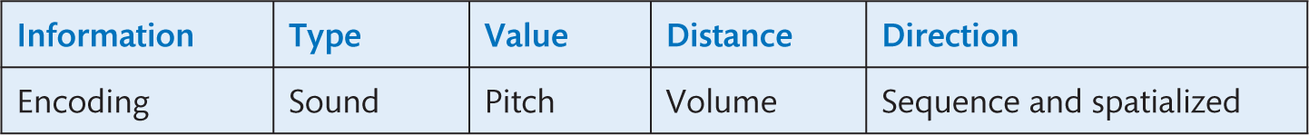
UI Design (3 of 4)
Human hearing is well equipped for discerning the azimuth of a source, but poor at determining elevation. Additional features may be required if the system is to be used in an environment with a range of elevations (e.g., a multi-storey building), but as an initial investigation this study will assume all sources are on a horizontal plane.
Different types of specks will be represented by different sounds. Pitch can then be used to indicate value: higher pitch means higher value.
To convey direction it was decided to use the spatial rendering of sounds, but to reinforce it with another dynamic system. The chosen mappings are shown in Table 19.2.
The design of the dynamic direction system is shown in Figure 19.10.
Notes:
Table 19.2 Sound study final audio encoding choice

Slide 38
UI Design (4 of 4)
An arc continuously sweeps around the participant, with a unique (in the audio interface) sounding when the sweep passes directly in front of the direction in which participants are facing.
The principal task for participants in an evaluation experiment was to listen to an audio environment, and to then draw a map of the specks distribution (location and type).
Each participant performed this task twice, once with an environment containing six objects, and once with an environment containing ten objects.
The principal task for participants in an evaluation experiment was to listen to an audio environment, and to then draw a map of the specks distribution (location and type).
Each participant performed this task twice, once with an environment containing six objects, and once with an environment containing ten objects.

Slide 39
The evaluation criteria are:
To what extent did the tool allow people to gain an overview of the data?—To be assessed by asking study participants to produce maps of the data distribution, and determining their accuracy.
Comparison between maps will allow trends to be identified, and any failings to be identified.
Were people able to prioritize information?—To be assessed by tasking study participants with selecting the highest values present in the datasets. The number of actual correct selections will be compared against the probability of doing so by chance.
Did participants identify any issues in the usability of the tools?—To be assessed through questionnaire, probing users’ confidence in use and opinions of features.

Slide 40
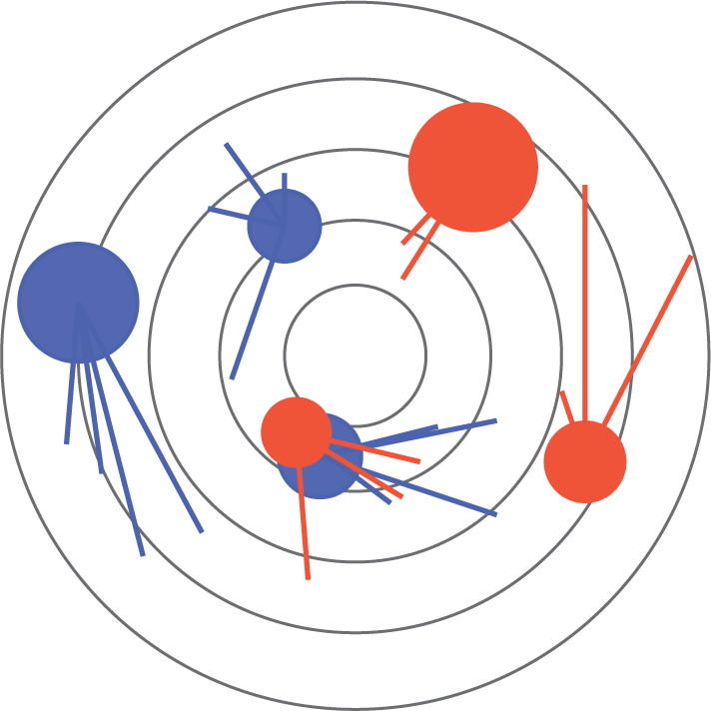
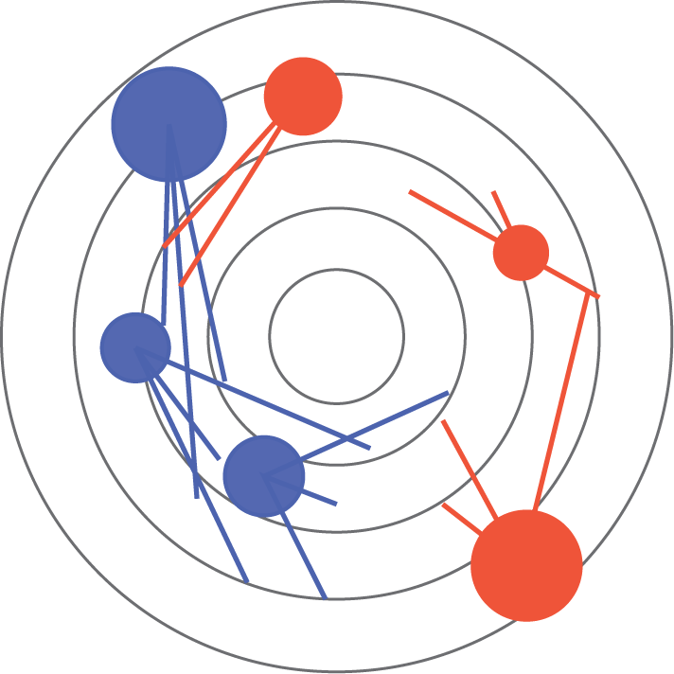
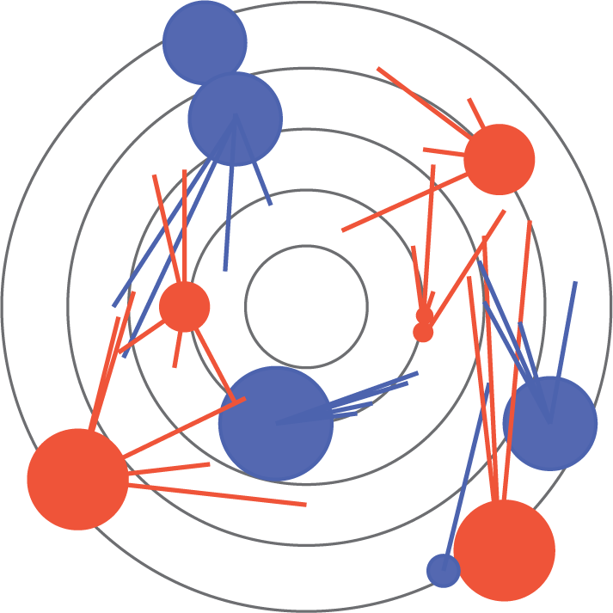
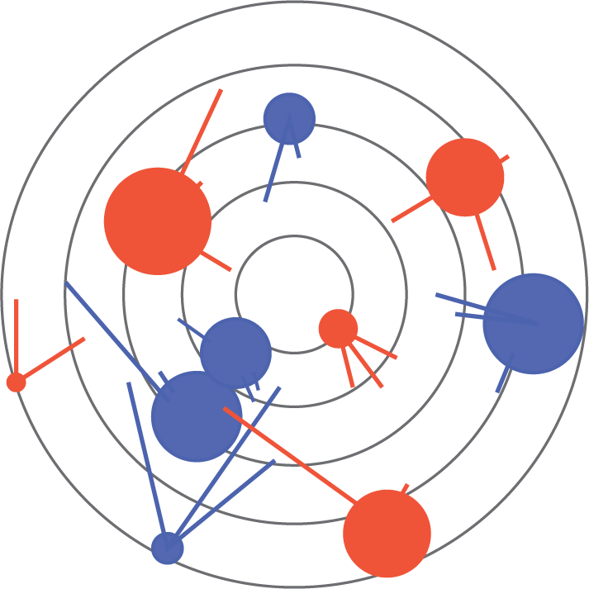
Figures 19.11 to 19.14 show an analysis of the distribution maps drawn by participants.
Notes:
Figure 19.11
Basic set 1 – audio maps
Figure 19.12
Basic set 2 – audio maps
Figure 19.13
Complex set 1 – audio maps
Figure 19.14
Complex set 2 – audio maps

Slide 41
Discussion (1 of 3)
The coloured circles represent the location, value (radius) and type (red for powder blue for liquid) for the chemical sounds.
The representation uses the same scaling as the training images that participants were exposed to.
Lines represent errors between where participants marked sound locations and their actual locations.
General trends in the errors were the marking of sound locations counter-clockwise to their true locations, seen most notably in Figure 19.12, and a tendency to place the sounds closer to the centre.
Both complex sets included a pair of liquid sounds placed in close proximity.
Participants using complex set 1 (Figure 19.13) did not distinguish between these two sounds, only marking one, while those using complex set 2 (Figure 19.14) did identify two separate sounds.
When using the complex sets some participants failed to identify low-value sounds at a distance, specifically the bottom-right liquid value.

Slide 42
Discussion (2 of 3)
The sweeping arc in effect negated the need for participants to move their head, since it explored the soundscape for them.
Participants reported confidence in identifying distance and direction; the confidence for direction was higher than that for distance.
Use of pitch to convey value did not greatly increase confidence in recognizing regions of high and low concentration.
Success in selecting high values in the soundscape was also relatively low, being in the order of 37.5% for full success, and 62.5% for partial success (when a graphical aid was not used).
The consistency between results suggests that difference in participants may play a larger role than the number of items being sonified.
To increase the robustness of the system, the method of choosing different pitch values for different levels could be adjusted.
For example, since in this case the highest values were important, pitch may be scaled higher at high-concentration values, using a logarithmic scale.

Slide 43
Discussion (3 of 3)
The diagrams produced by participants were relatively accurate considering that they had limited exposure to ideal maps.
As the sound density increases, the potential for interference between them becomes an issue.
In the current system, sounds at a distance are particularly vulnerable, with participants failing to differentiate two close-proximity sounds (while other participants could differentiate equivalent sounds when closer to centre—and thus louder), and only 1 in 5 identifying a low-value sound masked by a higher-valued one.
However, if the aim is to identify the highest values in a sonification, then a full understanding of distribution may not be required.
Overall the sonification of data demonstrated potential in providing an overview of its distribution, offering an omnidirectional representation without visual attention, in environments where people would be surrounded by data and are mobile.

Slide 44
Challenge
What methods of evaluation would you use if you were asked to evaluate a prototype iPhone app?

Slide 45
Summary and key points
Mobile computing offers particular challenges for designers as the context makes it hard to understand how people use mobiles in the first place and how they might like to use them in the future.
Design is constrained by the features of the target device.
Evaluation needs to focus on key issues.

