Slide 1

Designing User Experience
A guide to HCI, UX and Interaction Design
Fourth Edition
Part IV
Foundations of UX design
Chapter 21
Memory and attention

Slide 2
Contents
21.1 Introduction
21.2 Memory
21.3 Attention
21.4 Human error

Slide 3
Aims
Memory and attention are two key abilities that people have.
They work together to enable us to act in the world.
For UX designers there are some key features of memory and attention that provide important background to their craft.
After studying this chapter you should be able to describe:
The importance of memory and attention and their major components and processes
Attention and awareness; situation awareness, attracting and holding attention
The characteristics of human error and mental workload and how it is measured.

Slide 4
Introduction
It is said that a goldfish has a memory that lasts only three seconds.
Imagine this were true of you: everything would be new and fresh every three seconds.
Of course, it would be impossible to live or function as a human being.
This has been succinctly expressed by Colin Blakemore (1988):
without the capacity to remember and to learn, it is difficult to imagine what life would be like, whether it could be called living at all. Without memory, we would be servants of the moment, with nothing but our innate reflexes to help us deal with the world. There could be no language, no art, no science, no culture.

Slide 5
Memory (1 of 5)
Memory is one of the main components of a psychological view of humans that aims to explain how we think and act.
It is shown in Figure 21.1 along with awareness, motivation, affect and attention (and other unnamed functions).
These subjects are covered in the next few chapters.
In introducing memory we begin with a brief discussion of what memory is not and in doing so we hope to challenge a number of misconceptions.

Slide 6
Memory (2 of 5)
There are several key issues about memory.
First, it is not just a single, simple information store—it has a complex, and still argued over, structure.
There are differences between short-term (or working) memory and long-term memory.
Short-term memory is very limited but is useful for holding such things as telephone numbers while we are calling them.
In contrast, long-term memory stores, fairly reliably, things such as our names and other biographical information, the word describing someone who has lost their memory and how to operate a cash dispenser.

Slide 7
Memory (3 of 5)
Second, memory is not a passive repository: it comprises a number of active processes.
When we remember something we do not simply file it away to be retrieved whenever we wish.
For example, we will see that memory is enhanced by deeper or richer processing of the material to be remembered.
Third, memory is also affected by the very nature of the material to be remembered.
Words, names, commands or images for that matter which are not particularly distinctive will tend to interfere with their subsequent recognition and recall.
Game shows (and multiple-choice examination questions) rely on this lack of distinctiveness. A contestant may be asked:
For £10,000 can you tell me . . . Bridgetown is the capital of which of the following?
(a) Antigua
(b) Barbados
(c) Cuba
(d) Dominica
As the islands are all located in the Caribbean they are not (for most contestants) particularly distinctive. However, this kind of problem can be overcome by means of elaboration (Anderson and Reder, 1979). Elaboration allows us to emphasize similarities and differences among the items.

Slide 8
Memory (4 of 5)
Fourth, memory can also be seen as a constructive process.
Bransford et al. (1972) were able to show that we construct and integrate information from, for example, individual sentences.
In an experiment they presented a group of people with a series of thematically related sentences and then presented them with a second set of sentences, asking ‘Have you seen this sentence before?’
They found that most people estimated that they had seen approximately 80% of these sentences before.
In fact all of the sentences were new.
Bransford et al. concluded that people are happy to say that they recognized sentences they have not seen providing they are consistent with the theme of the other sentences.

Slide 9
Memory (5 of 5)
Finally, many researchers would now argue that memory cannot be meaningfully studied in isolation, as it necessarily underpins all other aspects of cognition (thinking).
For example, object recognition relies on memory; the production and understanding of language relies on some form of internal lexicon (or dictionary); finding our way about town relies on an internal representation of the environment, sometimes described as a cognitive map (Tversky, 2003); the acquisition of skills often begins with internalizing and remembering instructions.
Memory is related to attention and these two are related to making mistakes, having accidents or doing things unintentionally.
Memory, attention and error are also related to emotion.
In this chapter we discuss the first three of these, devoting Chapter 22 to looking at emotion, or ‘affect.’

Slide 10
Working memory
Memory is usually divided into a set of memory processes and a number of different types of memory store.
As we have already noted, working memory, first identified and named by Baddeley and Hitch (1974), is made up from three linked components, namely a central executive, a visuospatial sketchpad and an articulatory loop (also called the phonological loop).
The central executive is involved in decision making, planning and related activities.
It is also closely linked to managing our ability to perform more than one thing at a time (see the section below which discusses the role of attention).
The articulatory or phonological loop can be thought of as behaving like a loop of audio tape.
When we are trying to call an unfamiliar telephone number or repeating a phrase in a foreign language, we tend to repeat the string of numbers (or words) either out loud or silently to ourselves.
This process is called rehearsal.
When we are doing this we are making use of the articulatory loop, which can also account for our experience of the inner voice.
The analogy of the audio tape is useful as it allows us to see that the articulatory loop is limited in both capacity and duration.

Slide 11
The visuospatial sketchpad
The visuospatial sketchpad (also called the scratchpad) is the visual and spatial information equivalent of the articulatory loop and has been linked to our mind’s eye.
We use our mind’s eye to visualize a route through a town or building or for the mental rotation of figures (visualize a coin and then rotate it to see what is on the other side).
The visuospatial sketchpad is also limited in capacity and duration unless refreshed by means of rehearsal.
Finally, the capacity of working memory itself is approximately three or four items (MacGregor, 1987; LeCompte, 1999) where an item may be a word or a phrase or an image.
It should be noted that older textbooks and papers suggest that the limit of short-term memory is 7 ± 2 items, sometimes called the magical number 7: this is now known to be incorrect.

Slide 12
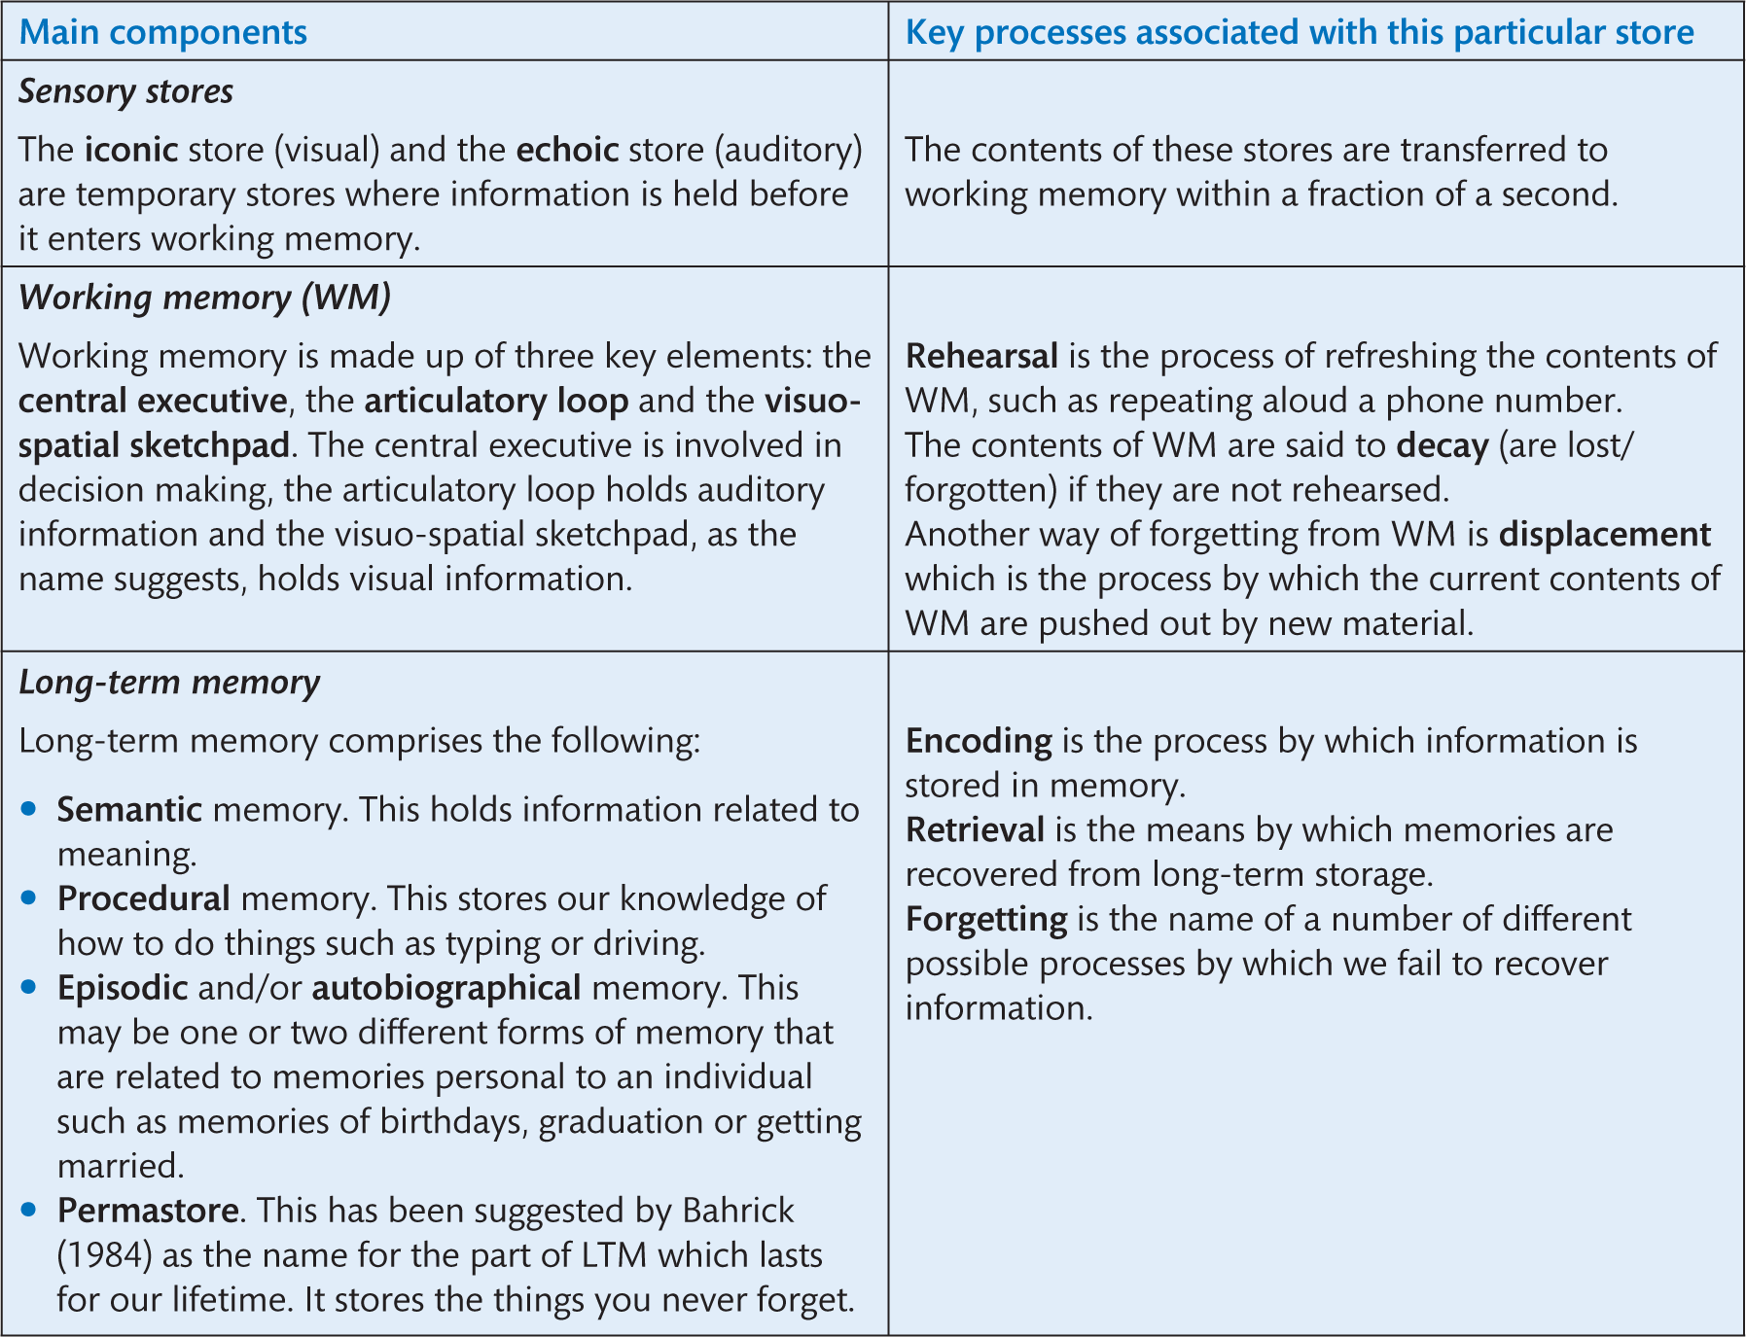
Table 21.1 A summary of the structure of memory

Slide 13
Long-term memory (1 of 2)
Long-term memory has an effectively unlimited capacity and memories stored there may last as long as an individual’s lifetime.
The coding (the internal representation) of the information held by it is primarily semantic in nature, that is, it is stored in terms of its meaning, for example, knowledge of facts and the meaning of words (contrast this with the binary encoding of information in a computer).
However, research has indicated that other forms of encoding are present too: for example, memories of music or the bark of a dog are encoded as auditory information, and similarly haptic (touch) encoding allows us to remember the feeling of silk and the sting of a cut.
Finally, olfactory (smell) and gustatory (taste) encoding allows us to recognize and distinguish between the smell and taste of fresh and rotten food.

Slide 14
Long-term memory (2 of 2)
In addition to semantic memory, long-term memory includes other kinds of memories such as episodic or autobiographical memory (memory of our personal history, for example our first kiss, graduation day, the death of a parent) and procedural memory (e.g., the knowledge of how to ride a bike, type, play the euphonium).
This neat three-way division of long-term memory into component parts—semantic, episodic and procedural—has been questioned by Cohen and Squire (1980) who argued that the real distinction is between ‘knowing that’ (declarative memory) and ‘knowing how’ (procedural memory), but in practice there is little between these two accounts.

Slide 15
Distinguishing between short-term and working memory
In their multi-store model of memory, Atkinson and Shiffrin (1968) distinguish between short- and long-term memory (reflecting William James’s primary and secondary memory division 70 years earlier).
While the term short-term memory (STM) is still widely used, we have chosen to employ the term working memory (WM) instead.
STM is usually characterized by a limited, temporary store for information before it is transferred to long-term memory, while WM is much more flexible and detailed in structure and function.
Our use of WM instead of STM also better reflects our everyday experience.

Slide 16
Challenge
Contrast listing the components of a bicycle (e.g., frame, wheels, etc.) with knowing how to ride a bicycle (e.g., sitting on the saddle and pedalling) and with your memory of the first time you rode a bicycle (e.g., How old were you? What sort of day was it? Who else was there?). Which is hardest to describe?

Slide 17
How do we remember?
In everyday English, to remember means both to retrieve information (‘I think her birthday is the 18th of June’) and to store information in memory (‘I’ll remember that’).
To remove this ambiguity we will use the terms store and encode to mean place in memory, and retrieve and recall to mean bring back from memory.
If what we want to store is not too complex (i.e., it does not exceed the capacity of working memory), we will typically rehearse it, that is, repeat the string of words either aloud or using our inner voice.
This is useful for remembering unfamiliar names or strings of numbers or words such as a foreign phrase, for example ‘Dos cervezas, por favor.’
This technique exploits the articulatory loop of working memory.
Similar strategies are also used to remember, for a short time, the shape of an object or a set of directions.

Slide 18
Chunking
The capacity of working memory can effectively be enhanced by chunking the material to be remembered first.
Chunking is the process by which we can organize material into meaningful groups (chunks).
For example, an apparently random string of numbers such as 00441314551234 may defeat most people unless it is chunked.
This particular number may be seen to be a telephone number made up from the code for international calls (0044), the area code for Edinburgh (131) and the prefix for Edinburgh Napier University (455), leaving only 1234 to remember.
Thus the string of numbers has been reduced to four chunks.

Slide 19
Elaboration
So how do we remember things for longer periods?
One answer is elaboration which has been developed as an alternative view of memory in itself.
The levels of processing (LoP) model proposed by Craik and Lockhart (1972) argues that rather than focusing on the structural, multi-store model of memory we should emphasize the memory processes involved.
The LoP model recognizes that any given stimulus (piece of information) can be processed in a number of different ways (or levels) ranging from the trivial or shallow all the way through to a deep, semantic analysis.
Superficial processing may involve the analysis of the stimulus’s surface features such as its colour or shape; a deeper level of analysis may follow which may test for such things as whether the stimulus (e.g., cow) rhymes with the word ‘hat.’
The final and deepest level of analysis is the semantic, which considers the stimulus’s meaning—does the word refer to a mammal?

Slide 20
Recognition and recall
Finally, we are able to retrieve stored information by way of recall and/or recognition.
Recall is the process whereby individuals actively search their memories to retrieve a particular piece of information.
Recognition involves searching our memory and then deciding whether the piece of information matches what we have in our memory stores.

Slide 21
How and why do we forget?
There are numerous theories of forgetting.
However, before we discuss their strengths and weaknesses, we begin with another key distinction, namely the difference between accessibility and availability.
Accessibility refers to whether or not we are able to retrieve information that has been stored in memory, while the availability of a memory depends on whether or not it was stored in memory.
The metaphor of a library is often used to illustrate this difference. Imagine you are trying to find a specific book in a library. There are three possible outcomes:
(a) you find the book (the memory is retrieved);
(b) the book is not in the library (the memory is not available); or
(c) the book is in the library but has been misfiled (not accessible).
There is, of course, a fourth possibility, namely that someone else has borrowed the book, which is where the metaphor breaks down!
As we described earlier, information is transferred from working memory to long-term memory to be stored permanently, which means that availability is the main issue for working memory while accessibility is the main (potential) problem for long-term memory.

Slide 22
Forgetting from working memory
The first and perhaps oldest theory is decay theory, which argues that memory simply fades with time, a point which is particularly relevant to working memory which maintains memories for only 30 seconds or so without rehearsal.
Another account is displacement theory, which has also been developed to account for forgetting from working memory.
As we have already seen, working memory is limited in capacity, so it follows that if we were to try to add another item or two to this memory, a corresponding number of items must be squeezed out.

Slide 23
Forgetting from long-term memory (LTM) (1 of 3)
We turn now to more widely respected theories of forgetting from long-term memory.
Again psychology cannot supply us with one, simple, widely agreed view of how we forget from LTM.
Instead there are a number of competing theories with varying amounts of supporting evidence.
Early theories (Hebb, 1949) suggested that we forget from disuse.
For example, we become less proficient in a foreign language learned at school if we never use it.
In the 1950s it was suggested that forgetting from LTM may simply be a matter of decay.
Perhaps memory engrams (= memory traces) simply fade with time, but except in cases of explicit neurological damage such as Alzheimer’s disease no evidence has been found to support this.

Slide 24
Forgetting from long-term memory (LTM) (2 of 3)
A more widely regarded account of forgetting is interference theory, which suggests that forgetting is more strongly influenced by what we have done before or after learning than the passage of time itself.
Interference takes two forms: retroactive interference (RI) and proactive interference (PI).
Retroactive interference, as the name suggests, works backward.
That is, newer learning interferes with earlier learning.
Having been used to driving a manual-shift car, spending time on holiday driving an automatic may interfere with the way one drives after returning home.

Slide 25
Forgetting from long-term memory (LTM) (3 of 3)
In contrast to RI, proactive interference may be seen in action in, for example, moving from word processor v1 to v2.
Version 2 may have added new features and reorganized the presentation of menus.
Having learned version 1 interferes with learning version 2.
Thus earlier learning interferes with new learning.
However, despite these and numerous other examples of PI and RI, there is surprisingly little outside the laboratory to support this theory.
Retrieval failure theory proposes that memories cannot be retrieved because we have not employed the correct retrieval cue.
Recalling the earlier library metaphor, it is as if we have ‘filed’ the memory in the wrong place.
The model is similar to the tip-of-the-tongue phenomenon.
All in all, many of these theories probably account for some forgetting from LTM.

Slide 26
The tip-of-the-tongue phenomenon
Researchers Brown and McNeill (1966) created a list of dictionary definitions of unfamiliar words and asked a group of people to provide words that matched them.
Not surprisingly, not everyone was able to provide the missing word.
However, of those people who could not, many were able to supply the word’s first letter, or the number of syllables or even words that sounded like the missing word itself.
Examples of the definitions are:
Favouritism, especially governmental patronage extended to relatives (nepotism)
The common cavity into which the various ducts of the body open in certain fish, birds and mammals (cloaca).

Slide 27
Attention (1 of 2)
Attention is a pivotally important human ability and is central to operating a machine, using a computer, driving to work or catching a train.
Failures in attention are a frequently cited reason for accidents: car accidents have been attributed to the driver using their mobile phone while driving; aircraft have experienced ‘controlled flight into terrain’ (to use the official jargon) when the pilots have paid too much attention to the ‘wrong’ cockpit warning; and control room operators can be overwhelmed by the range and complexity of instruments to which they must attend.
Clearly we need to be able to understand the mechanism of attention, its capabilities and limitations, and how to design to make the most of these abilities while minimizing its limitations.

Slide 28
Attention (2 of 2)
Attention is an aspect of cognition that is particularly important in the design and operation of safety-critical interactive systems (ranging from the all too frequently quoted control room operator through to inspection tasks on mundane production lines).
While there is no single agreed definition of attention, Solso (1995) defines it as ‘the concentration of mental effort on sensory or mental events,’ which is typical of many definitions.
The problem with definitions in many ways reflects how attention has been studied and what mental faculties researchers have included under the umbrella term of attention.
However, the study of attention has been split between two basic forms, namely selective attention and divided attention.
Selective (or focused) attention generally refers to whether or not we become aware of sensory information.
Indeed, Cherry (1953) coined the term the cocktail party effect to illustrate this.

Slide 29
The cocktail party effect
Cherry (1953), presumably while at a cocktail party, had noticed that we are able to focus our attention on the person we are talking to while filtering out everyone else’s conversation.
This principle is at the heart of the search for extraterrestrial intelligence (SETI), which is selectively listening for alien radio signals against the background of natural radio signals.

Slide 30
Selective and divided attention
Studies of selective attention have employed a dichotic listening approach.
Typically, participants in such experiments are requested to shadow (repeat aloud) one of the two voices they will hear through a set of headphones.
One voice will be played through the right headphone while another is played through the left—hence dichotic.
In contrast to selective attention, divided attention recognizes that attention can be thought of in terms of mental resources (Kahneman, 1973; Pashler, 1998) that can in some sense be divided between tasks being performed simultaneously (commonly referred to as multi-tasking).
For example, when watching television while holding a conversation, attention is being split between two tasks.
Unless an individual is very well practised, the performance of two simultaneously executed tasks would be expected to be poorer than attending to just one at a time.
Studies of divided attention might employ the same physical arrangements as above but ask the participant to attend (listen to) both voices and, say, press a button when a keyword is heard spoken in either channel.

Slide 31
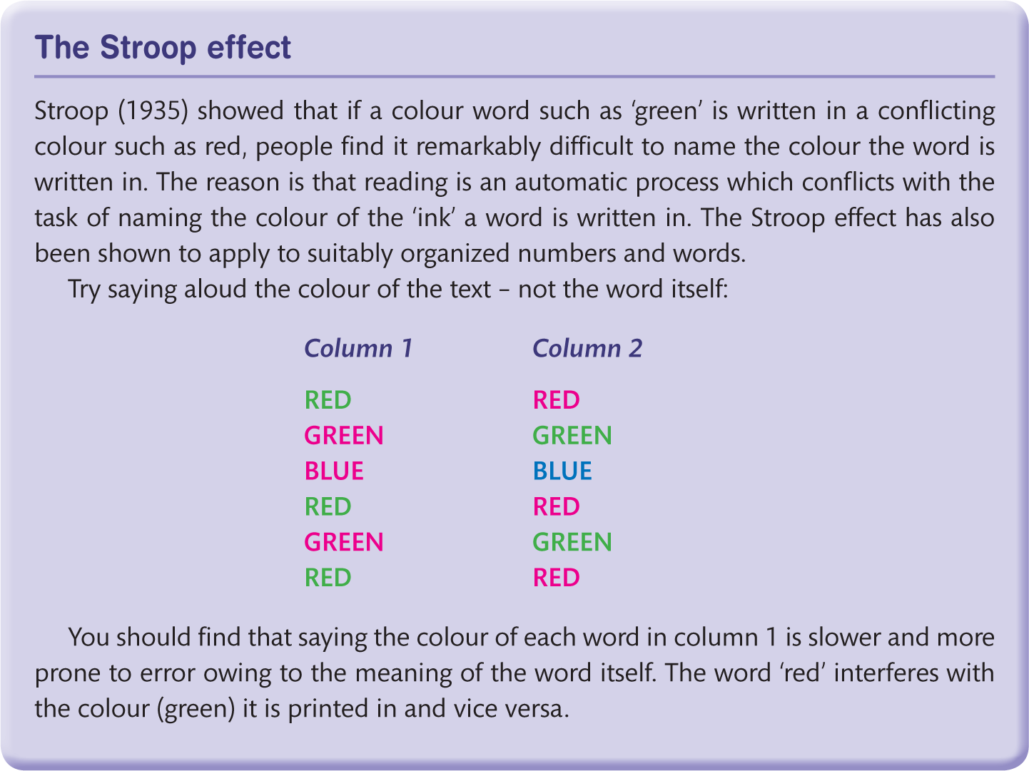
Box 21.4 The Stroop effect

Slide 32
How attention works
To date, there have been a number of different accounts or models of attention.
The earliest date from the 1950s and are characterized by likening attention to a bottleneck.
Later theories have concentrated on an allocation model that treats attention as a resource that can be spread (or allocated) across a number of different tasks.
Other views of attention have concentrated on the automatic/controlled processing divide and on sequential/parallel processing.
As in most aspects of psychology, there is no single account of attention; instead there is a mosaic of complementary views.

Slide 33
‘Bottleneck’ theories of attention
We begin with Donald Broadbent’s single-channel theory of attention (Broadbent, 1958).
He proposed that information arriving at the senses is stored in short-term memory before being filtered or selected as being of interest (or being discarded), which in practice means that we attend to one particular channel and ignore others.
This information (this channel) is then processed by a limited-capacity processor.
On being processed, instructions may be sent to motor effectors (the muscles) to generate a response.
The presence of short-term memory, acting as a temporary buffer, means that information which is not selected is not immediately discarded either.
Broadbent realized that we might be able to attend to this information stored in the short-term memory, but switching between two different channels of information would be inefficient.
(It has been observed by a number of researchers that Broadbent’s thinking reflects the technology of his day, as in many ways this single-channel model of attention is similar to the conventional model of a computer’s central processing unit (CPU), which also has a single channel and is a serial processing device—the von Neumann architecture.)
This original single-channel model (sometimes referred to as a bottleneck account of attention) was refined and developed by Broadbent’s co-workers and others (Triesman, 1960; Deutsch and Deutsch, 1963; Norman, 1968) but remained broadly similar.

Slide 34
Attenuation (1 of 2)
Triesman argued for the attenuation of the unattended channel, which is like turning down the volume of a signal, rather than an on–off switch.
In Triesman’s model, competing information is analysed for its physical properties, and for sound, syllable pattern, grammatical structure and meaning, before being attended.
The later Deutsch and Deutsch (1963) and Deutsch–Norman (Norman, 1968) models ­completely rejected Broadbent’s early selection model, instead arguing for a later-selection filter/pertinence account.
Selection (or filtering) only occurs after all of the sensory inputs have been analysed.
The major criticism of this family of single-channel models is their lack of flexibility, particularly in the face of a competing allocation model discussed below.

Slide 35
Attenuation (2 of 2)
It has also been questioned as to whether any single, general-purpose, limited-capacity processor can ever account for the complexity of selective attention.
The reality of everyday divided attention presents even greater problems for such accounts.
As we have just discussed, models of selective attention assume the existence of a limited-capacity filter capable of dealing with only one information channel at a time.
However, this is at odds with both everyday experience and experimental evidence.

Slide 36
Attention as capacity allocation
Next, we briefly discuss an example of a group of models of attention which treat attention as a limited resource that is allocated to different processes.
The best known is Kahneman’s capacity allocation model (Kahneman, 1973).
Kahneman argued that we have a limited amount of processing power at our disposal and whether or not we are able to carry out a task depends on how much of this capacity is applied to the task.
Of course, some tasks require relatively little processing power and others may require more—perhaps more than we have available.
This intuitively appealing account does allow us to explain how we can divide our attention across a number of tasks depending upon how demanding they are and how experienced we are in executing them.
However, there are a number of other variables that affect the ways in which we allocate this attentional capacity, including our state of arousal and what Kahneman describes as enduring dispositions, momentary intentions and the evaluation of the attentional demands.

Slide 37
Enduring dispositions
Enduring dispositions are described as the rules for allocating capacity that are not under voluntary control (e.g., hearing your own name spoken), and momentary intentions are voluntary shifts in attention, such as responding to a particular signal.
There is a further variable that is how aroused we are.
Arousal in this context may be thought of as how awake we are.
Figure 21.4 is a diagram of the capacity allocation model in which we can see the limit capacity; the central processor has been replaced by an allocation policy component that governs which of the competing demands should receive attention.
While Kahneman portrays attention as being more flexible and dynamic than the single-channel models, he is unable to describe how attention is channelled or focused.
Similarly, he is unable to define the limits of what is meant by ‘capacity.’

Slide 38
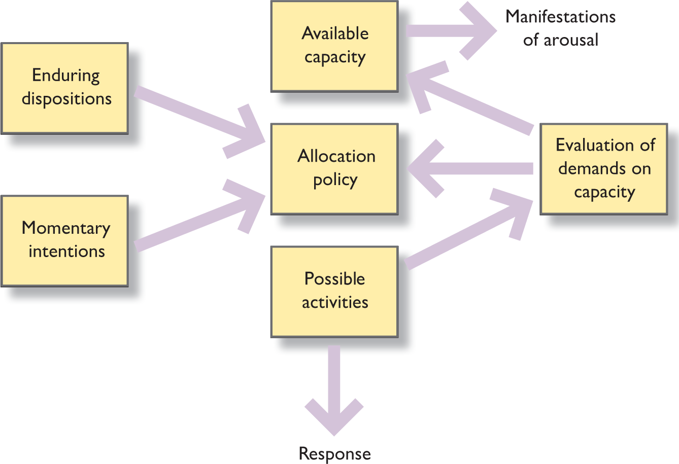
Figure 21.4 Kahneman’s capacity allocation model

Slide 39
Automatic and controlled processing
In contrast to the foregoing models of attention, Schneider and Shiffrin (1977) observed that we are capable of both automatic and controlled information processing.
We generally use automatic processing with tasks we find easy (and this, of course, is dependent upon our expertise in this task) but use controlled processing on unfamiliar and difficult tasks.
Schneider and Shiffrin distinguish between controlled and automatic processing in terms of attention as follows.
Controlled processing makes heavy demands on attention and is slow, limited in capacity and involving consciously directing attention toward a task.
In contrast, automatic processing makes little or no demand on attention, is fast, unaffected by capacity limitations, unavoidable and difficult to modify, and is not subject to conscious awareness.

Slide 40
Schneider and Shiffrin
Schneider and Shiffrin found that if people are given practice at a task, they can perform it quickly and accurately, but their performance is resistant to change.
An example of apparent automaticity in real life occurs when we learn to drive a car.
At first, focused attention is required for each component of driving, and any distraction can disrupt performance.
Once we have learnt to drive, and as we become more experienced, our ability to attend simultaneously to other things increases.
Moving from this very brief treatment of models of attention, we now consider how a wide range of internal and external factors can affect our ability to attend.

Slide 41
Factors affecting attention
Of the factors that affect our ability to pay attention to a task, stress is the most important.
Stress is the effect of external and psychological stimuli on us and directly affects our level of arousal.
Arousal is different from attention in that it refers to a general increase or decrease in perceptual and motor activity.
For example, sexual arousal is typified by heightened levels of hormonal secretions, dilation of the pupils, increased blood flow and a whole range of mating behaviours.
Stressors (stimuli which cause stress) include such things as noise, light, vibration (e.g., flying through turbulence) and more psychological factors such as anxiety, fatigue, anger, threat, lack of sleep and fear (e.g., think about the days before an examination).

Slide 42
Yerkes–Dodson law
As long ago as 1908, Yerkes and Dodson found a relationship between performance of tasks and level of arousal. Figure 21.5 is an illustration of this relationship—the so-called Yerkes–Dodson law.
There are two things to note about this relationship.
First, for both simple and complex tasks there is an optimal level of arousal.
As our level of arousal increases, our ability to execute a task increases until we reach a point when we are too aroused and our performance falls off sharply.
Second, simple tasks are more resistant to increased levels of arousal than are complex tasks.
The other aspect of this is the skill of the individual involved.
A simple task to a highly skilled individual is likely to be seen as complex by a less skilled or able individual.

Slide 43
Vigilance
Vigilance is a term applied to the execution of a task wherein an individual is required to monitor an instrument or situation for a signal.
Perhaps the classic example of a vigilance task is being on watch on board a ship.
During the Second World War mariners were required to be vigilant in scanning the horizon for enemy ships, submarines, aircraft or icefloes.
Wartime aside, vigilance is still an important element of many jobs— consider the role of the operator of a luggage X-ray machine at an airport, or a safety inspector checking for cracks or loose fittings on a railway track.

Slide 44
Attention drivers!
Wikman et al. (1998) have reported differences in the performance of inexperienced (novice) and experienced drivers when given a secondary task to perform while driving.
The drivers were asked to do such things as changing a CD, operating the car radio or using a mobile (cell) phone.
Unsurprisingly, the novice drivers were distracted more (allocated their attention less effectively) than the experienced drivers.
Experienced drivers took their eyes off the road for less than three seconds, while novice drivers were found to weave across the road.

Slide 45
In-car systems
The use of spoken messages in-car, particularly for satellite navigation (satnav) systems, is now becoming commonplace. The challenge for the designers of these systems is
(a) to attract the attention of the driver without distracting him or her, and
(b) to avoid habituation—that is, the driver learning to ignore the nagging voice.
The choice of voice is also critical.
Honda have decided upon ‘Midori’—the name given to the voice of an unnamed bilingual Japanese actress whose voice is ‘smooth as liqueur.’
In contrast, Italian Range Rovers are equipped with a voice which is argumentative in tone, and Jaguar (the English motor manufacturer) retains British colloquialisms to reinforce their brand image.
These brand images aside, manufacturers have found that drivers tend to listen to female voices more than male voices.
Other issues in in-car HCI concern the design of devices such as phones and satellite navigation systems that require complex operation and hence result in divided attention (Green, 2012).

Slide 46
Mental workload
Mental workload addresses issues such as how busy the user or operator is and how difficult are the tasks assigned to him or her—will he or she be able to deal with an additional workload?
A classic example of this occurred in the 1970s when it was decided to remove the third crew member from a flight team on board a medium to large passenger jet.
The Federal Aviation Administration now requires measures of the mental workload on the crew prior to the certification of a new aircraft or new control system.
Turning now to design issues in respect of mental workload, the first observation is that a discussion of mental workload does not necessarily equate workload with overload.
Indeed, the reverse is often true: just consider the potential consequences of operator/user boredom and fatigue (Wickens and Hollands, 2000, p. 470).
There are a number of different ways in which workload can be estimated, one of which is the NASA TLX scale.
This scale (Table 21.2) is a subjective rating procedure that provides an overall workload score based on a weighted average of ratings on six subscales.

Slide 47
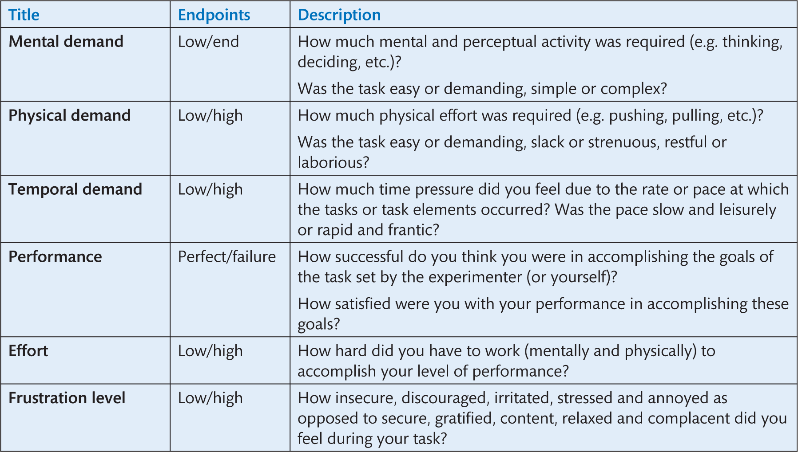
Table 21.2 Measuring workload
Source: Wickens, C.D. and Hollands, J.G. (2000) Engineering Psychology and Human Performance (3rd edn), © 2000. Printed and electronically reproduced by permission of Pearson Education, Inc., Upper Saddle River, New Jersey.

Slide 48
Visual search (1 of 2)
Visual search has been researched extensively by psychologists and ergonomists and refers to our ability to locate particular items in a visual scene.
Participants in a visual search study, for example, may be required to locate a single letter in a block of miscellaneous characters.
Try to find the letter ‘F’ in the matrix in Figure 21.6.

Slide 49
Visual search (2 of 2)
This is a good example of how perception and attention overlap and an understanding of the issues involved in visual search can help in avoiding interactive systems
Research has revealed that there is no consistent visual search pattern which can be predicted in advance.
Visual search cannot be presumed to be left to right, or clockwise rather than anti-clockwise, except to say that searching tends to be directed toward where the target is expected to be.
However, visual attention will be drawn toward features which are large and bright and changing (e.g., flashing, which may be used for warnings).
These visual features can be used to direct attention, particularly if they have a sudden onset (i.e., a light being switched on, or a car horn sounding).
Megaw and Richardson (1979) found that physical organization can also have an effect on search patterns.
Displays or dials organized in rows tended to be scanned from left to right (just as in reading Western languages, but raising the question of cultural bias—would the same be true for those cultures who read from right to left or from top to bottom?).

Slide 50
Edge effect
Parasuraman (1986) has reported evidence of an edge effect wherein during supervisory tasks (i.e., the routine scanning of dials and displays) operators tended to concentrate on the centre of the display panel and tended to ignore the periphery.
As Wickens and Hollands (2000) note, research into visual scanning behaviour has yielded two broad conclusions.
First, visual scanning reveals much about the internal expectancies that drive selective attention.
Second, these insights are probably most useful in the area of diagnostics.
Clearly those instruments which are most frequently watched are likely to be the most important to an operator’s task.
This should guide design decisions to place the instruments in prominent locations or to locate them adjacent to one another.

Slide 51
Just how long is it reasonable to wait?
It is generally accepted that delays of less than 0.1 second are taken to be effectively instantaneous, but delays of a second or two may be perceived by the user of an interactive system as being an interruption in the free flow of his or her interaction.
Delays of more than 10 seconds present problems for people.
Minimizing delay is important in the design of websites for which numerous, often contradictory, guidelines have been published.
Here are two perfectly reasonable suggestions:
The top of your page should be meaningful and fast.
Simplify complex tables as they display more slowly.

Slide 52
Signal detection theory (1 of 3)
It is late at night. You are asleep alone in your apartment. You are awoken by a noise. What do you do?
For many people the first thing to do is to wait and see (as it were) whether they hear the noise again.
Here we are in the domain of signal detection ­theory—was there really a signal (e.g., the sound of breaking glass by the local ­axe-­murderer) and if so, are we to act on it—or was it just the wind or a cat in the ­dustbin?
Signal detection theory (SDT) is applicable in any situation in which there are two different, non-overlapping states (i.e., signal and noise) that cannot be easily discriminated—that is, for example, did a signal appear on the radar screen, did it move, has it changed size or shape?
In such situations we are concerned with signals which must be detected, and in the process one of two responses may be produced—for example, ‘I detected the presence of a signal, so I shall press the stop button,’ or ‘I failed to see anything, so I shall continue to watch.’

Slide 53
Signal detection theory (2 of 3)
This may vary in importance from the trivial, for example, recognizing that a job has been printed (the printer icon has disappeared from the application’s status bar), through to the safety-critical, for example, a train driver spotting (or not) a stop light.
The following compelling examples of the importance of SDT have been identified by Wickens and Hollands (2000): the detection of a concealed weapon by an airport security guard; the identification of a malignant tumour on an X-ray plate by a radiologist; and a system malfunction detected by a nuclear plant supervisor.
Their list goes on to include identifying critical incidents in the context of air traffic control, proof-reading, detecting lies from a polygraph (lie detector) and spotting hairline cracks in aircraft wings, among other things.
SDT recognizes that an individual faced with such a situation can respond in one of four ways: in the presence of a signal, the operator may detect it (hit) or fail to detect it (miss); in the absence of a signal, the operator may correctly reject it (correct rejection) or incorrectly identify it (false alarm).

Slide 54
Signal detection theory (3 of 3)
The probability of each response is typically calculated for a given situation and these figures are often quoted for both people and machines.
So, a navigational aid on board an aircraft (e.g., ground collision radar) might be quoted as producing false alarms (also called false positives) at a rate of less than 0.001—one in a thousand.
Similar figures are quoted as targets for medical screening operators (e.g., no more than 1 in 10,000 real instances of, say, breast cancer should be missed while 1 in 1000 false alarms are acceptable).

Slide 55
Transcript from Apollo XIII: barber poles and the Moon
The Apollo flights to the Moon in the late 1960s and early 1970s are excellent examples of both user-centred design and brilliant and innovative ergonomic design.
One of the innovations can be found in the design of the Apollo spacecraft which used barber poles to provide status information to the astronauts.
A barber pole is a striped bar signalling that a particular circuit or function is active (e.g., the communication system—the talkback system), or, as can be seen in the transcript below, measures of liquid helium and the state of the electrical systems. In the transcript we see that Jim Lovell reports to Mission Control that main bus ‘B is barber poled and D is barber poled, helium 2, D is barber pole’:
55:55:35—Lovell: ‘Houston, we’ve had a problem. We’ve had a main B bus undervolt.’
55:55:20—Swigert: ‘Okay, Houston, we’ve had a problem here.’
. . .
55:57:40—DC main bus B drops below 26.25 volts and continues to fall rapidly.
55:57:44—Lovell: ‘Okay. And we’re looking at our service module RCS helium 1. We have—B is barber poled and D is barber poled, helium 2, D is barber pole, and secondary propellants, I have A and C barber pole.’ AC bus fails within two seconds.
Interestingly, the use of a barber pole can be found in modern operating systems. For example, the OS X system uses barber poles (Figure 21.8).

Slide 56
Human error
Human error is studied in a wide variety of ways.
Some researchers conduct laboratory investigations while others investigate the causes of major accidents after the event.
A typical example of a laboratory study is that by Hull et al. (1988) who asked 24 ordinary men and women to wire an electric plug.
They found that only five succeeded in doing so safely, despite the fact that 23 of the 24 had wired a plug in the previous 12 months.
In analysing the results of this study it was found that a number of different factors contributed to these failures, including:
Failure to read the instructions
Inability to formulate an appropriate mental model
Failure of the plug designers to provide clear physical constraints on erroneous actions. This last point was regarded as the most significant.

Slide 57
Understanding action slips
Unhappily, error is an inescapable fact of life.
Analysis of the causes of major accidents has found that human error is primarily responsible in 60–90% of all major accidents (Rouse and Rouse, 1983; Reason, 1997).
This figure is consistent with the findings of commercial organizations: for example, Boeing, the aircraft manufacturer, estimate that 70% of all ‘commercial airplane hull-loss accidents’ are attributable to human error.
Research conducted by Reason (1992) has given insight into everyday errors.
In one study he asked 36 people to keep a diary of action slips (i.e., actions which have deviated from what they intended) for a period of four weeks.

Slide 58
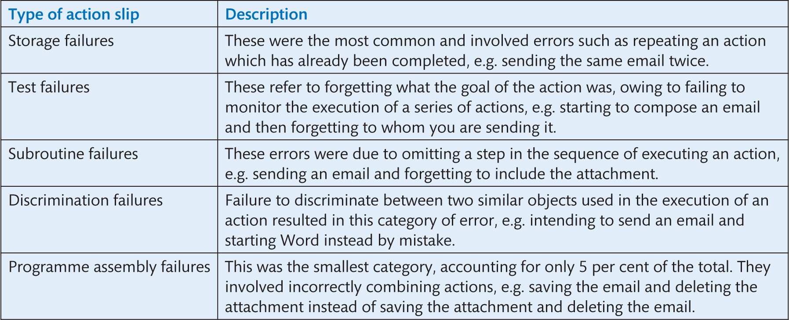
Table 21.4 Action slips

Slide 59
Reducing action slips
Designers should design to minimize the chance of slips.
For example, ‘wizards’ prompt people for, and help them recall, the steps which need to be undertaken to complete a task, such as installing a printer.
In the image of the sequence in Figure 21.10 the system prompts to obtain information to allow the operating system to install a printer.
The advantage of this approach is that only relatively small amounts of information are required at any one time.
It also has the advantage of an error correction system (i.e., use of the Back and Next steps).

Slide 60
Avoiding mistakes when marking
One of the most demanding tasks in the work of an academic is marking coursework and examination scripts and tabulating the results without making mistakes.
Figure 21.11 is a snapshot of a spreadsheet to help reduce errors in this process.
It is an example of good practice in this kind of manual tabulation of data as it employs a number of semi-automated checks (with corresponding error messages): in the column labelled Checked is a note indicating that an error message will appear if ‘either the mark inserted for a question is more than the maximum mark obtainable for that question or ….’
The author of the system has annotated the spreadsheet using comments and has used a series of if statements to check the inputted data.
So, for example, marks should be entered for three questions only and an error is signalled if this number is exceeded.

Slide 61
Challenge
What is wrong with the error message in Figure 21.12? How would you reword it?

Slide 62
Summary
We have seen that memory is divided into a number of different stores, each of different size, make-up and purpose.
Information arriving at the senses is held very briefly in the sensory stores before moving on to working memory.
Working memory (the modern equivalent of short-term memory) holds three or four items for up to 30 seconds unless rehearsed.
Information may subsequently be stored in the long-term memory store with additional processing.
The contents of long-term memory last a long time (minutes, hours, days, even years) and are held in several different types of memory, including memory for skills (procedural memory), semantic memory which holds the meaning of words, facts and knowledge generally, autobiographical memory which holds our personal experiences, and finally perma-store which holds information that literally may last a lifetime.

Slide 63
Key points
In terms of design these limitations and capabilities translate into two important principles: the need to chunk material to reduce the load on working memory; the importance of designing for recognition rather than recall.
Attention can be thought of in terms of being divided or selective.
Divided attention refers to our ability to carry out more than one task at a time, though our ability to carry out multiple tasks also depends upon our skill (expertise) and the difficulty of the task.
In contrast, selective attention is more concerned with focusing on particular tasks or things in the environment.
It should come as no surprise that we make errors while using interactive devices.
These errors have been classified and described by a range of researchers, storage failures being the most common.
While all errors cannot be prevented, measures can be taken to minimize them, using devices such as wizards and automated error checking.

