Slide 1
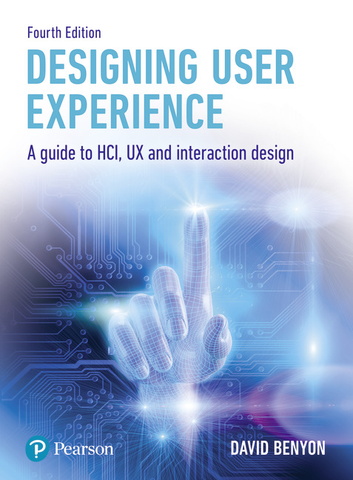
Designing User Experience
A guide to HCI, UX and Interaction Design
Fourth Edition
Chapter 24
Social interaction

Slide 2
Contents
24.1 Introduction
24.2 Human communication
24.3 People in groups
24.4 Presence
24.5 Culture and identity

Slide 3
Aims
Human beings are generally social creatures and an understanding of the social side of interactions is a necessary part of designing UX.
Designers should always consider the social impact that their designs will have.
Disciplines contributing to understanding social issues include (social) anthropology, sociology and social psychology.
These disciplines tend to use different methods and to focus on different aspects of the social.
For example, anthropology has pioneered ethnographic approaches to understanding social settings, psychology tends to favour controlled experiments, while sociology takes a stance often focused more toward the needs of societies as a whole.
The aim of this chapter is to see people as living within cultures and participating with others.

Slide 4
After studying this chapter you should be able to:
Understand the main issues in human communication
Understand issues concerned with participating in groups
Understand presence
Understand the main issues of identity and culture.

Slide 5
Introduction
The discipline of social psychology brings together the psychological and sociological.
A classic definition of social psychology states that it is:
an attempt to understand and explain how the thoughts, feelings and behaviours of individuals are influenced by the actual, imagined, or implied presence of others. (Allport, 1968)
With the rise of social networking websites and online communities such as Second Life or World of Warcraft, social interaction is an increasingly important part of designing interactive systems.
People need to be able to work with others. (Much of the discussion in Chapters 15 and 16 concerned group working and support of social networking.)
Another aspect that will become increasingly important is knowing where you are and who you are! Augmented and virtual reality systems aim to make you feel present somewhere else.
The sense of presence is ‘being there,’ whether present in a place or in the presence of other people. As people have multiple identities through their online ‘selves,’ so issues of culture and identity also become increasingly important.
In this chapter we are not going to be able to explore the whole of the world’s accumulated knowledge of social issues. However, we can look at four key aspects of people engaged in social interaction: human communication; participating in groups; issues of presence; and culture and identity.

Slide 6
Human communication
Social interaction begins with the ability to communicate.
Understanding communication is usually traced back to theories of semiotics and how we exchange signs through some communication channel.
Ferdinand de Saussure expressed many of the ideas as related to language, but others such as Umberto Eco (Eco, 1976) have broadened out semiotic theories of communication to all manner of signs.
O’Neil (2008) discusses the role of semiotics in new media and Sickiens de Souza (2005) develops a design method based on a semiotic approach.

Slide 7
Semiotics
Semiotics, or semiology, is the study of signs and how they function.
Signs can take a variety of forms such as words, images, sounds, gestures or objects.
A sign consists of a signifier and the signified. The two always travel together, which is why Eco (Eco, 1976) prefers the term ‘sign vehicle.’
Signs are transmitted from a transmitter to a receiver along a communication channel.
Words are transmitted through speech along the auditory communication channel or through writing using the visual channel.
The signifier is the concrete representation and the signified is the abstract concept that is denoted by the signifier.
Signs will frequently have wider interpretations, the connotations.

Slide 8
Communication (1 of 2)
Semiotics is a very general theory of communication.
In terms of human–human communication there are two key components to be considered: a linguistic element (i.e., what is said) and a non-verbal element.
The non-verbal element of communication is more popularly known as ‘body language’ or non-verbal communication (NVC).
NVC includes movement and body position, eye gaze, touch and gesture.
It also includes aspects of the environment in which any communication takes place, including the distance between the people communicating.
Third, NVC deals with paralinguistic features of a communication such as prosody (tone, pitch and rhythm of speech) and the use of linguistic acts such as humour and sarcasm.
Whilst it is generally argued that NVC is a vital part of communication, there is still no definitive view on how big a part it plays.

Slide 9
Communication (2 of 2)
Communication is necessary if people are to form relationships with each other.
Communication is also central to how those relationships are perceived, bringing in issues of trust, negotiation, persuasion and establishing shared and agreed understandings (‘common ground’).
Communication needs to be seen both in the short term and in the long term. In the context of interactive systems design, communication is often mediated by technologies; the effectiveness of the communication depends on how the technologies are designed.

Slide 10
Speech and language
Clearly, much communication between people takes place through the use of language, both spoken and written.
There is still some controversy concerning whether language is an innate human ability or whether it is something that is learned.
Noam Chomsky was an early pioneer of language understanding, though his work is not very accessible, ingrained in the philosophy of mind of the period that was dominated by the HIP view of people.
Most recently, Steven Pinker, a philosopher at Harvard, argues that language is central to the way we are and the way we think and Nass and Brave have published Wired for Speech, a book that presents a huge body of empirical research showing how innate the ability of speech and language is (Nass and Brave, 2005).

Slide 11
Speech
Speech has many characteristics other than just the words.
Prosody concerns the rhythm, stress and intonation of speech.
Variations in pitch and the tone of speech and the speed of delivery all contribute to the meanings that are conveyed.
Prosody is very important for conveying emotions, and subtle variations of meaning that can be lost in written language.
We all know how written forms of communication such as e-mail can cause difficulties because of the lack of non-verbal signals.
Of course, written language has long used italic, bold and other typographic cues to indicate emphasis.
Nowadays emoticons or emojis have been developed in order to add some of these additional cues to written communication.

Slide 12
Analysing discourse
There is a considerable body of knowledge concerned with understanding written and verbal communication.
Discourse analysis and conversation analysis are two examples of how communication can be analysed.
Discourse analysis looks at the various speech acts that are involved in a communication.
For example, ‘Hello’ is a greeting and ‘How are you?’ is a question.
In conversation analysis more emphasis is put on turn-taking and how the conversation flows.

Slide 13
Non-verbal communication
Non-verbal communication refers to the host of signs that are used in communication, whether intentionally or not, outside of the spoken channel. There are a number of different forms of NVC.
Facial expressions
A very important component of NVC is our range of facial expressions—indeed, significant proportions of the brain are thought to be involved in understanding each other’s expressions.
Facial expressions concern changes in the eyes, mouth, cheeks and other facial muscles.
Companies such as Sensory Logic exploit this to infer and manage emotional aspects of situations.

Slide 14
NVC—Gesture
Another key aspect of NVC for many people is the role of gesture.
When we speak we move our hands, head and body.
This is often used to display the structure of the utterance by enumerating elements or showing how they are grouped, pointing at people or objects for emphasis, a disambiguating gesture, and to give an illustration of shapes, sizes or movements.
Gestures can be very effective methods of communication (particularly at a distance) to indicate placement or movement.
They are becoming increasingly important as communication methods within interactive systems.
Gestures are not limited to hand movements: whole-body movements are often used to clarify the target of a speech reference—as in the case of someone turning toward a whiteboard when discussing its contents.

Slide 15
Challenge
Find someone else to do this with. First, take turns to explain to each other (1) directions to the exit from the building, and (2) the plot of a film (preferably with lots of action) that you have enjoyed recently. You should do this in a standing position and must not use gesture. Second, note approximately how far apart you have chosen to stand.

Slide 16
NVC—Body language
Body posture and movement expresses attitudes and moods and the whole range of stronger emotions.
Bodily posture itself is also revealing of our attitude and emotional state.
Confident people are erect and square with shoulders back.
A positive attitude to others is expressed by leaning forward toward them, together with smiling and looking.
Bodily contact for most people is confined to shaking hands, patting each other on the back (found frequently among politicians and senior academics) and kissing; it is governed by strict rules—some of these are legally binding, others are a matter of good taste.
Social anthropologists often classify cultures into contact and non-contact cultures.
Reading body language and what it really means is a popular pastime for the press, particularly with respect to politicians or famous couples.
Handshakes are often given as an example of the power balance in a relationship.
Folding the arms is seen as putting a barrier between two discussants.
Eye contact is important to engender trust and conviction whereas shifting the eyes or looking down conveys insecurity.
Mirroring is an interesting phenomenon in which people will unconsciously copy the body movements of those they are interacting with. It often happens at meetings where people lean forward one after the other, and then one by one lean back.
Personal space is another aspect of body language.

Slide 17
First impressions
Evidence is mounting to support the intuitive idea that first impressions are highly significant in forming an opinion of someone.
A study by Tricia Prickett found that observers could predict whether an applicant would be offered a job by watching the first 15 seconds of a recording of an interview.
The popular book Blink by Malcolm Gladwell is one of several that present the ideas of ‘think slicing’: our unconscious ability to see familiar patterns of behaviour based on narrow slices of experience.
To some extent we are all expert at weighing up people and situations and our quickly formed first impressions are often right (Gladwell, 2000).
First impressions has become an important part of Web design and measures of first impression can be used as an evaluation method for your Web design (Lindgaard, et al., 2006)

Slide 18
Proxemics (1 of 2)
The term proxemics was coined by Edward Hall (1966) to describe the study of our use of space and how various differences in that use can make us feel more relaxed or anxious.
Proxemics applies to two main contexts:
(a) physical territory, such as why desks face the front of a classroom rather than toward a centre aisle, and
(b) personal territory, which may be thought of as a ‘bubble’ of space which we maintain between ourselves and others.
Physical distances between people indicate intimacy and friendship.
There are major cross-cultural differences in spatial behaviour: for example, Arabs and Latin Americans prefer to get up close whereas the Swedes and the Scots require a good deal more personal space.
But how far apart do we stand? Proxemics tells us that the intimate distance for embracing or whispering is perhaps 15–50 cm (and occasionally even closer), the personal distance for conversations among good friends is 50–150 cm, the social distance for conversations among acquaintances is 1–3 metres, and the public distance used for public speaking is 3+ metres.

Slide 19
Proxemics (2 of 2)
If these spatial norms are violated, we may do one or more of the following:
Shift position
Decrease eye contact
Change orientation (turn away from the other person)
Decrease duration of responses
Give fewer ‘affiliative’ responses.
However, there is some contrary evidence that if we spend more time in such situations, then we perceive the other person as warmer and more persuasive.

Slide 20
Common ground
A study of synchronous, co-located work (i.e., working together at the same time in the same place) conducted by Gary and Judith Olson and reported in 2000 involved observing the work of people in nine corporate sites.
The Olsons found that the people they observed all normally share office space.
Table 24.1 summarizes their findings and is reproduced from Olson and Olson (2000).
If we look at the fifth row down, Shared local context, people sharing a common space are all aware of the time of day (nearly lunchtime, working late) and the consequences of this knowledge—it is the end of the week, it is payday, the next working day is a week away because of the local holiday.
All of this is quite unremarkable until thought is given to supplying this background, contextual information by means of technology to people who are not present.

Slide 21
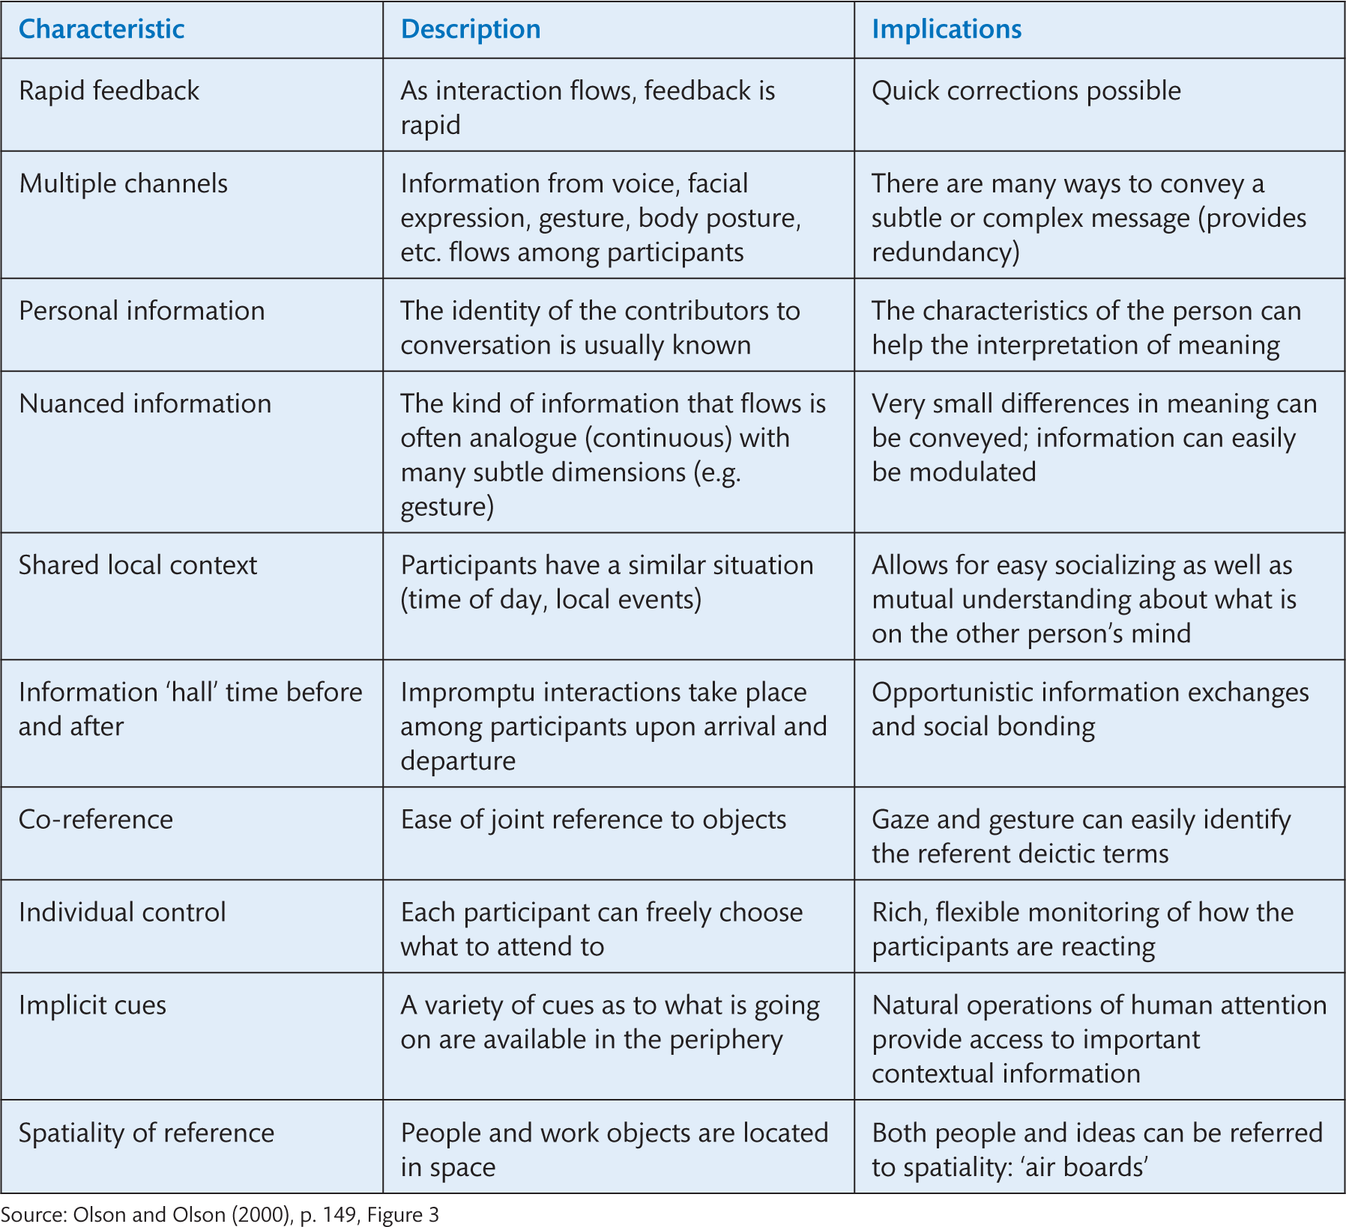
Source: Olson and Olson (2000), p. 149, Figure 3
Notes:
Table 24.1 Strengths and advantages of sharing the same space synchronously

Slide 22
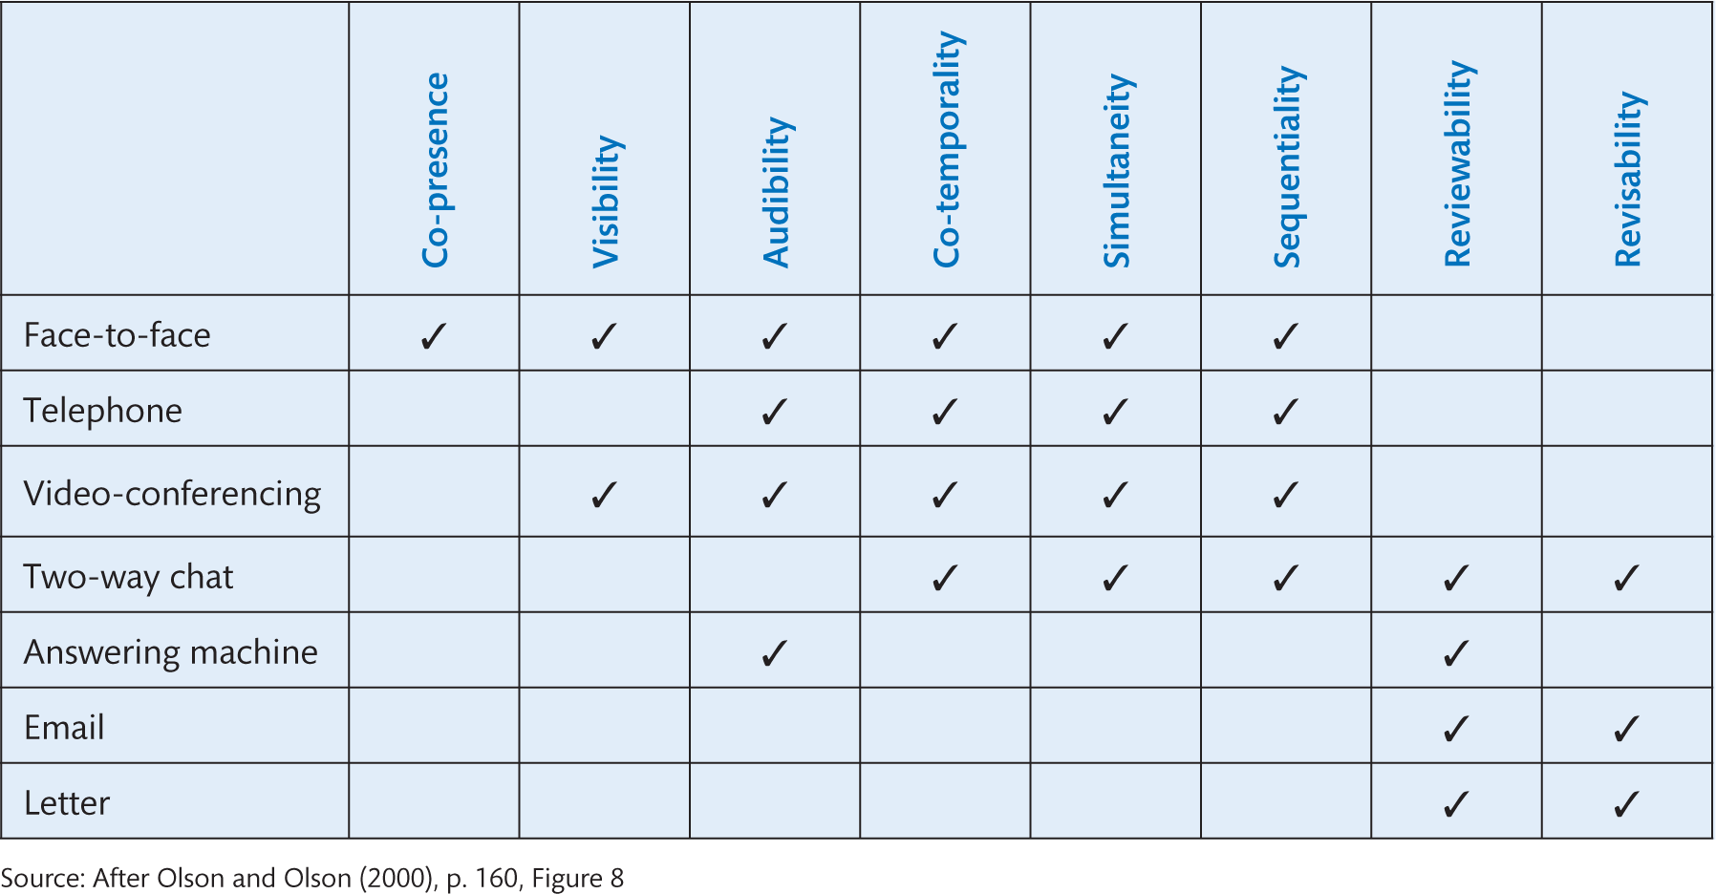
Table 24.2 Achieving common ground
Source: After Olson and Olson (2000), p. 160, Figure 8

Slide 23
Common ground
These characteristics are defined by the Olsons as follows.
Co-presence implies access to the same artefacts to support the conversation. Co-presence also implies shared reference and shared context.
Co-temporality leads to understanding of the same ‘circadian’ context (the participants know whether or not it is morning, lunchtime, evening or just much too late).
Visibility and audibility provide ‘rich clues’ to the situation.
Simultaneity and sequentiality ‘relieve the person of having to remember the context of the previous utterance when receiving the current one.’
Reviewability and revisability are the means by which people can review and revise carefully what they mean and have opportunities to make sense of what is being communicated to them. (We return to ideas of co-presence, and other forms of presence in Section 24.4.)

Slide 24
Physical distance
Physical distance can make a difference to how we perceive other people and interact with them in situations involving trust, persuasion and cooperation.
A study by Bradner and Mark (2002) set out to investigate this.
The researchers had students work in pairs with a ‘confederate’ (someone working for the researchers who pretended to be just an ordinary participant). The details of the experimental set-up were as follows:
Each pair undertook tasks designed to investigate deceptive, persuasive and cooperative behaviour.
The pairs communicated either by instant messaging or by videoconferencing (only one medium per pair).
Some of the participants were told their co-worker was in the same city, others that they were 3000 miles away—in reality, the confederate was just in the next room.
The researchers checked the participants’ perceptions of the confederate’s location by having them sketch their relative locations.

Slide 25
Physical distance
Those who were told their colleague was in a distant city were more likely to deceive, were less persuaded by their colleague, and initially cooperated less with them than those who believed that they were in the same city.
The different media made no difference to the effect. Why should this have been so?
Bradner and Mark suggest that social impact theory may be the main explanation for the results.
Essentially, people are more likely to be influenced by, and less likely to deceive, others who are located nearby.
The study also reinforces other findings that adding video does not make much difference to interpersonal interaction.
They conclude that designers of technology need to be concerned with ‘bridging social distance, as well as geographic distance.’

Slide 26
People in groups
The behaviour toward one another of two or more persons who have convergent interests (positive interdependence).
Each perceives that progress toward his own goal will be enhanced by the progress of the other person or persons as well and each expects reciprocation.
As you can see from this, cooperation is not an unselfish behaviour, but depends on the recognition of mutual benefits.
Studies of cooperation are cross- and multi-disciplinary, including anthropological and naturalistic animal studies (especially primatology), experimental and social psychology, and studies from mathematics.
For example, Axelrod (1984, revised edition 2006) has studied cooperation in the real world in many different domains, from international politics to computer chess, and has concluded that tit-for-tat is a successful model of the observed behaviour.
Tit-for-tat is a strategy that starts with explicit cooperation and follows by doing what the other party did last.

Slide 27
A view from primatology
The idea that cooperation during hunting led to the evolution of human social and moral behaviour has received recent support.
Capuchin monkeys have been observed to pay one another for the work done in getting food.
U.S. primatologists discovered that, after a collaborative hunting effort, the monkey left holding the spoils willingly shared out the food.
One of the team noted: ‘Tit-for-tat is essential in our economies, and even our morality emphasizes how one good turn deserves another.
Our lives depend on our ability to co-operate with one another and to reciprocate for the help of others.’

Slide 28
The Swiss at play
Swiss psychologists have been trying to work out why human beings have evolved to cooperate rather than act in a mostly selfish manner.
They invented a laboratory game in which volunteers passed money to each other.
The rules prevented a player from directly returning the favour to the donor—they had to give their cash to a third party.
As the game developed, the researchers noticed that the most generous players actually began to accumulate the most money.
The researchers conclude that doing good deeds increases the likelihood that someone else will treat you better.

Slide 29
Group formation
Groups do not just pop into existence, they need to be formed.
Studies by social psychologists suggest that most groups (larger than two people—which is a special case) go through a series of predictable phases.
Figure 24.6 showing these phases and their characteristics is derived from the work of Tuckerman (1965) and other authors—note that ‘decay’ is not always regarded as a phase in the life of a group.
You might be familiar with the ideas since they are often used—and misused—by people leading group activities of various sorts.

Slide 30
Challenge
Think of groups you have been part of. At what stages in the group’s life could you have used (or did you use) technologies to support the communication process?

Slide 31
Online communities
Jenny Preece and Howard Rheingold are two people who have investigated the emergence of online communities where the same processes of group formation, normalization and decay can be found (Rheingold, 2000, 2003; Preece, 2000).
Online communities need to have some shared interests and goals and need the active participation of their members.
Shared social conventions, languages and protocols evolve and are more or less adhered to.
In some situations the groups evolve more highly specialized and nuanced shared views, in which case they become ‘communities of practice’ (Wenger, 1998).
However, the Web is also littered with examples of very short-lived groups.
Online communities can be significantly helped if there is a moderator who oversees the group’s activities.
The moderator needs to facilitate discussions, keeping them on-topic and stopping any aggressive behaviours, weeding discussions to remove old or irrelevant material and promoting and generally managing the community.

Slide 32
Social network analysis
Social network analysis (SNA) is the study of people’s social relationships.
Sociograms are network diagrams that can be used to show how people are linked to each other and the strength of different relationships.
SNA can be used to look at the ties between people in a network, the composition of the network, roles, density and distance between people.
Cliques can be identified and illustrated through sociograms.

Slide 33
Social norms
Social norms affect the way people interact in groups.
A classic study was carried out at the Hawthorne Works of the Western Electric Company in the late 1920s and early 1930s.
The original intention was to investigate how improved working conditions might improve productivity in the factory’s ‘Bank Wiring Room.’
The variables that the researcher manipulated were the temperature, lighting, humidity and length of working day (including such things as rest periods).
The workers were placed in a separate experimental room where each of these factors was varied one by one.
It was found that each change increased productivity.
As a final test, all of the improvements were removed, yet productivity remained at the same high level.
Much thought has been given as to why this should be.

Slide 34
The Hawthorne Effect
One popular conclusion was that the workers in the experimental room felt that because their supervisor had been replaced by an observer they were freer to talk to each other and were more cheerful.
Alongside this, social norms—what is considered acceptable behaviour—changed: absenteeism had fallen, morale had increased, hard work was the norm.
When these experiments were re-analysed, it was suggested that the reason that behaviour changed was more to do with the fact that the workers knew they were being monitored.
In general, the phenomenon that an observer changes the behaviour of what is being observed is known as the Hawthorne Effect.

Slide 35
Compliance (1 of 3)
Haney et al. (1973) were interested in how we adopt roles in a group.
If we are assigned a role, to what extent do we comply with the demands of the role itself, regardless of how arbitrary or unreasonable they may seem? (Note: this is more usually known as the Zimbardo study, after one of the most well known of the researchers.)
Eighteen male undergraduates from Stanford University were selected from a group of volunteers. The 18 were tested to ensure they were ‘normal’ using interviews and questionnaires (i.e., they had no serious emotional problems). Then a coin was flipped to divide the group into nine guards and nine prisoners. Each student had previously said that they would prefer to be a prisoner.
Day 1: With the cooperation of the local police (and as a surprise) the prisoners were arrested, cuffed, stripped, de-loused and given a smock to wear. They were then herded into 6' × 9' cells. The guards were given khaki uniforms, mirrored shades, a club and a whistle. They were told not to use physical violence.

Slide 36
Compliance (2 of 3)
After 2–3 days: Everyone had adopted their roles. The guards denied prisoners bathing and sleep, and made them do push-ups. The prisoners became compliant and passive, and began to call each other by number rather than by name.
After 6 days (of 14): The prisoners began to show signs of significant emotional stress —bouts of crying, rashes and depression. At this point the experiment was terminated.
What had happened to the participants?
Haney and colleagues concluded that they had ceased to behave as individuals and had complied with group norms, which in turn were being reinforced by others’ compliant behaviour.

Slide 37
Compliance (3 of 3)
A modified version of the experiment was recently staged by BBC television in the United Kingdom.
In the later stages, prisoners and guards rebelled against their imposed roles and briefly collaborated with each other as a ‘commune.’
However, the structure and organization imposed by the designers of the experiment did not allow sufficient autonomy for the commune to function effectively.
After a short time, the group polarized again, the guards proposing an even more severe regime for the prisoners.
As in Haney’s original version, the experiment was terminated before its planned end-date.

Slide 38
Group think
Group thinking refers to the effect that working in a group—particularly a tight-knit group—can have on people’s thoughts and decision making.
According to this view, groups adopt more extreme views than individuals—views which may be highly risky or highly cautious.
Groups will often accept a higher degree of risk than individuals: this has been found in many experimental studies, of which Stoner (1961) was the first.
Evidence of the effect can be found in many everyday occurrences, but usually only comes to light in cases of disaster or near disaster.
The astronauts of Apollo XI, for example, are reported to have accepted a risk of 50:50 that they would not make it back from the Moon.
Explanations for this effect include the theory that people who lead or dominate groups tend to be risk-takers and that the group brings with it a diffusion of personal responsibility.

Slide 39
Conformity (1 of 2)
Early, classic work by Asch (1951, 1956) and later studies investigated different dimensions of conformity and cross-cultural comparisons.
In the classic study Asch asked participants to decide which of three comparison lines of different lengths matched a standard line.
To summarize briefly, participants almost always made the right decision when tested on their own.
When placed in groups with people who had been coached to give the wrong answer, 32% of individuals agreed with the majority—although there were wide individual differences and some people never conformed. Reasons given included:
Didn’t want to upset the experiment by disagreeing
Thought their eyesight might be faulty
Not aware of giving the wrong answer
Didn’t want to ‘appear different.’

Slide 40
Conformity (2 of 2)
The number of people who could be induced to conform varied according to group size and the degree of unanimity, task difficulty and whether answers were given in private.
Many later studies have found conflicting results, and among the reasons for this cultural factors are significant.
A high proportion of the studies were carried out with students (easy to find, easy to persuade away from other tasks) and in the years of campus revolts lower conformity rates were observed.
As well as cultural changes over time, there are well-established differences between ethnic and national cultures.
To take a couple of extreme examples, the Japanese and Americans are among the most conformist nations and the French and Portuguese among the least (according to the evidence from conformity studies, which do have their limitations).

Slide 41
Groups and technology
These findings may be diverting insights into our own behaviour, but how might the theory help us to understand the effects of computer technologies on groups working together?
One area of research has focused on the claim that group decision support system (GDSS) helps to remedy undesirable aspects of group decision making, such as the effects of conformity.
More specifically, researchers have investigated whether the ‘social distance’ and anonymity enforced by interacting through technology as disembodied entities overcome these effects.
In a typical study, Sumner and Hostetler (2000) compared students using computer conferencing (e-mail) with those holding face-to-face meetings to complete a systems analysis project.
Those in the computer condition made better decisions: more group members participated, a wider range of opinions were generated and more rigorous analysis was carried out.
They also felt at a greater psychological distance from each other and took longer to arrive at a decision.
However, the effect of anonymity is less clear-cut.

Slide 42
Postmes and Lea
Postmes and Lea (2000) conducted a meta-analysis of 12 independent studies.
The only reliable effect of anonymity was to lead to more contributions, especially critical ones.
They argue that performance in decision making is influenced by the strength of group identity and social norms as well as by system characteristics such as anonymity.
It is suggested that this is because anonymity affects two rather different social processes—depersonalization and accountability.
Some thinkers believe that new Web and communication technologies are radically changing the way people work together and the impact this will have on the world (Rheingold, 2003).

Slide 43
Group productivity and social loafing
It is well established (Harkins and Szymanski, 1987; Geen, 1991) that people tend to under-exert themselves in groups.
Typically, for example, the output of brainstorming groups tends to be less than that of the same number of individuals working in isolation.
This effect has been named social loafing and tends to occur more frequently when it is hard for individual effort to be identified, or when there is weak group identity, or when the group is not very cohesive.
However, some individuals may work harder—social compensation—to make up for their lazier colleagues if the group is important to them.

Slide 44
Production blocking
Another phenomenon that can decrease group productivity is production blocking—where one person’s contribution simply gets in the way of another’s, principally by causing the second person to forget what they were about to say.
It has been suggested that communicating via computers may help to avoid social loafing and production blocking.
McKinlay et al. (1999) investigated this in their laboratory study of undergraduates.
We report this in a reasonable amount of detail so you can appreciate how this type of experiment is carried out.
The groups carried out brainstorming and decision-making tasks, working in groups of three.
One set of groups worked under normal face-to-face conditions and a second set used computer-conferencing software.
The remaining groups were ‘nominal groups’ only—that is, they worked individually, but their outputs were aggregated to provide a comparison with that of the true groups.

Slide 45
Hypotheses
Two main hypotheses (or ideas) were tested:
Hypothesis 1. The nominal groups would produce more ideas. This was what previous research had suggested.
The relative output from the groups’ brainstorming confirmed this. (The groups had to come up with lists of the advantages and disadvantages of an extra thumb.)
But it did not seem that production blocking accounted for the difference, since both the computer-mediated and face-to-face groups could ‘jot down’ ideas as they occurred to them.
Hypothesis 2. There would be less social compensation in the computer-mediated group than in the face-to-face group. This was based on the theory that the computer group would be less socially cohesive.
These groups worked with a scenario about surviving an accident in the Arctic or the desert and had to prioritize a list of items of equipment according to their survival value. The discussion took place either around a table or by text-conferencing.
A degree of social loafing was deliberately introduced by including a confederate (someone acting under instructions without the knowledge of the others) as one of the three people. Each confederate either contributed constructively or ‘loafed.’
It was found that when a social loafer was present, people spoke more in face-to-face groups, but less in computer-mediated groups.

Slide 46
Discussion
What did the researchers conclude from these results?
First, they wondered whether the computer-mediated groups were really less cohesive or whether it was simply more difficult to identify that someone was apparently being lazy.
Examining the transcripts of the sessions suggested that the computer group worked more individually, so this suggests that the loafers may have escaped undetected.
The text-conferencing medium in real life may be sufficiently social to allow loafing to happen, but not to foster compensatory behaviour.
It is suggested that the computer technology may need to be supplemented by activities which enhance group identity if groups are to work together effectively in such media.

Slide 47
In summary: the social psychology of groups
People behave differently in groups.
Social psychology tells us much about the change in behaviour from individuals to groups.
Technology has the potential to mitigate or enhance some of these effects.
Predicting social effects in computer-mediated groups requires careful thought to identify the real issues.
Finally, there are individual differences to take into account.
We have not strayed into this area so as to keep this material to a manageable length, but you should be aware that factors such as personality, gender and so forth will also affect how individuals work in groups.

Slide 48
Challenge
Think of groups you have been part of. How did the group work out?

Slide 49
Presence (1 of 2)
The sense of presence is a key component of social interaction.
Exactly what presence is is still a philosophically charged issue.
Part of the problem with the term is that it is used both as a philosophical construct and as shorthand when talking about telepresence. These two meanings often get confused in discussions.
Presence has been described in various ways, as the sense of ‘being there,’ or as ‘the illusion of non-mediation’ (Lombard and Ditton, 1997) by which they mean that the technology in an interaction seems to disappear.
As with much discussion of presence, the issue of whether the interaction is mediated or not becomes critical.
A high degree of presence is achieved if the medium through which a person experiences something appears to disappear.

Slide 50
Presence (2 of 2)
Although presence is normally thought of with respect to high-fidelity, high-technology communication devices—telepresence—it can apply to any medium.
For example, a person may achieve a high sense of presence when reading a book.
They may feel transported to another land depicted in the book, or may feel close to a character in a book.
The same is true of radio drama and TV, and becomes more so in the more immersive media such as cinema.
Even in a cinema, your sense of presence can be broken by the sight of a person coming in late.
In full virtual reality (VR) the very vivid displays cut out any other peripheral sights, and the sights you have are controlled by moving your head.
This more immersive experience should make the medium vanish.
Unfortunately, the weight and awkwardness of much of today’s equipment does not quite achieve the ideal effect.

Slide 51
The psychology of well-being
The way in which we live and socialize has a huge impact on how we feel.
The psychology of well-being is a serious academic discipline looking at the factors that make people feel fulfilled, satisfied and well.
There is also a lot of ‘pop’ psychology and easy fixes for striving for well-being.
Interaction designers should pay attention to this work as, arguably, part of their job is to increase the opportunities for well-being.
Emotion research, psychology, presence, attitudes, financial and career security.
There are many factors contributing to well-being.
A philosophical treatment is given by Riva et al. (2004).
They argue that humans are social beings, pre-programmed to prioritize the presence of others.
The sense of presence of the other arises from the integration of information about three levels of being of the sensed person, all arrived at from the observation of the physical cues inherent in actions: the physical, the physiological and the psychological.

Slide 52
A three-level view of presence (1 of 2)
They take a three-level view of presence.
At the physical level, people either confirm that the patterns of bodily movements are those of a recognized person, or they register those of an unknown person.
At the physiological level, people infer the emotional state of the person from how they are behaving.
At the psychological level, people interpret their observations in terms of the likely mode of cognition of the other person.
Presence can be described as the feeling of being somewhere, and co-presence that of being somewhere with someone else.
When presence is mediated by technologies, the sense of presence experienced through a communication channel is a combined function of the extent to which the person is addressed on the three levels:
the sensorimotor (does the system respond appropriately—how and on what timescale—to body movements),
the perceptual (e.g., the quality of sound and visual presentations), and
the conceptual.

Slide 53
A three-level view of presence (2 of 2)
Things such as ‘cyber-sickness’ may cause a break in presence.
High fidelity is not always associated with high presence, especially the co-presence with others that is our focus.
The conceptual level of co-presence is largely generated by the information exchanged between the participants, as in a conversation. It is more or less important to overall presence depending on the activity.
A high degree of presence is necessary to control things at a distance such as with telemedicine, or controlling the Mars lander.

Slide 54
Social presence (1 of 2)
The sense of presence is a key component of social interaction.
This sense includes feelings of being in the world, a sense of being in a place and a sense of being with other people.
Social presence was defined by Short et al. in 1976 as the ‘degree of salience of the other person in a mediated communication and the consequent salience of their interpersonal interactions’ (p. 65).
They refer this idea back to previous concepts of immediacy and intimacy and to the importance of these to interpersonal interactions.
Biocca et al. (2001) identify co-presence, co-location and mutual awareness as facets of social presence along with psychological involvement and behavioural engagement.
Awareness has been important in the field of Computer Supported Cooperative Work (CSCW) for a long time, with novel technological solutions being proposed that allow people to be aware of what others are doing in remote locations (see Chapter 16).
There are several technologies that are helping to achieve a high level of social presence, most notably the new videoconferencing facilities such as Cisco’s telepresence and HP’s Halo (Figure 24.7).
These systems use life-size displays, with careful design and a mirroring of meeting room layout to create a real sense of being with other people who are remote.

Slide 55
Social presence (2 of 2)
Another view of social presence relates it to connectedness.
Smith and Mackie (2000) argue that the pursuit of connectedness is a fundamental need that drives the search for social relationships and belonging to community.
Connectedness is something that can be provided with relatively light and mobile technologies.
For example, the hug-me T-shirt provides the wearer a light squeeze when the actuators are activated from a remote device.
Another device connects a ring on one lover to an earring on the other. Rubbing the ring makes the earring warm.
The Stress OutSourced project which is described as ‘crowdsourcing’ massage. People connected to the wearer over the Internet can send a massage to a stressed individual using their wearable module.
A sense of connectedness can be provided though e-mail, the phone, instant messaging and so on. There is little awareness offered by these technologies (the person on the other end of the phone could be doing anything), but there is some sense of presence.
Clear areas of advance include notions of network presence where people see themselves as part of a large network, not simply connected one-to-one.
With more effective tools to enable people to feel more present in their social networks, economic and social benefits will be derived.

Slide 56
Technology and Social presence
The challenges that lie ahead for technological supporting of social presence include both technological issues and design issues.
Technologies need to become lighter and less intrusive (see also Section 2.4).
High degrees of presence are only enabled through high-tech solutions such as the Halo system above.
Similarly, connecting people through virtual environments is still relatively slow and cumbersome and these restrictions affect the sense of really being with another person.
Certainly some work in the Presenccia project has shown that people react to avatars in some ways that are similar to how they react in a real situation (e.g., people have been embarrassed if an attractive female avatar comes too close).
This demonstrates a degree of social presence.
Much more needs to be done, however, before avatars become effective virtual humans.
Technologies should fit more easily into people’s lives both at home (e.g., with large displays embedded in walls) and on the move.
Technologies need to be designed to better match the social activities of people and this will provide new forms of social presence and new ways of connecting people.

Slide 57
Challenge
How important is social presence and what is the importance of physical presence?

Slide 58
Culture and identity
In the globalized world we live in, issues of culture and identity are increasingly important.
People are concerned that globalization leads to a world dominated by the attitudes and values of big (usually American) organizations.
It is sometimes referred to as the McDonaldization of the world.
Furthermore, it is a thoroughly intertwined world, with the Internet joining cultures in new ways.
Many people see this as a threat to the diversity of cultures, and see diversity of cultures as a key component of the vitality of ideas and thoughts.
If everyone gets their definitions of ideas from Wikipedia, where is the argument and debate that fuels new ideas and new perspectives?
Besides national and ethnic cultures, there is a need to consider subcultures and the things that social groups identify with.
Marcus and Gould (2012) discuss globalization, internationalization (preparing systems so that they can be made available for an international distribution) and localization (the process of adapting systems for particular cultures).
He gives advice on ensuring that metaphors, icons, language, appearance and other aspects of a system are able to be localized to cultural mores.

Slide 59
Cultural differences (1 of 2)
Designers of interactive systems should be sensitive to the values of different cultures and subcultures.
The best-known analysis of (national) cultural differences comes from Geert Hofstede (1994).
Since the late 1970s Hofstede and his co-workers have been developing theories of cultural differences and have created an industry advising businesses on how to approach doing business with people from different cultures.
His theories arose out of a detailed analysis of interviews with IBM employees across 53 countries.
He described the patterns of thinking, feeling and acting of these cultures in terms of five dimensions.
Power Distance concerns the extent to which a country centralizes power through strong hierarchical structures or distributes it across people in a more equitable, heterarchical way.
This difference affects the way people perceive and approach expertise, authority, security certification and so on.
Aaron Marcus gives the example of the difference between a Malaysian university website and a Dutch one.
Malaysia is much higher on the Power Distance scale and this is reflected in the site’s design.
An important consideration for designers is how to present their designs. Will people respect a design if it embodies very different attitudes?

Slide 60
Cultural differences (2 of 2)
Individualism versus Collectivism is another dimension that divides cultures around issues of individual challenge, honesty, truth and privacy against society support for training and collective harmony.
Masculine versus Feminine differentiates cultures that are at the assertive, competitive and tough end of the scale from those that are at the family, tender and people-oriented end.
Uncertainty Avoidance concerns the extent to which a culture embraces an expressive, active and emotional stance against one that focuses on clarity, simplicity and reducing errors.
Long-term or Short-term perspective is the fifth dimension, concerning cultures that perceive themselves as having a long tradition against those that identify with a shorter timescale.
There are some surprising differences between cultures. For example, Marcus and Gould (2012) suggest that Chinese and North American people organize their homes differently.
Different typography, aesthetics and colours also need to be considered.

Slide 61
Identity (1 of 2)
Another important area that is being changed through interactive technologies is the idea of identity.
As individuals we are shaped by the cultures that we live in and the values that we hold. In the globalized world of the ‘information age’ these values are shaped, not just by our immediate surroundings and our basic needs to work, eat and play, but also by global trends and influences.
As we now have multiple identities, such as in Second Life (Figure 24.12), will we become confused?
Manuel Castells has written a trilogy of books (1996, 1997, 1998) analysing the changes that the post-industrial age is bringing.
As the Internet becomes increasingly dominant, so those who are excluded from the dominant set of values may react badly to this exclusion.
For the rest of us, the images and ideas that dominate may lose the appropriate moral background that we have had in the past.
Cassells sees a growing juxtaposition of individualism and communalism.
We are a world of individuals with our profiles on Facebook or MySpace and with our own set of preferred websites and RSS feeds.
On the other hand we join online communities and feel identified with different groups and collections of individuals. The Internet makes this much easier to do.

Slide 62
Identity (2 of 2)
For the students of the future he emphasizes just how important education is—but it is education that allows people to adapt, to learn to learn.
People need flexible personalities in order to cope with the rapid nature of change in the twenty-first century.
Another key writer on identity and cyber-culture is Sherry Turkle (2005).
She writes on the changes to how we come to know ourselves through participation in online communities and games such as MMORPGs (massively multiplayer online role-playing games).
These various virtual environments allow us to have multiple personalities and identities, to role-play and to explore different aspects of ourselves.
The sense of immersion one gets from these environments is very much a factor of the degree of presence we feel.
People can become completely absorbed in games, even when quite low-tech.
Turkle does not necessarily see this as a bad thing, as culture can hold people back through its values as well as support them.
She also writes on cyber-companionship, and how people identify with and form relationships with robots, cyber-pets and other artificial companions.

Slide 63
Summary and key points
Human beings are generally social creatures and an understanding of the social side of interactions is a necessary part of designing interactive systems. Designers should always consider the social impact that their designs will have.
The study of the social side of interaction is an important part of interactive systems design.
Designers need to be aware of the social effects that their designs may have on people.
Understanding both verbal and non-verbal communication is important.
People often work together in groups and these go through typical phases of forming, storming, ‘norming’ and performing.
The sense of presence, the feeling of ‘being there,’ is an important aspects of interaction design.
Designers need to be aware of cultural differences and to understand the importance of identity.

