Slide 1
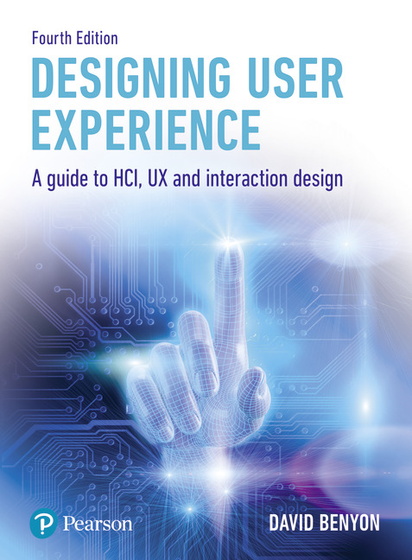
Designing User Experience
A guide to HCI, UX and Interaction Design
Fourth Edition
Chapter 25
Perception and navigation

Slide 2
Contents
25.1 Introduction
25.2 Visual perception
25.3 Non-visual perception
25.4 Navigation

Slide 3
Aims
Perception and navigation are two important abilities that people have.
Perception is concerned with how we come to know an environment through our senses.
Navigation is concerned with how we move through environments.
Until now the study of perception and navigation concentrated primarily on the physical world.
Now that we are introducing interaction in information spaces and interaction through novel devices the world is becoming a more complex and media-rich place.
In this chapter we look at issues of perception—how we can sense what is going on—and navigation—how we move through environments.

Slide 4
After studying this chapter you should be able to:
Understand various theories of visual perception
Understand other forms of perception
Understand how we navigate in physical environments
Understand navigation in information spaces.

Slide 5
Introduction (1 of 2)
How we perceive, understand and make our way through the world is critical to our existence as people.
The physical environment has to be sensed for us to know it is there, what is there and how we can move from location to location.
Nowadays the physical world is often computationally enabled (see Chapter 18).
Thus we need to know not just what things there are in the environment, but what those things can do and what information content they may provide for us.
Moreover, this mixed reality world is highly dynamic.
Whilst many aspects of the physical world are relatively static (such as roads, buildings and other geographic features), the world of information content is not.
The movement of people and traffic through streets and public spaces is also highly dynamic.
Sensing and navigating, adjusting to changes and evaluating the changing world are essential skills for a human living in an environment.

Slide 6
Introduction (2 of 2)
In terms of interactive systems design, understanding human perceptual abilities is important background for the design of visual experiences and provides background for some of the advice on design discussed in Chapter 12 and the guidelines in Chapter 4.
Hearing and haptics are important background for the design of multimodal and mixed reality systems provided in Chapter 13.
Navigation is central to the development of any information space, including mobile and ubiquitous environments, websites and collaborative environments.

Slide 7
Visual perception
Visual perception is concerned with extracting meaning (and hence recognition and understanding) from the light falling on our eyes.
Visual perception allows us to recognize a room and the people and furniture therein, or to recognize the Windows XP ‘start’ button, or the meaning of an alert.
In contrast, vision is a series of computationally simpler processes.
Vision is concerned with such things as detecting colour, shapes and the edges of objects.
Normally sighted people perceive a stable, three-dimensional, full-colour world filled with objects.
This is achieved by the brain extracting and making sense of the sensory data picked up by our eyes.
The study of visual perception is often divided into a number of interwoven threads, namely
theories of visual perception (accounts of how we perceive the world and how these can be explained), including depth perception, pattern recognition (including such things as how we recognize each other) and
developmental aspects (how we learn to perceive, or how our perceptual abilities develop).

Slide 8
Richard Gregory
Richard Gregory has presented (Gregory, 1973, among many related works) a good example of a constructivist account of visual perception.
He has argued that we construct our perception of the world from some of the sensory data falling on our senses.
His theory is based on the nineteenth-century thinking of Helmholtz who had concluded that we perceive the world by means of a series of unconscious inferences.
Gregory has drawn on numerous practical examples of the constructive/interpretative processes to support his theory.
Of this supporting evidence we shall consider perceptual constancies and so-called visual illusions (actually better described as perceptual illusions).

Slide 9
Perceptual constancy
A red car appears red in normal daylight because it reflects the red elements of (white) light.
Yet the same car will appear red at night or parked under a yellow street light.
This is an example of a perceptual constancy—in this instance, colour constancy.
Similarly, a coin always appears coin-shaped (i.e., disc-shaped) no matter how it is held in one’s hand.
This too is an example of another constancy—shape constancy.
This ability to perceive an object or a scene in an unchanged fashion, despite changing illumination, viewpoint and so forth affecting the information arriving at our senses, is described as perceptual constancy.

Slide 10
Perceptual illusions (1 of 3)
Visual (perceptual) illusions are studied because they are thought to be very revealing of how perception works by understanding what happens when perception does not work!
The argument goes like this.
Perception is seamless and, as it works very well, it is almost impossible to find a way into the process unless we study it when it does not work. When perception is faulty we can, so to speak, lift a corner and peek underneath and see how it works.
Figure 25.1 is an illustration of the Müller–Lyer illusion.
The central shaft of the upper figure looks longer despite being exactly the same length as the one below. Gregory explains this illusion by suggesting that our knowledge of the real world causes us to infer (incorrectly) that the upper figure must have a longer shaft.

Slide 11
Perceptual illusions (2 of 3)
Figure 25.2 is an image of the corner of a door in a corridor.
A vertical Müller–Lyer ‘arrow’ can be seen, made up from the door frame and the wall.
A vertical Müller–Lyer ‘arrow’ points away from the viewer and thus appears to be longer than an equivalent ‘arrow’ pointing toward the viewer.

Slide 12
Perceptual illusions (3 of 3)
Figure 25.3 illustrates a pair of Necker cubes.
The Necker cube illustrates hypothesis testing very effectively.
Gregory has argued that when we are faced with an ambiguous figure such as a Necker cube we unconsciously form a hypothesis that the cube is, say, facing to the right or left.
But if we gaze for a few more seconds at the figure it appears to turn inside-out and back again as we try to make sense of the figure.
We make unconscious inferences.

Slide 13
Summary
Gregory has produced an interesting and engaging account of visual perception that is supported by numerous examples.
However, the central weakness of his argument lies with the question—how do we get started?
If visual perception relies on knowledge of the world, how do we bootstrap the process?
We can only acquire (visual) knowledge of the world from visual perception, which relies on knowledge of the world.

Slide 14
Direct perception
In sharp contrast to Gregory’s work is that of J.J. Gibson. Gibson’s work on visual perception dates back to the Second World War (Gibson, 1950) and his work for the U.S. military in improving the training of aircraft pilots, particularly during taking off and landing.
He observed that a pilot sitting in the fixed point (the pilot’s seat at the front of the aircraft) experiences the world apparently flowing past him.
Gibson called this flow of information the optic array.
This optic flow supplies unambiguously all information relevant to the position, speed and altitude of the aircraft to the pilot.
So there is no need for unconscious inference or hypothesis testing.
Figure 25.4 is an illustration of the flow of the optic array.

Slide 15
Texture gradient
As we drive down a road the environment appears to flow out and past us as we move. What is actually happening is that the texture of the environment is expanding.
Texture gradients provide important depth information.
Examples of texture gradients include such things as pebbles on a beach or trees in a wood.
As we approach a beach or a forest the texture gradient expands as individual pebbles or trees reveal themselves against the higher density of pebbles and trees of the beach or forest.
Equally, as we retreat from a scene the texture gradient is seen to condense.

Slide 16
Affordance
Thus Gibson argued (Gibson, 1966, 1979) that the environment provides all of the information we require to experience it.
Gibson also introduced the idea of affordance (Gibson, 1977), which has been a recurring concept in HCI design for many years.
In practice, many psychologists believe that there is merit in both theories: Gibson offers an account for optimal viewing conditions, Gregory for suboptimal (or restricted) conditions.

Slide 17
Depth perception
While understanding how we perceive depth is not particularly relevant to everyday office applications, it is often essential to the effective design of games, multimedia applications and virtual reality systems.
When designing to give the impression of three-dimensionality (a sense of depth and height) we need to understand how we pick up information from the environment which we interpret as height and depth.
Depth perception is usually divided into the role of primary (relevant to immersive virtual reality systems) and secondary depth cues (more important to non-immersive applications such as games).
We begin with the primary depth cues and their key application in virtual reality systems.

Slide 18
Primary depth cues
The four key primary depth cues are retinal disparity, stereopsis, accommodation and convergence. A cue is a means or mechanism that allows us to pick up information about the environment. Two of these four cues make use of the two different retinal images we have of the world; the other two rely on the muscles that control the movement and focusing of our eyes.
Retinal disparity. As our eyes are approximately 7 cm apart (less if you are a child, more if you have a big head), each retina receives a slightly different image of the world. This difference (the retinal disparity) is processed by the brain and interpreted as distance information.
Stereopsis is the process by which the different images of the world received by each eye are combined to produce a single three-dimensional experience.
Accommodation. This is a muscular process by which we change the shape of the lens in our eyes in order to create a sharply focused image. We unconsciously use information from these muscles to provide depth information.
Convergence. Over distances of 2–7 metres we move our eyes more and more inward to focus on an object at these distances. This process of convergence is used to help provide additional distance information.

Slide 19
Secondary depth cues
Light and shade. An object with its attendant shadow (Figure 25.5) improves the sense of depth.
Linear perspective. Figure 25.6 illustrates some examples of the use of linear perspective to give an impression of depth.
Height in horizontal plane. Distant objects appear higher (above the horizon) than nearby objects. Figure 25.7 is a screenshot of a chessboard which uses height in the horizontal plane to give the impression of the black pieces being further away than the white.
Motion parallax. This cannot be demonstrated in a static image as it depends upon movement. It is perhaps best seen when looking out through a window in a fast-moving train or car. Objects such as telegraph poles that are nearby are seen to flash past very quickly while, in contrast, a distant building moves much more slowly.
Overlap. An object which obscures the sight of another is understood to be nearer. Figure 25.8 illustrates this point with an image of three overlapping windows.
Relative size. Smaller objects are usually seen as being further away, particularly if the objects in the scene are of approximately the same size (Figure 25.9).
Texture gradient. Textured surfaces appear closer; irregularities tend to be smoothed out over distance (Figure 25.10).

Slide 20
Factors affecting perception
Perceptual set refers to the effect of such things as our expectations of a situation, our state of arousal and our past experiences on how we perceive others, objects and situations.
For example, as children we all interpreted every sound on our birthdays as the delivery of birthday cards and presents; to nervous fliers, every noise is the sound of engine failure or the wings falling off.
More than 50 years ago, Bruner and Postman (1949) demonstrated a link between expectation and perception.
They briefly presented the sentences in Box 25.1 and asked a number of people to write down what they had seen.
People reliably wrote down what they had expected they had seen, for example, Paris in the spring, rather than Paris in the the spring which is what they had seen.
A similar demonstration appears in Box 25.1 where, if we follow the findings of Bruner and Postman’s demonstration, we would expect people to write down ‘patience is a virtue’ rather than ‘patience is a a virtue.’

Slide 21
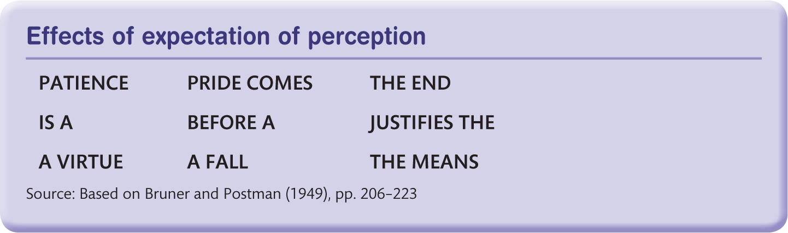
Effects of expectation of perception

Slide 22
The Gestalt laws of perception
The Gestaltists were a group of psychologists working in the early years of the twentieth century who identified a number of ‘laws’ of perception that they regarded as being innate (i.e., we are born with them).
While they did not create a theory of visual perception as such, their influence is still widely regarded as important.
Indeed, despite their age, these laws map remarkably well onto a number of modern interface design features, as described in Chapter 12.

Slide 23
Proximity
The law of proximity refers to the observation that objects appearing close together in space or time tend to be perceived together. For example, by the careful spacing of objects they will be perceived as being organized into either columns or rows (Figure 25.12).
This law also applies to auditory perception, where the proximity of auditory ‘objects’ is perceived as a song or a tune.

Slide 24
Continuity
We tend to perceive smooth, continuous patterns rather than disjoint, interrupted ones. Figure 25.13 will tend to be seen as a continuous curve rather than the five semi-circles from which it was actually constructed.

Slide 25
Part–whole relationships
This is an example of the classic ‘law’—the whole is greater than the sum of its parts. Figure 25.14(a) is made up from the same number of H’s as Figure 25.14 (b): same parts—different whole(s).

Slide 26
Similarity
Similar figures tend to be grouped together. Figure 25.15 is seen as two rows of circles with a single row of diamonds sandwiched between them.

Slide 27
Closure
Closed figures are perceived more easily than incomplete (or open) figures. This feature of perception is so strong that we even supply missing information ourselves to make a figure easier to perceive. Figure 25.16 is either four triangles or a Maltese cross.

Slide 28
Colour perception
At the back of each eye is the retina, which contains two types of light-sensitive cells called rods and cones.
The rods (which are rod-shaped) number approximately 120 million and are more sensitive than the cones (which are cone-shaped).
However, they are not sensitive to colour.
The 6 or 7 million cones provide the eye’s sensitivity to colour.
The cones are concentrated in the part of the retina called the fovea which is approximately 0.3 mm in diameter.
The colour-sensitive cones are divided into ‘red’ cones (64%), ‘green’ cones (32%) and ‘blue’ cones (2 %).
The ‘colour’ of these cones reflects their particular sensitivity.
The cones are also responsible for all high-resolution vision (as used in such things as reading), which is why the eye moves continually to keep the light from the object of interest falling on the fovea.

Slide 29
Non-visual perception
In addition to visual perception, people are endowed with other ways of sensing the external environment.
These are usually identified as our other four senses: taste, smell, touch and hearing.
However, this classification disguises a number of subtleties that exist within each of these senses.
As technology continues to advance, we can expect our abilities to sense things to be improved and enhanced through the use of implants that can sense additional phenomena in the environment.
For example, we could imagine a scenario in the future when the ability to sense radiation might become important.
At present, we sense radiation only after it has done us damage (e.g., through a change in skin colour).
With a suitable sensor implanted in our body and connected directly to the brain we could sense it at a distance.

Slide 30
Auditory perception (1 of 2)
The first distinction to be made is between hearing and audition (auditory perception).
Just as vision is concerned with the physiological and neurological processing of light (with visual perception being the extraction of meaning from the patterns of light), hearing is the processing of variations in air pressure (sound) and auditory perception is the extraction of meaning from the patterns of sound, for example recognizing a fire alarm or holding a conversation.
Sound comes from the motion (or vibration) of an object.
This motion is transmitted through a medium (such as air or water) as a series of changes in pressure.
Figure 25.17 is an illustration of a single (pure) sound wave.
The height of the wave is a measure of the sound’s loudness: the time from peak to peak is its frequency (or pitch).

Slide 31
Auditory perception (2 of 2)
Loudness
The heights of the peaks (and the depths of the troughs) indicate how loud the sound is. Loudness is measured in decibels (dB). On the decibel scale, the smallest audible sound (near total silence) is 0 dB. The decibel scale is logarithmic, which means that a sound of 40 dB is 10 times louder than the same sound at 30 Db.
It should be noted that prolonged exposure to any sound above 85 dB will cause hearing loss.

Slide 32
Frequency
The frequency of the sound wave is the pitch of the sound – low-frequency sounds like the rumble of an earthquake have a very low pitch, while high-frequency sounds like those of screaming children have a high pitch.
Human hearing is quite limited in terms of the range of frequencies we can detect, and as we get older we tend to lose the ability to hear higher-pitched sounds.
So while children may be able to hear a dog whistle or the sound of a bat’s echo location, adults usually cannot.
(The pipistrelle bat emits its echolocation signals at about 45 kHz, whereas the noctule bat uses a lower frequency of about 25 kHz or so.)
The range of hearing for a typical young person is 20 to 20,000 hertz.

Slide 33
How do we hear?
The outer part of the ear (or pinna) is shaped to capture sound waves.
If a sound is coming from behind or above the listener, it will reflect off the pinna in a different way from if it is coming from in front of or below the listener.
The sound reflection changes the pattern of the sound wave that is recognized by the brain and helps determine where the sound has come from.
From the pinna, the sound waves travel along the ear canal to the tympanic membrane (the eardrum).
The eardrum is a thin, cone-shaped piece of skin about 10 mm wide.
The movement of the eardrum is then amplified by way of ossicles (a small group of tiny bones).
The ossicles include the malleus (hammer), the incus (anvil) and the stapes (stirrup).
This amplified signal (approximately 22*) is then passed on to the cochlea.
The cochlea transforms the physical vibrations into electrical signals.
The cochlea is a snail shell–shaped structure, and is made up from a number of structures including the scala vestibuli, the scala media, the basilar membrane and the organ of Corti.

Slide 34
Haptic perception
Haptic perception has become in recent years an area of significant research.
Again we distinguish between the sense of touch and haptic perception, which is the interpretation of this sense (see Figure 25.19).
Haptic perception starts with touch, which is sensed by receptors lying both beneath the skin surface (cutaneous receptors) and in the muscles and joints (kinaesthetic receptors).
This sense provides the data about objects and surfaces in contact with the individual. It should also be remembered that heat and vibration can also be sensed from a source with which we are not in direct contact.
Haptic perception provides a rich ‘picture’ of an individual’s immediate surroundings and is essential to manipulating objects.

Slide 35
Haptics
In HCI, the term haptics refers to both sensing and manipulating through the sense of touch (Tan, 2000).
The keyboard and mouse are haptic input devices.
Tan divides haptics into two components—tactile sensing, that is, sensing via the outsides of our bodies (skin, nails and hair), and
kinaesthetic sensing, which concerns the knowledge we have of our body’s position.
As I type, I am aware of my forearms resting on the table, the crick in my neck and the looseness of my shoes on my feet—this information is provided by the proprioceptic nerves.
Unlike visual perception and audition which can be thought of as input systems, the haptic system is bidirectional.
Activities such as the reading of Braille text by blind people require the use of both the sensing and manipulation aspects of the haptic system.
Tan notes that, historically, work on haptic systems display has been driven by the need to develop ‘sensory-substitution systems for the visually or hearing impaired.’

Slide 36
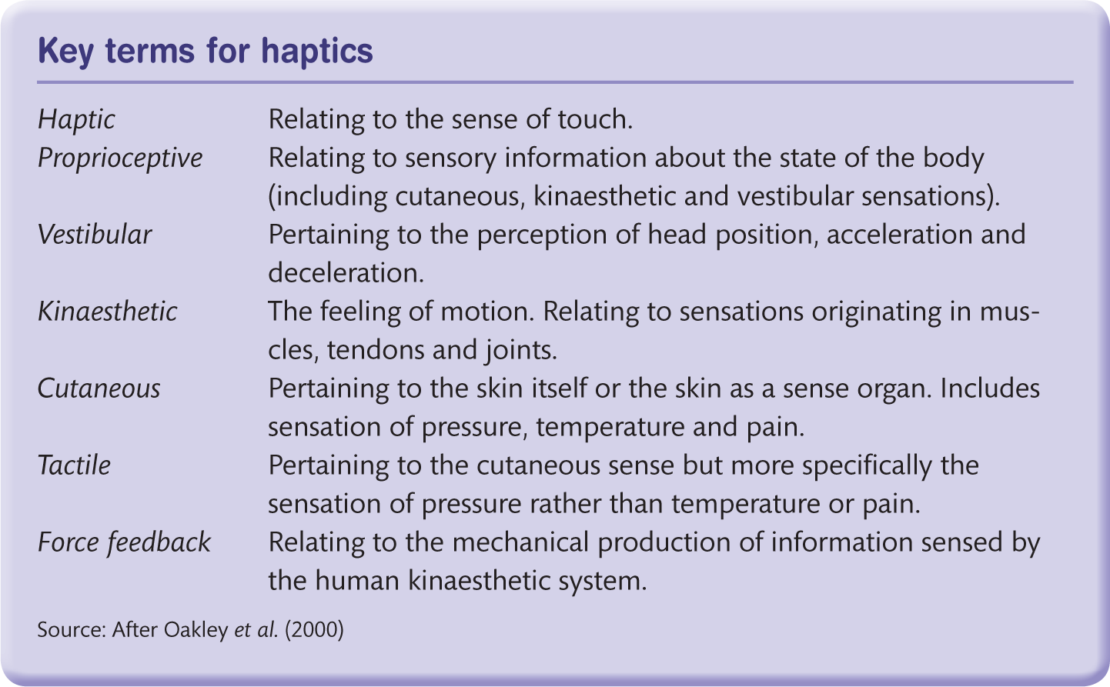
Key terms for haptics

Slide 37
Taste and smell
Taste, or gustation, and smell, or olfaction, are two senses that have not been used much in interactive systems, primarily because they have not been digitized.
The systems that are available for making smells rely on releasing chemicals into the air, or on enclosing smells in some container that can be scratched or otherwise disturbed to release the smell.
A secondary problem with smell is that it is difficult to disperse.
So, for highly interactive experiences it is difficult to provide one smell at one moment and another at the next moment.
Smell has been used in the cinema, but without any great success, and was a part of the all-round sensory experience in the 1950s, the Sensorama (Figure 25.20).
Taste is experienced through the taste buds in the mouth and in Western views was originally considered to have four states—sweet, salty, sour and bitter—but Eastern traditions have included a fifth, umami, which translates roughly as savoury, or brothy.

Slide 38
Challenge
We developed a visual virtual environment for a botanical garden. When people tried it, what do you think they missed from the real experience?

Slide 39
Navigation (1 of 2)
Perception is how we sense the environment; navigation is concerned with finding out about, and moving through, the environment.
Navigation includes three different but related activities:
Object identification, which is concerned with understanding and classifying the objects in an environment.
Exploration, which is concerned with finding out about a local environment and how that environment relates to other environments.
Wayfinding, which is concerned with navigating toward a known destination.

Slide 40
Navigation (2 of 2)
Although object identification is somewhat akin to exploration, its purpose is different.
Exploration focuses on understanding what exists in an environment and how the things are related.
Object identification is concerned with finding categories and clusters of objects spread across environments, with finding interesting configurations of objects and with finding out information about the objects.
Navigation is concerned both with the location of things and with what those things mean for an individual. How many times have you been told something like ‘turn left at the grocer’s shop, you can’t miss it,’ only to drive straight past the supposed obvious landmark?
Objects in an environment have different meanings for different people.

Slide 41
Cognitive maps
A lot of work in psychology has been done on how people learn about environments and with the development of ‘cognitive maps,’ the mental representations that people are assumed to have of their environment (Tversky, 2003).
Barbara Tversky points out that people’s cognitive maps are often inaccurate because they are distorted by other factors.
The city of Edinburgh is actually further west than the city of Bristol, but people distort this because they assume that the United Kingdom lies north–south.
In a similar way people think Berkeley is east of Stanford.
Mental map representations are rarely wholly complete or static.
Ecological considerations are concerned with the cues that people draw from the immediate environment as they interact with it.
People develop knowledge of the space over time and through the experience of interacting with and within a space.
There is still much debate about how much knowledge is ‘in the head’ and how much is ‘in the world.’
Hutchins (1995) considered the different forms of mental ‘maps’ in developing his ideas on distributed cognition when he looked at Polynesian navigators and the different perceptions and methods that they appear to have for navigation.

Slide 42
Wayfinding
Wayfinding is concerned with how people work out how to reach their destination.
For Downs and Stea (1973) and Passini (1994) the process involves four steps:
orienting oneself in the environment, choosing the correct route, monitoring this route, and recognizing that the destination has been reached.
To do this people use a variety of aids, such as signposts, maps and guides.
They exploit landmarks in order to have something to aim for.
They use ‘dead reckoning’ at sea or elsewhere when there are no landmarks.
With dead reckoning you calculate your position by noting the direction you have headed in, the speed of travel and the time that has passed.
This is usually correlated with a landmark whenever possible.

Slide 43
Finding one’s way
Learning to find one’s way in a new space is another aspect of navigation considered by psychologists (Kuipers, 1982; Gärling et al., 1982).
First, we learn a linked list of items.
Then we get to know some landmarks and can start relating our position with regard to these landmarks.
We learn the relative position of landmarks and start building mental maps of parts of the space between these landmarks.
These maps are not all complete.
Some of the ‘pages’ are detailed, others are not, and more importantly, the relations between the pages are not perfect. Some may be distorted with respect to one another.

Slide 44
Kevin Lynch
In the 1960s the psychologist Kevin Lynch identified five key aspects of the environment: nodes, landmarks, paths, districts and edges (Lynch, 1961).
Districts are identifiable parts of an environment that are defined by their edges.
Nodes are smaller points within the environment; those with particular significance may be seen as landmarks.
Paths connect nodes.
These concepts have endured, though not without criticism.
The main issue is to what extent are features of the environment objectively identified.
Other writers (Barthes, 1986) have pointed out that the identification of these features is much more subjective.
It is also important to consider the significance and meanings that are attached to spaces by people.

Slide 45
Different people
Different people see things differently at different times.
Shoppers see shopping malls in a different way from skateboarders.
A street corner might feel very different in the middle of the day from how it does at night.
There are different conceptions of landmarks, districts, etc., depending on cultural differences such as race, gender or social group.
The ship’s captain can see many more different landmarks in the ebb and flow of a river than the novice.
Navigation in a wilderness is a wholly different activity from navigation in a museum.

Slide 46
Space syntax
An interesting approach to architectural understanding is provided by the space syntax theory of Hillier (1996).
This theory looks at the connectivity of nodes in a space: how closely connected one node is to another through the paths that link them.
Hillier uses the theory to explore issues of legibility of a space—how easy it is to understand the connections and how visible different connections are.
By concentrating on people’s movement through space, many of the features of the space are revealed.
Using the theory, social phenomena such as burglary rates and house prices can be predicted.
Chalmers (2003) adapts and applies the theory to the design of information spaces.

Slide 47
Environmental knowledge
In addition to the five features identified by Lynch, it is generally assumed that there are three different types of knowledge that people have of an environment: landmark, route and survey knowledge (Downs and Stea, 1973).
Landmark knowledge is the simplest sort of spatial knowledge in which people just recognize important features of the environment.
Gradually they will fill in the details between landmarks and form route knowledge.
As they become more familiar with the environment they will develop survey knowledge, the ‘cognitive map’ of the environment.

Slide 48
Challenge
Write down your journey from home to work or college. Identify where you have a clear and detailed cognitive map and where you have only sketchy knowledge. Identify the main landmarks on your route and distinguish where you have just route knowledge against where you have survey knowledge. Give examples of where ecological decisions are made (i.e., where you rely on knowledge in the world).
List the nodes, paths, edges and districts on your route. Discuss this with a colleague and identify areas of agreement/disagreement.

Slide 49
Designing for navigation
The essential thing about designing for navigation is to keep in mind the different activities that people undertake in a space—object identification, wayfinding and exploration—and the different purposes and meanings that people will bring to the space.
Of course, designing for navigation has been the concern of architecture, interior design and urban planning for years and many useful principles have been developed that can be applied to the design of information spaces.
The practical aim of navigation design is to encourage people to develop a good understanding of the space in terms of landmark, route and survey knowledge.
However, another aim is to create spaces that are enjoyable and engaging.
Design (as ever) is about form and function and how these can be harmoniously united.

Slide 50
Characteristics of the environment (1 of 2)
One commentator on the aesthetics of space is Norberg-Schulz (1971), another is Bacon (1974).
Bacon suggests that any experience we have of space depends on a number of issues. These include:
Impact of shape, colour, location and other properties on the environment
Features that infuse character
Relationships between space and time—each experience is based partly on those preceding it
Involvement.
These all have an impact on navigation.
Too much similarity between different areas of an environment can cause confusion.

Slide 51
Characteristics of the environment (2 of 2)
The design should encourage people to recognize and recall an environment, to understand the context and use of the environment and to map the functional to the physical form of the space.
Another important design principle from architecture is the idea of gaining gradual knowledge of the space through use.
Designers should aim for a ‘responsive environment,’ ensuring the availability of alternative routes, the legibility of landmarks, paths and districts and the ability to undertake a range of activities.
Gordon Cullen developed a number of urban design principles known as ‘serial vision.’
Benyon and Wilmes (2003) applied this theory to the design of a website.

Slide 52
Signage
Good, clear signposting of spaces is critical in the design of spaces. There are three primary types of sign that designers can use:
Informational signs provide information on objects, people and activities and hence aid object identification and classification.
Directional signs provide route and survey information. They do this often through sign hierarchies, with one type of sign providing general directions being followed by another that provides local directions.
Warning and reassurance signs provide feedback or information on actual or potential actions within the environment.
Of course, any particular sign may serve more than one purpose, and an effective signage system will not only help people in getting to their desired destination but also make them aware of alternative options.
Signage needs to integrate aesthetically with the environment in which it is situated, so that it will help both good and poor navigators.
Consistency of signage is important, but so is being able to distinguish different types of sign (Figure 25.23).

Slide 53
Maps and guides
Maps can be used to provide navigational information.
Supplemented with additional detail about the objects in the environment, they become guides.
There are many different sorts of map, from the very detailed and realistic to the highly abstract schematic.
We have already seen examples of schematic maps such as the map of the London Underground (Chapter 12).
We have also seen site maps in websites that show the structure of the information and how it is classified and categorized.
Maps are social things—they are there to give information and help people explore, understand and find their way through spaces.
They should be designed to fit in with the signage system.
Like signs, there will often be a need for maps at different levels of abstraction.

Slide 54
Challenge
How can we adapt these ideas to the design of information spaces such as websites?

Slide 55
Social navigation
A well-designed environment with good signage and well-designed navigational aids such as maps will be conducive to good navigation, but even in the best-designed environment people will often turn to other people for information on navigation rather than use more formalized information artefacts.
When navigating cities people tend to ask other people for advice rather than study maps. Information from other people is usually personalized and adapted to suit the individual’s needs.
Even when we are not directly looking for information we use a wide range of cues, both from features of the environment and from the behaviour of other people, to manage our activities.
We might be influenced to pick up a book because it appears well thumbed, we walk into a sunny courtyard because it looks attractive, or we might decide to see a film because our friends enjoyed it.
We find our way through spaces by talking to or following the trails of others.
The whole myriad of uses that people make of other people, whether directly or indirectly, is called social navigation.

Slide 56
Summary
Navigation is an important, and very general, activity for people to undertake.
Navigation requires people to explore, wayfind and identify objects in an environment.
In Chapter 18 this general model was applied to ubiquitous computing environments where a more functional description of ‘overview, wayfind, interpret’ was adopted.
Elsewhere we see similarities with Shneiderman’s mantra for visualization: ‘overview first, zoom and filter, and details on demand.’

Slide 57
Summary and key points
Perception relies on our five senses and how we interpret the signals we receive.
It is a constructed process that involves us making inferences from these sometimes ambiguous signals.
Navigation concerns how we move through environments and make sense of the objects that are in the environment.
We can learn much from studying navigation in geographical spaces and indeed apply design principles from urban planning and architecture to the design of information spaces.
Perception is concerned with how we get to know about an environment and how we monitor our interaction with an environment.
Good design will help people obtain a survey knowledge of the environment.
Navigation is concerned with the three key activities of wayfinding, exploration and object identification.

