Slide 1
from High school hype to NBA stardom
Isaac Ke
November 17,2020

Slide 2
Importance of Study
Motivating question: In the basketball journey from high school to college and then to the NBA, how well does success translate from one level to the next?
Meaningfully describe relationship between HS rank, draft pick, and NBA performance
More accurate scouting reports
NBA teams draft better players
More strategic endorsement deals
Less risk and higher rate of return
Re-define false stigmas of young athletes
More winning franchises
Increased fan engagement & revenue
Motivate and encourage the young generation

Slide 3
Goals
Aim 1
Test hypothesis that a player’s high school rank and draft pick have a strong positive association with NBA career longevity
Aim 2
Test hypothesis that a better high school rank and draft pick lead to a higher professional performance ceiling

Slide 4
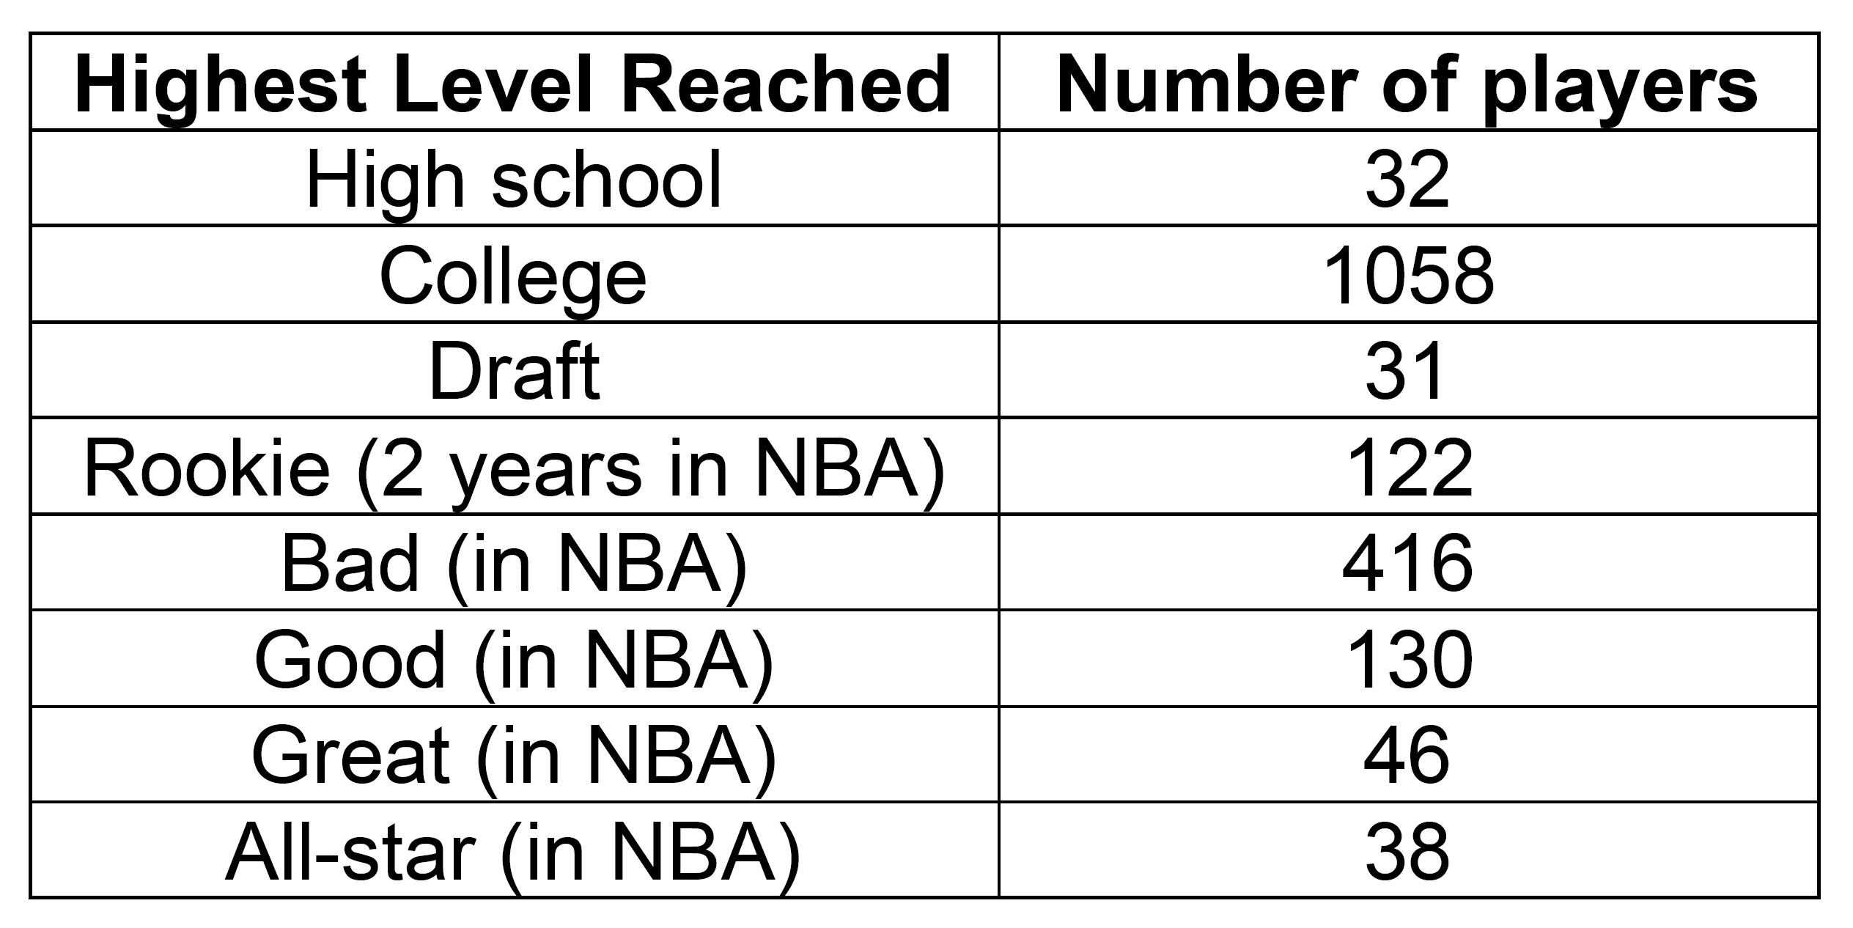
Data
1,885 high school basketball players who played between 1998-2013
High school rank (1 is best, 100 is worst)
Draft pick (1 is best, 60 is worst)
Total NBA seasons played
Highest level reached

Slide 5
Method 1: Exploratory Data Analysis
Histograms
Boxplots
Scatterplots

Slide 6
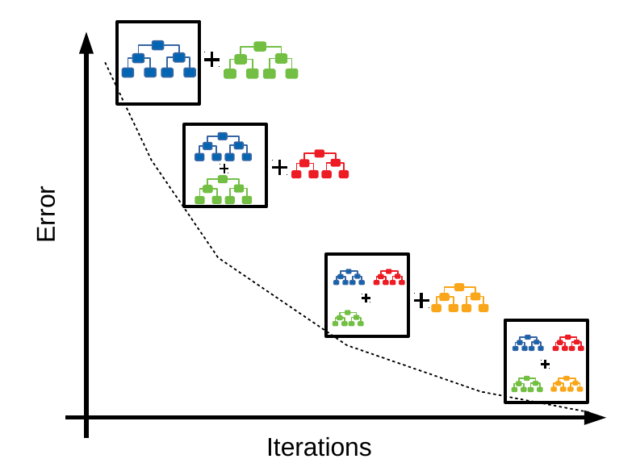
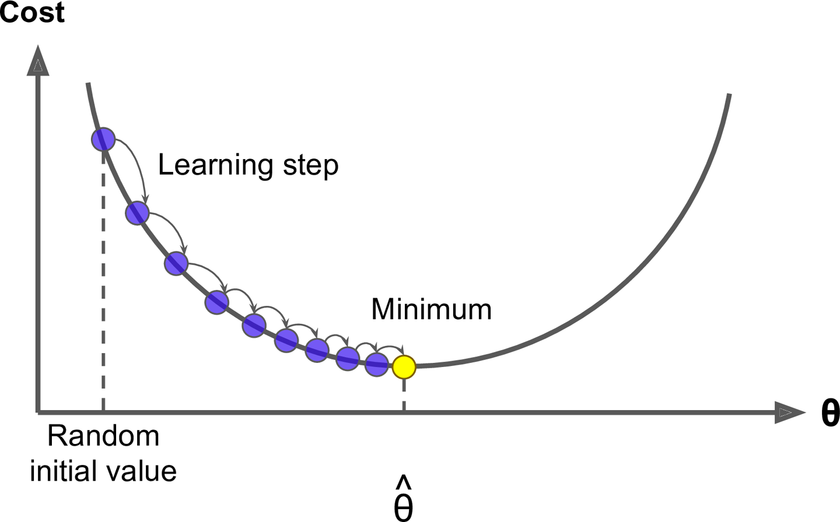
Method 2: Gradient Boosting Machine
Aim 1 (model NBA career longevity – total seasons played)
GBM – sequential formation of an additive ensemble of weak learners using gradient descent algorithm
Model selection based on loss function RMSE
80/20 train/test split
5-fold cross validation to tune hyperparameters over a grid

Slide 7
Method 3: Proportional Odds Model
Aim 2 (model maximum performance level reached – highest level reached)
“Ordered logistic regression” – extension of binary logistic regression that applies to a categorial response with 2+ ordered levels
Proportional odds assumption

Slide 8
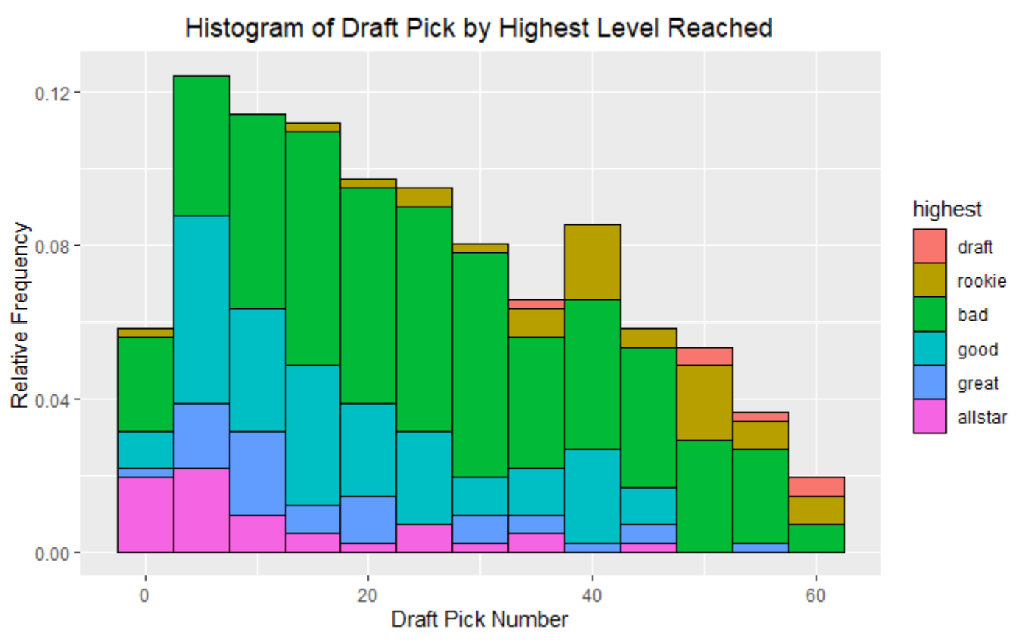
Results: Exploratory Data Analysis - Histogram
Players drafted higher tend to become better NBA players
There is still a handful of “busts” who are drafted relatively high but end up being bad players

Slide 9
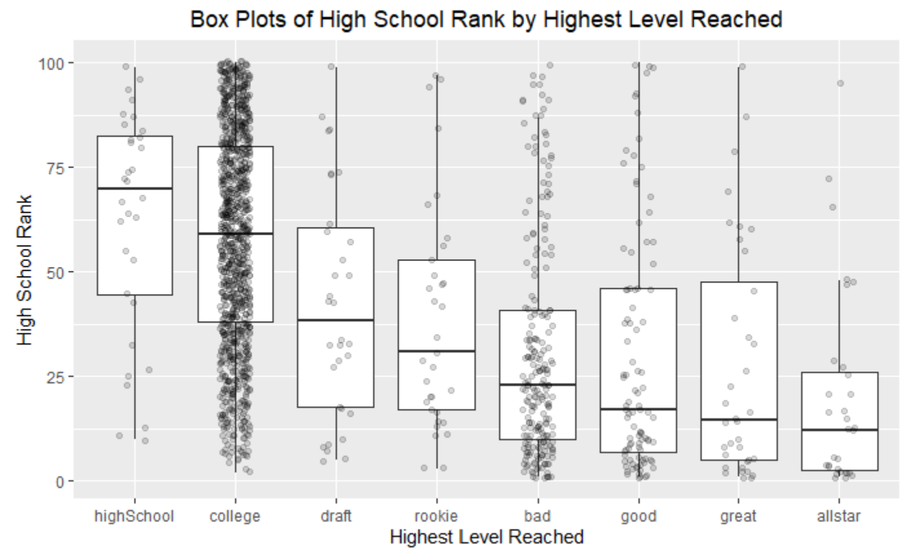
Results: Exploratory Data Analysis - Boxplots
Median high school rank goes up the higher up one goes in NBA level
Majority of players hit a ceiling in college
Most players who make it to the NBA end up being bad
Distributions move from being left skewed to right skewed
There are always “busts” and ”underdogs”

Slide 10
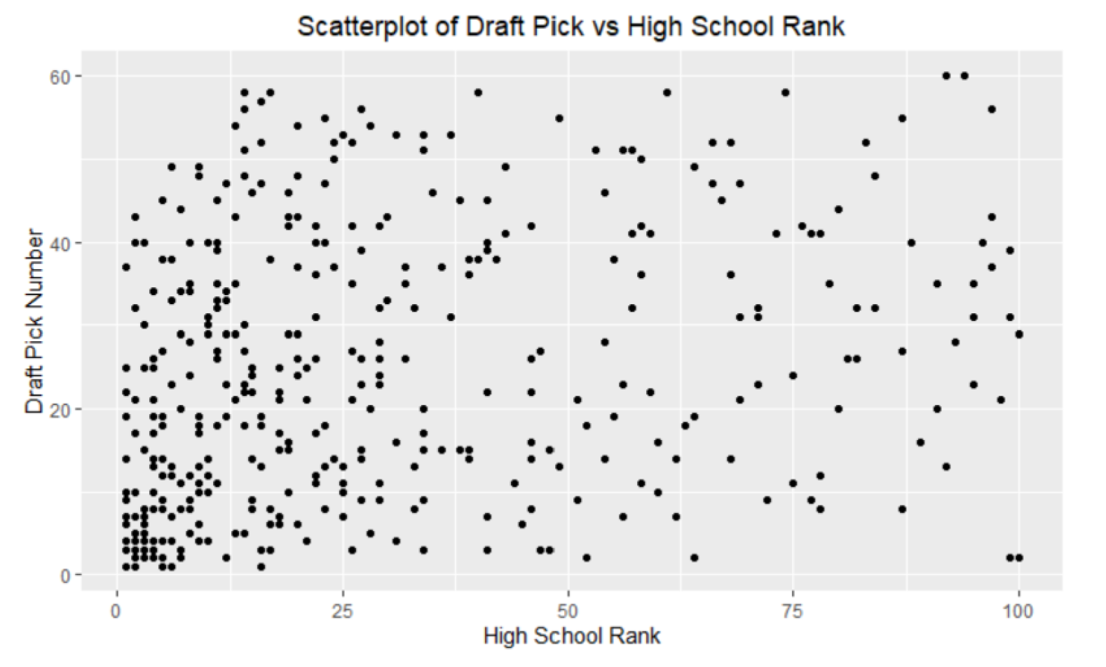
Results: Exploratory Data Analysis - Scatterplots
correlation = 0.28

Slide 11
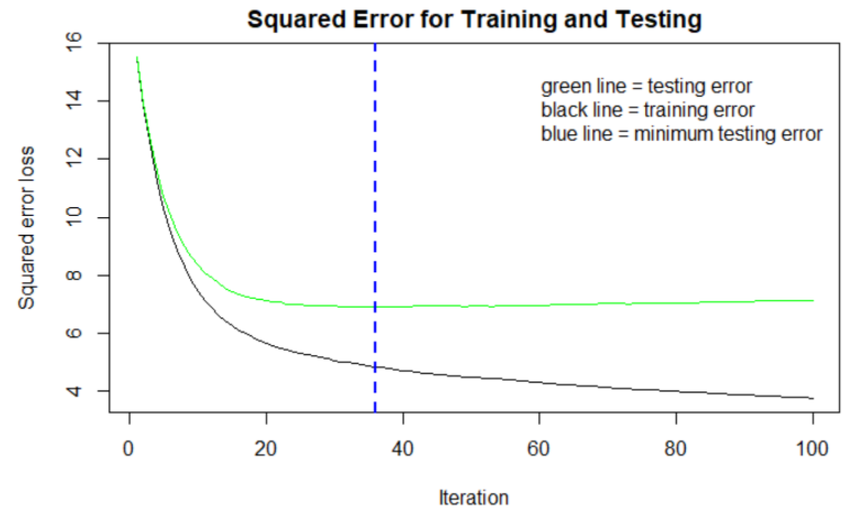
Results: Gradient Boosting Machine - Model
Best model
Number of trees: 36
Tree depth: 7
Learning rate: 0.1
RMSE Test: 2.627

Slide 12
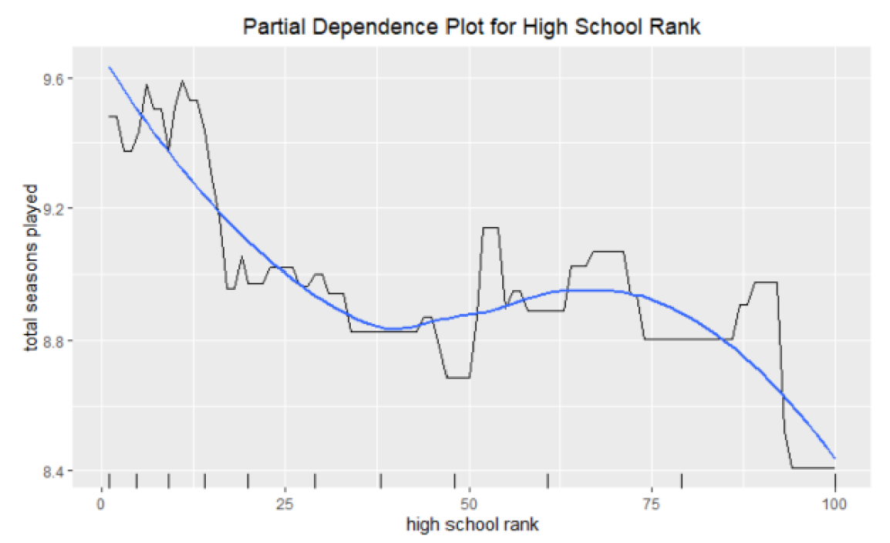
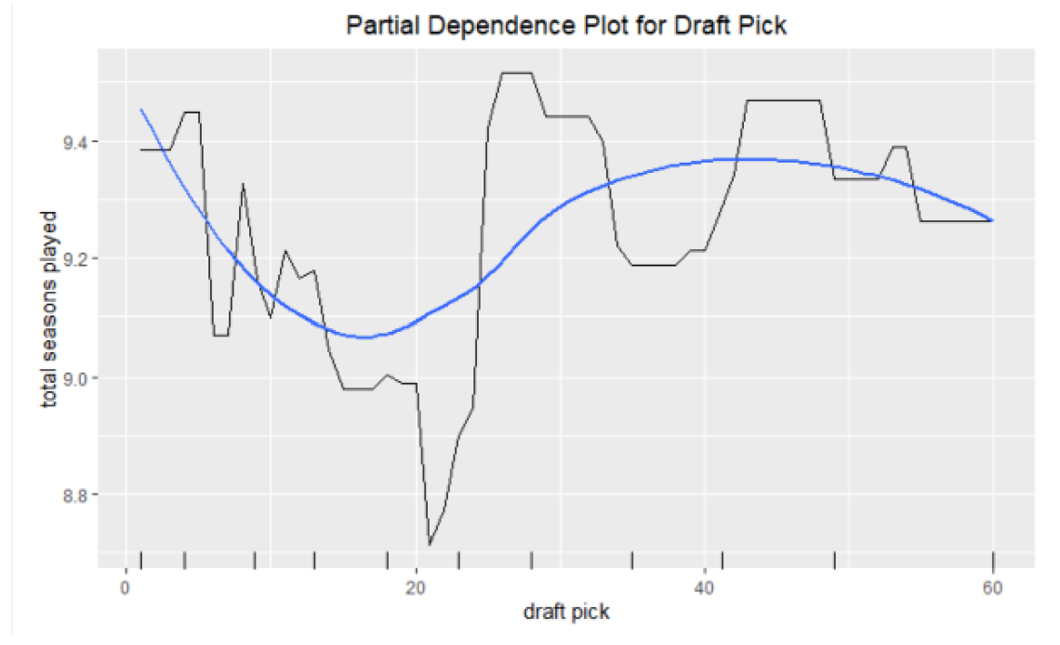
Results: Gradient Boosting Machine
Relative influence: average decrease in MSE at each split across all trees that used the variable
High school rank has a 25% more relative influence on total seasons played compared to draft pick
Partial dependence: average change in response when one variable is varied while others are held constant

Slide 13
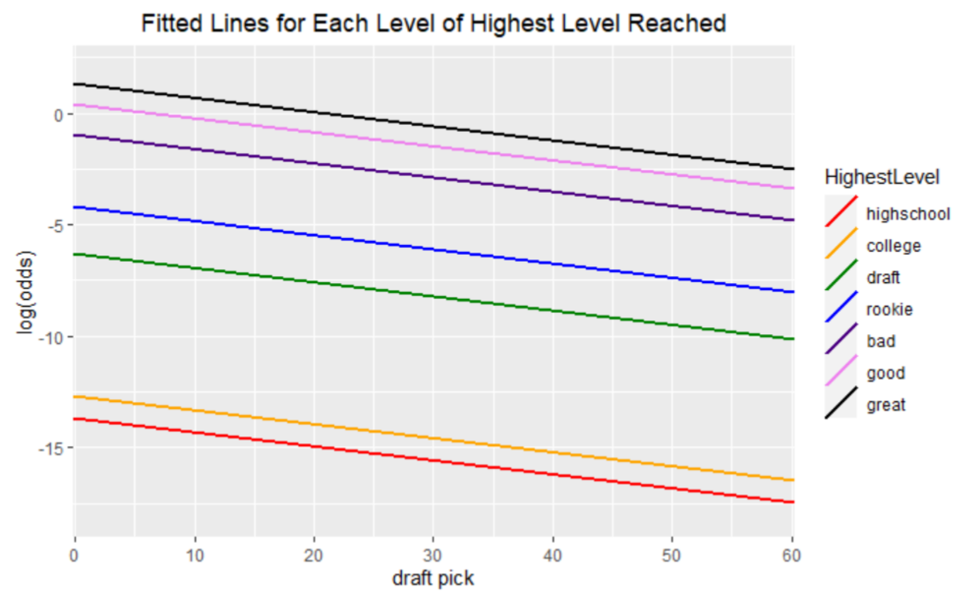
Results: Proportional Odds Model
Variable | Unit Odds “Increase” | P-value
High school rank | 0.1% | 0.39
Draft pick | 6.13% | <0.000001

Slide 14
Results: Proportional Odds Model - Prediction
HS Rank: 100
Draft Pick: 60
Bad: 52.7%
All-star: 0.5%
HS Rank: 1
Draft Pick: 1
Bad: 27.4%
HS Rank: 50
Draft Pick: 30
Bad: 63.4%
All-star: 20%
All-star: 3.7%

Slide 15

Conclusion
HS rank is a slightly better indicator of NBA career longevity compared to draft position
Draft position is a much better indicator of performance level compared to HS rank
High school and college success does provide an advantage in the NBA, but nothing is guaranteed
Mediocre players are at an increased risk of under-performing in the NBA
Being at the bottom of the rankings does not imply success is not achievable

Slide 16
Q&A

