Slide 1
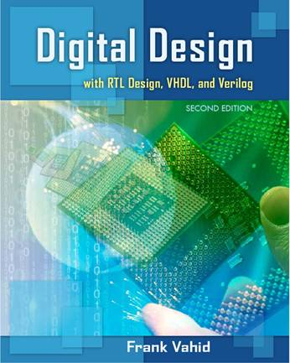
Digital Design
Chapter 1: Introduction
Slides to accompany the textbook Digital Design, with RTL Design, VHDL, and Verilog, 2nd Edition,
by Frank Vahid, John Wiley and Sons Publishers, 2010.
http://www.ddvahid.com
Copyright © 2010 Frank Vahid
Instructors of courses requiring Vahid's Digital Design textbook (published by John Wiley and Sons) have permission to modify and use these slides for customary course-related activities, subject to keeping this copyright notice in place and unmodified. These slides may be posted as unanimated pdf versions on publicly-accessible course websites.. PowerPoint source (or pdf with animations) may not be posted to publicly-accessible websites, but may be posted for students on internal protected sites or distributed directly to students by other electronic means. Instructors may make printouts of the slides available to students for a reasonable photocopying charge, without incurring royalties. Any other use requires explicit permission. Instructors may obtain PowerPoint source or obtain special use permissions from Wiley – see http://www.ddvahid.com for information.

Slide 2

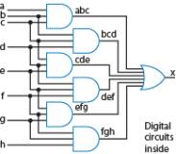
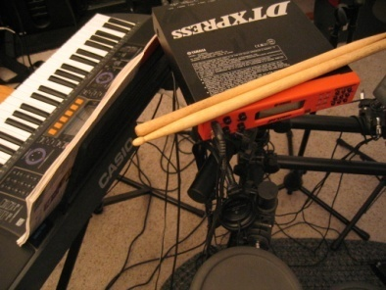
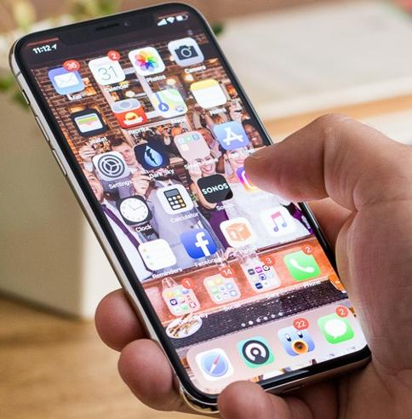
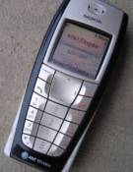

1.1
Why Study Digital Design?
Look “under the hood” of computers
  Solid understanding --> confidence, insight, even better programmer when aware of hardware resource issues
Electronic devices becoming digital
  Enabled by shrinking and more capable chips
  Enables:
    Better devices: Sound recorders, cameras, cars, cell phones, medical devices, game consoles,...
    New devices: smartphones, smart assistants...
  Known as “embedded systems”
    Thousands of new devices every year
    Designers needed: Potential career direction
Satellites
DVD
Video
Musical
players
recorders
instruments
Portable
instruments
smartwatches
music players
Cell phones
Cameras
TVs
smartphones
???
1995
1997
1999
2001
2003
2005
2007
2009
2011
2013
2015
Years shown above indicate when digital version began to dominate
  (Not the first year that a digital version appeared)

Slide 3
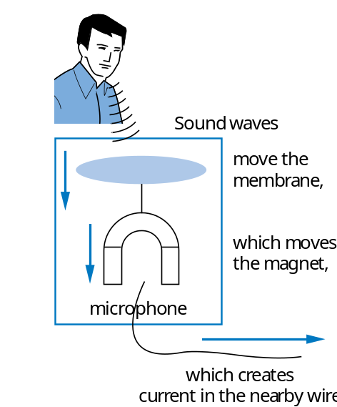
1.2
What Does “Digital” Mean?
Analog signal
  Infinite possible values
    Ex: voltage on a wire created by microphone
Digital signal
  Finite possible values
    Ex: button pressed on a keypad
1
2
3
4
2
digital
signal
analog
signal
a
Possible values:
1.00, 1.01, 2.0000009,
... infinite possibilities
Possible values:
0, 1, 2, 3, or 4.
That’s it.
4
value
value
3
2
a
1
0
time
time

Slide 4
Digital Signals with Only Two Values: Binary
Binary digital signal -- only two possible values
  Typically represented as 0 and 1
  One binary digit is a bit
  We’ll only consider binary digital signals
  Binary is popular because
    Transistors, the basic digital electric component, operate using two voltages (more in Chpt. 2)
    Storing/transmitting one of two values is easier than three or more (e.g., loud beep or quiet beep, reflection or no reflection)
value
1
0
time

Slide 5
Example of Digitization Benefit
3
3
Volts
2
2
lengthy transmission
(e.g, cell phone)
1
original signal
1
received signal
Analog signal (e.g., audio, video) may lose quality
  Voltage levels not saved/copied/transmitted perfectly
Digitized version enables near-perfect save/cpy/tran.
  “Sample” voltage at particular rate, save sample using bit encoding
  Voltage levels still not kept perfectly
  But we can distinguish 0s from 1s
0
0
time
time
How fix -- higher, lower, ?
01
10
11
10
11
a2d
Volts
a
digitized signal
lengthy transmission
(e.g, cell phone)
1
1
0
0
time
time
Can fix—distinguish 0s/1s, restore
same
Not a perfect re-creation
due to a2d and d2a
Let bit encoding be:
1 V: “01”
2 V: “10”
3 V: “11”
01
10
11
10
11
d2a
3
Volts
Higher sampling
rate and more bits per
encoding improves re-creation
2
1
0

Slide 6
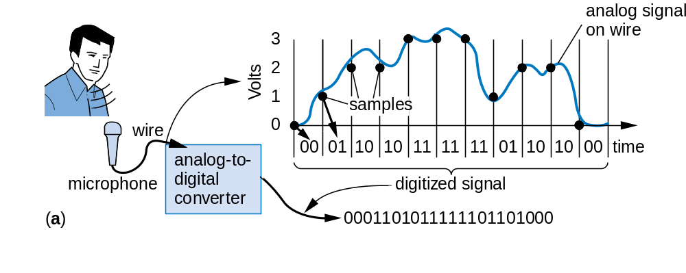
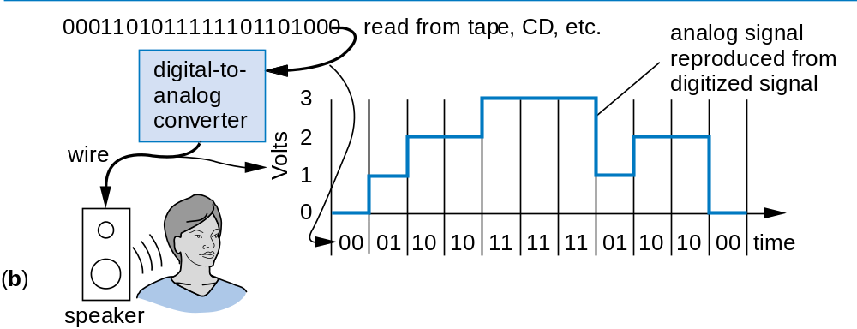
Digitization Benefit: Can Store on Digital Media
Store on CD, USB drive, etc. No deterioration.
a

Slide 7
Digitized Audio: Compression Benefit
Digitized audio can be compressed
  e.g., MP3s
  A CD can hold about 20 songs uncompressed, but about 200 compressed
Compression also done on digitized pictures (jpeg), movies (mpeg), and more
Digitization has many other benefits too
Example compression scheme:
00 means 0000000000
01 means 1111111111
    1X means X
0000000000 0000000000 0000001111 1111111111
00
00
10000001111
01
a

Slide 8
How Do We Encode Data as Binary for Our Digital System?
analog
button
a
phenomena
Some inputs inherently binary
  Button: not pressed (0), pressed (1)
Some inputs inherently digital
  Just need encoding in binary
  e.g., multi-button input: encode red=001, blue=010, ...
Some inputs analog
  Need analog-to-digital conversion
  As done in earlier slide -- sample and encode with bits
0
1
sensors and
other inputs
r
ed
blue
g
r
een
black
electric
digital
signal
data
0
0
0
A2D
r
ed
blue
g
r
een
black
digital
data
0
0
1
Digital System
r
ed
blue
g
r
een
black
digital
digital
0
1
0
data
data
33 degrees
D2A
air
electric
signal
temperature
actuators and
sensor
other outputs
0
0
1
0
0
0
0
1

Slide 9
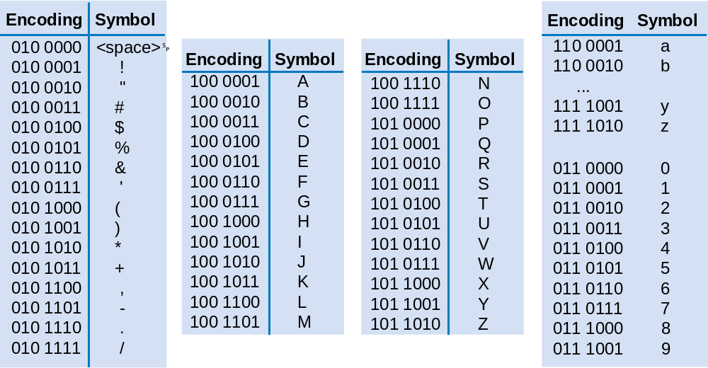
How to Encode Text: ASCII, Unicode
Sample ASCII encodings
ASCII: 7- (or 8-) bit encoding of each letter, number, or symbol
Unicode: Increasingly popular 16-bit encoding
  Encodes characters from various world languages
Question:
What does this ASCII bit sequence represent?
1010010 1000101 1010011 1010100
R E S T
a

Slide 10
How to Encode Numbers: Binary Numbers
Each position represents a quantity; symbol in position means how many of that quantity
  Base ten (decimal)
    Ten symbols: 0, 1, 2, ..., 8, and 9
    More than 9 -- next position
      So each position power of 10
    Nothing special about base 10 -- used because we have 10 fingers
  Base two (binary)
    Two symbols: 0 and 1
    More than 1 -- next position
      So each position power of 2
5
2
3
10
4
10
3
10
2
10
1
10
0
1
0
1
Q: How much?
4
3
2
1
0
+
=
2
2
2
2
2
a
4
+
1
=
5

Slide 11
Using Digital Data in a Digital System
A temperature sensor outputs temperature in binary
The system reads the temperature, outputs ASCII code:
  “F” for freezing (0-32)
  “B” for boiling (212 or more)
  “N” for normal
A display converts its ASCII input to the corresponding letter
temperature sensor
0
0
1
0
0
0
0
1
"33"
Digital System
if (input <= "00100000") // "32"
output = "1000110" // "F"
else if (input >= "11010100") // "212"
a
output = "1000010" // "B"
else
output = "1001110" // "N"
1
0
0
1
1
1
0
"N"
display
N

Slide 12
Converting from Binary to Decimal
Just add weights
  1₂ is just 1*2⁰, or 1₁₀.
  110₂ is 1*2² + 1*2¹ + 0*2⁰, or 6₁₀. We might think of this using base ten weights: 1*4 + 1*2 + 0*1, or 6.
  10000₂ is 1*16 + 0*8 + 0*4 + 0*2 + 0*1, or 16₁₀.
  10000111₂ is 1*128 + 1*4 + 1*2 + 1*1 = 135₁₀. Notice this time that we didn’t bother to write the weights having a 0 bit.
  00110₂ is the same as 110₂ above — the leading 0’s don’t change the value.
a
2
9
2
8
2
7
2
6
2
5
2
4
2
3
2
2
2
1
2
0
Useful to know powers of 2:
512
256
128
64
32
16
8
4
2
1
a
Practice counting up by powers of 2:
512
256
128
64
32
16
8
4
2
1

Slide 13
Converting from Decimal to Binary
Desired decimal
Current
Binary
Put 1 in leftmost place without sum exceeding number
Track sum
number:
12
sum
number
16 > 12, too big;
0
(a)
0
16
Put 0 in 16’s place
8
4
2
1
8 <= 12, so put
0
1
(b)
1 in 8’s place,
8
8
current sum is 8
16
4
2
1
8+4=12 <= 12, so put
0
1
1
a
(c)
1 in 4’s place,
12
current sum is 12
16
8
4
2
1
Reached desired 12,
0
1
1
0
0
(d)
so put 0s in remaining
done
places
16
8
4
2
1

Slide 14
Converting from Decimal to Binary
Example using a more compact notation
Desired decimal
Binary
number:
23
number
1
0
1
1
1
sum:
0
16
8
4
2
1
16
(a)
16
(b)
20
a
(c)
22
(d)
23
(e)

Slide 15
Example: DIP-Switch Controlled Channel
Ceiling fan receiver should be set in factory to respond to channel “73”
Convert 73 to binary, set DIP switch accordingly
Desired value: 73
a
Q:
0
1
0
0
1
0
0
1
(a)
128
64
32
16
8
4
2
1
(b)
sum:
64
72
73
DIP switch
1
channel receiver
0
"34"
0
0
1
0
0
0
1
0
"73"
0
1
0
0
1
0
0
1
InA
if (InA = InB)
InB
Out = 1
else
Ceiling fan
Out = 0
module
Out
(c)
0

Slide 16
Base Sixteen: Another Base Used by Designers
8
A
F
Nice because each position represents four base-two positions
  Compact way to write binary numbers
Known as hexadecimal, or just hex
16
4
16
3
16
2
16
1
16
0
8
A
F
1000
1010
1111
h
e
x
bina
r
y
h
e
x
bina
r
y
0
0000
8
1000
1
0001
9
1001
Q: Write 11110000 in hex
2
0010
A
1010
3
0011
B
1011
4
0100
C
1100
F
0
5
0101
D
1101
a
6
0110
E
1110
Q: Convert hex A01 to binary
7
0111
F
1111
a
1010
0000
0001

Slide 17
Decimal to Hex
Easy method: convert to binary first, then binary to hex
Convert 99 base 10 to hex
First convert to binary:
0
1
1
0
0
0
1
1
a
128
64
32
16
8
4
2
1
Then binary to hex:
a
6
3
(Quick check: 6*16 + 3*1 = 96+3 = 99)
a

Slide 18
Hex Example: RFID Tag
Batteryless tag powered by radio field
  Transmits unique identification number
  Example: 32 bit id
    8-bit province number, 8-bit country number, 16-bit animal number
    Tag contents are in binary
    But programmers use hex when writing/reading
(b)
Pr
o
vince #
City #
Animal #
(c)
Pr
o
vince
:
7
City
:
160
Animal
:
513
(a)
(d)
00000111
10100000
00000010 00000001
(e)
07
A0
02 01
RFID
tag
(f)
Tag ID in hex: 07A00201

Slide 19
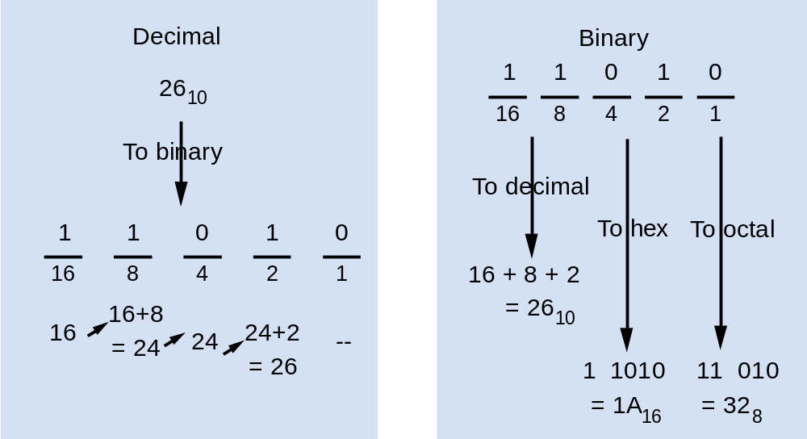
Converting To/From Binary by Hand: Summary

Slide 20
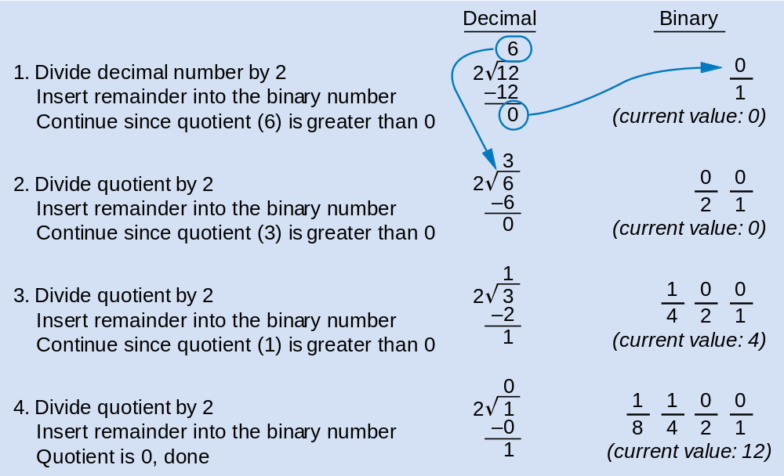
Divide-By-2 Method Common in Automatic Conversion
Repeatedly divide decimal number by 2, place remainder in current binary digit (starting from 1s column)
Note: Works for any base N—just divide by N instead

Slide 21
Bytes, Kilobytes, Megabytes, and More
Byte: 8 bits
Common metric prefixes:
  kilo (thousand, or 10³), mega (million, or 10⁶), giga (billion, or 10⁹), and tera (trillion, or 10¹²), e.g., kilobyte, or KByte
BUT, metric prefixes also commonly used inaccurately
  2¹⁶ = 65536 commonly written as “64 Kbyte”
  Typical when describing memory sizes
Also watch out for “KB” for kilobyte vs. “Kb” for kilobit

Slide 22
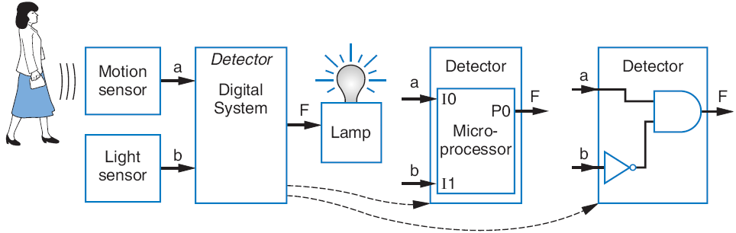
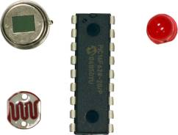
1.3
Implementing Digital Systems: Programming Microprocessors Vs. Designing Digital Circuits
Programmed
microprocessor
Custom designed
digital circuit
Desired motion-at-night detector
Microprocessors a common choice to implement a digital system
  Easy to program
  Cheap (as low as $1)
  Readily available
I
0
P0
void main()
{
while (1) {
P0 = I0 && !I1;
// F = a and !b,
}
}
a
1
I
1
P1
0
I
2
P2
1
I
3
P3
b
I
4
P4
0
I
5
P5
1
I
6
P6
F
0
I
7
P7
6:00
7:05
7:06
9:00
9:01
time

Slide 23

Digital Design: When Microprocessors Aren’t Good Enough
With microprocessors so easy, cheap, and available, why design a digital circuit?
  Microprocessor may be too slow
  Or too big, power hungry, or costly
Wing controller computation task:
50 ms on microprocessor
5 ms as custom digital circuit
If must execute 100 times per second:
100 * 50 ms = 5000 ms = 5 seconds
100 * 5 ms = 500 ms = 0.5 seconds
Microprocessor too slow, circuit OK.

Slide 24
Digital Design: When Microprocessors Aren’t Good Enough
Commonly, designers partition a system among a microprocessor and custom digital circuits
Q: How long for each
implementation option?
Image Sensor
Micro-
processor
(
a
)
(Read,
Compress,
and Store)
5+8+1
=14 sec
Memory
Image Sensor
Read
circuit
Compress
circuit
.1+.5+.8
=1.4 sec
Sample digital camera task execution times (in seconds) on a microprocessor versus a digital circuit:
(
b
)
Memory
Store
circuit
a
Task | Microprocessor | Custom Digital Circuit
Read | 5 | 0.1
Compress | 8 | 0.5
Store | 1 | 0.8
Image Sensor
Read
circuit
Compress
circuit
.1+.5+1
=1.6 sec
(
c
)
Microprocessor
(Store)
Memory
Good
compromise

Slide 25
Chapter Summary
Digital systems surround us
  Inside computers
  Inside many other electronic devices (embedded systems)
Digital systems use 0s and 1s
  Encoding analog signals to digital can provide many benefits
    e.g., audio—higher-quality storage/transmission, compression, etc.
  Encoding integers as 0s and 1s: Binary numbers
Microprocessors (themselves digital) can implement many digital systems easily and inexpensively
  But often not good enough—need custom digital circuits

