Slide 1

Digital Design
Chapter 2:
Combinational Logic Design
Slides to accompany the textbook Digital Design, with RTL Design, VHDL, and Verilog, 2nd Edition,
by Frank Vahid, John Wiley and Sons Publishers, 2010.
http://www.ddvahid.com
Copyright © 2010 Frank Vahid
Instructors of courses requiring Vahid's Digital Design textbook (published by John Wiley and Sons) have permission to modify and use these slides for customary course-related activities, subject to keeping this copyright notice in place and unmodified. These slides may be posted as unanimated pdf versions on publicly-accessible course websites.. PowerPoint source (or pdf with animations) may not be posted to publicly-accessible websites, but may be posted for students on internal protected sites or distributed directly to students by other electronic means. Instructors may make printouts of the slides available to students for a reasonable photocopying charge, without incurring royalties. Any other use requires explicit permission. Instructors may obtain PowerPoint source or obtain special use permissions from Wiley – see http://www.ddvahid.com for information.

Slide 2
2.1
Introduction
Let’s learn to design digital circuits, starting with a simple form of circuit:
  Combinational circuit
    Outputs depend solely on the present combination of the circuit inputs’ values
    Vs. sequential circuit: Has “memory” that impacts outputs too
b=0
Digital
F=0
a
System
b=0
Digital
F=0
Motion
System
sensor
Digital
System
F
b=1
Digital
F=1
Lamp
System
Light
b
b=1
Digital
F=1
sensor
System
b=0
Digital
F=1
if a=0 and b=0, then F=0
System
if b=0, then F=0
if a=0 and b=1, then F=0
if b=1, then F=1
if a=1 and b=0, then F=1
Cannot dete
r
mine
v
alue of
(a)
a
(b)
if a=1 and b=1, then F=0
(c)
F solely from present
input value
a
a
Note: Slides with animation are denoted with a small red "a" near the animated items

Slide 3
2.2
Switches
Electronic switches are the basis of binary digital circuits
  Electrical terminology
    Voltage: Difference in electric potential between two points (volts, V)
      Analogous to water pressure
    Resistance: Tendency of wire to resist current flow (ohms, Ω)
      Analogous to water pipe diameter
    Current: Flow of charged particles (amps, A)
      Analogous to water flow
    V = I * R (Ohm’s Law)
      9 V = I * 2 ohms
      I = 4.5 A
4.5 A
–
+
4.5 A
9 V
2 ohms
0
V
9
V
4.5 A
a
If a 9V potential difference is applied
across a 2 ohm resistor, then 4.5 A of
current will flow.

Slide 4
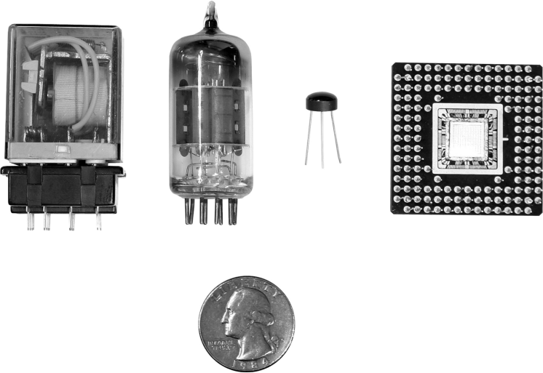
Switches
A switch has three parts
  Source input, and output
    Current tries to flow from source input to output
  Control input
    Voltage that controls whether that current can flow
The amazing shrinking switch
  1930s: Relays
  1940s: Vacuum tubes
  1950s: Discrete transistor
  1960s: Integrated circuits (ICs)
    Initially just a few transistors on IC
    Then tens, hundreds, thousands...
control
input
“off”
source
output
input
a
control
input
“on”
source
output
input
(
b
)
discrete
transistor
relay
vacuum tube
IC
quarter
(to see the relative size)

Slide 5

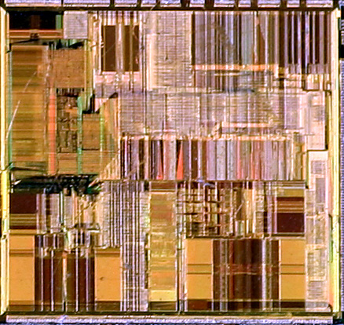
Moore’s Law
IC capacity doubling about every 18 months for several decades
  Known as “Moore’s Law” after Gordon Moore, co-founder of Intel
    Predicted in 1965 predicted that components per IC would double roughly every year or so
  Book cover depicts related phenomena
    For a particular number of transistors, the IC area shrinks by half every 18 months
      Consider how much shrinking occurs in just 10 years (try drawing it)
      Enables incredibly powerful computation in incredibly tiny devices
  Today’s ICs hold billions of transistors
    The first Pentium processor (early 1990s) needed only 3 million
An Intel Pentium processor IC
having millions of transistors

Slide 6
2.3
The CMOS Transistor
CMOS transistor
  Basic switch in modern ICs
A positive
voltage here...
...attracts electrons here,
turning the channel between
the source and drain into
a conductor
a
nMOS
gate
1
0
gate
o
xide
IC pa
c
kage
sou
r
ce
drain
conducts
does not
conduct
pMOS
gate
1
0
(
a
)
IC
Silicon -- not quite a conductor or insulator:
Semiconductor
does not
conducts
conduct

Slide 7

CMOS Transistor Analogy

Slide 8
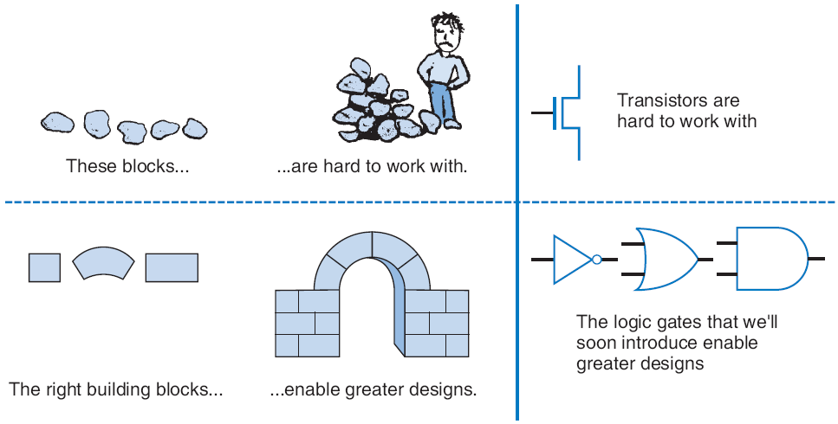
2.4
Boolean Logic Gates
Building Blocks for Digital Circuits
(Because Switches are Hard to Work With)
“Logic gates” are better digital circuit building blocks than switches (transistors)
  Why?...

Slide 9
Boolean Algebra and its Relation to Digital Circuits
To understand the benefits of “logic gates” vs. switches, we should first understand Boolean algebra
“Traditional” algebra
  Variables represent real numbers (x, y)
  Operators operate on variables, return real numbers (2.5*x + y - 3)
Boolean Algebra
  Variables represent 0 or 1 only
  Operators return 0 or 1 only
  Basic operators
    AND: a AND b returns 1 only when both a=1 and b=1
    OR: a OR b returns 1 if either (or both) a=1 or b=1
    NOT: NOT a returns the opposite of a (1 if a=0, 0 if a=1)
a
b
AND
0
0
0
a
0
1
0
1
0
0
a
b
OR
1
1
1
0
0
0
0
1
1
1
0
1
a
NOT
1
1
1
0
1
1
0

Slide 10
Boolean Algebra and its Relation to Digital Circuits
Developed mid-1800’s by George Boole to formalize human thought
  Ex: “I’ll go to lunch if Mary goes OR John goes, AND Sally does not go.”
    Let F represent my going to lunch (1 means I go, 0 I don’t go)
    Likewise, m for Mary going, j for John, and s for Sally
    Then F = (m OR j) AND NOT(s)
  Nice features
    Formally evaluate
      m=1, j=0, s=1 --> F = (1 OR 0) AND NOT(1) = 1 AND 0 = 0
    Formally transform
      F = (m and NOT(s)) OR (j and NOT(s))
        Looks different, but same function
        We’ll show transformation techniques soon
    Formally prove
      Prove that if Sally goes to lunch (s=1), then I don’t go (F=0)
      F = (m OR j) AND NOT(1) = (m OR j) AND 0 = 0
a
b
AND
0
0
0
0
1
0
1
0
0
1
1
1
a
b
OR
0
0
0
0
1
1
1
0
1
1
1
1
a
NOT
0
1
1
0

Slide 11
Evaluating Boolean Equations
Evaluate the Boolean equation F = (a AND b) OR (c AND d) for the given values of variables a, b, c, and d:
  Q1: a=1, b=1, c=1, d=0.
    Answer: F = (1 AND 1) OR (1 AND 0) = 1 OR 0 = 1.
  Q2: a=0, b=1, c=0, d=1.
    Answer: F = (0 AND 1) OR (0 AND 1) = 0 OR 0 = 0.
  Q3: a=1, b=1, c=1, d=1.
    Answer: F = (1 AND 1) OR (1 AND 1) = 1 OR 1 = 1.
a
a
b
AND
0
0
0
0
1
0
1
0
0
1
1
1
a
b
OR
0
0
0
0
1
1
1
0
1
1
1
1
a
NOT
0
1
1
0

Slide 12
Converting to Boolean Equations
Convert the following English statements to a Boolean equation
  Q1. a is 1 and b is 1.
    Answer: F = a AND b
  Q2. either of a or b is 1.
    Answer: F = a OR b
  Q3. a is 1 and b is 0.
    Answer: F = a AND NOT(b)
  Q4. a is not 0.
    Answer:
      (a) Option 1: F = NOT(NOT(a))
      (b) Option 2: F = a
a

Slide 13
Converting to Boolean Equations
Q1. A fire sprinkler system should spray water if high heat is sensed and the system is set to enabled.
  Answer: Let Boolean variable h represent “high heat is sensed,” e represent “enabled,” and F represent “spraying water.” Then an equation is: F = h AND e.
Q2. A car alarm should sound if the alarm is enabled, and either the car is shaken or the door is opened.
  Answer: Let a represent “alarm is enabled,” s represent “car is shaken,” d represent “door is opened,” and F represent “alarm sounds.” Then an equation is: F = a AND (s OR d).
  (a) Alternatively, assuming that our door sensor d represents “door is closed” instead of open (meaning d=1 when the door is closed, 0 when open), we obtain the following equation: F = a AND (s OR NOT(d)).
a

Slide 14
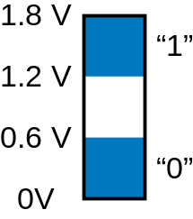
Relating Boolean Algebra to Digital Design
Boolean
algebra
Boole’s intent: formalize
human thought
N
O
T
OR
AND
Symbol
x
F
x
x
(mid-1800s)
y
F
y
F
x
F
x
y
F
x
y
F
Switches
For telephone
switching and other
electronic uses
Truth table
0
1
0
0
0
0
0
0
(1930s)
1
0
0
1
1
0
1
0
1
0
1
1
0
0
1
1
1
1
1
1
Showed application
of Boolean algebra
to design of switch-
based circuits
1
0
0
Shannon (1938)
y
y
x
Transistor
circuit
x
F
x
F
F
y
Digital design
x
y
0
x
Implement Boolean operators using transistors
  Call those implementations logic gates.
  Lets us build circuits by doing math -- powerful concept
1
1
Next slides show how these circuits work.
Note: The above OR/AND implementations are inefficient; we’ll show why, and show better ones, later.
1 and 0 each actually corresponds to a voltage range

Slide 15

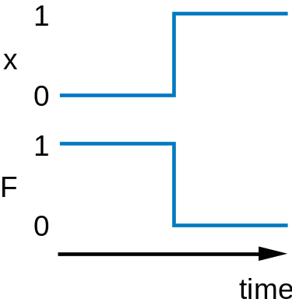
NOT gate
1
1
x
F
0
1
x
0
1
1
F
x
F
1
0
0
0
a
a
a
0
(
)
(
b
)
When the input is 0
When the input is 1

Slide 16

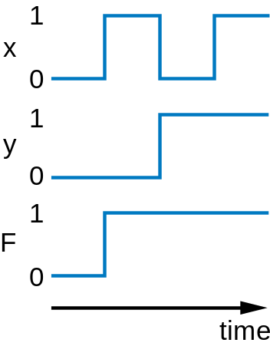
OR gate
0
0
x
y
F
0
0
0
1
y
0
y
0
1
1
1
0
1
0
x
0
x
1
0
1
1
1
F
F
x
0
1
y
x
0
0
y
a
a
1
1
(
a
)
(
b
)
When an input is 1
When both inputs are 0

Slide 17

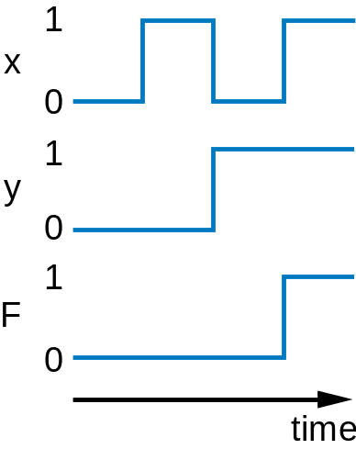
AND gate
x
y
F
0
0
0
0
0
0
1
0
1
1
x
0
1
y
x
y
1
0
0
F
1
1
1
F
1
y
1
1
y
0
1
x
0
x
a
a
1
1
(
a
)
(
b
)
When both inputs are 1
When an input is 0

Slide 18
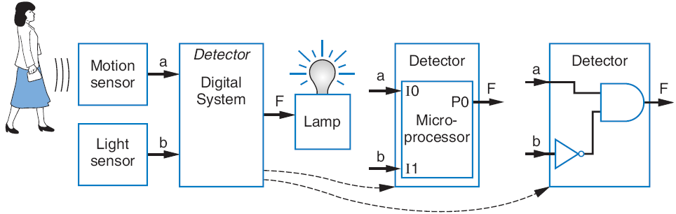
Building Circuits Using Gates
Recall Chapter 1 motion-in-dark example
  Turn on lamp (F=1) when motion sensed (a=1) and no light (b=0)
  F = a AND NOT(b)
  Build using logic gates, AND and NOT, as shown
  We just built our first digital circuit!

Slide 19
Example: Converting a Boolean Equation to a Circuit of Logic Gates
Start from the output, work back towards the inputs
Q: Convert the following equation to logic gates: F = a AND NOT( b OR NOT(c) )
a
a
b
F
c

Slide 20
More examples
F = (a AND NOT(b)) OR (b AND NOT(c))
F = a AND (s OR d)
2
1
3
1
2
a
a
b
s
F
F
d
c
(
a
)
a
a
(
b
)
Start from the output, work back towards the inputs

Slide 21
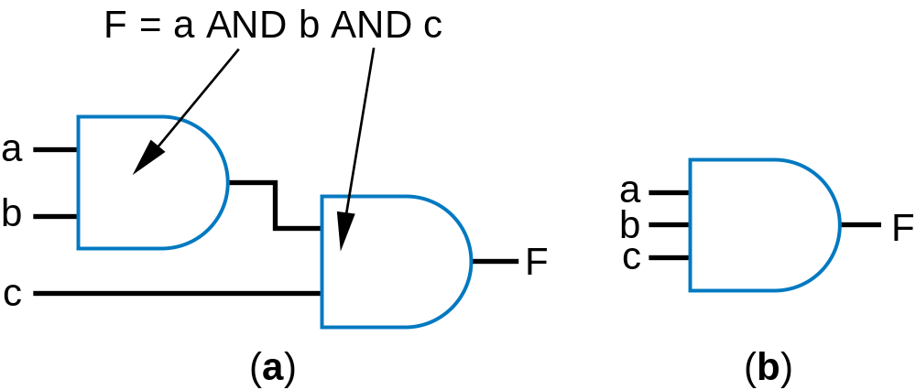
Using gates with more than 2 inputs
Can think of as AND(a,b,c)

Slide 22


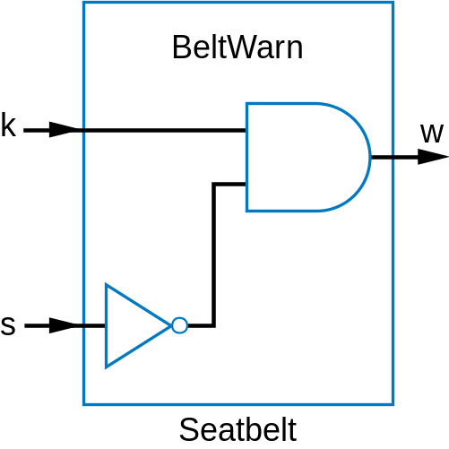
Example: Seat Belt Warning Light System
Design circuit for warning light
Sensors
  s=1: seat belt fastened
  k=1: key inserted
Capture Boolean equation
  seat belt not fastened, and key inserted
Convert equation to circuit
Timing diagram illustrates circuit behavior
  We set inputs to any values
  Output set according to circuit
w = NOT(s) AND k
a
Inputs
k
1
0
s
1
0
a
Outputs
1
w
0
time

Slide 23
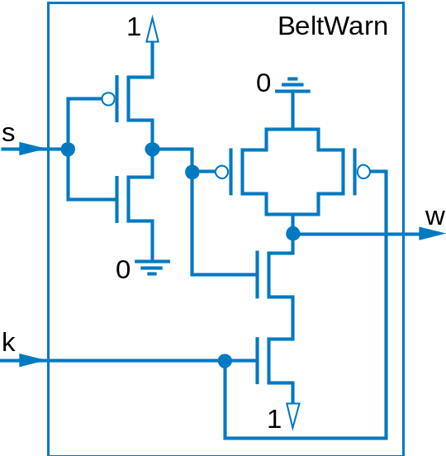
Gates vs. switches
Notice
  Boolean algebra enables easy capture as equation and conversion to circuit
    How design with switches?
    Of course, logic gates are built from switches, but we think at level of logic gates, not switches
w = NOT(s) AND k
a

Slide 24
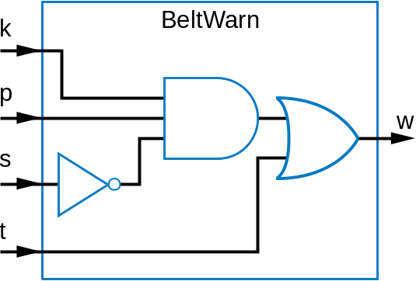
More examples: Seat belt warning light extensions
Only illuminate warning light if person is in the seat (p=1), and seat belt not fastened and key inserted
w = p AND NOT(s) AND k
k
Belt
W
a
r
n
p
w
a
s
Given t=1 for 5 seconds after key inserted. Turn on warning light when t=1 (to check that warning lights are working)
w = (p AND NOT(s) AND k) OR t
a

Slide 25
Some Gate-Based Circuit Drawing Conventions
no
y
es
x
F
y
no
y
es
a
ok
a
not ok

Slide 26
2.5
Boolean Algebra
By defining logic gates based on Boolean algebra, we can use algebraic methods to manipulate circuits
Notation: Writing a AND b, a OR b, NOT(a) is cumbersome
  Use symbols: a * b (or just ab), a + b, and a’
    Original: w = (p AND NOT(s) AND k) OR t
    New: w = ps’k + t
      Spoken as “w equals p and s prime and k, or t”
      Or just “w equals p s prime k, or t”
      s’ known as “complement of s”
    While symbols come from regular algebra, don’t say “times” or “plus”
      "product" and "sum" are OK and commonly used
Boolean algebra precedence, highest precedence first.
Symbol Name Description
( ) Parentheses Evaluate expressions nested in parentheses first
’ NOT Evaluate from left to right
* AND Evaluate from left to right
+ OR Evaluate from left to right

Slide 27
Boolean Algebra Operator Precedence
Evaluate the following Boolean equations, assuming a=1, b=1, c=0, d=1.
  Q1. F = a * b + c.
    Answer: * has precedence over +, so we evaluate the equation as F = (1 *1) + 0 = (1) + 0 = 1 + 0 = 1.
  Q2. F = ab + c.
    Answer: the problem is identical to the previous problem, using the shorthand notation for *.
  Q3. F = ab’.
    Answer: we first evaluate b’ because NOT has precedence over AND, resulting in F = 1 * (1’) = 1 * (0) = 1 * 0 = 0.
  Q4. F = (ac)’.
    Answer: we first evaluate what is inside the parentheses, then we NOT the result, yielding (1*0)’ = (0)’ = 0’ = 1.
  Q5. F = (a + b’) * c + d’.
    Answer: Inside left parentheses: (1 + (1’)) = (1 + (0)) = (1 + 0) = 1. Next, * has precedence over +, yielding (1 * 0) + 1’ = (0) + 1’. The NOT has precedence over the OR, giving (0) + (1’) = (0) + (0) = 0 + 0 = 0.
a
Boolean algebra precedence, highest precedence first.
Symbol Name Description
( ) Parentheses Evaluate expressions nested in parentheses first
’ NOT Evaluate from left to right
* AND Evaluate from left to right
+ OR Evaluate from left to right

Slide 28
Boolean Algebra Terminology
Example equation: F(a,b,c) = a’bc + abc’ + ab + c
Variable
  Represents a value (0 or 1)
  Three variables: a, b, and c
Literal
  Appearance of a variable, in true or complemented form
  Nine literals: a’, b, c, a, b, c’, a, b, and c
Product term
  Product of literals
  Four product terms: a’bc, abc’, ab, c
Sum-of-products
  Equation written as OR of product terms only
  Above equation is in sum-of-products form. “F = (a+b)c + d” is not.

Slide 29
Boolean Algebra Properties
Commutative
  a + b = b + a
  a * b = b * a
Distributive
  a * (b + c) = a * b + a * c
    Can write as: a(b+c) = ab + ac
  a + (b * c) = (a + b) * (a + c)
    (This second one is tricky!)
    Can write as: a+(bc) = (a+b)(a+c)
Associative
  (a + b) + c = a + (b + c)
  (a * b) * c = a * (b * c)
Identity
  0 + a = a + 0 = a
  1 * a = a * 1 = a
Complement
  a + a’ = 1
  a * a’ = 0
To prove, just evaluate all possibilities
Example uses of the properties
Show abc’ equivalent to c’ba.
  Use commutative property:
    a*b*c’ = a*c’*b = c’*a*b = c’*b*a
Show abc + abc’ = ab.
  Use first distributive property
    abc + abc’ = ab(c+c’).
  Complement property
    Replace c+c’ by 1: ab(c+c’) = ab(1).
  Identity property
    ab(1) = ab*1 = ab.
Show x + x’z equivalent to x + z.
  Second distributive property
    Replace x+x’z by (x+x’)*(x+z).
  Complement property
    Replace (x+x’) by 1,
  Identity property
    replace 1*(x+z) by x+z.
a

Slide 30
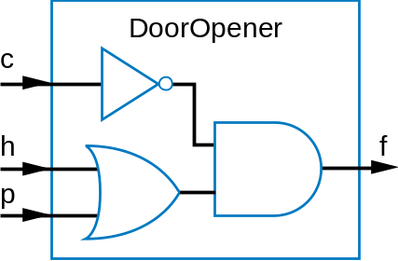
Example that Applies Boolean Algebra Properties
Want automatic door opener circuit (e.g., for grocery store)
  Output: f=1 opens door
  Inputs:
    p=1: person detected
    h=1: switch forcing hold open
    c=1: key forcing closed
  Want open door when
    h=1 and c=0, or
    h=0 and p=1 and c=0
  Equation: f = hc’ + h’pc’
Can the circuit be simplified?
      f = hc' + h'pc‘
      f = c'h + c'h'p (by the commutative property)
      f = c'(h + h'p) (by the first distrib. property)
      f = c'((h+h')*(h+p)) (2nd distrib. prop.; tricky one)
      f = c'((1)*(h + p)) (by the complement property)
      f = c'(h+p) (by the identity property)
a
a
h
DoorOpener
Simplified
circuit
c
f
p
Simplification of circuits is covered
in Sec. 2.11 / Sec 6.2.

Slide 31
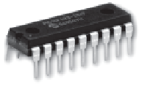
Example that Applies Boolean Algebra Properties
Found inexpensive chip that computes:
    f = c’hp + c’hp’ + c’h’p
  Can we use it for the door opener?
    Is it the same as f = hc’ + h’pc’?
Apply Boolean algebra:
h
DoorOpener
c
f
Commutative
  a + b = b + a
  a * b = b * a
Distributive
  a * (b + c) = a * b + a * c
  a + (b * c) = (a + b) * (a + c)
Associative
  (a + b) + c = a + (b + c)
  (a * b) * c = a * (b * c)
Identity
  0 + a = a + 0 = a
  1 * a = a * 1 = a
Complement
  a + a’ = 1
  a * a’ = 0
p
f = c’hp + c’hp’ + c’h’p
f = c’h(p + p’) + c’h’p (by the distributive property)
f = c’h(1) + c’h’p (by the complement property)
f = c’h + c’h’p (by the identity property)
f = hc’ + h’pc’ (by the commutative property)
Same! Yes, we can use it.
a

Slide 32
Boolean Algebra: Additional Properties
Null elements
  a + 1 = 1
  a * 0 = 0
Idempotent Law
  a + a = a
  a * a = a
Involution Law
  (a’)’ = a
DeMorgan’s Law
  (a + b)’ = a’b’
  (ab)’ = a’ + b’
  Very useful!
To prove, just evaluate all possibilities

Slide 33

Example Applying DeMorgan’s Law
  (a + b)’ = a’b’
  (ab)’ = a’ + b’
Aircraft lavatory sign example
Behavior
  Three lavatories, each with sensor (a, b, c), equals 1 if door locked
  Light “Available” sign (S) if any lavatory available
Equation and circuit
  S = a’ + b’ + c’
Transform
  (abc)’ = a’+b’+c’ (by DeMorgan’s Law)
  S = (abc)’
New circuit
  Alternative: Instead of lighting “Available,” light “Occupied”
  Opposite of “Available” function
  S = a’ + b’ + c’
  So S’ = (a’ + b’ + c’)’
    S’ = (a’)’ * (b’)’ * (c’)’ (by DeMorgan’s Law)
    S’ = a * b * c (by Involution Law)
  Makes intuitive sense
    Occupied if all doors are locked
Circuit
a
Circuit
b
S
a
S
b
c
c

Slide 34
Example Applying Properties
Commutative
  a + b = b + a
  a * b = b * a
Distributive
  a * (b + c) = a * b + a * c
  a + (b * c) = (a + b) * (a + c)
Associative
  (a + b) + c = a + (b + c)
  (a * b) * c = a * (b * c)
Identity
  0 + a = a + 0 = a
  1 * a = a * 1 = a
Complement
  a + a’ = 1
  a * a’ = 0
For door opener f = c'(h+p) , prove door stays closed (f=0) when c=1
  f = c'(h+p)
  Let c = 1 (door forced closed)
  f = 1'(h+p)
  f = 0(h+p)
  f = 0h + 0p (by the distributive property)
  f = 0 + 0 (by the null elements property)
  f = 0
Null elements
  a + 1 = 1
  a * 0 = 0
Idempotent Law
  a + a = a
  a * a = a
Involution Law
  (a’)’ = a
DeMorgan’s Law
  (a + b)’ = a’b’
  (ab)’ = a’ + b’

Slide 35
Complement of a Function
Commonly want to find complement (inverse) of function F
  0 when F is 1; 1 when F is 0
Use DeMorgan’s Law repeatedly
  Note: DeMorgan’s Law defined for more than two variables, e.g.:
    (a + b + c)' = (abc)'
    (abc)' = (a' + b' + c')
Complement of f = w'xy + wx'y'z'
  f ' = (w'xy + wx'y'z')'
  f ' = (w'xy)'(wx'y'z')' (by DeMorgan’s Law)
  f ' = (w+x'+y')(w'+x+y+z) (by DeMorgan’s Law)
Can then expand into sum-of-products form

Slide 36
2.6
Representations of Boolean Functions
English 1: F outputs 1 when a is 0 and b is 0, or when a is 0 and b is 1.
English 2: F outputs 1 when a is 0, regardless of b’s value
(
a
)
a
a
b
F
b
0
0
1
Equation 1: F(a,b) = a’b’ + a’b
F
0
1
1
Equation 2: F(a,b) = a’
1
0
0
(
b
)
(
c
)
1
1
0
Circuit 1
a
Truth table
a
F
(
d
)
Circuit 2
T
he function F
A function can be represented in different ways
  Above shows seven representations of the same functions F(a,b), using four different methods: English, Equation, Circuit, and Truth Table

Slide 37
Truth Table Representation of Boolean Functions
Define value of F for each possible combination of input values
  2-input function: 4 rows
  3-input function: 8 rows
  4-input function: 16 rows
Q: Use truth table to define function F(a,b,c) that is 1 when abc is 5 or greater in binary
a
b
F
a
b
c
F
a
b
c
d
F
0
0
0
0
0
0
0
0
0
0
1
0
0
1
0
0
0
1
1
0
0
1
0
0
0
1
0
1
1
0
1
1
0
0
1
1
(
a
)
1
0
0
0
1
0
0
1
0
1
0
1
0
1
1
1
0
0
1
1
0
1
1
1
0
1
1
1
(
b
)
1
0
0
0
1
0
0
1
a
b
c
F
1
0
1
0
0
0
0
0
1
0
1
1
0
0
1
0
1
1
0
0
a
0
1
0
0
1
1
0
1
0
1
1
0
1
1
1
0
1
0
0
0
1
1
1
1
1
0
1
1
(
c
)
1
1
0
1
1
1
1
1

Slide 38
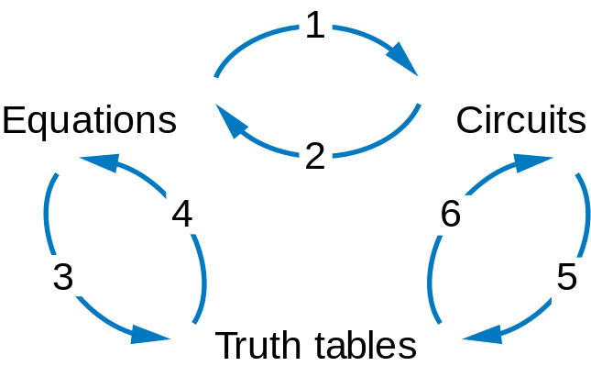
Converting among Representations
Can convert from any representation to another
Common conversions
  Equation to circuit (we did this earlier)
  Circuit to equation
    Start at inputs, write expression of each gate output
c
c'
h
F = c'(h+p)
p
h+p

Slide 39
Converting among Representations
More common conversions
  Truth table to equation (which we can then convert to circuit)
    Easy–just OR each input term that should output 1
  Equation to truth table
    Easy—just evaluate equation for each input combination (row)
    Creating intermediate columns helps
Inputs
Outputs
Term
a
b
F
F = sum of
0
0
1
a’b’
0
1
1
a’b
1
0
0
1
1
0
F = a’b’ + a’b
Q: Convert to equation
a
b
c
F
0
0
0
0
Q: Convert to truth table: F = a’b’ + a’b
0
0
1
0
0
1
0
0
Inputs
Output
0
1
1
0
a
b
a
1
0
0
0
'
b
'
a
' b
F
ab’c
a
0
0
1
0
1
1
0
1
1
0
1
0
1
1
1
1
0
1
abc’
1
0
0
0
0
1
1
1
1
abc
a
1
1
0
0
0
F = ab’c + abc’ + abc

Slide 40
Example: Converting from Truth Table to Equation
Parity bit: Extra bit added to data, intended to enable detection of error (a bit changed unintentionally)
  e.g., errors can occur on wires due to electrical interference
Even parity: Set parity bit so total number of 1s (data + parity) is even
  e.g., if data is 001, parity bit is 1 → 0011 has even number of 1s
Want equation, but easiest to start from truth table for this example
a b c P
0 0 0 0
0 0 1 1
0 1 0 1
0 1 1 0
1 0 0 1
1 0 1 0
1 1 0 0
1 1 1 1
Convert to eqn.
P = a'b'c + a'bc' + ab'c' + abc

Slide 41
Example: Converting from Circuit to Truth Table
First convert to circuit to equation, then equation to table
a
ab
(ab)'
b
c'
F
c
(ab)'c'
Inputs
Outputs
a
b
c
ab
(ab)'
c'
F
0
0
0
0
1
1
1
0
0
1
0
1
0
0
0
1
0
0
1
1
1
0
1
1
0
1
0
0
1
0
0
0
1
1
1
1
0
1
0
1
0
0
1
1
0
1
0
1
0
1
1
1
1
0
0
0

Slide 42
Standard Representation: Truth Table
How can we determine if two functions are the same?
  Recall automatic door example
    Same as f = hc’ + h’pc’?
    Used algebraic methods
    But if we failed, does that prove not equal? No.
Solution: Convert to truth tables
  Only ONE truth table representation of a given function
    Standard representation—for given function, only one version in standard form exists
f = c’hp + c’hp’ + c’h’
f = c’h(p + p’) + c’h’p
f = c’h(1) + c’h’p
f = c’h + c’h’p
(what if we stopped here?)
f = hc’ + h’pc’
Q: Determine if F=ab+a’ is same
function as F=a’b’+a’b+ab, by converting
each to truth table first
F = ab + a'
F = a’b’ +
a’b + ab
a
b
F
a
b
F
0
0
1
0
0
1
a
0
1
Same
1
0
1
1
1
0
0
1
0
0
1
1
1
1
1
1

Slide 43
Truth Table Canonical Form
Q: Determine via truth tables whether ab+a' and (a+b)' are equivalent
F = ab + a
'
F = (a+b)
'
a
b
F
a
b
F
0
0
1
0
0
1
0
1
1
0
1
0
1
0
0
1
0
0
1
1
1
1
1
0
Not equivalent
a

Slide 44
Canonical Form – Sum of Minterms
Truth tables too big for numerous inputs
Use standard form of equation instead
  Known as canonical form
  Regular algebra: group terms of polynomial by power
    ax² + bx + c (3x² + 4x + 2x² + 3 + 1 --> 5x² + 4x + 4)
  Boolean algebra: create sum of minterms
    Minterm: product term with every function literal appearing exactly once, in true or complemented form
    Just multiply-out equation until sum of product terms
    Then expand each term until all terms are minterms
Q: Determine if F(a,b)=ab+a’ is equivalent to F(a,b)=a’b’+a’b+ab, by converting first equation to canonical form (second already is)
F = ab+a’ (already sum of products)
F = ab + a’(b+b’) (expanding term)
F = ab + a’b + a’b’ (Equivalent – same three terms as other equation)
a

Slide 45
Canonical Form – Sum of Minterms
Q: Determine whether the functions G(a,b,c,d,e) = abcd + a'bcde and H(a,b,c,d,e) = abcde + abcde' + a'bcde + a'bcde(a' + c) are equivalent.
      G = abcd + a'bcde
      G = abcd(e+e') + a'bcde
      G = abcde + abcde' + a'bcde
      G = a'bcde + abcde' + abcde (sum of minterms form)
      H = abcde + abcde' + a'bcde + a'bcde(a' + c)
      H = abcde + abcde' + a'bcde + a'bcdea' + a'bcdec
      H = abcde + abcde' + a'bcde + a'bcde + a'bcde
      H = abcde + abcde' + a'bcde
      H = a'bcde + abcde' + abcde
Equivalent
a

Slide 46
Compact Sum of Minterms Representation
List each minterm as a number
Number determined from the binary representation of its variables’ values
  a'bcde corresponds to 01111, or 15
  abcde' corresponds to 11110, or 30
  abcde corresponds to 11111, or 31
Thus, H = a'bcde + abcde' + abcde can be written as:
  H = ∑m(15,30,31)
  "H is the sum of minterms 15, 30, and 31"

Slide 47
Multiple-Output Circuits
Many circuits have more than one output
Can give each a separate circuit, or can share gates
Ex: F = ab + c’, G = ab + bc
a
a
b
b
F
F
c
c
a
a
G
G
(
a
)
(
b
)
Option 1: Separate circuits
Option 2: Shared gates

Slide 48
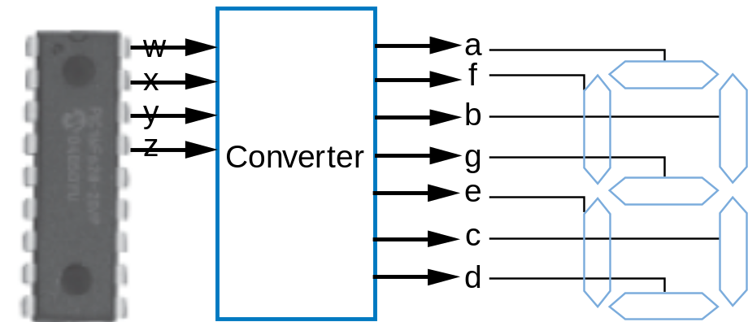
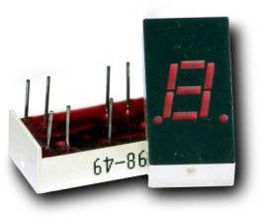
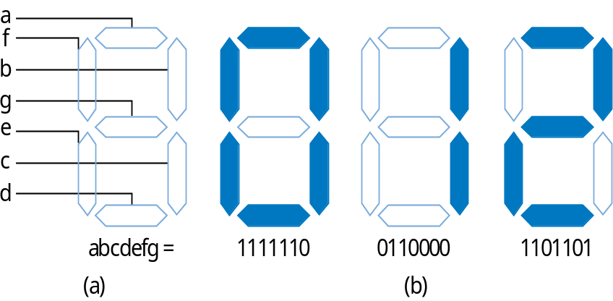
Multiple-Output Example:
BCD to 7-Segment Converter

Slide 49
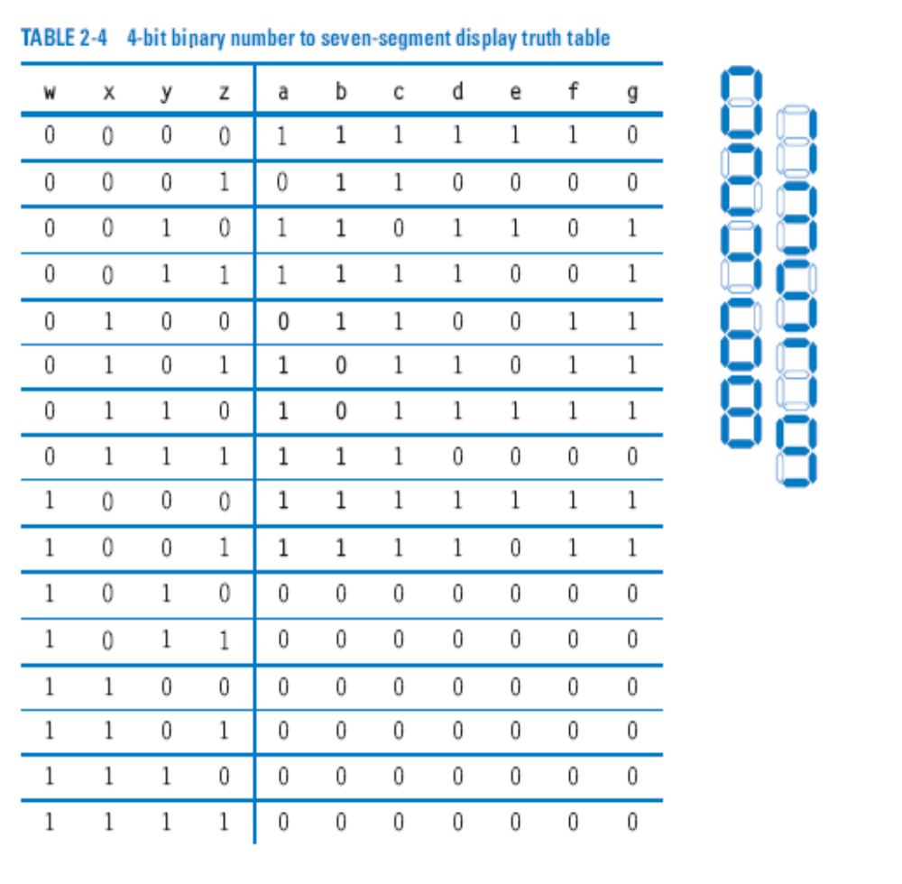
Multiple-Output Example:
BCD to 7-Segment Converter
a
f
b
g
e
c
d
a = w’x’y’z’ + w’x’yz’ + w’x’yz + w’xy’z + w’xyz’ + w’xyz + wx’y’z’ + wx’y’z
b = w’x’y’z’ + w’x’y’z + w’x’yz’ + w’x’yz + w’xy’z’ + w’xyz + wx’y’z’ + wx’y’z
...
a

Slide 50
2.7
Combinational Logic Design Process
Step
Description
Step 1:
Capture
behavior
Create a truth table or equations, whichever is most natural for the given problem, to describe the desired behavior of each output of the combinational logic.
Capture the function
This substep is only necessary if you captured the function using a truth table instead of equations. Create an equation for each output by ORing all the minterms for that output. Simplify the equations if desired.
2A: Create equations
Step 2:
Convert
to circuit
2B: Implement as a gate-based circuit
For each output, create a circuit corresponding to the output’s equation. (Sharing gates among multiple outputs is OK optionally.)

Slide 51
Example: Three 1s Pattern Detector
Problem: Detect three consecutive 1s in 8-bit input: abcdefgh
    00011101 → 1
    10101011 → 0
    11110000 → 1
  Step 1: Capture the function
    Truth table or equation?
      Truth table too big: 2^8=256 rows
      Equation: create terms for each possible case of three consecutive 1s
    y = abc + bcd + cde + def + efg + fgh
  Step 2a: Create equation -- already done
  Step 2b: Implement as a gate-based circuit
a
a
a
abc
b
c
bcd
d
cde
e
y
def
f
efg
g
fgh
h

Slide 52
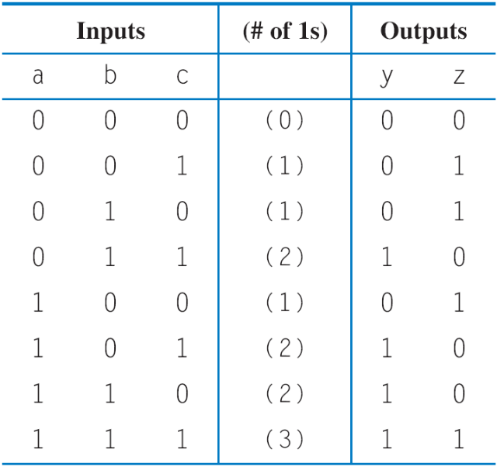
Example: Number of 1s Counter
Problem: Output in binary on two outputs yz the # of 1s on three inputs
    010 → 01
    101 → 10
    000 → 00
  Step 1: Capture the function
    Truth table or equation?
      Truth table is straightforward
  Step 2a: Create equations
    y = a’bc + ab’c + abc’ + abc
    z = a’b’c + a’bc’ + ab’c’ + abc
    Optional: Let's simplify y:
      y = a'bc + ab'c + ab(c' + c) = a'bc + ab'c + ab
  Step 2b: Implement as a gate-based circuit
a
a
b
c
a
a
a
b
b
c
z
c
a
a
y
b
b
c
c
a
a
b
c
b

Slide 53
Simplifying Notations
Used in previous circuit
a
a
a
a
b
b
b
b
c
c
c
c
a
a
b
b'
(a)
(b)
c
a
List inputs multiple times
→ Less wiring in drawing
Draw inversion bubble rather than inverter. Or list input as complemented.

Slide 54
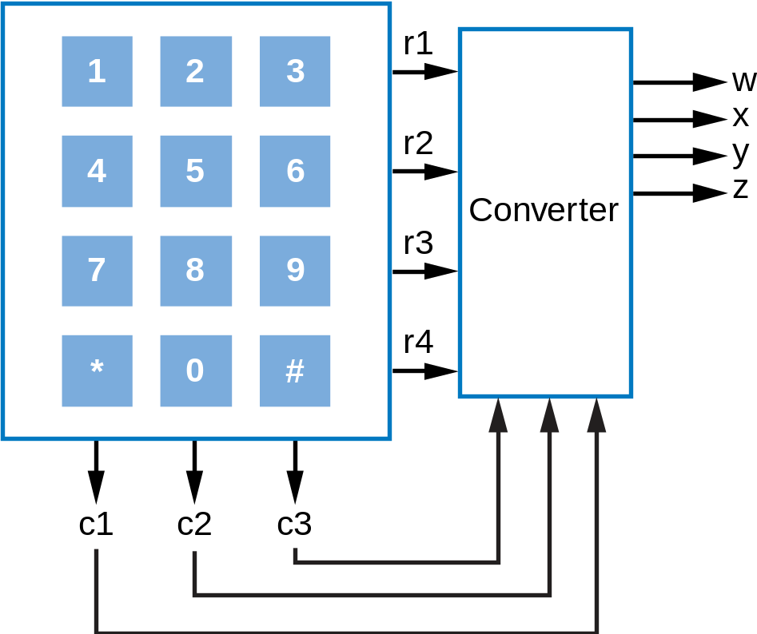
Example: Keypad Converter
Keypad has 7 outputs
  One per row
  One per column
Key press sets one row and one column output to 1
  Press "5" → r2=1, c2=1
Goal: Convert keypad outputs into 4-bit binary number
  0-9 → 0000 to 1001
  * → 1010, # → 1011
  nothing pressed: 1111

Slide 55
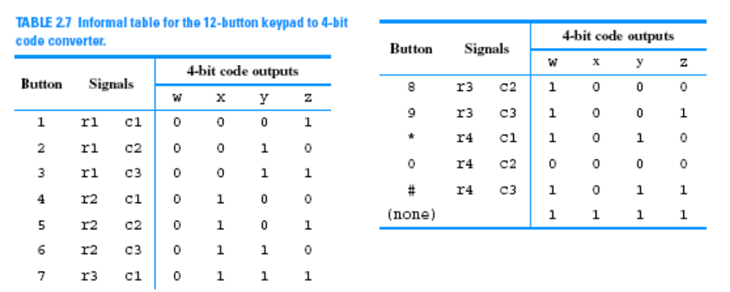
Example: Keypad Converter
Step 1: Capture behavior
  Truth table too big (2^7 rows); equations not clear either
  Informal table can help
a
a
Step 2b: Implement as circuit (note sharable gates) ...
      w = r3c2 + r3c3 + r4c1 + r4c3 + r1'r2'r3'r4'c1'c2'c3'
      x = r2c1 + r2c2 + r2c3 + r3c1 + r1'r2'r3'r4’c1'c2'c3'
      y = r1c2 + r1c3 + r2c3 + r3c1 + r4c1 + r4c3 + r1'r2'r3'r4'c1'c2'c3'
      z = r1c1 + r1c3 + r2c2 + r3c1 + r3c3 + r4c3 + r1'r2'r3'r4'c1'c2'c3'
a

Slide 56
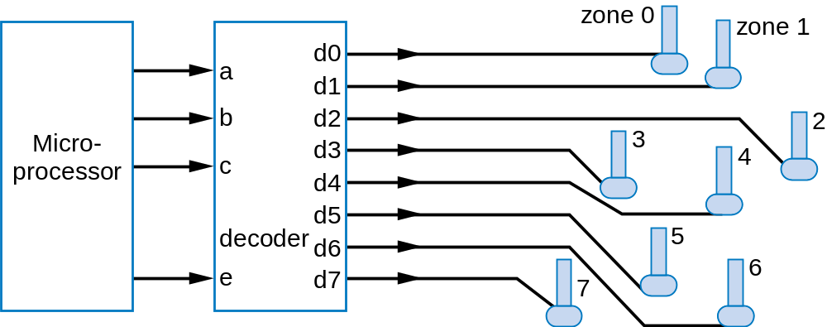
Example: Sprinkler Controller
Microprocessor outputs which zone to water (e.g., cba=110 means zone 6) and enables watering (e=1)
Decoder should set appropriate valve to 1
Step 1: Capture
behavior
d0 = a'b'c'e
a
d1 = a'b'ce
d2 = a'bc'e
d3 = a'bce
d4 = ab'c'e
d5 = ab'ce
d6 = abc'e
d7 = abce
Equations seem like a natural fit

Slide 57
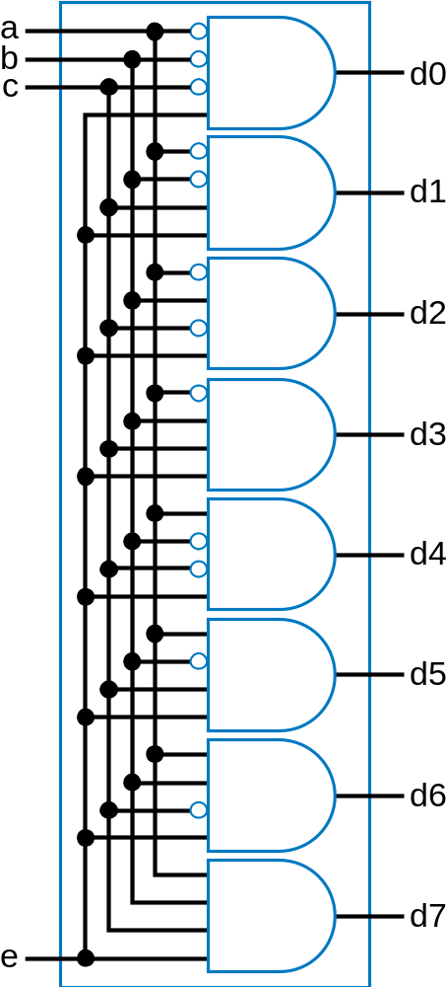
Example: Sprinkler Controller
Step 2b: Implement as circuit
d0 = a'b'c'e
d1 = a'b'ce
d2 = a'bc'e
d3 = a'bce
d4 = ab'c'e
d5 = ab'ce
d6 = abc'e
d7 = abce

Slide 58
2.8
More Gates
1
NAND
1
NOR
NAND
NOR
XOR
XNOR
x
x
x
F
F
x
y
y
y
F
y
a
x
y
F
x
y
F
x
y
F
x
y
F
x
F
0
0
1
0
0
1
0
0
0
0
0
1
0
1
1
0
1
0
0
1
1
0
1
0
x
y
1
0
1
1
0
0
1
0
1
1
0
0
y
1
1
0
1
1
0
1
1
0
1
1
1
0
0
NAND: Opposite of AND (“NOT AND”)
NOR: Opposite of OR (“NOT OR”)
XOR: Exactly 1 input is 1, for 2-input XOR. (For more inputs -- odd number of 1s)
XNOR: Opposite of XOR (“NOT XOR”)
NAND same as AND with power & ground switched
  nMOS conducts 0s well, but not 1s (reasons beyond our scope) – so NAND is more efficient
Likewise, NOR same as OR with power/ground switched
NAND/NOR more common
AND in CMOS: NAND with NOT
OR in CMOS: NOR with NOT

Slide 59
More Gates: Example Uses
Aircraft lavatory sign example
  S = (abc)’
Detecting all 0s
  Use NOR
Detecting equality
  Use XNOR
Detecting odd # of 1s
  Use XOR
  Useful for generating “parity” bit common for detecting errors
Circuit
a
b
S
c
0
0
1
a0
0
b0
a1
A=B
b1
a2
b2

Slide 60
Completeness of NAND
Any Boolean function can be implemented using just NAND gates. Why?
  Need AND, OR, and NOT
  NOT: 1-input NAND (or 2-input NAND with inputs tied together)
  AND: NAND followed by NOT
  OR: NAND preceded by NOTs
  Thus, NAND is a universal gate
    Can implement any circuit using just NAND gates
Likewise for NOR

Slide 61
Number of Possible Boolean Functions
How many possible functions of 2 variables?
  2² rows in truth table, 2 choices for each
  2⁽²²⁾ = 2⁴ = 16 possible functions
N variables
  2^{N} rows
  2^{(2N)} possible functions
a
b
F
0
0
0 or 1 2 choices
0
1
0 or 1 2 choices
1
0
0 or 1 2 choices
1
1
0 or 1 2 choices
2⁴ = 16
possible functions
a
b
f0
f1
f2
f3
f4
f5
f6
f7
f8
f9
f10
f11
f12
f13
f14
f15
0
0
0
0
0
0
0
0
0
0
1
1
1
1
1
1
1
1
0
1
0
0
0
0
1
1
1
1
0
0
0
0
1
1
1
1
1
0
0
0
1
1
0
0
1
1
0
0
1
1
0
0
1
1
1
1
0
1
0
1
0
1
0
1
0
1
0
1
0
1
0
1
0
a
b
b’
a’
1
a AND b
a OR b
a XOR b
a NOR b
a NAND b
a XNOR b

Slide 62
2.9
Decoders and Muxes
Decoder: Popular combinational logic building block, in addition to logic gates
  Converts input binary number to one high output
2-input decoder: four possible input binary numbers
  So has four outputs, one for each possible input binary number
Internal design
  AND gate for each output to detect input combination
Decoder with enable e
  Outputs all 0 if e=0
  Regular behavior if e=1
n-input decoder: 2^{n} outputs
d0
1
d0
0
d0
0
d0
0
0
i0
d1
0
1
i0
d1
1
0
i0
d1
0
1
i0
d1
0
0
i1
d2
0
0
i1
d2
0
1
i1
d2
1
1
i1
d2
0
d3
0
d3
0
d3
0
d3
1
i1’i0’
d0
d0
0
1
i0
d1
0
i1’i0
d1
1
i1
d2
0
e
d3
1
i1i0’
d2
1
i1i0
d3
d0
0
1
i0
d1
0
1
i1
d2
0
e
d3
0
i1
i0
a
a
0

Slide 63
Decoder Example
New Year’s Eve Countdown Display
  Microprocessor counts from 59 down to 0 in binary on 6-bit output
  Want illuminate one of 60 lights for each binary number
  Use 6x64 decoder
    4 outputs unused
2
1
0
2
1
0
0
Happy
0
1
0
i0
d0
0
0
1
New Year
1
0
0
i1
d1
0
1
0
1
0
0
0
i2
d2
1
0
0
2
0
0
0
0
0
0
Processor
i3
d3
3
a
0
0
0
i4
0
0
0
i5
d58
0
0
0
e
d59
0
0
0
d60
d61
58
6x64
d62
59
dcd
d63

Slide 64
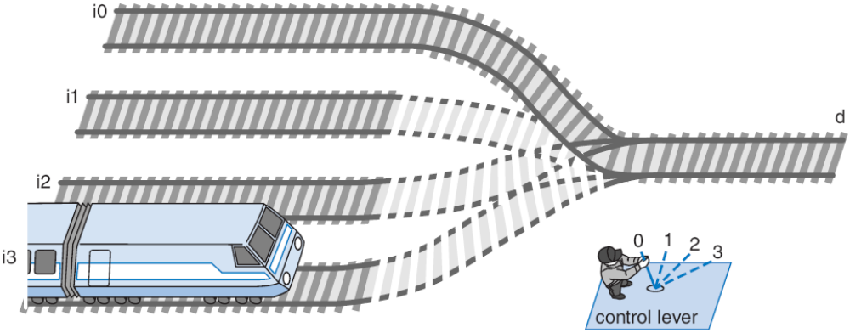
Multiplexor (Mux)
Mux: Another popular combinational building block
  Routes one of its N data inputs to its one output, based on binary value of select inputs
    4 input mux → needs 2 select inputs to indicate which input to route through
    8 input mux → 3 select inputs
    N inputs → log₂(N) selects
  Like a rail yard switch

Slide 65
Mux Internal Design
i0
i0 (1*i0=i0)
2
×
1
2
×
1
2
×
1
1
d
i0 (0+i0=i0)
i0
i0
i0
i1
i1
d
i1
d
i1
d
0
0
s0
s0
s0
a
0
1
2x1 mux
0
s0
i0
4
⋅
1
i0
i1
i1
d
i2
d
i2
i3
s1
s0
i3
4x1 mux
s1
s0

Slide 66
Mux Example
City mayor can set four switches up or down, representing his/her vote on each of four proposals, numbered 0, 1, 2, 3
City manager can display any such vote on large green/red LED (light) by setting two switches to represent binary 0, 1, 2, or 3
Use 4x1 mux
Mayor’s switches
a
1
4x1
on/off
i0
2
i1
i2
d
Proposal
3
i3
Green/
Red
LED
s1
s0
4
manager's
switches

Slide 67
Muxes Commonly Together – N-bit Mux
a3
i0
2x
1
Simplifying
notation:
b3
i1
d
s0
4-bit
4
a2
i0
2x
1
4
2x1
C
i1
d
A
I
0
4
b2
s0
4
D
C
is short
B
I
1
f
or
a1
i0
2x
1
s0
b1
i1
d
c3
s0
2x
1
s0
c2
a0
i0
d
b0
i1
c1
s0
s0
c0
Ex: Two 4-bit inputs, A (a3 a2 a1 a0), and B (b3 b2 b1 b0)
  4-bit 2x1 mux (just four 2x1 muxes sharing a select line) can select between A or B

Slide 68
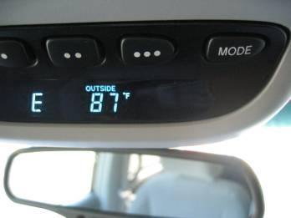
N-bit Mux Example
From the car's central computer
8-bit
a
T
8
4x1
I0
A
8
To the above-mirror display
I1
8
D
I
8
D
I2
M
8
I3
s1
s0
x
y
W
e'll design
this later
b
utton
Four possible display items
  Temperature (T), Average miles-per-gallon (A), Instantaneous mpg (I), and Miles remaining (M) – each is 8-bits wide
  Choose which to display on D using two inputs x and y
    Pushing button sequences to the next item
  Use 8-bit 4x1 mux

Slide 69
2.10
Additional Considerations
Non-Ideal Gate Behavior -- Delay
x
1
1
1
F
x
x
x
y
0
0
0
1
1
1
y
y
y
0
0
0
(1.8
V)
1
1
1
F
F
F
(0
V)
0
0
0
time
time
time
(
a
)
(
b
)
a
(
c
)
ideal
a
more realistic
with delay but otherwise ideal
a
Real gates have some delay
  Outputs don’t change immediately after inputs change

Slide 70
Circuit Delay and Critical Path
k
Belt
W
a
r
n
p
1 ns
1 ns
1 ns
1 ns
w
a
s
1 ns
1+1+1+1+1 = 5 ns
1 ns
1 ns
1 ns
1+0.5+1+1+1+1+1 = 6.5 ns
0.5 ns
t
1 ns
1+1+1 = 3 ns
C
r
itical path del
a
y = 6.5 ns
Henc
e
, circuit
’
s del
a
y is 6.5 ns
Wires also have delay
Assume gates and wires have delays as shown
Path delay – time for input to affect output
Critical path – path with longest path delay
Circuit delay – delay of critical path

Slide 71
Active Low Inputs
Data inputs: flow through component (e.g., mux data input)
Control input: influence component behavior
  Normally active high – 1 causes input to carry out its purpose
  Active low – Instead, 0 causes input to carry out its purpose
  Example: 2x4 decoder with active low enable
    1 disables decoder, 0 enables
  Drawn using inversion bubble
d0
0
d0
0
1
i0
d1
0
1
i0
d1
0
1
i1
d2
0
1
i1
d2
0
e
d3
0
e
d3
1
1
0
(
a
)
(
b
)

Slide 72
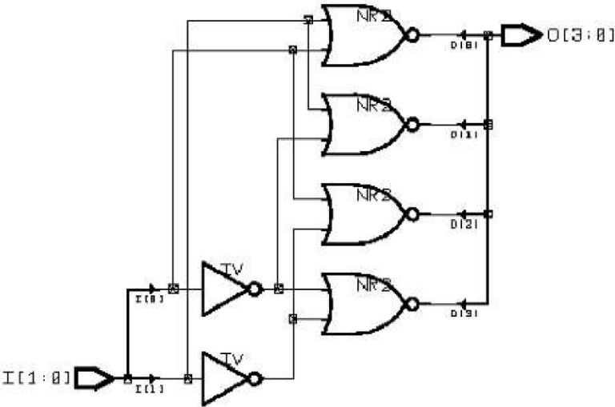
Schematic Capture and Simulation
Inputs
Inputs
a
i0
i0
i1
Simulate
i1
Simulate
Outputs
Outputs
d3
d3
d2
d2
d1
d1
d0
d0
Schematic capture
  Computer tool for user to capture logic circuit graphically
Simulator
  Computer tool to show what circuit outputs would be for given inputs
    Outputs commonly displayed as waveform

Slide 73
Chapter Summary
Combinational circuits
  Circuit whose outputs are function of present inputs
    No “state”
Switches: Basic component in digital circuits
Boolean logic gates: AND, OR, NOT – Better building block than switches
  Enables use of Boolean algebra to design circuits
Boolean algebra: Uses true/false variables/operators
Representations of Boolean functions: Can translate among
Combinational design process: Translate from equation (or table) to circuit through well-defined steps
More gates: NAND, NOR, XOR, XNOR also useful
Muxes and decoders: Additional useful combinational building blocks

