Slide 1
Nigerian Health Data Analysis
Jadons Hub Power BI Mentorship Project
Isaac Mbagwu

Slide 2
Project Overview
This project analyzes hospital patient disease records using Power BI.
Goal: Extract actionable health insights from over 2,000 patient records.
Focus Areas: Disease incidence, mortality rates, demographics and trends.

Slide 3
Project Objectives
Identify states with highest incidence of Malaria and Cholera.
Determine state with highest Cholera mortality rate.
Compare Rural vs Urban disease occurrence.
Analyze mortality trends in 2010 and 2018.
Identify peak year for Meningitis.
Determine most affected age group for Diarrhoea.

Slide 4
Dataset Overview
2,247 reported patient cases.
10 disease types.
Key fields: State, Settlement, Disease, Age Group, Health Status, Report Year.
Each row represents an individual patient record.

Slide 5
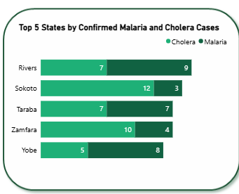
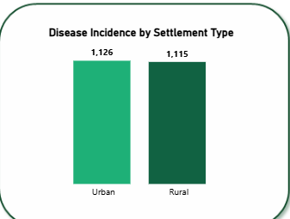
Key Findings – Disease Incidence
Certain states show significantly higher Malaria and Cholera cases.
Urban settlements report slightly higher total cases than rural areas.
Disease distribution varies geographically across Nigeria.

Slide 6
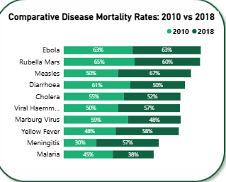
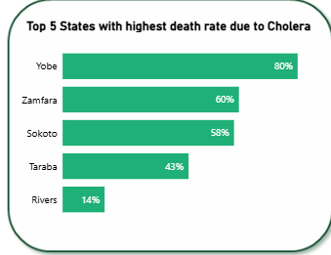
Key Findings – Mortality Rates
Some states record very high Cholera mortality rates.
Mortality rates differ significantly across diseases.
Comparison between 2010 and 2018 shows noticeable shifts in fatality patterns.

Slide 7
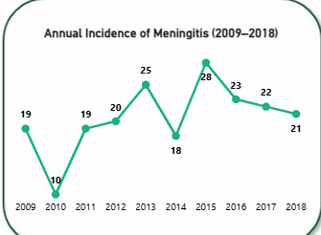
Meningitis Trend Analysis (2009–2018)
Meningitis cases peaked in 2015.
Incidence fluctuates year-over-year.
Trend analysis helps identify outbreak patterns.

Slide 8
Age Group Analysis – Diarrhoea
Young adults appear most affected.
Disease burden varies by demographic group.
Targeted awareness programs are recommended.

Slide 9
Recommendations
Strengthen Cholera intervention programs in high-mortality states.
Increase public health awareness for vulnerable age groups.
Enhance disease surveillance systems.
Improve resource allocation during peak outbreak years.

Slide 10
Conclusion
Data-driven insights can improve healthcare response.
This dashboard supports evidence-based decision making.
Power BI enables clear, interactive public health storytelling.

