Slide 1


.NET 5 & C#9

Slide 2


Frameworks .NET

Slide 3
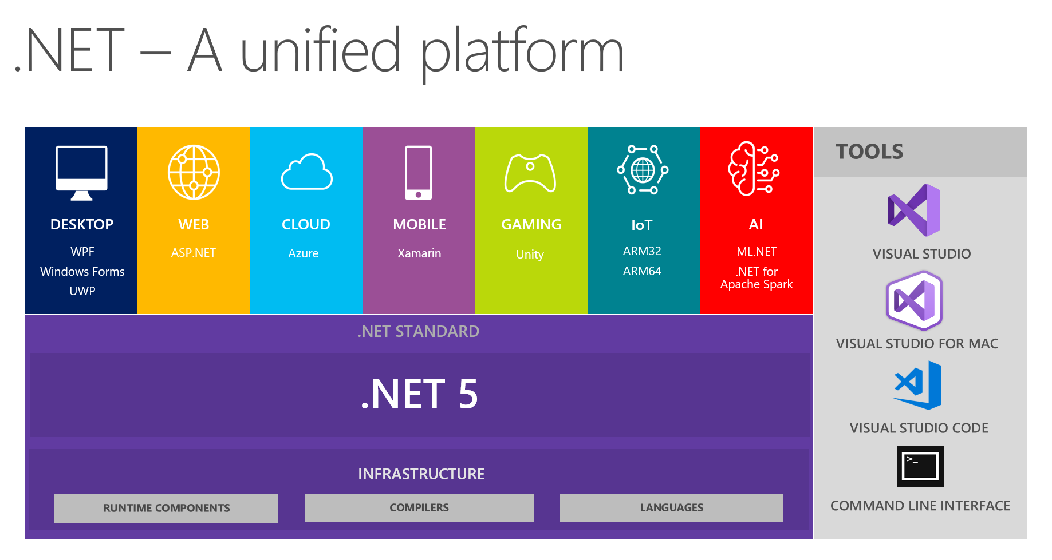

Slide 4
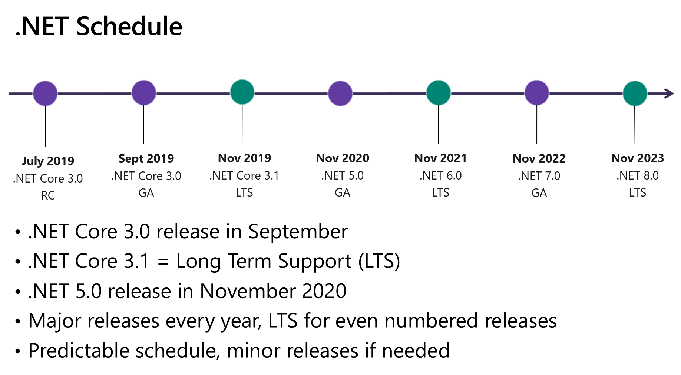

Slide 5


