Slide 1
Home work
USC-HW20-Tableau ALL DATA BASED ON (https://www.citibikenyc.com/system-data)

Slide 2
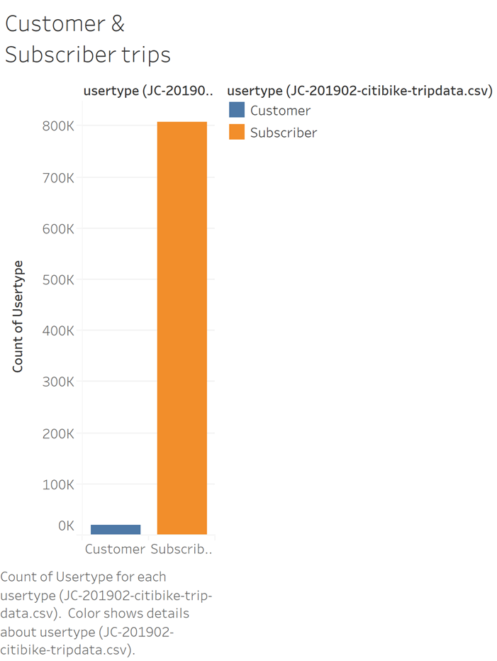
Total Number of Trips recorded
Customer and Subscriber make up to the total of 827,257 based on the JC-201902 data set from citibikenyc.com

Slide 3
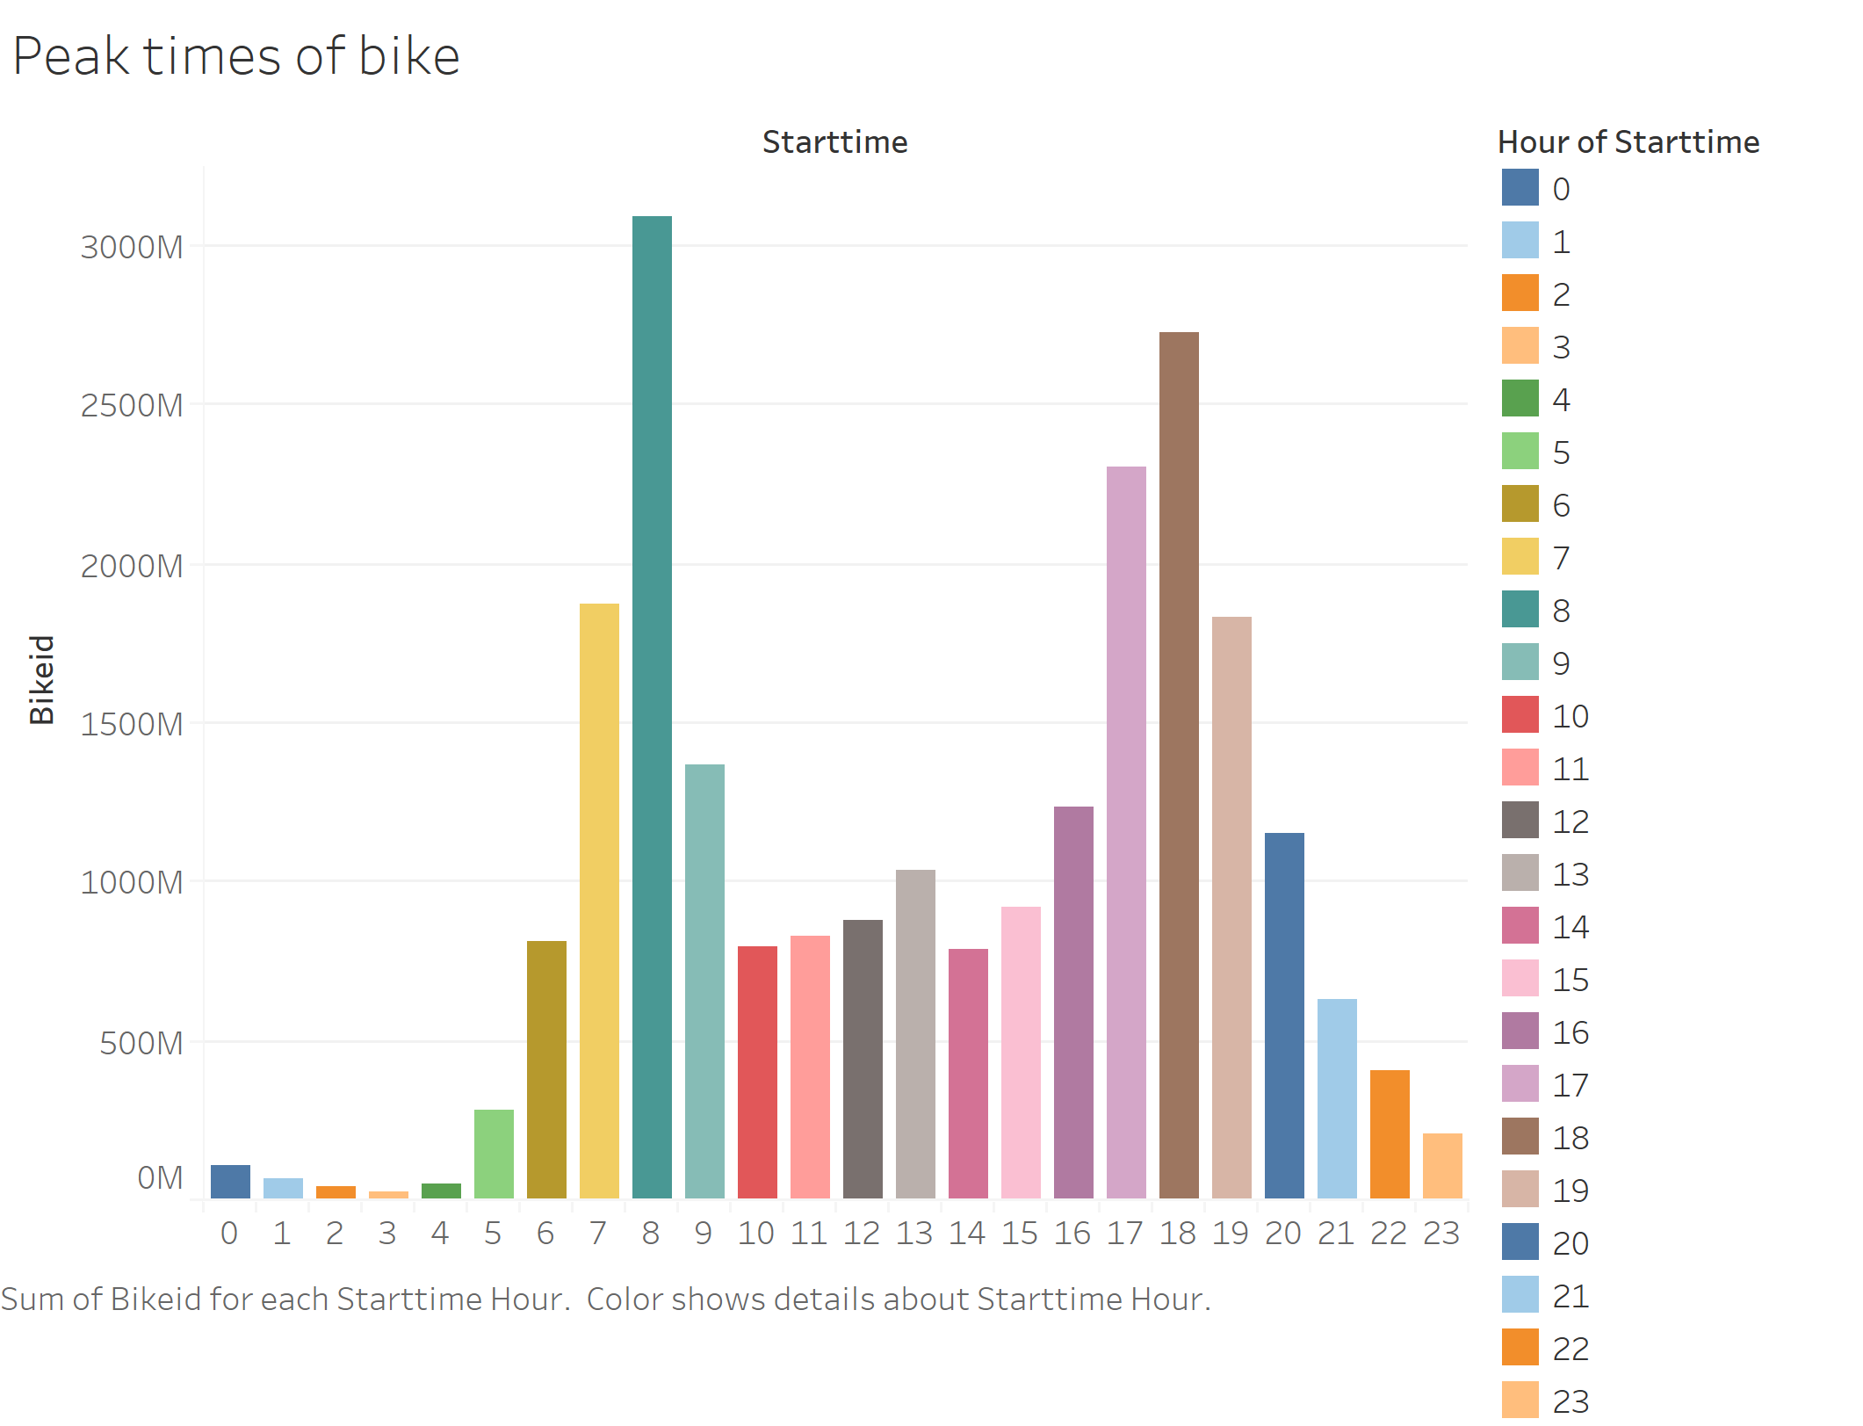

Slide 4
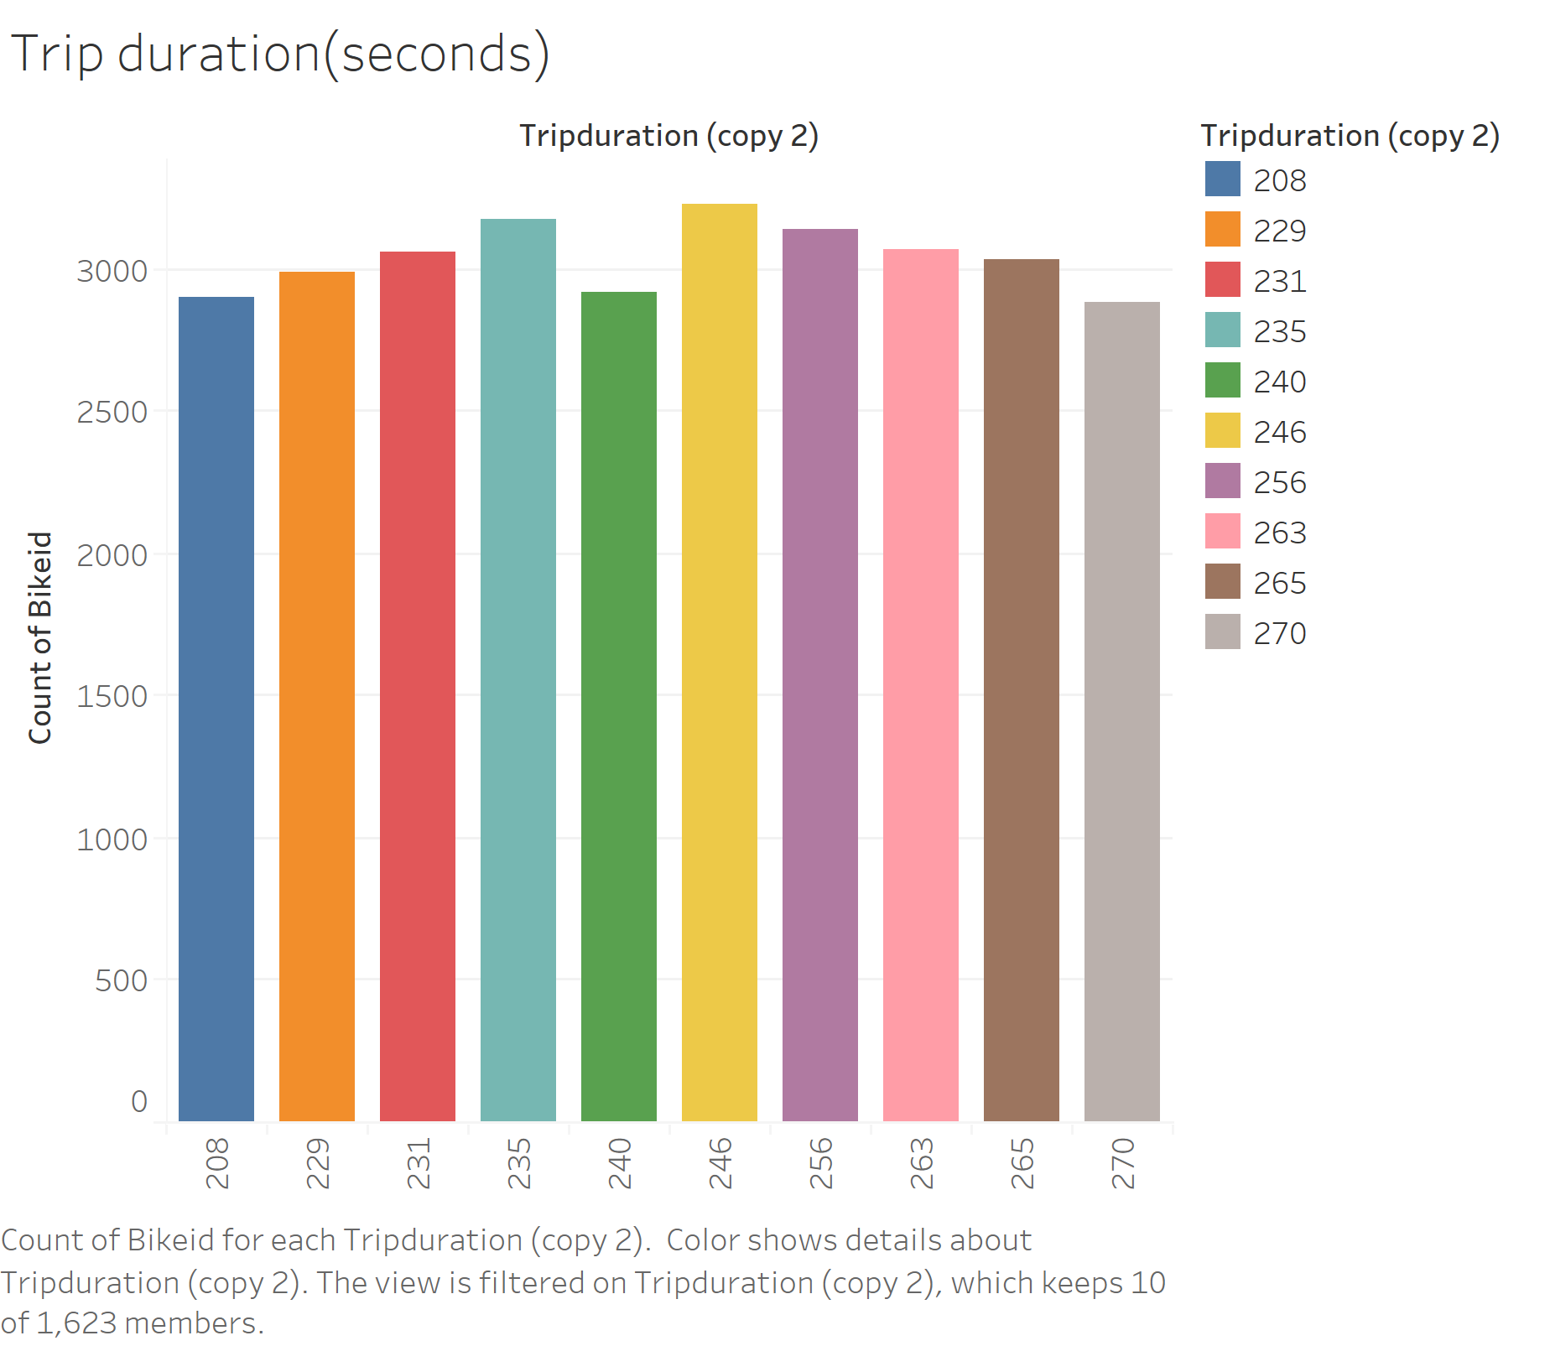

Slide 5
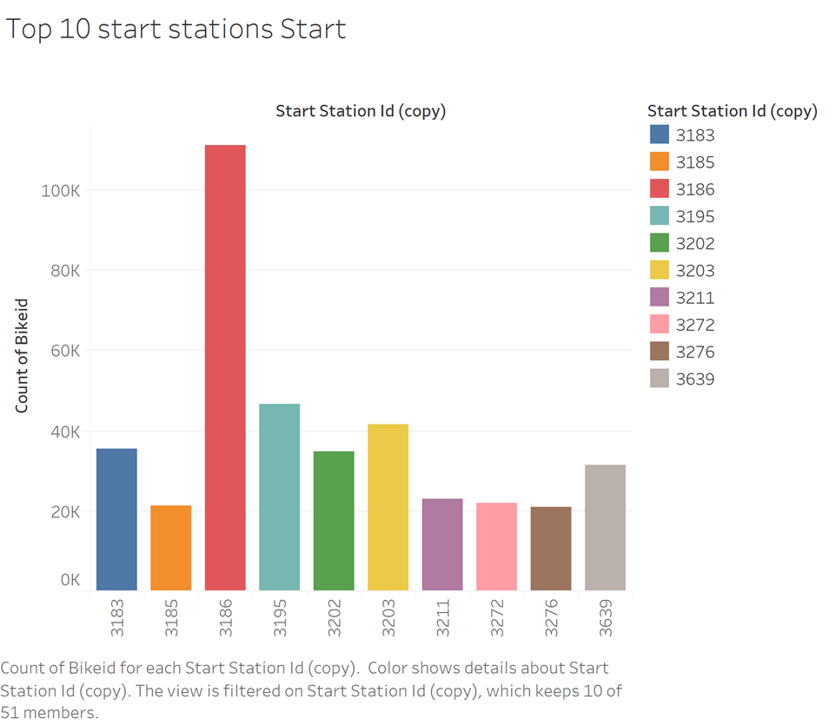
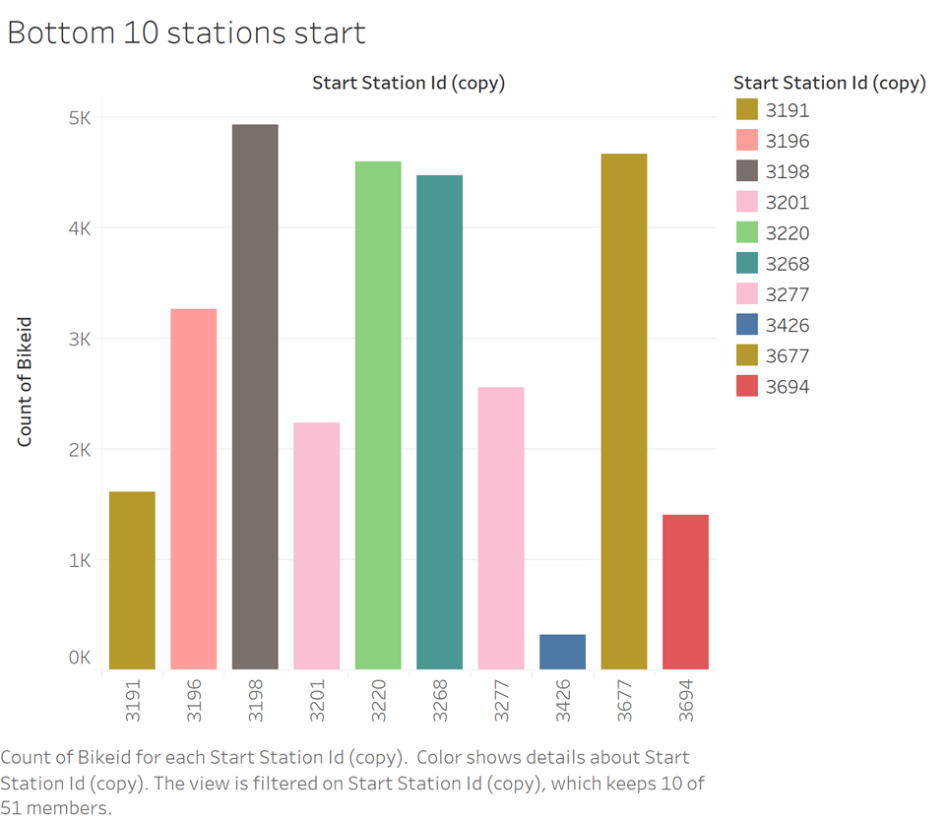
Top 10 vs Bottom 10 station starts

Slide 6
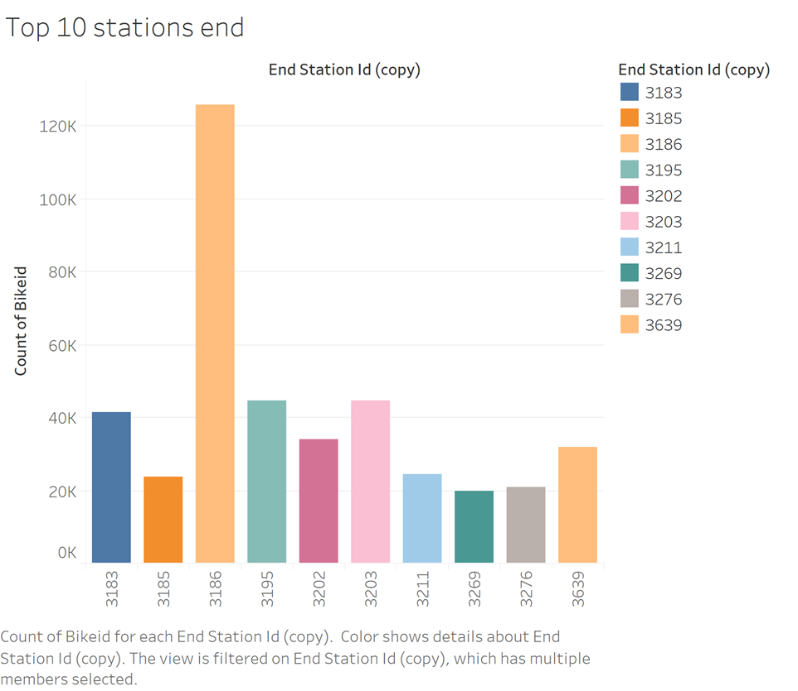
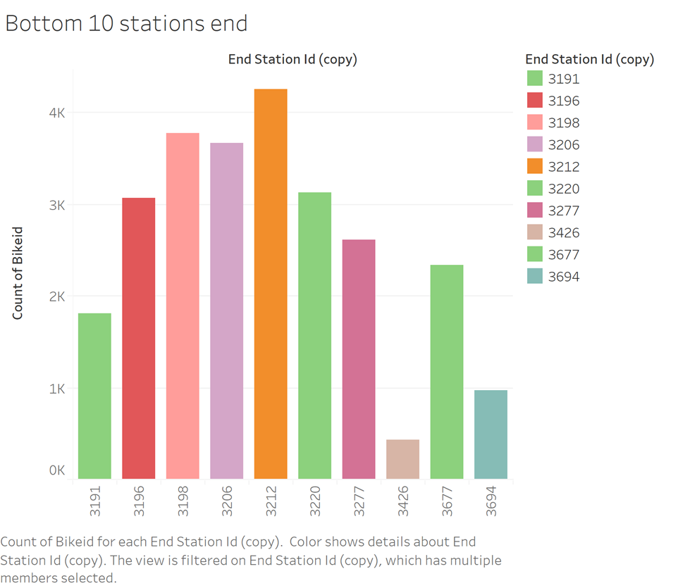

Slide 7
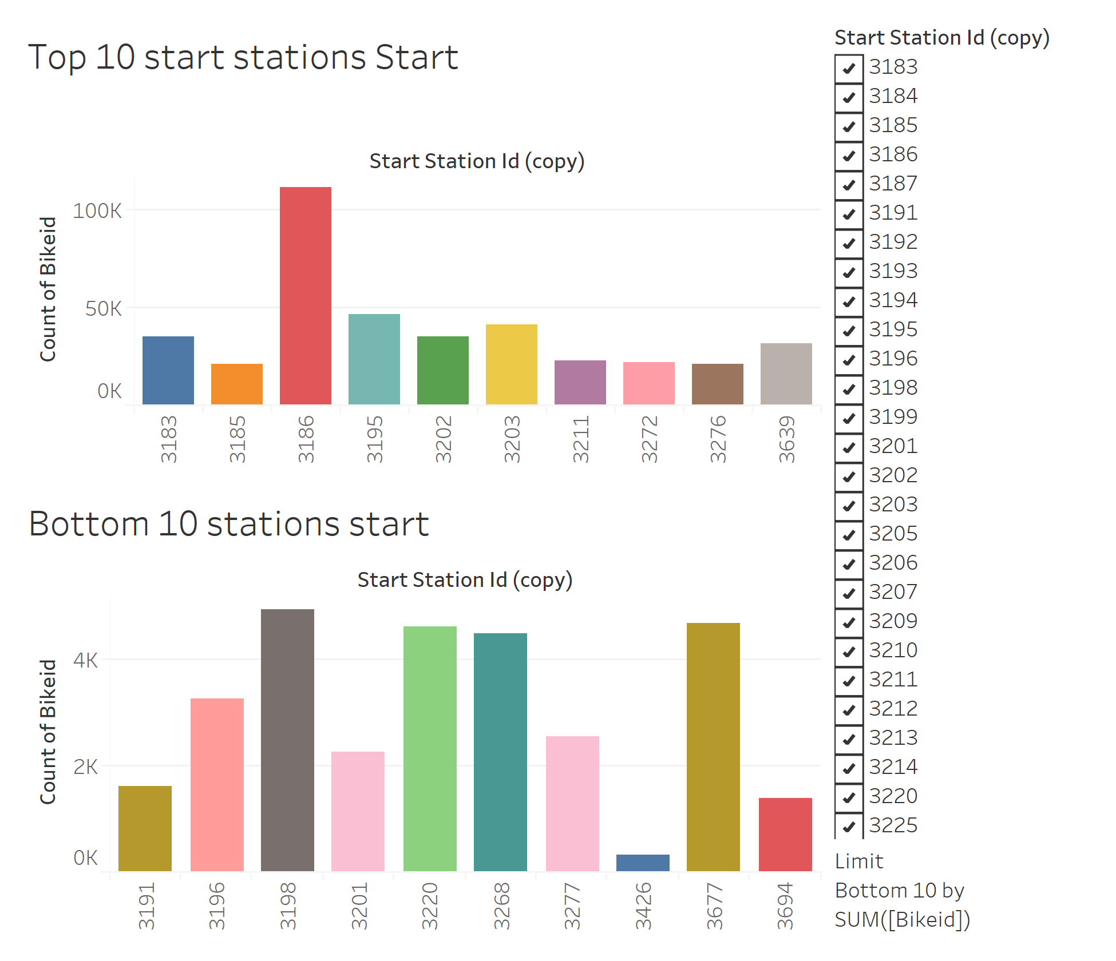

Slide 8
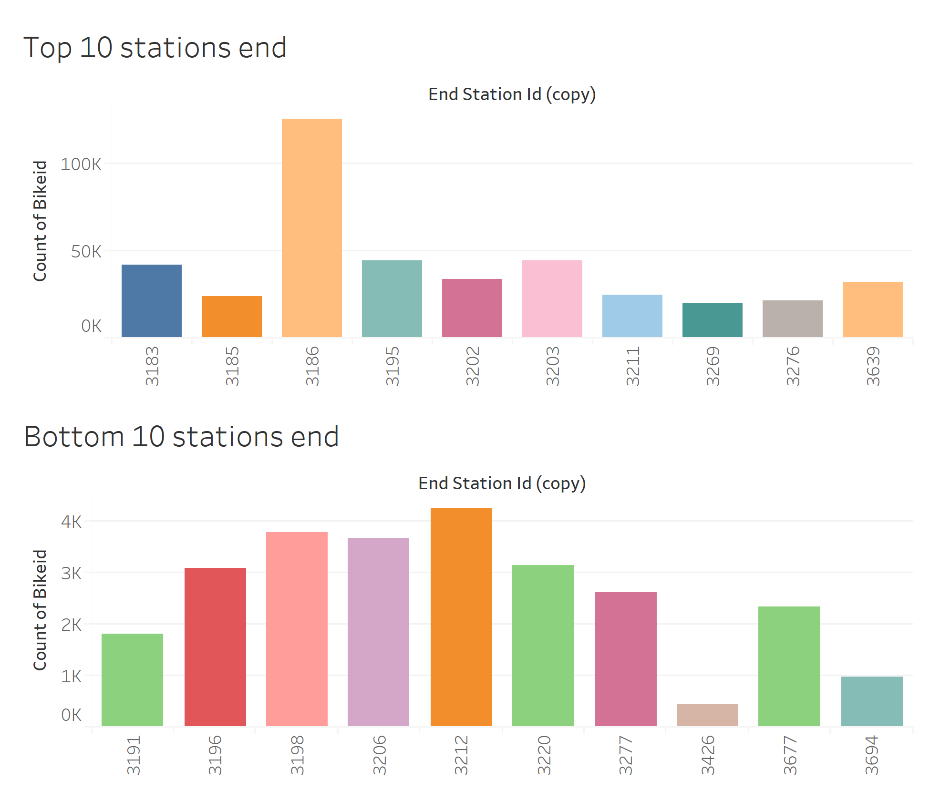

Slide 9
