Slide 1
Introduction to A level
Getting ready for A level

Slide 2
Starter - Decrypt the message
Alan has used a substitution cipher to send a message. The substitutions are non-sequential, but the same substitution is always made. For example, he has substituted the letter H with the letter I.
Joan observes that one letter appears more than any other and uses her knowledge of letter frequencies as a starting point to decrypt the message. Alan always writes his messages in English.
DTTM DT OF MIT QOMEITF
Can you help Joan decrypt the message?
You can see a full version of this question and check your answer here: adacomputerscience.org/questions/encrypt_04
Notes:
Question here https://adacomputerscience.org/questions/encrypt_04?examBoard=all&stage=all

Slide 3
Objectives
Understand the opportunities available when studying Computer Science at A level.
Understand the key concepts that will be covered at A level.
Understand how to use Ada Computer Science to refresh your knowledge of core topics before you start A level
To know how Ada Computer Science can be used to help you prepare for A level

Slide 4
Look to the future
"Demand for software developers is expected to grow 22% from 2019 to 2029.”
"The global artificial intelligence (AI) job market is projected to grow by 16.4% annually to $190.6 billion by 2025.”
"The tech industry indirectly supports 2.5 additional jobs for each job created."
"Nearly 61% of all STEM (Science, Technology, Engineering, Mathematics) jobs require computer science knowledge."
Notes:
Statistics from: https://wifitalents.com/statistic/computer-science-job/#sources

Slide 5

Careers in Computer Science
You will learn skills that are relevant to many different career paths. Here are some roles in Computer Science you may want to research further:
Software engineer
Data Scientist
DevOps engineer
Cybersecurity engineer
Penetration testers
Game designer/developer
Notes:
Image from Pixabay

Slide 6
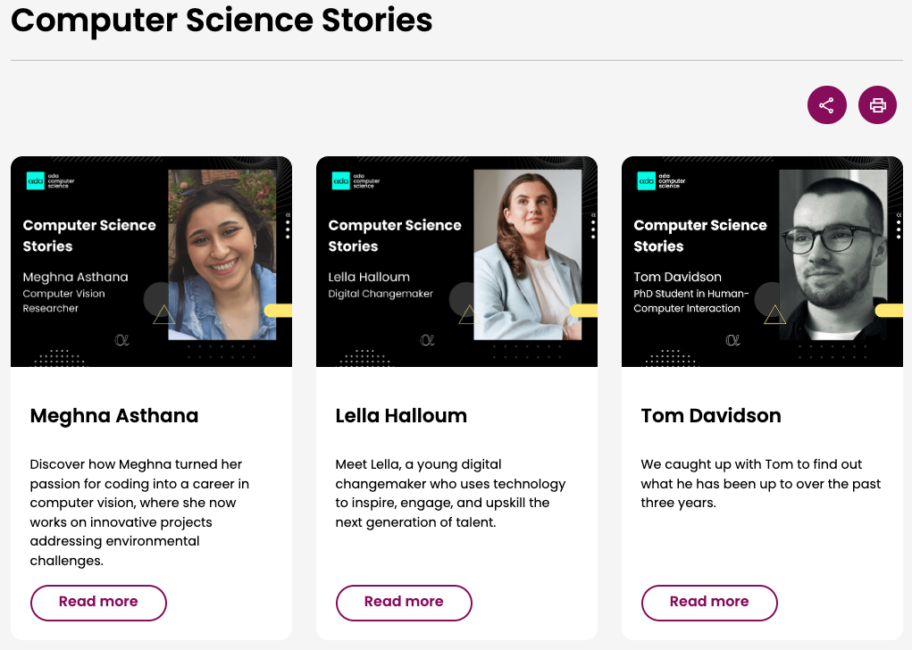
Computer Science Stories
Take some time to visit Computer Science stories on Adato read more about the successes of other Computer Science students.

Slide 7



What is Ada Computer Science?
Free online platform built and maintained by the Raspberry Pi Foundation and the University of Cambridge
Designed for teachers and learners (aged 14+)
Written by computer science subject experts

Slide 8
A level strands covered
AI and machine learning
Impact of technology
Algorithms and data structures
Models of computation
Computing systems
Networks
Creating media
Programming
Data and information
Safety and security
Design and development
Software projects
Effective use of tools
With over 50+ topics covered

Slide 9
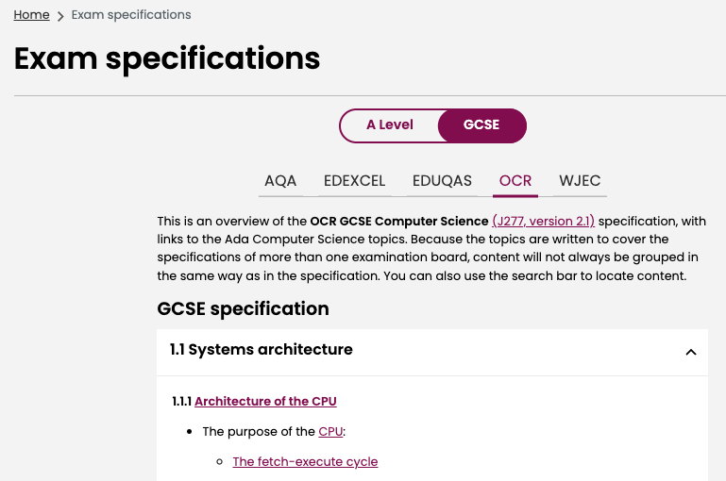
Exam Specifications
Choose your exam specification and take some time to familiarise yourself with the content by following the links.

Slide 10
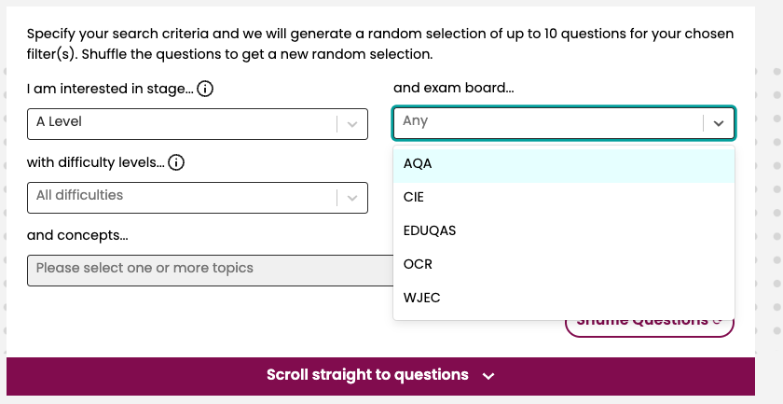
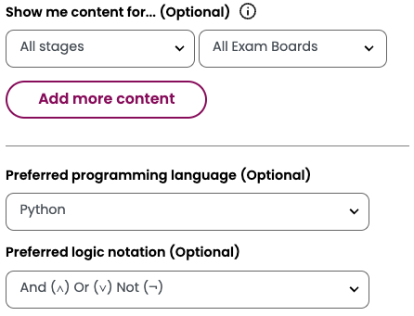
Content and question filters
All content and questions can be filtered and organised to your course.

Slide 11
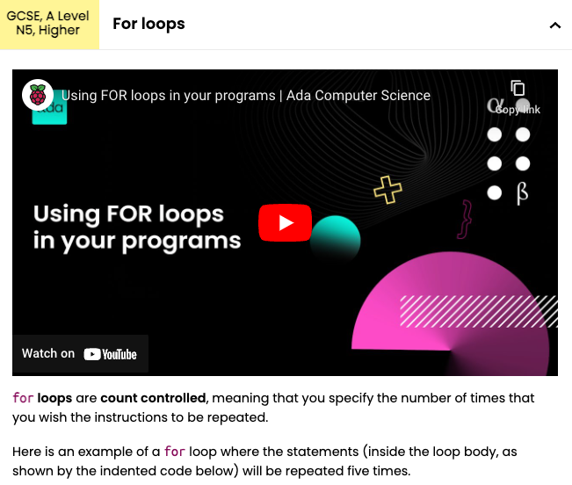
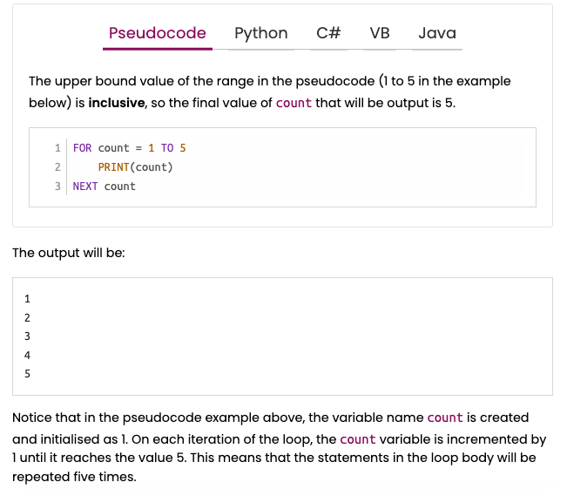
Concept pages
Concept pages contain extensive knowledge on topics, with diagrams, videos and code examples in pseudocode, Python, C#, VB and Java.

Slide 12
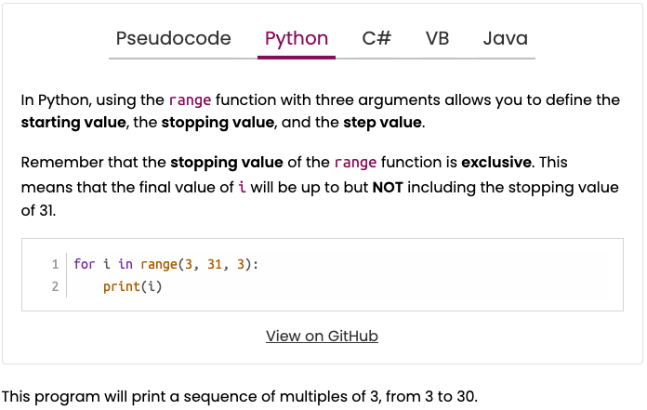
Program code
Hundreds of downloadable, executable code examples, accessible in GitHub and in multiple programming languages.

Slide 13
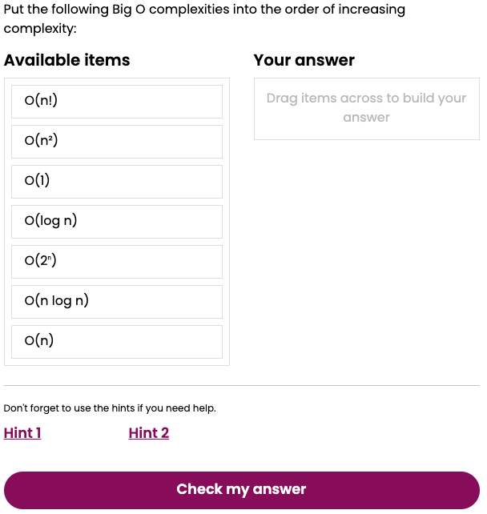
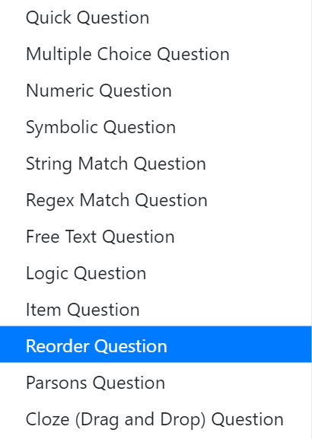
Self-marking questions
More than 1000 self-marking questions with feedback for common wrong answers. Eleven question types. Designed to help learners self-assess and reinforce learning.

Slide 14
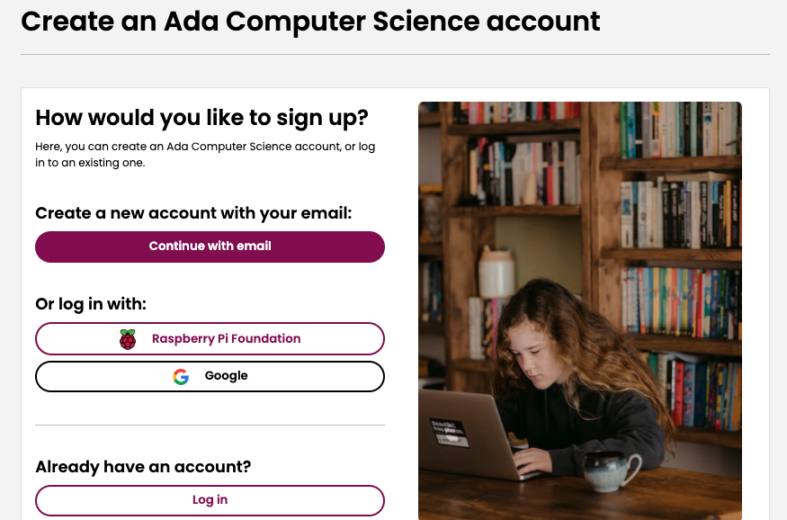
Sign up and Login
Go to Sign up in the top right corner of the website and register using your school email address.
Notes:
Teachers may wish to provide students with their class codes to join their group. You can read more on how to do this here

Slide 15
Summer Task - Preparing you for A level
To help you prepare for A level, there are three quizzes for you to try out on Ada Computer Science.
Quiz 1 - Computing Systems - GCSE to A level transition
Quiz 2 - Programming - GCSE to A level transition
Quiz 3 - Networks - GCSE to A level transition
Don’t worry if you’re not sure about the answers now, give them a try and use the hints for help if you need to.

Slide 16
Plenary
Review learning objectives:
Understand the opportunities available when studying Computer Science at A level
Understand the key concepts that will be covered at A level
To be confident in what to expect from your A level Course
To know how Ada Computer Science can support teachers and students
Next , in preparation for September you can:
Complete the quizzes on Ada
Review content in Ada and attempt more questions to prepare for A level

