Slide 2
Notes:
Strong support from R management

Slide 3
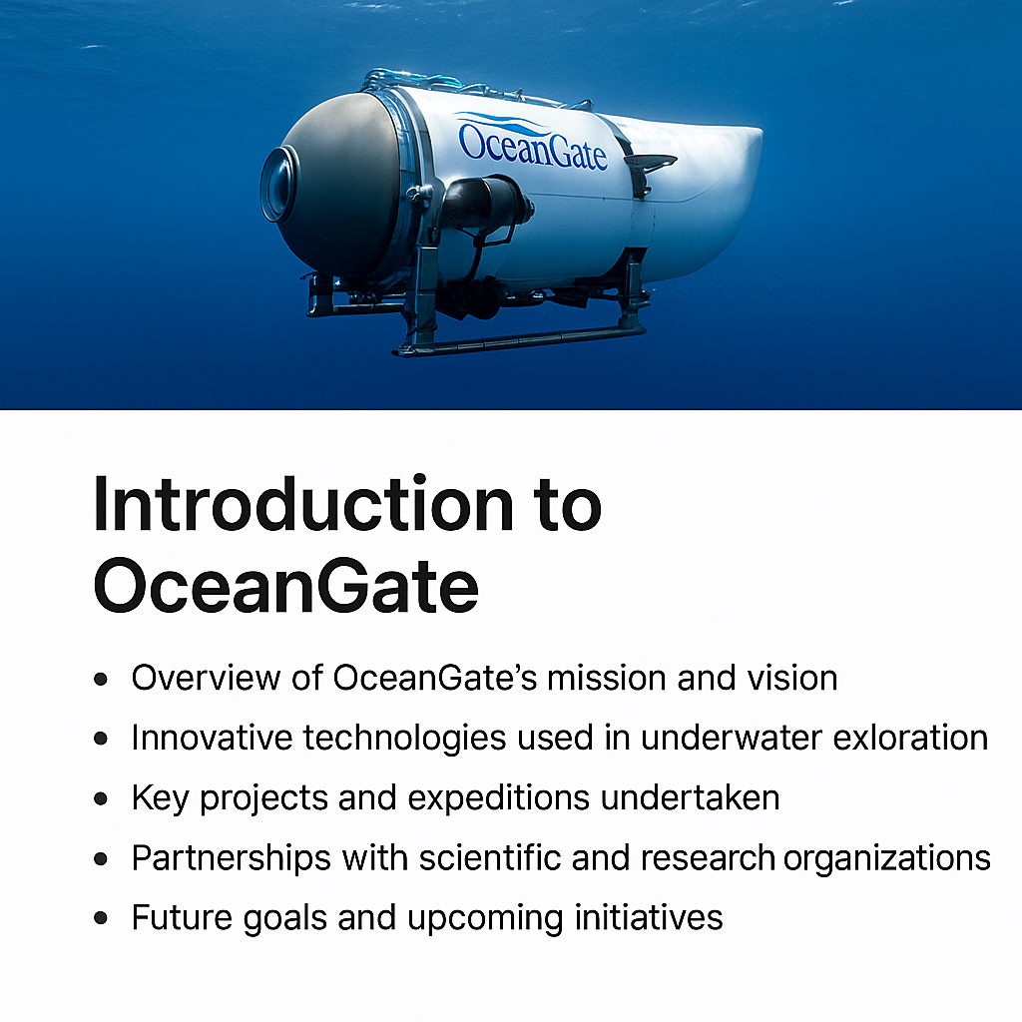
Notes:
Ocean Gate is dedicated to advancing our understanding of the ocean through innovative exploration and technology. Our mission is to open the oceans, enabling researchers, scientists, and explorers to access the depths of the seas like never before. We achieve this through the development and deployment of cutting-edge submersibles and underwater technology. Among our key projects are groundbreaking expeditions to the Titanic wreck site and the exploration of deep-sea ecosystems, which have provided invaluable data and insights. Our collaborations with esteemed scientific and research organizations, such as NOAA and various universities, enhance our ability to push the boundaries of marine science. Looking ahead, Ocean Gate is committed to expanding our technological capabilities and undertaking new initiatives that will further unlock the secrets of the ocean, contributing to global efforts in marine conservation and understanding.

