Slide 1
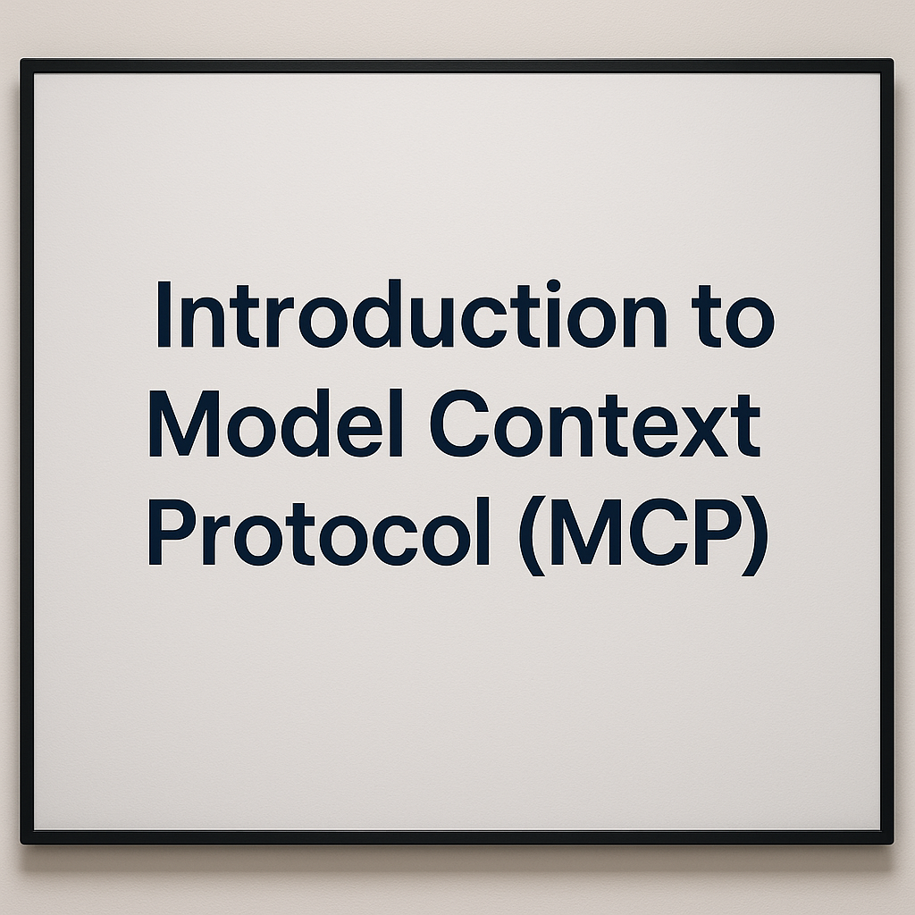
Notes:
The Model Context Protocol, or MCP, is an innovative framework developed by Anthropic, a leading organization in the field of artificial intelligence.

Slide 2
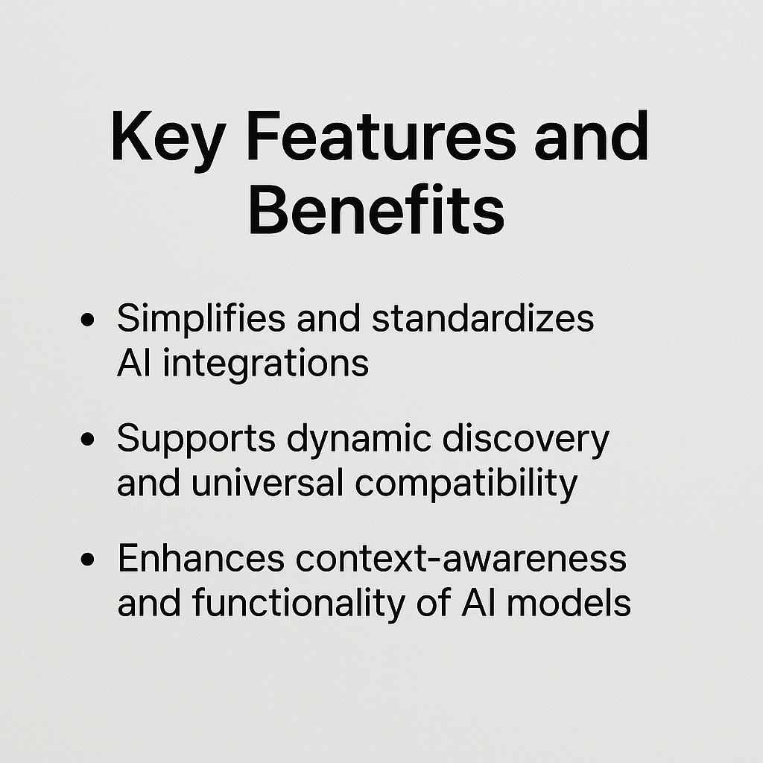
Notes:
.irstly, it simplifies and standardizes AI integrations. What this means is that our platform provides a streamlined approach to incorporating AI into various applications, reducing the complexity and effort required from developers. By offering a standardized method, we ensure consistency and reliability across different implementations.

Slide 3
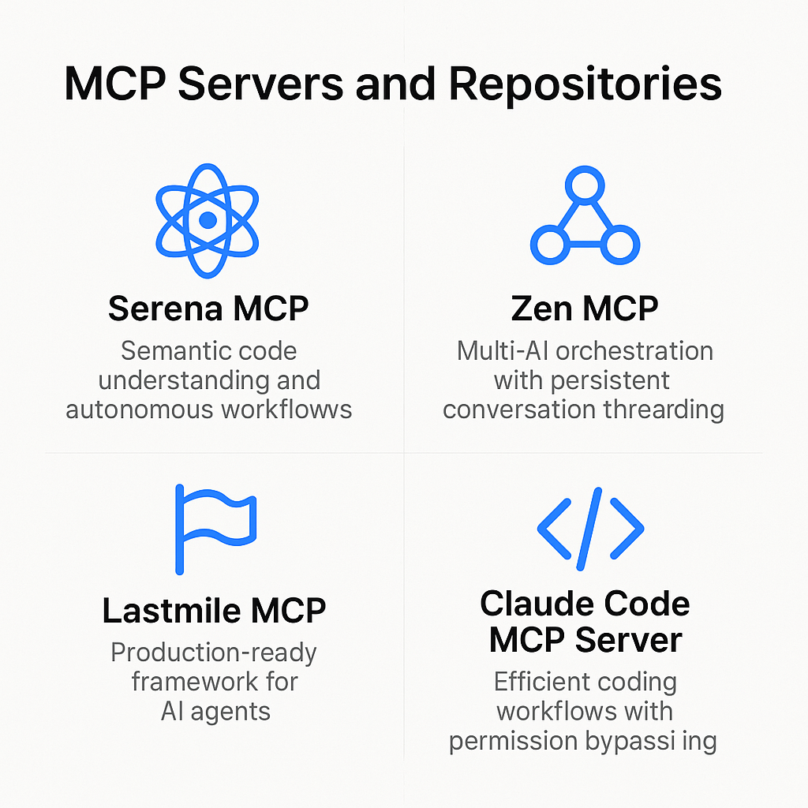
Notes:
By leveraging these MCP servers and repositories, we can significantly enhance our AI capabilities, ensuring more efficient and effective development and deployment of AI solutions.

Slide 4
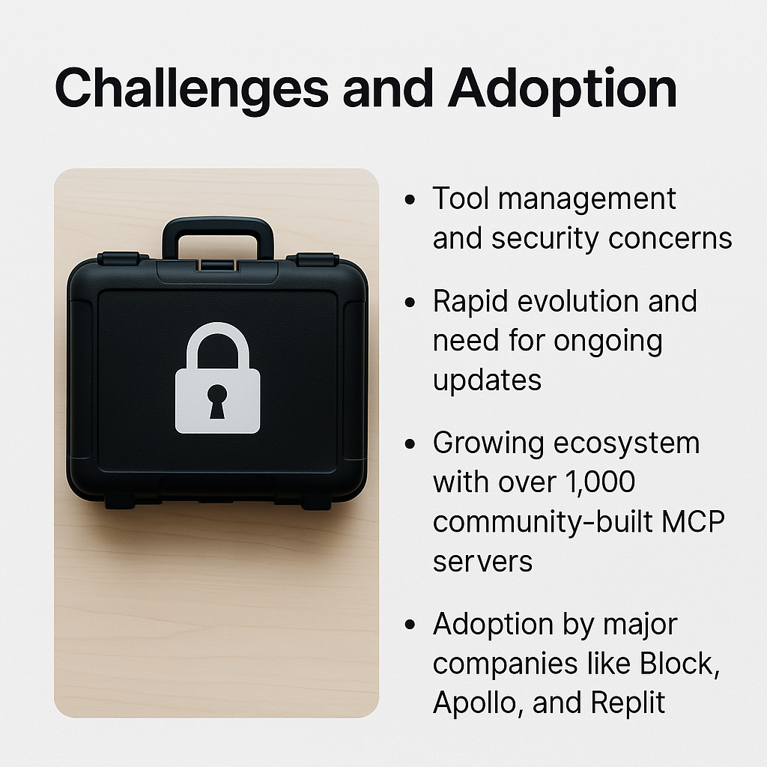
Notes:
Managing tools and addressing security concerns are significant challenges in the current technological landscape.

