Slide 1
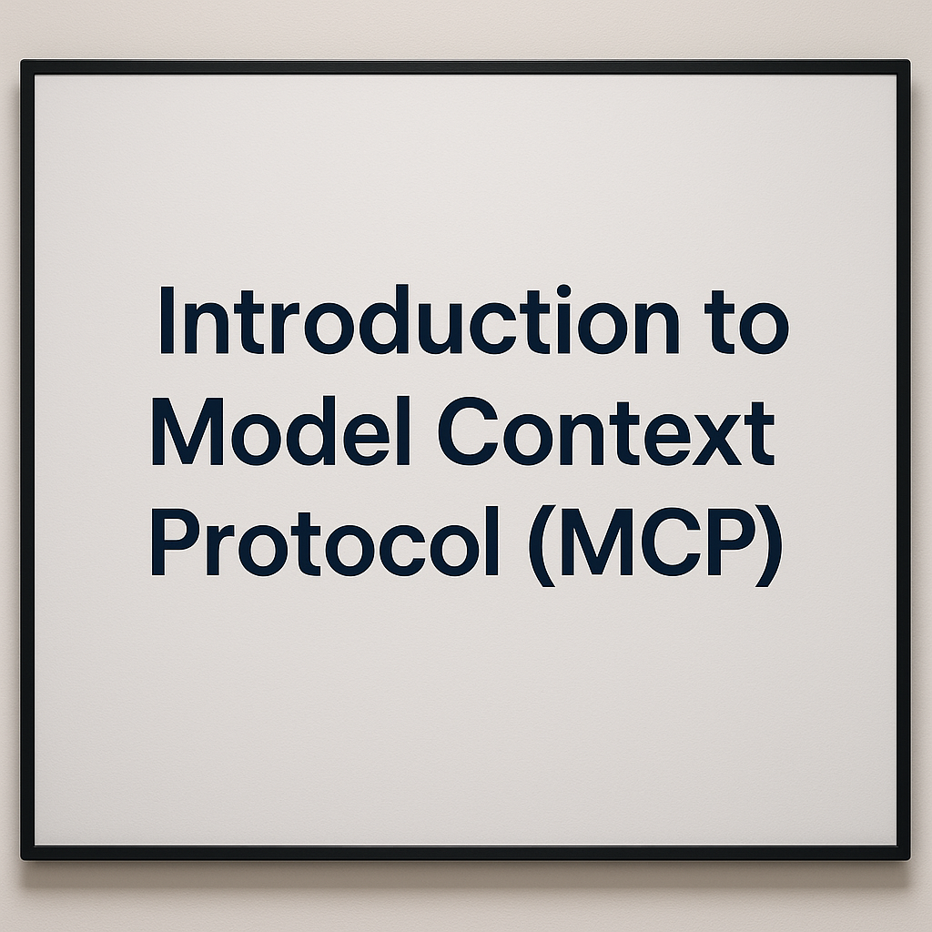
Notes:
The Model Context Protocol, or MCP, is an innovative framework developed by Anthropic, a leading organization in the field of artificial intelligence. This protocol was designed to significantly enhance the integration of AI systems by providing a standardized method for connecting AI models to a variety of external data sources and tools. The primary goal of MCP is to streamline and simplify the process of AI integration, making it more efficient and accessible for developers and organizations. By offering a uniform approach, MCP mitigates the complexities and inconsistencies that often arise when interfacing with different data sources and tools. Since its introduction in early 2025, MCP has been gaining considerable traction within the AI community. Its adoption is growing as more entities recognize the value of a standardized protocol in ensuring that AI models can easily and reliably access the information they need to perform optimally. This increased adoption highlights the industry's move towards more cohesive and interoperable AI systems, paving the way for more robust and versatile AI applications in various sectors.

Slide 2
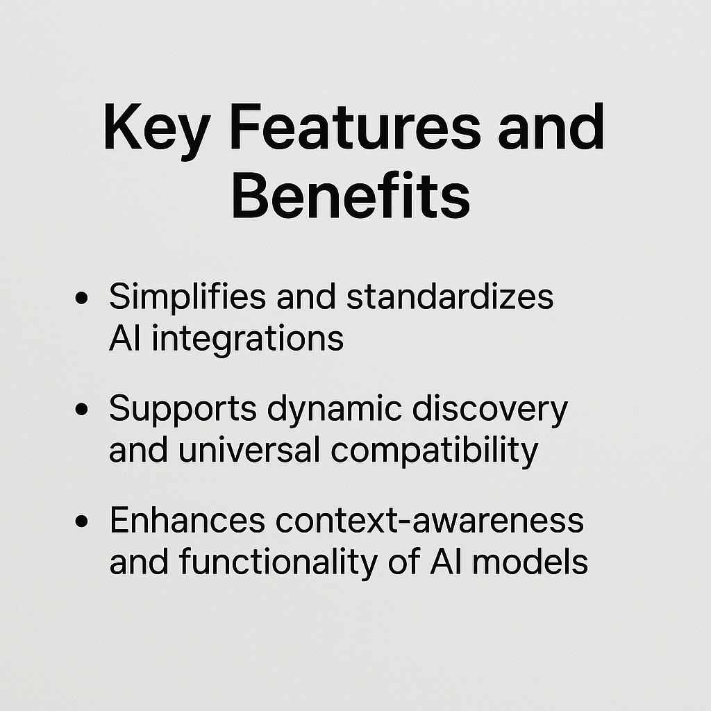
Notes:
Our product offers several key features and benefits that significantly improve the integration and functionality of artificial intelligence systems. Firstly, it simplifies and standardizes AI integrations. What this means is that our platform provides a streamlined approach to incorporating AI into various applications, reducing the complexity and effort required from developers. By offering a standardized method, we ensure consistency and reliability across different implementations.
Additionally, our solution supports dynamic discovery and universal compatibility. This feature allows the system to automatically identify and integrate with a wide range of AI models and tools, regardless of their origin. It ensures that users are not restricted to a specific set of technologies, thus promoting flexibility and adaptability in their AI strategies. This universal compatibility is crucial in a rapidly evolving tech landscape where new models and tools are continually being developed.
Lastly, our platform enhances the context-awareness and functionality of AI models. By providing rich contextual data and advanced analytics, it enables AI systems to make more informed and accurate decisions. This improvement in context-awareness means that AI can better understand and respond to the nuances of different scenarios, leading to more effective and efficient outcomes. Overall, these features collectively empower users to leverage AI more effectively, driving innovation and improving performance across various applications.

Slide 3
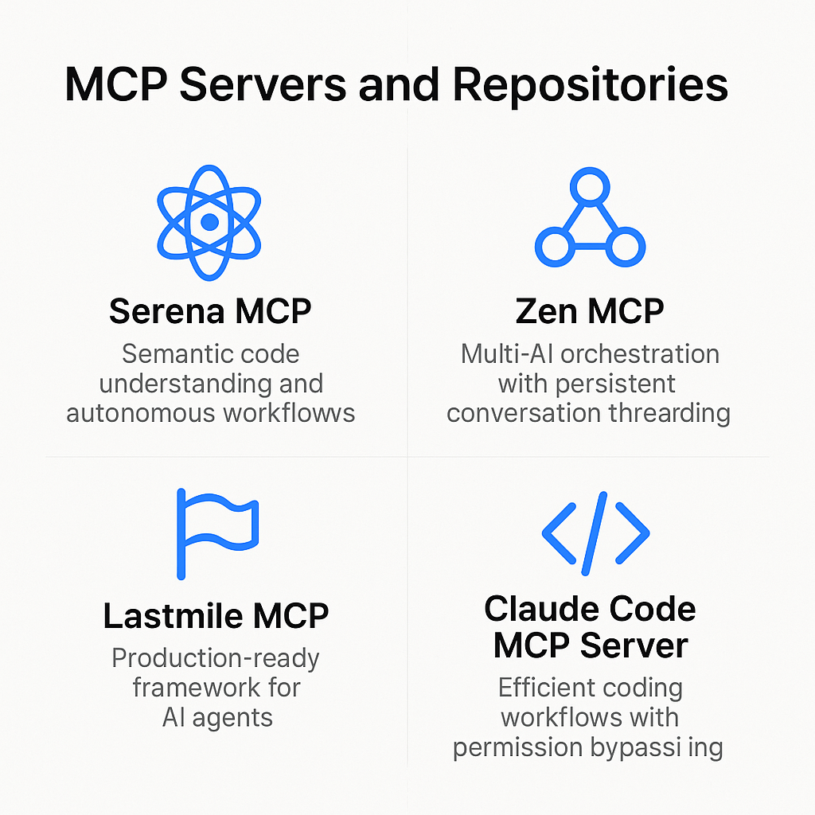
Notes:
Our presentation today will delve into the various MCP servers and repositories that are integral to our AI infrastructure. First, let's discuss the Serena MCP. This server is designed for semantic code understanding and facilitating autonomous workflows. Essentially, it enhances the ability of our AI to comprehend code at a deep level, enabling more intuitive and effective automation of coding tasks.
Next, we have the Zen MCP, which stands out due to its multi-AI orchestration capabilities combined with persistent conversation threading. This means it can manage multiple AI agents simultaneously while maintaining continuous and coherent conversations over extended periods. This is particularly useful in scenarios where complex, multi-step interactions are required, ensuring that context is preserved throughout.
Moving on, the Lastmile MCP is our production-ready framework for deploying AI agents. It is specifically tailored to transition AI solutions from development to production seamlessly. This framework ensures that our AI agents are robust, reliable, and ready to handle real-world applications right out of the box.
Lastly, we have the Claude Code MCP Server, which focuses on creating efficient coding workflows. One of its standout features is permission bypassing, which allows for smoother integration and operation within various coding environments by reducing the need for constant manual intervention. This leads to a more streamlined and uninterrupted coding process.
By leveraging these MCP servers and repositories, we can significantly enhance our AI capabilities, ensuring more efficient and effective development and deployment of AI solutions.

Slide 4
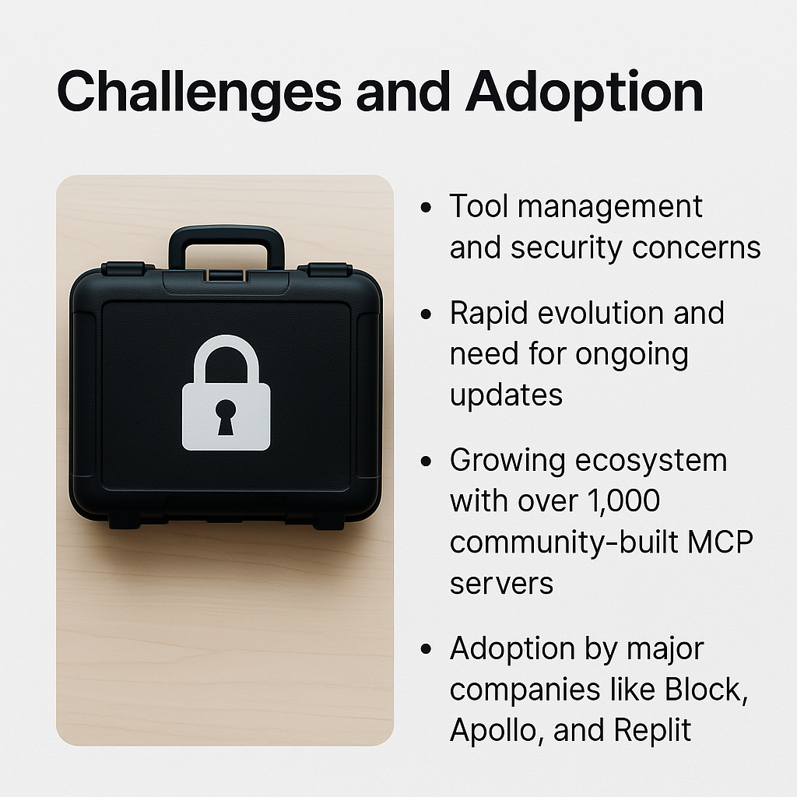
Notes:
Managing tools and addressing security concerns are significant challenges in the current technological landscape. As we integrate more tools into our workflows, ensuring they are secure and managed effectively becomes increasingly complex. This is compounded by the rapid evolution of technology, necessitating continuous updates and adaptations to stay current and secure. The ecosystem is also expanding rapidly, with over 1,000 community-built MCP servers now available, reflecting the wide range of applications and the thriving community support. This growth indicates a robust and dynamic environment but also adds to the complexity of management and security. Furthermore, the adoption of these tools and systems by major companies like Block, Apollo, and Replit highlights their growing importance and credibility in the industry. These companies’ adoption serves as a testament to the tools’ capabilities and reliability, setting a precedent for others in the industry to follow. Therefore, while the challenges are significant, the ongoing updates, community support, and endorsement by major companies provide a strong foundation for overcoming these obstacles and ensuring successful adoption.

