Slide 1


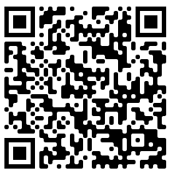
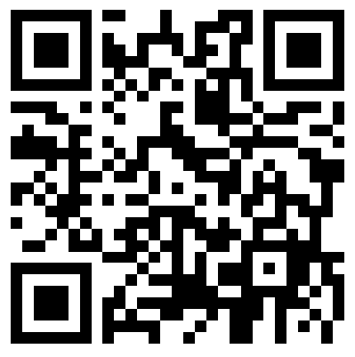




Get ready for .NET 7
Workshop Repo
Survey / SWAG
Isaac Levin
.NET Developer Advocate
@isaacrlevin

