Slide 1
SyriaTel Customer Churn Prediction
Logistic Regression Model Evaluation
Presented by Isaac Macharia

Slide 2
Business Problem
Customer churn represents a significant revenue threat to the organization. This initiative focuses on proactively identifying high-risk customers to enable targeted retention strategies and optimize resource allocation. Performance evaluation emphasizes metrics that accurately measure the model’s effectiveness in detecting at-risk customers and supporting churn mitigation efforts.

Slide 3
Success Metrics
Success will be measured using key performance metrics that reflect both overall effectiveness and churn detection capability. These include;
Accuracy to assess overall performance.
Precision to evaluate the quality of positive predictions.
Recall to measure the model’s ability to detect churn
F1-Score to balance precision and recall
Confusion Matrix to analyze prediction errors in detail.

Slide 4
Model Results Overview
Accuracy
The model achieves an overall accuracy of 85.9% across 667 test samples. However, the dataset is highly imbalanced, with 570 non-churn customers compared to only 97 churn customers. This imbalance means the high accuracy is largely driven by the model’s strong performance on the majority (non-churn) class. As a result, accuracy alone may overstate the model’s effectiveness in detecting churn, and additional metrics are required to properly assess its ability to identify at-risk customers.

Slide 5
Class Performance Analysis
The model demonstrates strong performance in predicting non-churn customers, with high precision (0.88), recall (0.96), and F1-score (0.92), indicating reliable identification of customers who are likely to stay. However, performance on the churn class is significantly weaker, with low recall (0.24) and F1-score (0.33). This means the model misses most customers who are at-risk of churning. While it is highly effective for the majority class, its ability to detect churn customers remains limited and requires improvement before deployment.

Slide 6
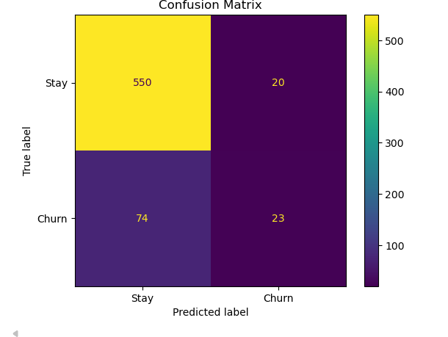
Confusion Matrix Insights
The model correctly identifies 550 non-churn customers and 23 churn customers. However, it incorrectly flags 20 customers as churn when they are not, and more critically, it fails to detect 74 actual churn customers. This means approximately 76% of churn customers go undetected. While the model performs well in identifying customers who will stay, its limited ability to capture at-risk customers significantly reduces its effectiveness for retention strategy implementation.

Slide 7
Business Risk Assessment
The model fails to identify the majority of churn customers, meaning most at-risk customers remain undetected. As a result, retention initiatives would not effectively target those who are most likely to leave, reducing the overall impact of intervention strategies. This limitation may lead to continued revenue leakage and operational inefficiencies. The model currently exhibits a bias toward predicting non-churn customers, highlighting the need for recalibration before deployment.

Slide 8
Strategic Recommendations
To improve results, we recommend refining the model to better identify customers who are likely to leave. This includes adjusting how the system evaluates risk, placing greater emphasis on correctly identifying at-risk customers rather than just overall accuracy, and exploring more advanced predictive approaches. These improvements will help ensure retention efforts are focused on the customers who matter most and reduce potential revenue loss.

Slide 9
Conclusion and recommendation
  While the model demonstrates strong overall accuracy (86%), it performs poorly in identifying customers at risk of churn, capturing only 24% of actual churn cases. As a result, the model is not yet suitable for deployment. Additional refinement is necessary to improve churn detection and minimize potential business risk.

Slide 10
Thank You

