Slide 1

Multi-layer Raft
Isaac Smead
CS666 Research Project
30 April, 2018

Slide 2
What is Raft?
Understandable consensus algorithm
Developed by Diego Ongaro and John Ousterhout (Stanford)
Best Paper Award at the 2014 USENIX Annual Technical Conference
Ongaro’s PHD thesis (August 2014)
Same performance as Paxos, easier to implement
Taught in distributed systems courses at Stanford and various other Universities
Industry Use
Docker
Apache Hydrabase

Slide 3
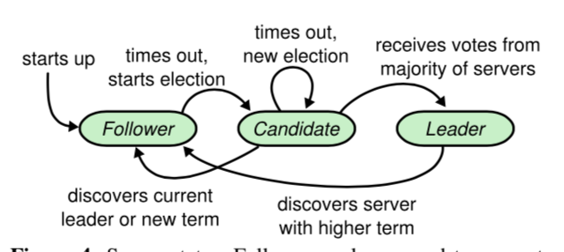
Raft Basics
Log based replicated state machine
Properties
Safety (non-Byzantine faults)
Availability (so long as majority of nodes correct )
Semi-asynchronous (tolerates network errors)
Commands complete when majority of nodes respond.
3 Node states
Picture worth 1000 words
https://raft.github.io/raftscope/index.html

Slide 4
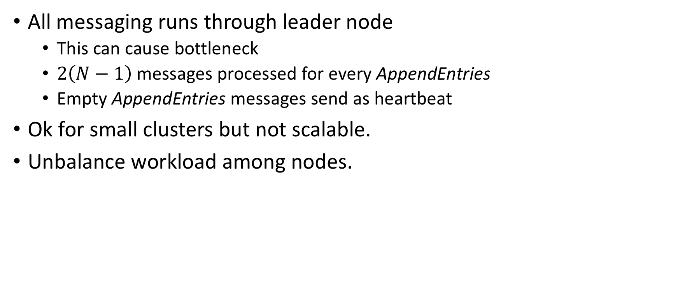
What’s wrong with Raft?
All messaging runs through leader node
This can cause bottleneck
$2\left(N−1\right)$ messages processed for every AppendEntries
Empty AppendEntries messages send as heartbeat
Ok for small clusters but not scalable.
Unbalance workload among nodes.

Slide 5
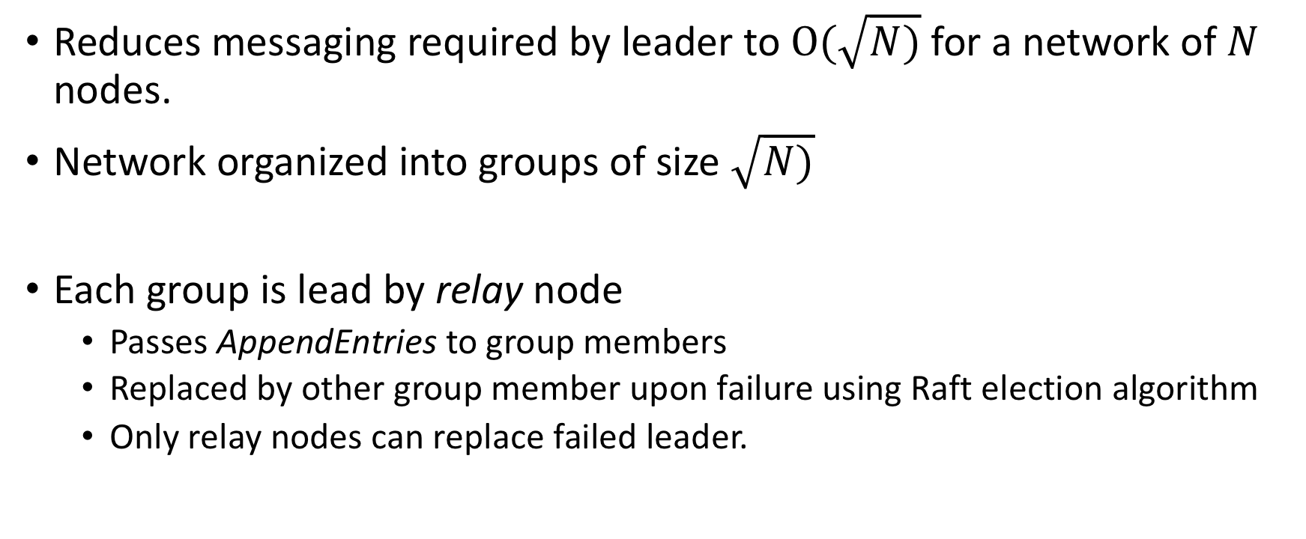
Introducing Multi-layer Raft
Reduces messaging required by leader to $Ο(\sqrt{N)}$ for a network of $N$ nodes.
Network organized into groups of size $\sqrt{N)}$
Each group is lead by relay node
Passes AppendEntries to group members
Replaced by other group member upon failure using Raft election algorithm
Only relay nodes can replace failed leader.

Slide 6
Group organization and message flow in multi-layer raft
group
F
1
L
F
2
L
leader
R
R
R
relay
3
F
F
follower
F
R
F

Slide 7
Node state lifecycle in multi-layer raft
times out,
new election
times out,
start election
Candidate
wins majority vote
start
loses election
Follower
discovers relay
with higher term
Relay
loses
election
discovers
leader with
higher term
times out,
start election
Leader
Candidate
wins majority vote
times out,
new election

Slide 8
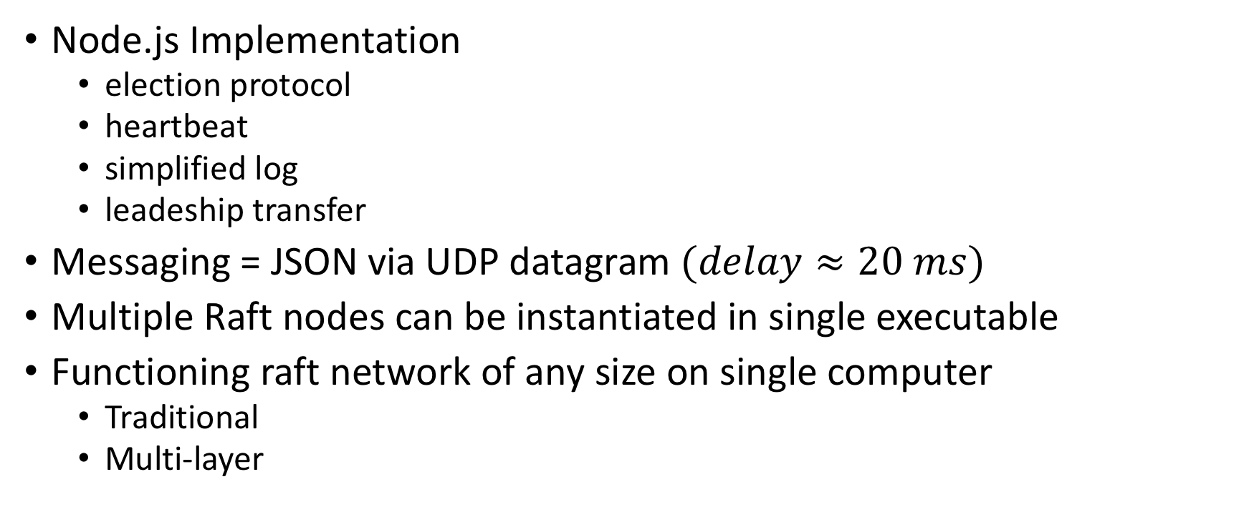
Implementation
Node.js Implementation
election protocol
heartbeat
simplified log
leadeship transfer
Messaging = JSON via UDP datagram $(delay≈20 ms)$
Multiple Raft nodes can be instantiated in single executable
Functioning raft network of any size on single computer
Traditional
Multi-layer

Slide 9
Testing
Killed of leader and measured recovery time
Stopped when new leader elected for Traditional Raft
Multi-layer Raft full recovery = leader election + relay replacement
3 test pairs
5 node Raft cluster vs 25 node multi-level network
9 node Raft cluster vs 81 node multi-level network
15 node Raft cluster vs 225 node multi-level network
Each pair used same configuration parameters (timeout etc)
1000 iterations per test, averages used for graphing

Slide 10
Average recovery times

Slide 11
Future research
Model performance effects of bottleneck on Raft
Throughput
Max number of nodes
System / network load
Apply model to study performance improvement with multi-level Raft
Full implementation / network testing (high cost)

Slide 12
Conclusion
Explored bottleneck issues with Raft
Defined and implemented multi-level Raft
Good start bringing scalability to Raft while maintaining understandability
Much interesting research still to be done.

Slide 13
Questions?

