Slide 1


4-Arquitetura Ambiente
DevOps
Ninja

Slide 2

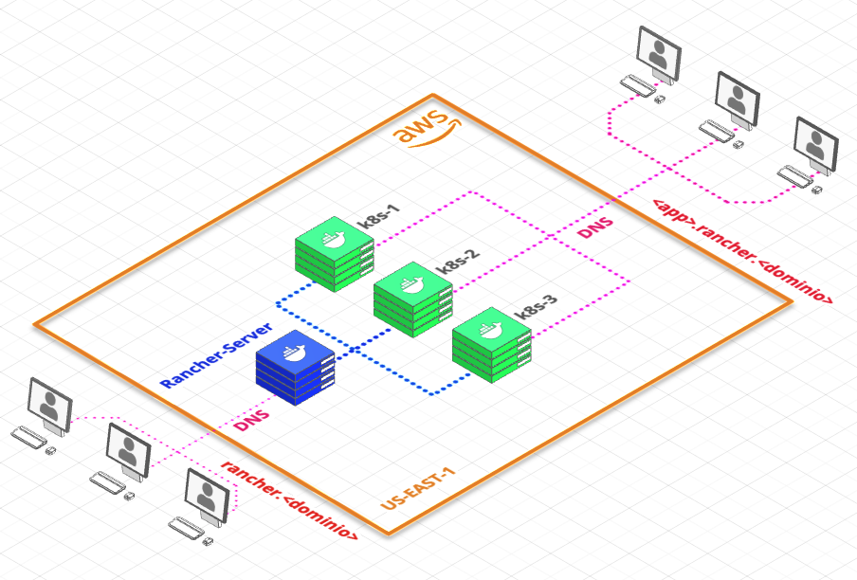
Arquitetura Ambiente

Slide 3
Environment Architecture
4 virtual machines
1 Rancher Server
3 for K8S cluster
1 domínio
rancher.<domínio>
app1.rancher.<dominio>
app2.rancher.<dominio>
For each virtual server
2-4 vcpu
4-6 gb ram
30 gb

