Slide 1
Section 3: System Design
Isaac Teo

Slide 2
Assumptions
Customers can upload as many photos as they would like
Customers can only view their own photos in their feed

Slide 3
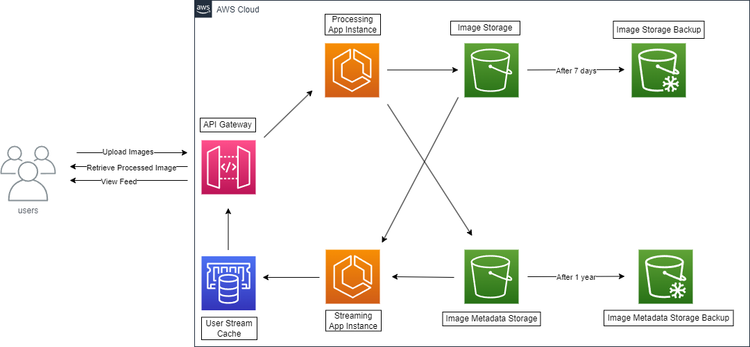
System Architecture Diagram

Slide 4
Some key points
By containerizing our existing applications, we can scale accordingly to the number of users
Spin up more instances as required, using AWS Elastic Load Balancer to distribute user requests
Business Intelligence requests can be served swiftly by keeping image metadata separately
Cache each user’s feed for faster load times, so we would only need to load the user’s most recently uploaded images since the user’s last viewing when updating their feed

Slide 5
Pros
Simple and streamlined design, integrates easily with existing developments
Easily scalable with AWS infrastructure

Slide 6
Cons
Data Retrieval, backup via duplication can be very costly due to image sizes
Might not be able to keep up the volume of feed requests as S3 and Glacier may not be efficient at streaming image data

