Slide 1
TRANSCRIPT INTELLIGENCE
What 100 conversations told us
about our customers, our product, and our team.
Findings & recommendations • Product & engineering leadership review
Senior Software Engineer take-home • May 2026

Slide 2
CONTEXT
We have 100 conversations. Three audiences. One question.
The brief
100
4,313
Process the transcripts and categorize by theme
Generate sentiment trends across call types
Show what other insights this data unlocks
transcripts
utterances
32
397
customer accounts
action items
My read of the brief
Feb–Apr
30 min
The required tasks are table stakes. The differentiator is showing how transcripts become a leadership tool — surfacing things scattered across hundreds of calls that no human can read in time.
data window (2026)
avg call duration
Each transcript ships with: full sentence-level transcript, per-utterance sentiment, speaker timing, meeting metadata, and an upstream-LLM summary with topics, action items, key moments.
Transcript Intelligence • Take-home findings
2

Slide 3
HEADLINES
Three things leadership should walk out knowing.
#1
#2
#3
An outage you can SEE in the data
Four accounts at HIGH churn risk — today
The recovery is real and on the data
The mid-March Detect outage shows up as a sentiment crater across all three call types — internal sentiment 1.8, support 1.4, external 2.1 in that week. The signature is unmistakable.
Cobalt Software, Northstar Pharma, Ridgeline Logistics, Meridian Capital have all four risk signals firing: dropping sentiment, churn-signal moments, competitor mentions, reliability hits.
Comply v2 launched April 4 — sentiment on launch-related calls jumps to 4.7. April external-call sentiment recovered to 4.1, above the pre-outage baseline of 4.0.
Fig. 5 (weekly sentiment) + 34-call narrative
Bonus insight: per-account risk score 0–12
Comply v2 narrative: 51 calls, avg sentiment 3.81
Transcript Intelligence • Take-home findings
3

Slide 4
HOW I BUILT IT
A pipeline you can audit, not a black box.
1
Ingest
Flatten 6-file folders into per-meeting + per-utterance frames. 100 meetings × 4,313 utterances.
2
Classify call type
Hybrid rules on title patterns + email domains. 100% deterministic, auditable.
3
Categorize themes
Fixed 8-theme taxonomy with keyword map; cross-validated with TF-IDF + KMeans.
4
Aggregate sentiment
Trust upstream per-utterance labels and meeting scores. Add: trends over time, in-call swings.
5
Bonus insights
Churn risk score, action-item tracker, narrative tracing, conversation dynamics.
Why hybrid? Rules are auditable for the things that have a clean signal (call type). ML and LLMs earn their keep on the messy stuff (themes, narratives). Both views must agree.
Transcript Intelligence • Take-home findings
4

Slide 5
CODE MAP
Each source file does one job — here's the map.
Required tasks
data_loader.py
Ingest 100 transcript folders → per-meeting + per-utterance frames
Foundation
call_type_classifier.py
Classify each call as support / external / internal (rule-based hybrid)
Required 1a
topic_categorizer.py
Map each call to one of 8 stakeholder themes; cross-validate with TF-IDF + KMeans
Required 1b
sentiment_analyzer.py
Aggregate sentiment by call type, theme, week, customer; detect in-call swings
Required 2
Bonus insights
churn_risk.py
Score each customer 0-12 across four churn signals; explain every flag
Bonus #1
action_item_tracker.py
Parse 397 action items, attribute owner + deadline, aggregate by person and customer
Bonus #2
narrative_tracer.py
Stitch together cross-call stories from a seed phrase (the Detect outage arc)
Bonus #3
conversation_dynamics.py
Talk-time per speaker, customer-voice share, calibrated coaching flags
Bonus #4
Pipeline & output
pipeline.py
Orchestrator: runs every module in order, persists CSVs + insights.json
Glue
visualizations.py
Render the 9 chart PNGs the slide deck uses
Glue
build_deck.js
Generate this PowerPoint from the chart PNGs and insights.json
Glue
Each module has a public function and a single responsibility. The pipeline is `run_pipeline(data, out)` — one call regenerates every CSV in the package.
Transcript Intelligence • Take-home findings
5

Slide 6
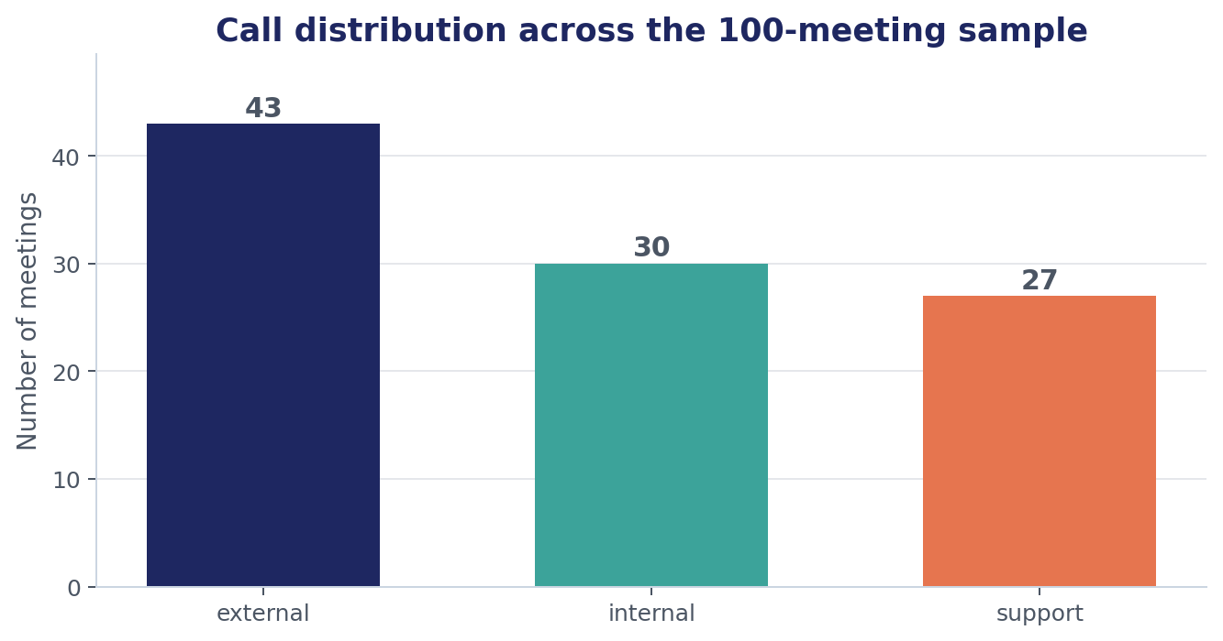
REQUIRED TASK 1A
Call type classification — three audiences cleanly separated.
Rules used (in priority order)
Title says 'Support Case' → support
Title starts 'Aegis / Customer' → external
Any non-aegiscloud.com attendee → external
Internal-meeting keyword in title → internal
Otherwise (Aegis-only attendees) → internal
Why rules, not an LLM? The signal is clean — every email has a domain, titles follow conventions. Rules cost zero, are deterministic, and a PM can read them and push back. If we ever see a meeting where rules fail, that's the moment to fall back to an LLM classifier.
Transcript Intelligence • Take-home findings
6

Slide 7
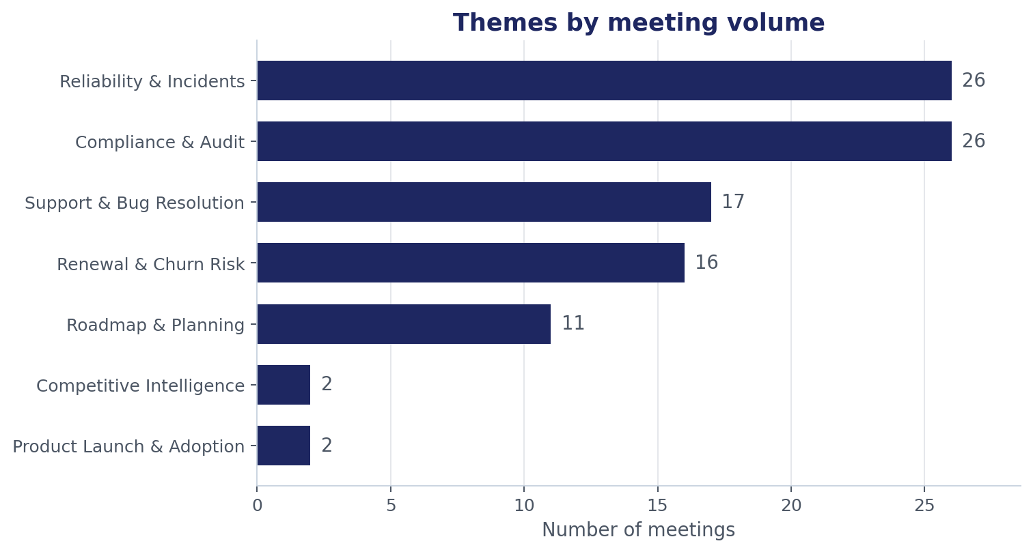
REQUIRED TASK 1B
Themes — built around stakeholders, not topic vocabulary.
8 themes, mapped to who cares
Reliability & Incidents → SRE, eng leadership
Renewal & Churn Risk → CS, sales leadership
Compliance & Audit → product, security
Product Launch & Adoption → PM, growth
Roadmap & Planning → eng leadership, PM
Support & Bug Resolution → support leadership
Pricing & Commercial → sales, finance
Competitive Intelligence → PM, marketing
Validated independently with TF-IDF + KMeans (k=8). Clusters surfaced same buckets PLUS distinct product lines (Aegis Identity, Aegis Protect) — a future enhancement.
Transcript Intelligence • Take-home findings
7

Slide 8
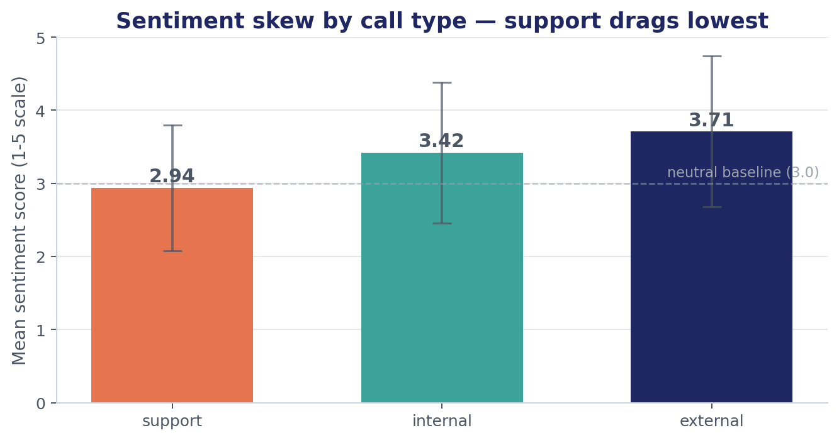
REQUIRED TASK 2
Sentiment by call type — the obvious finding has a non-obvious twist.
What it tells us
Support is most negative (2.94) — by definition customers are calling about a problem.
External calls are most positive (3.71) — these are relationship-management.
But std-dev is highest on EXTERNAL (1.03) — when external goes wrong, it really goes wrong.
Lowest external = 1.6 (Blackridge URGENT). Highest support call still 4.8 (a granular-restore success).
So-what
Don't track 'support sentiment' as a metric — it'll always be lowest. Track support sentiment TRENDS and outliers. And watch the external-call variance: a single very-negative external call is worth more attention than ten very-negative support tickets.
Transcript Intelligence • Take-home findings
8

Slide 9
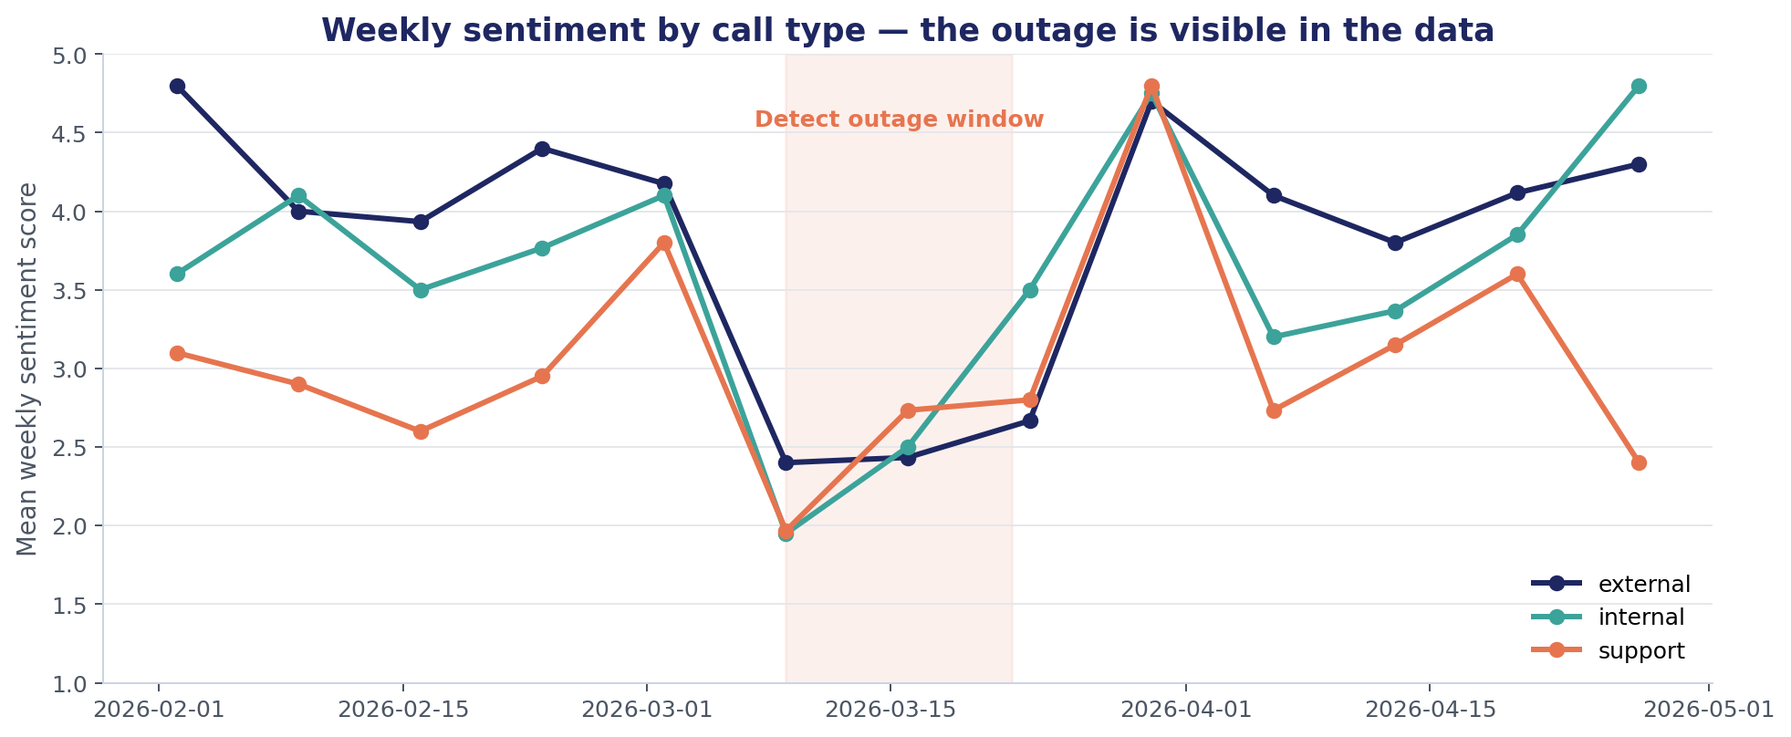
THE SIGNAL WE FOUND
Sentiment over time — the outage is visible in the data.
ALL THREE call types crater in the week of March 9-15. Internal hits 1.95 (war room). Support hits 2.6 (customers feel it). External hits 2.4 (account managers in damage-control). They recover together by April. This is exactly the kind of system-wide signal a single sentiment model on a single channel would miss.
Transcript Intelligence • Take-home findings
9

Slide 10
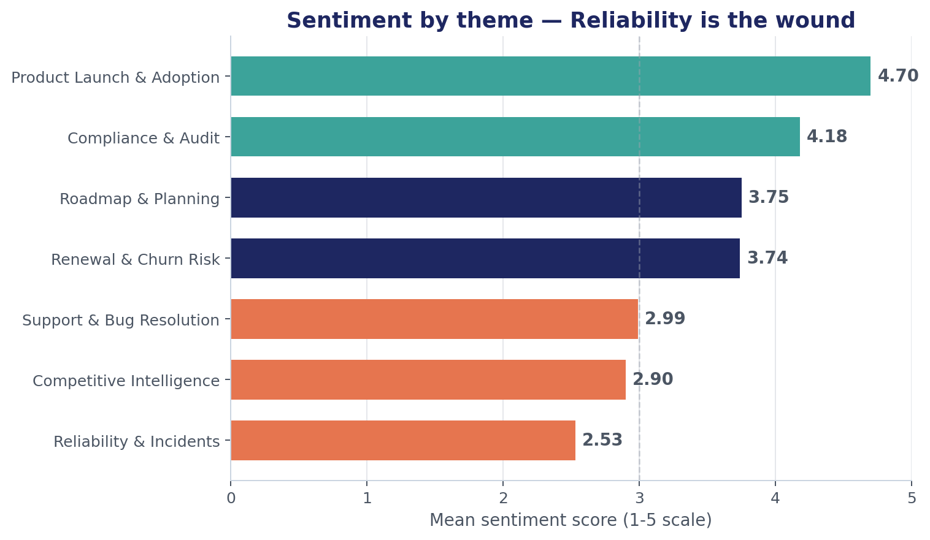
REQUIRED TASK 2
Sentiment by theme — Reliability is the wound, Compliance is the strength.
Implications by stakeholder
ENG LEADERSHIP: every Reliability conversation is below the neutral line (mean 2.53). Reliability investment isn't optional.
PRODUCT: Compliance is your customer's love language right now (mean 4.18). Lead with Comply v2 in renewals.
GTM: Renewal & Churn Risk (3.74) is healthier than expected — the team is recovering accounts well.
MARKETING: Competitive Intelligence calls all skew negative (mean 2.90) — competitors are showing up at painful moments, not strong ones.
Transcript Intelligence • Take-home findings
10

Slide 11
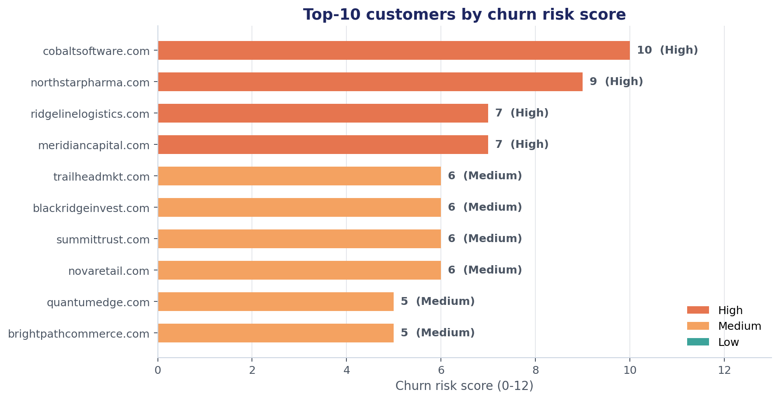
BONUS INSIGHT 1 OF 4
Churn risk early-warning — explainable, actionable, ranked.
How the score works
Sentiment trajectory (0-3)
Churn-signal key moments (0-3)
Competitor mentions (0-3)
Reliability/SLA exposure (0-3)
Total 0–12; bucketed High / Med / Low
EVERY flag is auditable: a CS lead can drill into Cobalt and see exactly which calls drove the score and why.
Action: assign a named exec sponsor to each High-risk account by Friday. Cobalt and Northstar both have competitor (SentinelShield) engagement — the clock is on.
Transcript Intelligence • Take-home findings
11

Slide 12
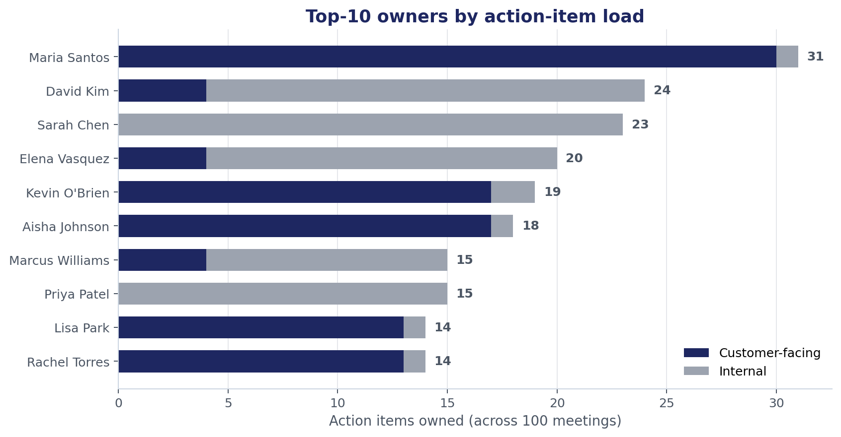
BONUS INSIGHT 2 OF 4
Action-item tracker — 397 commitments, fully attributed.
What we extracted
397 action items across 100 meetings
394 (99%) parsed to a named owner
56 (14%) carry an explicit deadline phrase
Maria Santos: 31 items, 30 customer-facing — burnout risk
16 customer accounts have ≥12 open commitments
So-what
Two products fall out of this: (1) a per-owner workload dashboard, (2) a per-customer commitment ledger so account managers can see every promise made to a customer across calls. The data is already here — it just isn't visible.
Transcript Intelligence • Take-home findings
12

Slide 13
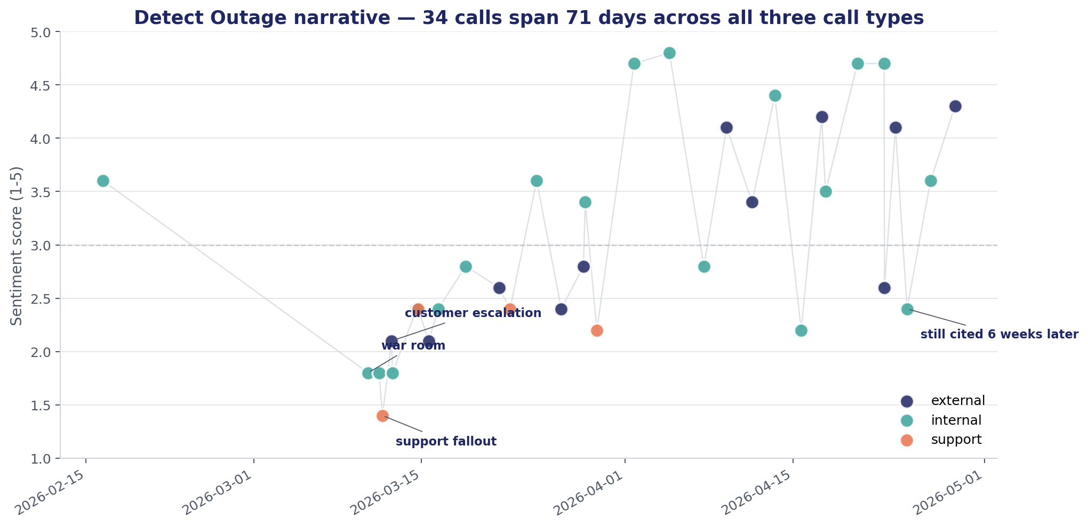
BONUS INSIGHT 3 OF 4
Cross-call narrative tracing — the outage as one story.
From a single seed phrase ('Detect outage') we trace 34 calls across 71 days, spanning all three call types and 14 customers.
This view answers questions a leader actually asks: 'How did we handle the outage?' 'Which customers are still bringing it up?'
Same template works for Comply v2 launch (51 calls, 25 customers) and SentinelShield competitive pressure (8 customer accounts).
Transcript Intelligence • Take-home findings
13

Slide 14
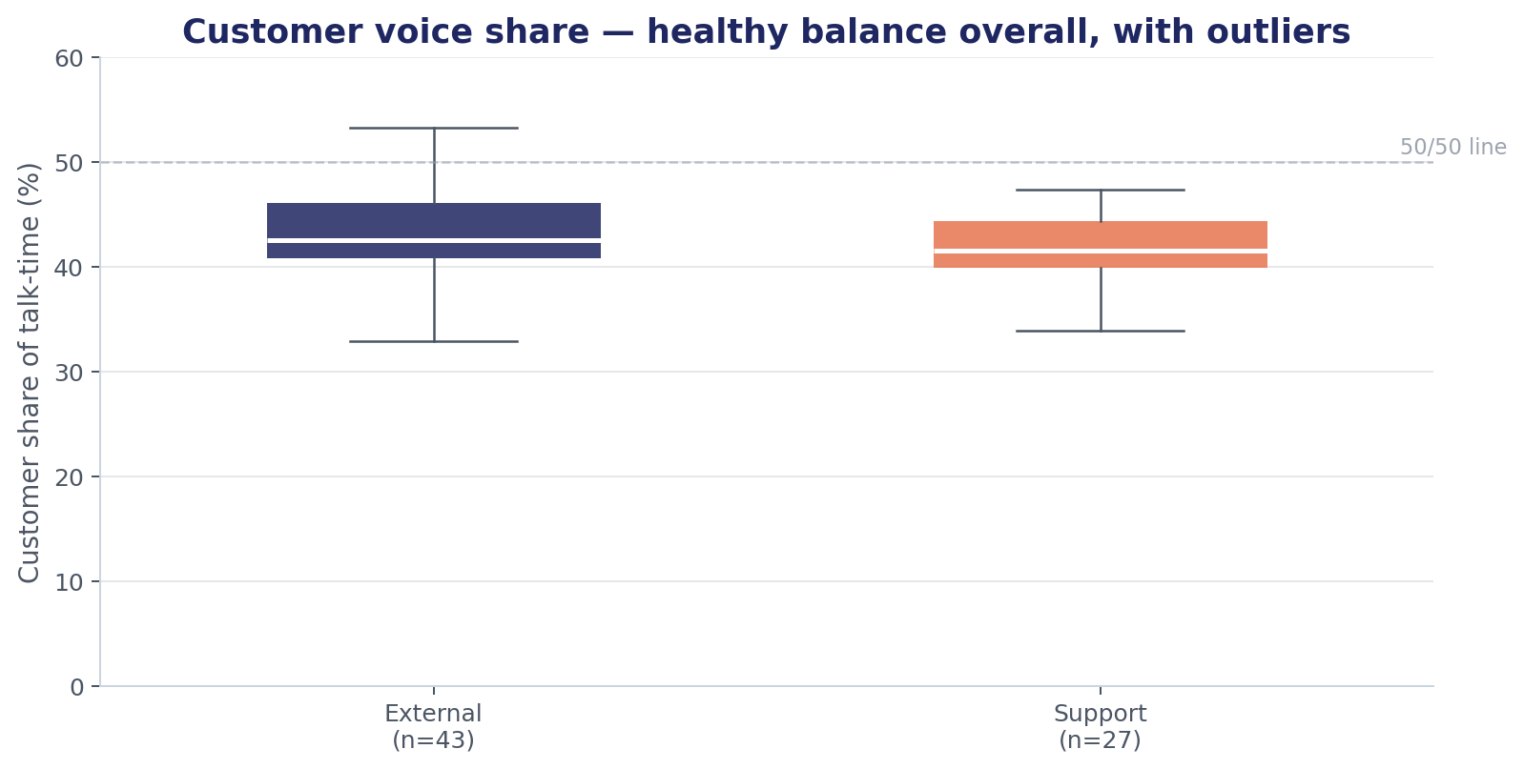
BONUS INSIGHT 4 OF 4
Conversation dynamics — call coaching, not surveillance.
What we measure
Aegis vs customer talk-time (mapped via email-domain → speaker name)
Per-speaker turns and longest-speaker dominance
Calibrated coaching flags using THIS dataset's distribution, not arbitrary thresholds
9 of 70 customer calls flagged — actionable not noisy
Healthy baseline. Aegis-side averages 57% talk-time on external calls — close to ideal. Calls where customers spoke MORE were renewals and competitive evals — exactly when listening matters most.
Transcript Intelligence • Take-home findings
14

Slide 15
PUTTING IT TOGETHER
Different leaders need different views of the same data.
Stakeholder
Their question
What we'd ship for them
Support leader
Which customers keep coming back?
Recurring-issue heatmap, support sentiment trend, time-to-resolution by theme
Sales / CS leader
Which accounts are at risk?
Churn risk dashboard (bonus #1), competitor watch, customer-commitment ledger (bonus #2)
Product manager
What are customers asking for?
Feature-request mining from key moments, theme-vs-sentiment matrix, adoption call tracking
Engineering lead
Where are we hurt and healing?
Reliability narrative tracing (bonus #3), incident-to-recovery sentiment arc, RCA action-item follow-through
Exec / GM
What's the company's story this quarter?
Cross-call narratives (bonus #3), aggregate sentiment, win/loss themes pulled from transcripts
Transcript Intelligence • Take-home findings
15

Slide 16
WHAT I'D DO MONDAY
Three concrete moves the data justifies.
#1
#2
#3
Stand up a churn-risk dashboard this sprint
Make the action-item ledger a renewal asset
Use narrative tracing for post-incident comms
The four high-risk accounts won't wait for a perfect product. Ship the per-account risk score with drill-down to the source calls. CS leaders can act on it day one.
Account managers walk into renewals not knowing every promise we ever made. Surface those by customer in their CRM. Single highest-leverage win in this dataset.
Today PMs hand-write incident retros. Auto-generate the timeline with sentiment arc and customer impact list. Share with customers as part of the trust-rebuilding loop.
Effort: 1 sprint (the model is in this notebook)
Effort: 1-2 sprints + Salesforce integration
Effort: Spike — most logic exists; needs UI
Transcript Intelligence • Take-home findings
16

Slide 17
IF I HAD ANOTHER WEEK
Where the next dollar goes.
Product-line dimension
True LLM-driven theme discovery
TF-IDF clustering surfaced Aegis Identity, Aegis Protect, Comply v2, Aegis Detect as distinct conversational worlds. Add product-line as a first-class facet.
Today themes are a fixed taxonomy. With 1k+ transcripts I'd run an LLM-driven theme discovery pass quarterly to catch emerging topics (data-residency, AI-governance) before they become trends.
Real-time alerting
Speaker fingerprinting
Hook the churn-risk + narrative-tracing into a Slack alert: 'A new call just landed in the SentinelShield narrative — sentiment 2.1 — recommend exec touch.'
Connect speakers across calls (today only inferable via email matching). Enables 'rep coaching' that compares the same rep across multiple meetings.
Trend significance testing
Feature-request mining
The weekly drop is visible by eye but I haven't proven it's significant. Bootstrap confidence bands on sentiment-by-week, and flag breakouts.
key_moments contains feature-request signals. With slightly more parsing, this becomes the PM's quarterly voice-of-customer summary, generated automatically.
Transcript Intelligence • Take-home findings
17

Slide 18
APPENDIX
Caveats, assumptions, and what to push back on.
Sample size
100 transcripts is small. Specific account-level claims (e.g. Cobalt at risk) are evidence not proof. With 1k+ I'd add significance testing.
Pre-computed labels
I trust upstream sentiment + topic labels. If those are systemically biased, my aggregates inherit the bias. We should sanity-check on a held-out sample.
Synthetic-feeling data
The dataset reads like coherent generated content (a few story arcs, ~32 customers). Findings are still defensible — I treat it as a realistic simulation.
Speaker-to-domain mapping
Best-effort match between speakerName and email local-part. I tested it; on this dataset talk-time splits look right (~57/43 on customer calls).
Churn risk weights
Equal weighting on the four signals is a heuristic. With churn outcomes as labels, we'd train weights instead of asserting them.
Privacy
Transcripts contain PII (names, customers, emails). Any production version needs proper access controls, redaction options, and audit logs from day one.
Transcript Intelligence • Take-home findings
18

Slide 19
Thank you.
Happy to walk through any of the code in Q&A.
Notebook + pipeline + raw outputs are in the package.

