Slide 1
Distribution Workshop: Random Numbers in R

Slide 2
Outline
Quick intro to distributions
Playing with continuous distributions
Playing with discrete distribution
Bootstrapping
R libraries necessary: tidyverse, ggplot2
require(tidyverse)
require(ggplot2)

Slide 3
Playing with Random Number Generation in R
Two functions you can try:
rnorm(n = , mean = , sd = )
n specifies how many numbers will be generated
See what happens as you change mean and sd
rbinom(n = , size = , prob = )
n specifies how many numbers will be generated
See what happens as you change the size and prob

Slide 4
Playing with Random Number Generation in R
Two functions you can try:
rnorm(n = , mean = , sd = )
n specifies how many numbers will be generated
See what happens as you change mean and sd
rbinom(n = , size = , prob = )
n specifies how many numbers will be generated
See what happens as you change the size and prob
These are called the PARAMETERS
Mean can be whatever
Sd must be > 0
Size must be an integer > 0
Prob must be between 0 and 1

Slide 5
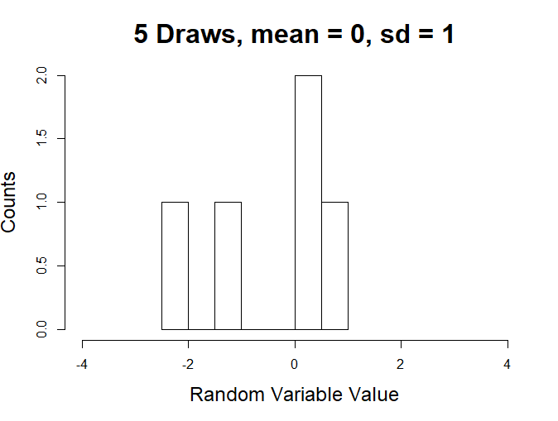
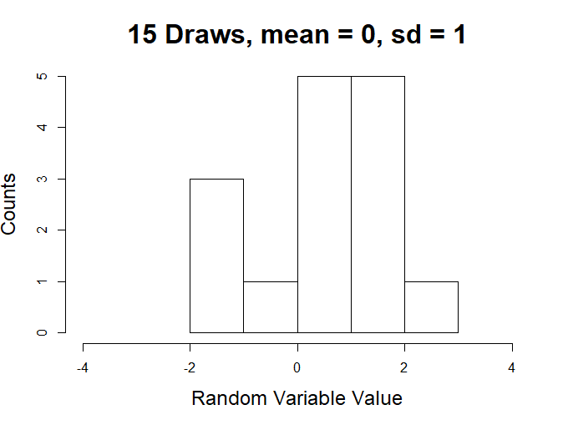
Rnorm Example Output Histograms

Slide 6
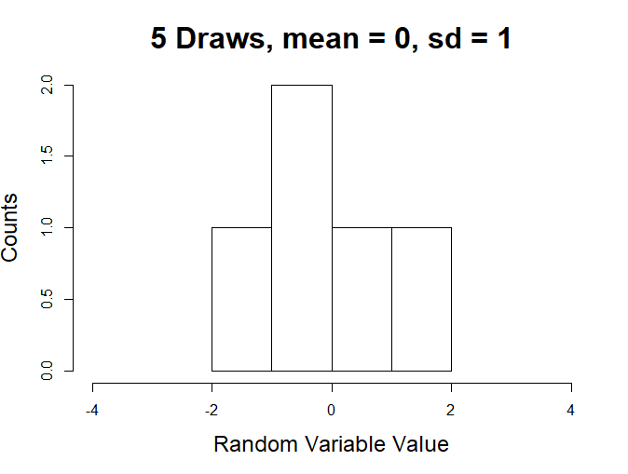
Rnorm Example Output Histograms

Slide 7
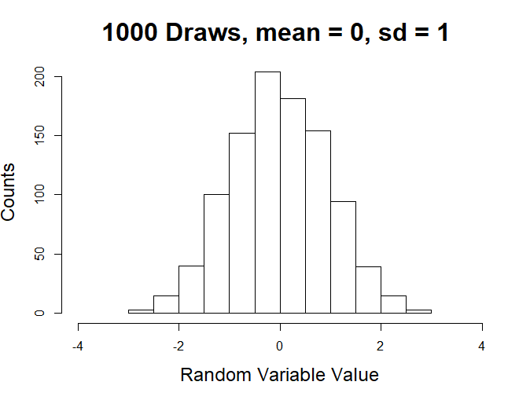
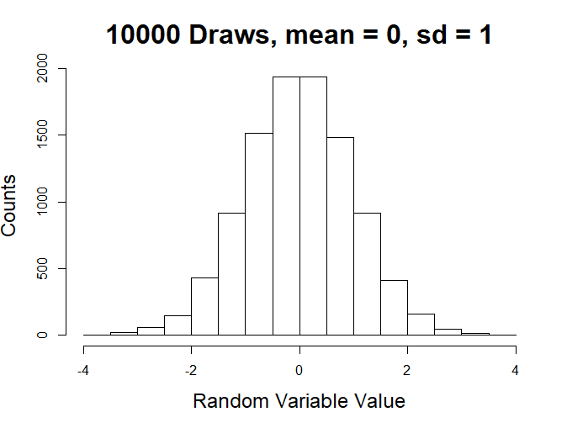
Rnorm Example Output Histograms

Slide 8
Rnorm Example Output Histograms
Summary: Randomness is evident in small samples, but a pattern emerges in large samples.
The pattern is the defining PROBABILITY DISTRIBUTION of the particular random number generator used

Slide 9
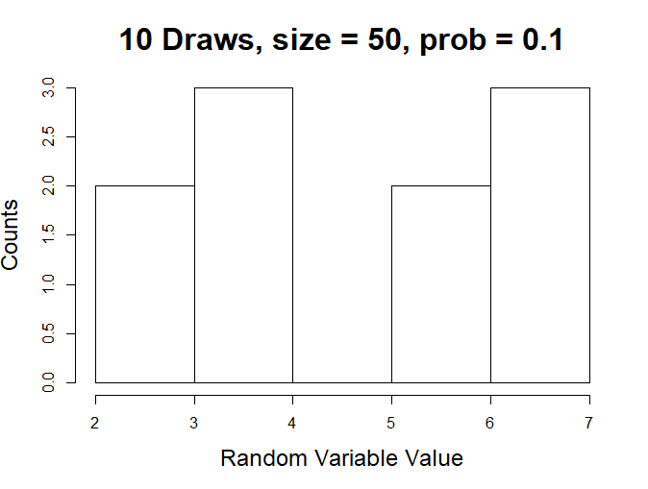
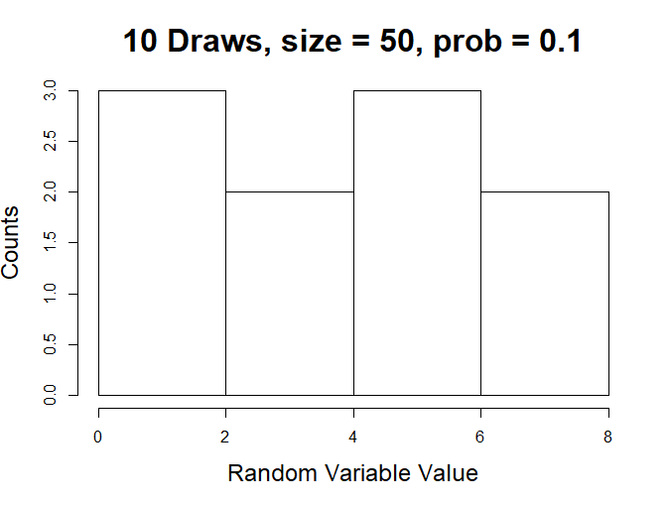
Now for rbinom

Slide 10
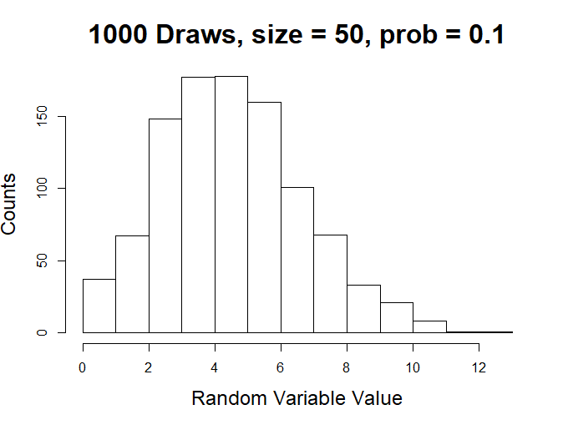
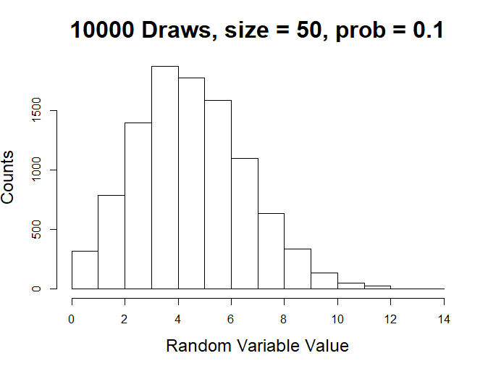
Now for rbinom
Again, a pattern emerges in large samples

Slide 11
But A Key Difference is Obscured by the Histograms
Sample ID | rbinom(size = 50, prob = 0.1) | Rnorm(mean = 0, sd = 1)
1 | 4 | 1.50912541
2 | 5 | 0.05016158
3 | 3 | -1.49817645
4 | 2 | -0.76979873
5 | 8 | 0.78406522
6 | 3 | -1.95249363
7 | 5 | -1.43578356
rbinom is only giving us integers (and positive ones at that) whereas rnorm is giving us “real numbers” (i.e., numbers with long base10 decimals)

Slide 12
But A Key Difference is Obscured by the Histograms
Sample ID | rbinom(size = 50, prob = 0.1) | Rnorm(mean = 0, sd = 1)
1 | 4 | 1.50912541
2 | 5 | 0.05016158
3 | 3 | -1.49817645
4 | 2 | -0.76979873
5 | 8 | 0.78406522
6 | 3 | -1.95249363
7 | 5 | -1.43578356
rbinom is giving us what is called a DISCRETE RANDOM VARIABLE
rnorm is giving us what is called a CONTINUOUS RANDOM VARIABLE

Slide 13
Probability Distributions 101
Distributions characterize random variables; Random variables are numbers that describe an event and that have some probability of occurring.
Examples of random variables:
Number of U to C mutations in a sequencing read
Time until a reaction occurs
Number of sequencing reads mapping to a particular gene

Slide 14
Probability Distributions 101
Distributions describe random variables; Random variables are numbers that describe an event and that have some probability of occurring
Examples of random variables:
Number of U to C mutations in a sequencing read
Time until a reaction occurs
Number of sequencing reads mapping to a particular gene
These only take on integer values and are thus called discrete random variables

Slide 15
Probability Distributions 101
Distributions describe random variables; Random variables are numbers that describe an event and that have some probability of occurring
Examples of random variables:
Number of U to C mutations in a sequencing read
Time until a reaction occurs
Number of sequencing reads mapping to a particular gene
This takes on real number values and is thus called a continuous random variable

Slide 16
Probability Distributions 101
In the real world, probability distributions should be thought about as ways to model random variables; Thus, they are crucial components of simulations, which aim to take a model and generate data.
Examples of random variables:
Number of U to C mutations in a sequencing read
Time until a reaction occurs
Number of sequencing reads mapping to a particular gene

Slide 17
Probability Distributions Are a Simulation’s Most Important Tool
To get good at writing and understanding simulations, you have to understand the various probability distributions at your disposal and what they can model

Slide 18
Continuous Distributions

Slide 19
Uniform Distribution: The Most Basic Bounded Distribution
R function: runif(n = , min = , max = )
Take a minute to play around with runif

Slide 20
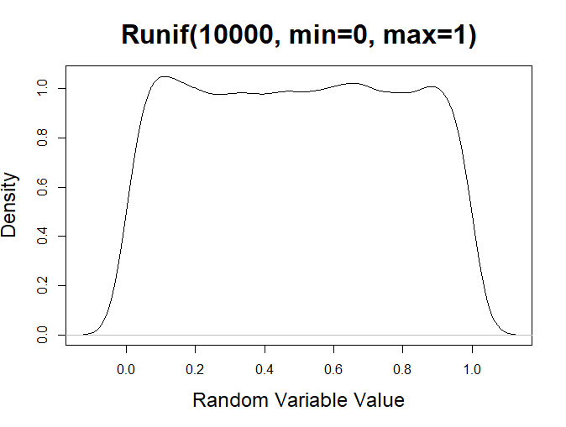
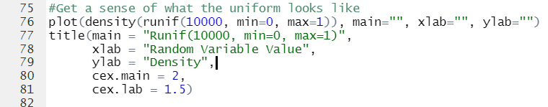
Uniform Distribution: The Most Basic Bounded Distribution
R function: runif(n = , min = , max = )

Slide 21
Uniform Distribution: The Most Basic Bounded Distribution
R function: runif(n = , min = , max = )
So min is the minimum number it will return, and max is the maximum

Slide 22
Uniform Distribution: The Most Basic Bounded Distribution
A common way to talk about distributions is to talk about the moments of the distribution
Moments describe properties of the distribution, like what a typical value of a random number generated from the distribution might be, or how much spread there is in the random numbers

Slide 23
Uniform Distribution: The Most Basic Bounded Distribution
Ex: Mean and Variance
Try estimating the mean and variance of a particular uniform distribution using the R functions mean and var
Take the square root of the variance estimate and compare it to if you use the R function sd rather than var

Slide 24
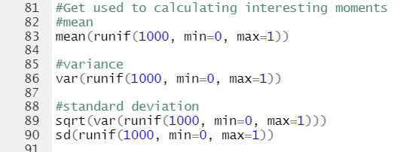
Uniform Distribution: The Most Basic Bounded Distribution
Ex: Mean and Variance

Slide 25

Uniform Distribution: The Most Basic Bounded Distribution
Ex: Mean and Variance
Moments like the Mean and Variance always depend on one or all of the parameters
Mean of a Uniform = $\frac{\min{+ max}}{2}$
Variance of a Uniform = $\frac{{\left(\max{− min}\right)}^{2}}{12}$

Slide 26
Examples of What a Uniform Distribution can Model?
Nice way to randomly select a value for something like a L2FC in an unbiased manner.
Turns out to be related to another distribution (the exponential distribution) in an interesting way

Slide 27
Beta Distribution: A Flexible Bounded Distribution
R function: rbeta(n = , shape1 = , shape2 = )
Take a minute to play around with rbeta

Slide 28
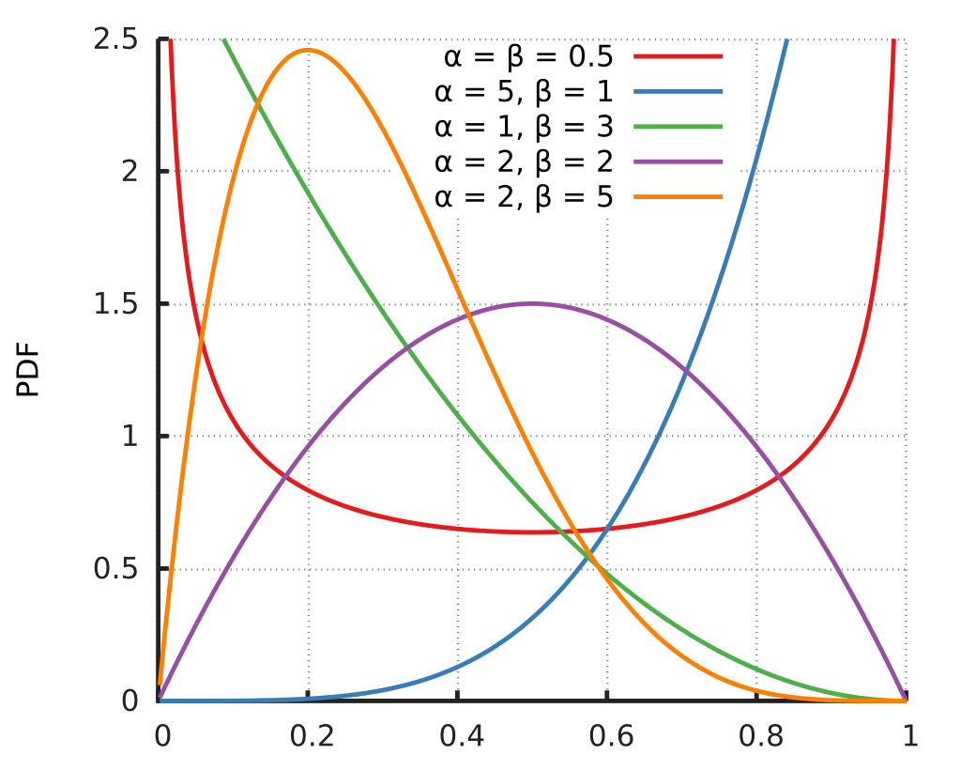
Beta Distribution: A Flexible Bounded Distribution
R function: rbeta(n = , shape1 = , shape2 = )
Here, α is shape1 and β is shape2
Properties of note:
Bounded between 0 and 1
Can get radically different shapes by altering shape1 and shape2

Slide 29
Beta Distribution: A Flexible Bounded Distribution
R function: rbeta(n = , shape1 = , shape2 = )
Here, α is shape1 and β is shape2
Note, you can mess around with this and any other random number generating function by multiplying the output and adding some value (i.e., scaling and translating)

Slide 30
What Might You Model with a Beta Distribution?
Anything TimeLapse s⁴U chemistry related
Oxidation probability
Mutation rate
Etc.

Slide 31
Gamma Distribution: A Flexible Positive Distribution
R function: rgamma(n = , shape = , rate = )
Can also specific scale = , where scale = 1/rate
Play around with the gamma distribution for a bit

Slide 32
Gamma Distribution: A Flexible Positive Distribution
Set shape = 1 and rate = whatever your heart desires
Make a density plot with n really large (like 10000)

Slide 33
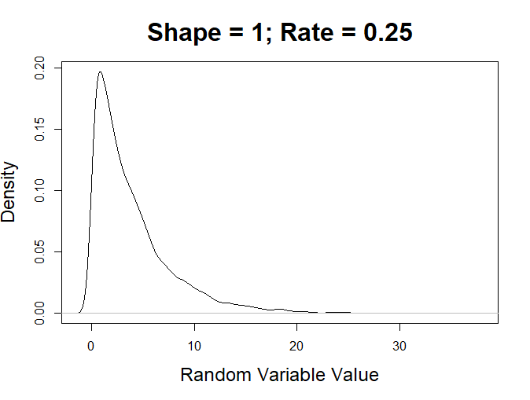
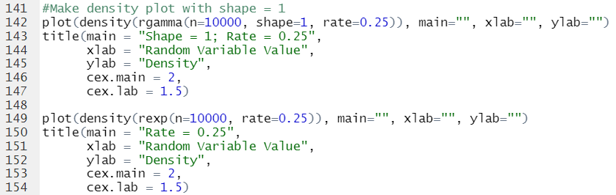
Gamma Distribution: A Flexible Positive Distribution
Set shape = 1 and rate = whatever your heart desires
Make a density plot with n really large (like 10000)

Slide 34
Gamma Distribution: A Flexible Positive Distribution
Now try another R function: rexp(n = , rate = ) with rate = whatever you used for the Gamma density. Make a similar density plot with rexp and compare

Slide 35
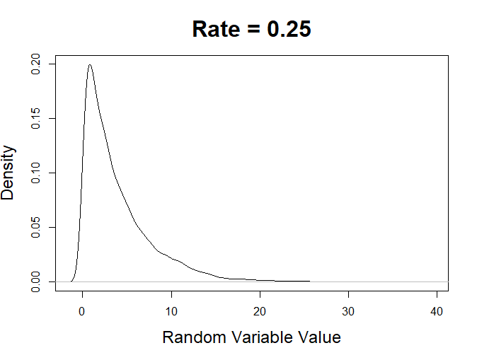
Gamma Distribution: A Flexible Positive Distribution
Now try another R function: rexp(n = , rate = ) with rate = whatever you used for the Gamma density. Make a similar density plot with rexp and compare

Slide 36
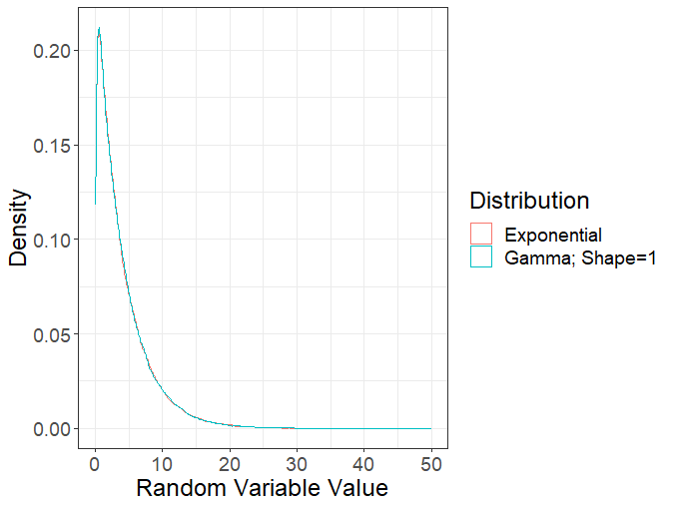
Gamma Distribution: A Flexible Positive Distribution
Now try another R function: rexp(n = , rate = ) with rate = whatever you used for the Gamma density. Make a similar density plot with rexp and compare
An exponential distribution is just a gamma distribution with shape = 1

Slide 37
But What is the Gamma Distribution Useful for Modeling?
It’s a flexible positive distribution, which means if you are just trying to randomly generate positive real numbers, this could be a great distribution to look to
Sometimes you can use the relationship between sums of exponentials and gammas to model times until reactions that have multiple rate limiting steps occur

Slide 38
Exponential Distributions Are Super Popular for Modeling Applications
If the rate at which an “event” (e.g., a reaction) occurs is constant, then the time until the next occurrence is well modeled as following an exponential distribution
This is the basis of the popular Gillespie algorithm

Slide 39
Exponential Distributions Are Super Popular for Modeling Applications
If the rate at which an “event” (e.g., a reaction) occurs is constant, then the time until the next occurrence is well modeled as following an exponential distribution
This is the basis of the popular Gillespie algorithm
To better understand how this algorithm works, we need to learn three neat properties of exponential distributions

Slide 40
Exponentials Are Memoryless
Say that the time until a reaction occurs follows an exponential distribution with rate = 0.5 min⁻¹
Simulate and store in a vector 1,000,000 reaction times using rexp

Slide 41
Exponentials Are Memoryless
Say that the time until a reaction occurs follows an exponential distribution with rate = 0.5 min⁻¹
Simulate and store in a vector 1,000,000 reaction times using rexp
Now, consider all the reaction times > 5 minutes
Now create a new vector that is the reaction times in the original vector that are greater than 5 minutes

Slide 42
Exponentials Are Memoryless
Say that the time until a reaction occurs follows an exponential distribution with rate = 0.5 min⁻¹
Simulate and store in a vector 1,000,000 reaction times using rexp
Now, consider all the reaction times > 5 minutes
Now create a new vector that is the reaction times in the original vector that are greater than 5 minutes
Calculate the percentage of “times” in the 1st vector that are greater than 3 minutes.
Compare that to the percentage of times in the 2nd vector that are greater than 8 (so 3 minutes after the cutoff) minutes

Slide 43
Exponentials Are Memoryless
Now, let’s scale it up to a whole distribution
Compare density plots of the original vector to that of the new vector minus 5 (so that the lower bound of the new vector is same as the old vector)

Slide 44
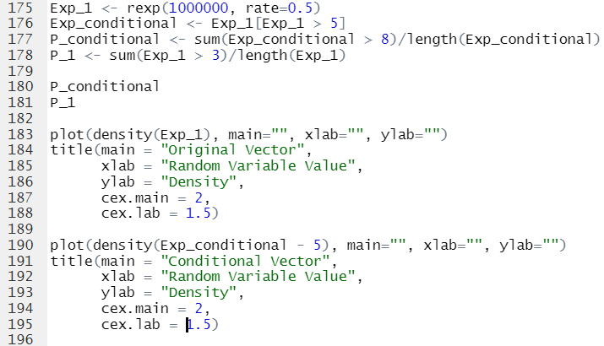
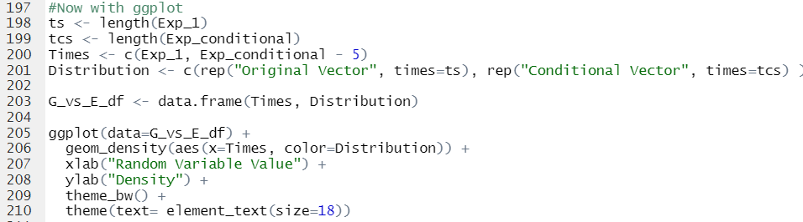
Code for 1 case and Density Plot
Using ggplot instead for density

Slide 45
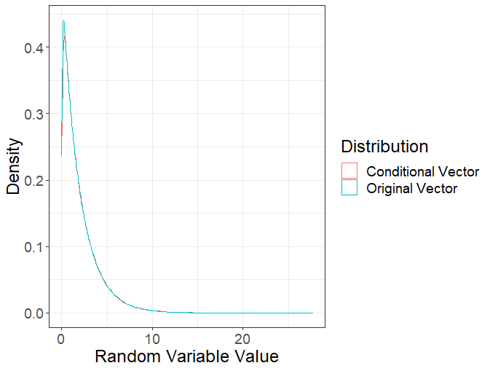
Exponentials Are Memoryless
Those are pretty similar!

Slide 46
Exponentials Are Memoryless
Memorylessness: No matter how long you have waited since the last reaction, the time you’ll have to wait until the next one is the same as when you started waiting

Slide 47
The Earliest Exponential is Still Exponential
Simulate 10 exponentials with whatever rate you please

Slide 48
The Earliest Exponential is Still Exponential
Simulate 10 exponentials with whatever rate you please
Now find the smallest of those 10 (using min function)

Slide 49
The Earliest Exponential is Still Exponential
Simulate 10 exponentials with whatever rate you please
Now find the smallest of those 10 (using min function)
Now do this a bazillion (or maybe 1,000,000) times, saving the minima in a vector (you’ll probably need a for loop)

Slide 50
The Earliest Exponential is Still Exponential
Simulate 10 exponentials with whatever rate you please
Now find the smallest of those 10 (using min function)
Now do this a bazillion (or maybe 1,000,000) times, saving the minima in a vector (you’ll probably need a for loop)
Compare the distribution of the mins to the distribution of an exponential with rate = 10*(rate you chose)

Slide 51
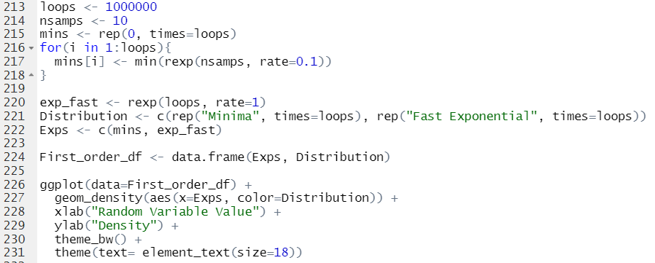
Example Code

Slide 52
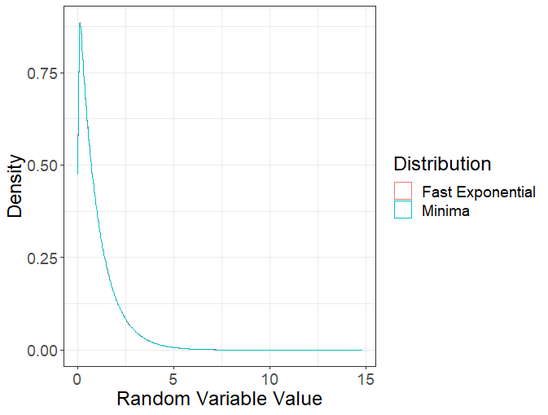
The Earliest Exponential is Still Exponential
Holy crap they’re the same again!!

Slide 53
The Earliest Exponential is Still Exponential
The distribution of the minimum of a set of exponential distributions, is itself an exponential distribution, with rate = sum or the rates of the exponentials

Slide 54
What is the Probability that a Particular Reaction is the One to Occur First?
Set two rates (call them rate1 and rate2), equal to whatever you want (they can even be equal, but this will be a bit boring)

Slide 55
What is the Probability that a Particular Reaction is the One to Occur First?
Set two rates (call them rate1 and rate2), equal to whatever you want (they can even be equal, but this will be a bit boring)
In a loop, generate an exponential random number using these two rates, and see which one is smaller

Slide 56
What is the Probability that a Particular Reaction is the One to Occur First?
Set two rates (call them rate1 and rate2), equal to whatever you want (they can even be equal, but this will be a bit boring)
In a loop, generate an exponential random number using these two rates, and see which one is smaller
Save the index of the smaller random number (so 1 if the exponential with rate 1 won, and 2 if it was the exponential with rate 2)

Slide 57
What is the Probability that a Particular Reaction is the One to Occur First?
Set two rates (call them rate1 and rate2), equal to whatever you want (they can even be equal, but this will be a bit boring)
In a loop, generate an exponential random number using these two rates, and see which one is smaller
Save the index of the smaller random number (so 1 if the exponential with rate 1 won, and 2 if it was the exponential with rate 2)
Compare the win percentage of rate1 to rate1/(rate1 + rate2)

Slide 58
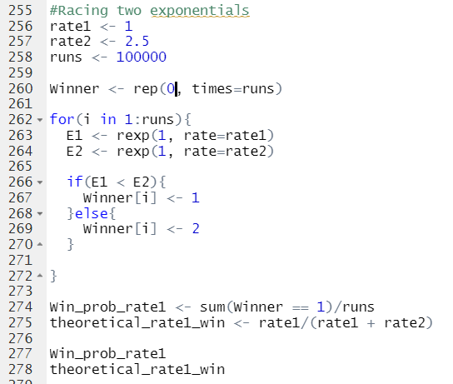
What is the Probability that a Particular Reaction is the One to Occur First?

Slide 59
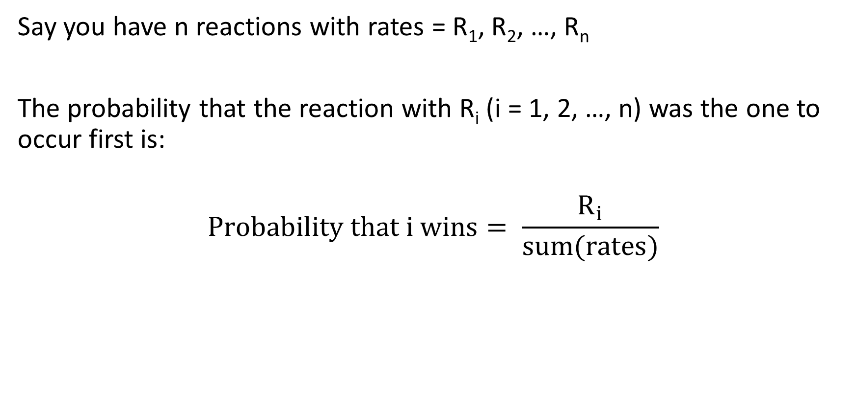
What is the Probability that a Particular Reaction is the One to Occur First?
Say you have n reactions with rates = R₁, R₂, …, R_{n}
The probability that the reaction with R_{i} (i = 1, 2, …, n) was the one to occur first is:
$$Probability that i wins= \frac{R_{i}}{sum(rates)}$$

Slide 60
How Does All of This Help Us Simulate Chemical Reactions?
The memoryless property means we just need to simulate the time until the first of a set of reactions occurs, then everything resets and we can update rates accordingly

Slide 61
How Does All of This Help Us Simulate Chemical Reactions?
The memoryless property means we just need to simulate the time until the first of a set of reactions occurs, then everything resets and we can update rates accordingly
We also know that the time until the first reaction occurs follows an exponential distribution (if we are modeling the individual reaction times using exponential distributions)

Slide 62
How Does All of This Help Us Simulate Chemical Reactions?
The memoryless property means we just need to simulate the time until the first of a set of reactions occurs, then everything resets and we can update rates accordingly
We also know that the time until the first reaction occurs follows an exponential distribution (if we are modeling the individual reaction times using exponential distributions)
Each time a reaction occurs, we can select which occurs by randomly choosing one of the possible reactions with probability discussed in the last activity

Slide 63
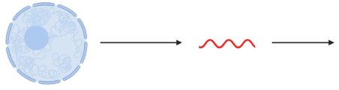

Gillespie Algorithm
We will simulate RNA and synthesis degradation in a single cell
ksyn
kdeg

Slide 64
Gillespie Algorithm
Step 1: Set the necessary parameters and initialize any vectors

Slide 65
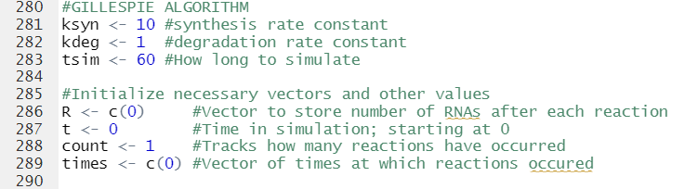
Gillespie Algorithm
Step 1: Set the necessary parameters and initialize any vectors

Slide 66
Gillespie Algorithm
Step 2: Simulate synthesis/degradation reactions until time is up

Slide 67
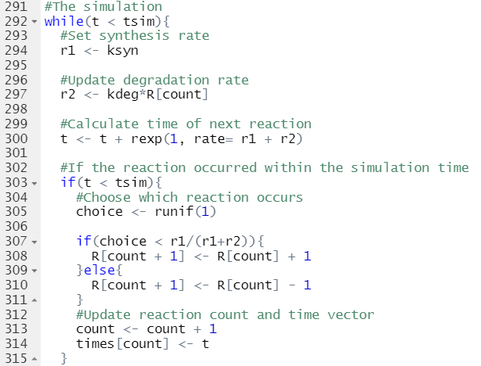
Gillespie Algorithm
Step 2: Simulate synthesis/degradation reactions until time is up

Slide 68
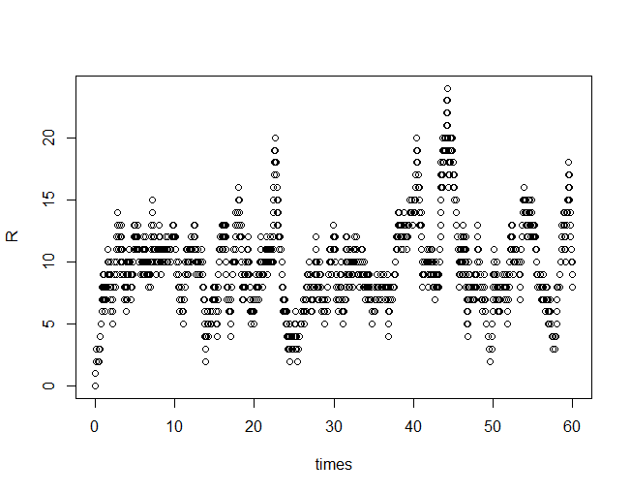
Plotting Number of RNA Over Time
Ksyn = 10
Kdeg = 1
Steady-state = 10; see how it kind of jumps around 10 at later times?
Number of RNA
Time

Slide 69
Normal Distribution: All Distributions Lead Here
Ever heard of the Central Limit Theorem? What does it really say?

Slide 70
Normal Distribution: All Distributions Lead Here
Choose one of the distributions we have talked about so far (or any of your liking, as long as it isn’t a Cauchy, or a Normal. Cauchy’s don’t work and Normals are boring)

Slide 71
Normal Distribution: All Distributions Lead Here
Choose one of the distributions we have talked about so far (or any of your liking, as long as it isn’t a Cauchy, or a Normal. Cauchy’s don’t work and Normals are boring)
Now simulate 1000 random numbers from that distribution and add them all up (or take their average, either will work)
So use sum or mean function in R

Slide 72
Normal Distribution: All Distributions Lead Here
Choose one of the distributions we have talked about so far (or any of your liking, as long as it isn’t a Cauchy, or a Normal. Cauchy’s don’t work and Normals are boring)
Now simulate 1000 random numbers from that distribution and add them all up (or take their average, either will work)
So use sum or mean function in R
Put it all in a loop (with 1,000,000 iterations) and store the sums or averages in a vector

Slide 73
Normal Distribution: All Distributions Lead Here
Choose one of the distributions we have talked about so far (or any of your liking, as long as it isn’t a Cauchy, or a Normal. Cauchy’s don’t work and Normals are boring)
Now simulate 1000 random numbers from that distribution and add them all up (or take their average, either will work)
Put it all in a loop (with 1,000,000 iterations) and store the sums or averages in a vector
Look at the density of the vector of sums or averages

Slide 74
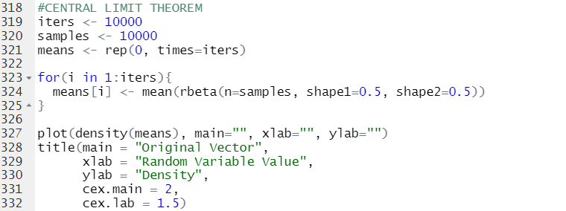
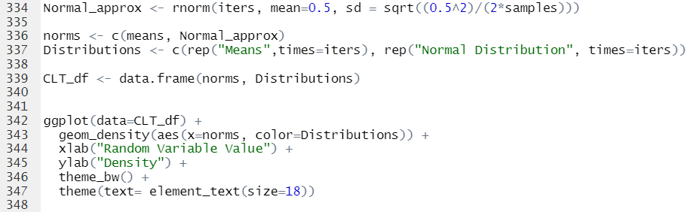
Plot to get Density
Comparing to Approximate Normal Distribution

Slide 75
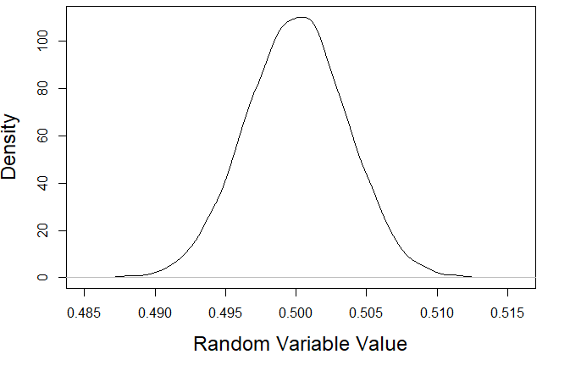
I Guarantee This is (Qualitatively) What it Looks Like

Slide 76
I Guarantee This is (Qualitatively) What it Looks Like
The CLT predicts the mean and variance of this distribution
Mean if Average = Mean of Random Variable
Mean if Sum = n*(Mean of Random Variable)
n = number of samples from the distribution used to calculate sum
Variance if Average = (Variance of Random Variable)/n
Variance if Sum = n*(Variance of Random Variable)

Slide 77
Plot to get Density
Comparing to Approximate Normal Distribution

Slide 78
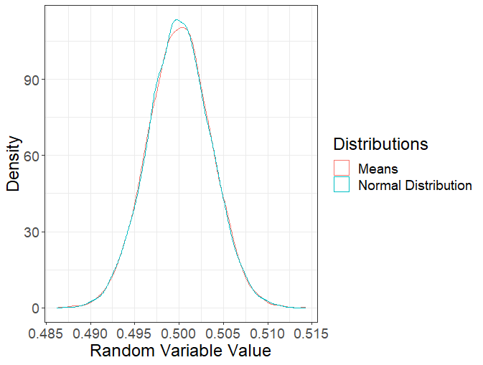
I Guarantee This is (Qualitatively) What it Looks Like
Here’s a plot showing the density of the means and that predicted by the CLT; Pretty good match!

Slide 79
Discrete Distributions
For discrete random variables, often there is a cute picture that can be used to explain where its affiliated probability distribution comes from
This often makes it easier to understand how these distributions can be used to model data

Slide 80
Binomial Distribution
The Model: If a given event (e.g., a U in a read) has two possible outcomes (e.g., U mutated or not mutated) and there are n such events (e.g., the number of Us in the read), then the number of “successes” follows a binomial distribution
R function: rbinom(n = , size = , prob = )
size is the number of events (n in description above)
prob is the probability of “success”

Slide 81
Play Around Trying to Do A Quick TimeLapse Simulation
Set the read length, number of reads, and mutation probabilities
Randomly generate number of Us in each read, and then randomly generate the number of mutations among the Us
Have fun

Slide 82
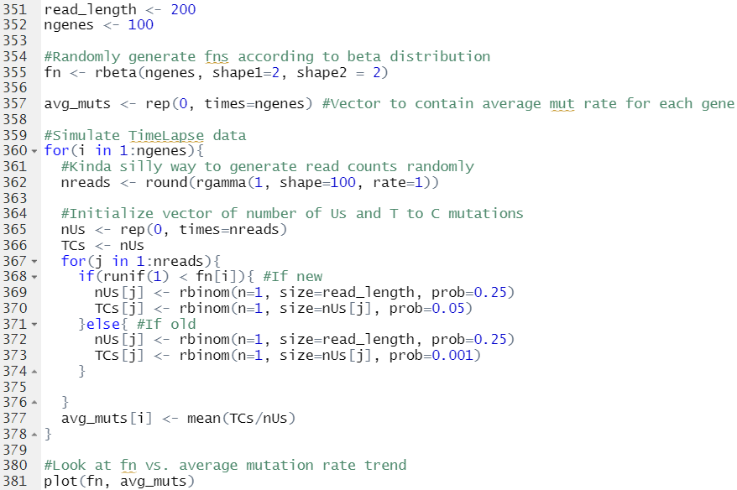
Play Around Trying to Do A Quick TimeLapse Simulation
Some things I did:
1) Simulated fns according to beta
2) Simulated reads according to rounded gamma
3) Looked at fn vs. average mutation rate trend

Slide 83
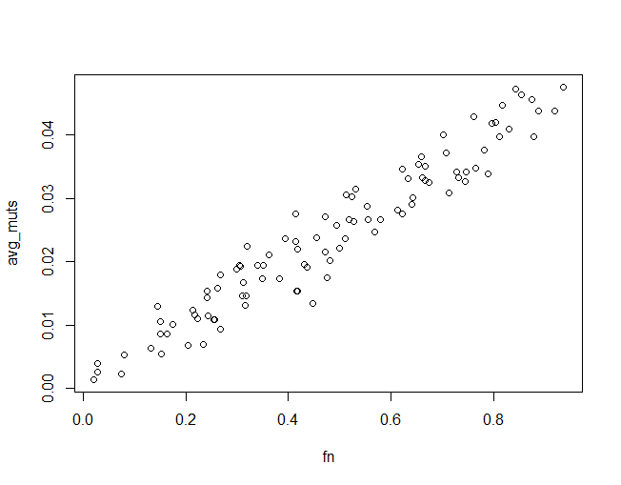
Play Around Trying to Do A Quick TimeLapse Simulation
Average Mutation Rate
True Fn

Slide 84
Poisson Distribution
The Model: Assume that events occur at a constant rate, that the events are independent, and that there is some time scale on which no more than 1 event can occur. The number of events in a given amount of time follows a Poisson distribution
R function: rpois(n = , lambda = )

Slide 85
Poisson Distributions Are Just Approximate Binomials
Compare a Poisson with any lambda you desire to a binomial with size*prob = lambda of the Poisson, size large (say greater than 50) and prob small (say less than 0.5)

Slide 86
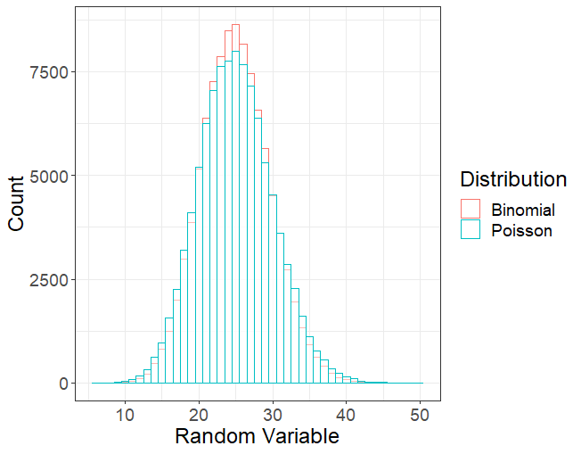
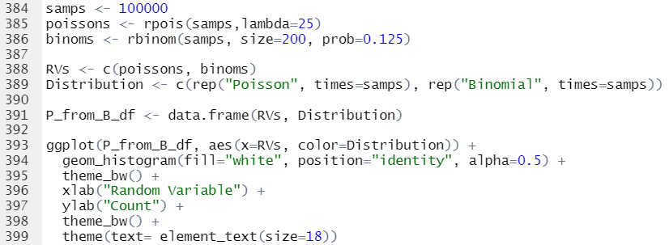
Code and Plot

Slide 87
Poisson Distributions Are Also Related to Exponential Distributions
Copy and paste your Gillespie code; but set kdeg = 0
So just tracking the number of RNAs synthesized
Set time to simulate for to whatever you desire (e.g., 60)
Store the total number of RNA at the end of the simulation in a vector, and repeat the simulation, resetting the timer to 0
Should be Poisson distributed with lambda = ksyn*(time you simulated for)

Slide 88
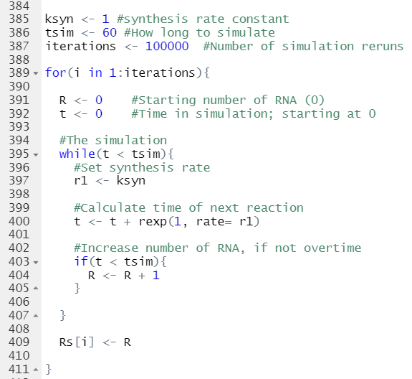
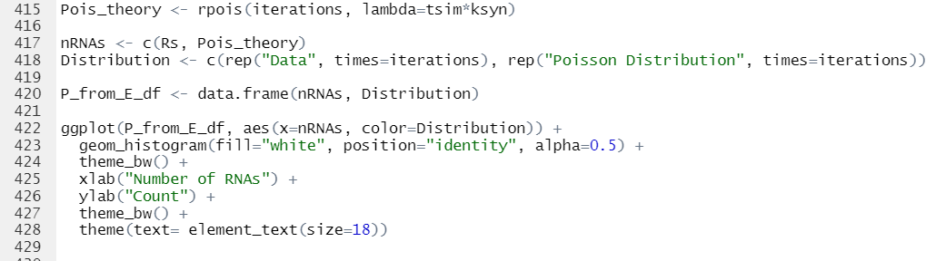
Poisson Distributions Are Also Related to Exponential Distributions
Plotting code:

Slide 89
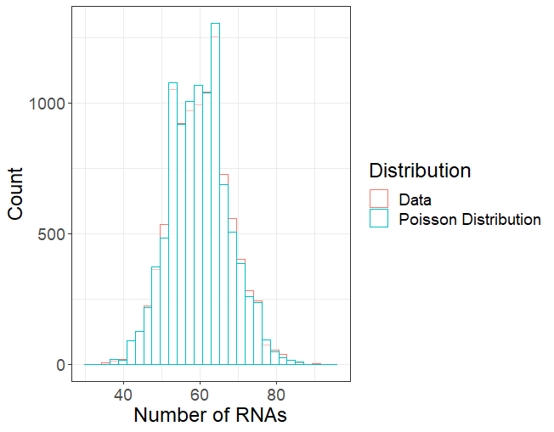
Poisson Distributions Are Also Related to Exponential Distributions

Slide 90
Negative Binomial
The Model: Assume that the number of events follows a Poisson distribution, but that there is some variability in the rate of the Poisson.
If the variability in the rate can be modeled as a Gamma distribution, then the number of events follows a negative binomial
R function: rnbinom(n =, size = , mu = )
size determines the variability of the negative binomial
mu is the mean

Slide 91
Negative Binomial
This is one of the go-to distributions for modeling RNA-seq read counts, so play around with it and get a since of what size does
R function: rnbinom(n =, size = , mu = )
size determines the variability of the negative binomial
mu is the mean

Slide 92
Bonus Feature: Bootstrapping
Goal: Estimate uncertainties when you are working with a method that only provides point estimates
Strategy: Assume the point estimate you get is the true answer, simulate data using the point estimate, recalculate a point estimate, and repeat. Standard deviation of recalculated point estimates can be used as an uncertainty quantification

Slide 93
Example: Efficient Fn Estimation
Try simulating TimeLapse data and estimating the fn with the Slavoff paper strategy:
Set a mutation rate cutoff (e.g., 0.035)
All reads with (number of TC mutations)/(number of Us) greater than or equal to the cutoff are called new. Everything else called old
Fn Estimate = (number of new reads)/(total number of reads)

Slide 94
Example: Efficient Fn Estimation
Try simulating TimeLapse data and estimating the fn with the Slavoff paper strategy:
Set a mutation rate cutoff (e.g., 0.035)
All reads with (number of TC mutations)/(number of Us) greater than or equal to the cutoff are called new. Everything else called old
Fn Estimate = (number of new reads)/(total number of reads)
Then use fn estimate and average mutation rate to simulate more TimeLapse data (for the same number of reads) and repeat the analysis, getting a vector of fn estimates
Can get uncertainty from standard deviation of fn estimates

Slide 95
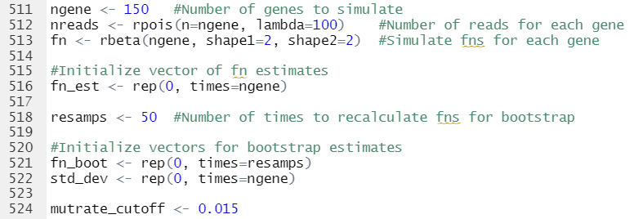
Example: Efficient Fn Estimation
Initialize needed vectors and variables at the top

Slide 96
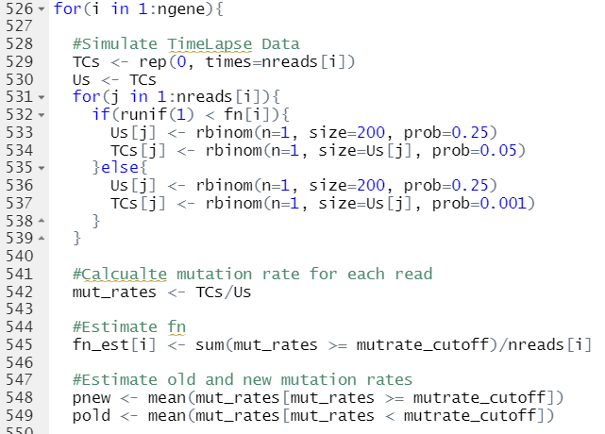
Example: Efficient Fn Estimation
Simulate TimeLapse data
Estimate Fn

Slide 97
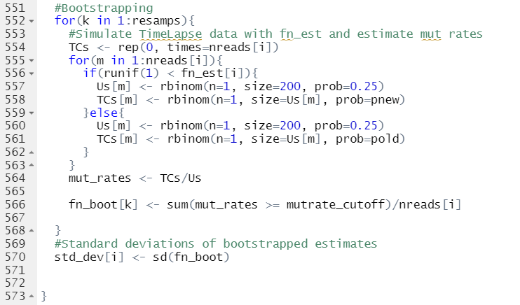
Example: Efficient Fn Estimation
Bootstrap:
Simulate TimeLapse data
Estimate fn
Repeat

Slide 98
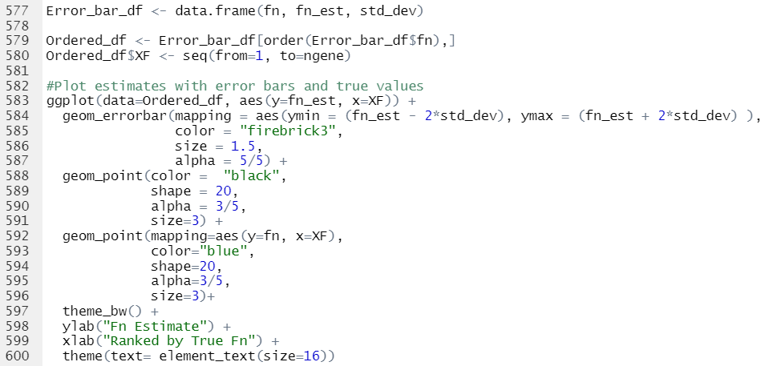
Example: Efficient Fn Estimation
Plot with uncertainties

Slide 99
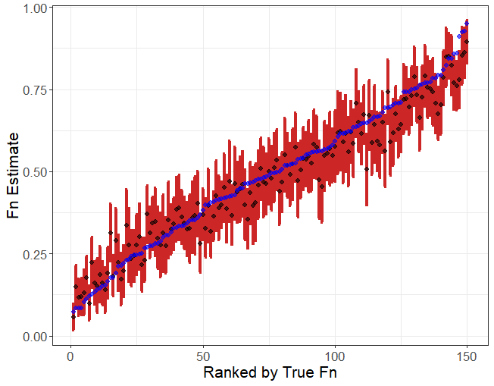
Example: Efficient Fn Estimation
Plot with uncertainties = 2*sd
Mutation rate cutoff = 0.015

