Slide 1
Running nf-core pipelines
Another IWV production

Slide 2
Step 0: Cluster Setup
Set environment variables (where dependencies will be downloaded to)
NXF_SINGULARITY_CACHEDIR
NXF_APPTAINER_CACHEDIR
NXF_CONDA_CACHEDIR
Create conda environment
`salloc –c 4`
`module load miniconda`
`conda config --add channels bioconda`
`conda config --add channels conda-forge`
`conda create -c conda-forge -c bioconda –name nfcore python=3.12 nf-core nextflow`

Slide 3
Step 1: Download pipeline
Good idea to pre-download pipelines you would like to use
Technically can be skipped, but due to fact that singularity images need to be downloaded, skipping this can be disastrous
Syntax looks like:
`nf-core download <pipeline name> -r <version> --outdir <directory name> -s singularity`
Example for rnaseq pipeline:
`nf-core download rnaseq -r 3.15.0 --outdir nf_rnaseq -s singularity`
Available pipelines can be found here: https://nf-co.re/pipelines
Go to a pipeline’s documentation to find it’s current version #

Slide 4

Step 1 tips
Not all pipelines are created equal
Some have fallen into disrepair
Some are still actively being developed
Things to check to determine if a pipeline can be trusted:
Stars (more is better; kind of like using h-index to judge PIs, but it’s an easy start)
Time since last release (more recent is better)
Whether it is development version
# of unanswered Issues / # of open Issues / # of closed Issues
Sus
Not a lot of stores, 4 years since last release

Slide 5

Step 1 tips
Not all pipelines are created equal
Some have fallen into disrepair
Some are still actively being developed
Things to check to determine if a pipeline can be trusted:
Stars (more is better; kind of like using h-index to judge PIs, but it’s an easy start)
Time since last release (more recent is better)
Whether it is development version
# of unanswered Issues / # of open Issues / # of closed Issues
Sus
Under development (yellow wrench), long time since last release

Slide 6

Step 1 tips
Not all pipelines are created equal
Some have fallen into disrepair
Some are still actively being developed
Things to check to determine if a pipeline can be trusted:
Stars (more is better; kind of like using h-index to judge PIs, but it’s an easy start)
Time since last release (more recent is better)
Whether it is development version
# of unanswered Issues / # of open Issues / # of closed Issues
Top-tier
Lots of stars, actively releasing new versions

Slide 7
Step 2: Download configuration files
yale_profile once again has files to help you configure nf-core pipelines
`git clone https://github.com/isaacvock/yale_profile.git`
Files of interest in this case are:
nextflow.config
run_nfcore.sh
Copy these into your working directory

Slide 8
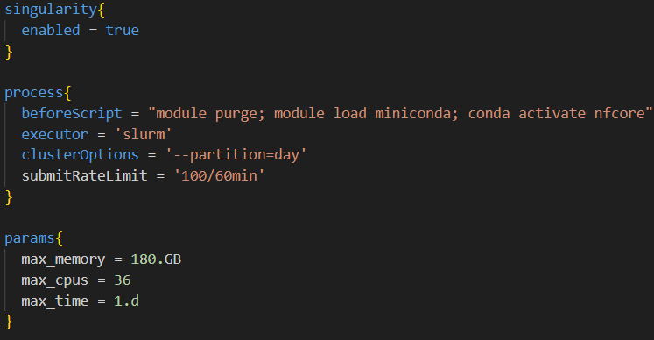
Step 2 tips
This tells nextflow to use Singularity
Other popular option is Docker, but Docker cannot be used on the cluster

Slide 9
Step 2 tips
beforeScript is code run before launching the job; activates the environment we have nextflow installed in
executor tells Nextflow to use SLURM
clusterOptions are options you would specify at top of a batch script
submitRateLimit is what Yale wants it to be

Slide 10
Step 2 tips
These are parameters specific to a given pipeline.
The params specify here are parameters present in all nf-core pipelines, which tell them the maximum amount of memory, CPUs, and job time they can request

Slide 11
Step 2 tips
See pipeline docs for other parameters you can specify; e.g., for rnaseq: https://nf-co.re/rnaseq/3.15.0/parameters/
See Nextflow docs for details about configuration: https://www.nextflow.io/docs/latest/config.html

Slide 12
Step 3: Create samplesheet
Always a csv file; column names differ for different pipelines
Check out documentation for a particular pipeline’s details
For example, rnaseq’s docs: https://nf-co.re/rnaseq/3.15.0
For rnaseq, the columns are:
sample (ID to give to a given sample)
fastq_1 (Path to first fastq file)
fastq_2 (Path to second fastq file if paired end; blank string “” otherwise)
strandedness (forward, reverse, or auto)

Slide 13
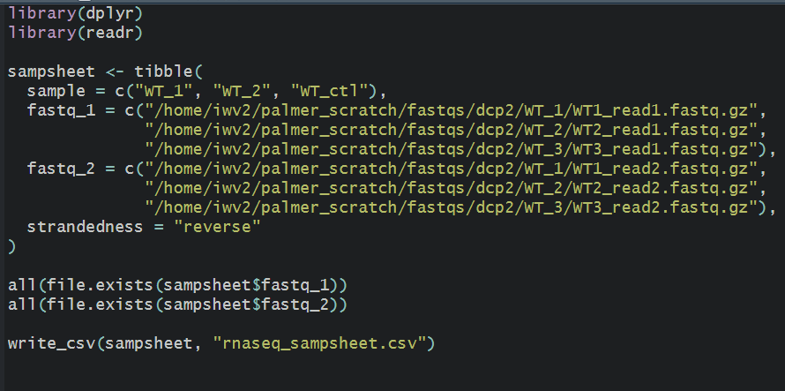
Step 3 tips
I like to do this step in R like a nerd:
2nd and 3rd to last lines allow me to check if I specified all paths correctly

Slide 14
Step 4: Test run
Run test profile to make sure pipeline will work for you
`nextflow run 3_15_0/ -profile test,singularity --outdir results`

Slide 15
Step 5: Run pipeline
`sbatch run_nfcore.sh`

Slide 16
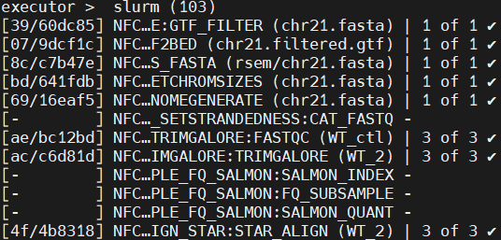
Tip #1: Finding log files
Nextflow uses a convoluted hashing system to give each job a unique alphanumeric ID
This is part of the run’s ID
There will be a directory called “work” created by Nextflow. Navigate to it with `cd work`

Slide 17
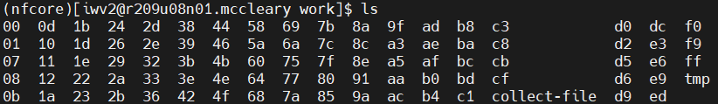
Tip #1: Finding log files
In work, you will find a bunch of directories with short alphanumeric names
We are looking for the folder called 39, as it is the first part of our ID
`cd` into it

Slide 18
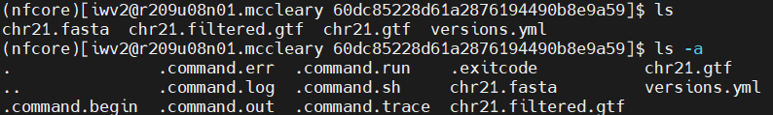
Tip #1: Finding log files
Now you will see temp files copied (or symlinked) to this location during the running of the step
More importantly though, there are a number of “hidden” files, which represent this step’s log files and potential error messages (view these with `ls –a`)
.command.err = any error messages
.command.log = log file
.command.out = probably standard out?
Not really sure what the others are

Slide 19
Tip #2: Resuming failed jobs
If a step fails, fix the problem, and then rerun the pipeline, adding `-resume` to your call to `nextflow run` (e.g., `nextflow run 3_15_0/ -resume …`)
If you don’t add `-resume`, the pipeline will start from the beginning
Sometimes this won’t work as expected, in which case you will have to read some of the troubleshooting documentation that has been written:
https://www.nextflow.io/blog/2019/demystifying-nextflow-resume.html
https://www.nextflow.io/blog/2019/troubleshooting-nextflow-resume.html
https://training.nextflow.io/basic_training/cache_and_resume/

