Slide 1
Running fastqEZbakR (and Snakemake pipelines more generally)
An IWV production

Slide 2
Step 0: Cluster setup
Add environment variable
SNAKEMAKE_CONDA_PREFIX = /home/<netid>/project/snakemake_envs
Create snakemake_envs directory at that location
Add to .bashrc; then run source .bashrc to update current session
Will update automatically thereafter
Create conda environment with Snakemake and snakedeploy installed
`salloc –c 4`
`module load miniconda`
`conda create -c conda-forge -c bioconda ‘snakemake<8.0.0’ snakedeploy –name deploy_snakemake`

Slide 3
Step 0 Notes
Environment variable makes sure that conda environments are created in project directory, where they won’t be deleted randomly
Current version of miniconda on cluster doesn’t have mamba
Still has benefits of mamba (fast) due to implementing libmamba solver
Will create problem with Snakemake if you don’t tell Snakemake that mamba isn’t explicitly installed

Slide 4
Step 1: Deploy workflow
Create directory to deploy pipeline to (only need to do this once per pipeline) in scatch60
`cd scratch60`
`mkdir fastq2EZbakR`
`conda activate deploy_snakemake`
`snakedeploy deploy-workflow https://github.com/isaacvock/fastq2EZbakR.git . --branch main`
You will now have two folders in this directory, config/ and workflow/

Slide 5
Step 1 Notes
Not particularly compute intensive, so this step could be done from the login node; best to just hop on an interactive node though
Walking through the main code: `snakedeploy deploy-workflow https://github.com/isaacvock/fastq2EZbakR.git . --branch main`
Link is to the fastq2EZbakR Github website
`.` tells it to deploy the workflow to the current directory
`--branch main` tells it to set it up to use the main branch of the Github
Nothing fancy happens at this step; two files are just copied to your current directory; no dependencies get installed or anything like that

Slide 6
Step 2: Download data
You can get example dataset with git:
`git clone https://github.com/isaacvock/example_nrseq_data.git`
If you already have directories named fastqs, annotations, genomes, or example_configs, then you would need to change those directory names before doing this
I like to have a data/ directory that I store all data in
`mkdir data` if it doesn’t already exist
Move each directory that got downloaded with `mv <directory name> data/`
Or you can move contents of this example data into folders of the same name if they already exist

Slide 7
Step 3: Download Snakemake profile
Make sure you are at the top of your pipeline directory
This means the directory that contains the directories named “data”, “config”, and “workflow” at this point
You can check directory content at any time by running `ls`
Clone profile repo
`git clone https://github.com/isaacvock/yale_profile.git`
Should now have a directory called yale_profile
Move run_slurm.sh file in that directory to the top directory:
`mv yale_profile/run_slurm.sh ./`

Slide 8
Step 3 notes
yale_profile directory has the following contents:
run_slurm.sh (before you moved it): Script you can call to run the pipeline
config.yaml: Species the resources requested by the pipeline
status-sacct-robust.sh: Script for checking job status
This very occasionally causes some problems where the cluster will say something like “wasn’t able to find job ID” and the job will crash
Just restart the pipeline and it should resolve itself
README: Just some documentation that is better read on Github (at this link: https://github.com/isaacvock/yale_profile )

Slide 9
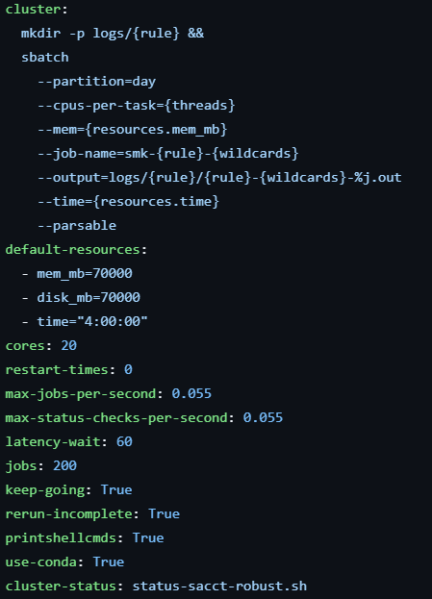
Step 3 notes
config.yaml looks like this:

Slide 10
This portion species the bash code that gets run with each step of the pipeline
Important details:
This is where the partition you request jobs on gets set
{threads} is related to cores: below
Number of CPUs that will get requested
Will either be equal to cores, or the max set by a particular rule
{resources.mem_mb}: resources in Snakemake are arbitrary named things that can be passed to rules to define cetain behaviors
Because this gets passed to --mem, will specify RAM requested by all rules
{resources.time} gets passed to --time and thus specifies the job time requested

Slide 11
This portion specifies the default RAM and job time requested
70 GB of RAM is default set here; 4 hours is default for the amount of job time
You will be able to specify rule-specific RAM and time requirements when necessary, in run_slurm.sh, discussed in later slide

Slide 12
This portion specifies any command Snakemake command line parameters you would like to set.
The full list of parameter options is here: https://snakemake.readthedocs.io/en/stable/executing/cli.html

Slide 13
Parameters you may want to change in some cases:
cores: maximum number of CPUs to request
Must be <= 64 on day partition, but should probably be <= 32
Not all steps can use multiple cores, but these will only request 1 CPU regardless of what you set here
Some steps that are parallelized see no benefit of going above a certain number of CPUs. These will request the highest useful number of CPUs, or whatever you set here if this value is higher than cores
keep-going: If one job fails, should you still try to run steps that don’t need the output of the failed step(s)
This portion specifies any command Snakemake command line parameters you would like to set.
The full list of parameter options is here: https://snakemake.readthedocs.io/en/stable/executing/cli.html

Slide 14
Step 4: Edit run_slurm.sh
Copy it into your working directory:
`cp yale_profile/run_slurm.sh .`
Technically you only need to change:
job-name
mail-user
Sometimes you will need to change
time, if you expect pipeline will take much shorter or longer than 12 hours
Shorter less important, though will save us a couple nickels if you decrease time
Call to snakemake
Can add resource requirements for particular rules as necessary

Slide 15
Step 5: Dry run to make sure things are alright
`snakemake -n --use-conda --conda-frontend conda --rerun-triggers mtime`
-n is what specifies that this is a “dry run”
Will just make sure that pipeline could be run if you so pleased
Will also print out the list of rules that will be run
All the extra code just covers annoying externalities
--use-conda needs to be specified with the environment variable from step 0 set
--conda-frontend tells Snakemake that mamba isn’t installed on this miniconda module
--rerun-triggers mtime is something you need to include when you run the pipeline, and thus it is good to check that setting it yields the desired output

Slide 16
Step 6: Run pipeline
`sbatch run_slurm.sh`

Slide 17
Clean up
Save results, logs, and config file to Team Drive/Microsoft Sharepoint
Some of the results files may be extraneous and can be deleted before transfer
I’ve tried to trim down the set of files created though, so it’s a relatively minimal set

Slide 18
The code
salloc -c 4
module load miniconda
conda create -c conda-forge -c bioconda --name deploy_snakemake 'snakemake<8.0.0' snakedeploy
mkdir fastq2EZbakR
cd fastq2EZbakR
snakedeploy deploy-workflow https://github.com/isaacvock/fastq2EZbakR.git . --branch main
git clone https://github.com/isaacvock/example_nrseq_data.git
git clone https://github.com/isaacvock/yale_profile.git
cp yale_profile/run_slurm.sh .
snakemake -n --use-conda --conda-frontend conda --rerun-triggers mtime
sbatch run_slurm.sh
Step 0:
Step 1:
Step 2:
Step 3:
Step 4:
Step 5:
Step 6:

Slide 19
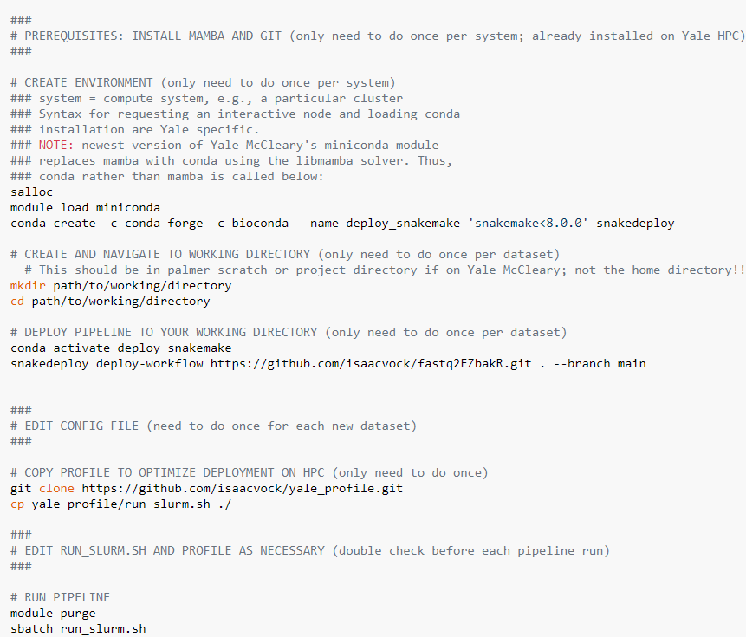
From the docs
Documentation link:
https://fastq2ezbakr.readthedocs.io/en/latest/slurm/

Slide 20
Tips #1: log files
When things go wrong, check the relevant log files
Located in logs/<rule name>/<run name>.log
E.g., if the maketdf rule fails for one sample named WT_1 (step where tracks get made), go to “logs/maketdf/WT_1.log”
In that folder, there will also be a .out file, which tells you the code that was run and may include some useful error messages in rare cases
Read the error messages carefully, see if you can figure out what went wrong, and if not, send me the log file as well as your pipeline config file

Slide 21
Tips #2: Requesting rule-specific resources
Each step in Snakemake pipeline is called a rule
Amount of RAM requested for each rule is set in yale_profile/config.yaml
Sometimes, certain rules need a lot more RAM than others
Could increase RAM requested for all steps, but this is wasteful
Can instead edit run_slurm to request rule-specific resources with --set-resources argument:
snakemake --profile yale_profile/ --rerun-triggers mtime --set-resources index:mem_mb=180000 align:time=12:00:00

