Slide 1
PIMID: A Full-System Simulator for Processing-in-Memory with Intricacy and Diversity
Yuan He¹, Masaaki Kondo¹, Galen M. Shipman²,
Jered B. Dominguez-Trujillo², and Kazi Asifuzzaman³
¹R-CCS, ²LANL, ³ORNL

Slide 2
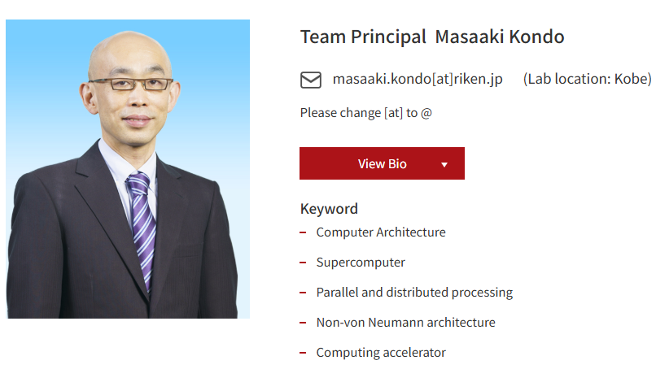
Next Generation High Performance Architecture Research Team RIKEN Center for Computational Science
FugakuNEXT

Slide 3
Outline
Introduction and motivation
Challenges in current PIM research tools
PIMID: our solution
Key features of PIMID
Comparison with existing Tools
Conclusions and future considerations

Slide 4
The Memory Wall Challenge
Growing Computational Demands
Conventional memory systems struggle to keep pace
Data movement costs dominate energy consumption
Need innovative approaches to reduce data movement
Processing-in-Memory (PIM) promises to
Integrate computation closer to the memory system
Reduce data movement between processor and memory
Improve performance and energy efficiency
But current PIM research tools have significant limitations...

Slide 5
Challenges in Current PIM Research Tools
Scope Limitations
Mostly device-centric
Limited full-system perspective
Technology Support
Mostly DRAM-centric
Missing SRAM, STT-MRAM, and other emerging memory technologies
Limited flexibility in architectural modeling
Assuming naive PE placements and addressing
Lacking network models for in-memory communication
Missing proper programming model support
Missing power models for compute parts

Slide 6

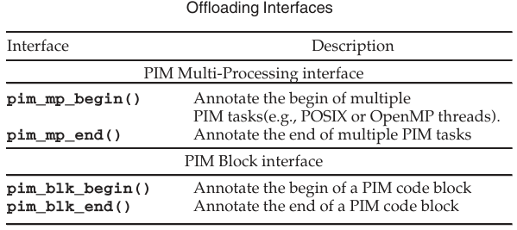
Our Solution => PIMID*
CPU
A comprehensive full-system PIM simulator built on proven foundations
Extended from MultiPIM
https://github.com/Systems-ShiftLab/MultiPIM
MultiPIM itself is already a somehow mature simulator allowing architectural exploration on PIM
We exetended it with new capabilities
Key features to add
Co-simulation of host and PIM devices
Multiple memory technologies support
Finer-grained configurability
Network model within the memory system
Power Model for compute
*PIMID = Processing-in-Memory with Intricacy and Diversity
MC

Slide 7
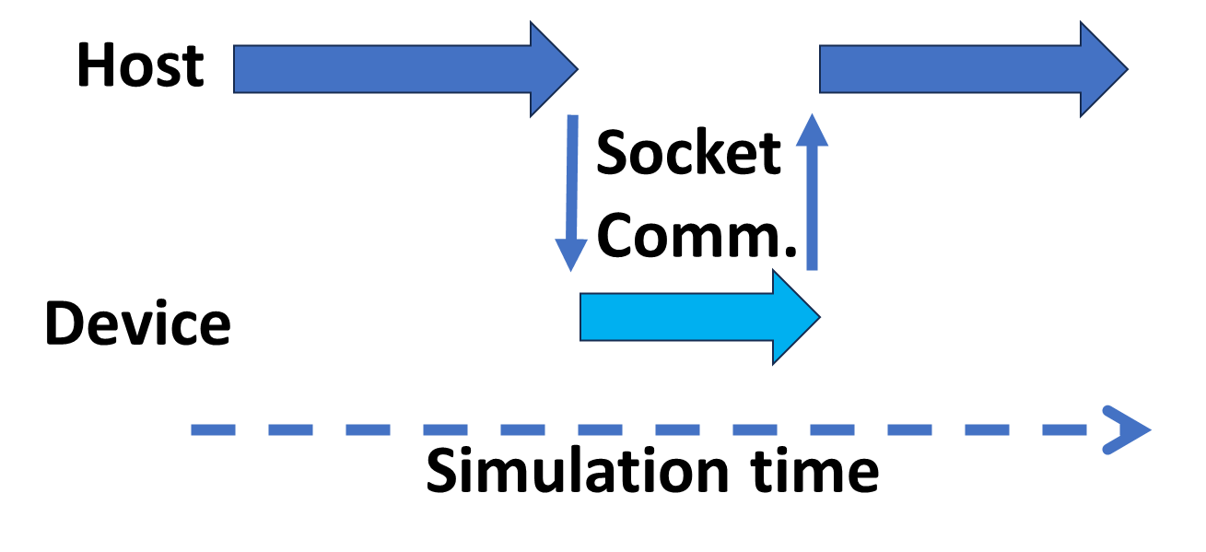
Key Feature 1: Host-Device Co-Simulation
Two MultiPIM processes co-simulate at the same time
They communicate through sockets to mimic interactions between host and devices
This enables one run to collect simulation results of the entire system

Slide 8
Key Feature 2: Multiple Memory Technologies
Current MultiPIM supports DRAM (DDR/HBM) through two extra tools
Timing from Ramulator
Power from DRAMPower
PIMID has added timing/power support for
SRAM through CACTI
STT-RAM from NVSIM
An interesting outcome after this would be to allow users to have simulated systems having devices from multiple memory technologies

Slide 9
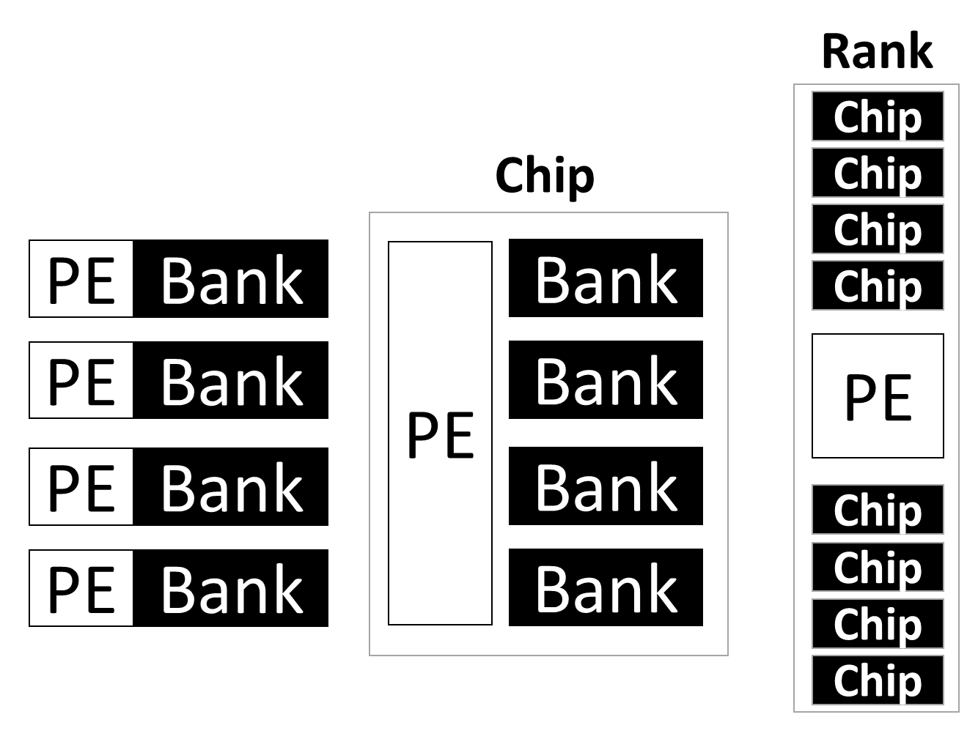
Key Feature 3: Fine-Grained PE Placements
PEs in MultiPIM are assumed to have a unified memory address space with the host so PEs can only be seen as rank-level components
Communication between PEs could only happen through the host memory controller
By allowing the placements of PEs inside memory chips and banks, we need to have Discrete addressing for subarray-/bank-/chip-wide PEs

Slide 10
Key Feature 4: Multiple Programming Model Support
Programming model support for multi-processing workloads in MultiPIM is shared memory
Workloads can be written/compiled with OpenMP and run in MultiPIM
This is OK if PEs are placed in ranks, a directory can be placed in the host MC to guarantee cache coherence between PEs
However, this is not reasonable if PEs are allowed to be placed near the banks or inside the chips => a lot of coherence traffic is about to cross the host MC
So we added message passing as another option
Workloads can be written/compiled through MPI with PIMID
Explicit message exchange happens between the PEs
=> A more realistic option here would be to have
Memory sharing up to chip scale
OpenMP-based workloads works if offloaded to PEs in the same chip
Message passing between PEs communicating beyond memory chips

Slide 11
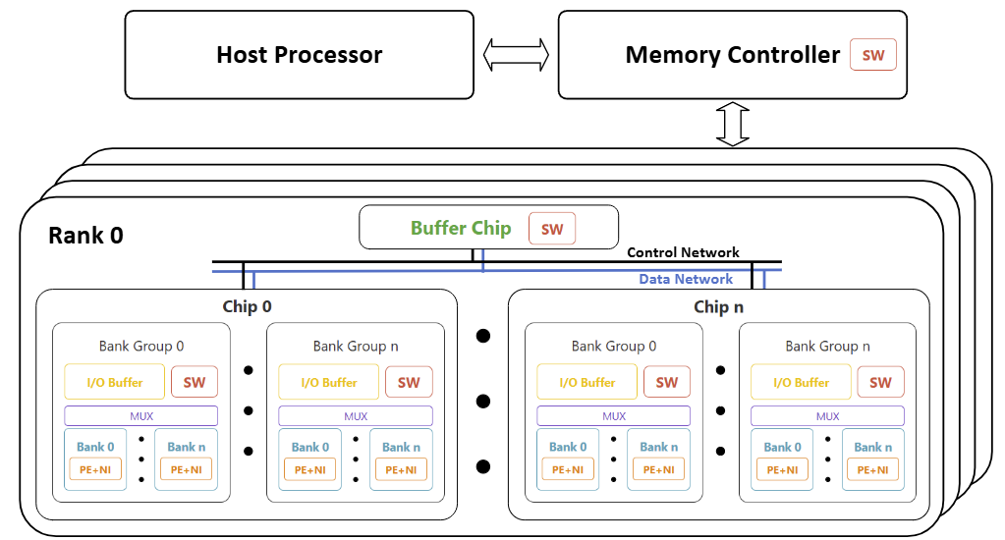
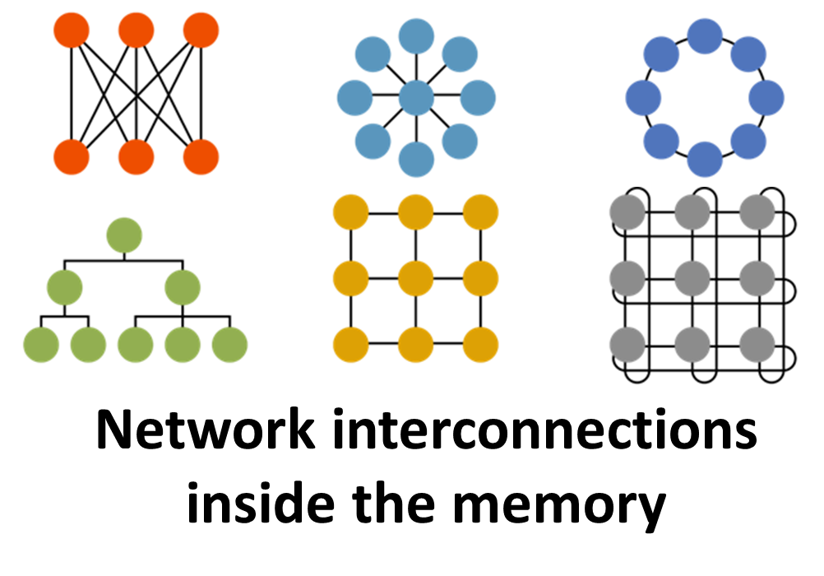
Key Feature 5: Flexible Network Support
MultiPIM already has booksim to support networking inside the memory
We integrated GARNET to enable comprehensive network modeling
Topologies
Routing algorithms
Flow control
Can see this as a hypothetic feature since current memory designs only have h-trees and crossbars internally

Slide 12
Key Feature 6: Comprehensive Power Modeling
No power modelling at all for computing parts in MultiPIM
We added McPAT to support power modelling for the host processor and PEs
From simple in-order to OoO cores with caches

Slide 13
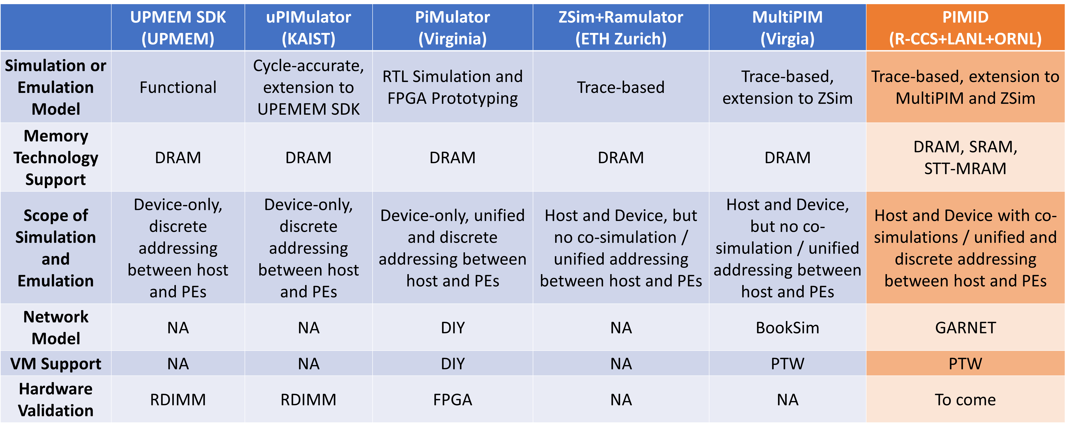
Comparisons with Existing Tools

Slide 14
Conclusions
PIMID advances PIM research through
Comprehensive scope - host-device co-simulation
Technology diversity - DRAM, SRAM, STT-MRAM support
Architectural flexibility - Fine-grained PE placement with multiple addressing modes
Programming model for MP workloads - OpenMP + MPI support
Detailed networking - GARNET-based interconnects
Complete power modeling - Host, PE, and memory power

Slide 15
Future Work
Immediate plan
Open-source release => Community access and contributions
Scheduled updates
Continued bug fixes and support
Hardware validation - validation support with FPGA?
Upgrade to Intel PIN 3

