Slide 1
PIMID: A Full-System Simulator with Intricacy and Diversity for Processing-in-Memory
Yuan He*, Masaaki Kondo*, Galen M. Shipman^,
Jered B. Dominguez-Trujillo^, and Kazi Asifuzzaman⁺
*R-CCS, ^LANL, ⁺ORNL

Slide 2
Outline
Introduction and motivation
Challenges in current PIM research tools
PIMID: our solution
Key features of PIMID
Sample simulation results
Comparison with existing Tools
Conclusions

Slide 3
The Memory Wall Challenge
Growing computational demands but…
Conventional memory systems struggle to keep pace
Data movement costs dominate energy consumption
Need innovative approaches to reduce data movement
Processing-in-Memory (PIM) promises to
Integrate computation closer to the memory system
Reduce data movement between computing and memory
Improve performance and energy efficiency
But current PIM research tools have significant limitations...

Slide 4
Challenges in Current PIM Research Tools
Scope Limitations
Mostly device-centric
Limited full-system perspective
Technology Support
Mostly DRAM-centric
Missing SRAM, STT-MRAM, and other emerging memory technologies
Limited flexibility in architectural modeling
Assuming naive PE placements and addressing
Lacking network models for in-memory communication
Missing proper programming model support
Missing power models for compute parts

Slide 5
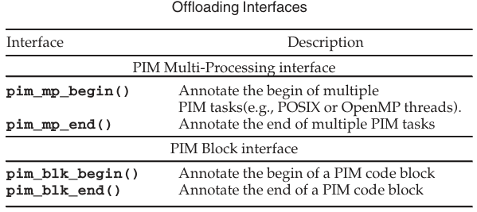
Our Solution => PIMID
A comprehensive full-system PIM simulator built on proven foundations
Extended from MultiPIM
MultiPIM itself is already a somehow mature simulator allowing architectural exploration on PIM
We exetended it with new capabilities
Key features of PIMID
Interface to add simulation drivers and models
Co-simulation of host and PIM devices
Multiple memory technologies support
Finer-grained placement of PEs
Multiple programming model support
Network model within the memory system
Power Models for compute and memory

Slide 6
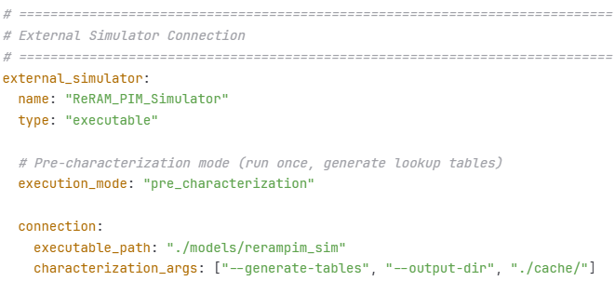
Key Feature 1: Interface for Extensions
PIMID is based on Intel PIN to generate instruction traces
Traces are fed to ZSim to for cache simulation and performance counting
Stats are fed to McPAT for power modelling
Memory-related instructions are fed to memory simulation models
A standard interface is provided so that
Additional execution models, memory models and power models can be attached
For simulation drivers, only trace-driven is currently supported, may consider to include execution-driven ones in the future

Slide 7
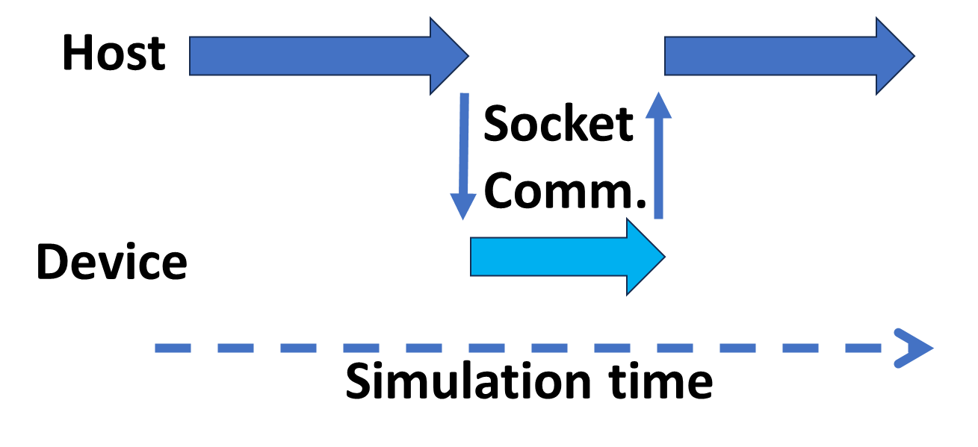
Key Feature 2: Host-Device Co-Simulation
Two MultiPIM processes co-simulate at the same time
They communicate through sockets to mimic interactions between host and devices
This enables one run to collect simulation results of the entire system

Slide 8
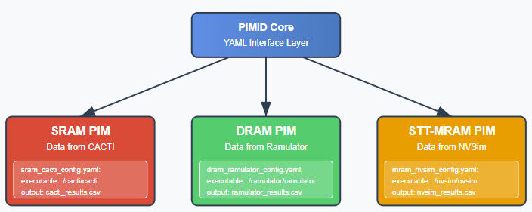
Key Feature 3: Multiple Memory Technologies
Current MultiPIM supports DRAM (DDR/HBM) through two extra tools
Timing from Ramulator
Power from DRAMPower
PIMID has added timing/power support for
SRAM through CACTI
STT-RAM from NVSIM
Simulation parameters are passed to these extra models for the generation of a table having access latencies and energy consumption
An interesting outcome after this would be to allow users to have simulated systems having devices from multiple memory technologies

Slide 9
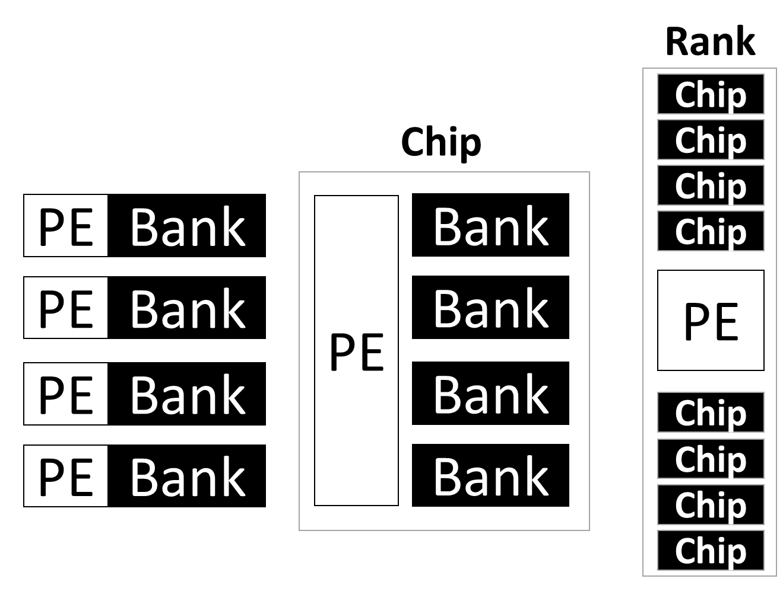
Key Feature 4: Fine-Grained PE Placements
PEs in MultiPIM are assumed to have a unified memory address space with the host so PEs can only be seen as rank-level components
Communication between PEs could only happen through the host memory controller
By allowing the placements of PEs inside memory chips and banks, we need to have Discrete addressing for subarray-/bank-/chip-wide PEs

Slide 10
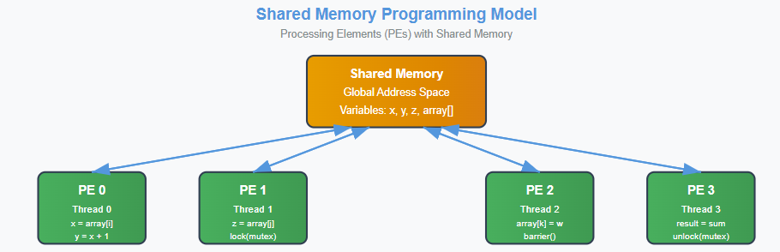
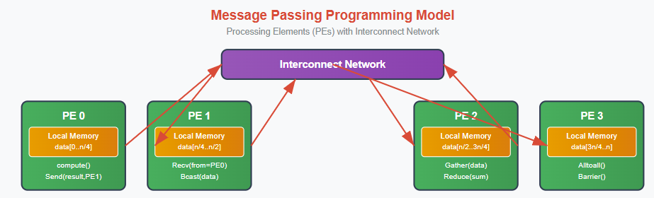
Key Feature 5: Multiple Programming Model Support
Programming model support for multi-processing workloads in MultiPIM is shared memory
Workloads can be written/compiled with OpenMP and run in MultiPIM
This is OK if PEs are placed in ranks, a directory can be placed in the host MC to guarantee cache coherence between PEs
However, this is not reasonable if PEs are allowed to be placed near the banks or inside the chips => a lot of coherence traffic is about to cross the host MC
So we added message passing as another option
Workloads can be written/compiled through MPI with PIMID
Explicit message exchange happens between the PEs
=> A more realistic option here would be to have
Memory sharing up to chip scale
OpenMP-based workloads works if offloaded to PEs in the same chip
Message passing between PEs communicating beyond memory chips

Slide 11
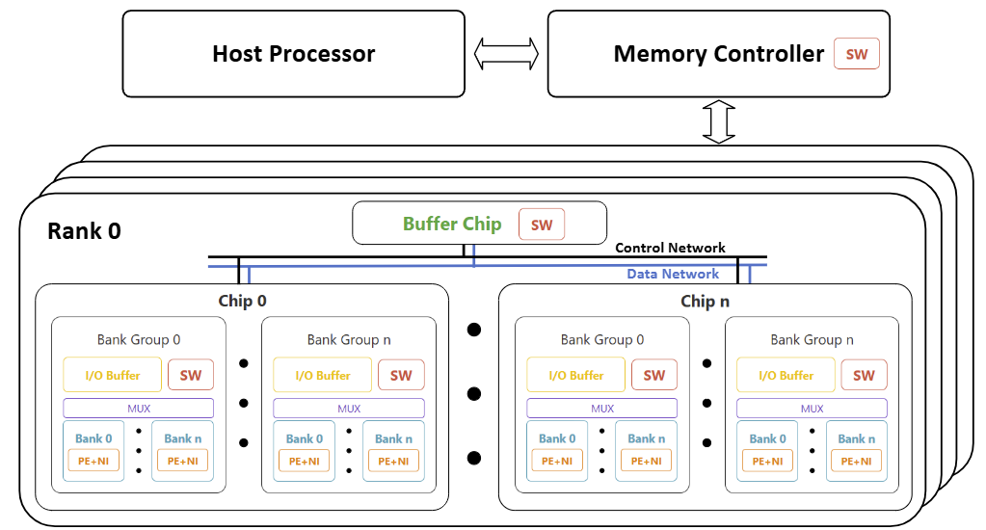
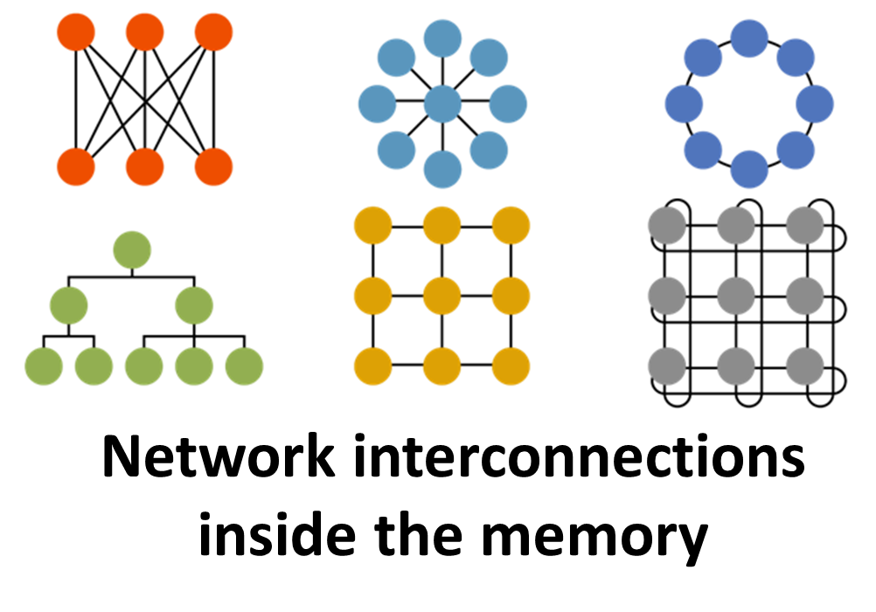
Key Feature 6: Flexible Network Support
MultiPIM already has booksim to support networking inside the memory
We integrated GARNET to enable comprehensive network modeling
Topologies
Routing algorithms
Flow control
Can see this as a hypothetic feature since current memory designs only have h-trees and crossbars internally

Slide 12
Key Feature 7: Comprehensive Power Modeling
No power modelling at all for computing parts in MultiPIM
We added McPAT to support power modelling for the host processor and PEs
From simple in-order to OoO cores with caches

Slide 13
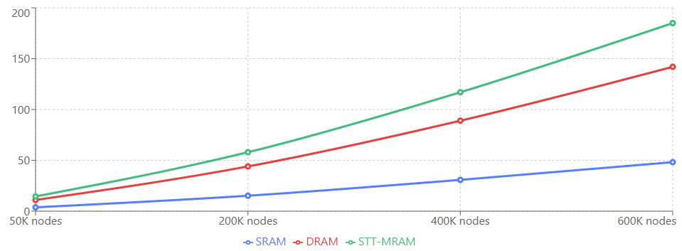
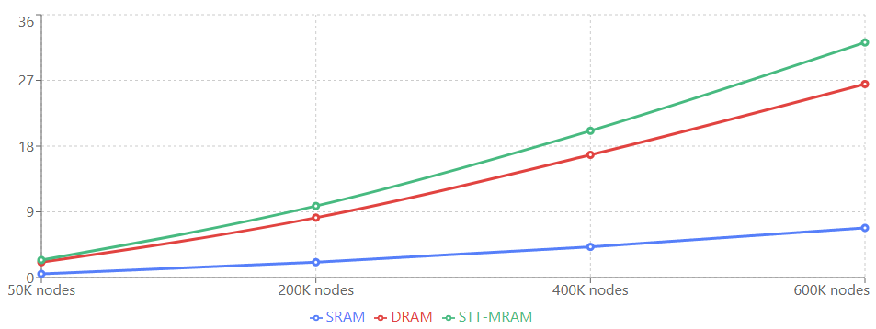
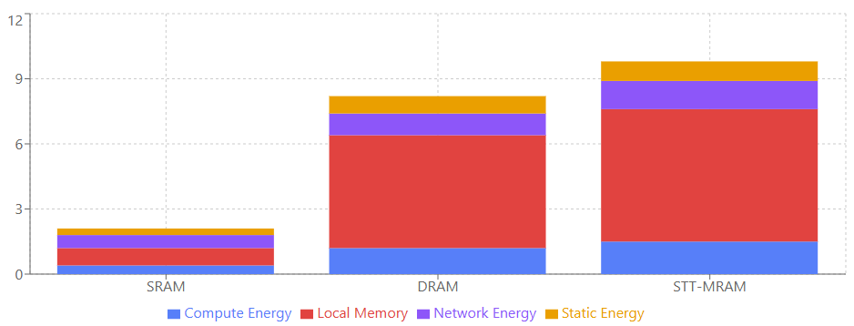
Sample evaluation results
32 Banks, 1 in-order PE per Bank
1MB per bank
Woth SRAM, DRAM and STT-MRAM
Tested with BFS workload, message passing
LHS, execution time, ms
RHS, energy consumption, mJ
Bottom, energy break-down for 200K nodes, mJ

Slide 14
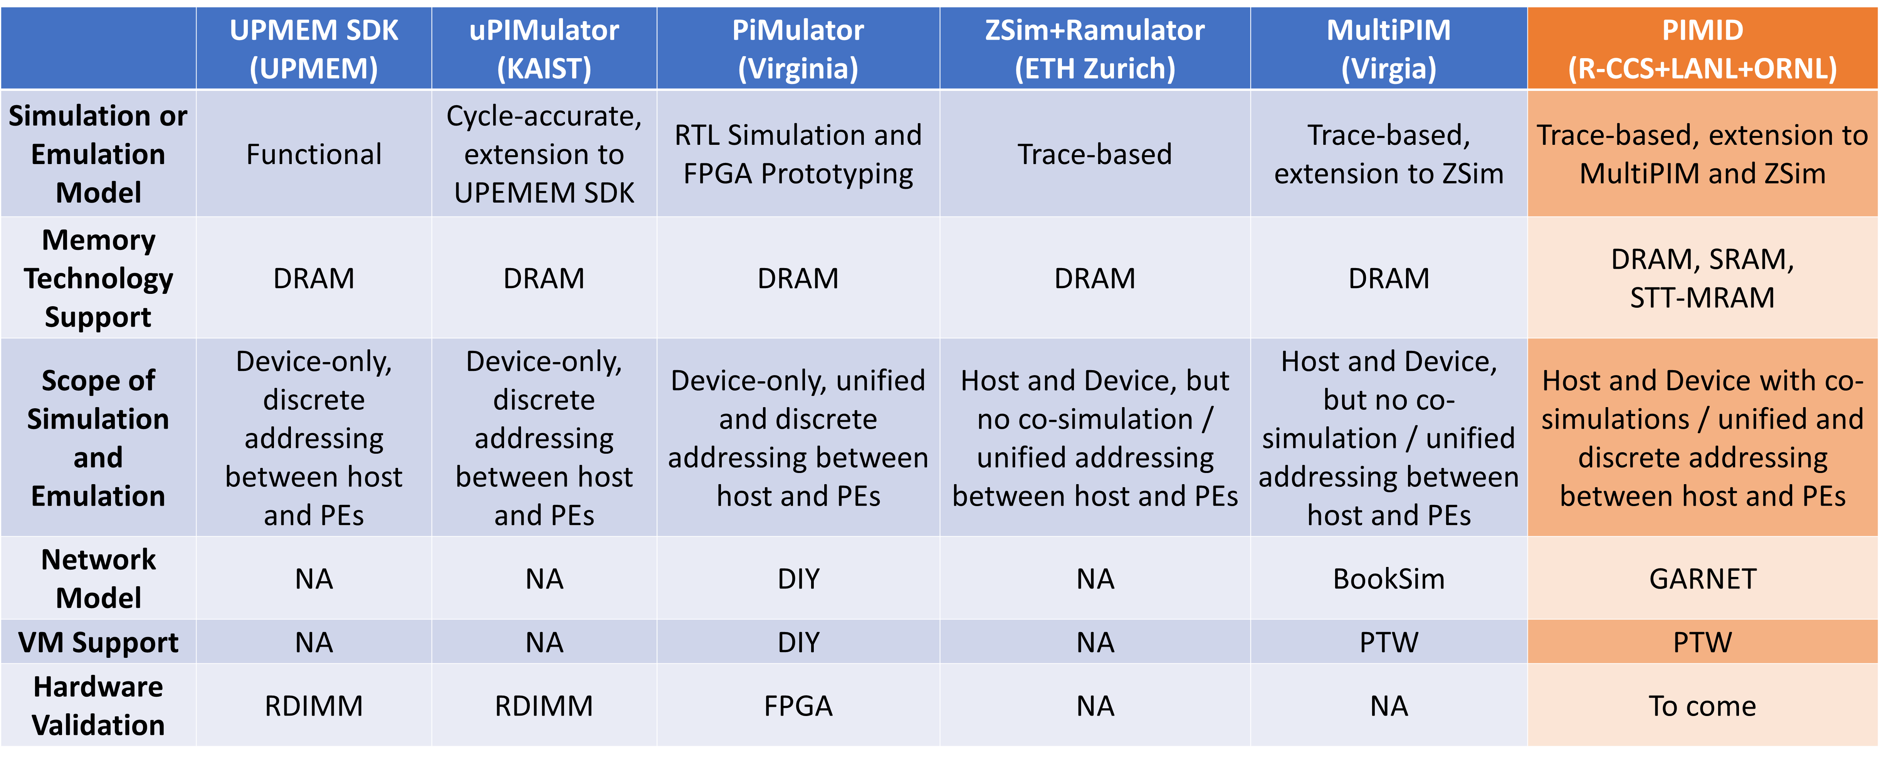
Comparisons with Existing Tools

Slide 15
Conclusions
PIMID advances PIM research through
Extensible – More simulation models
Comprehensive scope - host-device co-simulation
Technology diversity - DRAM, SRAM, STT-MRAM support
Architectural flexibility - Fine-grained PE placement with multiple addressing modes
Programming model for MP workloads - OpenMP + MPI support
Detailed networking - GARNET-based interconnects
Complete power modeling - Host, PE, and memory power
Please stay tuned with us for the first release (soon)!

Slide 16
Back-up slides

Slide 17
Future Work
Immediate plan
Open-source release => Community access and contributions
Scheduled updates
Continued bug fixes and support
Hardware validation - validation support with FPGA?
Upgrade to Intel PIN 3

Slide 18
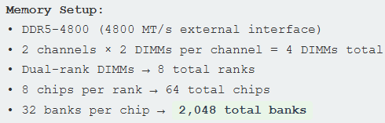
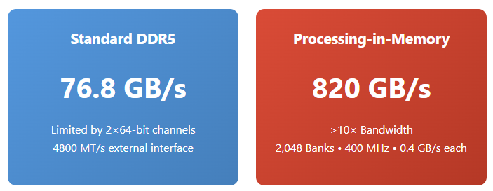
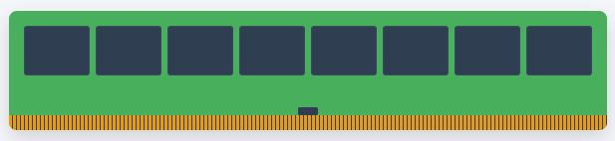

(Potential) Power of PIM
Assuming each bank has a PE and each PE can directly access the bank
Reality Check
While PIM offers >10× theoretical bandwidth advantage, real applications typically see 2-10× improvement due to data locality constraints. The true benefit isn't just bandwidth, but massive energy savings by eliminating data movement and enabling highly parallel computations where locality can be maintained.
Best suited for: Matrix operations, image processing, neural network inference, and database analytics where data can stay local to computation.

Slide 19
(Potential) Power of PIM (cont.)
Assuming each bank has a PE and each PE can directly access the bank
Limitations
Data Locality: Data must be in the right bank for processing
Inter-Bank Communication: Moving data between banks is very expensive
Load Balancing: Uneven workloads leave many banks idle
Programming Complexity: Applications need complete restructuring
Limited Per-Bank Compute: Each PE typically has simple capabilities
Power & Thermal: 2,048 parallel units create heat challenges
Subarray: 3.3-6.6TB/s
Bank: 820GB/s
Bank Group: 205-410GB/s
Chip: 153.6GB/s
Rank: 153.6GB/s

Slide 20

Our Solution => PIMID
CPU
A comprehensive full-system PIM simulator built on proven foundations
Extended from MultiPIM
https://github.com/Systems-ShiftLab/MultiPIM
MultiPIM itself is already a somehow mature simulator allowing architectural exploration on PIM
We exetended it with new capabilities
Key features to add
Co-simulation of host and PIM devices
Multiple memory technologies support
Finer-grained configurability
Network model within the memory system
Power Model for compute
MC

Slide 21
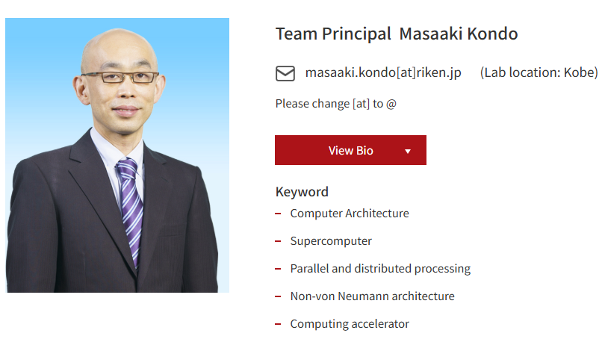
Next Generation High Performance Architecture Research Team RIKEN Center for Computational Science
FugakuNEXT

