Slide 1
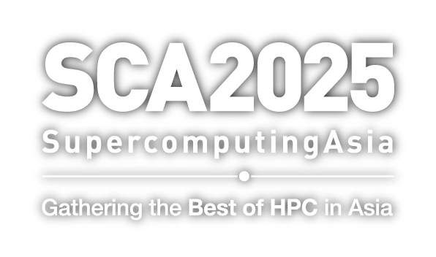

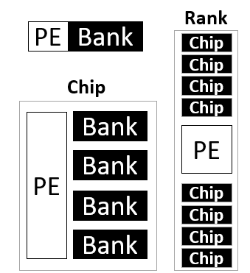
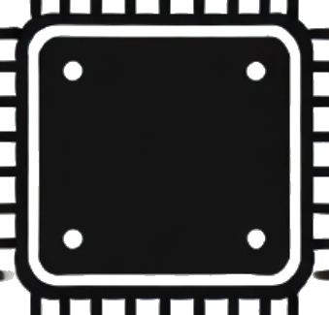
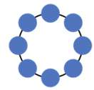
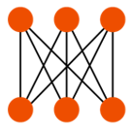





PIMID: A Full-System Simulator for Processing-in-Memory with Intricacy and Diversity
Yuan He*, Masaaki Kondo*, Galen M. Shipman⁺, and Jered B. Dominguez-Trujillo⁺
*RIKEN Center for Computational Science and ⁺Los Alamos National Laboratory
Introduction
Recently, Processing-in-Memory (PIM) starts to look promising for the longstanding memory wall challenge and it offers a way forward by integrating computational capabilities directly into memory systems. Despite the popularity, current research tools for PIM still face many limitations, mostly in scope and flexibility. Key features, such as host and device co-simulation, memory organization, and networking remain underdeveloped.
Challenges in Current PIM Research Tools
❌ Mostly device-centric therefore missing the host and device co-simulation capability
❌ Limited support for diverse memory technologies (mostly DRAM) and power modelling
❌ Naïve placement of Processing Elements (PEs) and lacking network models
❌ Overlooked data communication and addressing disparities between the host and PEs
Our Solution: PIMID (and Its Features)
Fine-grained placements of PEs
Various underlying memory technologies
Multiple Underlying Memory Technologies
CACTI for SRAM
Ramulator for DRAM
NVSim for STT-MRAM
Fine-Grain Placements of PEs in Different Layers of the Memory
Subarrays
Banks
Chips
Ranks
Logic die
DRAM
SRAM
STT
MRAM
Host and Device Co-Simulation
Different ZSim processes representing host and device domains
Host and device domains interact through socket communication
Host
Power and Energy Modelling
McPAT for host, PEs and the network
CACTI, Ramulator and NVSim for memories
GARNET for
Advanced
Network Support
Topologies
Routing
Flow control
Socket
Comm.
Device
Simulation time
Network interconnections inside the memory
Comparisons of Mainstream PIM Research Tools
 | UPMEM SDK (UPMEM) | uPIMulator (KAIST) | PiMulator (Virginia) | ZSim+Ramulator (ETH Zurich) | MultiPIM (Virginia) | PIMID (R-CCS+LANL)
Simulation or Emulation Model | Functional | Cycle-accurate | FPGA Prototyping | Trace-based | Trace-based | Trace-based
Memory Technology Support | NA | DRAM | DRAM | DRAM | DRAM | DRAM, SRAM, STT-MRAM
Scope of Simulation and Emulation | PIM device | PIM device | Full-system | Host and PIM device, but no co-simulation | Host and PIM device, but no co-simulation | Full-system
PE Placements | Chips | Banks | Banks, chips and ranks | Ranks and logic die | Ranks and logic die | Subarrays, banks, chips, ranks and logic die
Addressing | Discrete | Discrete | Discrete and unified | Unified | Unified | Discrete and unified
VM Support | NA | NA | NA or DIY | NA | PTW | PTW
Network Model | NA | NA | NA or DIY | NA | BookSim | GARNET
Power Model | NA | NA | Measurement | Memory only | Memory only | Host, PE and memory
Hardware Validation | UPMEM RDIMM | UPMEM RDIMM | FPGA | NA | NA | To come
Conclusions and Future Work
PIMID bridges the gap in PIM research tools by offering a comprehensive and high-fidelity simulation framework. It enables detailed exploration of PIM architectures, paving the way for innovative memory-centric computing solutions. We are going to open-source PIMID and add more features, including the support for storage class memories and hardware validations.

