Slide 1
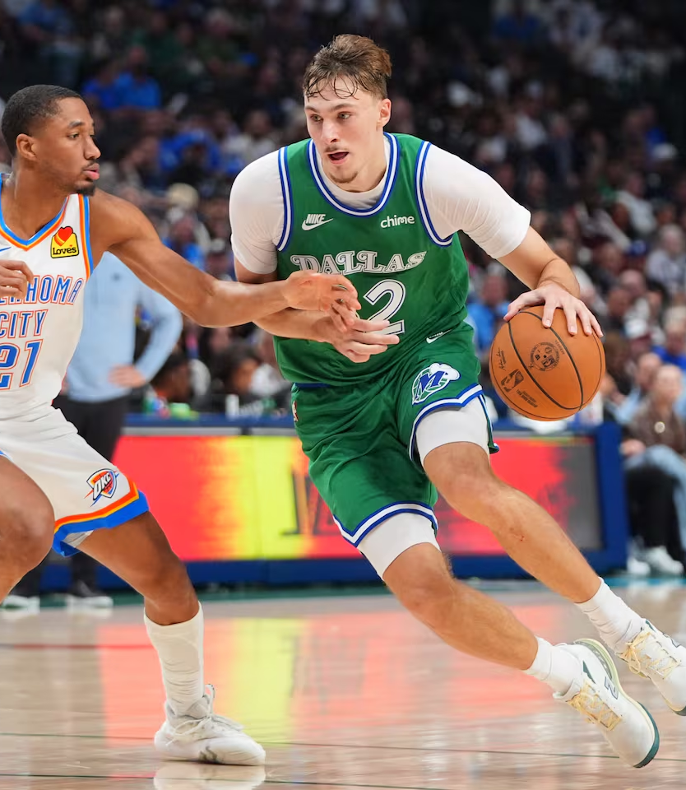
Rookie Radar: Predicting Rookie of the Year
Isaac Yu

Slide 2
Data Acquisition & Cleaning
Sources:
Official NBA Stats from 2010-2026
Used 2010-2025 seasons to train the models
ESPN for past ROTYs from 2010-2025.
Features Included:
Player Information:
Name, Age, Team, Season
Traditional Statistics:
PTS, REB (OREB/DREB), AST, STL, BLK, TOV, PF, FG/3P/FT splits, DD/TD, +/-, % Games Played
Advanced Statistics:
OFFRTG, DEFRTG, NETRTG, AST%, AST Ratio, AST/TO, REB% (OREB%/DREB%), TOV Ratio, eFG%, TS%, USG%, Pace, PIE, Possessions
ROTY Status (Yes/No)
Cleaning:
Standardized stats to per-game
Removed redundant, highly correlated, & highly skewed variables (for LASSO Regression)
Splitting the Data:
80% training & 20% testing split
Stratified so each split includes at least one ROTY

Slide 3
LASSO Regression
Pros:
Highly interpretable
Performs feature selection (penalty shrinks predictors to 0)
Works well with high-dimensional data
Cons:
Less flexible
Introduces bias
Assumes predictors have linear relationships
Note: Lasso Regression was modelled utilizing 10-fold cross-validation
Methodology & Justifications
Conducted Exploratory Data Analysis to investigate trends/imbalances
Created class weights due to address large class imbalances
Trained the model on the training set & evaluated model using testing set
Examined predicted probabilities for accuracy
Random Forest
Pros:
Handles complex, non-linear relationships
Robust to multicollinearity & noise
Handles class imbalances well
Low modeling assumptions
Strong predictive accuracy
Cons:
Complex & less interpretable
Struggles with linear relationships
Prone to overfitting
Note: Random Forest was modelled using the ALL predictors, some predictors (from variable importance plot), and was cross-validated

Slide 4
Findings, Interpretations, & Final Model
Final Model: Random Forest Full Model
Reasoning:
Willing to sacrifice interpretability for predictive power (task is to predict ROTY)
Findings aligns most with the NBA’s Kia Rookie Ladder standings (as of November 29th)
Accuracy between full, reduced, and cross-validated models are relatively similar
Random Forest is robust when having lots of predictors
Top Predictors: +/-, 3PM, Age, Pace, DEFRTG, TS %, NETRTG, OFFRTG, BLK, FT %
Player | Team | Probability of ROTY
Cooper Flagg | Dallas Mavericks | 64.4%
Kon Knueppel | Charlotte Hornets | 58.8%
VJ Edgecombe | Philadelphia 76ers | 57.2%
Jeremiah Fears | New Orleans Pelicans | 55.6%
Derik Queen | New Orleans Pelicans | 49.6%

Slide 5
Methodology & Justifications
Conducted Exploratory Data Analysis to investigate trends/imbalances
Created class weights due to address large class imbalances
Trained the model on the training set & evaluated model using testing set
Examined predicted probabilities for accuracy
Lasso Regression
Random Forest (Full Model)
Random Forest (Reduced Model)
Random Forest (CV Model)
More interpretable, Less flexible
Performs feature selection
Assumes linear relationships
Scaled predictors
Utilized 10-fold cross-validation techniques
Non-parametric
Handles class imbalances well
Low modeling assumptions
Strong predictive accuracy
Utilized class weights and designated sample sizes to handle class imbalances
Plotted Variables against Mean Decrease Accuracy, displayed variable importance
Selected 15/22 of the variables for the reduced model
Attempt to increase interpretability
Utilized selected variables from the Variable Importance Plot
Used 5-fold cross-validation techniques

Slide 6
Agenda
Introduction
Timeline
Areas of growth
Summary
Primary goals
Presentation Title

Slide 7

Introduction
At Contoso, we empower organizations to foster collaborative thinking to further drive workplace innovation. By closing the loop and leveraging agile frameworks, we help business grow organically and foster a consumer-first mindset.

Slide 8


Primary goals
ANNUAL REVENUE GROWTH

Slide 9
Quarterly performance

Slide 10
Areas of growth
Time period | B2B | Supply chain | ROI | E-commerce
Q1 | 4.5 | 2.3 | 1.7 | 5.0
Q2 | 3.2 | 5.1 | 4.4 | 3.0
Q3 | 2.1 | 1.7 | 2.5 | 2.8
Q4 | 4.5 | 2.2 | 1.7 | 70

Slide 11
“Business opportunities are like buses. There’s always another one coming.”
Richard Branson

Slide 12




Meet our team
Mirjam Nilsson
Rajesh Santoshi
Chief Executive Officer
VP Marketing
Takuma Hayashi
Flora Berggren
President
Chief Operations Officer

Slide 13








Meet our extended team
Takuma Hayashi
Graham Barnes
President
VP Product
Mirjam Nilsson
Rowan Murphy
Chief Executive Officer
SEO Strategist
Flora Berggren
Elizabeth Moore
Chief Operations Officer
Product Designer
Rajesh Santoshi
Robin Kline
VP Marketing
Content Developer

Slide 14





Plan for product launch
Planning
Marketing
Design
Strategy
Launch
Synergize scalable e-commerce
Disseminate standardized
metrics
Coordinate
e-business applications
Foster holistically superior methodologies
Deploy strategic networks with compelling
e-business needs

Slide 15
Timeline
Nov 20XX
May 20XX
Disseminate standardized metrics
Deploy strategy networks with compelling e-business needs
Sep 20XX
Synergize scalable
e-commerce
Jan 20XX
Mar 20XX
Coordinate e-business applications
Foster holistically superior methodologies

Slide 16

Areas of focus
B2B market scenarios
Cloud-based opportunities
Develop winning strategies to keep ahead of the competition
Capitalize on low-hanging fruit to identify a ballpark value
Visualize customer directed convergence
Iterative approaches to corporate strategy
Establish a management framework from the inside

Slide 17



How we get there
ROI
Envision multimedia-based expertise and cross-media growth strategies
Visualize quality intellectual capital
Engage worldwide methodologies with web-enabled technologies
Niche markets
Pursue scalable customer service through sustainable strategies
Engage top-line web services with cutting-edge deliverables
Supply chains
Cultivate one-to-one customer service with robust ideas
Maximize timely deliverables for real-time schemas

Slide 18


Summary
At Contoso, we believe in giving 110%. By using our next-generation data architecture, we help organizations virtually manage agile workflows. We thrive because of our market knowledge and great team behind our product. As our CEO says, “Efficiencies will come from proactively transforming how we do business.”

Slide 19




Thank you
Mirjam Nilsson
mirjam@contoso.com
www.contoso.com

