Slide 1
Dispatching emergency vehicles as calls come in
An online dispatcher, a greedy baseline and an annoyingly complex mid range decision making algorithm
UVEC 2026 Programming Stream · October 25, 2026
Notes:
~0:20. Our task: dispatch a fleet of emergency vehicles on a grid city, as the calls come in. In the next 12 minutes: the problem, three ways to solve it (a greedy baseline, our online dispatcher, and a CP-SAT solver that sees the future), how they compare, and how we checked it all.

Slide 2

The problem
Input (the brief's example)
10:45
2
10:45 15 N 20 W 45
11:00 2 S 3 E 30
16:02 4 E 15
vehicles
one call per line: time, blocks N/S, blocks E/W, job minutes
Minimise total response delay
16:02
the sum, over every call, of arrival on scene minus call time
Base
11:00
Every block takes 1 minute. Vehicles start the day at base and end it there.
Vehicle 0: 15 minutes north, then 20 west. The north/south leg always comes first.
Notes:
~1:00. The input is the brief's format: the number of vehicles, then one line per call: the time it comes in, blocks north or south, blocks east or west, and how long the job takes once a vehicle is there. Every block takes one minute, and a vehicle drives the north/south leg first, so vehicle 0 here goes 15 minutes north, then 20 west. We score a schedule by total response delay: for every call, the time from the call coming in to a vehicle arriving on scene, summed over the day.

Slide 3






The rules
Calls as they come
Grid travel
No decision may use a call before its time comes
1 minute per block, north/south leg first
Committed once driving
Wait anywhere
Calls still waiting in a queue can be reassigned
Idle vehicles may park away from base
Midnight ends the day
No calls after 00:00: finish the queue, then go home
Notes:
~0:45. A few rules shape everything that follows, and we confirmed them with the organizers. Calls are handled as they come: no decision may use a call before its time, so this is an online problem. Once a vehicle is driving to a job it's committed, but calls still waiting in a queue can be moved. Idle vehicles may wait anywhere, not only at base. No call comes in after midnight, and that's our only end-of-day signal: from midnight each vehicle finishes its calls, then goes home. We never look at where the input file ends to decide the day is over.

Slide 4
Three approaches
 | Greedy | Ours (online) | CP-SAT (hindsight)
Sees | Calls that have come in | Calls that have come in | The whole day, in advance
Who goes | Soonest arrival, in call order; never revisited | Re-plans every waiting call at each event | Optimal routes for the whole day
Queue order | First come, first served | Least total delay: exact up to 12 calls, local search beyond | Optimal
Idle vehicles | Return to base | Wait at spots near past calls | Return to base
Role | Baseline | Our submission | Yardstick: breaks the as-they-come rule
Notes:
~1:15. We built three solvers. Greedy is the baseline: take calls in order, give each to the vehicle that can get there soonest, and never revisit that choice; idle vehicles go home. Ours sees exactly what greedy sees, only calls that have come in, but every time something happens it re-plans every waiting call across every vehicle, and it parks idle vehicles near where calls have been coming from. CP-SAT is different in kind: it reads the whole day in advance and computes the optimal routes. That breaks the as-they-come rule, so it isn't a submission. It's our yardstick for how much better anyone could do.

Slide 5
Greedy vs ours: one queue
One vehicle is busy at base until 09:30. Three calls come in meanwhile:
A
09:05 · 10 N · 30-min job
B
09:10 · 2 S · 5-min job
C
09:12 · 2 S 1 E · 5-min job
Greedy
first job
A
B
C
183 min
A 35 · B 72 · C 76
Ours
first job
B
C
A
99 min
B 22 · C 26 · A 51
09:00
09:30
10:00
10:30
total delay
Greedy fixed the order as each call came in. Ours re-plans the queue the moment the vehicle frees up and does the two short calls first: 46% less delay with the same information.
Notes:
~0:50. Here's the difference in one picture. One vehicle is busy at base until 09:30. Meanwhile a far call with a 30-minute job comes in, then two short calls close by. Greedy assigned them in the order they came, so the two short calls wait behind the long one: 183 minutes of total delay. Ours re-plans the queue when the vehicle frees up, takes the two short calls first, then the far one: 99 minutes. Same information, 46% less delay. (Both numbers are from running dispatcher.py on this input.)

Slide 6



Inside our dispatcher
1
2
3
4
Something happens
Re-plan the queue
Dispatch
Reposition
A call comes in or a vehicle frees up
Every waiting call over every vehicle
Leave for the first call in each queue; driving is committed
Idle vehicles go to standby spots; after midnight, home
Re-planning, by how many calls are waiting
≤ 7
8 to 12
13 or more
Try every split and every order
Exact dynamic program over subsets
Cheapest insertion, then moves and swaps
Notes:
~1:15. Our dispatcher is an event loop. When a call comes in or a vehicle frees up, we re-plan the whole queue: which vehicle takes which waiting call, and in what order, to minimise total delay. Each vehicle leaves for the first call in its queue, and once it's driving it's committed. Idle vehicles go to standby spots; after midnight they go home instead. How we plan depends on the queue: up to 7 waiting calls we try every split and order; up to 12 an exact dynamic program over subsets gives the same answer much faster; beyond that, cheapest insertion followed by local search. Ties go to the plan that leaves vehicles better placed for the next call.

Slide 7



Where idle vehicles wait
19.7 → 9.9 min
average drive from the nearest vehicle to these 20 calls: all at base vs at the spots
Spots are the k-median of every call seen so far; base counts as 3 calls
A vehicle moves only if coverage improves by at least 1 minute
Beat return-to-base on 1,600 of 1,980 simulated days (worse on 215)
◆ past calls ● standby spots □ base (typical_day, 3 vehicles)
Notes:
~0:45. Where should an idle vehicle wait? We put vehicles at the k-median of the calls seen so far: the spots that minimise the drive to past calls, with base counted as three calls so a single early call doesn't drag a vehicle across town. A vehicle only moves if that improves average coverage by at least a minute, which avoids driving around for nothing. On this sample day the average drive to a call drops from about 20 minutes to about 10. Across our 1,980 simulated days, standby beat return-to-base on 1,600 and lost on 215.

Slide 8


CP-SAT: perfect hindsight
Reads the whole day first
40 / 40
So it's a yardstick, not a valid online dispatcher
small random days where CP-SAT matched trying every possible schedule
One route per vehicle
Circuit constraints with exact timing, including waiting for a call and drifting home
19 / 40
Proves its answer is optimal
of those days where greedy was not optimal
On small days; on big ones it reports its best schedule and a lower bound
Notes:
~0:55. CP-SAT is the constraint solver in Google OR-Tools. We give it the whole day: each vehicle's route is a circuit through its calls, with exact timing, including waiting for a call to come in and the vehicle drifting back toward base between jobs. On small days it proves the answer optimal; on larger days it gives its best schedule and a lower bound. We checked it against brute force: on 40 small random days it matched trying every possible schedule every time, and greedy was not optimal on 19 of those 40.

Slide 9
1,980 simulated days
−23.5%
average delay per call vs greedy: 22.6 → 17.3 min
1,709
days better than greedy; 142 worse, the rest tied
−8.2%
from re-planning alone, with the same return-to-base rule
Days per suite: 1,200 · 400 · 200 · 120 · 60. Overloaded days average 132 calls for 8 vehicles.
Notes:
~0:50. Now the results. We generated 1,980 days across five suites: mixed days, specific demand patterns, rush hours, a large city with about 8 vehicles, and overloaded days. Average delay per call: greedy 22.6 minutes, ours with return to base 20.7, ours with standby 17.3, which is 23.5% below greedy. Ours was better on 1,709 days and worse on 142. Re-planning alone, with greedy's return-to-base rule, is worth 8%; standby parking is worth the rest.

Slide 10
How close to hindsight?
+0.6 to 2.1%
above the optimum under its rules, without seeing the future
7 to 19% below
with standby: waiting near demand beats foresight plus going home
~6% more
is all we'd gain by knowing the city's true call pattern
Return-to-base rules; optimum proven on 164 of 230 days.
Notes:
~0:50. How much is left on the table? On 230 sampled days we compared with CP-SAT's optimum, under its rules: return to base. Greedy is 4 to 19% above it. Our dispatcher under the same rules is 0.6 to 2.1% above, without seeing the future. With standby it's 7 to 19% below that optimum, because parking near demand is worth more than perfect foresight. And if we told our dispatcher the city's true call pattern, it would gain only about 6% more (3 to 9% by suite), so demand estimation is close to its ceiling. If asked: on hindsight_check.py's tiny random days (1 to 25 calls) the per-day average gap is about 4%, because a few minutes on a 30-minute day is a big percentage.

Slide 11

What didn't help
Kept
The backlog planner: −4.6% on rush days, −6.1% on overloaded days
Holding calls hurts more the longer you wait
2 min +0.6% · 5 min +3.8% · 10 min +13%
1,920 simulated days (all suites but the overloaded one).
Notes:
~0:50. We also tried ideas that didn't make it, each measured on 1,920 simulated days at its best setting. Holding calls a few minutes to batch them always hurt, more the longer we held them. Keeping a backup vehicle near base hurt. Weighting recent calls, penalising long jobs, smoothing the demand map and re-planning every minute were all within half a percent. Moving to standby more eagerly saved half a percent of delay but cost 11% more driving, so we kept the stricter threshold. The backlog planner is the one that made the cut.

Slide 12
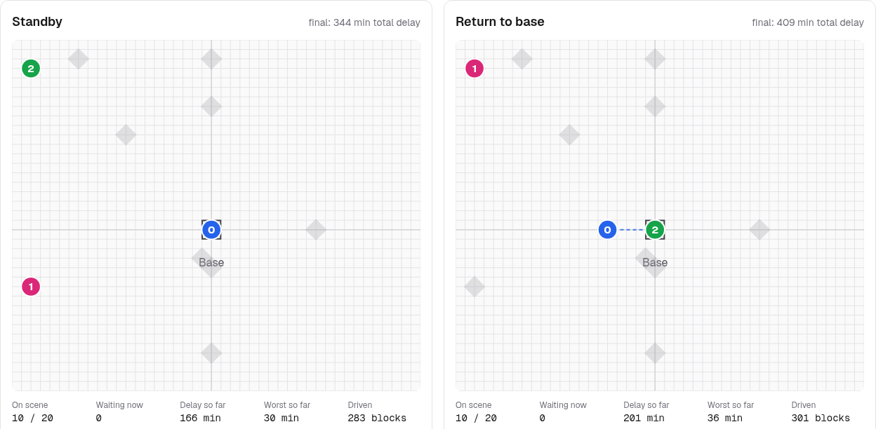

How we know it's right
Independent validator replays every schedule
9 tricky cases with hand-checked totals
12 malformed inputs: a clear error naming the line
Backlog DP matches brute force on random backlogs
Big days: never worse than oldest-first
Web replay (apps/web), typical_day at 12:15: standby on the left, return to base on the right
No peeking: future calls change nothing earlier
No-replan mode = hindsight greedy, exactly
344 vs 409 min
Base mode never beats CP-SAT's proven optimum
total delay that day: standby vs return to base
Notes:
~0:55. How do we know the schedules are right? run_checks.py runs eight checks, all passing. An independent validator replays every schedule and recomputes the delay. Tricky cases have hand-computed totals, and bad input gets a clear error naming the line. The no-peeking test cuts every call from some time T on and checks that nothing the dispatcher did before T changes. Our no-replan mode reproduces the hindsight greedy exactly, and base mode never beats CP-SAT's proven optimum. On the right is the web replay: standby and return-to-base side by side, minute by minute. Good moment for a 30-second demo if time allows.

Slide 13
Takeaways
1
2
3
Re-plan the queue
Wait near the calls
Close to the ceiling
At every event, not once per call: −8% delay vs greedy under the same rules
Standby spots: −23.5% vs greedy, and below the return-to-base hindsight optimum
Within 0.6 to 2.1% of perfect hindsight under its own rules
Try it: python dispatcher.py input.txt · replay: apps/web · Questions?
Notes:
~0:30. Three takeaways. Re-planning the queue beats committing early. Waiting near demand beats going home. And we're within about 2% of perfect hindsight under the same rules, without seeing the future. Thanks, happy to take questions or show the replay.

Slide 14
Appendix: sample inputs
Input | Vehicles | Calls | Greedy | Ours, base | Ours, standby | CP-SAT optimum
example | 2 | 3 | 44 | 44 | 44 | 44
edge_cases | 2 | 7 | 114 | 108 | 114 | 108
single_vehicle | 1 | 7 | 615 | 462 | 462 | 416
typical_day | 3 | 20 | 409 | 409 | 344 | 380
rush_hour | 2 | 12 | 1553 | 1256 | 1256 | ≤ 1075
large_city | 4 | 35 | 724 | 712 | 728 | ≤ 678
Total response delay in minutes; bold = lowest online result. CP-SAT sees the whole day and uses return-to-base rules; ≤ marks the best it found in 30 s (not proven). Standby can beat it (typical_day) because it may park away from base.
Notes:
Backup slide for questions. Totals from running each solver on inputs/*.txt. single_vehicle shows re-planning's effect most: one vehicle, so the queue order is everything (615 vs 462). typical_day shows standby beating even the hindsight optimum under return-to-base rules.

