Slide 1
POWER BI DATA ANALYTICS PORTFOLIO
Olympic Insights
using Data Analytics
Milestone Project 3 | Created by Mohd Isaar |
Data source: Olympic Games dataset (WsCube Tech)
DATASET SCOPE
TOTAL MEDALS ANALYSED
PRIMARY ANALYTICS TOOL
1896–2022
20,412
Power BI
Historical modern Olympiads
Cleaned medal outcomes
DAX · Power Query modeling
PORTFOLIO PROJECT · POWER BI & DAX · COMPREHENSIVE OLYMPIC ANALYSIS

Slide 2
PROJECT FOUNDATIONS
Objective, Data and Tools
GOALS & STAKEHOLDERS
CORE QUESTIONS & METHODOLOGY
Analyse Olympic data from 1896 to 2022: medals, athletes, sports and host countries.
Help the IOC (International Olympic Committee) see which countries perform best and how hosting and demographics matter.
Questions: Who wins the most medals? Does hosting help? How do gender and age change over time?
Tools: Power BI, DAX and Power Query.
DATA ARCHITECTURE · 1896–2022 OLYMPIC GAMES DATASET · 20,412 CLEANED MEDALS

Slide 3

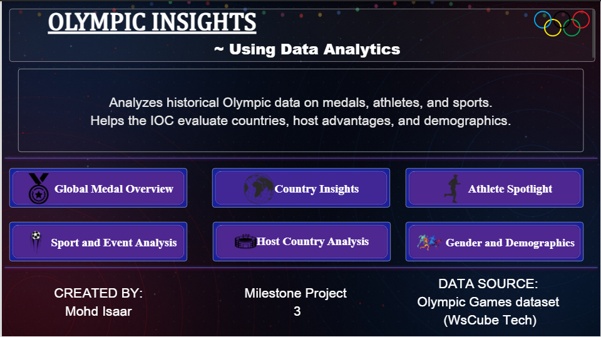
DASHBOARD NAVIGATION · PAGE 01
Home Page
Interactive Power BI dashboard with 7 pages: Home plus 6 analysis pages.
Navigation buttons on every page.
Slicers: Season, Year, Sport, Country and Host Country.
Pages: Global Medal Overview, Country Insights, Athlete Spotlight, Sport and Event Analysis, Host Country Analysis, Gender and Demographics.
REPORT PORTAL · POWER BI INTERACTIVE REPOSITORY

Slide 4
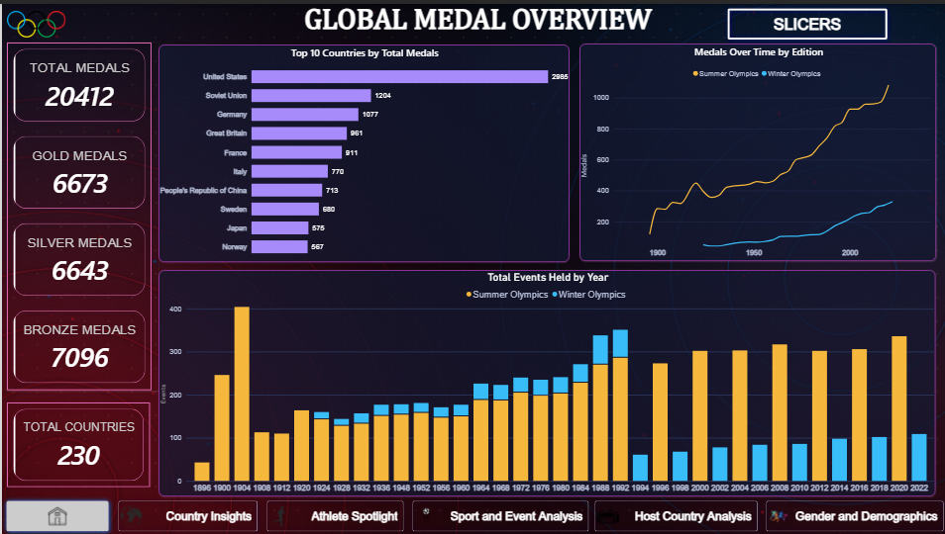
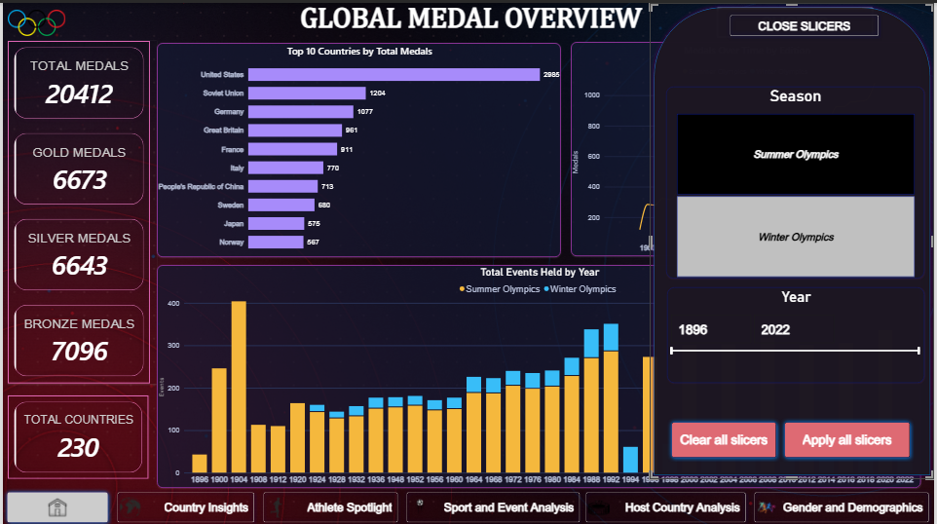
REPORT PAGE 01
Global Medal Overview
20,412 medals: 6,673 gold, 6,643 silver, 7,096 bronze.
230 participating countries.
Top countries: United States 2,985, Soviet Union 1,204, Germany 1,077.
Summer medals have grown much faster than Winter medals.
Insight: the three medal types are almost equal, with bronze slightly higher.

Slide 5
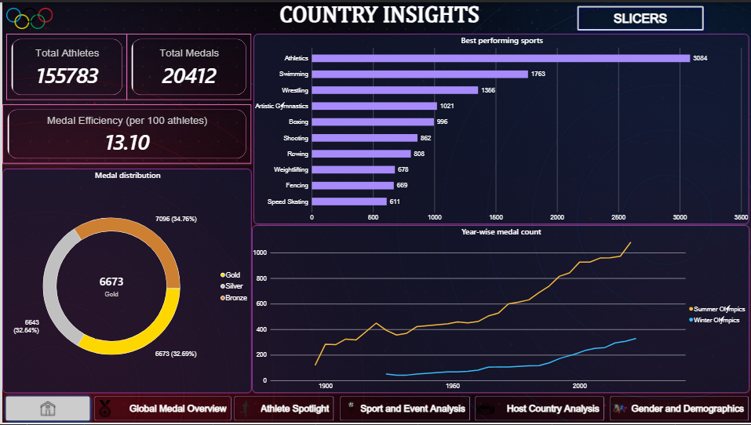
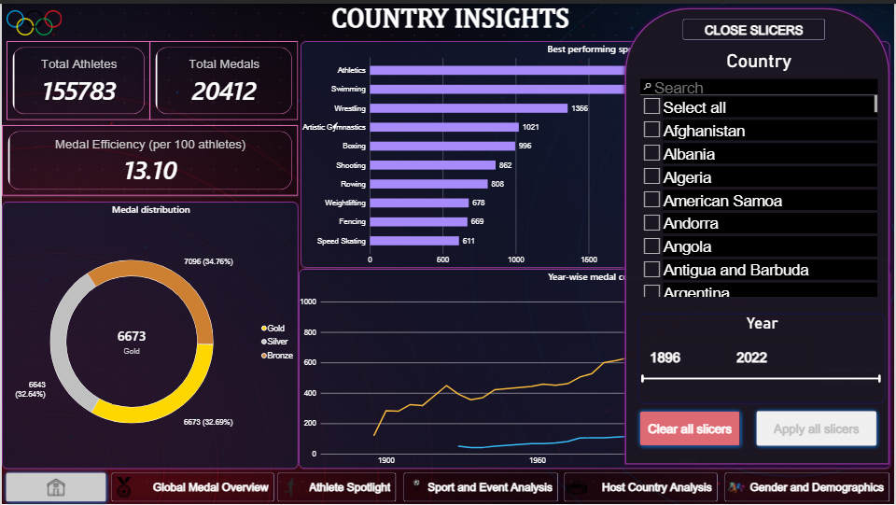
REPORT PAGE 02
Country Insights
155,783 athletes won 20,412 medals.
Medal efficiency: 13.10 medals per 100 athletes.
Top sports: Athletics 3,084, Swimming 1,763, Wrestling 1,356.
Medal split: gold 32.7%, silver 32.5%, bronze 34.8%.
Use the Country slicer to see any one country.

Slide 6
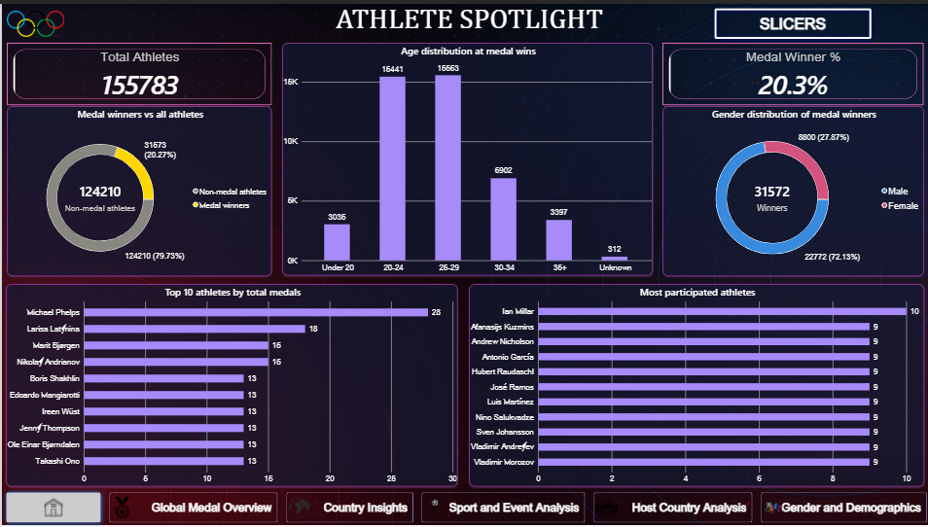
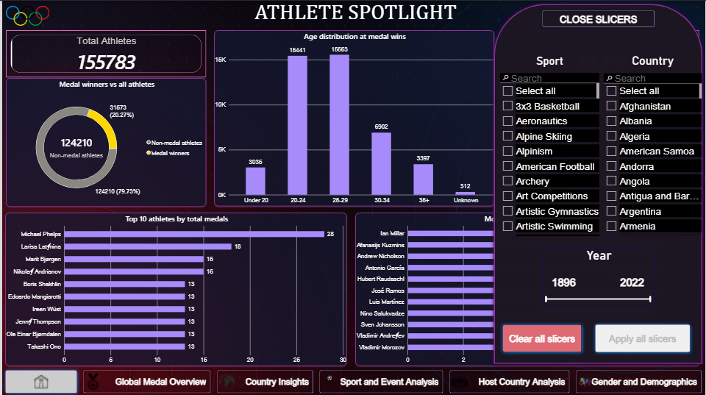
REPORT PAGE 03
Athlete Spotlight
Michael Phelps leads with 28 medals, then Larisa Latynina with 18.
About 20.3% of athletes (31,573) won at least one medal.
Most medal wins come at ages 20-29.
Medal winners are about 72% male and 28% female.
Note: medal winners are more than total medals because a team medal counts for every team member.

Slide 7
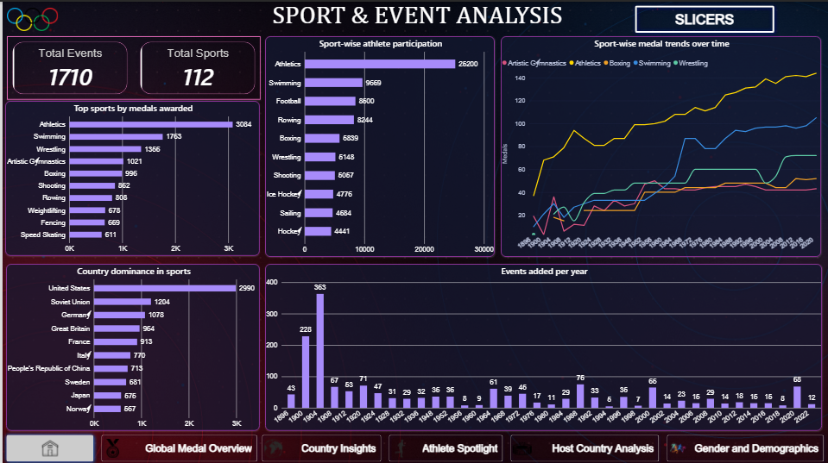
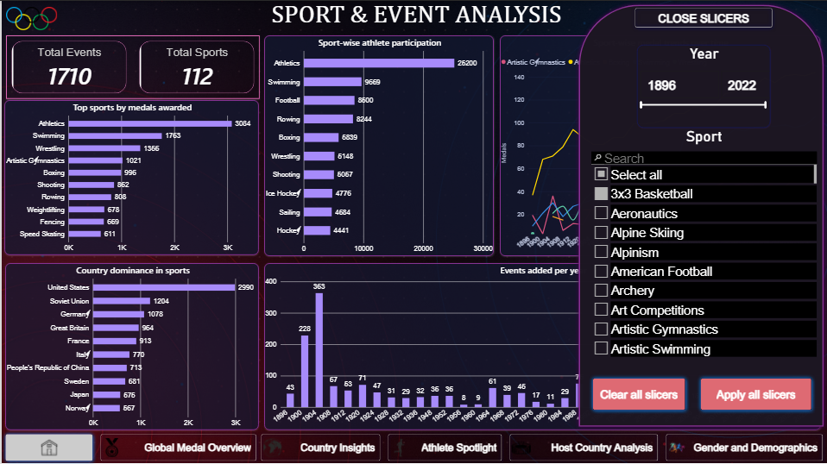
REPORT PAGE 04
Sport and Event Analysis
1,710 events and 112 sports.
Athletics has the highest participation (about 26,200), then Swimming and Football.
Events added per year peaked in 1904 (363 events).
Note: the 1900 and 1904 counts look high because events are counted by name, so variants of the same event count separately.

Slide 8
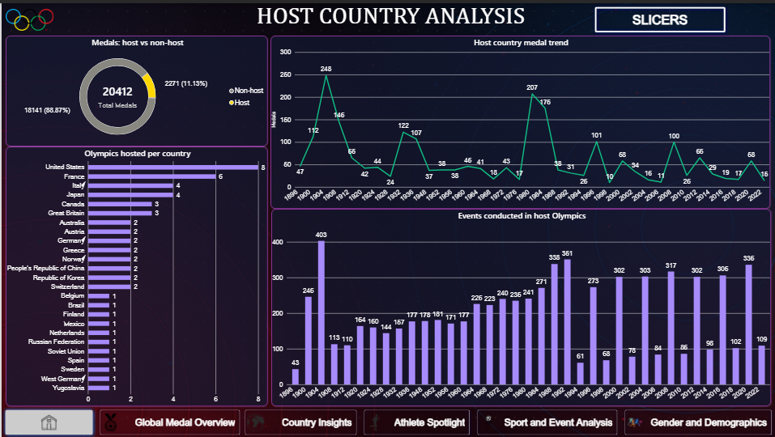
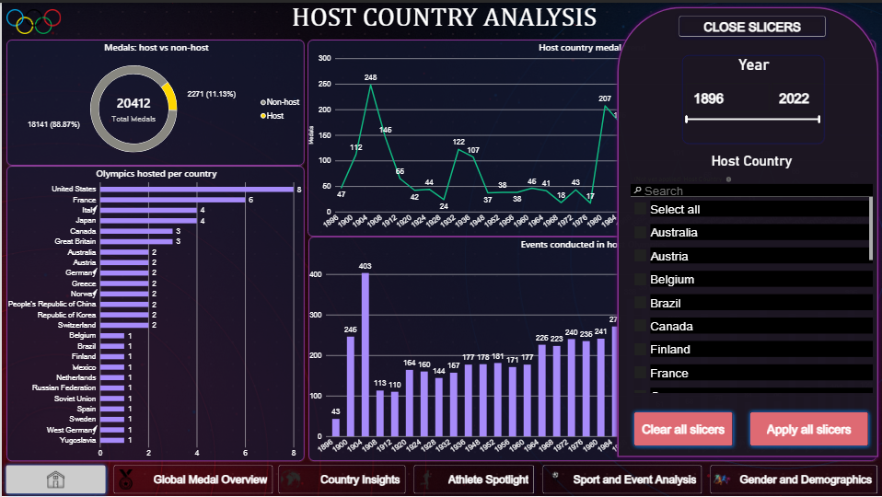
REPORT PAGE 05
Host Country Analysis
Host countries won 11.13% of medals (2,271 of 20,412).
Non-host countries won 88.87% (18,141).
United States has hosted the most times (8), then France (6).
Host-year medal counts peaked in 1984 and 1904.
Note: Germany and West Germany are counted as separate hosts.

Slide 9
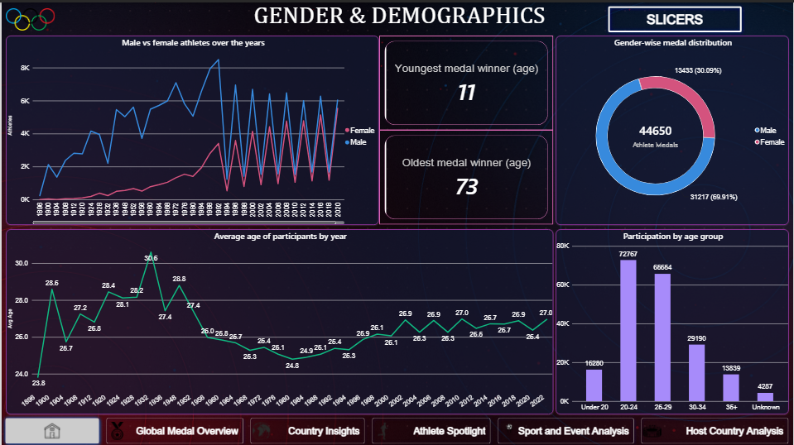
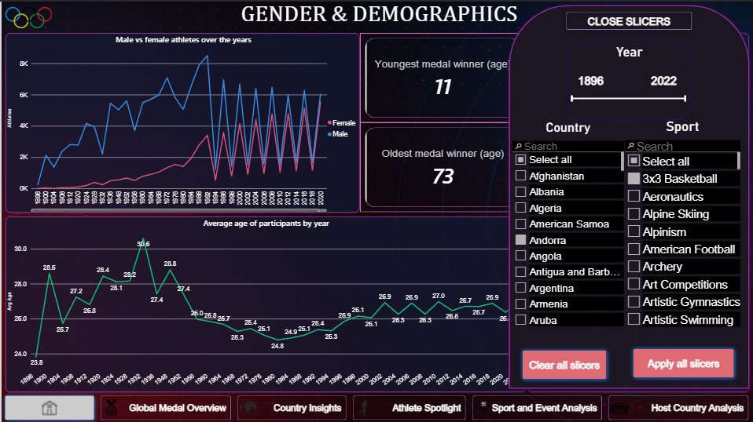
REPORT PAGE 06
Gender and Demographics
About 30% of athlete medals went to women (13,433 of 44,650).
Male participation is higher but the gap is narrowing.
Youngest medal winner is 11, oldest is 73.
Average athlete age is about 26-27 in recent Games.
Note: 44,650 is more than 20,412 because a team medal counts for every team member.
Note: the zigzag in the gender line chart is real. Summer and Winter Games fall in different years after 1992.

Slide 10
SYNTHESIS
Key Takeaways
WHAT THE DATA SHOWS
PEOPLE AND PLACES
Medals are concentrated in a few countries: United States 2,985, Soviet Union 1,204, Germany 1,077.
Athletics (3,084) and Swimming (1,763) award the most medals.
Summer medals have grown much faster than Winter medals.
Gold, silver and bronze are almost equal (32.7%, 32.5%, 34.8%).
Hosting gives a small medal share (11.13%), not a dominant one.
Female participation is increasing, with about 30% of athlete medals going to women.
Most medal wins come at ages 20-29.
About 20.3% of athletes won at least one medal.
PROJECT SUMMARY - MILESTONE PROJECT 3 - MOHD ISAAR - POWER BI PORTFOLIO

Slide 11
FUTURE SCOPE
Challenges and Next Steps
CHALLENGES SOLVED
NEXT STEPS
Removed the 1906 Intercalated Games and the 1956 Equestrian events so totals match on every page (20,412 medals).
Handled team medals: the tally counts a team medal once, but athlete-level pages count every team member.
Connected the country slicer by activating the relationship between the tables.
Add predictive analysis of future medal counts.
Add more recent data (Paris 2024 and Milano Cortina 2026).
Merge historic countries (USSR, West Germany) with their successors for fairer country comparisons.
GitHub link: https://github.com/isaar1/Milestone_Project-Olympic_Insights
PROJECT SUMMARY - MILESTONE PROJECT 3 - MOHD ISAAR - POWER BI PORTFOLIO

