Slide 1

.
To reinvent productivity to empower every person and every organization on the planet to do more and achieve more

Slide 2
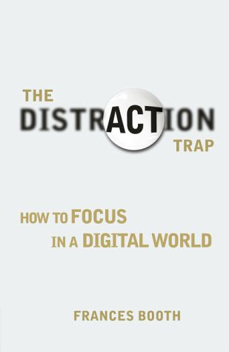
USA TODAY
In a digital world of distraction, you get lost in social media, loose valuable time and loose the ability to deep think about problems.

Slide 3
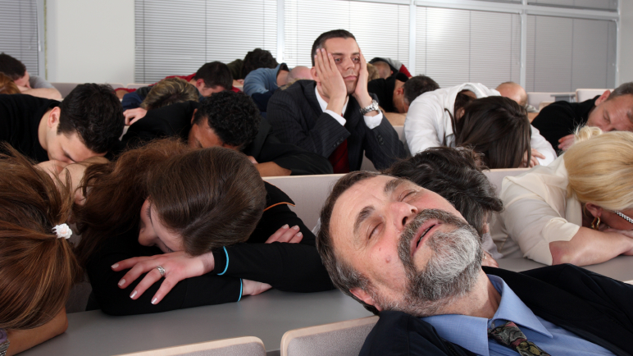
Typical solution is organizing internal focus meetings, excluding a connection with the outside world.

Slide 4

Wasting time in a meeting creates large amounts of stress. Harvard Study with 400 professionals proofs that
"Relaxed people are more Productive"

Slide 5

harmon.ie found that at companies with more than 1,000 employees, these kinds of digital distractions can waste more than $10 million each year

Slide 6

Notwificador!
Get notified on important happenings concerning your business, allowing your employees to be more productive in this digital distractive world.

Slide 7
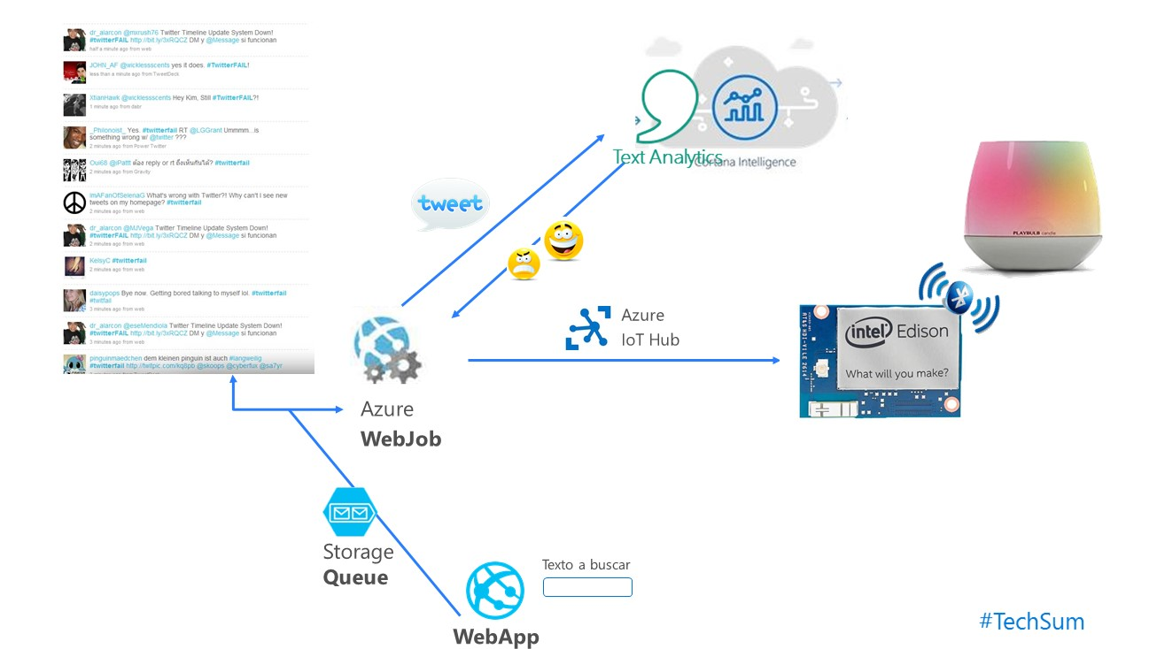
DEMO

