Slide 1
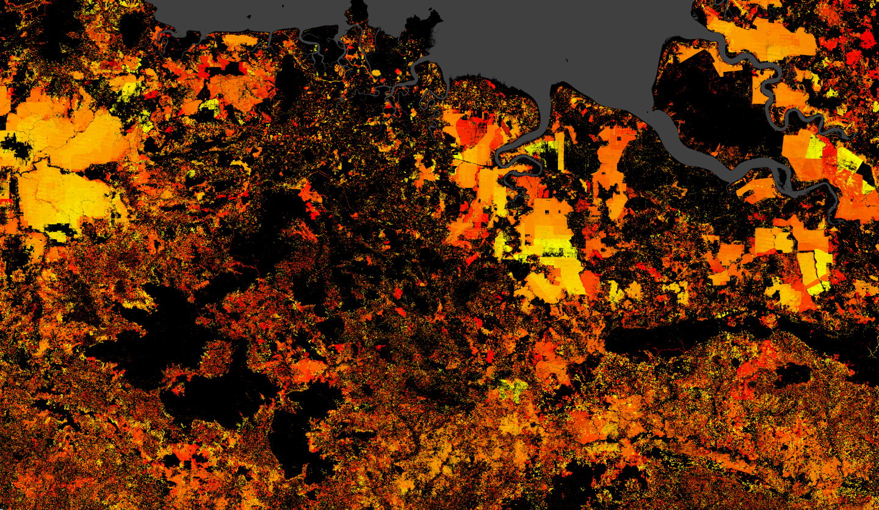
Choosing and using land cover-land use data for infectious disease models

Slide 2
What is land cover/land use, and why is it interesting from an infectious disease perspective?
Notes:
Kim fornace;
Ecological communities;
Vector abundance;
“frontier” risk

Slide 3
Land cover vs. land use – what’s the difference?
Notes:
Include silhouettes of forest and field, and then add a cow/ add some kind of management regime
Include satellite silhouette to measure the former, but not the latter

Slide 4
Satellites generally measure land cover and in some cases this can be used as a proxy for land use
Notes:
Comparison between e.g. forest (distinguishing between forest management regimes cf GeoWiki) and cropland detection
Cropping intensity not something it’s necessarily easy to detect, nor agricultural inputs, grazing intensity
If what we’re interested in is the ecology of disease, then these differences can really matter – it’s important to bear in mind what satellite data can and can’t tell us

Slide 5
Three axes of measurement: spatial, temporal and thematic
Notes:
Spatial – how high resolution spatially are we?
Temporal – how high resolution temporally are we? Annual? 5-year epoches? Decadal? And what kind of time series are we looking at?
Thematic – in what kind of detail are the land classes described? And how are grid-cells described: “single class” or proportion cover?
Good thematic resolution AND temporal resolution AND spatial resolution is challenging – often the phenomena we’re interested in for things like zoonoses and vectors are boundary phenomena that occur as landscapes are changing, fragmenting, transitioning from one class (e.g. forest) through a porosity phase into e.g. cropland – these kinds of dynamics can be hard to capture from satellites alone

Slide 6
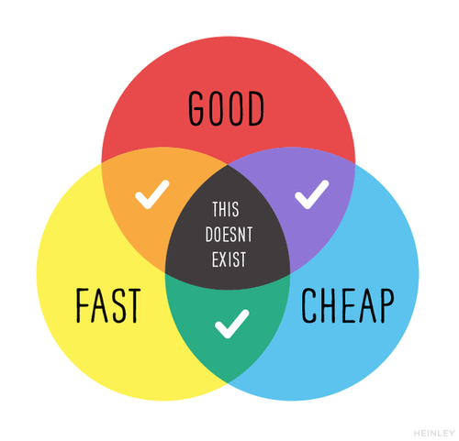
Pick two…
https://medium.com/@devsociety_/good-cheap-fast-pick-two-and-how-ngos-can-play-the-triangle-like-a-pro-20d1380884a8
Notes:
Comparison between e.g. forest (distinguishing between forest management regimes cf GeoWiki) and cropland detection
Cropping intensity not something it’s necessarily easy to detect, nor agricultural inputs etc
If what we’re interested in is the ecology of disease, then these differences can really matter – it’s important to bear in mind what satellite data can and can’t tell us

Slide 7
Spatial vs. temporal vs. thematic depth: pick two
Notes:
Comparison between e.g. forest (distinguishing between forest management regimes cf GeoWiki) and cropland detection
Cropping intensity not something it’s necessarily easy to detect, nor agricultural inputs etc
If what we’re interested in is the ecology of disease, then these differences can really matter – it’s important to bear in mind what satellite data can and can’t tell us

Slide 8
Uncertainty in satellite land cover classification and why it matters (and what can we do about it)
Notes:
“Scenes” classified as satellites pass, and landscapes change in appearance over the year
Different years landscapes may appear different
Landscapes are discretised into cells; often criterion of >50% cover masks what is actually highly heterogeneous
Land cover change time series often include a selection algorithm to determine when a class can “change” type but it’s notable that these may be restricted to certain transitions, e.g. ESA-CCI, which can impact our ability to quantify land cover change (i.e. the transition) – read the manual!

Slide 9
Extracting land cover-land use metrics from raster data
Notes:
Show polygon with cover – generally with disease data we’re working with polygons which present challenges for interpretation
Conversely with point data you could extract a consistent buffer that you expect has some biological/epi relevance
Extract using exactextractr
Lots of metrics you can derive – what links to the process?
Area = sensitive to size
% cover = sensitive to size and also does not account for how population is distributed
Exposure = population weighting so you get an estimate of the % of population in an area that’s “exposed” to that land cover type -> problem is that the population layers we use to derive these metrics are themselves modelled and often with LC as an input, so you have the potential for circularity that is difficult to quantify.

Slide 10
Some practical decision-making and cross-comparison
Notes:
If you want good spatial/thematic resolution, consider exploring how temporally dynamic landscape in your study region appears to have been in the time period of interest
(using a decent spatial/temporal resolution dataset) – if it’s been fairly stable, a single epoch might be sufficient
Be careful about quantifying land cover change from a time series – ensure the time series has been designed to do this stably
Cross-compare multiple datasets – are there areas of significant disagreement?
Visually inspect – ESA-CCI has some extremely strange behaviours pre-2000 that may limit the benefit of the extra years on the timeseries

Slide 11
Land cover-land use data sources (present day)
Notes:
Often a trade off between spatial and temporal resolution (but not always)
Broad multi-class: ESACCI; MODIS; COPERNICUS
Spatial and temporal detail but thematically restricted: Hansen, Liu landsat
Vegetation indices: EVI/NDVI from COPERNICUS and MODIS
Extremely fine-scale but temporally and thematically restricted: Global Urban Footprint (GUF) https://www.dlr.de/eoc/en/desktopdefault.aspx/tabid-9628/16557_read-40454/

Slide 12
Land cover-land use data sources (future)
Notes:
Land Use Harmonization
Modelled and important to note some caveats/issues that arise when using these kinds of data – lack of comparability
Uncertainty rarely well quantified and much more difficult to draw future conclusions from than climate data

Slide 13
Now… open up R
Notes:
Read in and visualize land cover across area of interest using two datasets (both saved in .nc)
Visualise for 2 years (start and end of timeseries)
Can see the comparison in what they offer – thematic versus temporal versus spatial
Extract yearly estimates from across the time-series – how similar are they from the two datasets?
Calculate several simple metrics of land cover and exposure using WorldPop
Calculate land cover around a buffer (i.e. point data)

