Slide 1
The Impact of COVID-19 on Access to Cancer Care in Rwanda: A Retrospective Time-series Study Using Electronic Medical Records Data
Authors:
Placide Habinshuti¹, Alphonse Nshimyiryo¹, Donald Fejfar², Anne Niyigena¹, Vincent K. Cubaka¹, Nadine Karema¹, Jean Bosco Bigirimana¹, Cyprien Shyirambere¹, Dale A. Barnhart^{1,3}, Fredrick Kateera¹, Isabel Fulcher⁴ on behalf of The Cross-Site COVID-19 Technical Working Group
Affiliations:
¹Partners In Health/Inshuti Mu Buzima (PIH/IMB), Kigali, Rwanda
²Partners In Health, Boston, United States of America (USA)
³Harvard Medical School, Boston, USA
⁴Department of Global Health and Social Medicine, Harvard Medical School, Boston, USA
Presenter:
Alphonse Nshimyiryo,
Data Analyst, Department of Research and Training, PIH/IMB
November 4, 2022

Slide 2
Background
Worldwide, the COVID-19 pandemic disrupted the provision of and access to routine healthcare services.
Chronic care patients, including cancer patients and people living in resource-limited settings have particularly been vulnerable.
However, little is known about the impact of COVID-19 on access to cancer care in low- and middle-income countries.
In this study, we assessed the impact of COVID-19 on access to cancer care in Rwanda.
We used electronic medical record (EMR) system data collected at the Butaro Cancer Center of Excellence between January 2016 and July 2021.

Slide 3

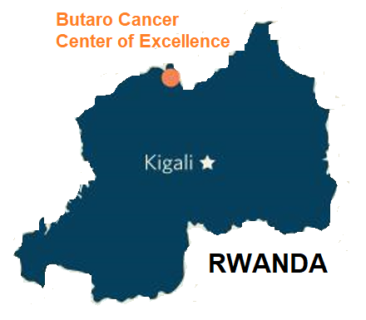
Butaro Cancer Center of Excellence (BCCOE)
Established in 2012 as the first cancer center in Rwanda.
Cancer care services at the BCCOE, include:
pathology-based diagnosis,
basic imaging,
chemotherapy, and
surgery.

Slide 4
Methods
We collected data on 8,970 patients who were observed during the study period:
7,140 patients in pre-COVID-19 (January 2016 – February 2020)
1,830 patients during COVID-19 (March 2020 – July 2021)
Measured outcomes, were the monthly number of new patients, number of clinical visits attended, number of scheduled appointments, and proportion of timely visits.
We did fit a generalized linear model with negative binomial distribution to predict outcomes for the COVID-19 period.
We computed monthly deviations (i.e. observed minus predicted count), and percent deviations.
All estimates were computed along with 95% prediction intervals.

Slide 5
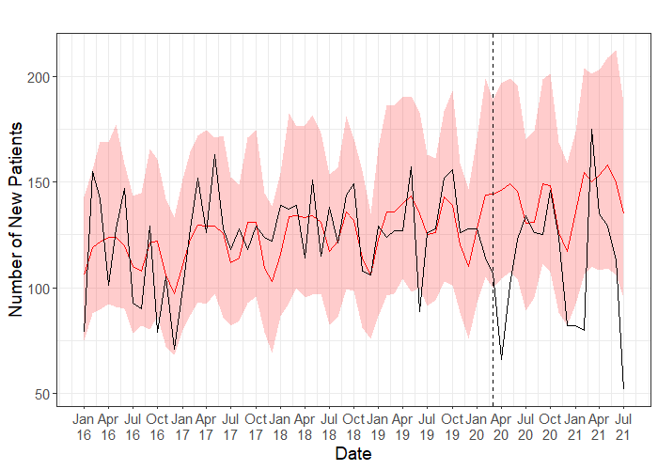
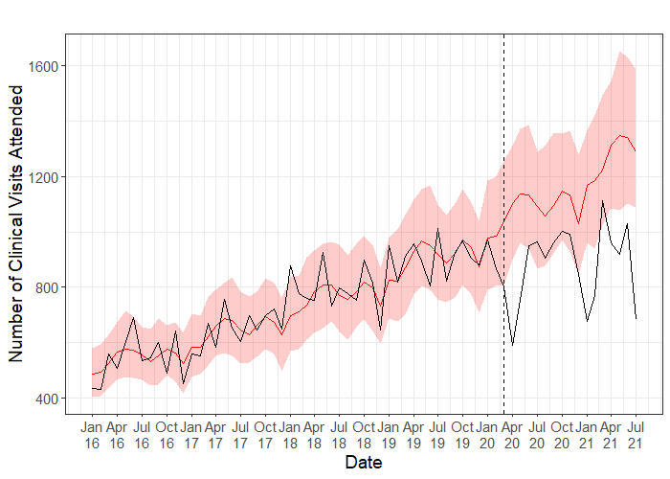
Time series models of new patients and clinical visits attended in pre-COVID-19 (January 2016 – February 2020) and during the pandemic (March 2020 – July 2021)

Slide 6
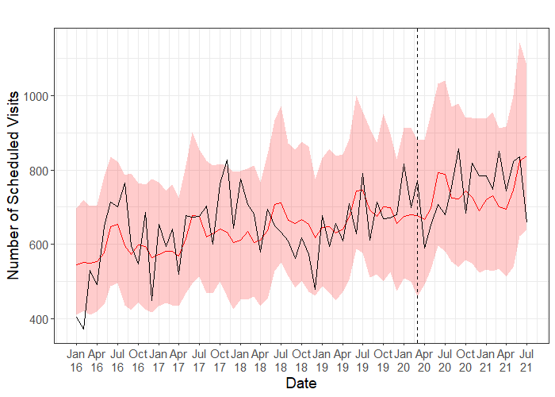
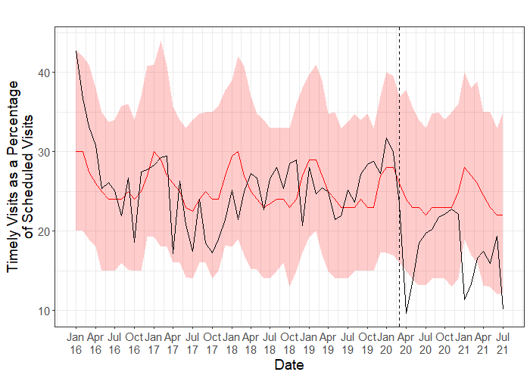
Time series models of scheduled appointments and timely visits as a percentage of scheduled appointments in pre-COVID-19 (January 2016 – February 2020) and during the pandemic (March 2020 – July 2021)

Slide 7
Cumulative counts and estimated deviations of outcomes during the COVID-19 period (March 2020 – July 2021)
Outcome | Observed Count | Expected Count | Estimated Deviation | Est. Percent Deviation (95% PI)
New Patients | 1900 | 2425.5 | -525.5 | -21.7% (-31.3%, -11.7%)
Scheduled Visits | 12741 | 12610.5 | 130.5 | 1.0% (-10.1%, 13.1%)
Clinical Visits Attended | 14911 | 19889.0 | -4978.0 | -25.0% (-31.1%, -19.1%)
Timely Visits (%) | 298.2 | 413.5 | -115.3 | -27.9% (-39.8%, -14.1%)

Slide 8
Discussion
We observed a significant drop in access to cancer care at the BCCOE during the COVID-19.
This could be attributed to the imposed measures to halt the spread of COVID-19 in Rwanda, including:
national and regional lockdowns,
restrictions on movements of people between places, and
suspension of public transport.
We particularly reported the largest declines in April 2020, January-February 2021 and July 2021 when these measures were imposed in Rwanda.
Our findings suggest delayed cancer diagnosis and treatment, which both may lead to negative health outcomes among our patient population in the coming months and years.
Notes:
A significant reduction in the cancer patient volume at health facilities during COVID-19 has also been reported from many other African countries¹ and Mexico².
¹Martei YM, Rick TJ, Fadelu T, et al. Impact of COVID-19 on Cancer Care Delivery in Africa: A Cross-Sectional Survey of Oncology Providers in Africa. JCO Global Oncology. 2021;(7):368-377. https://ascopubs.org/doi/pdf/10.1200/GO.20.00569
²Doubova S V, Leslie HH, Kruk ME, Pérez-Cuevas R, Arsenault C. Disruption in essential health services in Mexico during COVID-19: an interrupted time series analysis of health information system data. BMJ Global Health. 2021;6:6204. https://gh.bmj.com/content/6/9/e006204

Slide 9
Thank you!!
To submit Q&A questions, go to www.menti.com & enter code 5535 6338

