Slide 1
Integrating capacity building into our multisite research
Bethany Hedt-Gauthier
Associate Professor, Harvard Medical School
@BHedtGauthier
Bethany_Hedt@hms.Harvard.edu

Slide 2
Acknowledgements
The Cross-Site COVID-19 Research Working Groups
Overall leads: Jean Claude Mugunga and Megan Murray
Technical and capacity building leads: Dale Barnhart and Isabel Fulcher
Site teams
Volunteers, Interns and Students
Partners In Health
Harvard Medical School
Funders
Largely unfunded, volunteered time.
Harvard and PIH core funding
Canadian Institute for Health Research
ICODA (Grand Challenges)
Mercury Project

Slide 3
Why integrated capacity building?
We will do better, more impactful research if all are engaged in meaningful ways.
We all have something to learn and something to teach. And we all want to grow within our careers.
Historically, opportunities are not fairly shared across all those engaged. We specifically want to address these historical imbalances.

Slide 4
Strategies for capacity building
Informal:
Open community meetings
Senior- and Peer-mentoring
Formal
Short course
Writing workshop

Slide 5
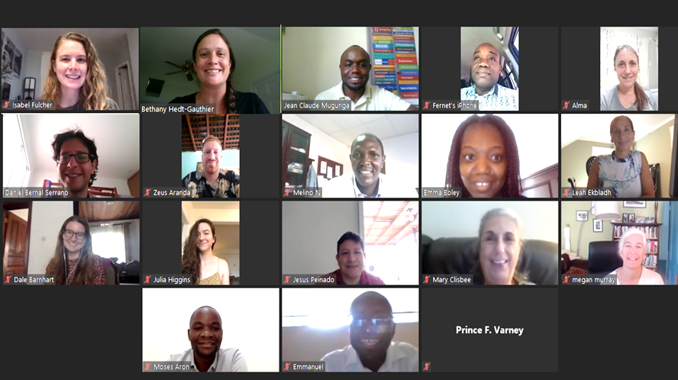
Informal
Biweekly meetings:
Present works in progress
Give feedback on methods and research.
Co-creating research works:
Opportunities for a range of individuals.
Mentoring/coaching for those leading the work.

Slide 6
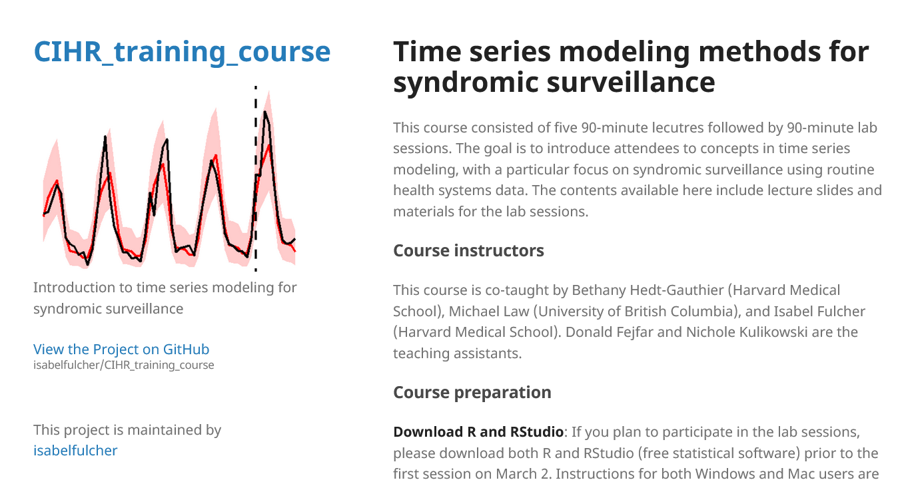
Time series analysis course
Objective: Increase confidence in surveillance methods; train statisticians to implement these methods in R.
Format:
Five sessions, fully online
1 hour general content; 2 hours statistical content
https://isabelfulcher.github.io/CIHR_training_course/

Slide 7
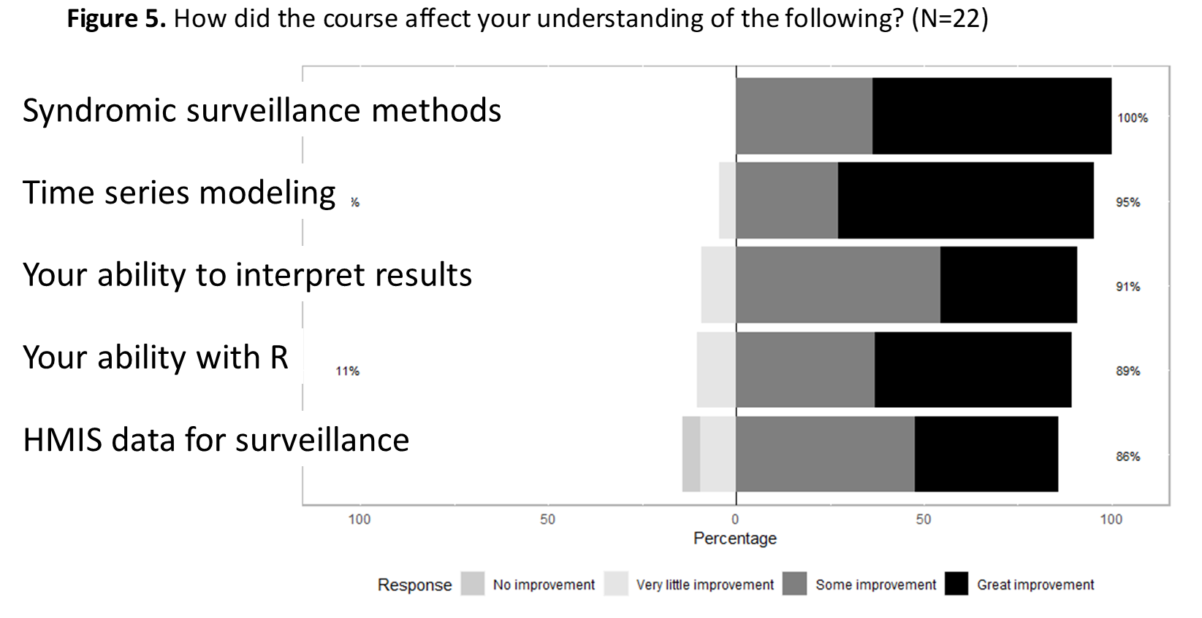

Slide 8
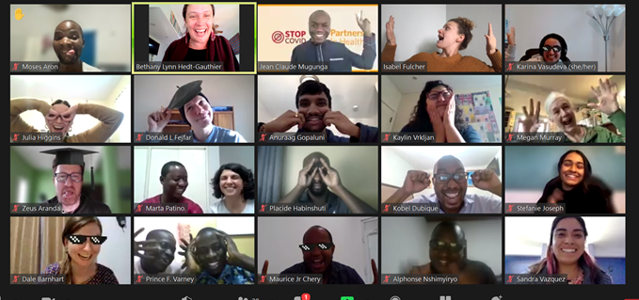
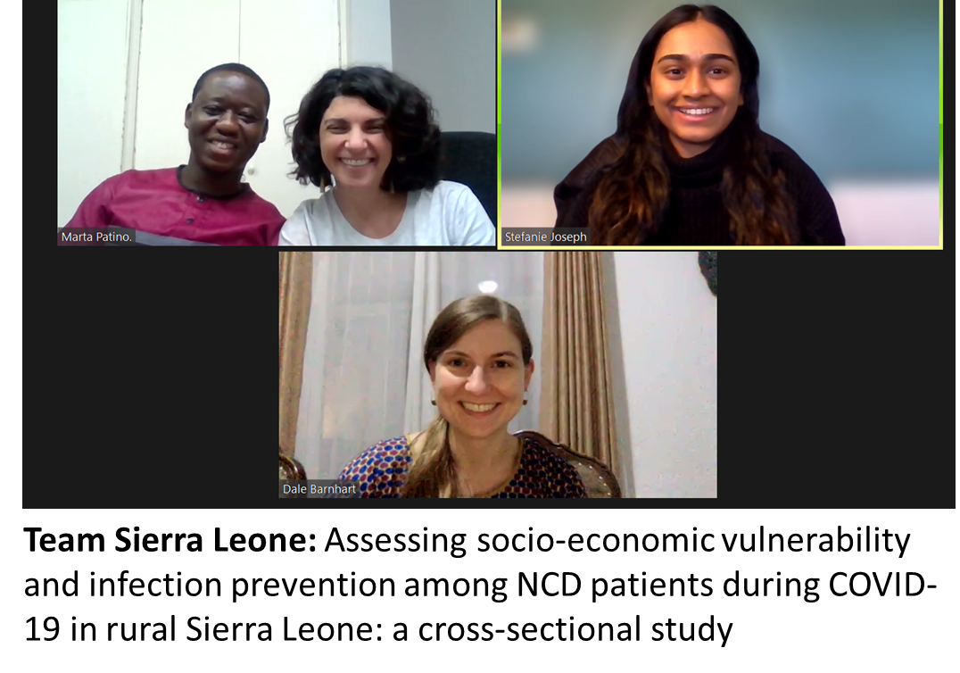
Writing workshop
Goal: Support six teams to produce papers from a set of available data.
Pre-workshop: Met with teams one-on-one to finalize results.
Workshop: Some core didactic lectures, lots of one-on-one time with mentor support.

Slide 9
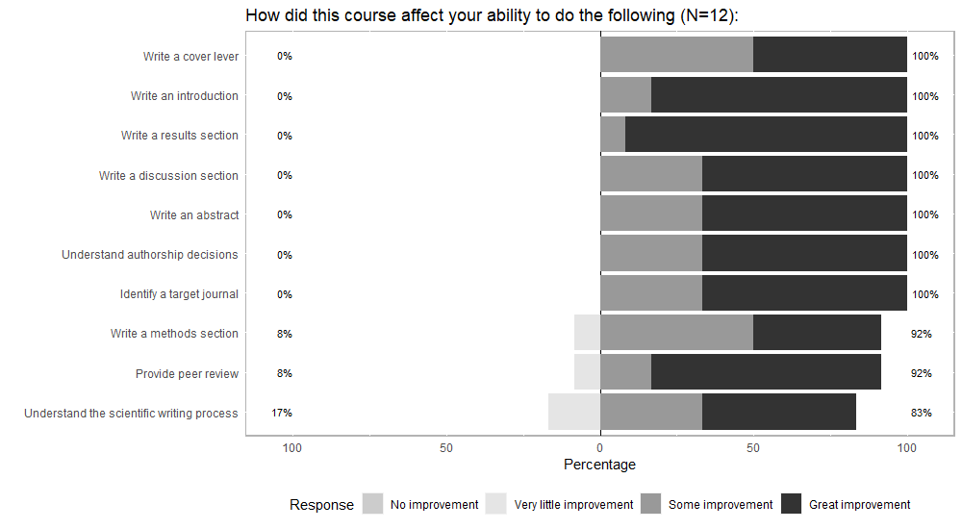

Slide 10
Lessons learned:
Lots of interest, more than we could satisfy.
Must prioritize accompaniment – supporting each other until achieve common goal.
Not everything for everyone – tailor to the needs of participants and offer enough to cover a range of needs/interests.
Be sensitive to time-zones and internet connectivity.

Slide 11
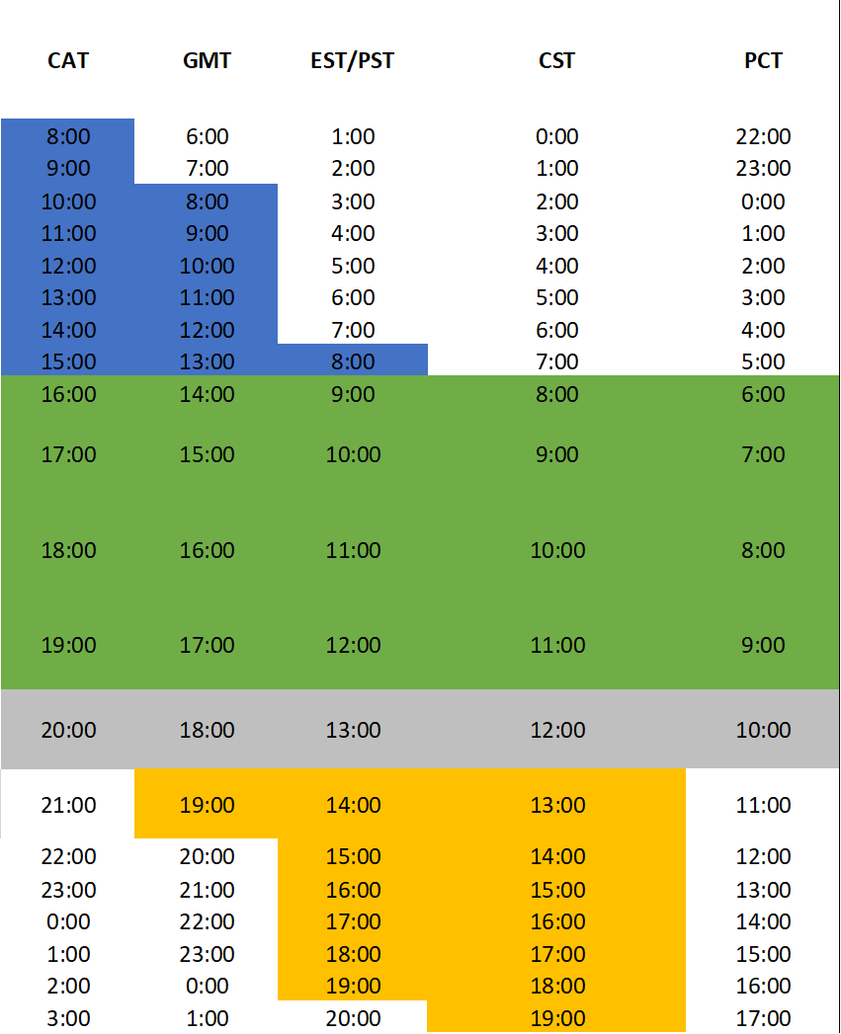
Lessons learned:
Lots of interest, more than we could satisfy.
Must prioritize accompaniment – supporting each other until achieve common goal.
Not everything for everyone – tailor to the needs of participants and offer enough to cover a range of needs/interests.
Be sensitive to time-zones and internet connectivity.

Slide 12
Questions/Feedback?
Bethany_Hedt@hms.Harvard.edu
@BHedtGauthier

