Slide 1
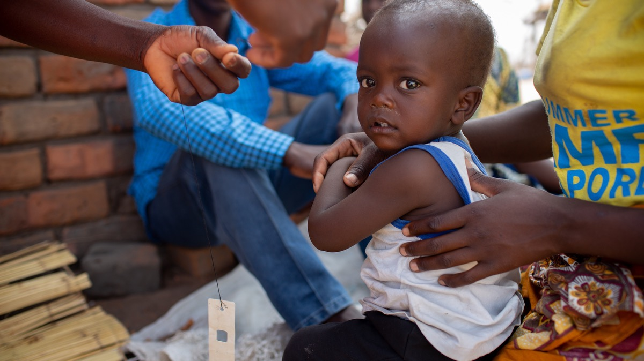
Childhood immunization during the COVID-19 pandemic: experience in Haiti, Lesotho, Liberia and Malawi
Emilia Connolly DO MPH
Abwenzi Pa Za Umoyo | November 2022

Slide 2
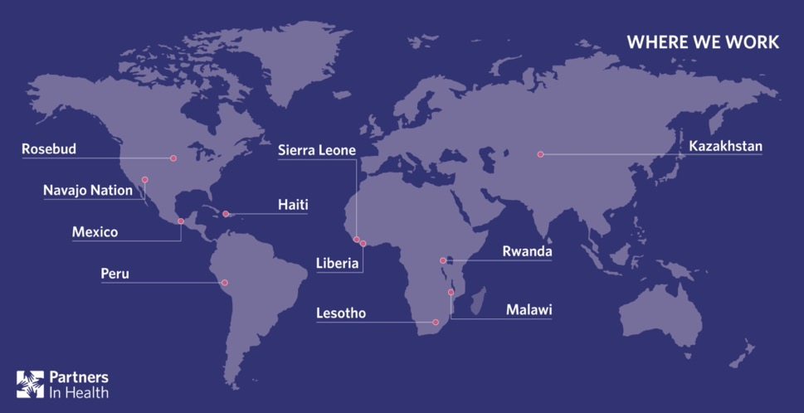
AUTHOR ACKNOWLEDGEMENT
Emilia Connolly,ª Emma J Boley,^{b} Donald Luke Fejfar,^{c} Prince F Varney,^{b} Moses B Aron,ª Isabel R Fulcher,^{d} Wesler Lambert,^{e} Melino Ndayizigiye,^{f} Michael R Law,^{g} Jean-Claude Mugunga^{c} & Bethany Hedt-Gauthier^{d} on behalf of the Cross-site COVID-19 Syndromic Surveillance Working Group
ª Partners In Health, P.O. Box 56, Neno, Malawi.
^{b} Partners In Health, Monrovia, Liberia.
^{c} Partners In Health, Boston, United States of America (USA).
^{d} Department of Global Health and Social Medicine, Harvard Medical School, Boston, USA.
^{e} Partners In Health, Port au Prince, Haiti.
^{f} Partners In Health, Maseru, Lesotho.
^{g} School of Population and Public Health, University of British Columbia, Vancouver, Canada.
Correspondence to Emilia Connolly (email: econnolly@pih.org).

Slide 3
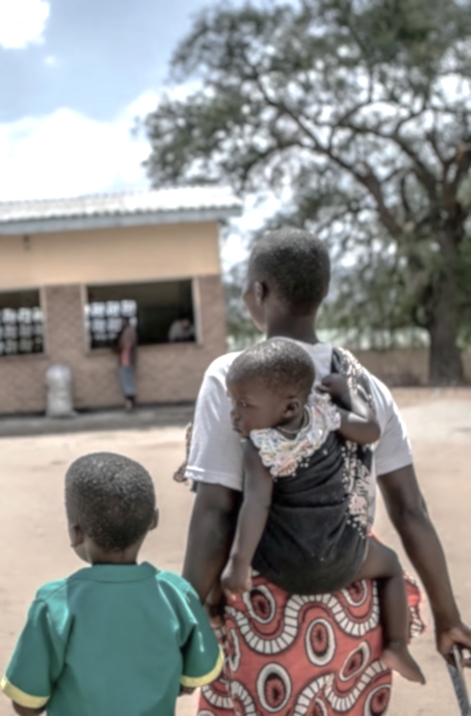
INTRODUCTION
COVID-19 pandemic interrupted essential services such as immunizations¹
Early pandemic models predicted severe interruptions and resulting increased mortality^{2,3}
COVID-19 mitigation measures had unintended effects on health service delivery^{4,5}
Gaps in sustained monitoring beyond initial prevention measures
Hartley and Perencevich 2020
Abbas et al 2020
Roberton et al. 2020
Haider et al 2020
WHO Pulse survey 2020
Notes:
Already inequitable coverage before pandemic in LMIC due to inadequate health infrastructure, insufficient human resources and supply chain disruptions. People living in the poorest households and in remote areas are least likely to have optimal vaccination coverage and uptake.5
Prior health emergencies such as H1N1 influenza and Ebola epidemics lead to secondary disease outbreaks.
One model by Abbas et al in early 2020 predicted that for every one excess COVID-19 death acquired during visits for routine vaccination, 84 deaths could be prevented by sustaining routine childhood immunization in Africa.
Mitigation measures - For example, of 105 countries included in the World Health Organization (WHO) pulse
survey in mid-2020, 50% reported partial disruptions and 10% reported severe disruptions in facility-based immunizations.15
Important gaps in the literature exist, including limited sustained monitoring beyond initial prevention measures, on-the-ground investigations in low- and middle-income countries outside Asia and little investigation within specific populations at risk.

Slide 4
OBJECTIVE
To examine changes in vaccination of children younger than 1 year during the COVID-19 pandemic (March 2020-August 2021) in Haiti, Lesotho, Liberia and Malawi
4 countries, 10 districts, 41 facilities and 6.4 million people
Allowed for investigation in varied geographic regions with different populations and mitigation measures and their practical application at local level
How can this help maintain immunization programmes and other essential services during acute health crises?

Slide 5
METHODS
Utilized negative binomial regression modeling⁶ from existing routine health information systems
Accounted for yearly and seasonal trends with historical data from Jan 2016 to Feb 2020*
Utilized models to extrapolate expected immunization counts without the pandemic with 95% confidence intervals
Reported cumulative difference in number of vaccinations and percent difference during three periods in the pandemic: Early (Mar-Aug 2020), Middle (Sep 2020-Feb 2021), Late (Mar-Aug 2021) with Total (Mar 2020-Aug 2021)
Analysis and visualizations done in R v4.0.4
Exclusions
Missing data for more than 20% baseline months or vaccine dose was missing data for any months in evaluation period (fit model assuming the data were missing at random)
301 facility indicator combinations, 8 (2.7%) were excluded
*Except for Haiti which started from January 2017
Fulcher et al. 2021

Slide 6
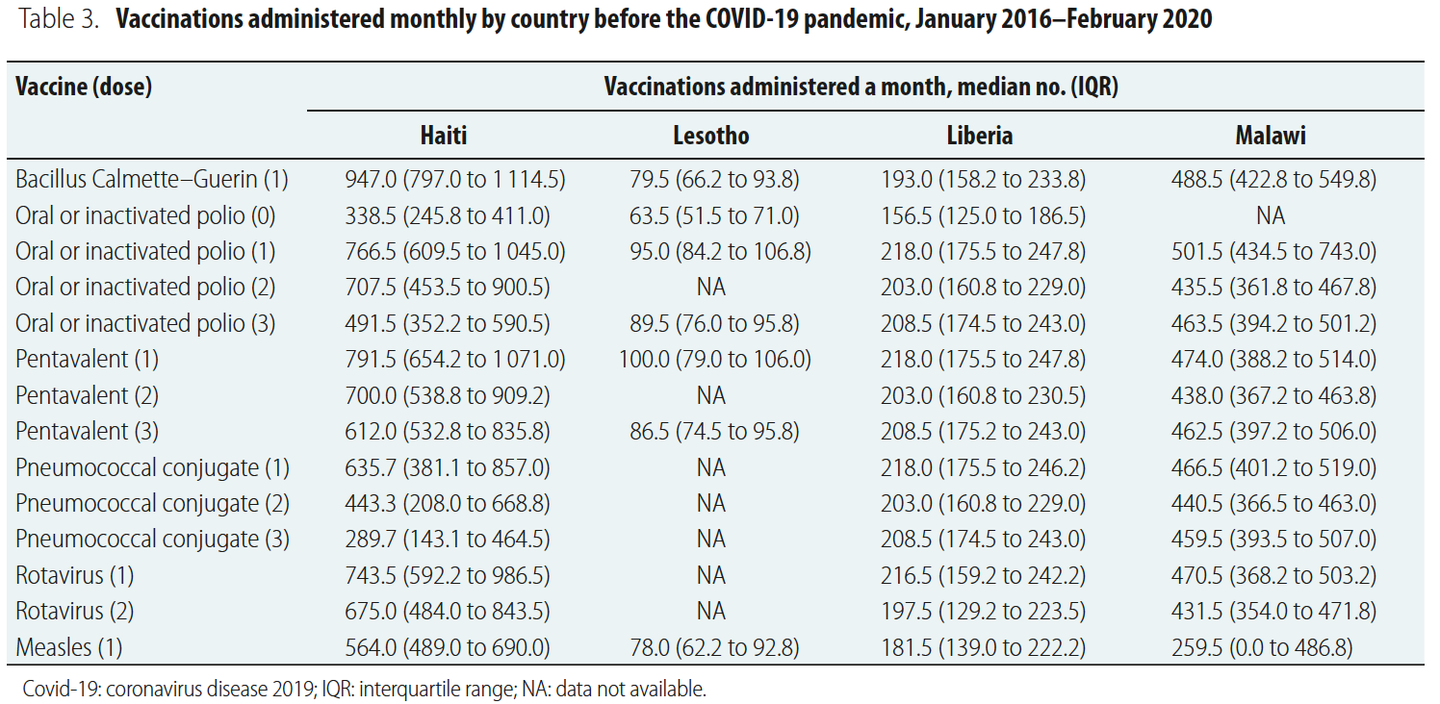
BASELINE DATA
Notes:
Immunization vaccine-dose combinations – considered 14 vaccine-dose combinations for children <1 year old as seen in the table.
The pentavalent vaccines contains hepatitis B, Haemophilus influenza type B and Dipththeria-tetanus and perfussis).
We report results for each vaccine dose by country
Some combinations are not included for specific countries, as you can see with the NA nonapplicable.
We grouped vaccines into five classes based on age at administration: at birth, at 6 weeks, at 10 weeks, at 14 weeks and at 36 weeks.
Lesotho had lowest number of monthly vaccinations from 63.5 for the first dose of Polio to 100 for pentavalent #1
Haiti had the highest number of vaccines from 289.7 pneumococcal dose 3 to 947 BCG vaccines administered per month

Slide 7
BASELINE DATA
Notes:
Immunization vaccine-dose combinations – considered 14 vaccine-dose combinations for children <1 year old as seen in the table.
The pentavalent vaccines contains hepatitis B, Haemophilus influenza type B and Dipththeria-tetanus and perfussis).
We report results for each vaccine dose by country
Some combinations are not included for specific countries, as you can see with the NA nonapplicable.
We grouped vaccines into five classes based on age at administration: at birth, at 6 weeks, at 10 weeks, at 14 weeks and at 36 weeks.
Lesotho had lowest number of monthly vaccinations from 63.5 for the first dose of Polio to 100 for pentavalent #1
Haiti had the highest number of vaccines from 289.7 pneumococcal dose 3 to 947 BCG vaccines administered per month

Slide 8
BASELINE DATA
Notes:
Immunization vaccine-dose combinations – considered 14 vaccine-dose combinations for children <1 year old as seen in the table.
The pentavalent vaccines contains hepatitis B, Haemophilus influenza type B and Dipththeria-tetanus and perfussis).
We report results for each vaccine dose by country
Some combinations are not included for specific countries, as you can see with the NA nonapplicable.
We grouped vaccines into five classes based on age at administration: at birth, at 6 weeks, at 10 weeks, at 14 weeks and at 36 weeks.
Lesotho had lowest number of monthly vaccinations from 63.5 for the first dose of Polio to 100 for pentavalent #1
Haiti had the highest number of vaccines from 289.7 pneumococcal dose 3 to 947 BCG vaccines administered per month

Slide 9
RESULTS
Overall Vaccination Deficits
March 2020 – August 2021
All countries except Libera had a cumulative deficit for the 14-dose combination
Only significant changes were a deficit for rotavirus doses 1 and 2 in Liberia and all vaccine-dose combinations in Malawi
March – August 2020
Declines except for Malawi
Statistically significant drops in measles for Haiti, Lesotho & Liberia with ending upward trend
Sep 2020 – February 2021
Most returned to expected levels with decreases at the end of the period
Country | Cumulative % Difference
Haiti | -5.1% (-16.8% to 19.9%)
Lesotho | -5.9% (-16.3% to 10.1%)
Liberia | +8.0% (-21.1% to 15.9%)
Malawi | -2.0% (-14.1% to 12.6%)
March – August 2021
Vaccination levels returned to expected or above baseline except in Malawi

Slide 10
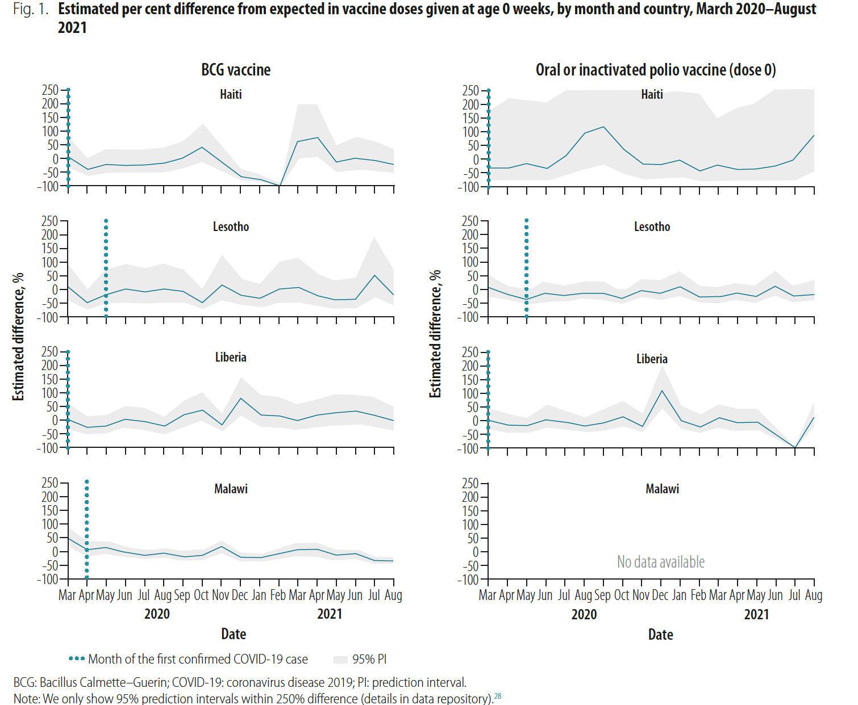
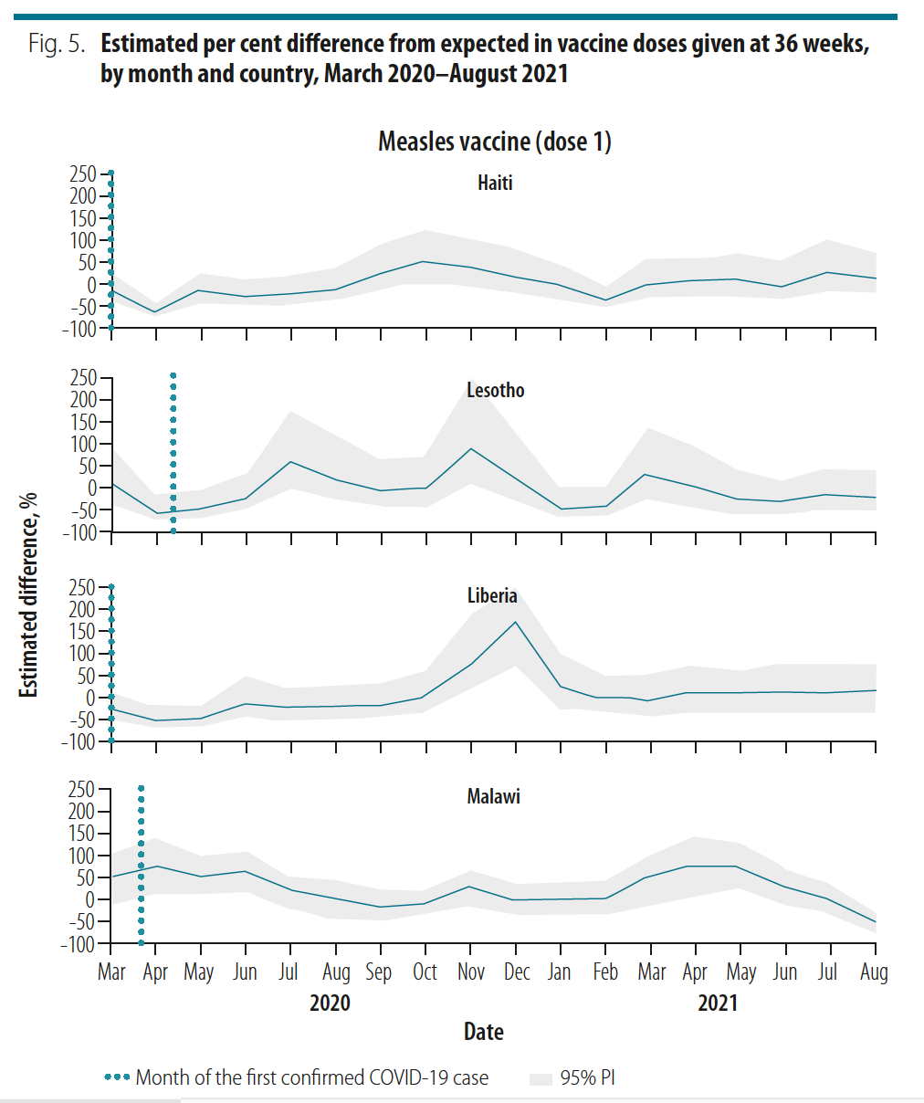
SELECTED RESULTS REVIEW

Slide 11
SELECTED RESULTS REVIEW
STOCKOUTS

Slide 12
SELECTED RESULTS REVIEW
COMMUNITY SENSITIZATION OR CATCH-UP CAMPAIGN

Slide 13
SELECTED RESULTS REVIEW
Variation In Pandemic Waves

Slide 14
DISCUSSION
Initial declines were observed in Europe^{10,11}, North America¹² and Asia¹³ in early 2020
Now studies in Africa are observing rebounds consistently and dependent on waves of infection¹⁴⁻¹⁶
Variations complex and varied by country and even by district. Importance of community health awareness, education and outreach
More pronounced declines with older children
Now juggling with COVID-19 vaccine and other emerging outbreaks and emergencies
Selected Feature | Haiti | Lesotho | Liberia | Malawi
COVID-19 Stringency index⁷*
Cumulative COVID-19 Cases per 1 million^{8,9^} | 1806 | 6667 | 1080 | 3073
Cumulative case fatality rate^{8,9}^ | 2.8% | 2.8% | 4.4% | 3.6%
Consistent Community outreach
*At beginning of the pandemic; all dropped by May 2021
^As of 31 August 2021
Hale et al. 2021
Dong et al. 2020
Our World in Data 2021
Middeldorp et al 2021
McDonald, et al. 2020
O’Leary et al. 2021
Zhong et al 2021
Hategeka et al 2021
Spencer et al 2020
Shet et al 2020
Notes:
Recent information of rebounds observed in studies mostly out of Africa –
2 studies in HIC demonstrated early rebounds in coverage with catch up campaigns and lifting of social distancing measures in the US and the Netherlands.
Kinshasa, systematic review and 170 countries from routine data collection
In our study, variations in vaccination coverage was complex due to the context, mitigation measures, strength of the local health system
We found from the results and consultations in the local context that community health awareness, education and outreach were critical to maintaining immunizations in childhood
More studies are warranted with now juggling the COVID-19 vaccination campaigns and other emerging outbreaks like Monkeypox and emergencies such as conflict and inclement weather
Our study has several limitations that included use of aggregated data at health facility level, with the potential that COVID-19 affected facility reporting but with broad support this is less likely, and limited generalizablility with only 4 countries but allows for broad geography and detailed assessment. Lastly we also excluded facilities with more than 20% missing baseline data to avoid undercounting. It is important to emphasize that we excluded very few facilities because of having more than 20% missing data, with a maximum number of four facilities, out of 41 facilities, excluded for a single vaccine dose indicator.

Slide 15
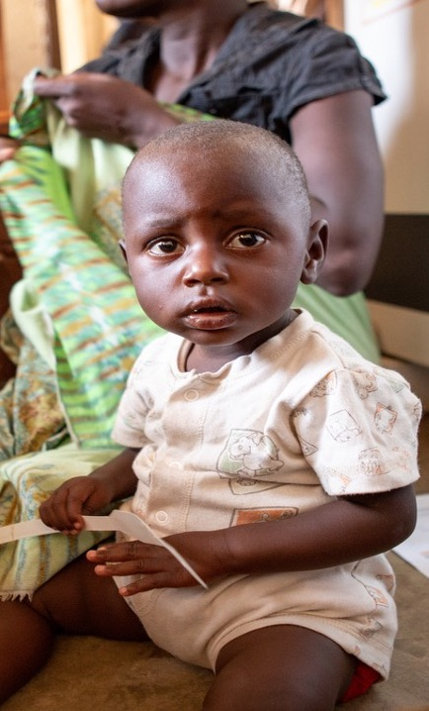
CONCLUSION
To ensure vaccine utilization rates are well maintained despite continued waves of COVID-19 and new outbreaks and emergencies, we need to:
Contextualize response within health systems with building capacity for health care staff including targeted community outreach clinics
Strengthen efforts to educate communities and parents on COVID-19 and the value of childhood vaccinations
To submit Q&A questions, go to www.menti.com & enter code 5535 6338
Notes:
We hope that these findings can help local and national health care systems strengthen their systems to extrernal health emergency shocks to maintain important essential health services such as immunizations.
Thank you.

Slide 16
REFERENCE
Hartley DM, Perencevich EN. Public health interventions for COVID-19: emerging evidence and implications for an evolving public health crisis. JAMA. 2020 May 19;323(19):1908–9. doi: http:// dx .doi .org/ 10 .1001/ jama.2020 .5910 PMID: 32275299
Abbas K, Procter SR, van Zandvoort K, Clark A, Funk S, Mengistu T, et al. Routine childhood immunisation during the COVID-19 pandemic in Africa: a benefit-risk analysis of health benefits of routine childhood immunization against the excess risk of SARS-CoV-2 infections during the COVID-19 pandemic in Africa. Lancet Glob Health. 2020 Oct;8(10):e1264–72. doi: http:// dx .doi .org/ 10 .1016/ S2214 -109X(20)30308 -9 PMID: 32687792
Roberton T, Carter ED, Chou VB, Stegmuller AR, Jackson BD, Tam Y, et al. Early estimates of the indirect effects of the COVID-19 pandemic on maternal and child mortality in low-income and middle-income countries: a modelling study. Lancet Glob Health. 2020 Jul;8(7):e901–8. doi: http:// dx.doi .org/ 10 .1016/ S2214 -109X(20)30229 -1 PMID: 32405459
Haider N, Osman AY, Gadzekpo A, Akipede GO, Asogun D, Ansumana R, et al. Lockdown measures in response to COVID-19 in nine sub-Saharan African countries. BMJ Glob Health. 2020 Oct;5(10):e003319. doi: http:// dx .doi .org/ 10 .1136/ bmjgh -2020 -003319 PMID: 33028699
Pulse survey on continuity of essential health services during the COVID-19 pandemic: interim report, 27 August 2020. Geneva: World Health Organization; 2020. Available from: https:// apps .who .int/ iris/ handle/ 10665/334048 [cited 2021 Mar 11].
Fulcher IR, Boley EJ, Gopaluni A, Varney PF, Barnhart DA, Kulikowski N, et al.; Cross-site COVID-19 Syndromic Surveillance Working Group. Syndromic surveillance using monthly aggregate health systems information data: methods with application to COVID-19 in Liberia. Int J Epidemiol. 2021 Aug 30;50(4):1091–102. doi: http:// dx .doi .org/ 10 .1093/ ije/ dyab094 PMID: 34058004
Hale T, Angrist N, Goldszmidt R, Kira B, Petherick A, Phillips T, et al. A global panel database of pandemic policies (Oxford COVID-19 Government Response Tracker). Nat Hum Behav. 2021 Apr;5(4):529–38. doi: http:// dx .doi.org/ 10 .1038/ s41562 -021 -01079 -8 PMID: 33686204
Dong E, Du H, Gardner L. An interactive web-based dashboard to track COVID-19 in real time. Lancet Infect Dis. 2020 05;20(5):533–4. doi: http:// dx .doi .org/ 10 .1016/ S1473 -3099(20)30120 -1 PMID: 32087114
Case fatality rate of COVID-19 [internet]. Oxford: Our World in Data; 2021. Available from: https:// ourworldindata .org/ explorers/ coronavirus -data-explorer ?zoomToSelection = true & time = 2020 -03 -14 .latest & facet = none & pickerSort = asc & pickerMetric = location & hideControls = true & Metric = Case+fatality+ rate & Interval = Cumulative & Relative+ to+ Population = false & Align+outbreaks = true & country = MWI ~LBR ~LSO ~HTI [cited 2021 Oct 23].
Middeldorp M, van Lier A, van der Maas N, Veldhuijzen I, Freudenburg W, van Sorge NM, et al. Short term impact of the COVID-19 pandemic on incidence of vaccine preventable diseases and participation in routine infant vaccinations in the Netherlands in the period March–September 2020. Vaccine. 2021 Feb 12;39(7):1039–43. doi: http:// dx .doi .org/ 10 .1016/ .vaccine .2020 .12 .080 PMID: 33478793
McDonald HI, Tessier E, White JM, Woodruff M, Knowles C, Bates C, et al. Early impact of the coronavirus disease (COVID-19) pandemic and physical distancing measures on routine childhood vaccinations in England, January to April 2020. Euro Surveill. 2020 May;25(19):2000848. doi: http:// dx .doi .org/10 .2807/ 1560 -7917 .ES .2020 .25 .19 .2000848 PMID: 32431288

Slide 17
REFERENCE
O’Leary ST, Trefren L, Roth H, Moss A, Severson R, Kempe A. Number of childhood and adolescent vaccinations administered before and after the COVID-19 outbreak in Colorado. JAMA Pediatr. 2021 Mar 1;175(3):305–7. doi: http:// dx .doi .org/ 10 .1001/ jamapediatrics .2020 .4733 PMID: 33284331
Zhong Y, Clapham HE, Aishworiya R, Chua YX, Mathews J, Ong M, et al. Childhood vaccinations: hidden impact of COVID-19 on children in Singapore. Vaccine. 2021 Jan 29;39(5):780–5. doi: http:// dx .doi .org/ 10 .1016/ j .vaccine .2020 .12 .054 PMID: 33414050
Hategeka C, Carter SE, Chenge FM, Katanga EN, Lurton G, Mayaka SM-N, et al. Impact of the COVID-19 pandemic and response on the utilization of health services in public facilities during the first wave in Kinshasa, the Democratic Republic of the Congo. BMJ Glob Health. 2021 Jul;6(7):e005955. doi: http:// dx .doi .org/ 10 .1136/ bmjgh -2021 -005955 PMID: 34315776
Spencer N, Nathawad R, Arpin E, Johnson S. Pandemics, epidemics and inequities in routine childhood vaccination coverage: a rapid review. BMJ Paediatr Open. 2020 Nov 2;4(1):e000842. doi: http:// dx .doi .org/ 10 .1136/ bmjpo -2020 -000842 PMID: 33195821
Shet A, Carr K, Danovaro-Holliday MC, Sodha SV, Prosperi C, Wunderlich J, et al. Impact of the SARS-CoV-2 pandemic on routine immunisation services: evidence of disruption and recovery from 170 countries and territories. The Lancet Global Health. 2022;10(2):e186-e94.

