Slide 1
Local responses to a global pandemic: experiences from a collaborative partnership spanning nine countries
7th Global Symposium on Health Systems Research
November 4, 2022
Isabel Fulcher, Harvard Medical School, USA
Alphonse Nshimyiryo, Inshuti Mu Buzima, Rwanda
Zeus Aranda, Compañeros En Salud, Mexico
Marco Tovar, Socios En Salud, Peru
Emilia Connolly, Abwenzi Pa Za Umoyo, Malawi
Bethany Hedt-Gauthier, Harvard Medical School, USA

Slide 2




Introduction & Overview
Research lightning talks
Capacity building initiatives
Contributor Question & Answer
Isabel Fulcher, PhD
Former Postdoctoral Fellow
Harvard Medical School, USA

Slide 3

Introduction & Overview
Research lightning talks
Capacity building initiatives
Contributor Question & Answer
Isabel Fulcher, PhD
Former Postdoctoral Fellow
Harvard Medical School, USA
Alphonse Nshimyiryo, MS
Data Analyst
Inshuti Mu Buzima, Rwanda
Zeus Aranda, MS
Research & Impact Coordinator
Compañeros En Salud, Mexico
Marco Tovar, MD
Medical Director
Socios En Salud, Peru
Emilia Connolly, MPH, MD
Chief Health Systems Policy Advisor Abwenzi Pa Za Umoyo, Malawi

Slide 4

Introduction & Overview
Research lightning talks
Capacity building initiatives
Contributor Question & Answer
Isabel Fulcher, PhD
Former Postdoctoral Fellow
Harvard Medical School, USA
Alphonse Nshimyiryo, MS
Data Analyst
Inshuti Mu Buzima, Rwanda
Zeus Aranda, MS
Research & Impact Coordinator
Compañeros En Salud, Mexico
Marco Tovar, MD
Medical Director
Socios En Salud, Peru
Emilia Connolly, MPH, MD
Chief Health Systems Policy Advisor Abwenzi Pa Za Umoyo, Malawi
Bethany Hedt-Gauthier, PhD
Associate Professor
Harvard Medical School, USA

Slide 5

Introduction & Overview
Research lightning talks
Capacity building initiatives
Contributor Question & Answer
Isabel Fulcher, PhD
Former Postdoctoral Fellow
Harvard Medical School, USA
Alphonse Nshimyiryo, MS
Data Analyst
Inshuti Mu Buzima, Rwanda
Zeus Aranda, MS
Research & Impact Coordinator
Compañeros En Salud, Mexico
Marco Tovar, MD
Medical Director
Socios En Salud, Peru
Emilia Connolly, MPH, MD
Chief Health Systems Policy Advisor Abwenzi Pa Za Umoyo, Malawi
Bethany Hedt-Gauthier, PhD
Associate Professor
Harvard Medical School, USA
Please go to
www.menti.com
Enter code
5535 6338
Submit questions during the session!

Slide 6

The Global Health Delivery Partnership
Division of Global Health Equity
Brigham and Women’s Hospital
Global Health Research Core
Dept of Global Health and Social Medicine
Harvard Medical School
Partners In Health

Slide 7
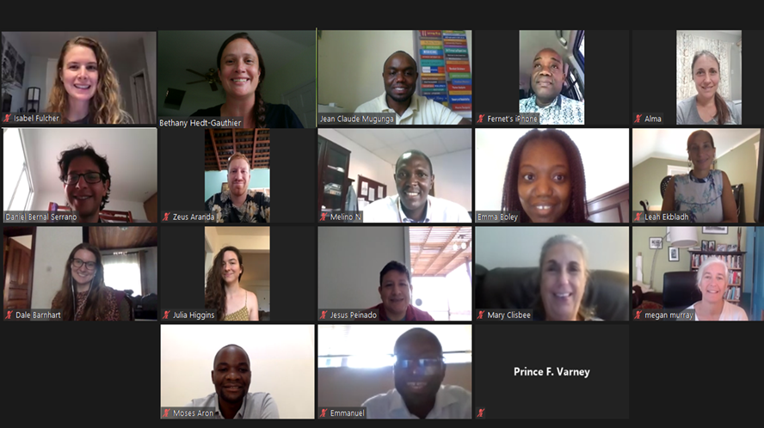
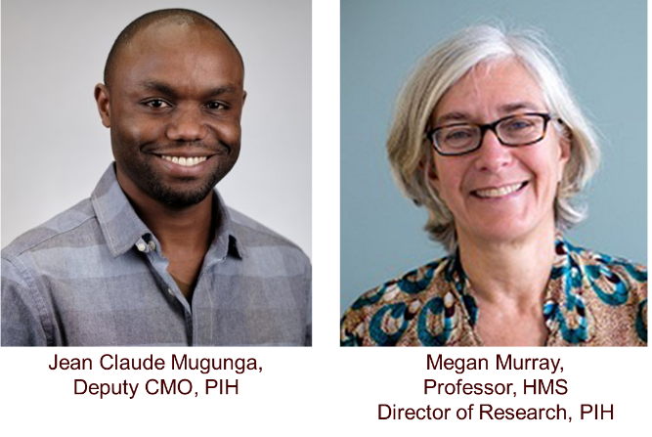
Cross-PIH site collaboration
Facilitate the development of high-quality COVID-related research at sites
Reduce duplicative work across both sites and clinical areas
Harmonize processes in a way that enables cross-site analyses
Promote equitable opportunities for participation in research and research dissemination

Slide 8
We implemented a variety of studies
Serosurveillance – what is the burden of COVID-19?
Cohort studies – how has COVID-19 affected specific populations?
Using routine health systems data for:
Syndromic surveillance – what regional areas may be having higher than expected rates of COVID-19-associated symptoms?
Health service utilization – did the number of individuals receiving care change during the COVID-19 pandemic?

Slide 9
Serosurveillance
Methods development: Extending lot quality assurance sampling to account for imperfect tests (Fulcher et al, 2022, BMC Public Health)
Protocol guidance: Should individuals receive the results of their antibody tests? (Mugunga et al., 2021, The Lancet)
Serosurveys: Supporting countries design studies and/or analyze data
Antibody tests among health workers in Haiti in April-September 2020
Population-based seroprevalence studies in Peru and Mexico

Slide 10
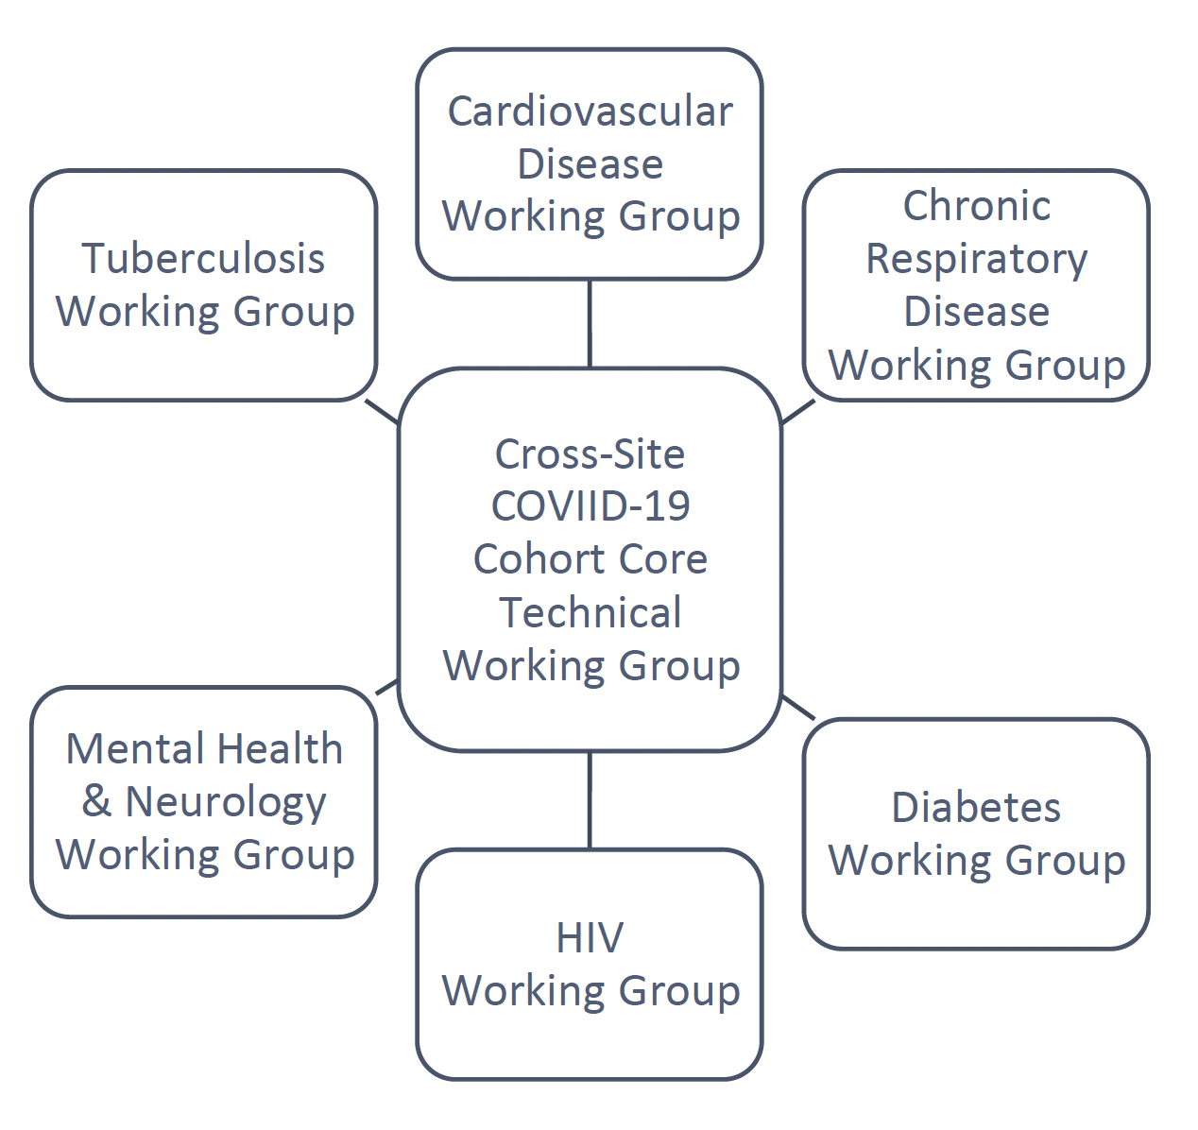
Cohort studies
To understand:
Epidemiology and progression of disease, overall and in specific risk-groups.
Changes in care and/or outcomes for chronic care patients.
Activities:
Create overall cohort designs that align with sites’ priorities
Develop data collection tools .
Facilitate protocol development and ethical approvals, including providing a core protocol template.
Harmonize data collection and processing procedures.
Seek funding to support activities centrally and at sites.
PIH Cross-Site COVID-19 Cohort Research Network:
A central core technical working group coordinated across multiple disease-specific teams

Slide 11
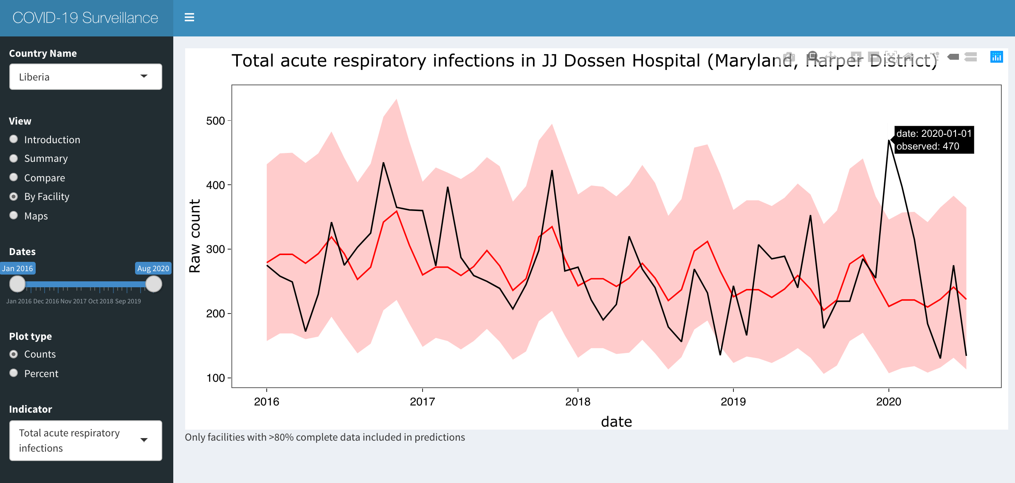
Using routine health systems data
Methods development:
Identifying deviations using monthly time series data
Monthly monitoring
Cross-site research
Acute respiratory infections in Liberia (Fulcher et al., IJE, 2021)
Childhood immunizations (Connolly et al., WHO Bulletin, 2021)
Maternal health service utilization (Aranda et al., BMJ Global Health, 2021)

Slide 12
How did the cross-site collaboration work?
Identifying research questions
Assembling a cross-site team
Ethical approvals & data sharing
Gathering resources
Biweekly working group meetings from April 2020 to June 2022
Brainstorm potential research activities
Assess interest across site to assemble a team
Decide on project roles at outset
Typically, 1-2 lead writers, 1-2 analysts, 1 scientific lead
Site-specific contributors
Identify what additional training or support is needed
Site-specific IRBs and DUAs
Non-PIH analysts (at Harvard) approved by each site
Governance structure documents were key for larger coordination
Technical support from graduate students, aligned with thesis goals
Received 3 grants to fund cross-site efforts, but some work was still unfunded

Slide 13
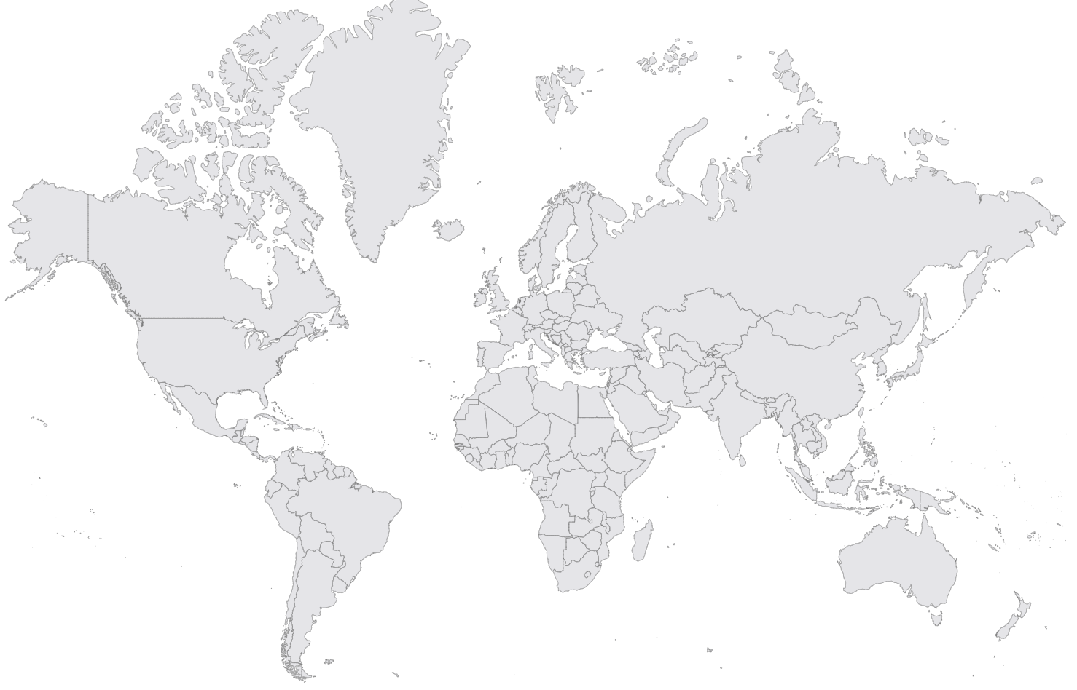
COVID-19 Multicountry Research Group
PIH/Boston
Nidia Correa
Jean Claude Mugunga
Natalie Price
PIH/Mexico
Zeus Aranda
Daniel Bernal
PIH/Peru
Leonid Lecca
Jesus Peinado
PIH/Malawi
Moses Aron
Emilia Connolly
PIH/Rwanda
Vincent Cubaka
Nadine Karema
Frederick Katera
PIH/Liberia
Emma Boley
Rebecca Cook
Prince Varney
PIH/Haiti
Peterson Abnis I Faure
Mary Clisbee
Wesler Lambert
Fernet Leandre
Jeune Marc Antionne
PIH/Lesotho
Thiane Mohlouoa
Meba Msuya
Melino Ndayizigiye
Patrick Nkundanyirazo
PIH/Sierra Leone
Thierry Binde
Chiyembekezo Kachimanga
Harvard Medical School
Alma Adler
Dale Barnhart
Leah Ekbladh
Molly Franke
Isabel Fulcher
Bethany Hedt-Gauthier
Megan Murray
Interns
Katherine Collamore
Don Fejfar
Anuraag Gopulani
Nichole Kulikowski
Ananya Tadikonda
Kate Tashman
Kartik Tyagi
Karina Vasudeva
Jessica Wang
University of British Columbia
Michael Law
University of Hong Kong
Karen Grepin

Slide 14
Submit your questions for Q&A!
After each research talk, there will be 2 minutes to ask clarifying questions
Submit other questions via www.menti.com
Moderator will collate questions for Q&A
If question is for specific presenter, please reference their first or last name
Questions will be public but can remain anonymous
Please go to
www.menti.com
Enter code
5535 6338

Slide 15
Panel Q&A
Alphonse Nshimyiryo, MS (Virtual)
The impact of COVID-19 on access to cancer care in Rwanda
Zeus Aranda, MS
Implementation and evolution of a community health worker-led COVID-19 contact tracing intervention in Chiapas, Mexico
Marco Tovar, MD
Seroprevalence of SARS-CoV-2 infection in Carabayllo, Peru
Emilia Connolly, MPH, MD
Childhood immunization during the COVID-19 pandemic
Bethany Hedt-Gauthier, PhD
Integrating capacity building into our multisite research

