Slide 1
AI APPLICATION · FINAL PROJECT (최종 발표)
Comparison of Four Optimizers for CNN-Based
Classification of Strawberry Leaf Diseases
CNN 기반 딸기 잎 질병 분류를 위한 4가지 최적화 알고리즘 비교
Using RGB images, three strawberry leaf-disease classes
RGB 이미지를 사용한 딸기 잎 질병 3종 분류
SGD · Adagrad · RMSprop · Adam | Small CNN vs ResNet-18
Notes:
Hello, today I'm presenting my project on comparing four optimizers, SGD, Adagrad, RMSprop and Adam, for classifying three strawberry leaf diseases with a CNN.
At the end, I also compare my small CNN with a pretrained ResNet-18, to see if a stronger model changes which optimizer is best.

Slide 2
OVERVIEW (개요)
Research question
연구 질문
How do SGD, Adagrad, RMSprop, and Adam affect classification accuracy,
convergence speed, and training time for one fixed CNN?
고정된 CNN 하나에서 SGD, Adagrad, RMSprop, Adam이 분류 정확도·수렴 속도·학습 시간에 어떤 영향을 주는가?
1
Best accuracy
최고 정확도
2
Fastest convergence
가장 빠른 수렴
3
Lowest training time
최단 학습 시간
Which optimizer classifies the three diseases most correctly.
Which reaches useful performance in the fewest epochs.
Which is cheapest to train on a laptop.
Notes:
My research question is how the four optimizers affect one fixed CNN in three ways.
First, accuracy: which optimizer classifies the three diseases most correctly.
Second, convergence: which one reaches useful performance in the fewest epochs.
Third, training time: which one is cheapest to train on a laptop.

Slide 3
EXPECTED OUTPUTS (예상 결과물)
What the project delivers
프로젝트 산출물
Target: Which optimizer best suits a small strawberry leaf classifier?
목표: 소형 딸기 잎 분류기에 가장 적합한 최적화 알고리즘은 무엇인가?
1
2
3
Speed & accuracy
속도·정확도
Curves & matrices
곡선·혼동 행렬
Per-disease metrics
질병별 지표
Time (s), epochs, s/epoch, and train / val / test accuracy per optimizer.
Performance graph and a confusion matrix for each of the four optimizers.
Precision, recall, F1 per class, with macro and weighted averages.
Notes:
The target of the project was to find which optimizer best suits a small strawberry leaf classifier.
I planned three outputs: speed and accuracy numbers for each optimizer, training curves and confusion matrices, and precision, recall and F1 for each disease.

Slide 4
INPUT DATA (입력 데이터)
The dataset
데이터셋 · Roboflow Universe 공개 데이터
Original split (7 classes) · 원본 분할
Strawberry Disease Detection Dataset
Roboflow Universe · strawberry-disease
3,440
Train set
학습 세트
Total images (전체 이미지)
4,918
License (라이선스)
CC BY 4.0
992
Valid set
검증 세트
Label format (라벨 형식)
YOLOv8
Resize (크기 조정)
280 × 280
486
Test set
테스트 세트
Augmentation (증강)
None applied
These counts cover all 7 classes; the 3-class totals come from the cleaning step. (이 수치는 7개 클래스 전체 기준이며, 3-클래스 합계는 정제 단계에서 산출됨)
Notes:
I used the Strawberry Disease Detection Dataset from Roboflow Universe.
It has 4,918 images in YOLOv8 format, resized to 280 by 280, with no augmentation, under a CC BY 4.0 license.
The split numbers here cover all seven original classes; the three-class numbers come from my cleaning step on the next slide.

Slide 5
CLASS SELECTION (클래스 선정)
From 7 classes to 3 leaf diseases
7개 클래스에서 잎 질병 3종으로
Cleaning and split · 정제 및 분할
7 original classes · 원본 7개 클래스
Cleaning step | Images
Photos scanned | 4,898
No selected class (removed) | −1,828
Duplicate photos (removed) | −1,823
Unique photos kept | 1,247
Leaf crops extracted (55 boxes too small, removed) | 3,429
✓
Leaf spot (점무늬병)
✓
Angular leaf spot (각반병)
→
✓
Powdery mildew leaf (흰가루병(잎))
Table 1. Dataset cleaning (데이터 정제). The cleaning script scanned 4,898 of the 4,918 exported images.
Anthracnose fruit rot (탄저병(과실))
Split | Angular leaf spot | Leaf spot | Powdery mildew | Photos
Train | 269 | 968 | 1,131 | 872
Validation | 49 | 210 | 264 | 187
Test | 58 | 205 | 275 | 188
Total | 376 | 1,383 | 1,670 | 1,247
Blossom blight (꽃마름병)
Gray mould (잿빛곰팡이병)
Powdery mildew fruit (흰가루병(과실))
Table 2. Leaf crops per split and class (분할·클래스별 잎 크롭 수); split 70 / 15 / 15 by photo.
Notes:
Out of the seven classes, I kept the three leaf diseases: leaf spot, angular leaf spot and powdery mildew on the leaf.
The cleaning script scanned 4,898 images, removed photos without these classes and duplicate photos, and kept 1,247 unique photos.
From those I cropped 3,429 leaves. I split 70/15/15 by photo, so crops from the same photo never end up in different splits.
Angular leaf spot is only about 11% of the data, so it is the rare class.

Slide 6
METHODOLOGY (연구 방법)
Pipeline and CNN model
파이프라인과 CNN 모델
1
Clean & crop
정제·크롭
2
Fixed split
고정 분할
3
Small CNN
소형 CNN
4
Tune & train
학습률 탐색·학습
→
→
→
Filter to 3 classes, remove duplicates, crop leaf regions
70 / 15 / 15, grouped by photo, identical for every run
4 conv blocks + GAP + dense, 3-class output
Learning-rate sweep, then 5 seeds per optimizer
CNN architecture · CNN 구조
›
›
›
›
›
Input
Conv 16
Conv 32
Conv 64
Conv 128
GAP
›
›
Dense 64
Output
128×128×3
3×3
3×3
3×3
3×3
ReLU
3
Held fixed across all runs: architecture, split, preprocessing, batch size, loss, epoch budget, early stopping. (모든 실행에서 고정: 구조·분할·전처리·배치 크기·손실·에폭·조기 종료)
Notes:
The pipeline has four steps: clean and crop, a fixed split, a small CNN, and then tuning and training.
The CNN has four convolution blocks with 16, 32, 64 and 128 filters, global average pooling, a dense layer of 64 and a 3-class output.
Everything except the optimizer and its learning rate is held fixed in every run.

Slide 7
EXPERIMENTAL VARIABLE (실험 변수)
The four optimizers
4가지 최적화 알고리즘
1
SGD
확률적 경사하강법
2
Adagrad
적응적 경사
Plain stochastic gradient descent — the simple baseline.
Adapts the step size per parameter; slows over time.
3
RMSprop
평균제곱근 전파
4
Adam
적응적 모멘트 추정
Uses a moving average of squared gradients to scale steps.
Combines momentum with RMSprop; a common strong default.
Each optimizer is tuned on the same learning-rate grid; everything else is held fixed. (모든 알고리즘에 동일한 학습률 탐색 적용, 그 외 조건은 모두 고정)
Notes:
These are the four optimizers.
SGD is the simple baseline. Adagrad adapts the step size for each parameter, but its steps get smaller over time.
RMSprop uses a moving average of squared gradients to scale its steps, and Adam combines momentum with RMSprop.
Every optimizer gets the same learning-rate search.

Slide 8
PILOT RUN (예비 실험)
Pilot: SGD trails, the adaptive optimizers tie
예비 실험 결과: SGD는 뒤처지고, 적응형 알고리즘 3종은 비슷함
Test F1 by disease class
질병별 테스트 F1 (시드 3개 평균)
+0.09
Macro-F1 gain of the best adaptive optimizer over SGD (p = 0.02)
적응형 알고리즘이 SGD보다 macro-F1 약 0.09 높음
p = 0.93
No significant difference between Adagrad, RMSprop and Adam
세 적응형 알고리즘 간 유의한 차이 없음
Pilot: 3 seeds per optimizer, library-default learning rates (0.01 / 0.001). Full table in the appendix. (알고리즘당 시드 3개, 기본 학습률 사용 · 전체 표는 부록 참조)
Notes:
The first pilot was conducted using default learning rates and no tuning. As you can see SGD performed worst.
The three adaptive optimizers did better than SGD, but there was no significant difference among them (p = 0.93).
Because the pilot used library-default learning rates, I revised the experiment design to give a fairer comparison and try to distinguish between Adagrad, RMSprop and Adam.
I use macro-F1 so that the rarer, harder class (angular leaf spot) counts as much as the common ones.

Slide 9
REVISED DESIGN (실험 설계 수정)
From pilot to final run
예비 실험에서 최종 실험으로: 무엇을 바꾸었나
 | Pilot run · 예비 실험 | Final run · 최종 실험
Learning rate 학습률 | Library defaults: 0.01 (SGD, Adagrad), 0.001 (RMSprop, Adam) | Tuned per optimizer on the same 6-value grid 동일한 6개 학습률 중 알고리즘별 최적값 선택
Random seeds 랜덤 시드 | 3 seeds | 5 paired seeds: identical starting weights and batch order for all four 시드 5개, 네 알고리즘 모두 동일한 초기 가중치·배치 순서
Tuning data 튜닝 데이터 | No tuning | Validation set only, separate seed (100); test set never used 검증 데이터만 사용 (시드 100), 테스트 데이터는 사용하지 않음
Dropout & loss 드롭아웃·손실 함수 | Dropout 0.3 and a class-weighted loss | No dropout, plain cross-entropy loss 드롭아웃 없음, 일반 교차 엔트로피 손실
Choosing the winner 최적 알고리즘 선정 | Highest mean score | Fixed rule with significance tests 유의성 검정을 포함한 사전 확정 기준
Learning-rate grid · 학습률 탐색 범위
0.1
0.03
0.01
0.003
0.001
0.0003
Same grid and same 40-epoch budget for every optimizer; each optimizer is compared at its best learning rate. (모든 알고리즘에 같은 범위·예산 적용, 각자 최적 학습률로 비교)
Notes:
Instead of using library-default learning rates, I tuned each optimizer over the same 6 learning rates, so every optimizer is compared at its best setting.
I increased from 3 to 5 random seeds, paired across optimizers, so every optimizer starts from exactly the same initial weights and sees the batches in the same order.
I tuned the learning rate strictly on the validation set, to stay unbiased and not expose the test data.
One more difference: the pilot also used dropout and a class-weighted loss, and the final runs used neither. So differences between the pilot and the final results don't come from tuning alone.

Slide 10
SELECTION RULE (선정 기준)
How the best optimizer is chosen
최적 알고리즘 선정 방법 · 최종 결과를 보기 전에 확정
1
Accuracy
정확도
2
Convergence
수렴 속도
3
Training time
학습 시간
Highest test macro-F1, significantly better than every other optimizer.
테스트 macro-F1이 가장 높고, 다른 모든 알고리즘보다 유의하게 우수
→
If tied: fewest epochs to reach validation macro-F1 ≥ 0.85.
동률이면: 검증 macro-F1 0.85 도달 에폭 수가 가장 적은 알고리즘
→
If still tied: least training time to reach the same target.
그래도 동률이면: 목표 도달 학습 시간이 가장 짧은 알고리즘
Paired t-test, 5 seeds, Holm, α = 0.05
Same paired test, among the tied optimizers
Wall-clock seconds, same laptop for every run
If all three criteria are tied, the optimizers are reported as equivalent.
세 기준 모두 동률이면 '동등'으로 보고합니다.
Macro-F1 weights the three diseases equally; angular leaf spot is only 11% of the images. (macro-F1은 세 질병을 동일한 비중으로 평가 · 각반병은 전체 이미지의 11%)
Notes:
Before looking at the final results, I fixed the rule for choosing the best optimizer.
First, accuracy: the winner has to be significantly better than all the others.
If there is a tie, I look at convergence: the fewest epochs to reach validation macro-F1 of 0.85.
If it is still tied, training time decides. If all three are tied, I report the optimizers as equivalent.

Slide 11
LEARNING-RATE SWEEP (학습률 탐색)
Learning-rate sweep results
학습률 탐색 결과 · 검증 macro-F1, 학습률당 1회 실행 (시드 100)
Learning rates | SGD | Adagrad | RMSprop | Adam
0.1 | 0.904 | 0.848 | 0.565 | 0.224
0.03 | 0.870 | 0.923 | 0.625 | 0.224
0.01 | 0.832 | 0.874 | 0.853 | 0.887
0.003 | 0.262 | 0.835 | 0.933 | 0.922
0.001 | 0.449 | 0.784 | 0.947 | 0.886
0.0003 | 0.240 | 0.573 | 0.899 | 0.920
Key points
핵심 내용
Six learning rates (seed 100, validation data only).
Too-high: Adam at 0.1 and 0.03 diverged and predicted only powdery mildew (0.224).
Too-low rates left SGD barely trained (0.24–0.45).
Table 3. Validation macro-F1 per learning rate (bold = best per optimizer; 0.224 = training diverged, model predicted only powdery mildew).
Optimizer | Best learning rate | Validation macro-F1
SGD | 0.1 | 0.904
Adagrad | 0.03 | 0.923
RMSprop | 0.001 | 0.947
Adam | 0.003 | 0.922
Table 4. Learning rate chosen for each optimizer. SGD's best value lies at the edge of the grid (0.1).
Notes:
Each optimizer was trained once at each of the six learning rates (seed 100, validation data only).
The sweep picked the relevant learning rates for the 4 optimizers.
Too-high rates broke training: Adam at 0.1 and 0.03 diverged and predicted only powdery mildew (0.224).
Too-low rates left SGD barely trained (0.24 to 0.45).
Adam's best two values were almost tied (0.922 at 0.003 vs 0.920 at 0.0003).
SGD's best value is the largest one tested, so an even larger rate might have done better. Because each rate was tried with one seed only, the choices carry some noise.

Slide 12
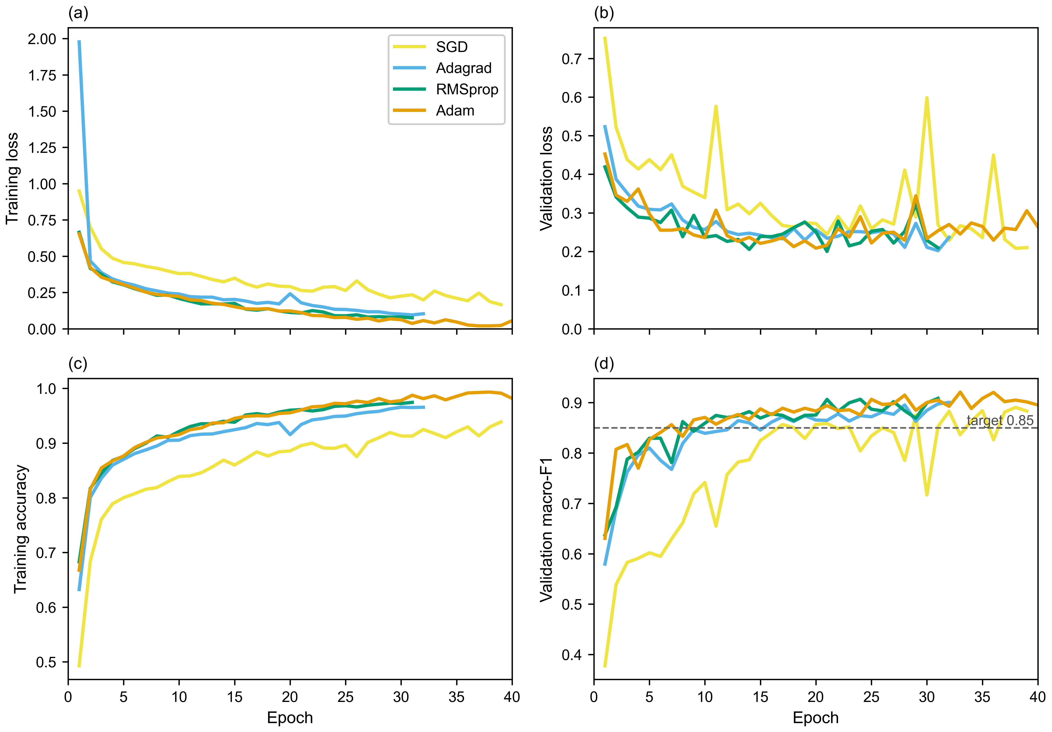
RESULTS (결과)
Training curves
학습 곡선 · 에폭에 따른 각 알고리즘의 학습 과정
Key points
핵심 내용
Adam and RMSprop pass validation macro-F1 0.85 first, after about 6 epochs.
Adam·RMSprop이 약 6 에폭에 목표 도달
SGD (lr 0.1) learns more slowly, and its validation curves are unstable.
SGD는 느리고 검증 곡선이 불안정
Later, training accuracy keeps rising while validation loss levels off: mild overfitting, which early stopping handles.
후반부 약한 과적합 → 조기 종료로 대응
Each line is the mean of the runs still training at that epoch (5 seeds; runs stop early at different epochs). Dashed line: target validation macro-F1 = 0.85.
Notes:
Panels a and b show the loss, c and d show the accuracy and validation macro-F1.
All three adaptive optimizers reduce the loss much faster than SGD.
SGD needs a high learning rate (0.1) to learn at all, and that makes its validation curves jumpy.
For the adaptive optimizers, validation loss flattens after roughly 15 epochs.
Training accuracy approaches 0.98 to 0.99, a sign of mild overfitting; early stopping keeps the epoch with the best validation score.

Slide 13
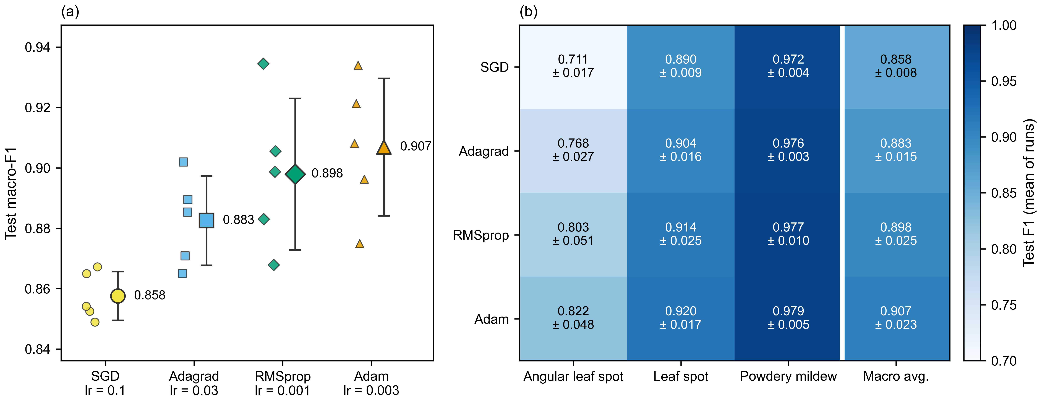
RESULTS (결과)
Test performance
테스트 성능 · Adam 평균 macro-F1 최고 (0.907), SGD 최저 (0.858)
(a) Small markers: individual runs; large marker: mean ± SD (n = 5). (b) Mean ± SD test F1 per disease class. Angular leaf spot separates the optimizers most.
Notes:
The ranking by mean test macro-F1 is Adam 0.907, RMSprop 0.898, Adagrad 0.883 and SGD 0.858. SGD is clearly last: all five SGD runs score below every Adam run.
The gap between Adam and RMSprop is small (0.009) compared with how much each one varies between seeds (SD 0.023 to 0.025), and their runs overlap: both have a best run of 0.934.
The heatmap shows where the optimizers differ. Powdery mildew is near-perfect for all four (0.97 to 0.98), while angular leaf spot separates them, from 0.711 for SGD to 0.822 for Adam.

Slide 14
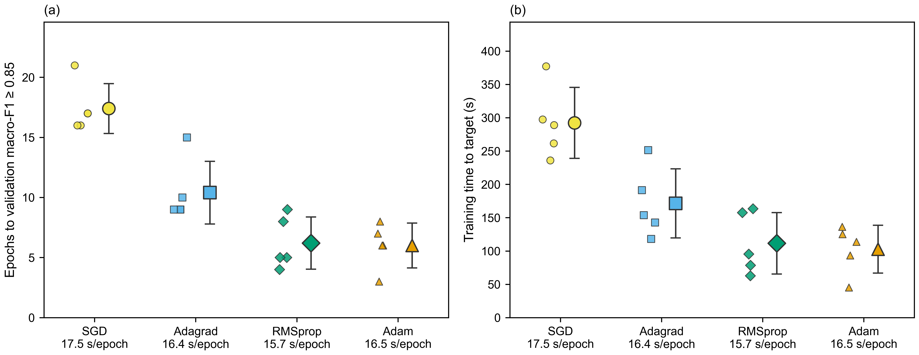
RESULTS (결과)
Convergence and training time
수렴 속도와 학습 시간 · Adam·RMSprop 약 6 에폭, SGD 약 17 에폭에 목표 도달
All 20 runs reached validation macro-F1 ≥ 0.85. Time per epoch is similar for all four (15.7–17.5 s), so the time differences come from the number of epochs needed.
Notes:
Mean epochs to reach validation macro-F1 0.85: Adam 6.0, RMSprop 6.2, Adagrad 10.4 and SGD 17.4.
Mean time to reach it: about 103 s for Adam, 112 s for RMSprop, 172 s for Adagrad and 292 s for SGD.
Seconds per epoch barely differ (median 15.7 to 17.5 s), so the time differences come from the number of epochs.
SGD is in theory the cheapest per step, so its slightly slower epochs reflect load on the laptop, not the optimizer.

Slide 15
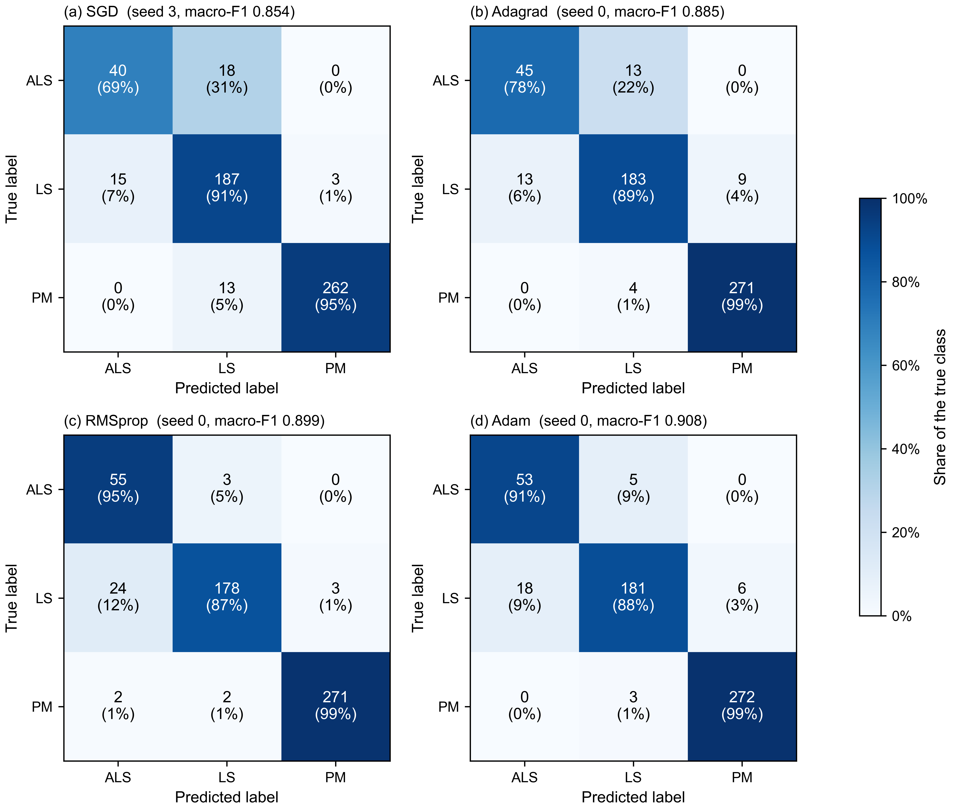
RESULTS (결과)
Confusion matrices
혼동 행렬 · 알고리즘별 오분류 유형
Most errors are angular leaf spot (Xanthomonas fragariae) and leaf spot (Mycosphaerella fragariae) confused with each other.
대부분의 오류는 각반병 ↔ 점무늬병 혼동
Powdery mildew is rarely misclassified (1–5% of its images).
흰가루병은 거의 오분류되지 않음
SGD labels 31% of angular leaf spot as leaf spot. RMSprop and Adam recognise 95% and 91% of it, but label more leaf spot as angular leaf spot (12% and 9%).
Adam·RMSprop은 각반병 검출↑, 점무늬병 오분류↑
One representative run per optimizer (the seed with the median test macro-F1). Cells: count (share of the true class). Test set: 58 angular leaf spot, 205 leaf spot, 275 powdery mildew; one angular leaf spot image ≈ 1.7%.
Notes:
Almost all mistakes are angular leaf spot and leaf spot confused with each other; both are spot diseases and look similar.
Powdery mildew is rarely misclassified (1 to 5% of its images, mostly as leaf spot).
SGD labels 31% of angular leaf spot as leaf spot. RMSprop and Adam recognise far more angular leaf spot (95% and 91%), but in return they label more leaf spot as angular leaf spot (12% and 9%).
Each matrix is a single run, and the test set has only 58 angular leaf spot images, so each image moves that row by about 1.7%.

Slide 16
RESULTS (결과)
Per-disease precision, recall and F1
질병별 정밀도·재현율·F1 · 소형 CNN, 시드 5개 평균
Class | SGD |  |  | Adagrad |  |  | RMSprop |  |  | Adam
 | Precision | Recall | F1 | Precision | Recall | F1 | Precision | Recall | F1 | Precision | Recall | F1
Angular leaf spot | 0.742 | 0.683 | 0.711 | 0.777 | 0.762 | 0.768 | 0.778 | 0.841 | 0.803 | 0.788 | 0.866 | 0.822
Leaf spot | 0.869 | 0.913 | 0.890 | 0.905 | 0.902 | 0.904 | 0.932 | 0.898 | 0.914 | 0.936 | 0.905 | 0.920
Powdery mildew | 0.983 | 0.961 | 0.972 | 0.973 | 0.978 | 0.976 | 0.974 | 0.980 | 0.977 | 0.978 | 0.980 | 0.979
Macro avg. | 0.865 | 0.852 | 0.858 | 0.885 | 0.881 | 0.883 | 0.895 | 0.906 | 0.898 | 0.901 | 0.917 | 0.907
Weighted avg. | 0.913 | 0.913 | 0.913 | 0.926 | 0.926 | 0.926 | 0.937 | 0.933 | 0.934 | 0.941 | 0.939 | 0.939
For angular leaf spot, the optimizers differ mainly in recall: SGD finds 68% of these images, Adam 87%.
각반병: 재현율 차이가 가장 큼 (SGD 68% → Adam 87%)
Precision stays at 0.74–0.79, so the adaptive optimizers find more angular leaf spot rather than becoming more precise.
정밀도는 비슷함 → 각반병을 더 많이 찾아냄
Mean of 5 seeds on the test set (58 angular leaf spot, 205 leaf spot, 275 powdery mildew images). Bold = best F1 per row. Standard deviations are in per_class_metrics.csv.
Notes:
This table shows precision, recall and F1 for each disease, averaged over the five seeds.
Powdery mildew is easy for every optimizer.
For angular leaf spot, the main difference is recall: SGD only finds 68% of the angular leaf spot images, while Adam finds 87%.
Precision stays around 0.74 to 0.79, so the adaptive optimizers mostly find more angular leaf spot instead of being more precise.

Slide 17
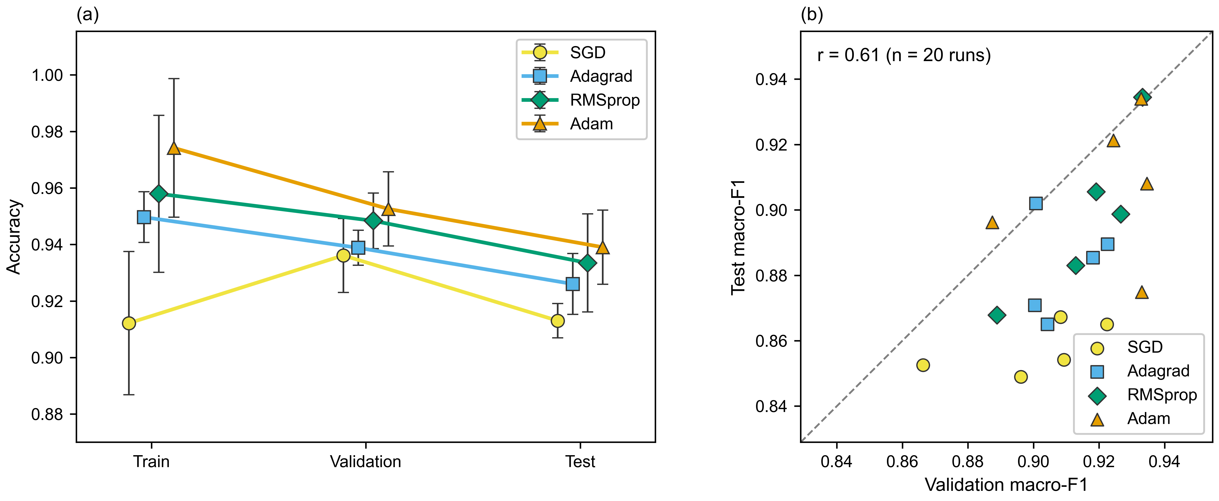
RESULTS (결과)
Generalisation
일반화 · 검증 점수는 테스트 점수를 약간 과대평가함
r = 0.61: a positive relationship, but not a very strong one.
Most runs sit below the line: validation scores are a bit higher than test scores.
(a) Mean ± SD of 5 runs; training accuracy is averaged during each epoch, so it can sit below validation accuracy (SGD). (b) Each point is one run; dashed line = equal scores.
Notes:
Accuracy drops from training to test for every adaptive optimizer, by about 2.4 to 3.5 points, and Adam's drop is the largest.
SGD's training accuracy looks lower than its validation accuracy because training accuracy is averaged while the weights are still changing, and SGD takes large, noisy steps.
Validation and test macro-F1 agree only moderately (r = 0.61), and most runs sit below the diagonal. So the model looks a bit better on validation than on the test set, which is expected because the best epoch was chosen on validation data.

Slide 18
RESULTS (결과)
Final results: summary table
최종 결과 요약 · 소형 CNN, 시드 5개 평균 ± 표준편차
Optimizer | LR | Test macro-F1 | Test acc. | Train acc. | Val. acc. | Epochs to 0.85 | Time to 0.85 (s) | s/epoch* | Best epoch
SGD | 0.1 | 0.858 ± 0.008 | 0.913 ± 0.006 | 0.912 | 0.936 | 17.4 ± 2.1 | 292 | 17.5 | 27.0
Adagrad | 0.03 | 0.883 ± 0.015 | 0.926 ± 0.011 | 0.950 | 0.939 | 10.4 ± 2.6 | 172 | 16.4 | 24.4
RMSprop | 0.001 | 0.898 ± 0.025 | 0.933 ± 0.017 | 0.958 | 0.948 | 6.2 ± 2.2 | 112 | 15.7 | 23.8
Adam | 0.003 | 0.907 ± 0.023 | 0.939 ± 0.013 | 0.974 | 0.953 | 6.0 ± 1.9 | 103 | 16.5 | 28.0
Adam has the best mean on accuracy, epochs to target and time to target; RMSprop is close behind on all three.
Adam이 세 기준 모두 평균 1위, RMSprop이 근소한 2위
Time per epoch is about the same for all four, so the time differences come from the number of epochs.
에폭당 시간은 비슷함 → 시간 차이는 에폭 수에서 비롯됨
Bold = best per column. Time to 0.85 = mean seconds to reach validation macro-F1 ≥ 0.85. *Median: three runs (SGD seeds 0 and 3, Adagrad seed 3) each had one very long epoch from a laptop pause, after they had already reached the target.
Notes:
This is the summary table for the final small-CNN runs.
Adam has the best mean on accuracy, epochs to target and time to target, and RMSprop is very close behind.
Time per epoch is about the same for all four, so the time differences come from the number of epochs needed.
I used the median for seconds per epoch, because three runs had one very long epoch when the laptop paused. That happened after they had already reached the target, so the time-to-target numbers aren't affected.

Slide 19
DECISION (선정 결과)
Decision: no single best optimizer
선정 결과: 단일 최적 알고리즘 없음 · 사전 확정 기준 적용
1
Accuracy
정확도
2
Convergence
수렴 속도
3
Training time
학습 시간
Mean test macro-F1: Adam 0.907, RMSprop 0.898, Adagrad 0.883, SGD 0.858.
Adam 평균 최고, 그러나 유의차 없음
Mean epochs to 0.85: Adam 6.0, RMSprop 6.2, Adagrad 10.4, SGD 17.4.
Adam·RMSprop이 가장 빠름
Mean time to 0.85: Adam ≈ 103 s, RMSprop ≈ 112 s, Adagrad ≈ 172 s, SGD ≈ 292 s.
시간 차이는 에폭 수에서 비롯됨
Adam, RMSprop and Adagrad not significantly different*
No significant difference among the tied optimizers* (Adam vs Adagrad: p = 0.06)
No significant difference among the tied optimizers*
Adam leads on every criterion on average, but not significantly: Adam (lr 0.003) and RMSprop (lr 0.001) are both sound choices; SGD is the weakest.
Adam이 모든 기준에서 평균 1위이나 유의차 없음 · Adam 또는 RMSprop 권장 · SGD가 가장 낮음
*Paired t-tests over 5 seeds, Holm-corrected, α = 0.05. A Friedman test across all four optimizers gives p = 0.0136: performance differs overall, mainly because SGD scores lowest.
Notes:
Applying the selection rule that I fixed before the final run:
On accuracy, Adam has the highest mean macro-F1, but it is not significantly better than RMSprop or Adagrad, so those three stay tied. Only SGD is significantly worse.
On convergence and on training time, Adam again has the best mean, but the differences among the tied optimizers are not significant either. Adam vs Adagrad on epochs was borderline (p = 0.03 before correction, 0.06 after), so I'd call it a trend.
So under my rule there is no single best optimizer. In practice, Adam has the best average on every criterion, so it is a reasonable default, with RMSprop an equally valid choice.
Not significant doesn't mean identical: with five seeds the test can only detect fairly large differences. The Friedman p = 0.0136 says the four optimizers are not all equal, which is mainly because of SGD.

Slide 20
RESNET-18 COMPARISON (ResNet-18 비교)
Why compare with ResNet-18?
ResNet-18을 선택한 이유 · 더 강한 모델로 Adam과 RMSprop을 구분할 수 있을까?
Why this model
선택 이유
Setup
실험 설정
The project is about optimizers, so ResNet-18 is a test condition, not a competitor.
Both are convolutional networks, so staying in the same model family keeps the comparison easy to interpret.
Pretrained on ImageNet, it suits a small dataset like mine (about 2,400 training crops).
It's the smallest standard ResNet, so it fit on my 2 GB GPU and made all 44 runs possible.
It's a widely used reference model in image classification, including plant-disease studies.
ImageNet-pretrained ResNet-18; only the last block (layer4) and a new 3-class output layer are trained.
Input 224×224 with ImageNet normalisation.
Same split, same 538 test images, 40-epoch budget and early stopping as the small CNN.
Same procedure: learning-rate sweep (0.01 to 0.00003, seed 100), then 5 paired seeds.
Chosen learning rates: SGD 0.01, Adagrad 0.001, RMSprop 0.0001, Adam 0.0003.
ResNet-18 was preferred over e.g. MobileNetV2 or EfficientNet-B0 for its simpler design and wider use as a baseline.
Notes:
To check if a stronger model could separate Adam from RMSprop, I repeated the same experiment with a pretrained ResNet-18.
The project is about optimizers, so ResNet-18 is a test condition, not a competitor.
Both are convolutional networks, so the comparison stays easy to interpret. It is pretrained on ImageNet, so it suits a small dataset like mine.
It's the smallest standard ResNet, so it fit on my 2 GB GPU and I could run all 44 runs. And it is widely used as a reference model, including in plant-disease studies.
I used exactly the same procedure as before: a learning-rate sweep first, then 5 paired seeds, on the same test images.

Slide 21
RESNET-18 COMPARISON (ResNet-18 비교)
Small CNN vs ResNet-18
소형 CNN 대 ResNet-18 · 테스트 macro-F1과 오류 수 (538장 중)
Optimizer | Small CNN macro-F1 | ResNet-18 macro-F1 | Small CNN test errors | ResNet-18 test errors
SGD | 0.858 ± 0.008 | 0.986 ± 0.003 | 46.8 | 5.6
Adagrad | 0.883 ± 0.015 | 0.991 ± 0.003 | 39.8 | 3.6
RMSprop | 0.898 ± 0.025 | 0.991 ± 0.004 | 35.8 | 3.8
Adam | 0.907 ± 0.023 | 0.990 ± 0.003 | 32.8 | 4.4
Every ResNet-18 run (lowest 0.983) scored higher than every small-CNN run (highest 0.934).
ResNet-18의 모든 실행이 소형 CNN의 모든 실행보다 높음
ResNet-18 makes about 90% fewer test errors: 4–6 instead of 33–47 of 538 images.
테스트 오류 약 90% 감소
The gain is biggest for SGD (+0.129) and smallest for Adam (+0.083).
향상 폭: SGD 최대, Adam 최소
Mean ± SD over 5 seeds. Test errors = mean number of misclassified test images (of 538). Bold = best per column.
Notes:
Here is the comparison on the same 538 test images.
ResNet-18 is much better with every optimizer: about 0.99 macro-F1 instead of 0.86 to 0.91.
Every ResNet-18 run scored higher than every small-CNN run.
It also makes about 90% fewer mistakes: around 4 to 6 wrong images instead of 33 to 47.

Slide 22
RESNET-18 COMPARISON (ResNet-18 비교)
Every run, both models
모든 실행 결과 · 시드 0–4, 테스트 macro-F1
Small CNN | Seed 0 | Seed 1 | Seed 2 | Seed 3 | Seed 4 | Mean | Lowest | Highest
SGD | 0.849 | 0.853 | 0.865 | 0.854 | 0.867 | 0.858 | 0.849 | 0.867
Adagrad | 0.885 | 0.902 | 0.871 | 0.865 | 0.889 | 0.883 | 0.865 | 0.902
RMSprop | 0.899 | 0.934 | 0.906 | 0.883 | 0.868 | 0.898 | 0.868 | 0.934
Adam | 0.908 | 0.896 | 0.875 | 0.921 | 0.934 | 0.907 | 0.875 | 0.934
ResNet-18 | Seed 0 | Seed 1 | Seed 2 | Seed 3 | Seed 4 | Mean | Lowest | Highest
SGD | 0.990 | 0.988 | 0.986 | 0.983 | 0.983 | 0.986 | 0.983 | 0.990
Adagrad | 0.988 | 0.993 | 0.995 | 0.992 | 0.988 | 0.991 | 0.988 | 0.995
RMSprop | 0.988 | 0.993 | 0.997 | 0.992 | 0.986 | 0.991 | 0.986 | 0.997
Adam | 0.988 | 0.991 | 0.988 | 0.987 | 0.993 | 0.990 | 0.987 | 0.993
Lowest ResNet-18 run: 0.983 (SGD, seed 4) > highest small-CNN run: 0.934 (RMSprop, seed 1).
Bold cells: the best small-CNN run and the worst ResNet-18 run. Values rounded to 3 decimals (small CNN: Adam seed 4 = 0.9340, RMSprop seed 1 = 0.9345).
Notes:
This slide shows every single run.
Even the worst ResNet-18 run, 0.983, is above the best small-CNN run, 0.934.
So the improvement isn't luck from one seed; it shows up in every run.

Slide 23
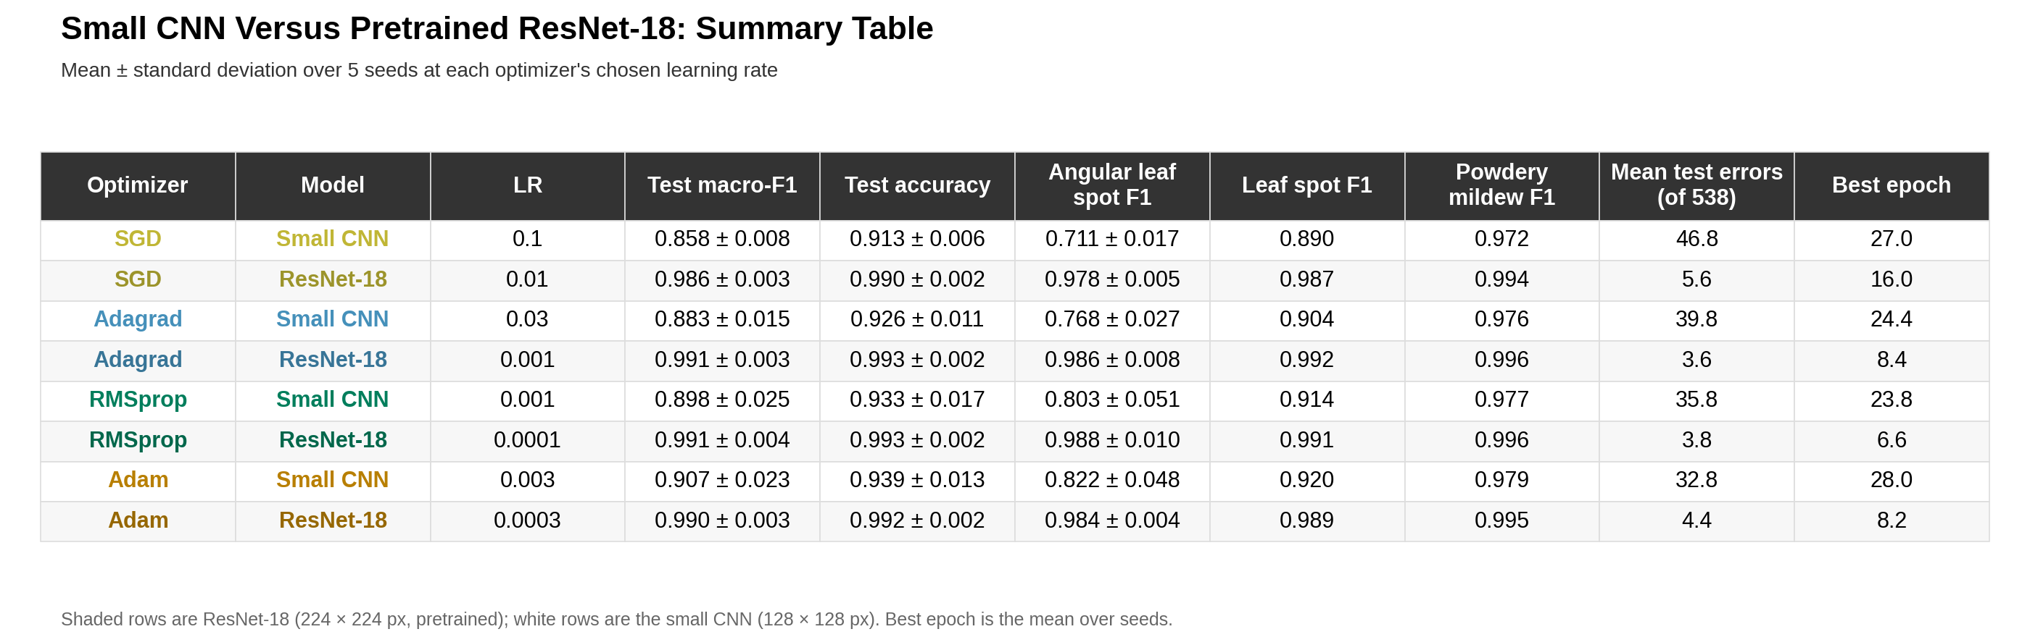
RESNET-18 COMPARISON (ResNet-18 비교)
Summary table
요약 표 · 선택된 학습률에서 시드 5개 평균 ± 표준편차
Angular leaf spot F1: 0.71–0.82 with the small CNN vs 0.98–0.99 with ResNet-18. Best epoch: about 7–16 vs 24–28.
Notes:
This table has all the details.
The biggest gain is on angular leaf spot, which goes from 0.71 to 0.82 with the small CNN to about 0.98 to 0.99 with ResNet-18.
ResNet-18 also finds its best epoch much earlier, around epoch 7 to 16 instead of 24 to 28.
Training times are not compared here, because the small CNN ran on a laptop CPU and ResNet-18 on a GPU.

Slide 24
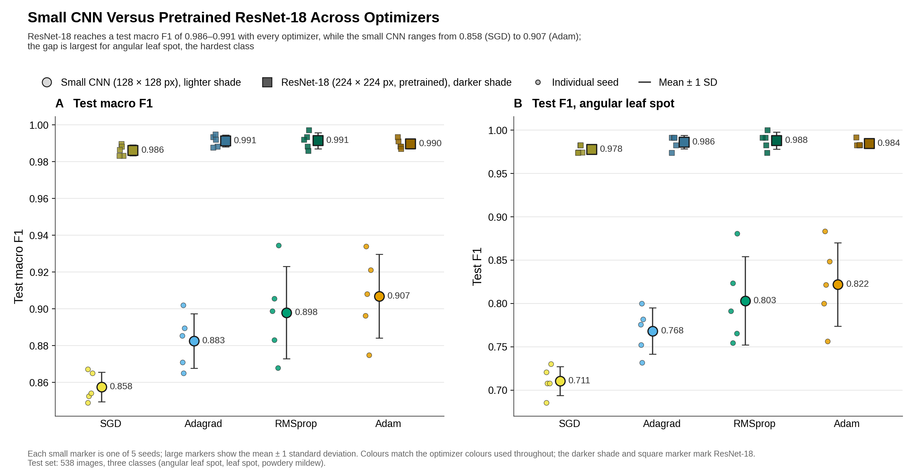
RESNET-18 COMPARISON (ResNet-18 비교)
Across optimizers
알고리즘별 비교 · ResNet-18에서는 알고리즘 간 차이가 거의 없음
Notes:
The figure shows the same thing visually.
The small-CNN points are spread out and differ between optimizers, while the ResNet-18 points are all packed together near 0.99.
With ResNet-18, the optimizer means are only 0.005 apart, compared with 0.049 for the small CNN.

Slide 25
RESNET-18 COMPARISON (ResNet-18 비교)
Can ResNet-18 separate Adam from RMSprop?
ResNet-18로 Adam과 RMSprop을 구분할 수 있는가? · 같은 선정 기준 적용
1
Accuracy
정확도
2
Convergence
수렴 속도
3
Training time
학습 시간
Mean test macro-F1: RMSprop 0.991, Adagrad 0.991, Adam 0.990, SGD 0.986.
네 알고리즘 모두 약 0.99
All 20 runs reached validation macro-F1 ≥ 0.80 in their first epoch.
모든 실행이 첫 에폭에 목표 도달
Time to target = one epoch: SGD 7.8 s, Adagrad 8.0 s, RMSprop 8.0 s, Adam 8.1 s.
SGD의 업데이트가 가장 단순해 약간 빠름
No significant differences (Friedman p = 0.21; Adam vs RMSprop p = 0.55)
Not informative: the target was too easy for a pretrained model
Only reflects the cost of one epoch, not learning
No: with ResNet-18 all four optimizers reach ≈ 0.99, so the optimizer barely matters once the model is strong.
아니오 · ResNet-18에서는 네 알고리즘 모두 약 0.99 → 모델이 강하면 알고리즘 선택의 영향이 매우 작음
Applied mechanically, the rule would pick SGD on time (about 0.2 s faster per epoch), but that measures SGD's simpler update, not better learning, so I don't count it as a win.
Notes:
So, can ResNet-18 separate Adam from RMSprop? No.
On accuracy, none of the differences are significant; Adam vs RMSprop is p = 0.55.
For convergence, every run reached the 0.80 target in its very first epoch, so this criterion couldn't tell them apart.
If I applied the rule mechanically, SGD would win on time, but only because one SGD epoch is about 0.2 seconds faster; SGD has the simplest update. That doesn't mean SGD learns better, so I don't treat it as a real win.
The honest answer is that with a strong pretrained model, the choice of optimizer barely matters.

Slide 26
DISCUSSION (논의)
Discussion
논의
Small CNN study
소형 CNN 실험
ResNet-18 comparison
ResNet-18 비교
Adaptive optimizers clearly beat plain SGD, in accuracy and in how fast they reach useful performance (about 6–10 vs 17 epochs).
The differences are largest on the rare, hard class: angular leaf spot F1 rose from 0.711 (SGD) to 0.822 (Adam); powdery mildew is near-perfect for all.
Every optimizer confuses angular leaf spot with leaf spot, so more angular leaf spot data or augmentation would likely help more than changing optimizer.
Adam reached the target in fewer epochs than Adagrad (6.0 vs 10.4), a trend that just missed significance after correction (p = 0.06).
A pretrained ResNet-18 scored about 0.99 with every optimizer; all 20 of its runs beat all 20 small-CNN runs.
It fixed most of the angular leaf spot ↔ leaf spot confusion (angular leaf spot F1 0.98–0.99).
The gap between optimizers shrank from 0.049 to 0.005: with a strong pretrained model, the choice of optimizer barely matters.
SGD was last with both models, the one consistent optimizer result.
Notes:
For the small CNN, the adaptive optimizers clearly beat plain SGD, both in accuracy and in how quickly they reach useful performance.
The differences between optimizers are largest on the rare, hard class, angular leaf spot; the easy class, powdery mildew, is near-perfect for all.
Because the main confusion is between the two spot diseases for every optimizer, more angular leaf spot data or augmentation is likely to help more than changing optimizer.
With ResNet-18, every optimizer reached about 0.99, and the gap between optimizers became ten times smaller. SGD was last with both models.

Slide 27
DISCUSSION (논의)
Limitations
한계점
Design and tuning
설계·튜닝
Data and measurement
데이터·측정
Only 5 seeds per optimizer: not enough to show a significant difference between Adam and RMSprop.
Learning rates were chosen from a single sweep run each (seed 100) on a coarse grid with roughly ×3 steps; another seed might pick slightly different rates.
SGD's best rate sat on the edge of the grid (0.1 small CNN, 0.01 ResNet-18), so its true best rate may lie outside the range tested.
Only the learning rate was tuned. Momentum, Adam's betas and weight decay stayed at defaults, and SGD had no momentum, which may make it look worse than usual.
No learning-rate schedules or data augmentation: a deliberately simple setting compared with real field data.
One dataset and one fixed split; only 58 angular leaf spot test images (1 image ≈ 1.7%).
The models classify ready-made leaf crops; a real system would first need to find the leaves.
Training times are only comparable within a model (small CNN on a laptop CPU, ResNet-18 on a GPU).
ResNet-18 hit a ceiling (≈ 0.99) and reached its 0.80 target in the first epoch, so it can't show optimizer differences.
ResNet-18 changes pretraining, depth and input size at once (most crops are ~160 px, enlarged to 224), so the gain belongs to the whole pipeline.
The pilot also used dropout and a class-weighted loss, so pilot vs final differences are not due to tuning alone.
Notes:
There are some limitations.
I only had 5 seeds per optimizer, which is not enough to prove a difference between Adam and RMSprop.
Learning rates were chosen from a single sweep run each, on a coarse grid, and SGD's best rate sat on the edge of the grid, so its true best rate may be outside the range I tested.
Only the learning rate was tuned. Momentum, Adam's beta values and weight decay stayed at library defaults, and SGD had no momentum, which may have made it look worse than it would normally.
No learning-rate schedules and no data augmentation were used, so the results show each optimizer in a deliberately simple setting.
On the data side, there is one dataset with one split, and only 58 angular leaf spot test images.
Training times can only be compared within each model, because the small CNN ran on a CPU and ResNet-18 on a GPU.
And ResNet-18 was close to perfect, so there was almost no room left to see optimizer differences.

Slide 28
CONCLUSION (결론)
Conclusion
결론 · 소형 딸기 잎 분류기에 가장 적합한 최적화 알고리즘은?
1
Adaptive beats SGD
적응형 > SGD
2
No single winner
단일 최적 없음
3
Model > optimizer
모델 > 알고리즘
Macro-F1 0.883–0.907 vs 0.858, and the target in 6–10 vs 17 epochs.
정확도와 수렴 속도 모두 SGD보다 우수
Adam had the best mean on all three criteria, but not significantly better than RMSprop or Adagrad.
Adam 평균 1위, 유의차 없음
ResNet-18 reached ≈ 0.99 with every optimizer and made about 90% fewer errors.
알고리즘 간 차이 0.049 → 0.005
SGD was last with both models
Practical default: Adam (RMSprop equally good)
The model mattered about ten times more
Use an adaptive optimizer (Adam is a sound default), and a pretrained model: it improves the classifier far more than any optimizer choice.
적응형 알고리즘(Adam) 사용 권장 · 사전학습 모델이 알고리즘 선택보다 훨씬 큰 개선을 가져옴
Next steps: more seeds, SGD with momentum, data augmentation, and a second disease task (AI Hub: Phytophthora blight vs wilt).
Notes:
To conclude, my target was to find which optimizer best suits a small strawberry leaf classifier.
First, the adaptive optimizers beat plain SGD: they were more accurate and reached useful performance two to three times faster.
Second, there was no single significant winner. Adam had the best average on all three criteria, so I would use it as the default, but RMSprop is just as good.
Third, the model mattered much more than the optimizer. A pretrained ResNet-18 reached about 0.99 with every optimizer, and the differences between optimizers almost disappeared.
So my answer is: use an adaptive optimizer like Adam, but if you want a better classifier, a pretrained model helps far more than switching optimizer.
Next, I would like to try more seeds, SGD with momentum, data augmentation, and a second disease task with the AI Hub blight and wilt data.
Thank you.

Slide 29
APPENDIX (부록)
Pilot run: full results
예비 실험 전체 결과 (시드 3개 평균)
Optimizer | LR | Best epoch | s/epoch* | Total time (s)* | Train acc. | Val. acc. | Test acc. | Test macro-F1
SGD | 0.01 | 31.0 | 15.19 | 596.6 | 0.870 | 0.865 | 0.853 | 0.804 ± 0.033
Adagrad | 0.01 | 28.3 | 15.11 | 604.5 | 0.963 | 0.949 | 0.931 | 0.893 ± 0.026
RMSprop | 0.001 | 23.7 | 15.60 | 483.7 | 0.953 | 0.940 | 0.926 | 0.888 ± 0.041
Adam | 0.001 | 22.0 | 15.86 | 502.3 | 0.943 | 0.936 | 0.918 | 0.884 ± 0.026
Table. Mean of 3 seeds; bold = best value in each column. *Median, because two runs had abnormally slow epochs caused by hardware load (Adam seed 1: 48.8 s/epoch; Adagrad seed 2: 62.5 s/epoch).
시드 3개 평균, 굵은 글씨 = 열별 최고값. *중앙값 사용: 하드웨어 부하로 비정상적으로 느려진 실행 2회 때문.
Notes:
This is the full pilot table for reference.
The pilot used library-default learning rates, 3 seeds, dropout and a class-weighted loss, so it is not directly comparable with the final runs.

